Slide 1


The National AgrAbility Project is supported by AgrAbility Project, USDA/NIFA Special Project 2021-41590-34813.
What is an Assistive Technology Assessment
Steve Swain, ATP
National AgrAbility Project
Ned Stoller, ATP/RET
AgrAbility Agricultural Engineer

Slide 2
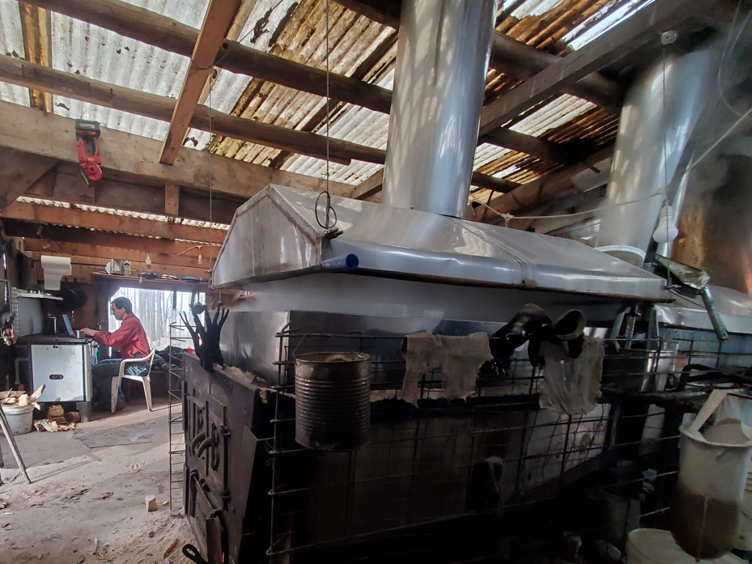
sugarbush

Slide 3
Learning Objectives
What is an assistive technology (AT) assessment
Why is an AT assessment important
Describe the Human, Activity, Context, and Assistive Technology (HAAT) AT assessment model
Learn where to find AT options

Slide 4
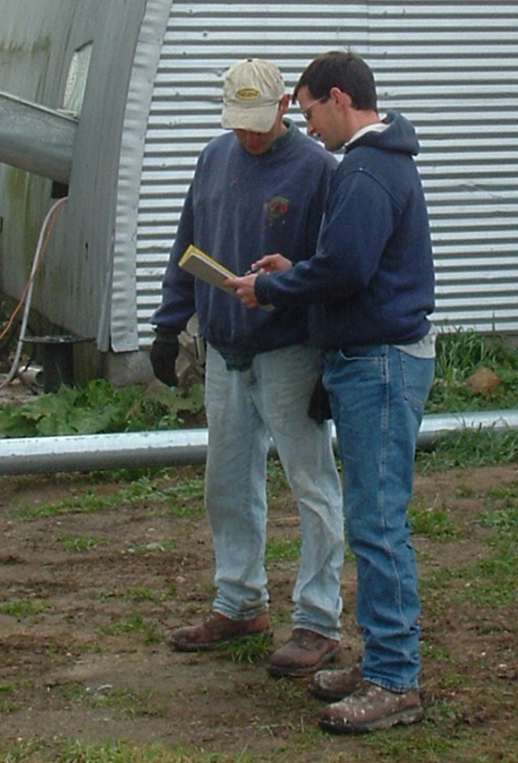
Assistive Technology Assessment
An assistive technology assessment is a careful study of a person and their abilities, environment, and activities so we can recommend solutions that enable them to do necessary tasks.

Slide 5
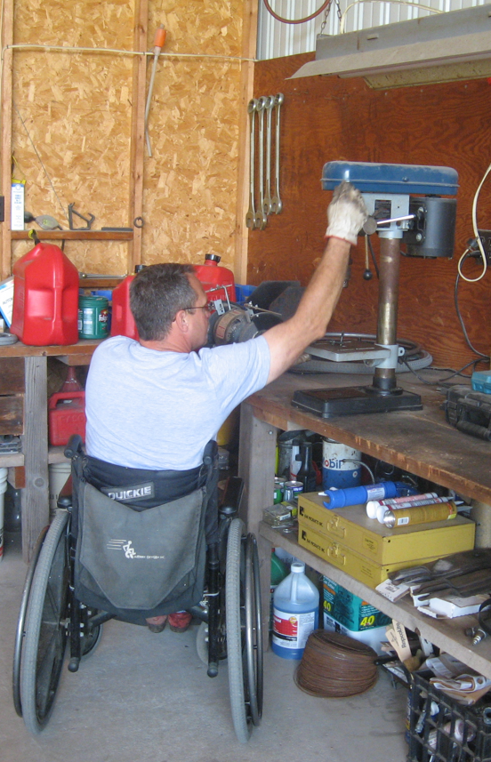
Outcomes of AT Assessments
Identify specific client goals
Better understand farming operation, client’s role on the farm, and modifications needed
Identify significant workplace barriers and functional limitations
To evaluate the client’s ability to safely complete desired work-related tasks
To inventory assets available as a basis for developing alternative solutions, including new enterprises
Opportunity to discuss desired AT, modifications, task restructuring, or reassignment.

Slide 6
What is Assistive Technology (AT)?
Any item, piece of equipment, or product system,
whether acquired commercially, modified, or customized,
that is used to increase, maintain, or improve
functional capabilities of individuals with disabilities.
(Assistive Technology Act of 1998)

Slide 7
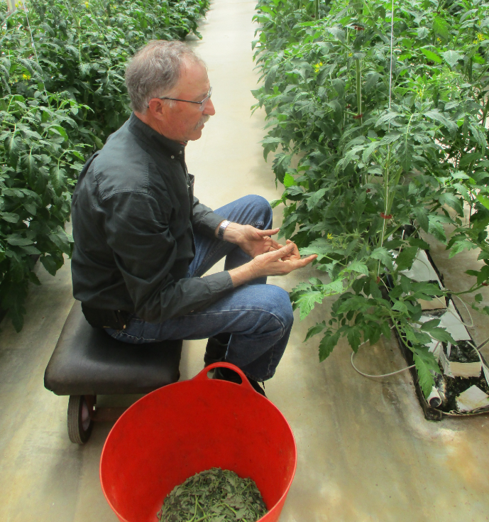
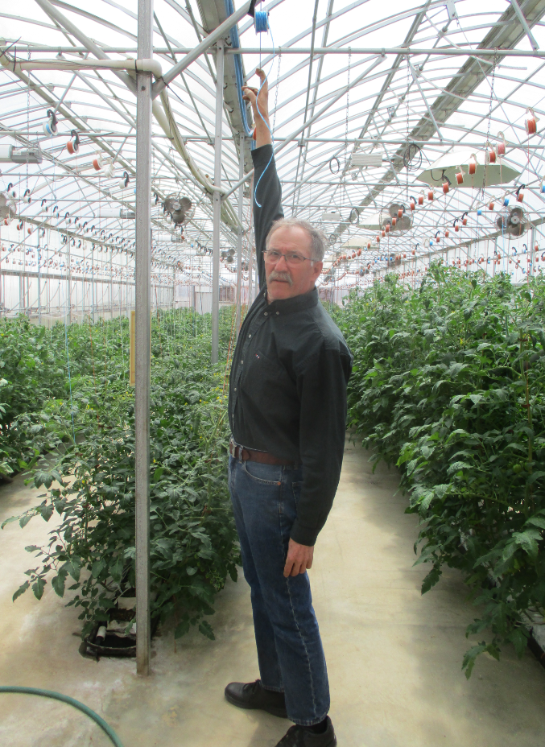

Vegetables: Greenhouse production
Trellis systems with suspended twine spools
  Overhead reaching or climbing step-stools to lower and lean vines weekly
  Pruning vines at knee level weekly
  Climbing and fine motor skills

Slide 8
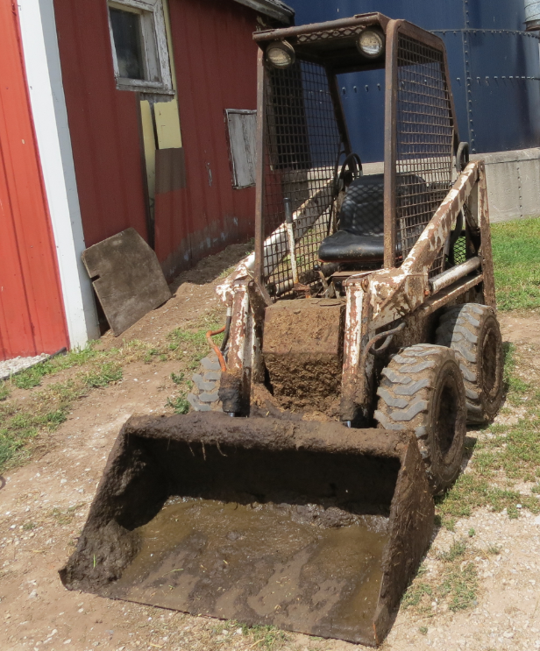

Accommodate Shoveling

Slide 9
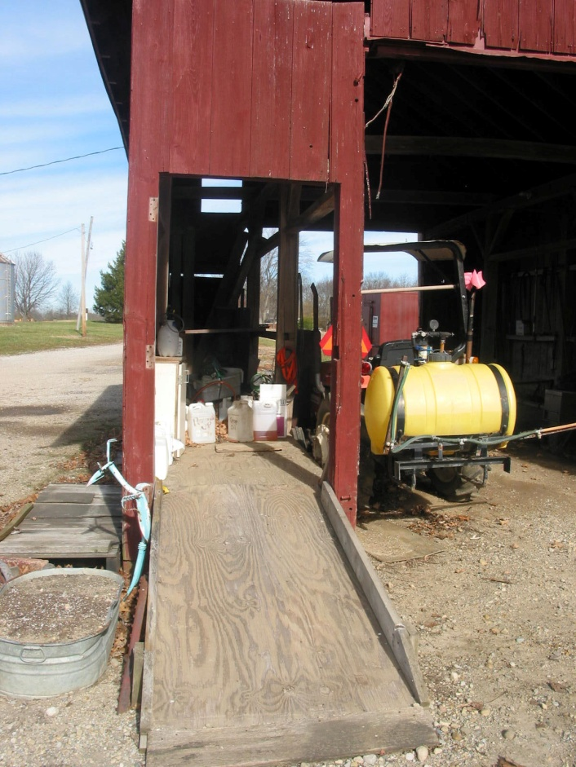
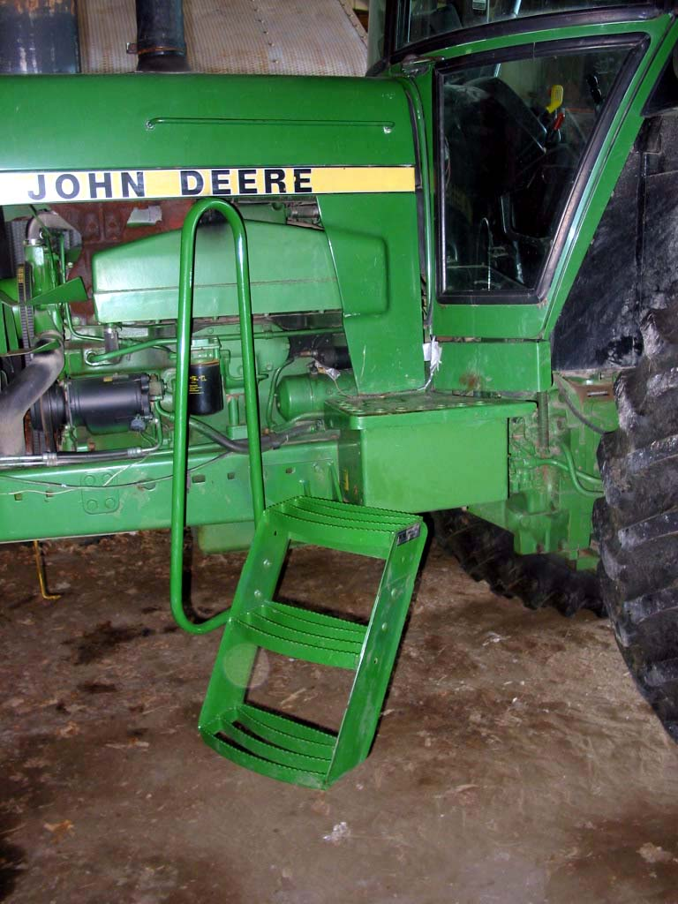
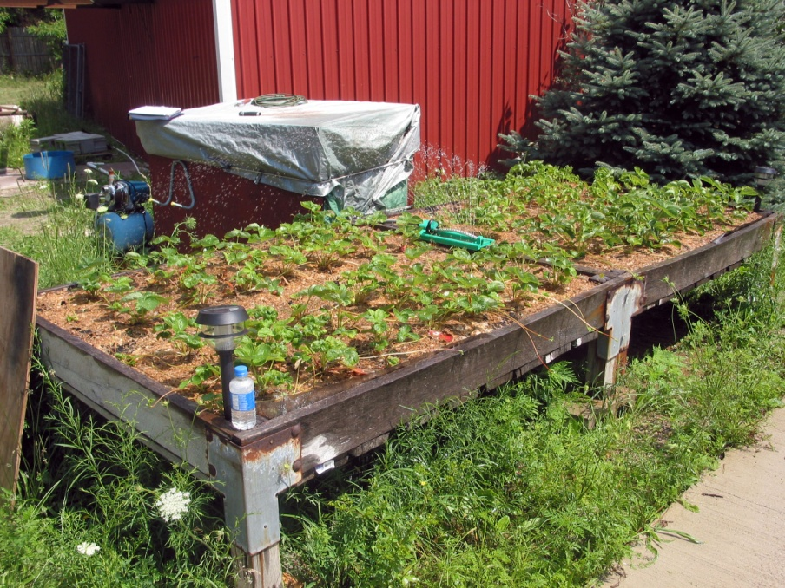
Assistive technology

Slide 10
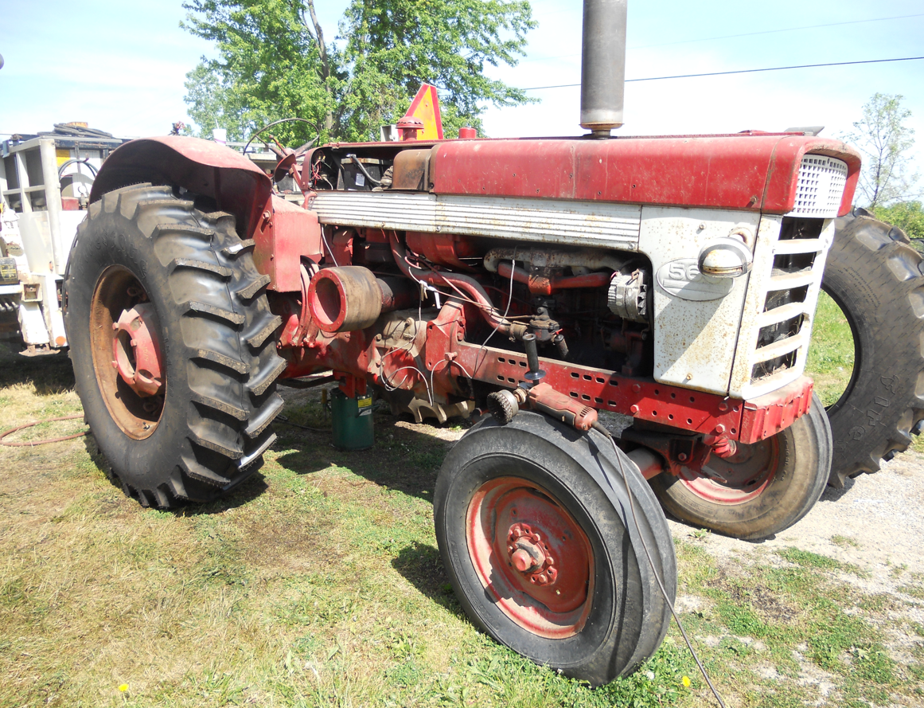
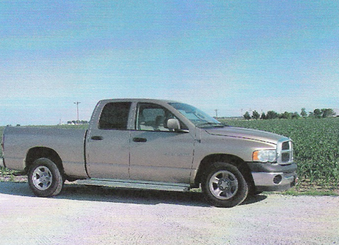
Not conventional farm equipment

Slide 11
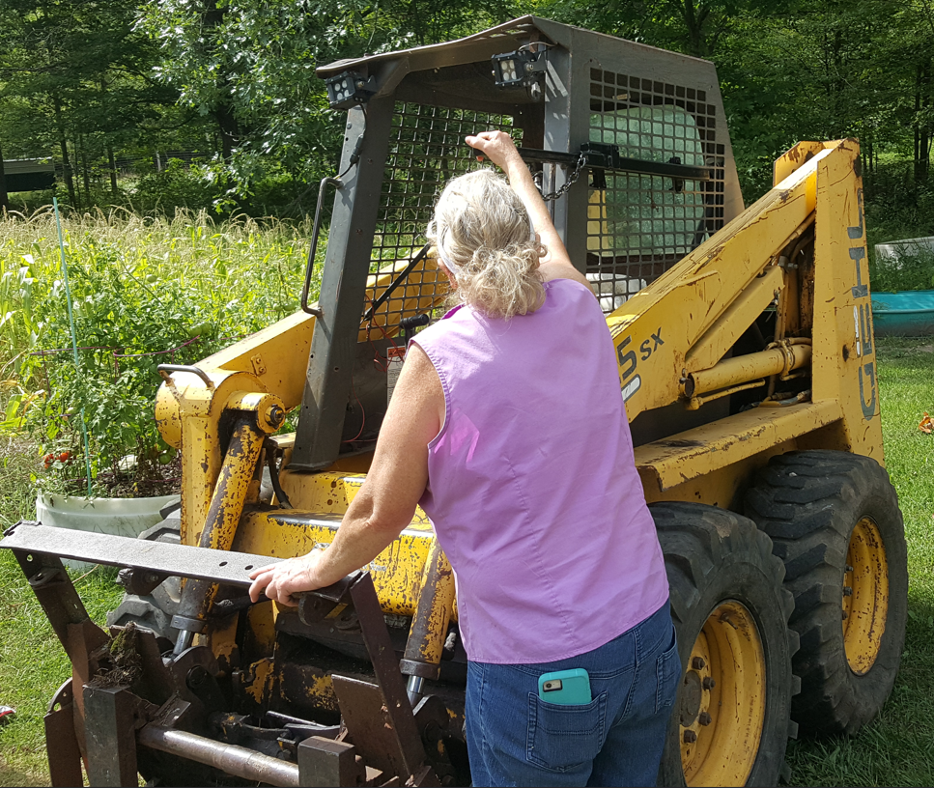
Goal of an AT Assessment
Help the person with disability meet their outcome measures with proper AT.
Finding the right AT the first time saves time and resources!
Is success being able to operate the AT well, or getting the job done?

Slide 12
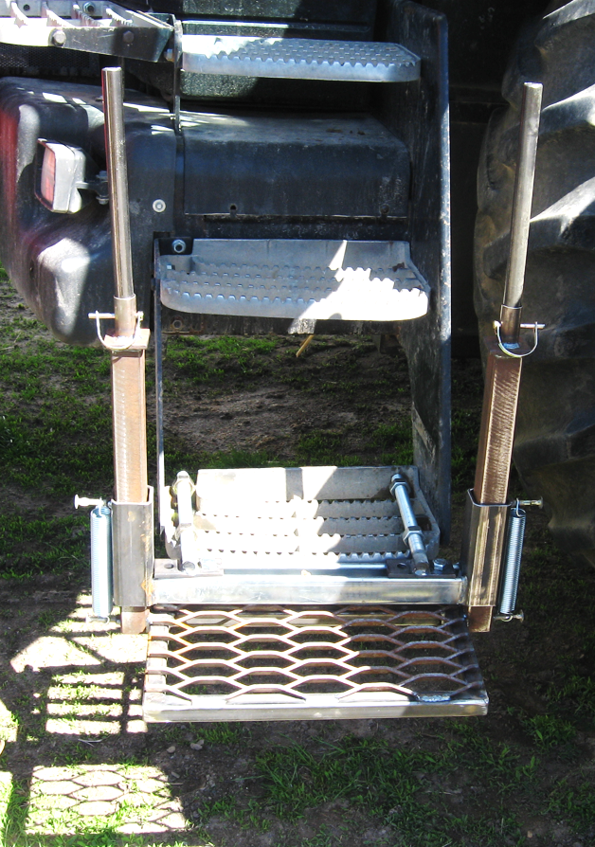
Goal of an AT Assessment
The wrong AT may be worse than no AT
  Frustrated with poor outcomes
  Worsened medical condition
  Reduced function or efficiency
  Inconvenient for other workers

Slide 13
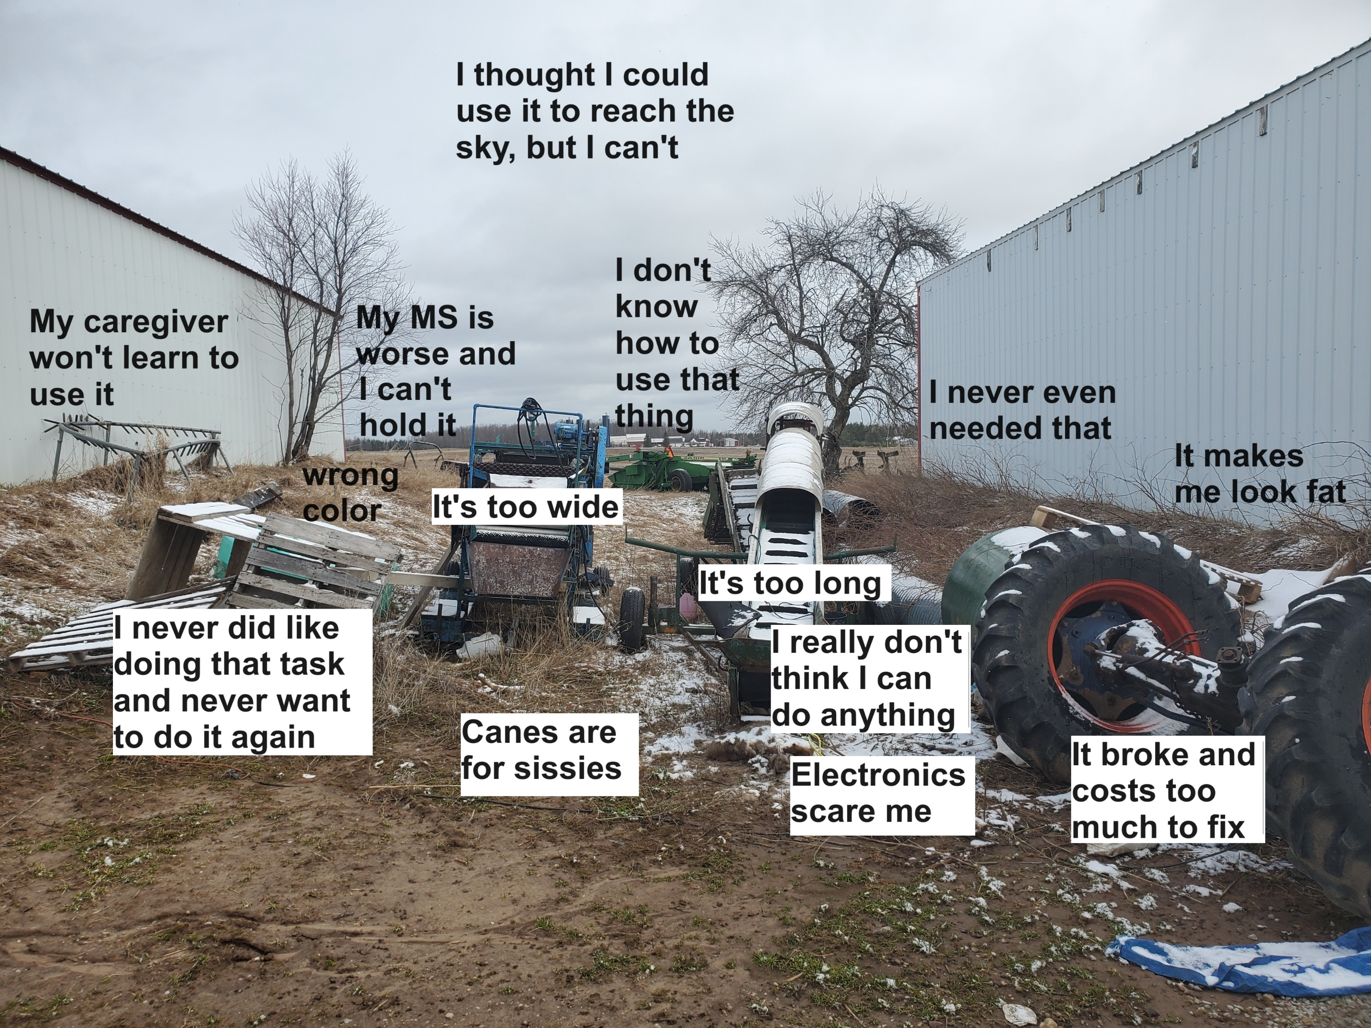
ABANDONMENT
I broke my leg when I used it

Slide 14
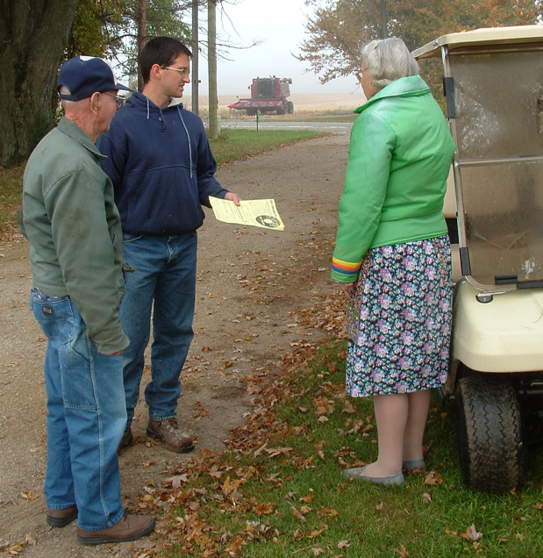
Abandonment
Very critical to include the customer in the AT assessment process!
and include caregivers in the assessment!

Slide 15
Abandonment
I’m scared of electronics
My MS is worse now
I really don’t think I can do anything.
I never even needed that
I thought I could use it to reach, but can’t
I never liked that task
My caregiver won’t learn to use it
I broke my leg using it
I don’t know how to
Unmet consumer goals
Unmet caregiver goals
Lack of skills
Unrealistic expectations
Unmotivated
Intimidated
Functional abilities/ needs have changed
Self-esteem
Lack of training

Slide 16

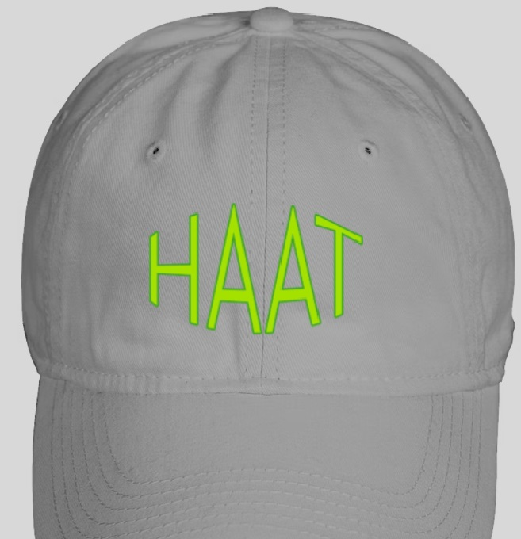
Human Activity Assistive Technology Model (HAAT)
Cook, Albert M., and Susan M. Hussey. Assistive Technologies: Principles and Practice. St. Louis: Mosby, 2002. Print.
Notes:
Where were you? What had you planned? Who was involved?

Slide 17
Human Activity Assistive Technology Model (HAAT)
Method to understand the appropriate place of assistive technologies in the life of a person with a disability.
Accounts for the human, the context and the activities
VERY LAST we identify potential interventions (AT solutions) that match the outcome measures (goals)
Notes:
Where to you want to go? Who will be involved?

Slide 18
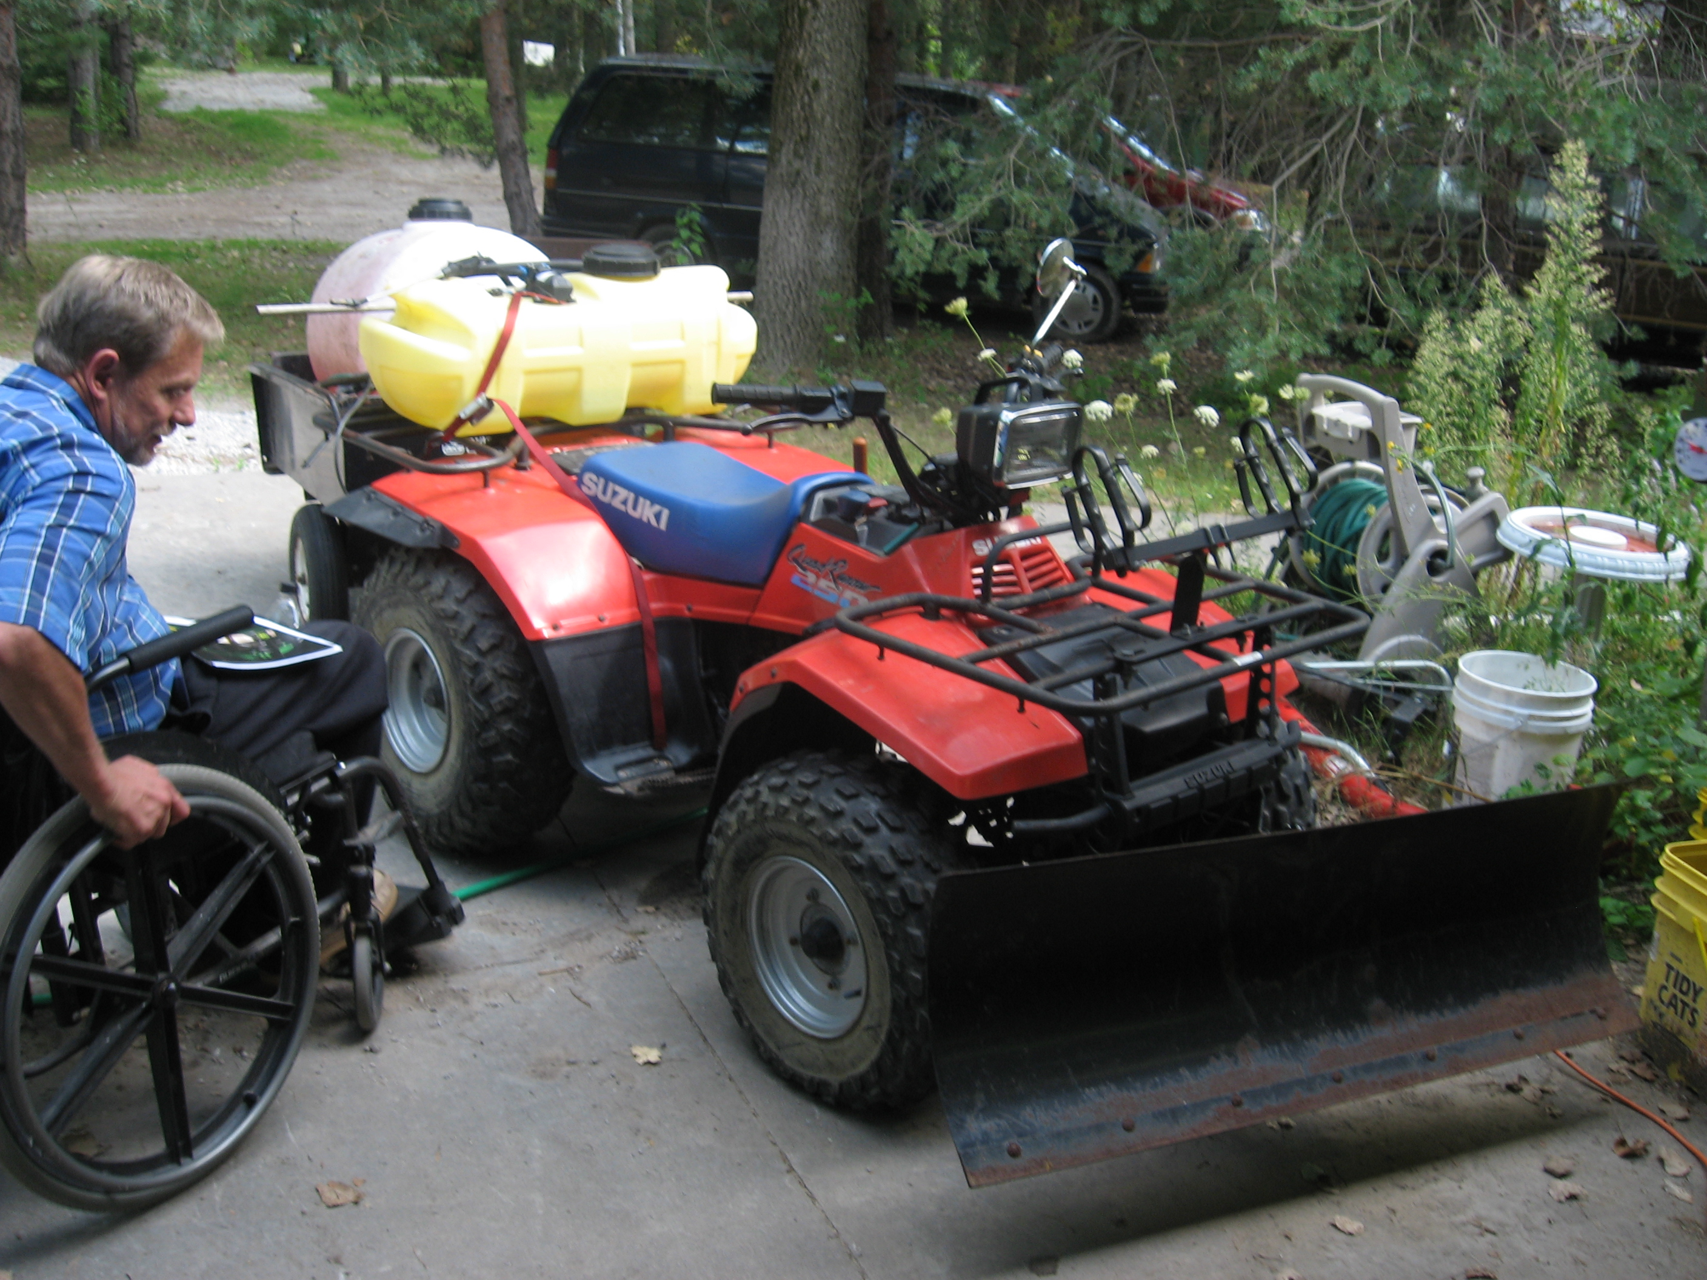
HAAT Human considerations
Physical
  Age, size
  Medical diagnosis
  Functional limitations
Notes:
What is your current role? What duties do you need to accept? What duties can be traded?

Slide 19
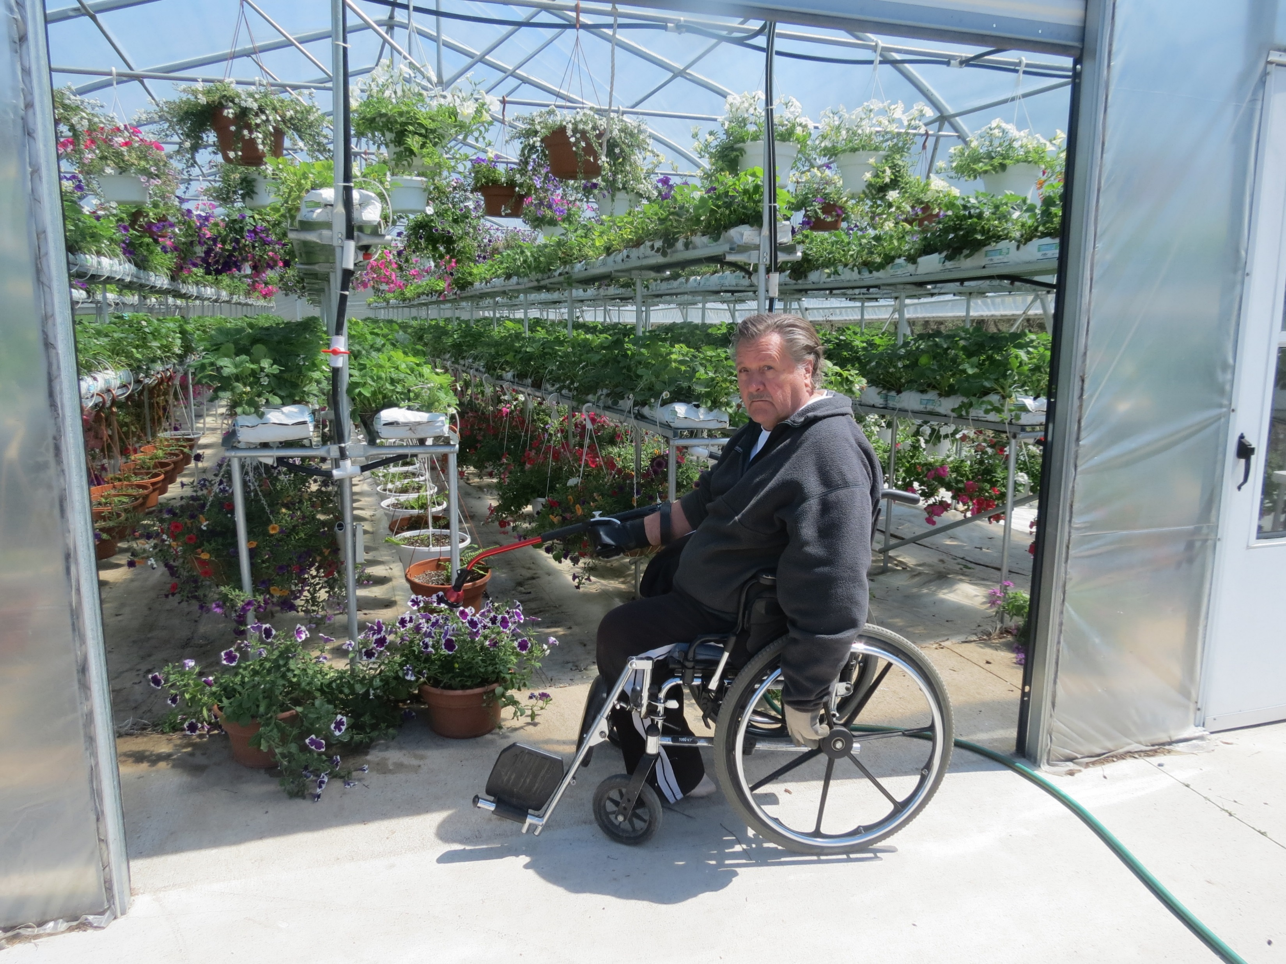
HAAT Human considerations
Emotional
Cognitive
Expertise
Notes:
Tractors for planting, harvest? Planters, seed packaging. Chemical and fertilizer handling. Combine and crop storage.

Slide 20
Human Activity Assistive Technology Model (HAAT)
CONTEXT –
Environment: extreme temps, exposure to elements, dust, humidity, rough terrain
Social: family, employees, finances, legal, pain management, opinions about doctors
Culture: work expected, farm is identity, food safety, government
Notes:
Tractors for planting, harvest? Planters, seed packaging. Chemical and fertilizer handling. Combine and crop storage.

Slide 21
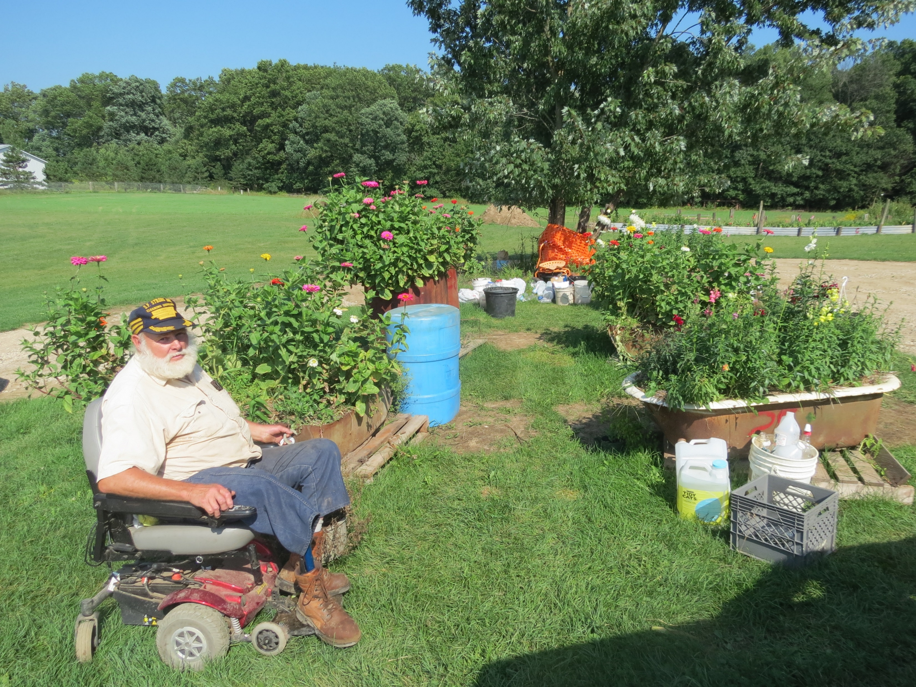
HAAT Context - environment
Notes:
Tractors for planting, harvest? Planters, seed packaging. Chemical and fertilizer handling. Combine and crop storage.

Slide 22
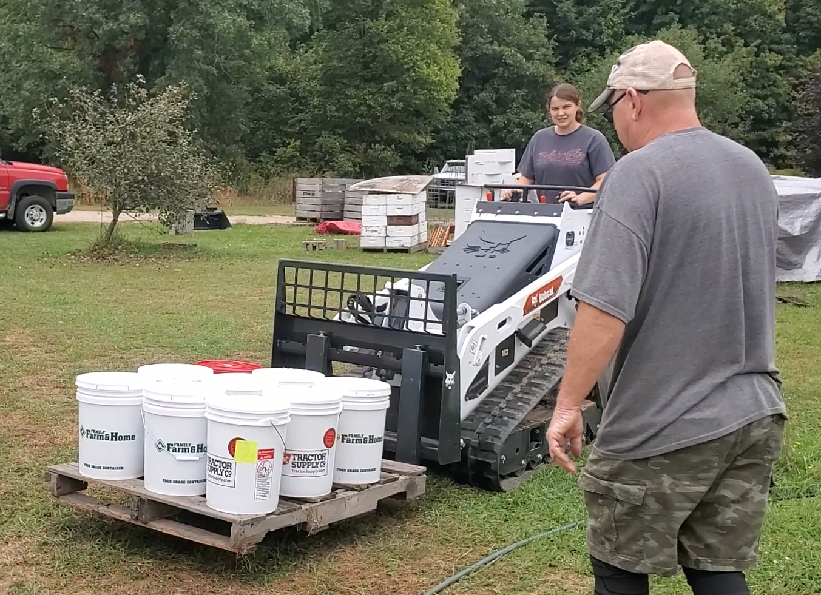
Caregiver Buy-in
Why is it important?
  Device Abandonment
  Ownership
  Investment
How do we get buy-in?
  Rapport, rapport, rapport
Notes:
AT Outcomes - AT use/abandonment, AT satisfaction, AT efficacy/impact, functional performance, cost analysis, psychosocial impact, etc.
If you feel like you have ownership of the technology or if you have invested time into learning how to use the device, you’ll likely want to help the AT user set it up, encourage use, keep up with maintenance, look for any updates needed (software, hardware).

Slide 23
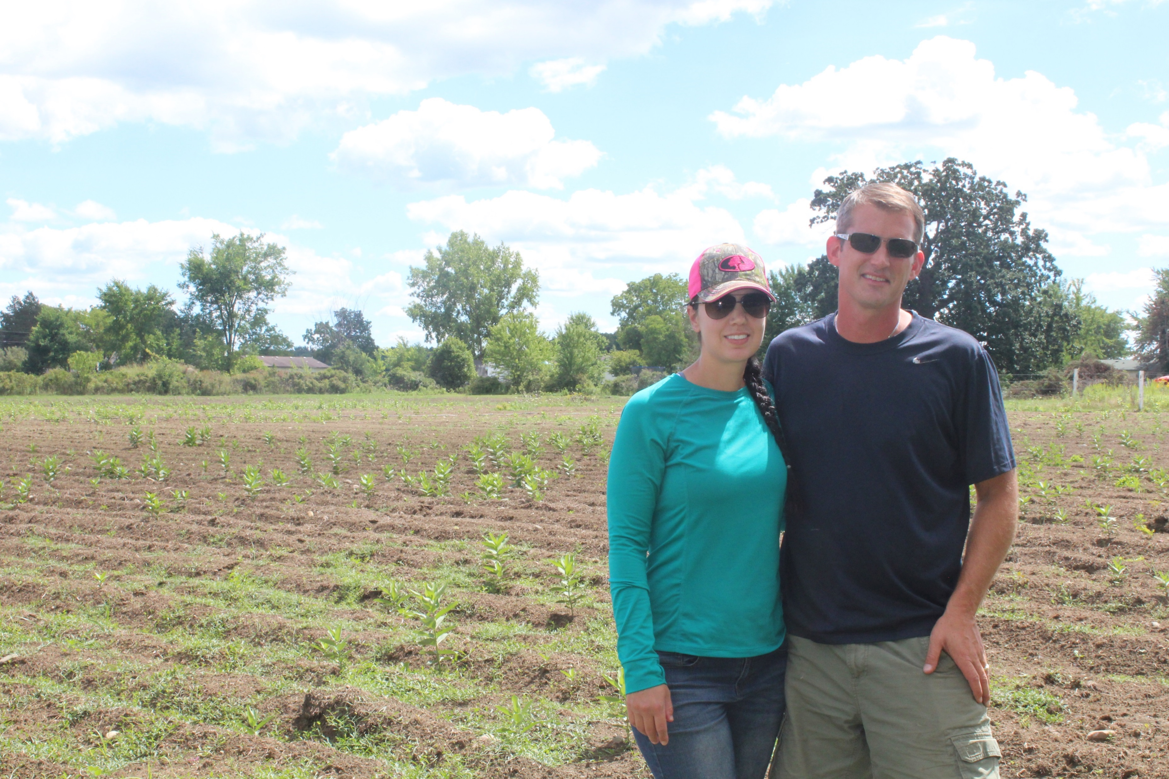
HAAT Context - social
Notes:
Tractors for planting, harvest? Planters, seed packaging. Chemical and fertilizer handling. Combine and crop storage.

Slide 24
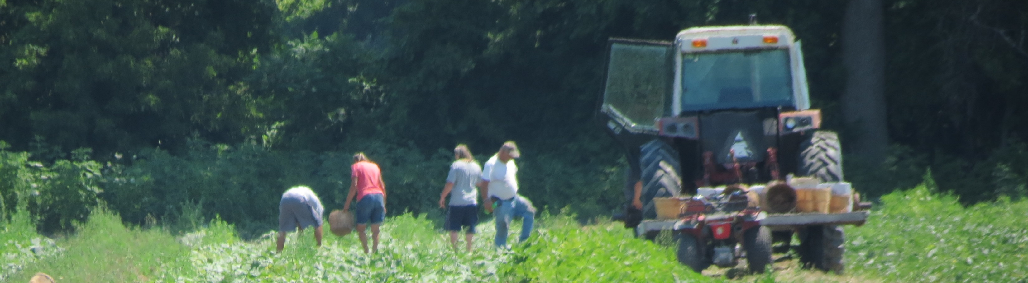
HAAT Activity- you need to study and understand farmer’s tasks!
Fill flats, seeding, watering, light adjustment, pot filling, transplanting, carrying pots, tillage, mulch, weeding, irrigation, spraying, cultivating, pruning, harvest, washing, packaging, transporting, sales, book keeping, field clean up
Notes:
Tractors for planting, harvest? Planters, seed packaging. Chemical and fertilizer handling. Combine and crop storage.

Slide 25
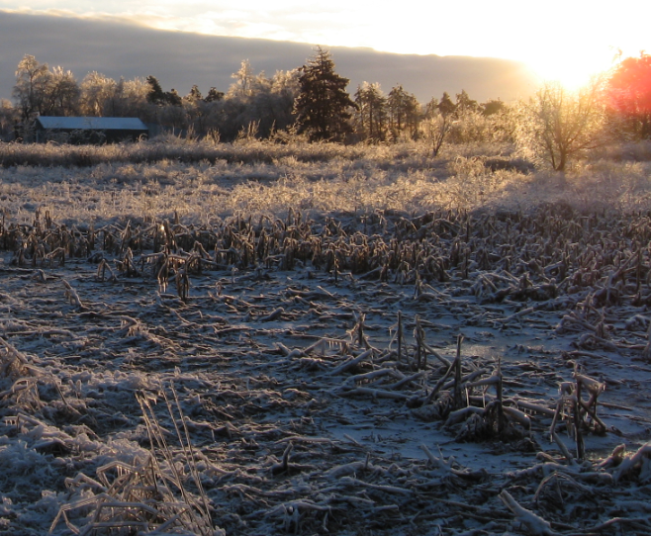
Physical Abilities Needed for Farming
Timing is crucial. The work needs done at proper times and seasons regardless of the farmer’s preference.
The farmer needs to be able to get all the necessary tasks done on time.
You can only get up so early and stay up so late! 24 hours runs out.
If it hurts to work and is unpleasant, there is less motivation to do it, and less likelihood of success on the farm.

Slide 26
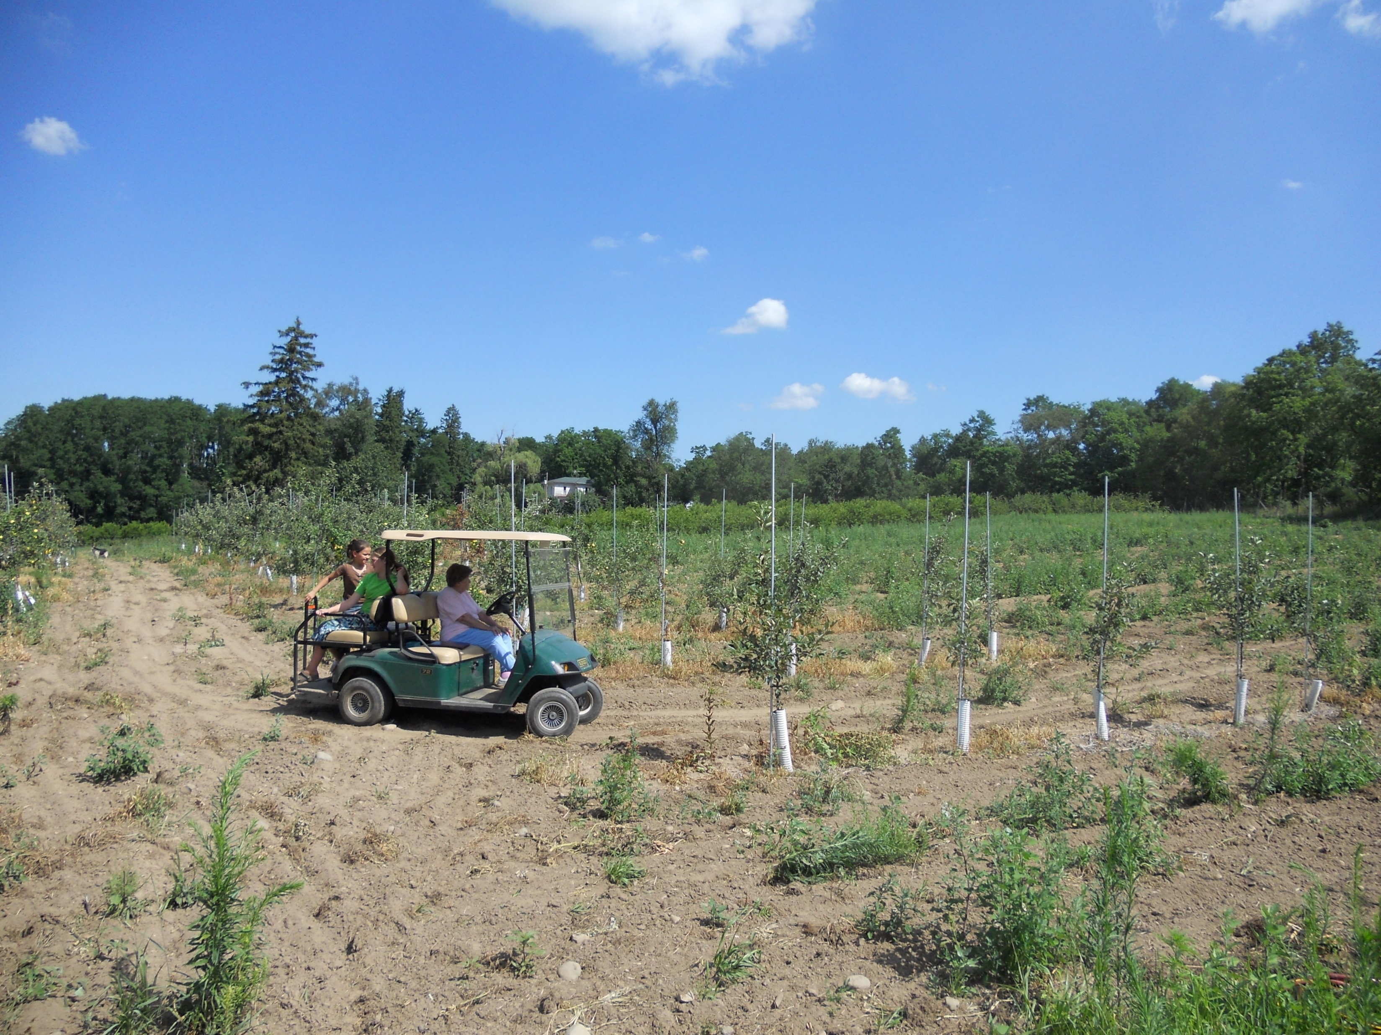
Human Activity Assistive Technology Model (HAAT)
Activity – when a person lacks the capacity to complete a task, the manner must be changed by using AT
  Hundreds of activities
  Farm, house, personal
  How do we prioritize?
    Remember the person
    Remember the context
Notes:
Tractors for planting, harvest? Planters, seed packaging. Chemical and fertilizer handling. Combine and crop storage.

Slide 27
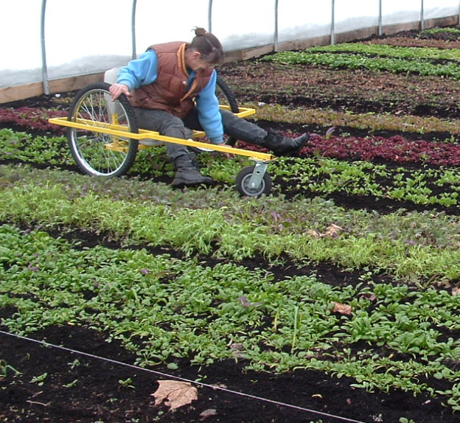
Physical Abilities Needed for Farming
Place a value your time.
Do most important things FIRST!
Evaluate your farm enterprises, and spend time on profitable efforts.
Be more efficient at things that need done most frequently. DAILY CHORES!
Invest in tools and equipment that give you the abilities you need to get essential tasks done on time.

Slide 28
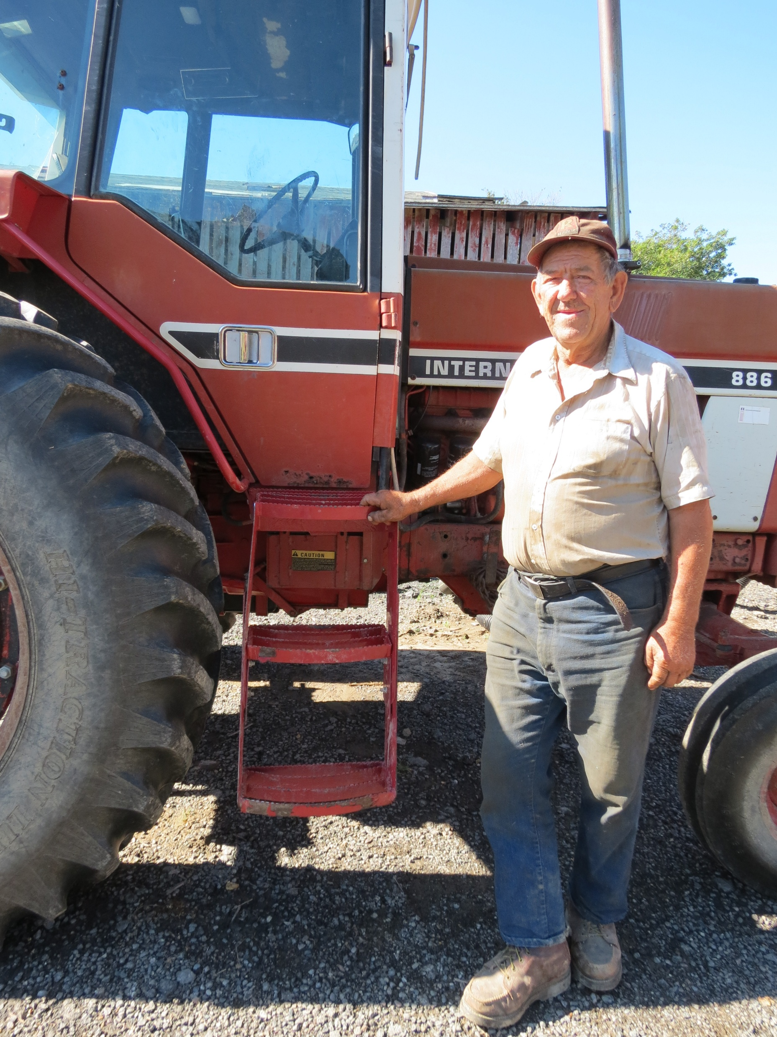
Prioritize tasks with SMILES!
  Safety. Are you safe doing it?
  Money. Is it financially important?
  Independence. Could other workers do it?
  Liking it. Do you enjoy it?
  Expense. How easy is it to accommodate?
  Spending time. How frequent is it?
Notes:
Tractors for planting, harvest? Planters, seed packaging. Chemical and fertilizer handling. Combine and crop storage.

Slide 29
Human Activity Assistive Technology Model (HAAT)
To provide interventions that meet the outcome measures:
  Consider the person
  Consider the context
  Consider the activity
Identify Assistive Technology last!

Slide 30
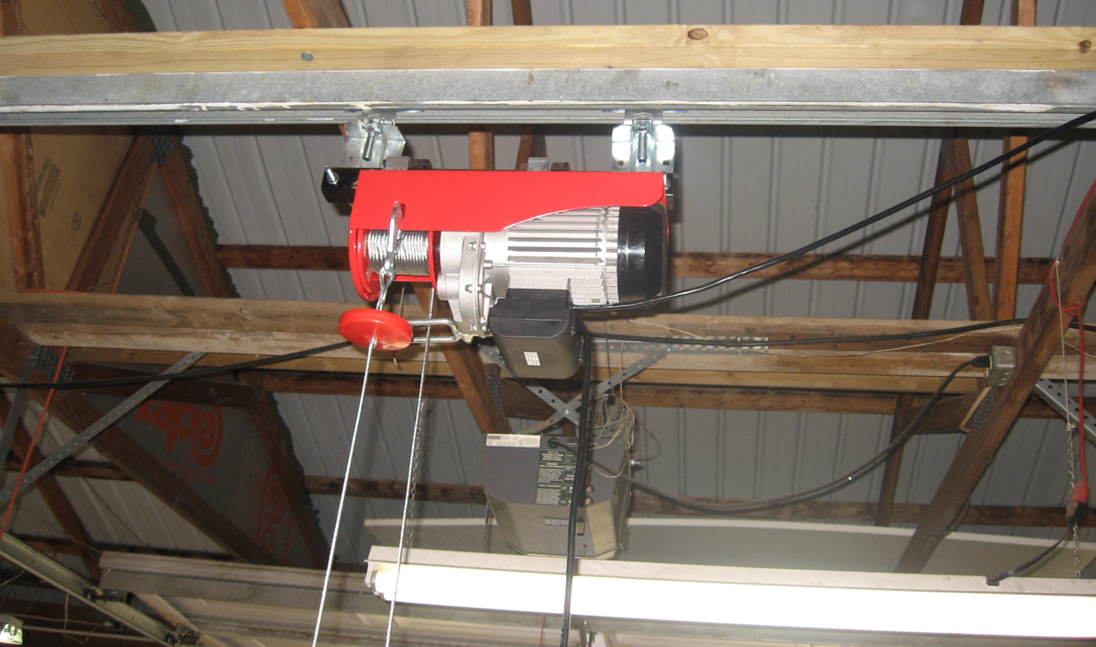
Principles for Providing AT
Do no harm

Slide 31
Principles for Providing AT
Keep the consumer and their goals as the central focus
Focus on functional abilities and potential
That’ll NEVER work!

Slide 32
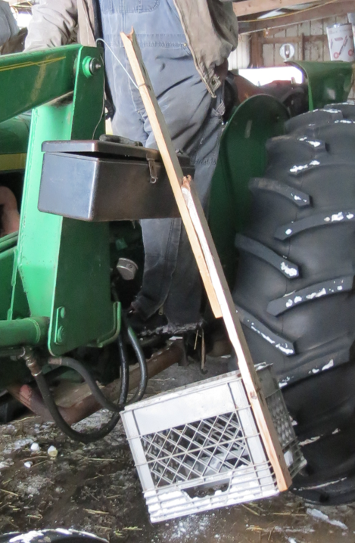
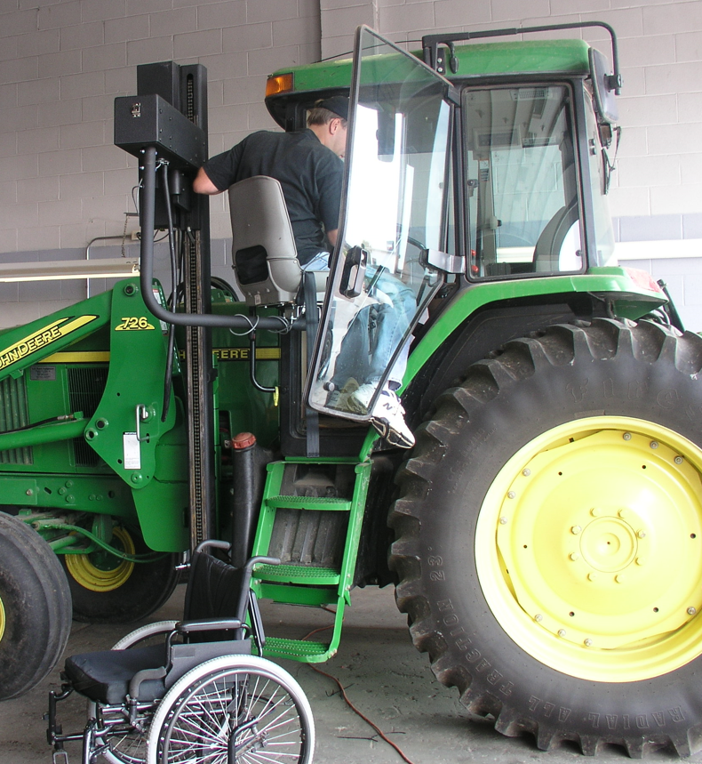
Principles for Providing AT
Offer the simplest but still effective solutions

Slide 33
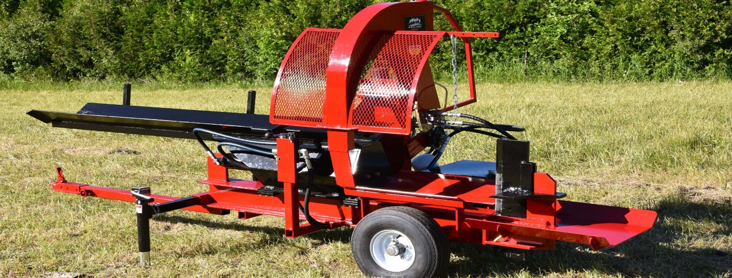
Principles for Providing AT
Offer the simplest but still effective solutions

Slide 34
Who can help us with information resources?
For agriculture-specific commercial and DIY AT, emerging technologies, appropriate service providers, and training opportunities stay in touch with National AgrAbility social media and www.AgrAbility.org
For general disability-relevant policies and regulations, advocacy and training opportunities contact your Center for Independent Living https://www.ilru.org/projects/cil-net/cil-center-and-association-directory
For general commercial AT, emerging technologies, and relevant AT research contact your state AT Act Program https://ataporg.org/
For job accommodations www.askJan.org
Beware homesteader videos on youtube!!!

Slide 35
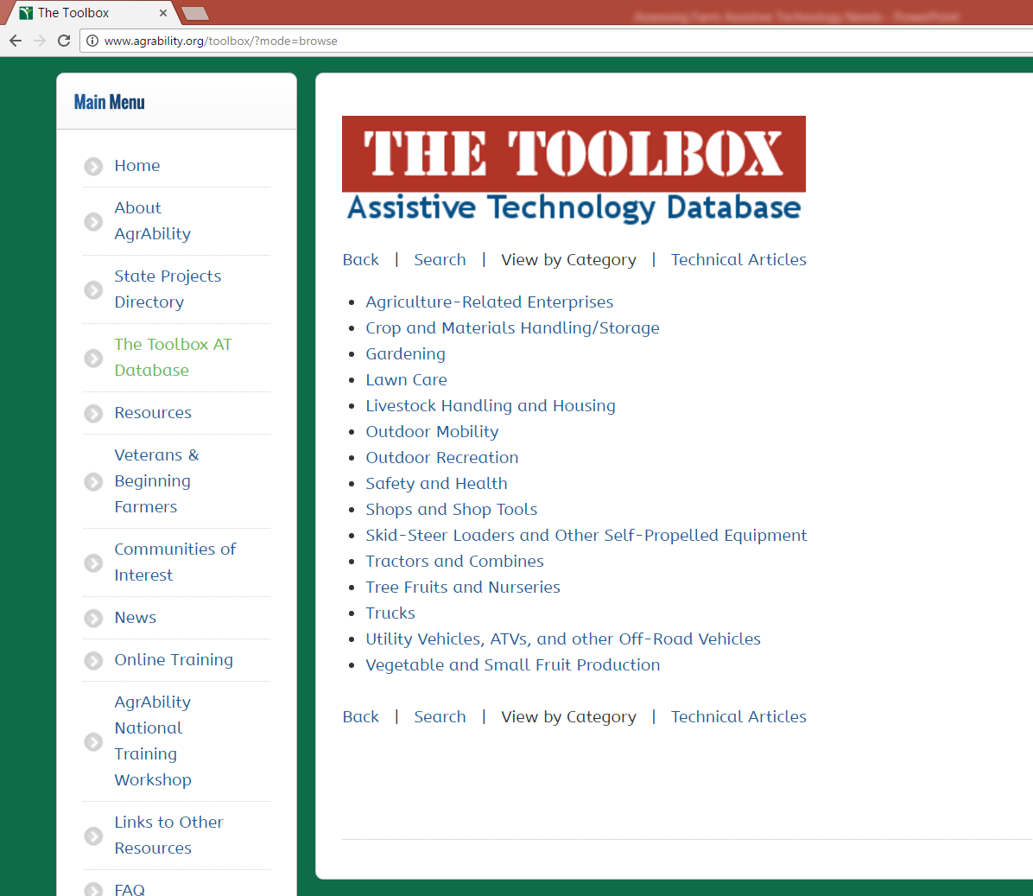
Agricultural AT Availability www.AgrAbility.org/toolbox
Notes:
Where to you want to go? Who will be involved?

Slide 36
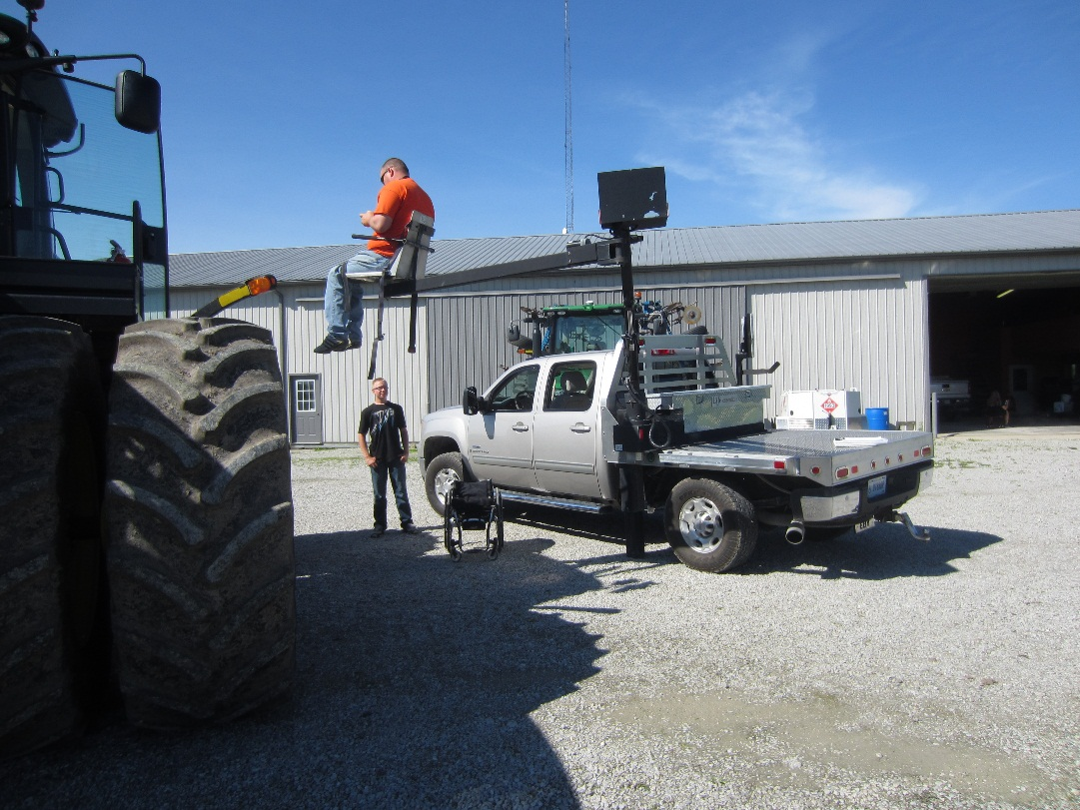
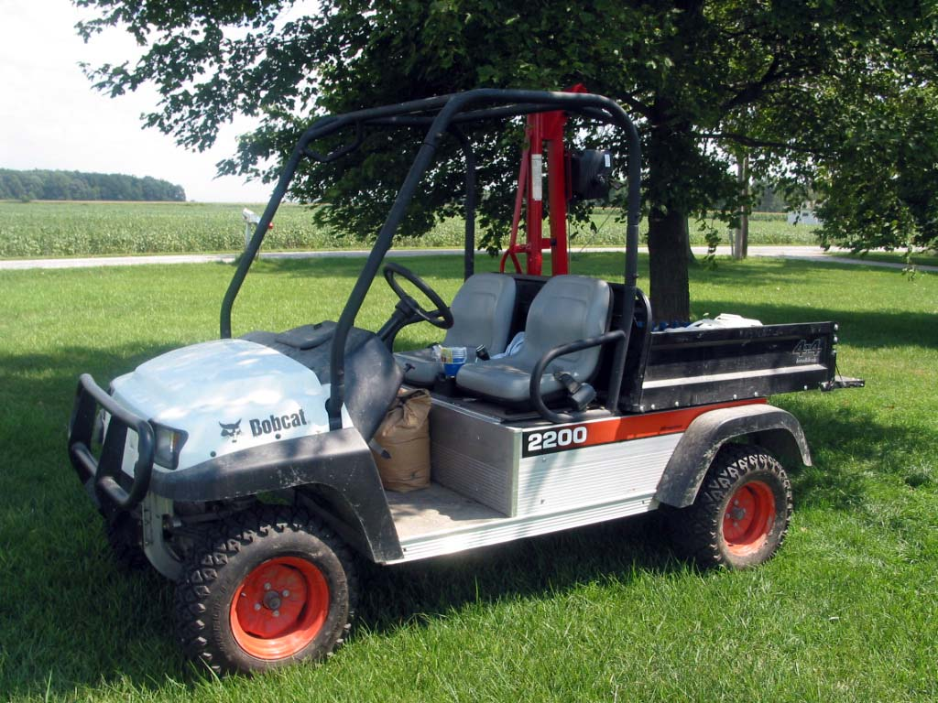
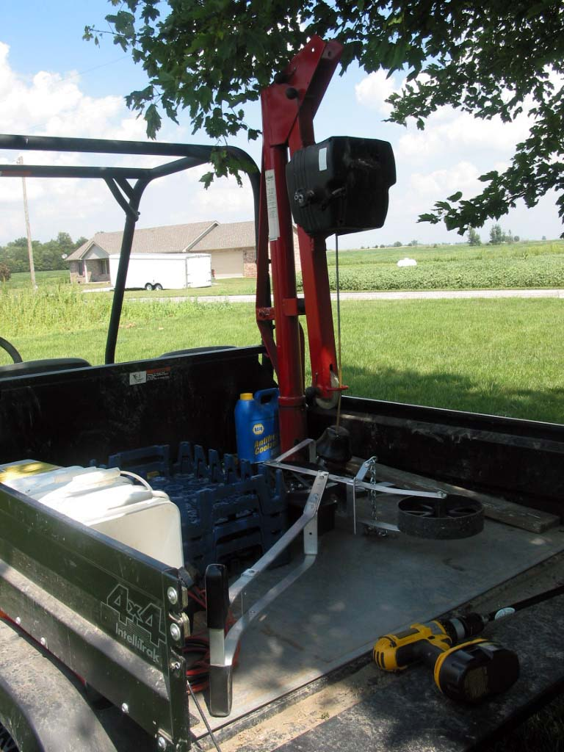
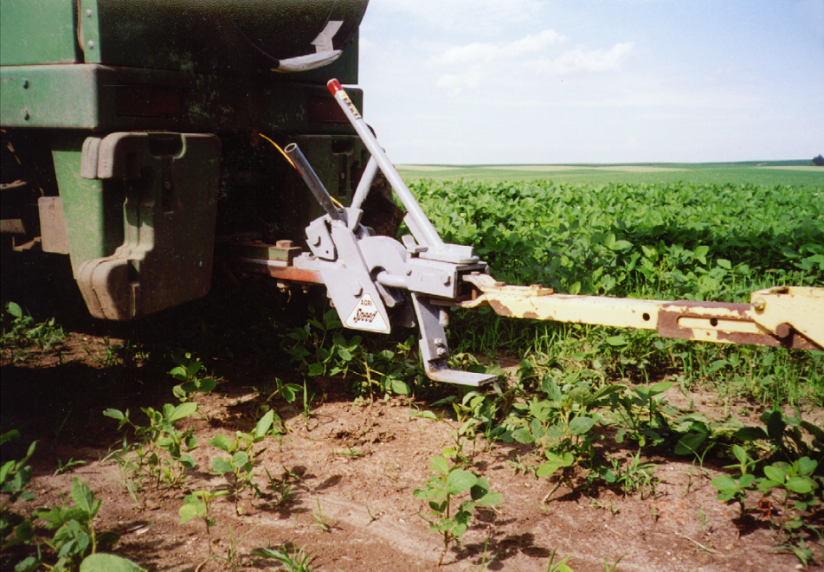
Assistive technology

Slide 37
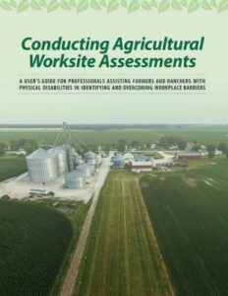

Purdue University is an Equal Opportunity/Equal Access institution.

Slide 38
The Service Delivery Cycle
  Referral finding appropriate candidates for AT interventions by phone interview
  AT Assessment and evaluation of farm site with rehabilitation professionals
  Make a plan listing outcome measures and recommending AT interventions
  Implement the plan with the farmer, funders, AT suppliers, fabricators
  Follow-up to make sure AT is functioning as intended and outcome measures are met
  Follow along to revisit steps 2,3,4 as needed
Notes:
Tractors for planting, harvest? Planters, seed packaging. Chemical and fertilizer handling. Combine and crop storage.

