Slide 1
Empowering the Fields
Smart Phone Accessibility for Farmers

Slide 2
Presenters
Jennifer Cunningham, OTR/L, ATP
Assistive Technology Professional
jennifer.cunningham@star-center.org
Lindsey B. Wilkerson, M.S. Clinical Mental Health Counseling
Assistive Technology Specialist
lindsey.wilkerson@star-center.org

Slide 3
STAR Center, Inc.
In 1988, Margaret and Chuck Doumitt realized the need for disability resources after two of their children were diagnosed with Batten’s Disease. The STAR Center is headquartered in Jackson, Tennessee, though we have offices in Nashville and Memphis. Our Assistive Technology team serves individuals in all 95 counties across the state.

Slide 4
Objectives
Increase Awareness: Educate attendees about the various functional limitations faced by farmers and the potential solutions offered by smartphone technology.
Highlight Key Features: Demonstrate specific smartphone features and applications that can assist farmers in overcoming their disabilities.
Encourage Adoption: Motivate farmers and stakeholders to embrace smartphone accessibility tools to enhance productivity and independence on the farm.

Slide 5
Smartphones…A Computer in Our Pocket!
With the progression of smartphone accessibility features and apps over the last 20 years, the way we live, work, and play has been drastically transformed into something we could have never imagined. For many people, a smartphone can actually replace electronics like an old laptop, digital music player, and digital camera in the same device.
Smartphones are…
designed to be extremely portable and fit in your hand
a more powerful version of a traditional cell phone
powerful enough to do many of the same things you
can do with a desktop or laptop computer
able to connect to the Internet over Wi-Fi or a cellular network
touch-sensitive, meaning there isn't a physical keyboard on the device

Slide 6
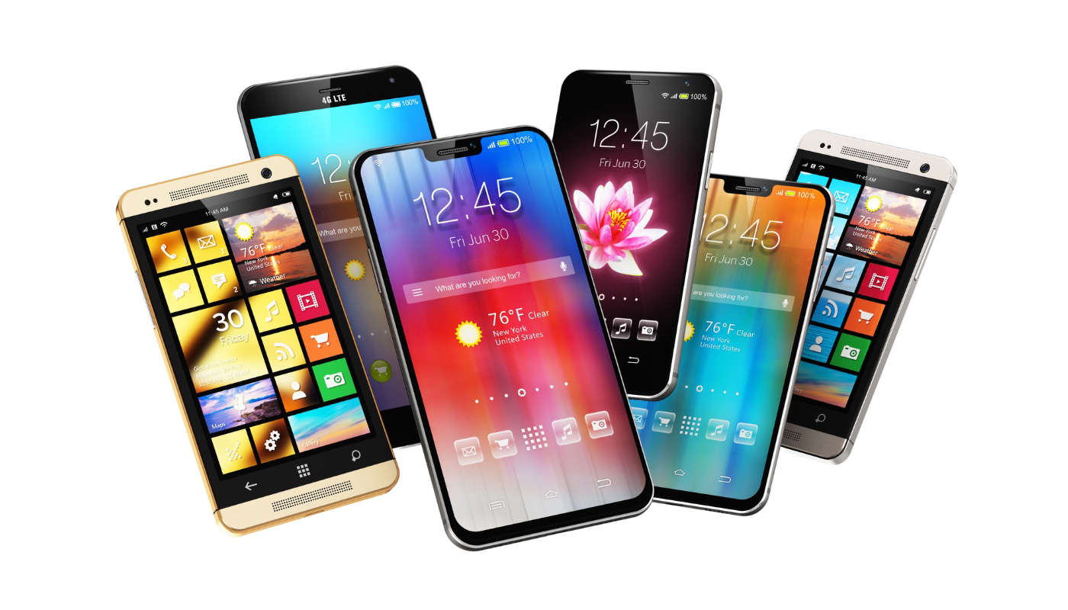
How Can Smart Phones Be Used in Farming?
Smartphones have become invaluable tools in modern farming, offering a range of applications that help farmers increase efficiency, productivity, and sustainability. Here are some key ways smartphones are used in farming:
Crop Monitoring and Management
Weather Forecasting
Soil Analysis
Farm Management
Pest and Disease Diagnosis
Market Access
Irrigation Management
Notes:
Apps like OneSoil and AGMRI use satellite imagery and AI-driven analytics to monitor crop health, detect issues like nutrient deficiencies or pest infestations, and provide actionable insights[1][2].
Accurate weather apps help farmers plan their activities by providing real-time weather updates and forecasts, which are crucial for planting, irrigation, and harvesting.
Apps like AgriApp offer soil testing services that analyze soil health and provide recommendations for fertilization and crop management[1].
Comprehensive farm management apps like My Crop Manager and fieldmargin help farmers keep track of their operations, manage resources, and maintain records of activities and expenses[1].
: Apps such as Plantix allow farmers to diagnose pest and disease problems by uploading photos of affected crops. The app then provides treatment recommendations[1].
Farmers can use apps to buy agricultural inputs like seeds and machinery, and to sell their produce online, reaching a wider market and getting better prices[3].
Some apps help farmers optimize their irrigation schedules based on weather data and soil moisture levels, ensuring efficient water use.
These tools make farming more data-driven and efficient, helping farmers make informed decisions and improve their overall productivity

Slide 7
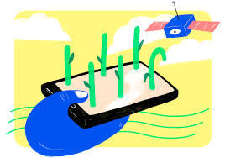
OneSoil
Free Scouting App
Satellite view and boundaries
Uses the Normalized Difference Vegetation Index (NDVI) to locate problem areas

Slide 8
AgriWebb
Livestock Management Software
Track livestock numbers and movement records on an interactive map
Built-in record keeping for inventory, treatments, feed, etc.
Connects to Bluetooth devices like RFID tags, scales, smart water tanks, smart rain gauges, etc.

Slide 9
Other Applications

Slide 10
But What about for Farmers with Disabilities?
Smartphones and applications can significantly enhance the lives of farmers with disabilities by providing tools that improve accessibility, efficiency, and independence.
Alternative Access
Medical Monitoring
Vision Support
Hearing Assistance
Notes:
Apps such as Be My Eyes connect visually impaired farmers with sighted volunteers through live video calls, helping them with tasks like identifying objects, reading labels, and navigating their environment[1].
Smart farming apps allow farmers to monitor and control equipment remotely. For example, they can manage irrigation systems, monitor crop health, and receive alerts about potential issues, reducing the need for physical presence in the field[2].
Digital agriculture solutions provide accessible formats for information on crop management, weather forecasts, and market prices, ensuring that farmers with disabilities can access the same valuable data as their peers[2].
Online platforms and apps offer training modules and support for farmers with disabilities, helping them learn new techniques and stay updated with best practices in agriculture[2].
Apps that facilitate buying and selling agricultural products online can help farmers with disabilities reach a wider market, ensuring they get fair prices for their produce without needing to travel[2].

Slide 11
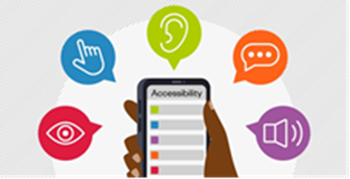
Smartphone Accessibility
Magnifier
Allows the device camera to be used like a magnifying glass
Zoom (iOS)/Screen Magnification (Android)
Provides magnification of the device screen
Spoken Content (iOS)/Select-to-Speak (Android)
Verbalizes specific text on the screen
VoiceOver (iOS)/TalkBack (Android)
Reads the entire screen with use of gestures
Live Captions (iOS)/Live Caption & Live Transcribe (Android)
Turns spoken dialogue into written text
Voice Control (iOS)/Voice Access (Android)
Controls the device hands-free

Slide 12
Be My Eyes: Be My AI
Notes:
14:25

Slide 13
Seeing AI App

Slide 14
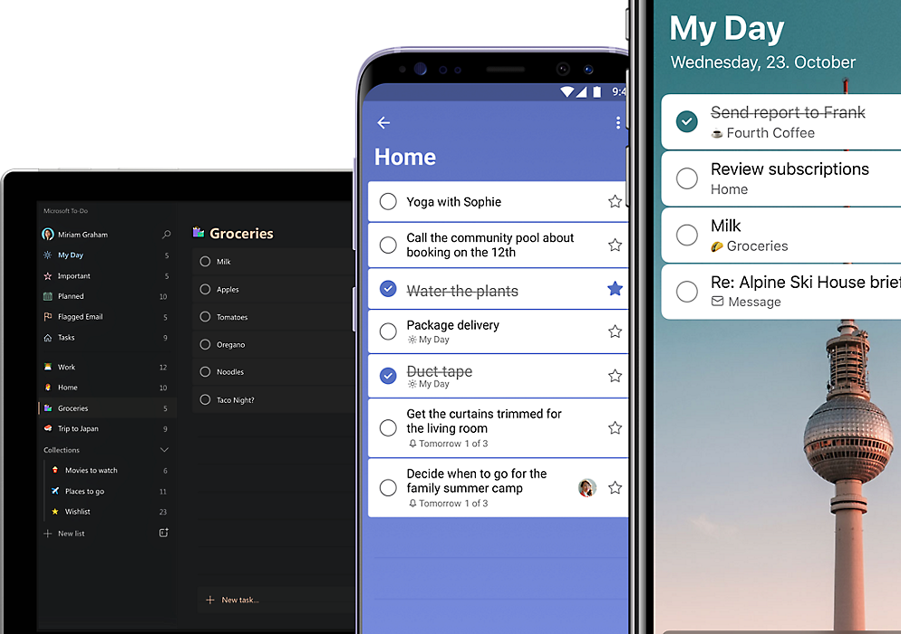
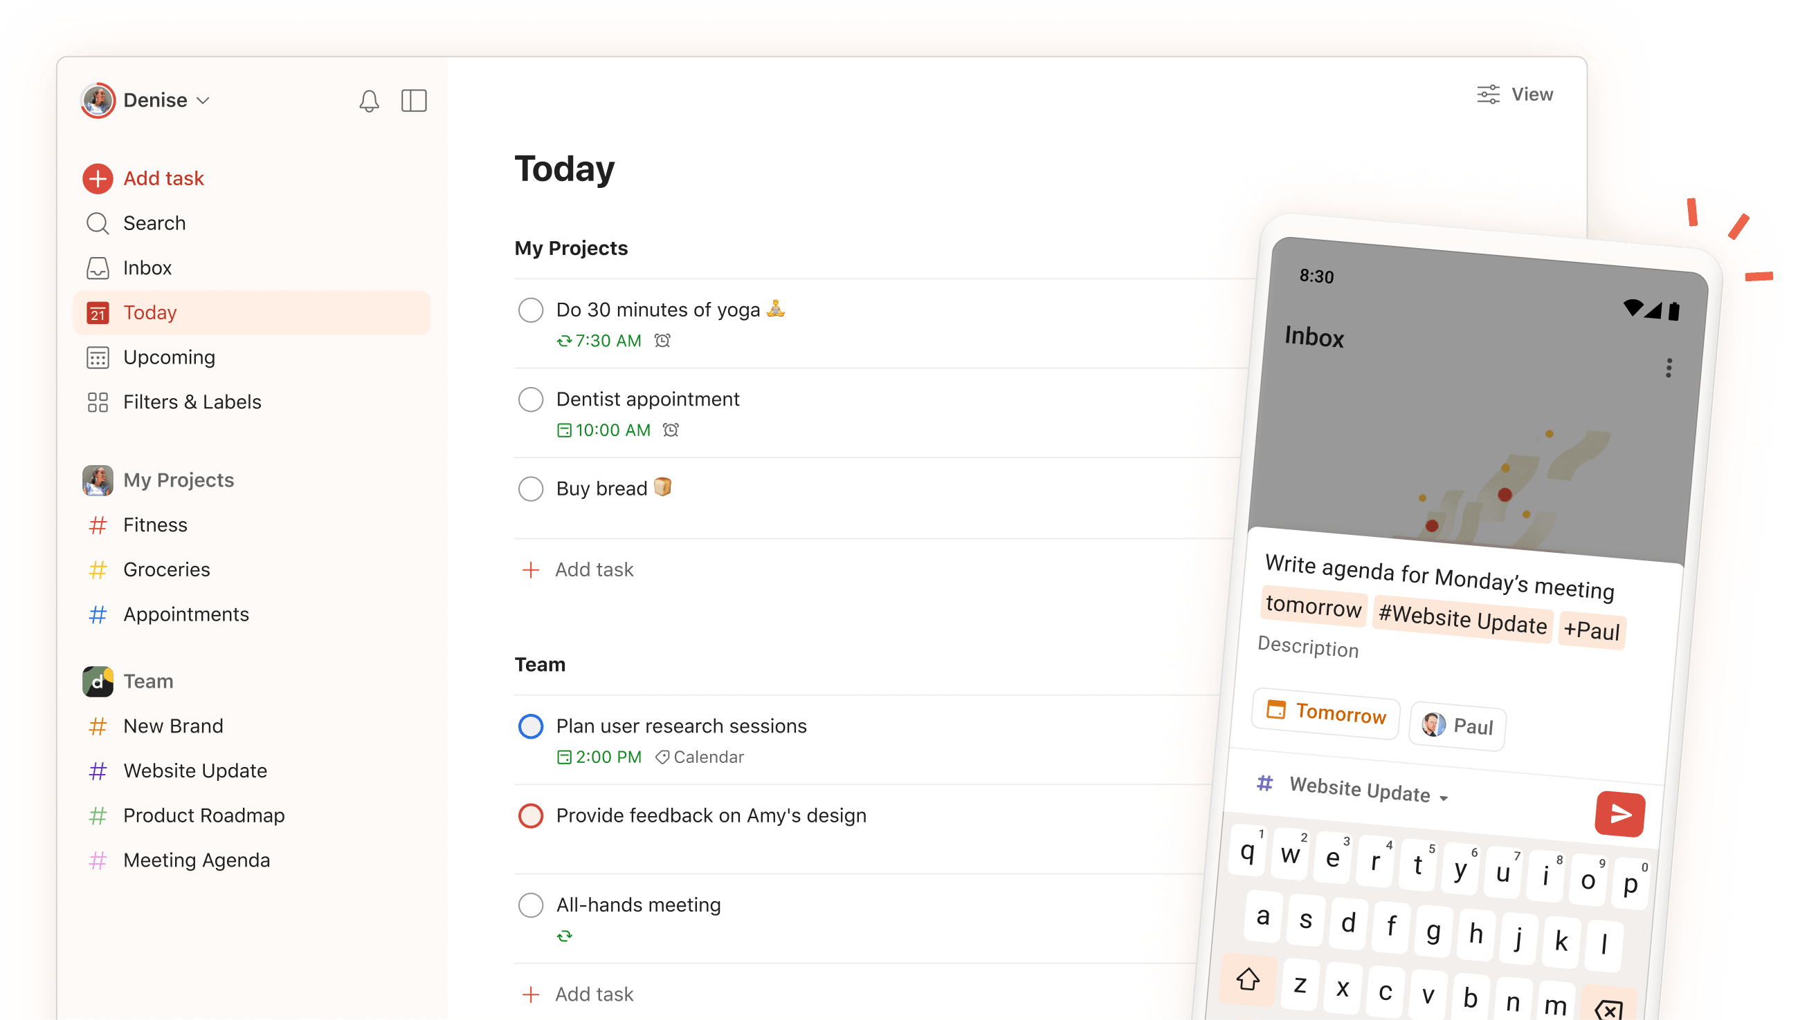
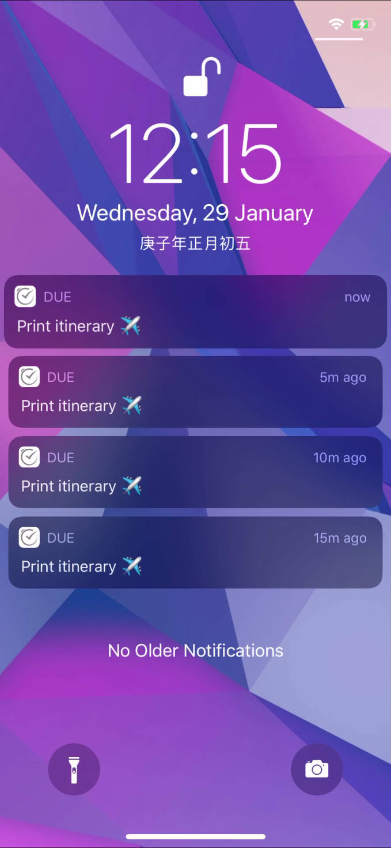
Task Lists and Reminders
Microsoft To Do
Todoist
Due
Notes:
MS To Do: Easily used across platforms. Integrates with Outlook and grabs flagged emails as tasks. Simple. Included with Microsoft account.
Todoist: Can be used across multiple platforms. Simple lists and reminders. Color coding available. Pricing up to $72/year for Pro version.
Due: Quick and easy reminder setting. Can be used across platforms. Repeatedly and persistently send notifications until task is completed.

Slide 15
Tips to Make a Smartphone Less Visually Cluttered
Confirm the phone operating system is current
Verify that commonly used apps are up-to-date
Change the wallpaper to a solid background (usually dark)
Remove any unused icons from the home screen
Go to Accessibility in settings and change font, contrast, etc.

Slide 16
Health App (iOS) / Health Connect (Android OS)
Activity
Heart Health
Sleep duration and quality
Mood and mindfulness
Environmental sound levels
Walking steadiness
Respiratory health
Medication reminders

Slide 17
Emergency Medical Information Medical ID (iOS) and Medical Info (Android)
Medical Conditions
Blood Type
Allergies
Medications
Weight/Height
Date of Birth
Address
Organ Donor Status
Emergency Contacts

Slide 18
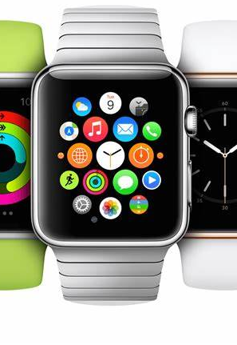
Smartwatches
Smartwatches are versatile, serving as an extension of your smartphone.
Smartwatches can help you:
find lost items
keep up with appointments
receive calls/texts/notifications
remind you to breathe
detect falls
monitor blood pressure/heart rate/oxygen saturation
detect abnormal heart rhythms

Slide 19
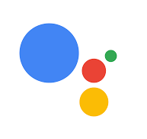
Artificial Intelligence
Virtual Assistants: Apps like Siri, Google Assistant, and Alexa that help users with tasks like setting reminders, answering questions, and controlling smart home devices.
Chatbots: A software app or online interface that uses generative artificial intelligence systems to carry on a conversation, similar to human communication.
Notes:
AI apps, or artificial intelligence applications, are software programs that use AI technologies to perform tasks that typically require human intelligence. These tasks can include learning, reasoning, problem-solving, understanding natural language, and recognizing patterns. Here are a few common types of AI apps:
Virtual Assistants: Apps like Siri, Google Assistant, and Alexa that help users with tasks like setting reminders, answering questions, and controlling smart home devices.
Chatbots: Used in customer service to provide instant responses to common queries and support issues.
Siri and Apple AI can offer several benefits to farmers by providing useful tools and insights to enhance their farming practices. Here are some ways they can help:
Voice-Activated Assistance: Farmers can use Siri to set reminders for tasks such as watering schedules, equipment maintenance, and crop monitoring. Siri can also provide weather updates, which are crucial for planning daily activities.
Data Management: Apple AI can help farmers organize and analyze data related to crop yields, soil health, and pest management. This can be done through apps that integrate with Apple's ecosystem, allowing farmers to make data-driven decisions.
Remote Monitoring: With the help of AI-powered apps, farmers can monitor their fields remotely using their iPhones or iPads. These apps can provide real-time data on crop health, soil moisture levels, and other important metrics.
Image Recognition: Apple AI's image recognition capabilities can help farmers identify pests, diseases, and nutrient deficiencies in crops by analyzing photos taken with their devices[1].
Task Automation: Siri Shortcuts can automate routine tasks, such as sending notifications when it's time to check irrigation systems or reorder supplies.
Collaboration and Communication: Farmers can use Siri to send messages, make calls, and set up meetings with suppliers, buyers, and team members, streamlining communication and collaboration.
By leveraging these tools, farmers can improve efficiency, reduce costs, and increase productivity. Are there any specific tasks or challenges you're facing on your farm that you'd like more information on? [1]: Forbes
References
[1] 10 Amazing Things You Can Do With Apple Intelligence On Your IPhone
[2] This is every Apple Intelligence feature that’s available now
[3] How Apple Intelligence will change how you use Siri on your iPhone ...
Chatbots can be incredibly beneficial for farmers by providing instant support, valuable insights, and streamlining various tasks. Here are some ways chatbots can help:
24/7 Support: Chatbots can provide round-the-clock assistance, answering common questions about crop management, pest control, and weather updates[1].
Personalized Advice: By analyzing data such as soil health, weather patterns, and crop conditions, chatbots can offer tailored recommendations to farmers[2].
Market Information: Chatbots can provide real-time updates on market prices, helping farmers make informed decisions about when to sell their produce[2].
Task Automation: Chatbots can automate routine tasks like scheduling irrigation, sending reminders for equipment maintenance, and tracking inventory[1].
Data Collection and Analysis: Chatbots can gather and analyze data from various sources, helping farmers monitor crop health, predict yields, and optimize resource usage[2].
Customer Engagement: For farmers who sell directly to consumers, chatbots can handle customer inquiries, take orders, and provide information about products[1].
By leveraging these capabilities, chatbots can help farmers improve efficiency, reduce costs, and increase productivity. Are there any specific tasks or challenges you're facing on your farm that you'd like more information on?
[1]: Chatfuel [2]: Copilot.Live
References
[1] Why farmers and agriculture businesses should use chatbots
[2] Chatbot For Farmers - Agriculture And Farmer Welfare
[3] LoginEKO’s Advanced Agriculture Chatbot

Slide 20
Unconventional Use of ChatGPT
Notes:
3:16

Slide 21
What would you like to know?

Slide 22
References
Star-center.org
OneSoil | Free Farming App for Precision Agriculture
Homepage - AgriWebb
11 Best Agricultural Apps in 2025 | Freeappsforme - Free apps for ...
Best Agriculture Apps for 2025 - CropLife
Agriculture Apps - Top must have mobile apps for the farmers
Farming Blind with Duck - YouTube
The Blind Life - YouTube
25 Life Changing Apps for People with Disabilities
National Impacts Database

