Slide 1
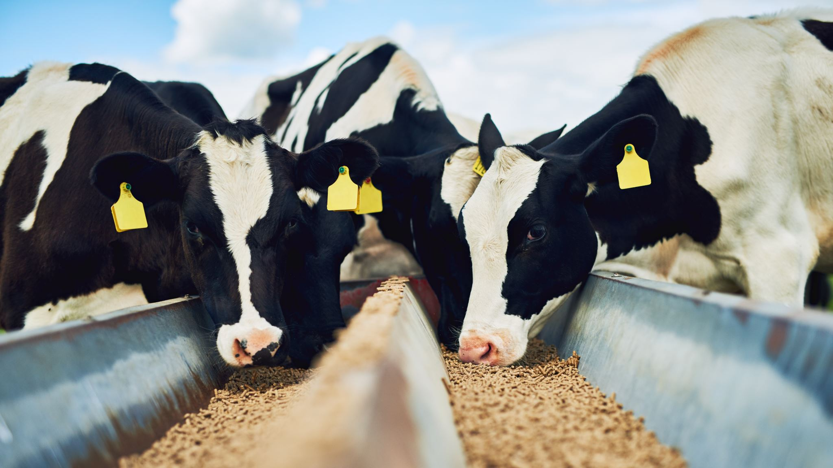
Farm Safety Dinner Theater
Jeremy Daubert
Virginia Cooperative Extension
AgrAbility Virginia
jdaubert@vt.edu

Slide 2
Building on What others have done
Michigan State Farm Stress
National AgrAbility Programs
Dr. Deborah Reed – University of Kentucky
Many Others

Slide 3
- University of Kentucky
Dr. Deborah Reed
“Ag Nurse”

Slide 4
Readers Theater
Fellowship
Dinner
Discussion

Slide 5
Community Partners
PC: Daniel Lin

Slide 6
Venue

Slide 7
Moderators
PC: Daniel Lin

Slide 8
Moderators

Slide 9
“Actors”
PC: Daniel Lin

Slide 10
Actors

Slide 11
Dinner

Slide 12
Considerations
Stand Alone or with something else
Time of Day
Current Scripts or new scripts
Safety/Mental Health Focus

Slide 13
Media Coverage at event
Decide what media coverage you want?
Think about confidentiality?
Do you want to allow pictures?
Interviews?

Slide 14
Outcomes
Conversations go in unique directions
Aging
Tractor turnover
Stress related
Youth on farm

Slide 15
Resources
https://psd.ca.uky.edu/webinarshandouts University of Kentucky toolkit
https://www.vpm.org/news/2023-02-06/rockingham-county-extension-office-farm-safety-harrisonburg
https://www.ruralhealthinfo.org/project-examples/1093
https://commons.lib.jmu.edu/cgi/viewcontent.cgi?article=1105&context=vjph
https://www.vabeginningfarmer.alce.vt.edu/resources/safety-health-wellness.html

Slide 16
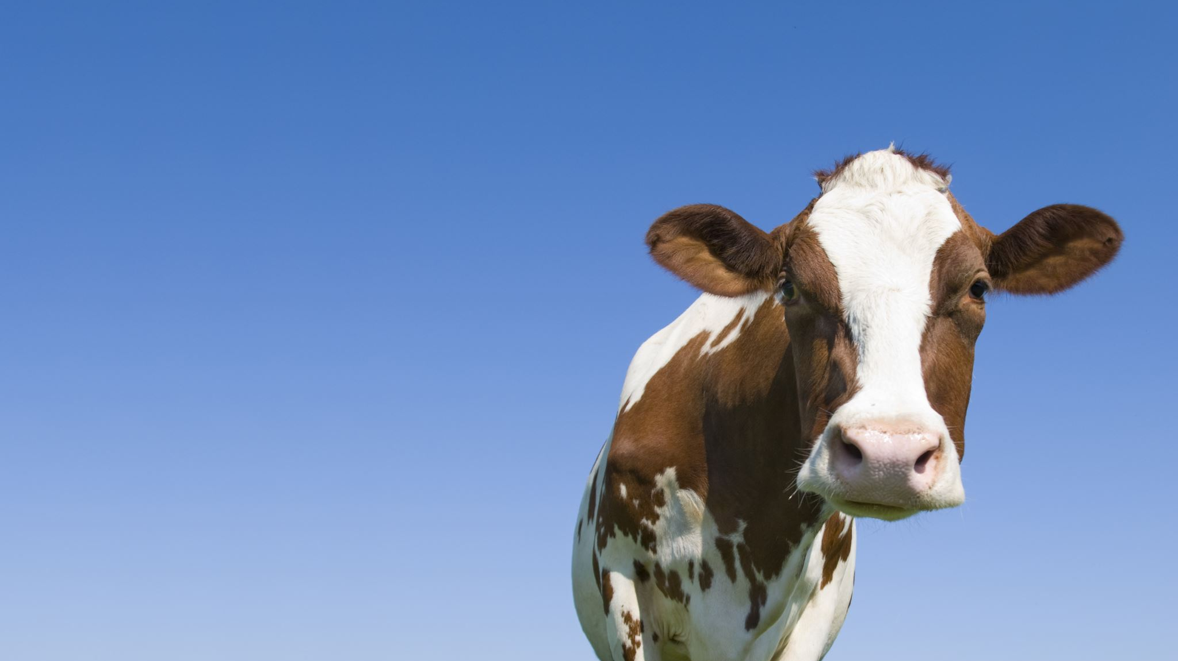
Thank You!
Jeremy Daubert
Rockingham County Extension – Dairy Science
AgrAbility Virginia
540-705-4627
jdaubert@vt.edu

