Slide 1
Successful SARE grant writing
Notes:
NCR SARE stands for North Central Sustainable Agriculture Research and Education

Slide 2
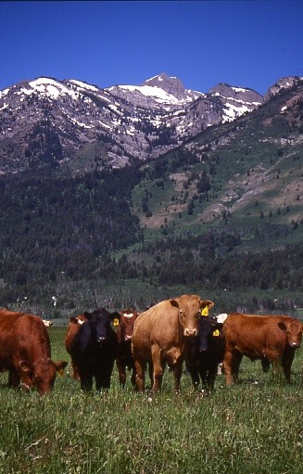
Opportunities to be involved with SARE
Serve as a grant application reviewer
SARE Outreach Committee
Regional SARE Administrative Councils
Ask your regional SARE program!
Notes:
Besides submitting a grant proposal, there are other ways to engage with SARE.

Slide 3
Contact Your SARE Regional Coordinator
Western SARE Regional Coordinator
Clayton Marlow
cmarlow@montana.edu, 406-994-5161
https://western.sare.org
North Central SARE Regional Coordinator
Beth Nelson
bethnelson@umn.edu, 612-626-4436
https://northcentral.sare.org
Northeast SARE Regional Coordinator
Vernon Grubinger
vernon.grubinger@uvm.edu, 802-656-7534, https://northeast.sare.org
Southern SARE Regional Coordinator
Jeffrey Jordan
jjordan@uga.edu, 770- 412-4787
https://southern.sare.org

Slide 4
Learning Objectives
Learn opportunities to be involved with SARE and general grant proposal resources
Learn about Michael Fields Institute
Learn about starting with the end in mind (logic models)
Learn about SARE grants in detail
Learn about specific SARE grants awarded with veterans or disability in the search term

Slide 5
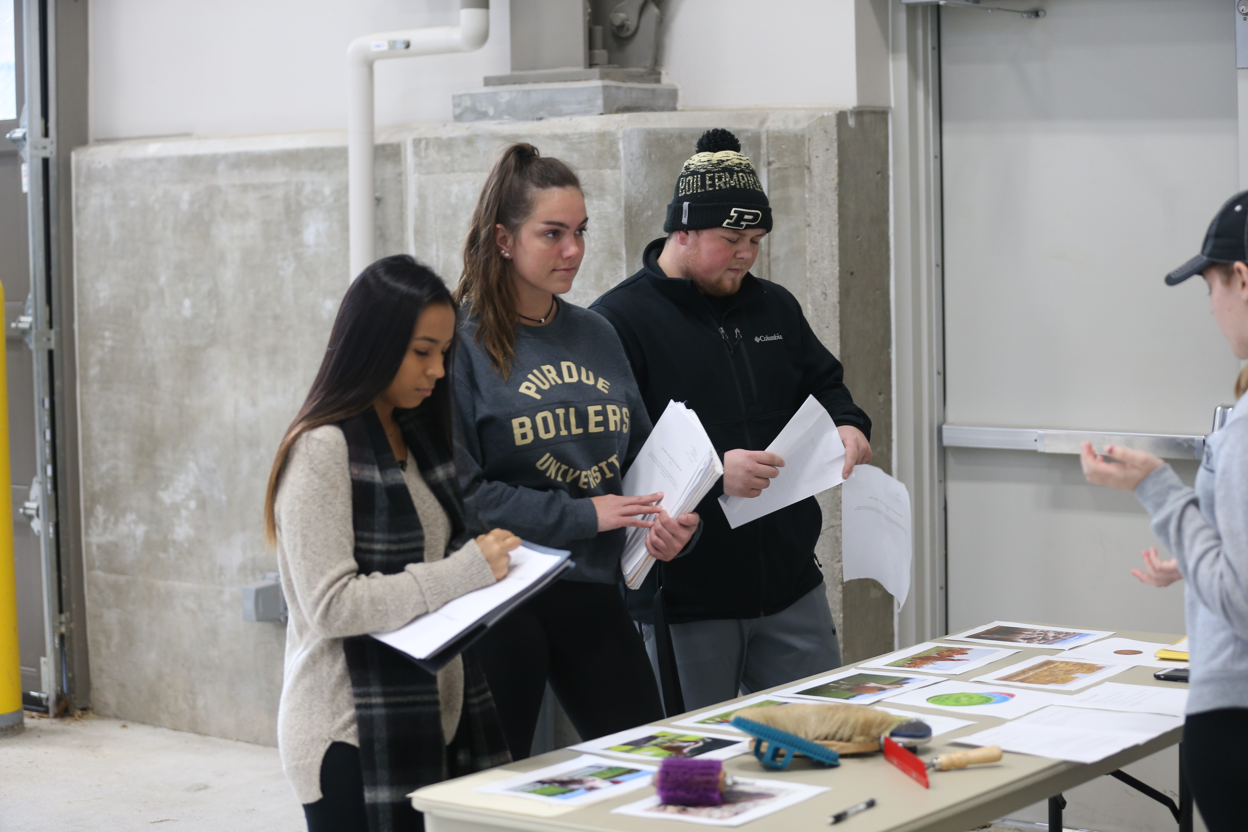
A grant proposal is like any project
Notes:
• It has tightly defined purposes,
• a clear strategy to accomplish them,
• on a defined and realistic timeline,
• the people, money, and other resources needed to accomplish them,
• a basis for evaluating the process when done,
• and an effective means of communicating results to any audience that
needs to hear them.
• Many projects are strengthened by thoughtfully built supporting coalitions.
• Good projects use existing resources to leverage additional ones. Funders often
favor or require matches of funding as an indicator of local commitment to a
project. Matches usually can be "in-kind" contributions (e.g., volunteer labor,
existing equipment, etc.), as well as actual dollars (“cash match”).

Slide 6
Planning process
• Include only active stakeholders in the planning process.
• Give yourself enough time. Setting project goals, objectives, strategies, timelines, budgets, evaluation processes, especially in a group, takes time.
• Be sure to ask the right questions and answer them carefully.
Michael Fields Agricultural Institute

Slide 7
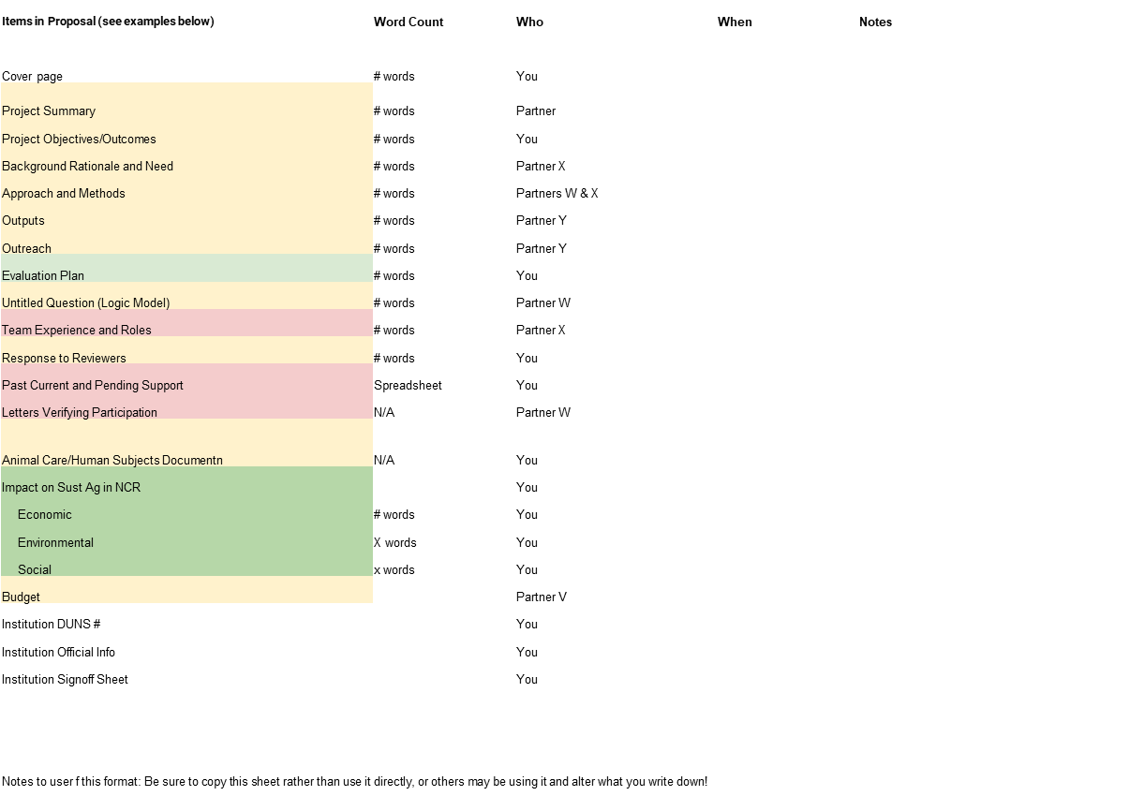
Planning process – organization helps
https://fyi.extension.wisc.edu/sustag/files/2021/10/Proposal-Management-Worksheet.xlsx you can get this Excel spreadsheet to help you with planning
University of Wisconsin

Slide 8
Questions to Consider in developing project – situational analysis
• What's the problem you seek to address?
• Have other people, locally or elsewhere, addressed this problem? If so,
what have you learned from their work, and how does your effort
relate to theirs?
• Who else might be concerned about your issues? Should they be involved in your project? What will they contribute?
• What is your principal strategy to resolve that problem? Why is this
strategy better than other approaches you might consider?
Michael Fields Agricultural Institute

Slide 9
Questions to Consider in developing project
• What's a realistic timeline, for action?
• What resources do you need to implement your project?
• Would others profit from knowing about your initiative? If so, are they
local, regional, national? What’s the best way to get the word out to
that audience?
Michael Fields Agricultural Institute

Slide 10
Questions to Consider – situational analysis
• How will you measure and evaluate your project's outcomes? Keep in mind how to assess your work impartially against both your project’s goals and its measurable objectives.
Michael Fields Agricultural Institute

Slide 11
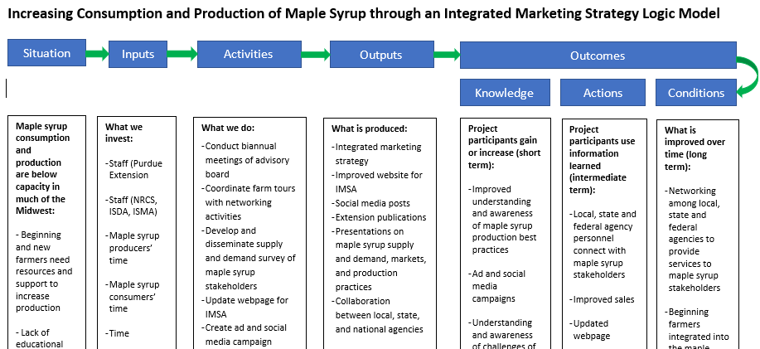
Developing project – A Logic model is very useful – an example
Notes:
Increasing Consumption and Production of Maple Syrup through an Integrated Marketing Strategy Logic Model
Situation
Inputs
Activities
Outputs
Outcomes
Knowledge
Actions
Conditions
What we invest:
Staff (Purdue Extension
Staff (NRCS, ISDA, ISMA)
Maple syrup producers’ time
Maple syrup consumers’ time
Time
Knowledge and intellectual capacity
Hardware and software
What is produced:
Integrated marketing strategy
Improved website for IMSA
Social media posts
Extension publications
Presentations on maple syrup supply and demand, markets, and production practices
Collaboration between local, state, and national agencies
Project participants use information learned (intermediate term):
Local, state and federal agency personnel connect with maple syrup stakeholders
Improved sales
Updated webpage
An integrated market strategy based off of survey results
Increased outlets for selling maple syrup
Improved attendance at annual festivals and events
What is improved over time (long term):
Networking among local, state and federal agencies to provide services to maple syrup stakeholders
Beginning farmers integrated into the maple syrup industry
Efficiencies in marketing and production
Functioning integrated marketing strategy taking into account consumption and production
Project participants gain or increase (short term):
Improved understanding and awareness of maple syrup production best practices
Ad and social media campaigns
Understanding and awareness of challenges of marketing maple syrup
Improved relationships among local, state and federal agencies
What we do:
Conduct biannual meetings of advisory board
Coordinate farm tours with networking activities
Develop and disseminate supply and demand survey of maple syrup stakeholders
Update webpage for IMSA
Create ad and social media campaign focused on nutritional and environmental benefits of maple syrup
Out of state field trips to successful maple syrup producers, marketers, and equipment suppliers
Develop integrated marketing strategy
Evaluate activities
Maple syrup consumption and production are below capacity in much of the Midwest:
- Beginning and new farmers need resources and support to increase production
- Lack of educational campaigns to potential consumers about maple syrup benefits
- Poor relationships among maple syrup stakeholders in the Midwest
Make sopies for the students

Slide 12
Developing project – A Logic model template
https://fyi.extension.wisc.edu/programdevelopment/files/2016/03/LM_UW-Coop-Ext-Logic-Model_WorksheetTableformat.pdf
Notes:
Are there any limitations in using a logic model – anything we should be cautious about? Yes. The most common limitations include: (1) a logic model represents intention, it is not reality; (2) it focuses on expected outcomes so people may overlook unintended outcomes (positive and negative); (3) it focuses on positive change – change isn’t always positive; (4) it may simplify the complex nature of causal attribution where many factors influence process and outcomes; (5) it doesn’t address whether we are doing the right thing – we may get caught up in creating a logic model and lose track of whether the program is the right thing to do; and (6) may stifle creativity and spontaneity. Does a logic model always have to be so linear? NO. Various formats are in use; cultural adaptations continue to evolve. Make copies for the students?

Slide 13
A Logic model template – second part
https://fyi.extension.wisc.edu/programdevelopment/files/2016/03/LM_UW-Coop-Ext-Logic-Model_WorksheetTableformat.pdf
Notes:
Are there any limitations in using a logic model – anything we should be cautious about? Yes. The most common limitations include: (1) a logic model represents intention, it is not reality; (2) it focuses on expected outcomes so people may overlook unintended outcomes (positive and negative); (3) it focuses on positive change – change isn’t always positive; (4) it may simplify the complex nature of causal attribution where many factors influence process and outcomes; (5) it doesn’t address whether we are doing the right thing – we may get caught up in creating a logic model and lose track of whether the program is the right thing to do; and (6) may stifle creativity and spontaneity. Does a logic model always have to be so linear? NO. Various formats are in use; cultural adaptations continue to evolve. Make copies for the students?

Slide 14
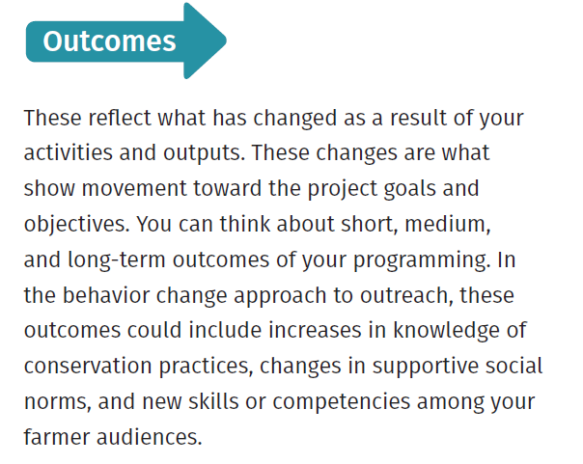
Logic Models – Key Elements
From NWF Grow More Training Program

Slide 15
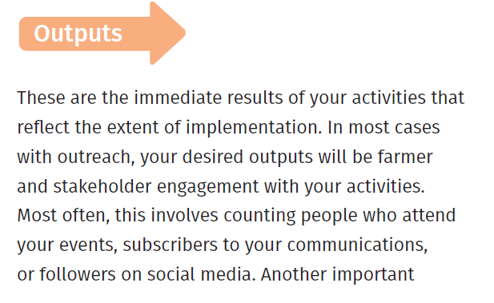
Logic Models – Outputs
From NWF Grow More Training Program

Slide 16
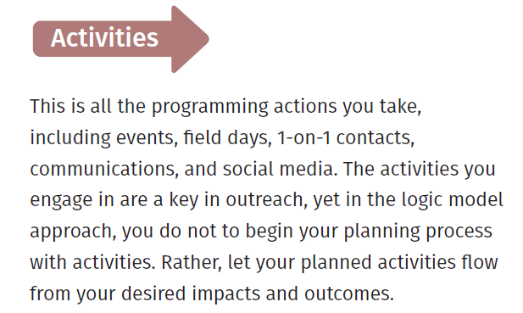
Logic Models – Activities
From NWF Grow More Training Program

Slide 17
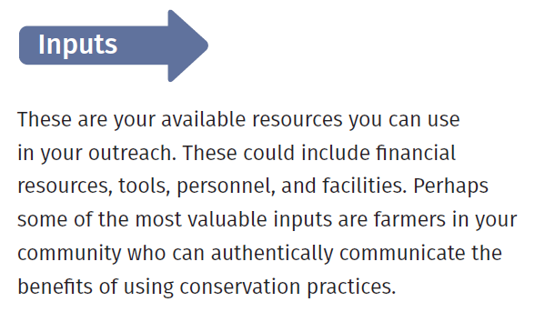
Logic Models – Inputs
From NWF Grow More Training Program

Slide 18
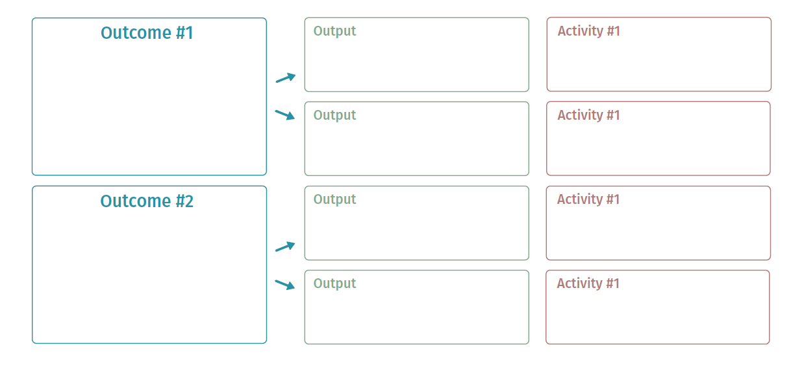
Logic Models –Elements
From NWF Grow More Training Program

Slide 19
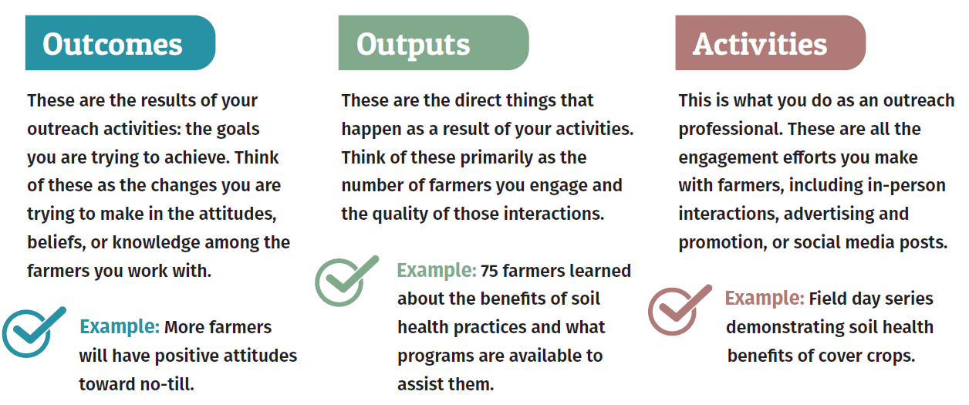
Logic Models – Key Elements Examples
From NWF Grow More Training Program

Slide 20
Finding Potential Funding – SARE grants are a great starting point
Using the call for proposals, program webinars and websites, designated program contacts, past grantees, the National Sustainable Agriculture Coalition’s Grassroots Guide to Federal Farm and Food Programs, http://sustainableagriculture.net/publications/grassrootsguide , the federal website www.grants.gov , https://northcentral.sare.org/grants/ and other resources to inform yourself

Slide 21
Finding Potential Funding - Understanding Federal Programs and Meeting Them Halfway
• Think creatively and broadly about your project's needs. Problems for which you seek help from federal resources are often complex, and often more than one type of assistance may contribute to their solution. • Identify programs with purposes and available resources suited to your project.
• Get information about past projects that programs have funded.

Slide 22
Finding Potential Funding
• Some questions to consider include:
• What is a program’s stated mission and objectives? Can you make a strong case that your project advances them? What projects has the program funded in the past? Does its form of assistance suit your needs?
• What is a program’s funding pool, average amount and duration of grants, percent of applicants who typically get funded? Is funding available upfront or (more typically) only on a reimbursement basis?

Slide 23
Understanding Federal Programs and Meeting Them Halfway
• What are eligibility requirements, financial match requirements, and restrictions on a program’s funding use?
• Do a program’s application deadlines and funding timeframes suit your project’s needs? Does the program fund multi-year projects?
• Do past grantees feel that a program’s reporting requirements are reasonable and that the program is well-administered?

Slide 24
What is USDA definition of Sustainability?
The U.S. Department of Agriculture is committed to working with partners and stakeholders toward the sustainability of diverse agricultural and food systems, where the sustainability of a system is judged by its success in advancing objectives related to the social, economic, and environmental dimensions of sustainability. These objectives include providing safe and nutritious food for all; providing decent incomes and wages for farmers and those working across the system; and conserving natural resources for the benefit of current and future populations.
Notes:
1988 Farm bill, directed by farmers and the three legged sustainability stool of the USDA planet, profit and people.

Slide 25
What is SARE? What is its mission?
North Central SARE (Sustainable Agriculture Research and Education) strengthens communities, increases producers' profitability, and improves the environment through grants and education.
Notes:
1988 Farm bill, directed by farmers and the three legged sustainability stool of the USDA

Slide 26
Sustainable Practices – ideas from the Youth Educator grant call
• Agroecology
• Agroforestry
• Beneficial Insects, Pollinator Habitat
• Climate Resilient Agriculture
• Cover Crops
• Crop/Landscape Diversity
• Educating/Mentoring New Farmers/Ranchers
• Farmland Access
• Food Sovereignty
• Holistic/Systems Approaches Integrated Pest Management (IPM)
• Labor Needs and Issues
• Nutrient Management
• Organic Agriculture
Permaculture
• Poultry and Small-Scale Livestock Production
• Proactive Weed Management
• Quality of Life Issues and Improvements
for Family and Community
• Regenerative Agriculture
• Renewable Energy
• Managed Grazing
• Soil Health
• Water Quality Improvement/Wetlands
• Value-Added and Direct Marketing
• Wildlife Preservation
• Other______________________
Notes:
1988 Farm bill, directed by farmers and the three legged sustainability stool of the USDA

Slide 27
NCR SARE includes many states:
Missouri
Nebraska
North Dakota
Ohio
South Dakota
Wisconsin
Illinois
Indiana
Iowa
Kansas
Michigan
Minnesota

Slide 28
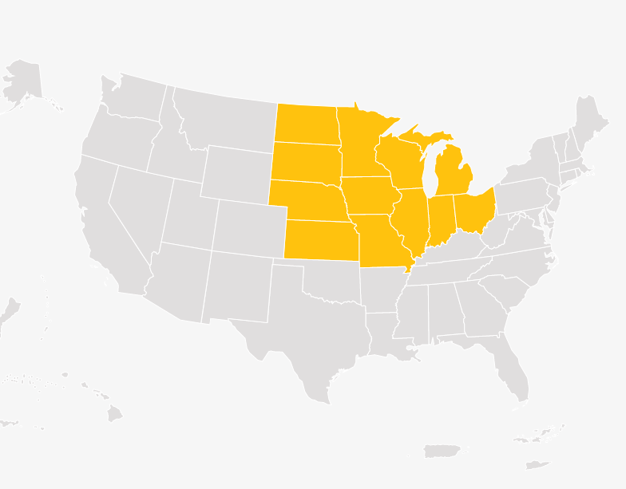
NCR SARE includes many states

Slide 29
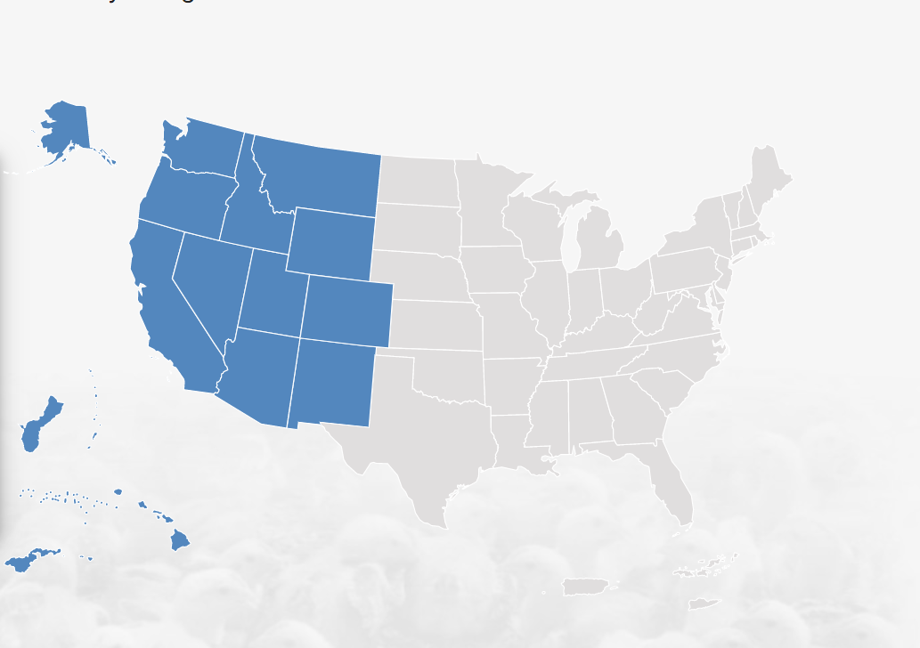
Other Regions as well – Western Region
Notes:
Western Region North Central, Northeast, South, and West

Slide 30
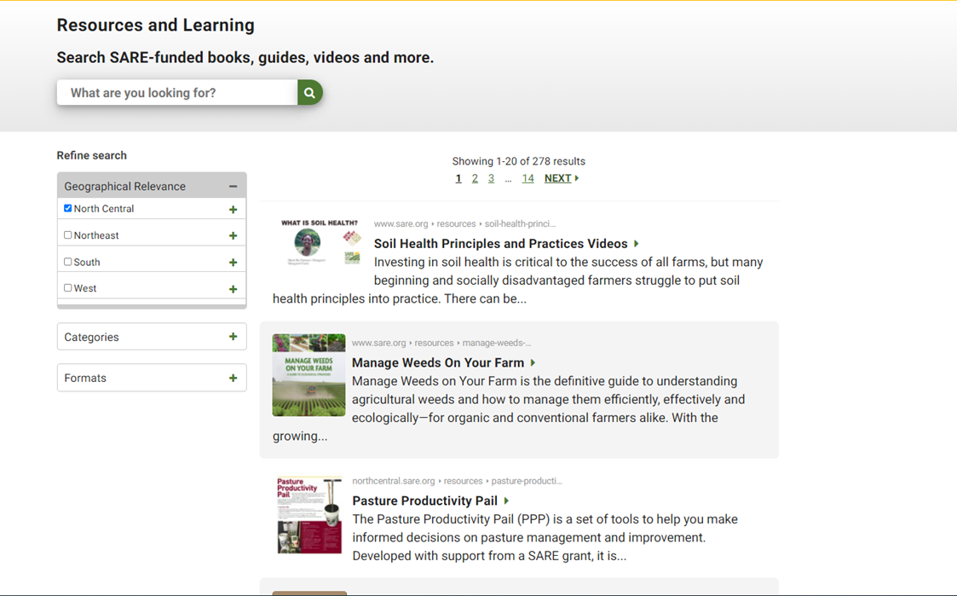
SARE Website: sare.org
Notes:
Point out that different regions have different time frames and even different grant requirements. We will look at North Central Region, but you can find your region in the SARE website and find the specific information on there. We have a list of the state contacts to call if you do not have internet access.

Slide 31
Request for proposals come out in August:
Farmer Rancher grant - Farmer Rancher grants are for ideas initiated by farmers and ranchers and are offered as individual grants ($15,000 maximum) or team grants for two or more farmers/ranchers who are working together ($30,000 maximum).
Partnership grant - Up to $40,000 total funding request per application is allowed, an Agricultural Professional is the grant applicant and the project coordinator, typically three or more farmers or ranchers are expected to be substantially involved in the project.
Research and Education grant - Research and Education grant awards range from $10,000 to $250,000.
Youth educator grant - Youth Educator Grants are competitive grants for educators to provide programming on sustainable agriculture for youth. $6,000 maximum

Slide 32
Request for proposals come out in February:
Professional Development grant - Applicants are educators who often represent but are not limited to, Extension, Natural Resources Conservation Service, and non-profit groups. PDP competitive grants are awarded for state and multi-state PDP projects that emphasize cross-agency training, using farmers as educators and addressing emerging issues in the farm community.
Graduate student grant - NCR-SARE’s Graduate Student Grant Program is a competitive grant program to fund graduate student projects that address sustainable agriculture issues. A candidate may only receive one NCR-SARE Graduate Student award during her or his graduate student career. Generally Graduate Student Grant awards can be up to $15,000.
All are grants working with farmers directing the work. The website has more information about each grant’s timeline and helpful resources.

Slide 33
Farmer directed research and education
All are grants working with farmers directing the work. The website has more information about each grant’s timeline and helpful resources. Timelines are subject to change.

Slide 34
Farmer/Rancher Grant –initiated by farmers
Farmer Rancher grants are for ideas initiated by farmers and ranchers and are offered as individual grants ($15,000 maximum) or team grants for two or more farmers/ranchers who are working together ($30,000 maximum).
Projects may last up to 23 months.
About 40 projects are funded each year.
Grants support producers who are protecting natural resources, enhancing communities, and boosting profitability.

Slide 35
Farmer/Rancher Grant –NCR Example
Outreach and networking multiply farmer and rancher project results.
NCR-SARE uses an online grant application system for this program. More information is available in the call for proposals.
The NCR-SARE Administrative Council makes grant-making decisions.
A sample call for proposals is available throughout the year, but you should always consult the current call for proposals when applying.

Slide 36
Farmer/Rancher Grant –annual timeline
Grant applications are reviewed and awarded on an annual timeline.
Download a presentation about completing a proposal for this grant program.
Take a look at grants that have been previously funded at https://projects.sare.org/search-projects/
Review the projects funded in the last grant cycle.
View a map of Farmer Rancher grants that have been funded in the North Central region.

Slide 37
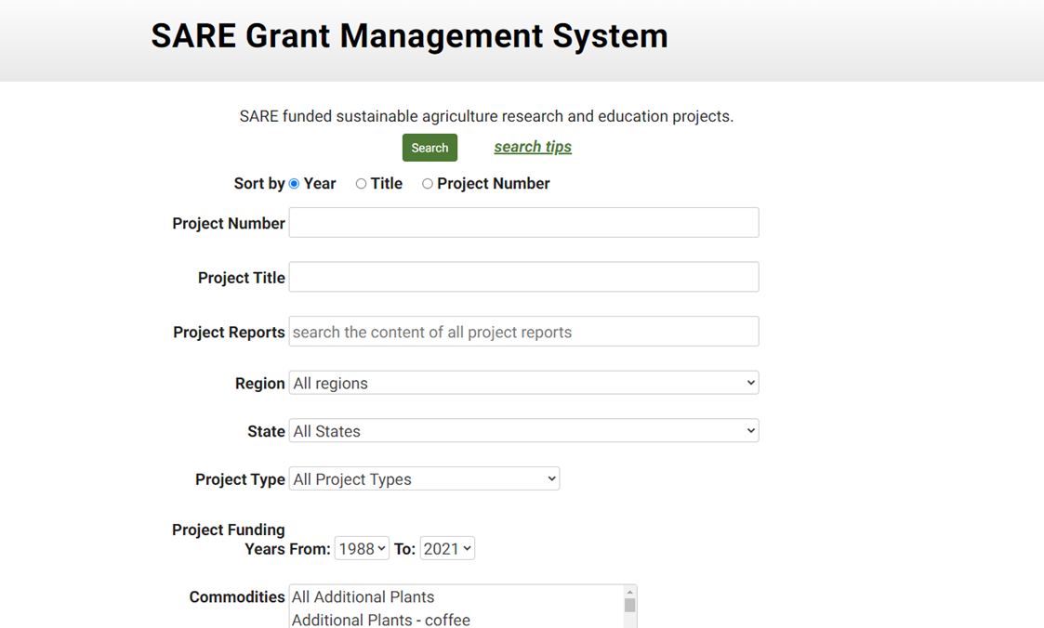
Project database to learn from others

Slide 38
Farmer/Rancher Grant –map of awards given in North Central Region

Slide 39
Farmer/Rancher Grant – Timeline for NCR
Timeline
Timelines are subject to change. Always use the due date listed in the current Call for Proposals.
Mid August – Call for Proposals Released
Early December – Proposals Due
February – Funding Decisions are Made
Spring – Funds Available to Recipients

Slide 40
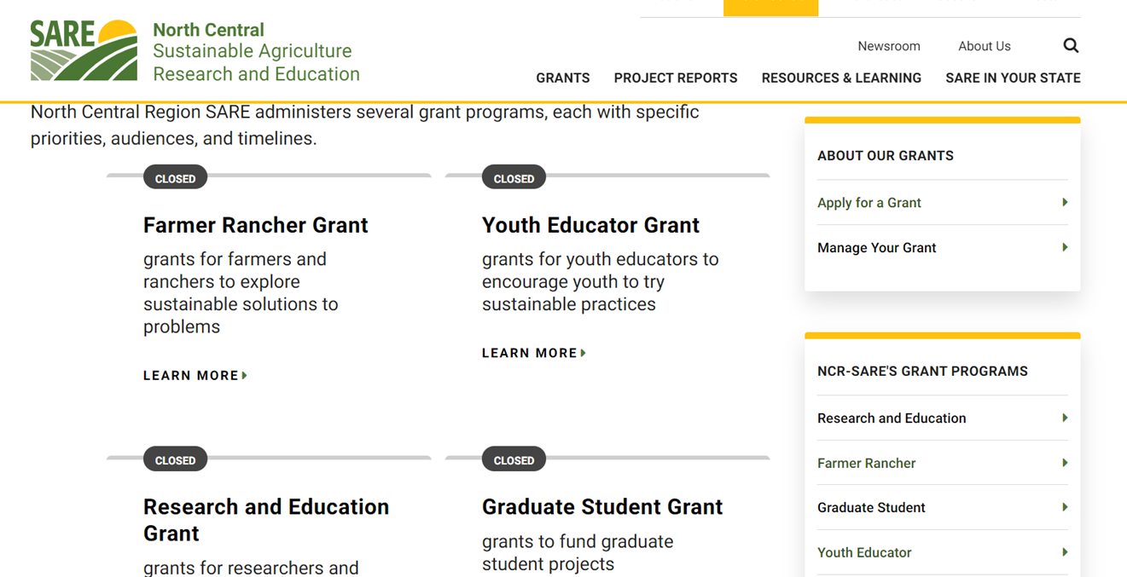
Grants requests for proposals come up throughout the year

Slide 41
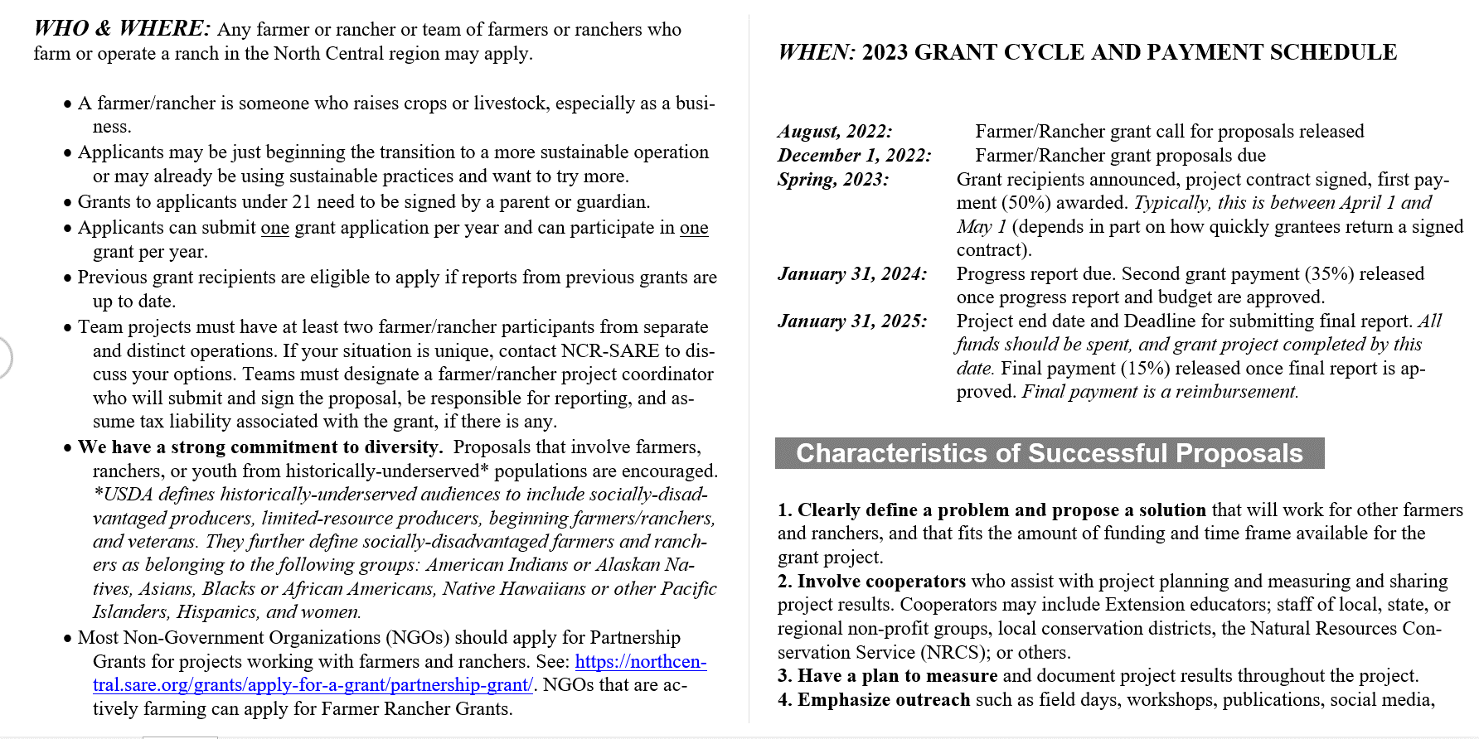
Farmer/Rancher Grant – Sample Call for Proposal
Notes:
They have a recording of a webinar too

Slide 42
Farmer/Rancher Grant – Eligibility
A farmer/rancher is someone who raises crops or livestock, especially as a business.
Applicants may be just beginning the transition to a more sustainable operation or may already be using sustainable practices and want to try more.

Slide 43
Strong Commitment to Diversity
We have a strong commitment to diversity. Proposals that involve farmers, ranchers, or youth from historically-underserved* populations are encouraged. *USDA defines historically-underserved audiences to include socially-disadvantaged producers, limited-resource producers, beginning farmers/ranchers, and veterans. They further define socially-disadvantaged farmers and ranchers as belonging to the following groups: American Indians or Alaskan Natives, Asians, Blacks or African Americans, Native Hawaiians or other Pacific Islanders, Hispanics, and women.

Slide 44
Farmer/Rancher Grant – Successful Proposals
1. Clearly define a problem and propose a solution that will work for other farmers and ranchers, and that fits the amount of funding and time frame available for the grant project.
2. Involve cooperators who assist with project planning and measuring and sharing project results. Cooperators may include Extension educators; staff of local, state, or regional non-profit groups, local conservation districts, the Natural Resources Conservation Service (NRCS); or others.
3. Have a plan to measure and document project results throughout the project.
4. Emphasize outreach such as field days, workshops, publications, social media,
videos, websites.
5. Demonstrate a good fit with SARE’s mission by explaining how your project will benefit other farmers and ranchers economically, ecologically, and socially.
6. Address reviewer concerns and explain revisions for proposals that are being resubmitted.

Slide 45
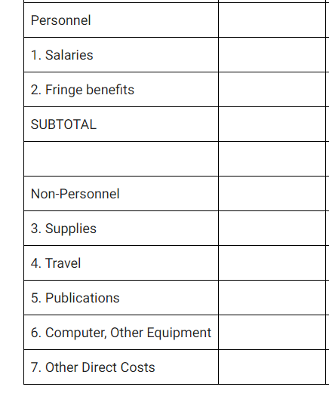
Farmer/Rancher Grant – Budget categories
Notes:
For SARE, hospitality and meals are included as part of ODC rather than materials/supplies which is different than Purdue – talk with your advisor and pre-awards coordinator to work on your budget. Timeline is IMPORTANT

Slide 46
Grants using Disability in the search term
Notes:
17 since 1988

Slide 47
Awarded SARE grants using disability in the search term
Notes:
17 since 1988

Slide 48
Improve the safety and health of women farmers by adapting farm tools and equipment

Slide 49
Awarded SARE grants using Veteran in the search term
Notes:
97 since 1988

Slide 50
Strawberry and Raspberry Season Extension Using Low Tunnel, High Tunnel, and Day Neutral and Primocane Species

Slide 51
Strawberry and Raspberry Season Extension proposal details

Slide 52
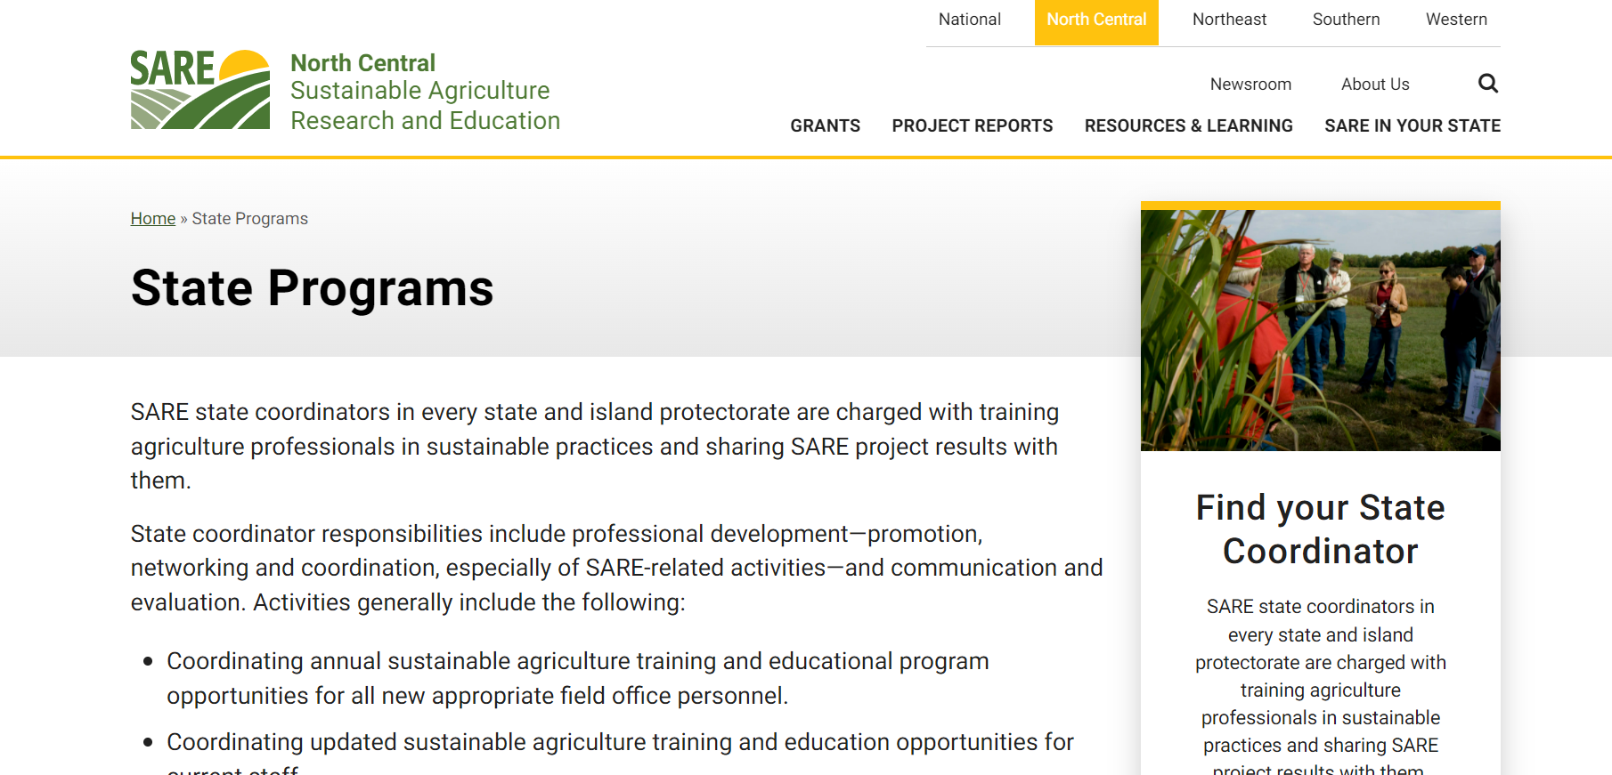
State coordinator you can call for specific questions
Lais McCartney
317-919-2691 text is best before calling

Slide 53
Get feedback to improve for next time
Understand the review process
Writing grants is a skill that develops over time and practice, like any writing skill

Slide 54
Checking in on our Learning Objectives
Learn opportunities to be involved with SARE and general grant proposal resources
Learn about Michael Fields Institute
Learn about starting with the end in mind (logic models)
Learn about SARE grants in detail
Learn about specific SARE grants awarded with veterans or disability in the search term

Slide 55
References
Excel spreadsheet to help you with planning with others https://fyi.extension.wisc.edu/sustag/files/2021/10/Proposal-Management-Worksheet.xlsx
Grow More National Wildlife Federation https://growingoutreach.nwf.org/grow-more/
In-Service Training On-line Introduction to Sustainable Agriculture
https://fyi.extension.wisc.edu/sustag/resources/in-service-training/
Logic model template https://fyi.extension.wisc.edu/programdevelopment/files/2016/03/LM_UW-Coop-Ext-Logic-Model_WorksheetTableformat.pdf
Michael Fields Agricultural Institute https://www.michaelfields.org/grants-advising-resources Wonderful resources for writing grants

