Slide 1
Creating Reliable Plans for DIY Assistive Technology
Jeff Kratochwill
Easterseals Wisconsin FARM Program Director
AgrAbility of Wisconsin Co-Director
Phone 608.279.9436
jkratochwill@eastersealswisconsin.com
Ned Stoller, Agricultural Engineer
Michigan AgrAbility

Slide 2
Objectives
1) Discuss what sources you use to find DIY assistive technology that farmers can build.
2) Discuss how you evaluate if a DIY project is a reliable idea for a farmer with disability to use.
3) Discuss how to take a DIY project and make it into plans that others could duplicate.

Slide 3
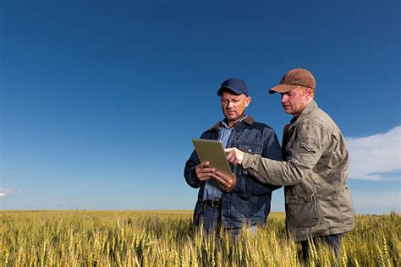
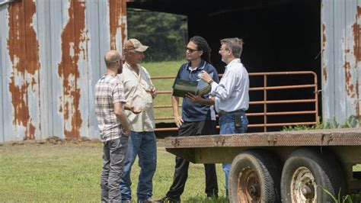
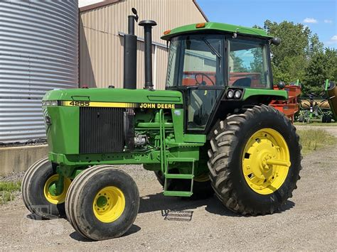
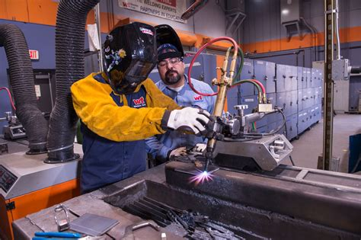
Sources for DIY Technology
Notes:
Informal sources: 1) youtube/google/Toolbox; 2) steal from what other professionals are doing to accomplish 3) farmer to farmer 4) The team and how I/we have accomplished before, 5) my experience on our farm, 6) welder/local fabrication/construction/ “willing”

Slide 4
Sources for DIY Technology
Bring outside Agency (Equipment vendor, Extension, etc)
Camera/Sketch design
Farmer
Hierarchy of Assistive technology
Notes:
1) Interview farmer on what has been tried before, 2) Hierarchy-do we need to DIY a product is a commercially available option already exists

Slide 5
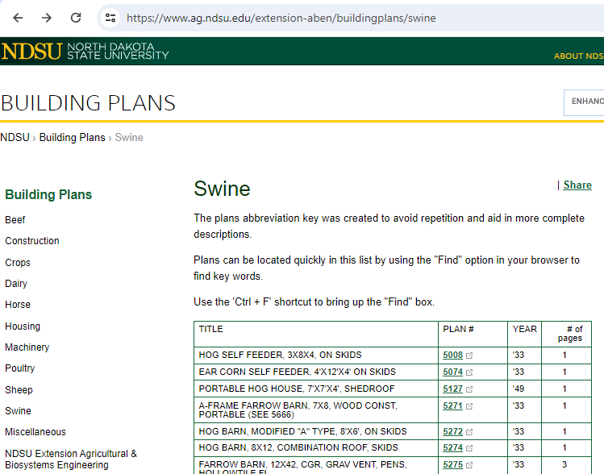
Sources for DIY Technology: North Dakota State University Ag building plans Midwest Plan Service Iowa State University
Notes:
1) Interview farmer on what has been tried before, 2) Hierarchy-do we need to DIY a product is a commercially available option already exists

Slide 6
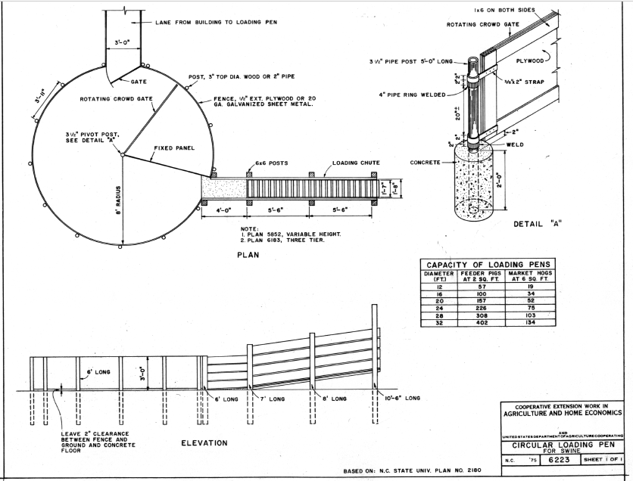

Slide 7
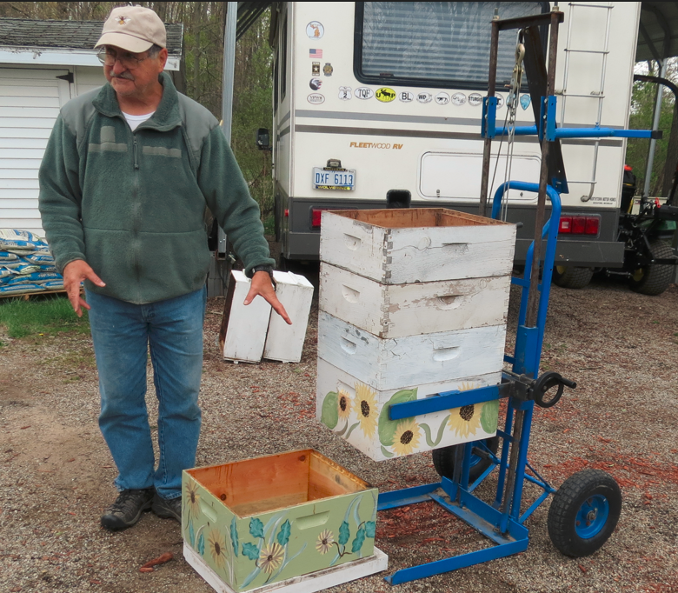
What are YOUR sources of DIY AT ideas?
Based on the invention of Bardwell Farms https://www.facebook.com/BardwellFarms/
https://youtu.be/LHhpWHRvKsI?si=pUXo_avGf11RRQYi

Slide 8
Evaluate AT Reliability
Individualized assessment
Farmer interview
Follow-up visit
Pro/Con list

Slide 9
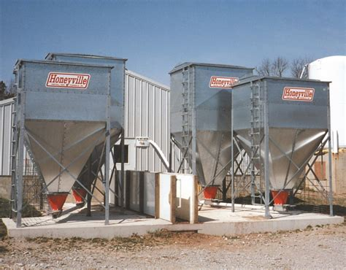
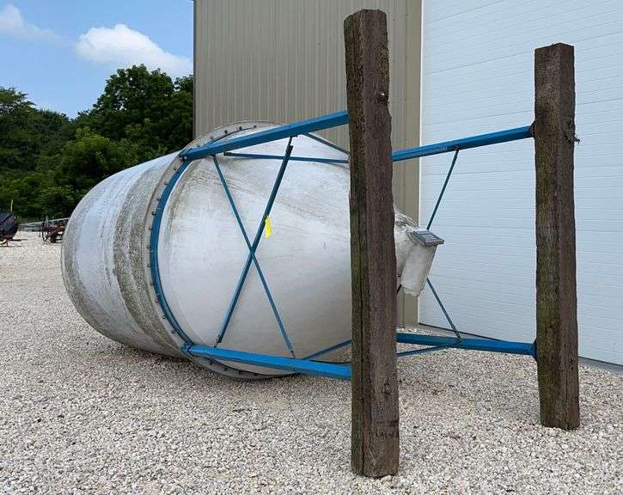
Evaluate DIY AT Reliability
Notes:
Safe; how evaluate its success, Ultimately you are responsible

Slide 10
AT Reliability: Is it safe?
Notes:
Safe; how evaluate its success, Ultimately you are responsible

Slide 11
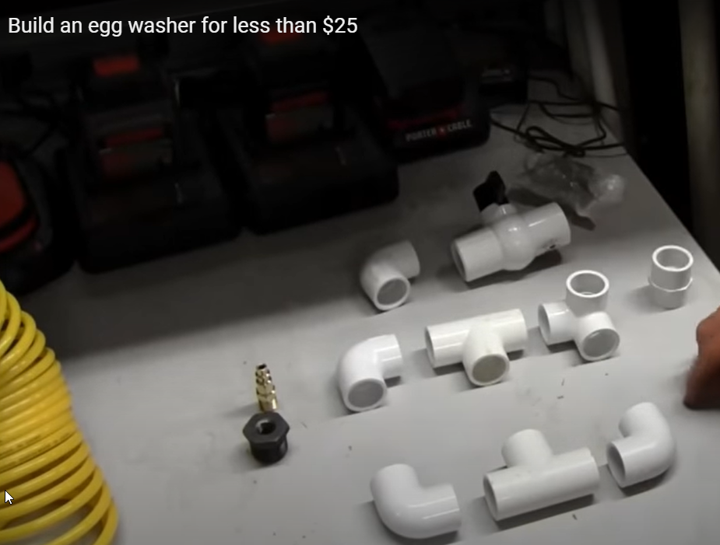
AT Reliability: How do we know if it really works?
How do YOU evaluate an idea before suggesting it?
Notes:
Safe; how evaluate its success, Ultimately you are responsible

Slide 12
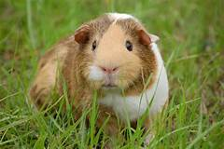
Proposing a new AT DIY idea
Notes:
If it truly new, then someone will be the first attempt

Slide 13
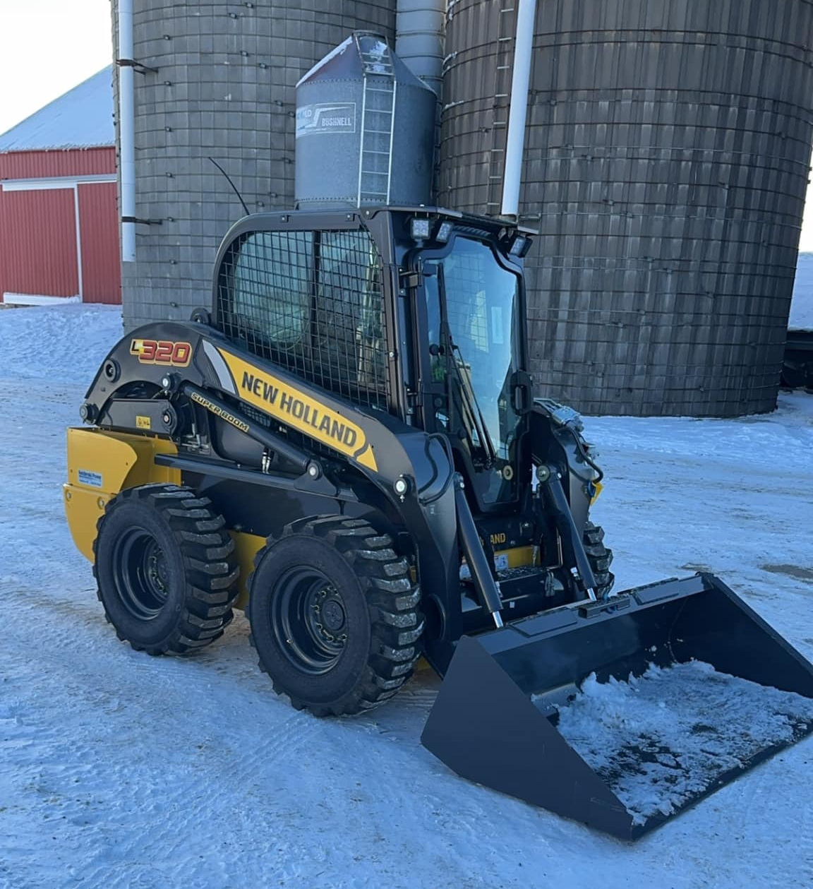
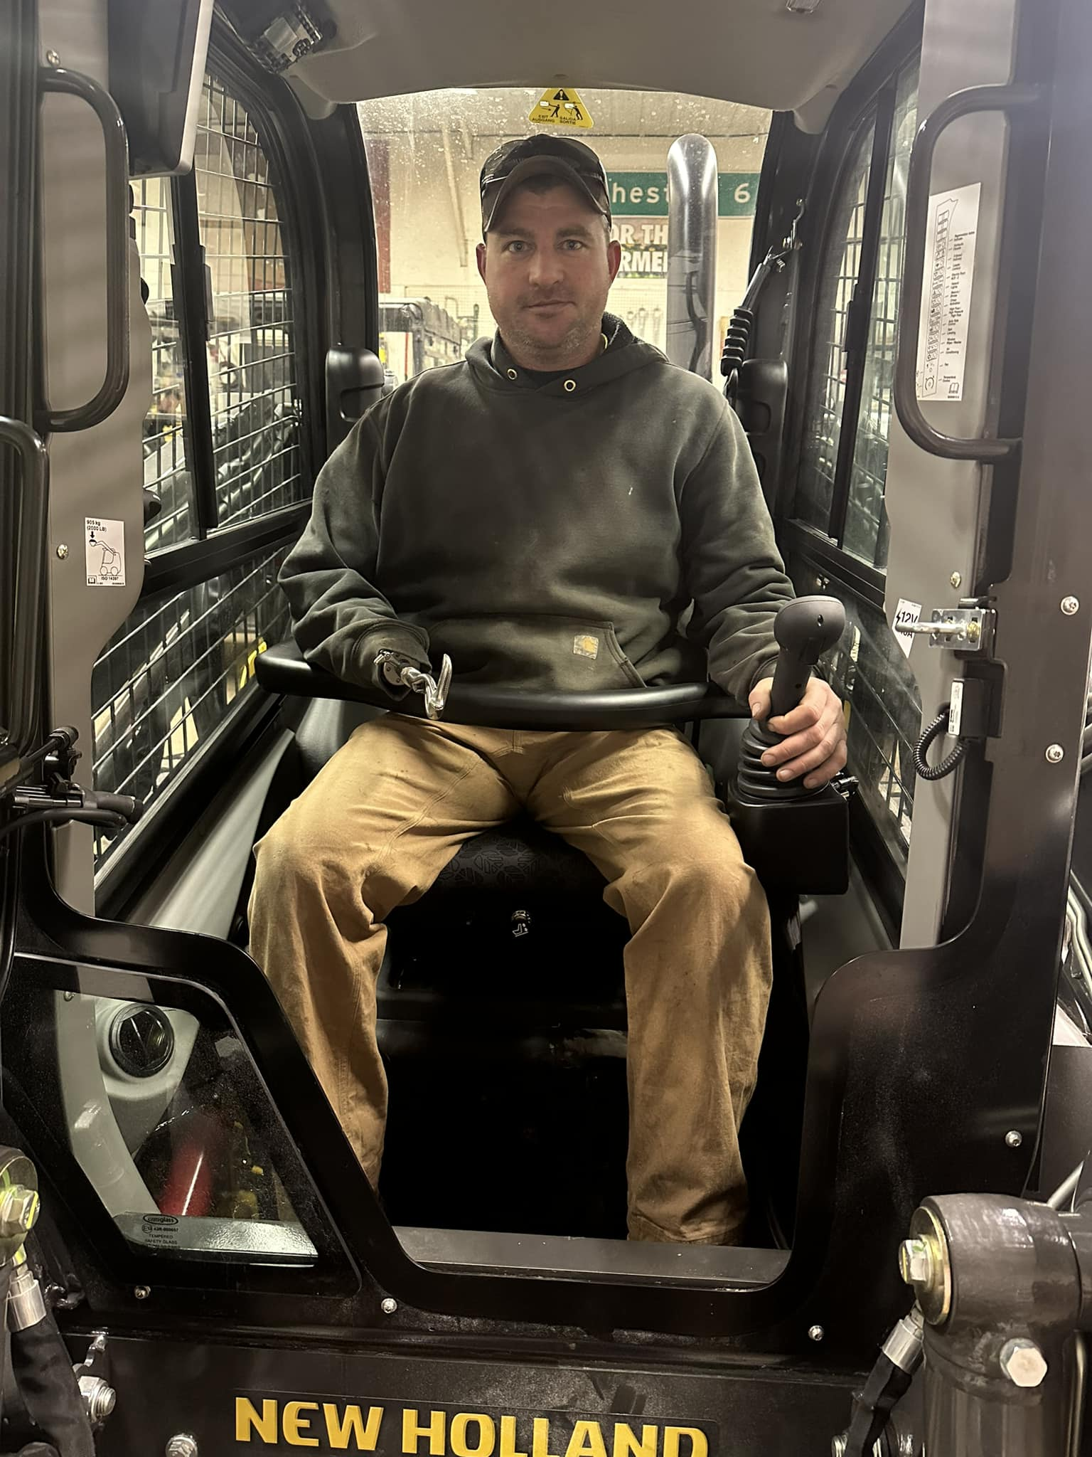
I want to give a huge shoutout to AgrAbility of Wisconsin and Wisconsin Department of Workforce Development DVR program for making this piece of equipment a reality for John. Equipped with a left hand only joystick and foot pedals to operate the bucket. Sometimes it’s really hard to find anything that comes easy like it used to for him, operating the skid loader being one of them. Thanks to these two incredible programs, this was delivered to him today.

Slide 14
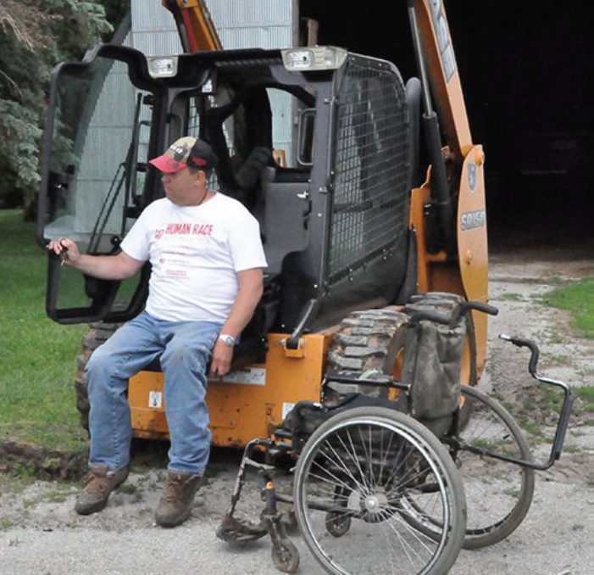

Slide 15
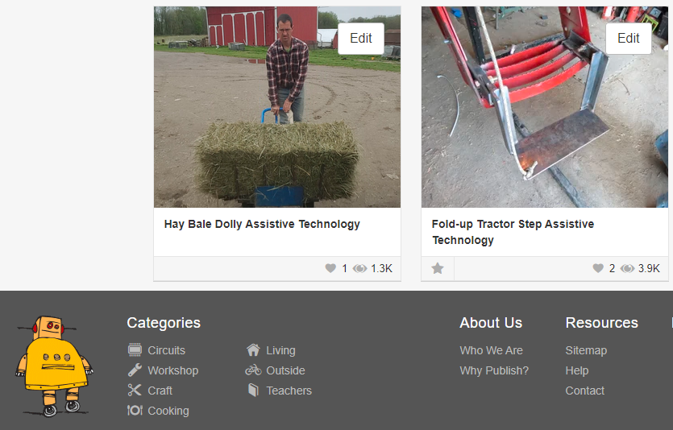
Lets talk about successful DIY AT projects that you want to make into shareable plans.

Slide 16
Discussion
Should AgrAbility create reliable peer reviewed plans for do-it-yourself (DIY) agricultural assistive technology? Would this be more credible than YouTube to learn about DIY projects? Could we keep it up-to-date and easy to find information? How would we use the Toolbox for this?
Jeff Kratochwill
Easterseals Wisconsin FARM Program Director
AgrAbility of Wisconsin Co-Director
Phone 608.279.9436
jkratochwill@eastersealswisconsin.com
Ned Stoller, Agricultural Engineer
Michigan AgrAbility
616-648-2712

