Slide 1
New Staff Training AgrAbility NTW March 14, 2022 Madison, Wisconsin
National AgrAbility Project
Purdue University

Slide 2
Session Overview
Overview of AgrAbility with emphasis on National AgrAbility Project (NAP)
History
Goals
Structure
Services
Personnel
Resources

Slide 3
AgrAbility History
Several similar programs prior to establishment of AgrAbility at federal level
AgrAbility began through the 1990 Farm Bill with funding starting in 1991
In 1991, there were 8 funded state and regional AgrAbility projects (SRAPS); as of 2022, there are 21 SRAPs and several previously-funded affiliate projects
One National AgrAbility Project (NAP) supports the SRAPs
Notes:
Included in 1990 Farm Bill; funded in 1991. Other pre-AgrAbility models existed in Vermont and Iowa. Maximum number of funded AgrAbility projects was 23 covering 25 states – reduced since 2013.

Slide 4
What Disability Types (Functional Limitations) does AgrAbility Address?
AgrAbility addresses a wide variety of disabling conditions in agriculture, including, but not limited to:
Amputation
Arthritis
Back impairment
Deafness/hearing impairment
Developmental disabilities, such as cerebral palsy or autism
Disabling diseases, such as cancer or heart disease
Mental/behavioral health problems
Respiratory diseases
Spinal cord injuries
Stroke
Traumatic brain injury
Visual impairments
Importance of staying with your realm of expertise!

Slide 5
Disability within the Agricultural Community
Causes of disability
Traumatic injury (agriculture is one of the most hazardous occupations). Many injuries also come from off-farm incidents.
Disease (Arthritis impacts many farmers)
Aging (Average age of U.S. farmers is 58+)
Prevalence of disability
At least 12.9% of farm population impacted by disability
At least 740,000 of the U.S. farm, ranch, and agricultural community impacted by disability
Miller and Aherin, 2018. Journal of Agricultural Safety and Health, 24(4): 243-260.
Notes:
Deboy, G.R., P.J. Jones, W.E. Field, J. Metcalf, and R.L. Tormoehlen. Estimating the Prevalence of Disability within the U.S. Farm and Ranch Population. Journal of Agromedicine, 13(3).

Slide 6
What Agricultural Operations does AgrAbility Serve?
Just as disability is a wide continuum, agriculture is also:
Row crops: corn, soy, wheat, cotton, etc.
Ranching
Sheep and goats
Dairy
Produce, including organic
Orchards
Agritourism
Niche markets, like llamas, herbs, etc.
Floriculture
Aquaculture
Hydroponics
Aquaponics
Urban agriculture

Slide 7
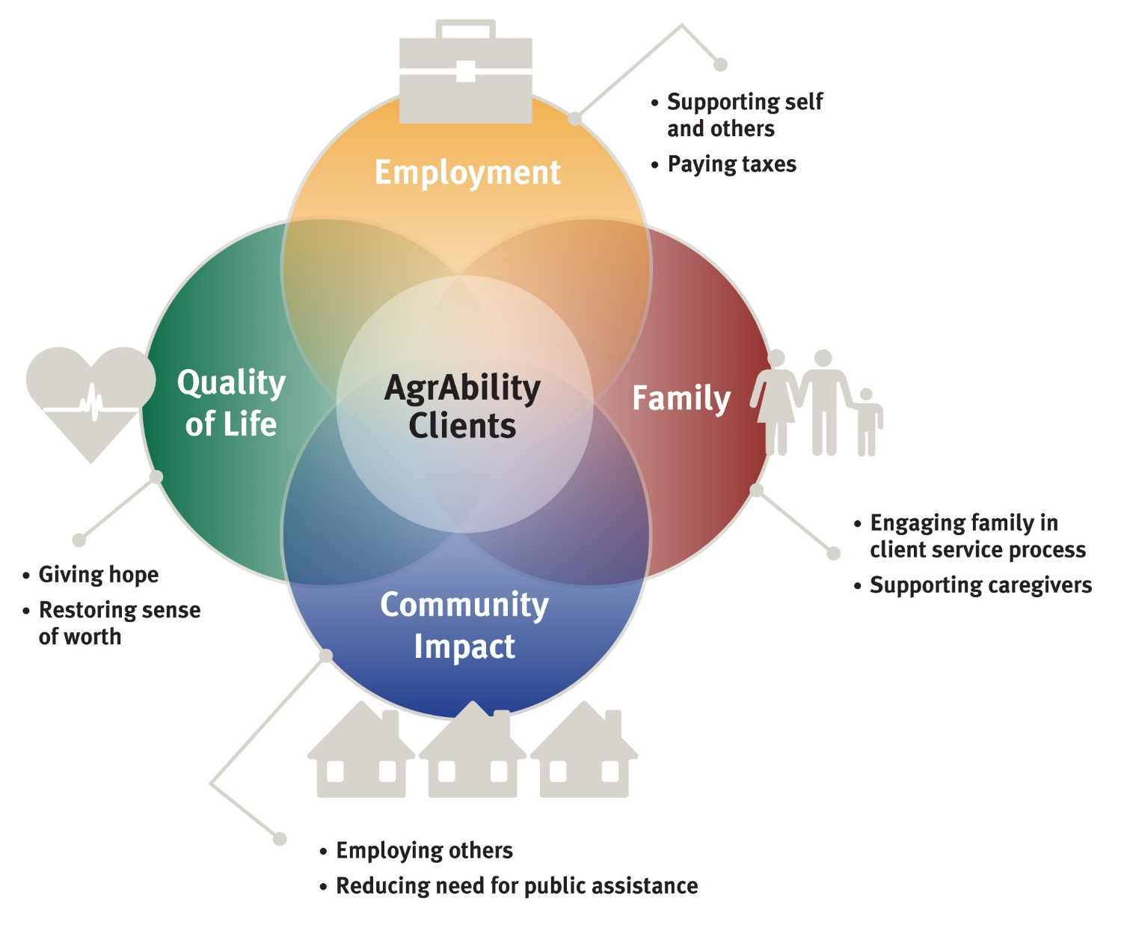
Multifaceted Impact

Slide 8
AgrAbility Projects 2022
Notes:
As of October 2014

Slide 9
AgrAbility Partnerships
All AgrAbility projects – state projects and the national project – are partnerships between a land-grant university and at least one disability-services program.
1862 and 1890 land-grant institutions are eligible to apply for AgrAbility grants.
Current 1890 grant holder = North Carolina A&T
Notes:
Many projects have more than one partner. Land-grant university Extension service must hold the grant. 1862 and 1890 land-grants are eligible to apply. 1994 are currently not eligible.

Slide 10
Current NAP Partners
Breaking New Ground Resource Center, Purdue University (lead organization)
Goodwill of the Finger Lakes (NY)
Osteoarthritis Action Alliance
AgriSafe Network
Colorado State University (evaluation specialists)
Washington State University (evaluation specialists)
Consultants
Many non-funded partners: FVC, RESNA, FFA, etc.

Slide 11
AgrAbility Services/Priorities
Education
Workshops; resource development; online education
Networking
Leveraging efforts with other groups; peer support
Direct Assistance
Site visits; consultations; business planning
Marketing
Publics awareness activities and materials
Notes:
These are the priority areas listed in the RFAs. Not exhaustive lists

Slide 12
Special Responsibilities of the NAP
Provide support to the state and regional AgrAbility Projects
Training
In-person
Virtual
Resources
Consultations with NAP specialists
Provide limited direct services to customers in states without AgrAbility projects
Notes:
SRAPs complete annual assessment of NAP and also suggestions for future work. Services in non-AgrAbility states generally consist of email or phone contact.

Slide 13
What Does AgrAbility Not Provide?
Funding
Equipment
Most funding for assistive technology comes through state vocational rehabilitation systems
Other sources of grants and loans are available (www.agrability.org/funding-assistance/)
Some state Assistive Technology Act projects can provide free or low-cost AT + loan programs
SRAPs can raise funds independent of USDA
Notes:
Some states partner with AT Act Projects, which usually have a lending “library” of AT or an AT re-use program.

Slide 14
What if Your State Doesn’t Have an AgrAbility Project
Can still get technical support from the National AgrAbility Project
Pilot project to hire limited number of consultants
Expanded web “roadmap”
Resources available at www.agrability.org
Encourage your state’s land-grant university(s) to apply for an AgrAbility grant

Slide 15
Resources for Farmer/Ranchers with Disabilities in All States
State Vocational Rehabilitation (VR) Agencies
U.S. Department of Veterans Affairs
Centers for Independent Living
State Assistive Technology Act Projects
Cooperative Extension
USDA
FSA
NRCS

Slide 16
Questions?

Slide 17
NAP Key Personnel
Bill Field, Project Director
Founder of Breaking New Ground
Overall project oversight
Liaison with USDA

Slide 18
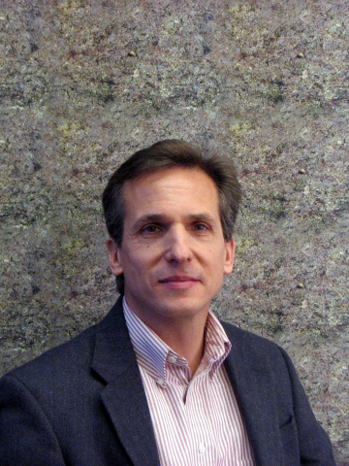
NAP Key Personnel
Paul Jones, Program Manager
Management of daily activities
Resource development

Slide 19
NAP Key Personnel
Chuck Baldwin, Special Populations Outreach Coordinator & Demographic Data Specialist
Networking with 1890 and 1994 land-grant institutions, Old Order Groups, others
Coordinates demographic data collection process

Slide 20
NAP Key Personnel
Cindy Chastain, Veteran Outreach Coordinator
Outreach to veterans with disabilities interested in agriculture and organizations that serve them

Slide 21
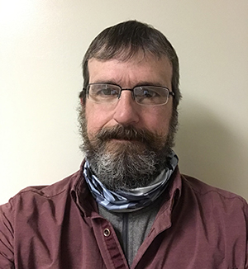
NAP Key Personnel
Ed Sheldon, Extension Outreach Coordinator
Coordinating resources and activities with project partners
Responding to help-line calls

Slide 22
NAP Key Personnel
Kimber J. Nicoletti-Martínez, Latino/Farm Worker Outreach Coordinator
Networking and outreach to farmworker communities and staff working with them

Slide 23
NAP Key Personnel
Ned Stoller, Assistive Technology Specialist
Resource for staff and clients related to selection of appropriate technology
Specialist in low-tech devices with international application

Slide 24
NAP Key Personnel
Steve Swain, “Retired” Assistive Technology Specialist and Indiana Rural Rehabilitation Specialist

Slide 25
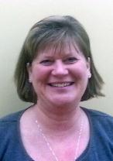
NAP Key Personnel
Goodwill of the Finger Lakes
Promotion of the Goodwill/AgrAbility partnership
National Training Workshop
Regional workshops
JoBeth
Rath
Tess
McKeel

Slide 26
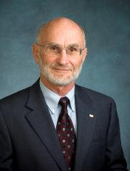
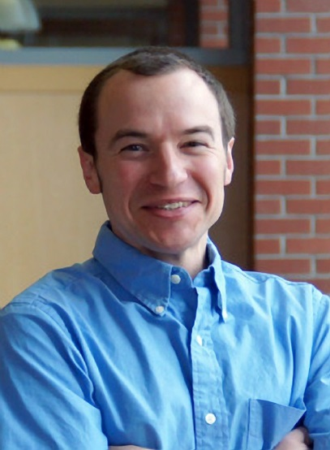
NAP Key Personnel
Evaluation Team
Objective analysis of NAP activities
Annual staff needs assessment
Demographic data
Quality of life evaluation
Bob Fetsch, Colorado State
University
Brian French
Washington State University

Slide 27
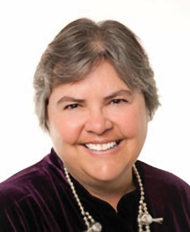
Consultants
Steve Etheridge
Vocational rehabilitation issues
Former VR counselor
Carla Wilhite
Occupational therapy issues
Professor at Colorado Mesa University and AgrAbility advisory team member

Slide 28
NAP Key Partners
Osteoarthritis Action Alliance
Survey on effective arthritis outreach
Resource development related to arthritis

Slide 29
NAP Key Partners
AgriSafe Network
Agriculture safety and health resources related to many areas
Opioids
Farm Stress
Resource Center

Slide 30
Questions?

Slide 31
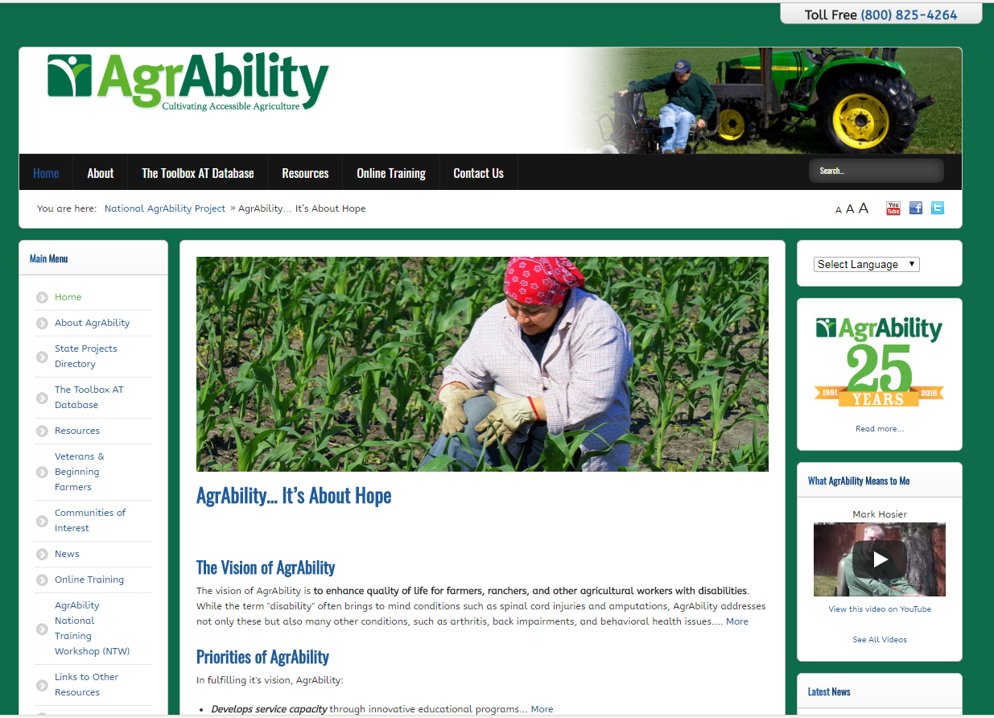
Educational Resources: www.agrability.org
Project information and contacts
Downloadable resources
Online training
Mobile friendly
Tour
Notes:
Discuss importance of site and give tour if feasible.

Slide 32
Educational Resources: www.agrability.org
Staff extranet: marketing, evaluation, staff resources
Logos
Demographic summaries
All-staff meeting archives
Photo library
Notes:
Discuss importance of site and give tour if feasible.

Slide 33
The Toolbox Assistive Technology Database
Print, CD, and web versions www.agrability.org/Toolbox
1,735 products to help agricultural workers with disabilities

Slide 34
Recent Publications

Slide 35
BACK on the Farm, BACK in the Saddle
Back problems = most common disabling conditions reported by AgrAbility clients.
21-page booklet discusses many aspects of back problems in ag settings
www.agrability.org/ resources/back
Notes:
Newest print resource. 30,000 copies in print.

Slide 36
Arthritis Resources
www.arthritis-ag.org
Arthritis and Agriculture
Plain Facts about Agriculture
¿Podrá ser la Artritis lo que me causa Dolor? (Could Arthritis be the cause of my Pain?)
Gaining Ground on Arthritis DVD
Notes:
Arthritis and Agriculture is AgrAbility’s most popular print resource with 70,000 copies in print. Plain Fact is for Old Order/Amish Communities. ¿Podrá ser la Artritis lo que me causa Dolor? is a fotonovla (comic book) in Spanish for migrant/seasonal workers.

Slide 37
Plowshares
30 technical reports on specific topics, such as farming with a spinal cord injury
Currently being updated

Slide 38
Conducting Agricultural Worksite Assessments
Step-by-step guide for evaluating farms and ranches
Reproducible assessment form

Slide 39
AT Secondary Injury Evaluation
Step-by-step guide for evaluating AT for secondary injury hazards
Reproducible assessment forms

Slide 40
Newsletters
AgrAbility Harvest
Annually to national audience
AgrAbility e-Note
Monthly to AgrAbility staff members and other interested parties

Slide 41
Other Staff-Specific Resources
AgrAbility staff listserv
Monthly Zoom sessions
Wide range of topics
Open discussion
Virtual office hours

Slide 42
Questions?

Slide 43
Questions?
“It feels like many of the farmers I have been working with recently are needing “big-ticket items”, such as the tractors that they have are too old to qualify to be modified for access, therefore they would need a whole new tractor and then modifications to be made.”
Tractor should be part of farm’s business plan
Equipment loans
Used equipment
Refer to Extension farm management
VR paid for tractor because it was cheaper than modifications - client paid difference

Slide 44
What is AgrAbility’s Impact?
AgrAbility recently conducted a multi-year study to compare the program’s impact with a no-treatment comparison group. Using the McGill Quality of Life (QOL) survey and a newly-developed Independent Living and Working (ILW) instrument, AgrAbility gathered data both on AgrAbility clients and on farmers/ranchers with disabilities who had not received services.
Fetsch, R. J., Jackman, D. M., & Collins, C. L. (2018). Assessing changes in quality of life and independent living and working levels among AgrAbility farmers and ranchers with disabilities. Disability and Health Journal, 11(2), 230-236. doi: https://doi.org/10.1016/j.dhjo.2017.08.001

Slide 45
Impact: Quality of Life (QOL)
The 199 AgrAbility client group participants showed increased QOL levels of 28%, while the 97 no-treatment comparison group’s QOL level fell by 4%.

Slide 46
Impact: Independent Living and Working (ILW)
The AgrAbility client group participants showed increased ILW levels of 30%, while the no-treatment control group increased only 8%.

