Slide 1
Collaborating with Goodwill and Other Non-Profits
Notes:
Hello I am Tess McKeel and I work for Goodwill of the Finger Lakes along with my colleague JoBeth Rath. Goodwill is the disability organization partner for the National AgrAbility Project.

Slide 2
The vision of AgrAbility is to enable a high quality lifestyle for farmers, ranchers, and other agricultural workers with disabilities. Goodwill’s vision is that every person has the opportunity to achieve his/her fullest potential and participate in and contribute to all aspects of life. Two Visions. Common goals.
Notes:
What do you think of when you hear Goodwill? Most people think of the stores, donated items, clothing, etc.

Slide 3
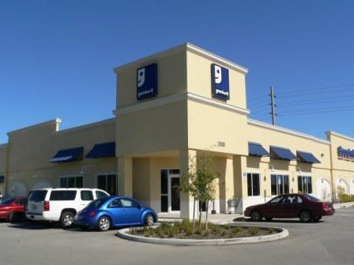
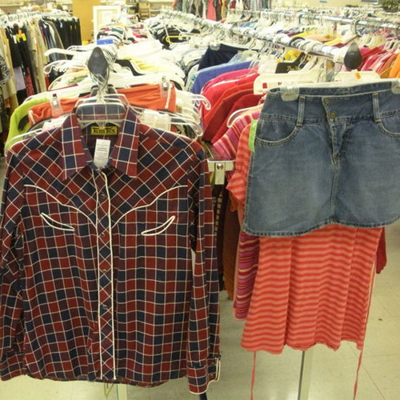
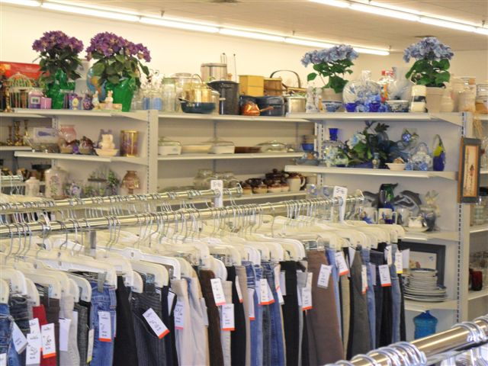
When you hear Goodwill, is this what you think of?
Notes:
What do you think of when you hear Goodwill? Most people think of the stores, donated items, clothing, etc.

Slide 4
Goodwill retail stores are a model of collaboration.
The Association for the Blind and Visually Impaired, and joined Goodwill as a mechanism to expand donated goods retail, and fund our mission.
Shared services through GII include branding, marketing, training and idea generation for successful business.
Notes:
The retail engine is what fuels us. Revenue from the stores help fund the many mission programs of each Goodwill Region.

Slide 5
Questions?
Your National AgrAbility Project Goodwill Team:
JoBeth Rath, National AgrAbility Project Partner
585.447.9015 585.402.2059 (cell) jbrath@goodwillfingerlakes.org
Tess McKeel, National AgrAbility Project Partner
585.447.9015 585.953.8430 (cell) tmckeel@goodwillfingerlakes.org

