Slide 1
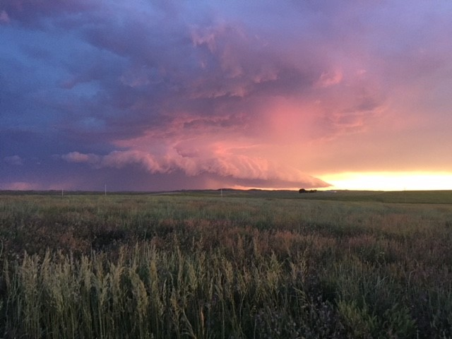
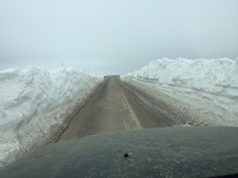
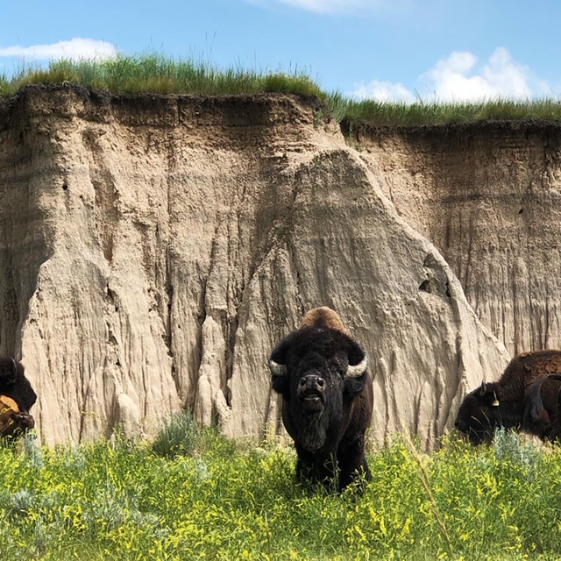
Tatanka Ki ‘ Owetu, AgrAbility
Pine Ridge Reservation, South Dakota

Slide 2
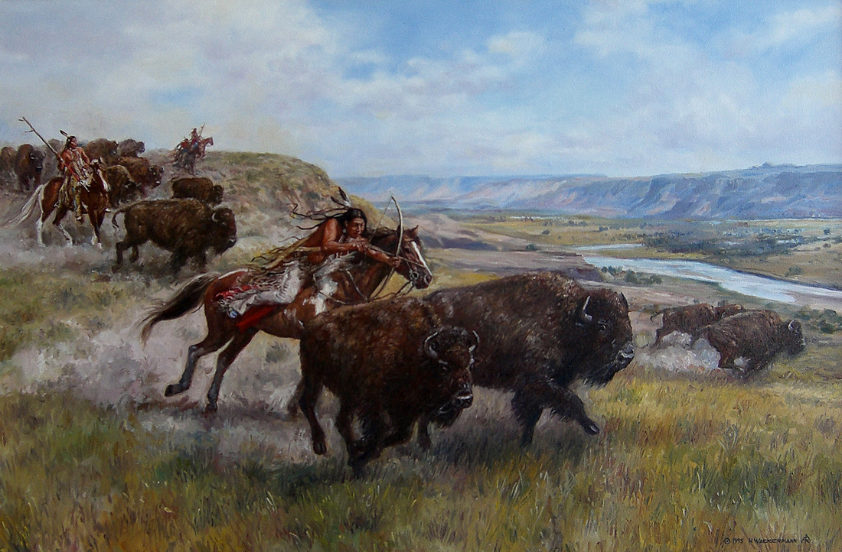
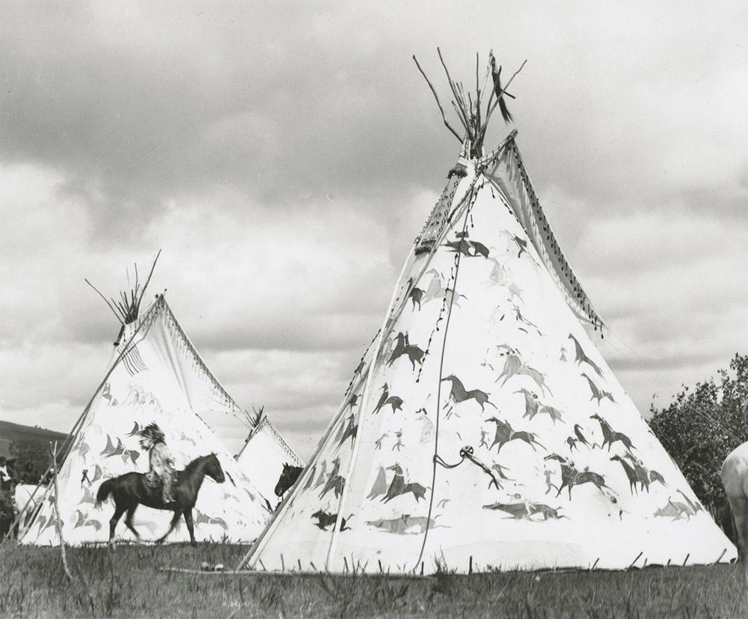
“If you lose something important to you, go back and search for it and you will find it.” – Sitting Bull, Hunkpapa Lakota
Historically, the Oglala Lakota were not an agrarian people. The vast herds of bison was both their community food system and formed much of their way of life.
When this was taken from them, for many, their Way of Life, ended.
Generations of trying to impose a foreign agricultural and economic system upon them has failed.
Beef cattle ranching represents that vast majority of agricultural operations on Pine Ridge Reservation, yet 2/3’s of the ag income from that goes to non-natives, leasing native land to run cattle.
Other federal laws prohibit Lakota people from using their own land as collateral to secure an ag loan, because that land is held in trust by the federal government. Native people are still viewed as wards of the state.

Slide 3
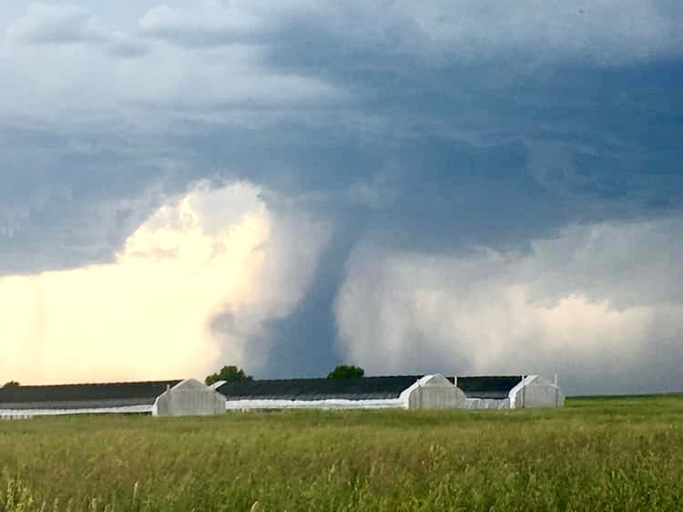
The Western Industrialized Way of farming & ranching relies heavily upon:
Insurance (crop, home, auto, farm)
Collateral (ability to get a loan)
Farm Equipment
Costly External Inputs
Family & Neighbors (with heavy equipment as well as an understanding of agriculture) to help.
A local bank willing to lend
Ability to establish a Line of Credit
State & County Resources and Officials willing and ready to help

Slide 4
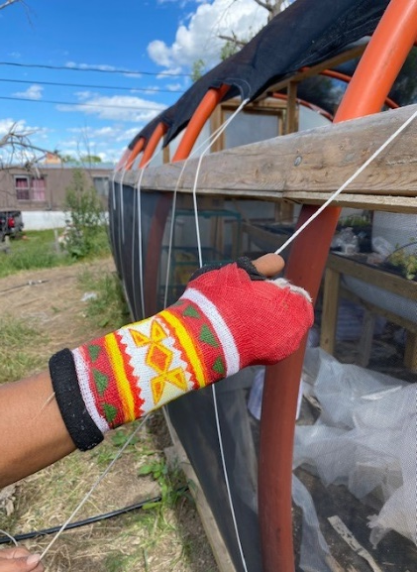
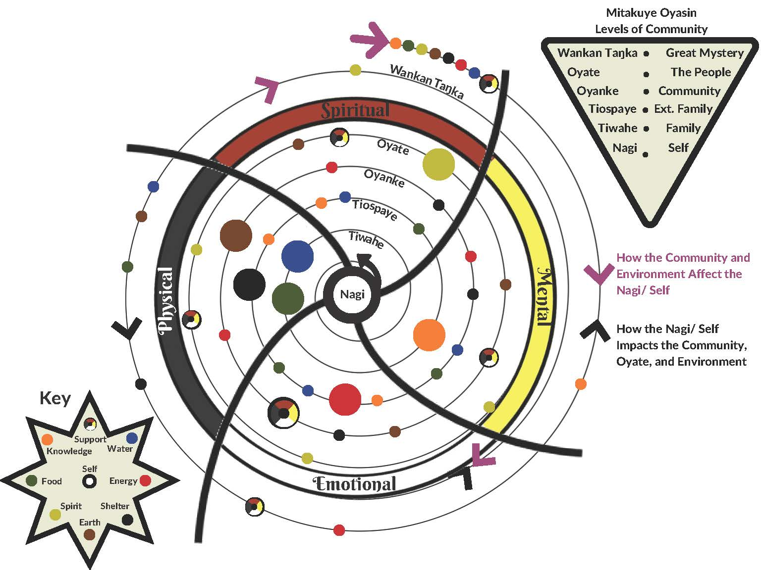
Programming must be Guided by Lakota Culture, Traditional Ecological Knowledge, and the needs of the Oyate (People).
“The old Lakota was wise. He knew that man’s heart, away from nature, becomes hard; he knew that a lack of respect for growing, living things soon led to a lack of respect for humans too.”
–Oglala Lakota, Luther Standing Bear

Slide 5
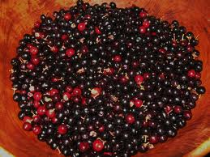
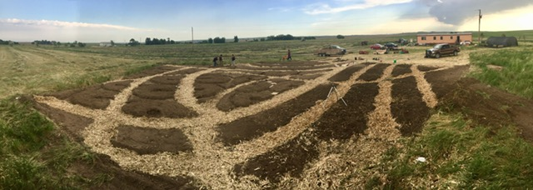
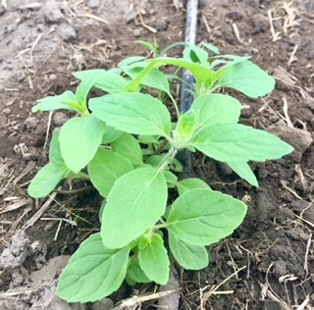
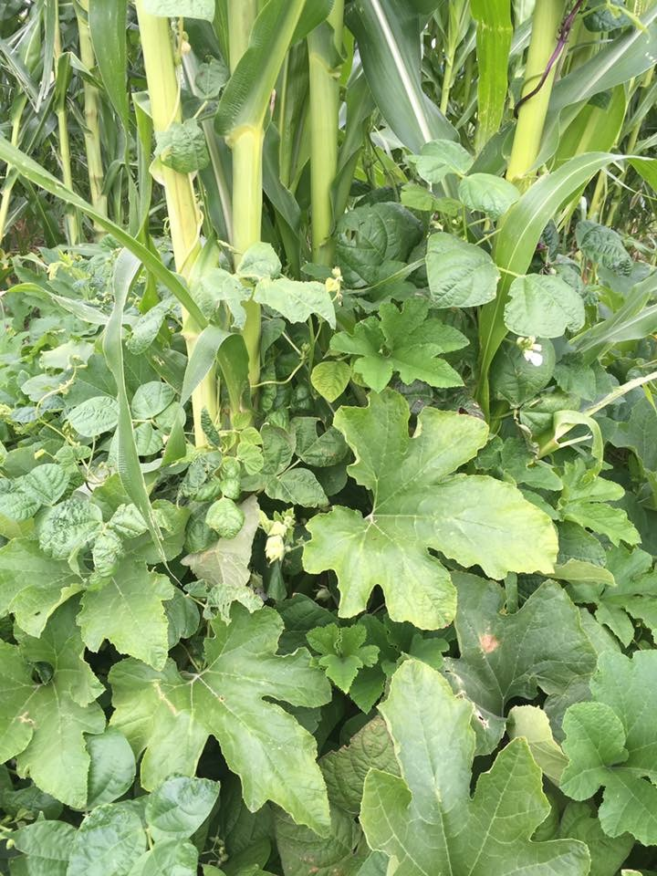
AgrAbility as a beginning Farmer Program. We focus on Low-cost Assistive-Technology & Traditional Ecological Knowledge With a Special emphasis on Traditional Plants as specialty crops

Slide 6
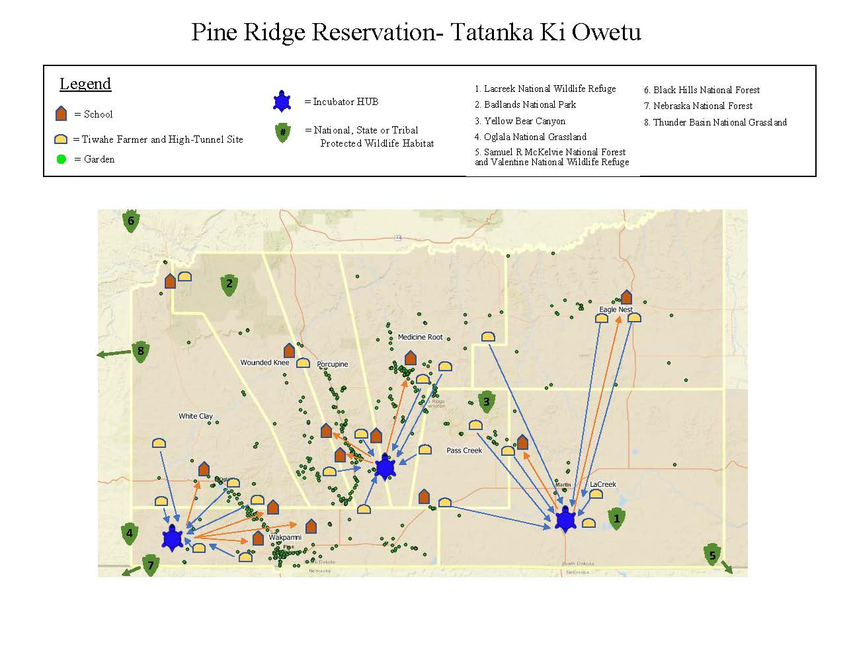
Note: the garden data was provided from a 2016 report released by Thunder Valley CDC prepared by Village Earth.

Slide 7
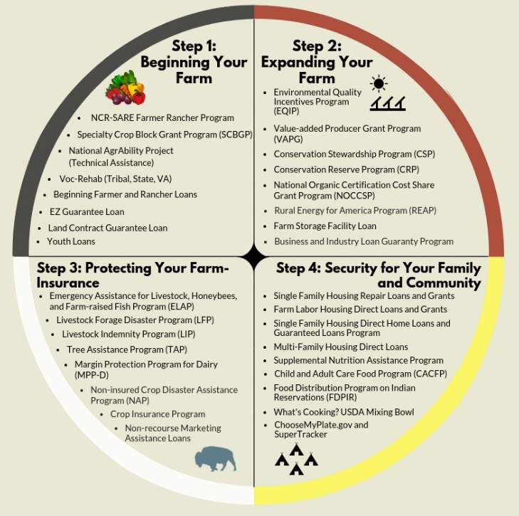
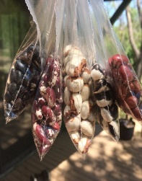
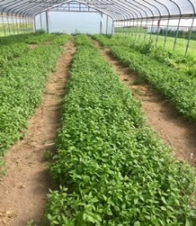
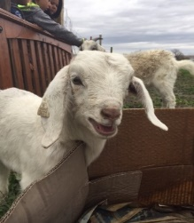
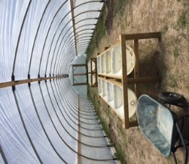
2020 Tribal Small Farmers’ Guide: For over 14 years, we’ve known that tribal communities deserved a Resource Guide. For fourteen years, we waited…
In 2019, we decided that we couldn’t wait anymore. So in addition to starting the two incubator-hubs, we decided we needed to start developing this guide. Supported by our fellow the Lakota Food Sovereignty Coalition member organizations, we started compiling the resource information that tribal farmers and growers on Pine Ridge needed to be aware of. Much of this information is also of use on other reservation.
2022 Tribal Small Farmers Resource Guide
Pine Ridge Reservation
Brought to you by the Pine Ridge Food Sovereignty Coalition, SDSU Pine Ridge Extension & the United States Dept. of Agriculture, 2020.
Compiled by: Patricia Hammond, Nick Ciaramitaro, Jason Schoch, Patrick Hall; Dr. Rhoda Burrows, SDSU Extension, Horticulture, Tribal Local Foods & AgrAbility Programs. Photography by Sarah Frelsi and Jason Schoch

Slide 8
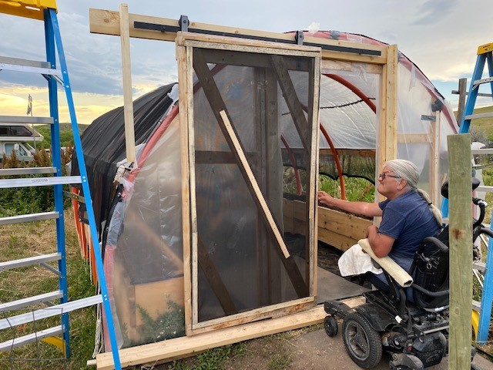
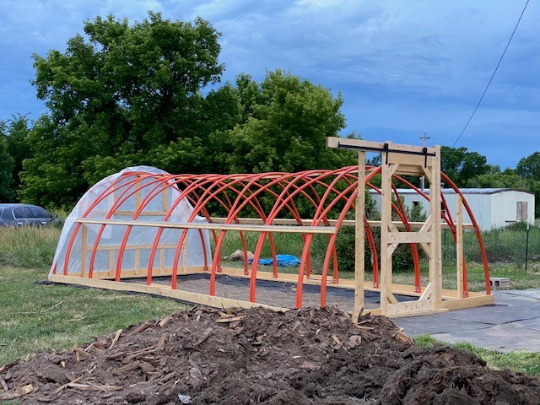
Two client hoop house’s designed to be wheel chair accessible, provide ease of entry and exit and built almost entirely of repurposed materials, found locally. We’re designing a small regenerative farming system that a tribal member can start up for around $1500 to $2000, well within Voc-Rehab’s budget. We training the local people to build these structures, how we source the materials.

Slide 9
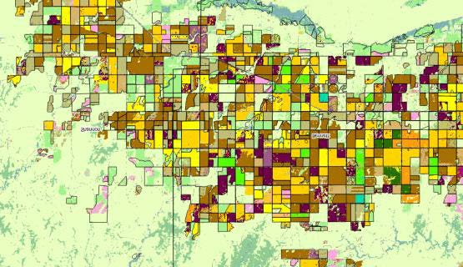
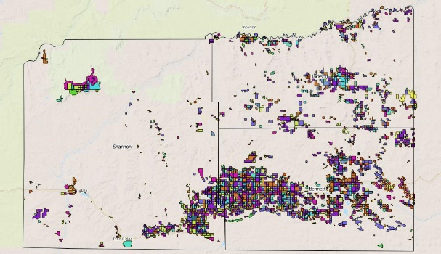
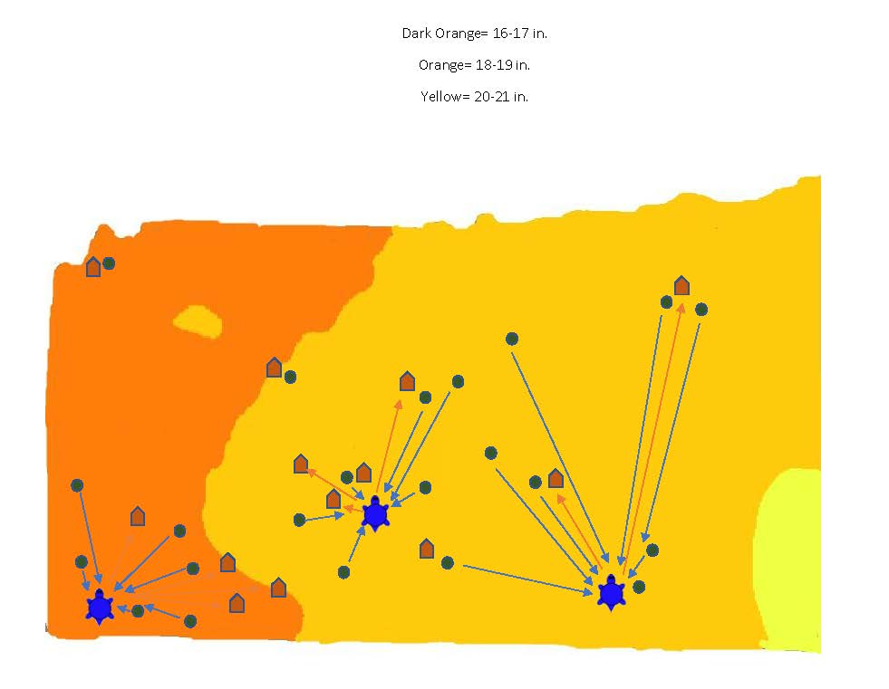
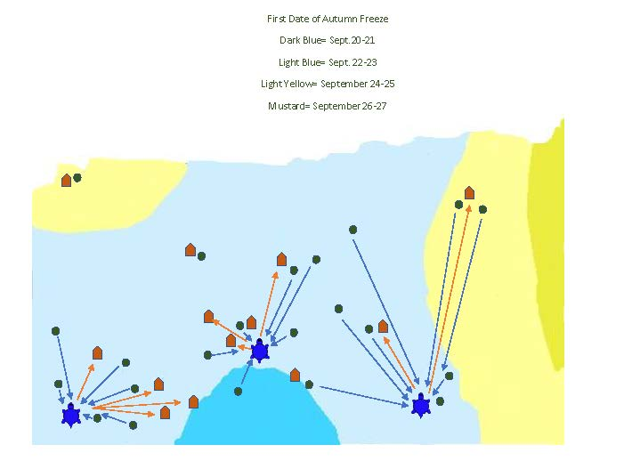
We’re trying to collate the data, so that you don’t have to. So that you can start planning your site even in the coldest depths of winter

Slide 10
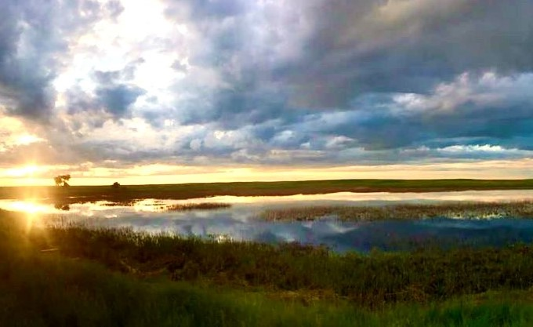
For More Information:
Please Contact:
Patricia Hammond
patricia.hammond@sdstate.edu
(605)858-8185
Jason Schoch
jason.schoch@sdstate.edu
(605)415-3104

