Slide 1
North Central Farm and Ranch Stress Assistance Center
Engaging Programs to Support Producer Well-being
This work is funded by USDA-NIFA 2020-70028-32728.

Slide 2
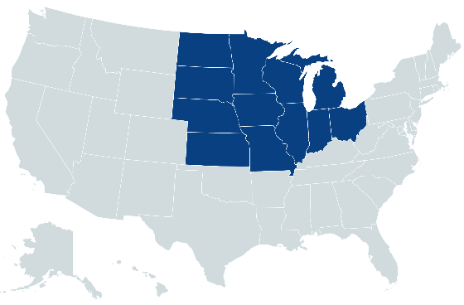
North Central Region

Slide 3
Key Network Collaborators

Slide 4
Producers in North Central Region
32% of US primary producers are in NC region (658,367)
80.9% male
94.7% white
11.5% veterans
52.1 average age
51.2% primary occupation is farming
Top 5 commodities: corn, soybeans, cattle, hogs, dairy

Slide 5
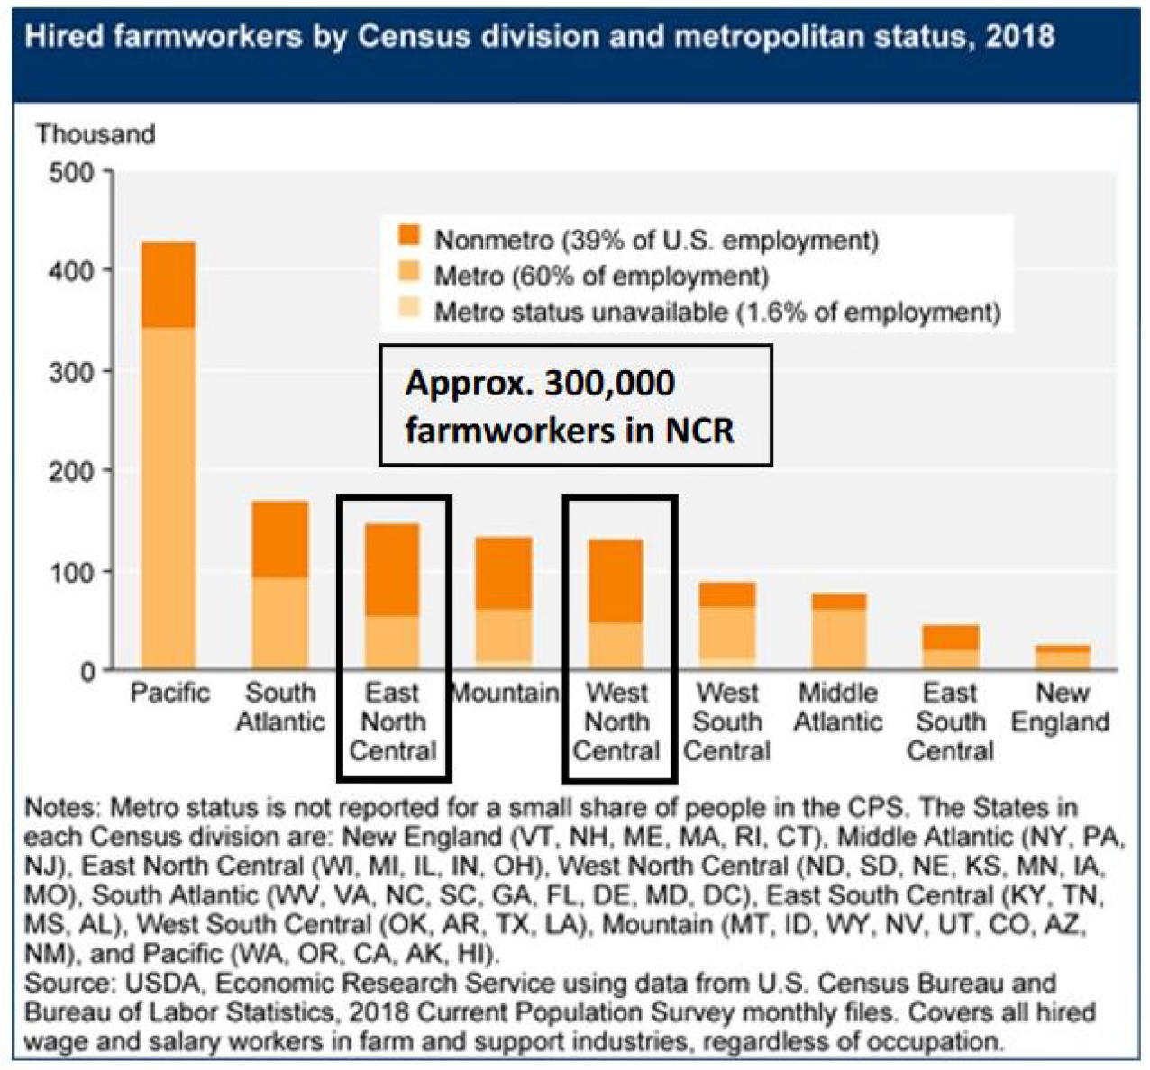
Farm Workers in North Central Region
Source: USDA ERS 2018

Slide 6
Severe environmental conditions in past 3 years
Drought (ND, SD)
Unusually heavy rainfall, flooding (IL, IA, IN, KS, MI, MN, MO, NE, OH, WI)
Late spring blizzards (SD)
Wildfires (KS)

Slide 7
Mental health worse among producers
Prevalence of anxiety: 27.0% to 71.0%
General population: 2.7% (GAD) to 18.1% (all)
Prevalence of depression: 8.7% to 58.3%
General US population: 7.1%
Some evidence of higher suicide rates
Up to 1.5 times higher among primary producers
Up to 1.15 times higher among agricultural workers
Heavy alcohol use: 9.4% among agricultural industry
All other full-time workers: 8.7%
Notes:
Studies about mental health among farmers include studies of: suicide, stress, depression, anxiety, burnout, non-specified mental health outcomes, mental health service use, and resilience.
These studies tend to look at relationships to demographic variables and physical health. After that, SES, help-seeking, farm and farmer related variables, pesticide use, substance use, coping, social support.
(Rudolphi, Berg, and Parsaik 2020) 71%, 58.3%
(Bjornestad, Brown, Weidauer 2019) – 8.7%
(Scarth, Stallones, Zwerling, and Burmeister 2000) – 9.8% depression – Iowa and Colorado. Iowa – 12.2%

Slide 8
Influences and impacts
Stress influenced by:
Uncontrollable conditions
Education
Decision-making authority
Legal status
Gender
Sense of self-efficacy or mastery

Slide 9
Influences and impacts
Stress can impact:
Family relationships
Mental health conditions such as depression, anxiety
Substance use
Physical health

Slide 10
Influences and impacts
Unresolved stress can lead to:
Higher rates of agricultural work-related injury
Absenteeism and presenteeism
Reduced quality of life
Suicidal ideation
Premature death due to suicide, heart disease, cancer, respiratory diseases

Slide 11
Getting help can be hard
Availability
Are there mental health providers in the area?
Accessibility
How far does someone have to drive to reach a provider?
Affordability
How much do services cost?
Does health insurance cover mental health services?
Acceptability
Do providers know/understand the context of agriculture?
Stigma
What ideas and beliefs do community members hold that may serve as barriers to seeking care?

Slide 12
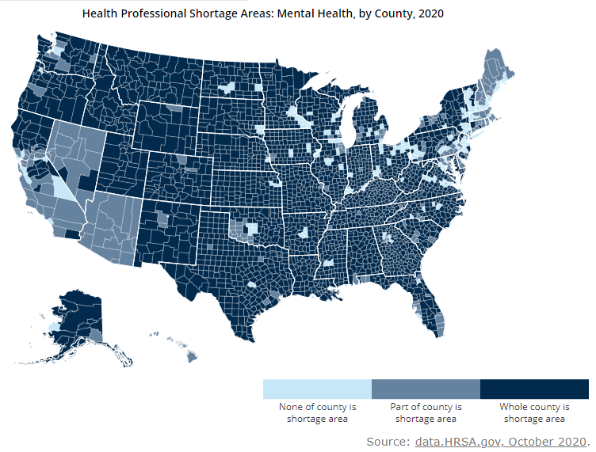
The majority of US counties are shortage areas

Slide 13
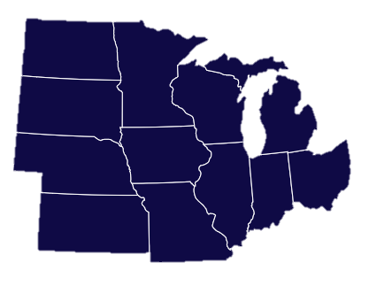
Engaging Programs to Support Producer Well-being

Slide 14
Engaging Programs to Support Producer Well-being
Training programs

Slide 15
Engaging Programs to Support Producer Well-being
Training programs
Telephone helplines

Slide 16
Engaging Programs to Support Producer Well-being
Training programs
Telephone helplines
Clearinghouse website and webinars

Slide 17
Engaging Programs to Support Producer Well-being
Training programs
Support groups
Telephone helplines
Clearinghouse website and webinars

Slide 18
Engaging Programs to Support Producer Well-being
Professional behavioral health services
Training programs
Support groups
Telephone helplines
Clearinghouse website and webinars

Slide 19
Interest Groups
Farm workers
Farm families and youth
Healthcare providers
Agribusiness and financial decision-making
Mental health and suicide prevention
Women producers
Identify and catalog existing resources
1
2
Create new resources
Disseminate and share resources
3
Notes:
The North Central region effort includes each individual states as well as small groups to work in specific topic areas. To date, many of the efforts around farm stress have been general or for conventional, primary producers, without specific attention to diverse groups within agriculture. The interest groups about farm workers, women producers, and farm families and youth are developing, piloting, and running programs specifically tailored to those audiences.
Farm workers – 9-week support groups for farm workers to increase access to and use of mental health services, increase sense of belonging and community, and reduce risk factors such as substance use
Women producers – developing programs about stressors women producers face and how to manage them
Farm families and youth – piloting and disseminating programs to help youth strengthen coping skills and understand mental health, as well as programs about communication skills for farm couples
The mental health and suicide prevention group is working together around specific programs to offer to those in agriculture, such as Mental Health First Aid, QPR, and Michigan State University’s Weathering the Storm programs for improving knowledge about mental health and skills to assist someone, among farmers
The agribusiness and financial decision-making interest group is working on tools and programs to assist producers with financial stressors, such as piloting a program pairing Extension health educators with farm financial educators to assist in farm financial assessments
The healthcare providers interest group is focusing on understanding what information providers need to better serve farmers, as well as offering training to this audience to improve agricultural literacy

Slide 20
Questions or Comments?
If you would like to receive the NC FRSAC monthly newsletter, please e-mail us to be added!
Dr. Josie Rudolphi Dr. Courtney Cuthbertson
josier@Illinois.edu cuthbert@Illinois.edu
The North Central Farm and Ranch Stress Assistance Center is funded by USDA-NIFA 2020-70028-32728.
Notes:
Add to newsletter

