Slide 1
Supporting Physical and Emotional Wellbeing for Rural Veterans
Knesha Rose-Davison, MPH, AgriSafe Network
Linda Emanuel, RN, AgriSafe Network

Slide 2
Presenters
Linda Emanuel, RN, Ag Producer, AgriSafe Network
Knesha Rose-Davison, MPH, AgriSafe Network

Slide 3
Objectives
By the end of this session, participants will be able to:
Discuss health disparities unique to men and women returning to rural America following one or more duty tours
Identify challenges and solutions to increase access to general support and mental health services for veteran farmers and ranchers.
Explore creative community-based opportunities to assist rural veterans farm/ranch in a safe workplace.

Slide 4
Notes:
Poll Title: Join instructions https://www.polleverywhere.com/join_instructions

Slide 5
Notes:
Poll Title: V eteran Farmers Think Tank https://www.polleverywhere.com/surveys/Vkdyr30G3R2tKIJ08wsjJ

Slide 6
Notes:
Image of American Flag and Message saying Thank You Veterans.

Slide 7
Rural Community:
Many veterans choose to live in rural communities for many reasons such as:
Living in a closer proximity to family, friends and community
Open space for recreation
Outdoor work
More privacy and quieter living space
Lower cost of living
Less crowded towns and schools
While rural communities offer many benefits to Veterans, this lifestyle is not without challenges. Veterans often experience issues with access to health, that are often intensified by combat-related illnesses and injuries.

Slide 8
Who are rural veterans?
Rural Area Characteristics
Low density
Sparse population
Distant from urban areas
Individual Differences ( Rural vs. Urban)
Social ties
Demographic characteristics
Culture
Access to institutional care and support
Notes:
Characteristics
Rural areas encompass all population, housing, and territory not included within an urban area (generally, rural places are characterized as low density, sparse population, not built up, and usually are relatively distant from urban areas)
Differences (Urban vs Rural)
Individuals living in rural areas typically differ from their urban counterparts in terms of social ties, demographic characteristics, culture, and access to institutional care and support. Veterans also differ from non-veterans in a variety of aspects.

Slide 9
Who are rural veterans? ( continued)
U.S. Department of Veterans Affairs has identified veterans living in rural areas as a population that faces many health disparities.
Notes:
Characteristics
Rural areas encompass all population, housing, and territory not included within an urban area (generally, rural places are characterized as low density, sparse population, not built up, and usually are relatively distant from urban areas)
Differences (Urban vs Rural)
Individuals living in rural areas typically differ from their urban counterparts in terms of social ties, demographic characteristics, culture, and access to institutional care and support. Veterans also differ from non-veterans in a variety of aspects.

Slide 10
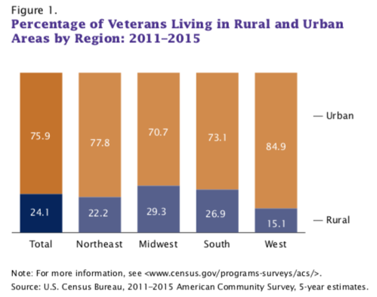
According to the U.S. Census Bureau, out of the 20 million veterans living in the United States from 2011-2015, about 5 million veterans lived in rural areas.
Resource: https://www.census.gov/content/dam/Census/library/publications/2017/acs/acs-36.pdf
Notes:
About 25% of veterans live in rural areas equating to approximately 5 million from the US Census Bureau.

Slide 11
Statistics:
58% of rural Veterans are enrolled in the VA health care system (significantly higher than the 37% enrollment rate of urban Veterans)
18% of rural enrolled Veterans have at least 1 service connected condition
6% of enrolled rural Veterans are women
15% of enrolled rural Veterans are minorities
52% earn less than $35,0000 annually
27% do not have access to home internet

Slide 12
Demographics:
Notes:
Rural veterans on average, are older than veterans who live in urban areas. 56 % of rural Veterans enrolled in VA’s health care system are over the age of 65.
Rural veterans were older than veterans who lived in urban areas (see Figure 3). The median age of rural
veterans was 65 years, compared with 63 years for urban veterans. This is not surprising given that
rural residents are generally older than urban residents.
This older population is medically complex and more likely to be diagnosed with diabetes, obesity, high blood pressure and heart conditions. These conditions require more frequent, continuous and costly care

Slide 13
Demographics continued:
Older Population Medically Complex
More Likely to be Diagnosed
Diabetes
Obesity
High Blood Pressure
Heart Conditions
These conditions require more frequent, continuous and costly care.
Nearly 460,000 rural Veterans served in Iraq and Afghanistan making the next generation of rural Veterans inclined to have multiple medical and combat-related issues, which also requires significant, on-going care.
Notes:
The health issues faced by rural veterans are often different from those of the general rural population due to disabilities and adverse health effects caused by their period of service.
According to the VHA Office of Rural Health, the most common diagnoses for rural Veterans in outpatient settings include high blood pressure, type 2 diabetes, acid reflux, post-traumatic stress disorder (PTSD), depressive disorder, as well as one or more service-connected disabilities.
Service-related and other health issues experienced by rural veterans can be worsened by the lack of specialty care available in rural areas, as well as other factors such as homelessness, poverty and substance abuse.

Slide 14
Rural Veterans Health Care Atlas ( FY2014)
Notes:
The Rural Veterans Health Care Atlas, produced by the Office of Rural Health’s GeoSpatial Outcomes Division, is a comprehensive resource for rural and Veteran stakeholders (including, but not limited to, researchers, planners, policy decision makers, as well as clinicians and patient care teams) to enhance health care delivery to rural Veterans, enrollees and patients.

Slide 15
Disabilities Affecting Veterans:
According to the 2016 Veterans Benefits Administration Annual Report, the following conditions were listed as prevalent service-connected disabilities affecting veterans:
Tinnitus and hearing loss
Post-traumatic stress disorder (PTSD)
Musculoskeletal issues
Scars, general
Diabetes mellitus
Paralysis of the sciatic nerve
Migraine

Slide 16
Rural Veteran Disparities:
Rural male veterans have higher rates of unemployment and disability, and have difficulty with access to mental health care.
In addition to the problems that males face, rural female veterans tend to have access issues related to child-care, transportation, the need for flexible hours for appointments.

Slide 17
Cigarette Smoking among Rural Veterans:
VA researchers studied data on 3,229 Iraq and Afghanistan Veterans to learn more about the relationship between cigarette smoking, rural residence, and mental health.
They discovered higher smoking rates among rural Veterans, when compared to urban Veterans, and among those with psychiatric disorders
Those living in “extremely rural areas” and those with psychiatric conditions were also considered more severely dependent on nicotine
The findings of this study further display the immediate need to reduce barriers for treatment for both smoking cessation and mental healthcare for veterans residing in rural areas.

Slide 18
Mental Health Veterans
Iraq or Afghanistan
20 percent suffer from either major depression or post-traumatic stress disorder.
19.5 percent of vets in these two categories have experienced a traumatic brain injury.
These three service-related disorders alone have an enormous impact on the demand for veteran mental health treatment.
2.1 million veterans received mental health treatment from the U.S. Department of Veterans Affairs 2006-2010
A study by the Substance Abuse and Mental Health Services Administration revealed that only 50 percent of returning vets who need veteran mental health treatment will receive these services.
According to the American Psychological Association, in 2005 22 percent of veterans sought veteran mental health treatment in the private sector rather than getting help from the VA.
Source: National Veterans Foundation
Notes:
Mental Health in Veterans
20 percent of the vets who served in either Iraq or Afghanistan suffer from either
major depression
post-traumatic stress disorder.
19.5 percent of vets in these two categories have experienced a
traumatic brain injury.
These three service-related disorders alone have an enormous impact on the demand for veteran mental health treatment.
According to the U.S. Government Accountability Office, 2.1 million veterans received mental health treatment from the U.S. Department of Veterans Affairs in the five year period from 2006 through 2010. A study by the Substance Abuse and Mental Health Services Administration revealed that only 50 percent of returning vets who need veteran mental health treatment will receive these services.

Slide 19
Post Traumatic Stress Disorder (PTSD)
A psychiatric disorder that can occur in people who have experienced or witnessed a traumatic event such as a natural disaster, a serious accident, a terrorist act, war/combat, rape or other violent personal assault.
AKA shell shock ( WWI), Combat fatigue ( WWII)
Affects approximately 3.5 percent of U.S. adults, and an estimated one in 11 people will be diagnosed PTSD in their lifetime.
Women are twice as likely as men to have PTSD.
Source: American Psychiatric Association
Notes:
People with PTSD have intense, disturbing thoughts and feelings related to their experience that last long after the traumatic event has ended. They may relive the event through flashbacks or nightmares; they may feel sadness, fear or anger; and they may feel detached or estranged from other people. People with PTSD may avoid situations or people that remind them of the traumatic event, and they may have strong negative reactions to something as ordinary as a loud noise or an accidental touch.

Slide 20
Link between TBI and PTSD
The New England Journal of Medicine performed a survey that identified a link between traumatic brain injury or TBI and post-traumatic stress disorder or PTSD.
The evidence showed that military members who experienced a traumatic brain injury were more than twice as likely to suffer from PTSD later on than service members who did not suffer a TBI.
The PTSD onset was generally 3-4 months after returning from deployment.

Slide 21
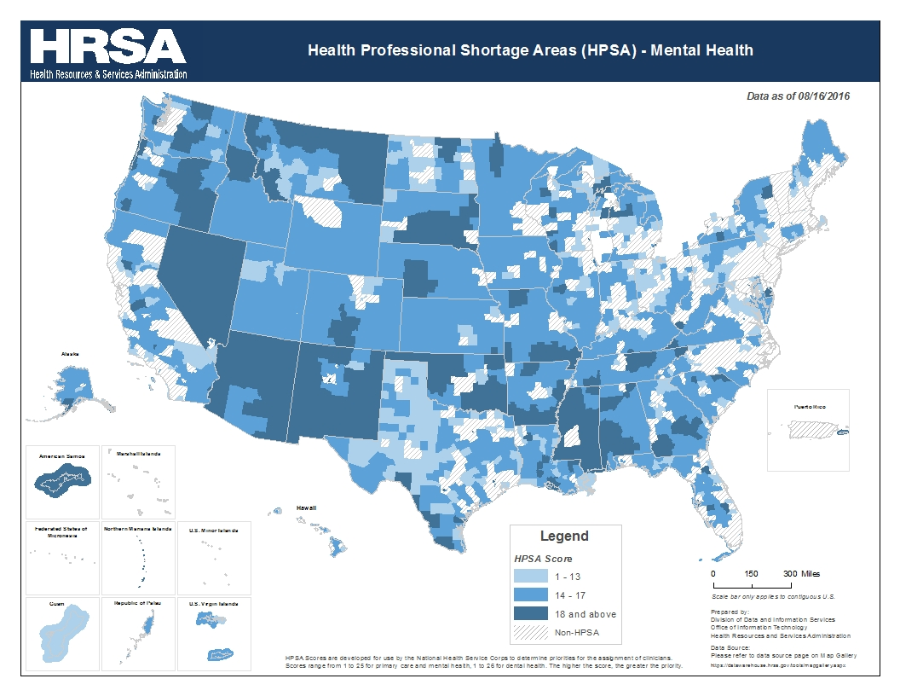
Notes:
Map showing county-level data on Mental Health Professional Shortage Areas (HPSAs), indicating counties that are entirely in a HPSA, partially in a HPSA, or not in a HPSA.
Source: data.HRSA.gov, 2017.

Slide 22
Mental Health Statistics
60 – 80 % of visits to healthcare providers in U.S. are related to stress --almost 20% of people live in rural areas. Substance Abuse and Mental Health Services Admiration (SAMHSA )
Nearly 74% of Americans who seek help for symptoms of depression will go to a primary care provider. Mental Health America
Unfortunately, the diagnosis of depression is missed about 50% of the time in a primary care setting. Mental Health America
According to SAMHSA, in 2012- 18.7% of non-metro county residents experienced mental illness within the past year…over 7 million people.
3.6% of these residents contemplated suicide

Slide 23
Rates of suicide per 100,000 population, by ranked overall by Standard Occupation Classification (SOC) group in 2012
Farmers have the highest rate of death by suicide among all the occupations.
Notes:
Rates were calculated using data from the U.S. Census Current Population Survey March supplement.
According to Centers of Disease Control and Prevention, farmers are in the occupational group with the highest overall rate of suicide at 84.5 per 100,000.
The Canadian Agricultural Safety Association National Stress Survey reported that 4 in 10 farmers believed they could effectively self-manage stress and mental health issues, and less than half of the participants were aware of professional resources available to them for coping with stress.

Slide 24
Challenges in Access to Mental Health Services:
Accessibility
Availability
Acceptability

Slide 25
Accessibility:
Rural residents often travel long distances to receive services, are less likely to recognize illness, and are less likely to be insured for mental health service

Slide 26
Availability:
Mental healthcare needs are not met in many rural communities across the country because adequate services are not present.
Rural communities tend to have much smaller populations when compared to urban areas. This combined with the overall shortage of mental health professionals, causes mental health providers to gravitate to practicing in urban areas that have higher populations.
Those living in rural communities often have to travel far distances in order to access facilities and clinics.

Slide 27
Acceptability:
A major reason many veterans avoid seeking out help for psychiatric issues is because of the perceived stigma associated with needing mental health care.
The stigma of needing or receiving mental health care and fewer options of trained professionals who work in rural areas create barriers to care for Veterans

Slide 28
Solutions:
Accessibility & Availability- Telemental Health Delivery to rural areas that do not have access to mental health clinics and facilities
Acceptability- the department of Defense launched an anti-stigma campaign called the “Real Warriors Campaign”, which is designed to promote resilience, recovery and support for returning service members, veterans, and their families.
“https://www.realwarriors.net/”

Slide 29
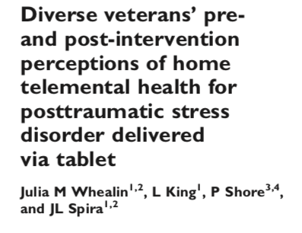
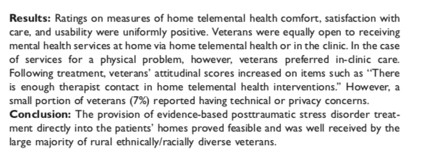

Slide 30
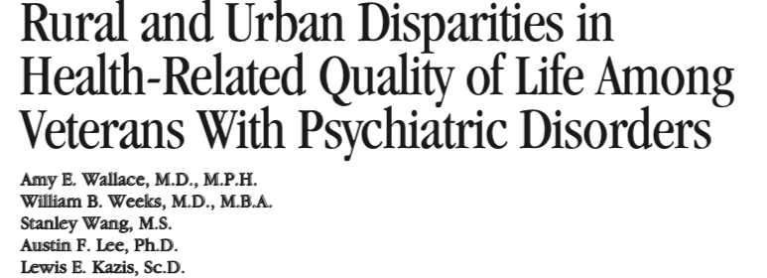
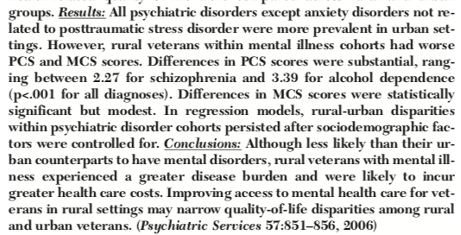

Slide 31
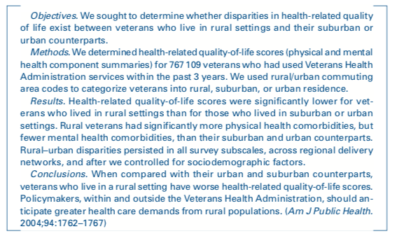

Slide 32
Community Based Opportunities:
The New Farmers Veterans Program at USDA gives veterans access to a variety of employment, educational, and entrepreneurial opportunities. Under the broad mission of making veterans critical actors in the vitality, safety, and sustainability of the food system, USDA prioritizes veterans for employment in federal offices related to agriculture and resource conservation. The USDA also guides veterans interested in pursuing a career in agriculture through various educational paths at land-grant colleges and through extension services.
https://newfarmers.usda.gov/veterans

Slide 33
Community Based Opportunities:
Veterans Agricultural Center of Connecticut (VACC) provides both training and therapy to returning combat and interested veterans through a six to eight-week hands-on training paired with online training. VACC provides instruction with a focus on organic hybrid-hydroponic systems. The goal of the program is to prepare veterans to start home-based farms or businesses. By the end of the program, participants will be employable for greenhouse operations, cooperatives, farm management, produce delivery, or sales.
http://www.vac-c.org/home.html

Slide 34
Community Based Opportunities:
Vets to Ag is a program at Michigan State University that trains homeless U.S. veterans to work in agriculture. Participants learn plant and soil science, equipment operation, integrated pest management, computer skills, and other topics. The program includes room and board for the entire training period, as well as both classroom instruction and hands-on training. The program also integrates job preparation and employer outreach skills
https://msustatewide.msu.edu/Programs/Details/3084

Slide 35
Resources:
https://www.ruralhealth.va.gov/aboutus/ruralvets.asp#com
https://www.ruralhealthinfo.org/topics/returning-soldier-and-veteran-health#health-concerns
https://www.census.gov/content/dam/Census/library/publications/2017/acs/acs-36.pdf
”Cigarette smoking rates among veterans: Association with rurality and psychiatric disorders,” Addictive Behaviors, March 2019.
What Is Posttraumatic Stress Disorder?
National Veterans Foundation
Health Professional Shortage Areas: Mental Health, by County, 2017- HRSA
Census of Fatal Occupational Injuries, 2016
The Top 10 Most Dangerous Jobs in America- Time

