Slide 1
How to work effectively with AgrAbility and DVR
A Primer for Farmers/Ranchers and program staff

Slide 2
Dr. James Craig RPT, J.D.; Ed.D. Colorado AgrABility Project Rural Rehabilitation Specialist Brady Haynes Agronomist and Farmer Sedgwick, CO

Slide 3
Background
Becoming a partner with AgrAbility and Vocational Rehabilitation
Notes:
ASK for help! Value your self worth search for resources

Slide 4
Planning and goals
Notes:
Why how mind map brain storm engage others ( family, care givers, counselors etc)

Slide 5
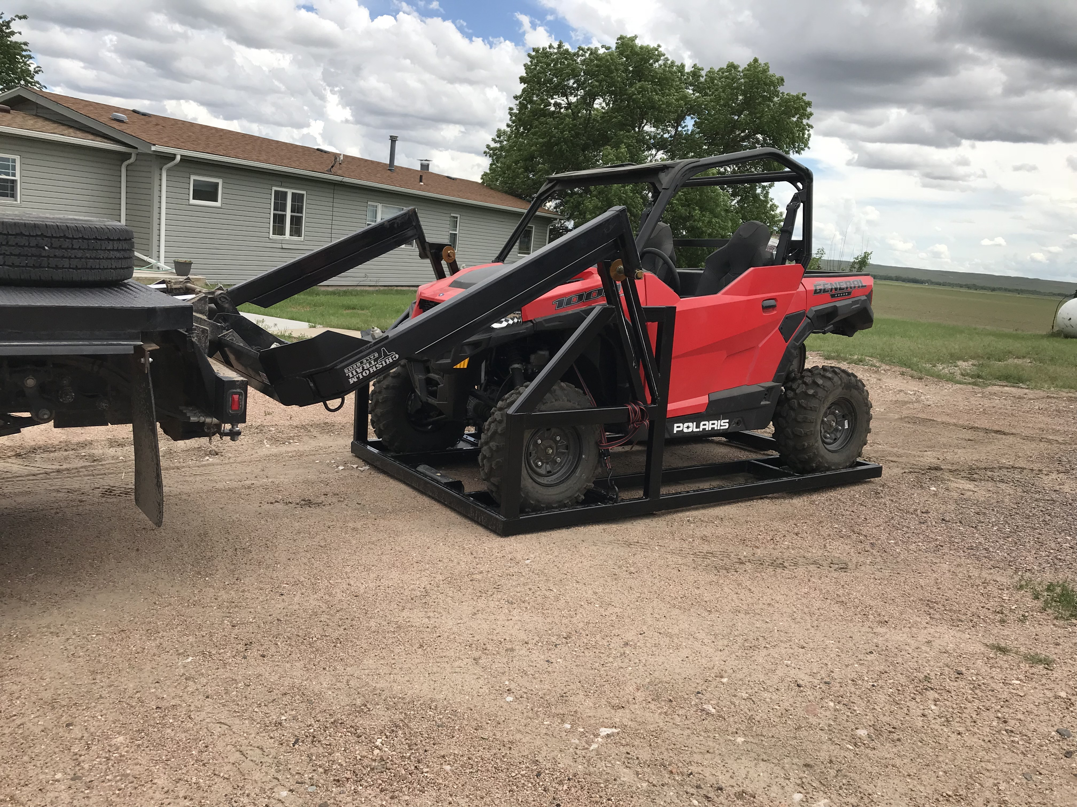

Slide 6
Set expectations
Notes:
Talk to others for reality check

Slide 7
Define your goals
Are they SMART?
Notes:
How do they fit in the overall map

Slide 8
Delegate and divide responsibilities
What is the best fit of skill sets?
Notes:
Use peoples talents but also get feedback from others – they may offer a fresh approach

Slide 9
What do you bring to the table?

Slide 10
ESTABLISH STRATEGY AND CHRONOLOGY

Slide 11
GUT CHECK! DOES EVERY ONE UNDERSTAND THE PLAN

Slide 12
Network with current and past clients

Slide 13
So you have a plan
WHAT NOW?

Slide 14
Communication !!
At each and every step

Slide 15
Adapting and remaining flexible
Avoid “Sticker Shock”

Slide 16
Remain curious
Question continually
Notes:
Why? How? Who?

Slide 17
Incorporate your new at
Keep your AgrAbility staff in loop

Slide 18
Adjust for shortcomings
Did we say remain flexible?

Slide 19
Feedback loop is vital

Slide 20
Use, evaluate, re-evaluate

Slide 21
Keep using the at
Identify issues and use feedback loop
Notes:
AgrAbility staff, dvr staff, national AgrAbility,

Slide 22
Make it Your own
Be creative
Modify as needed

Slide 23
Re-check communications
Has it fallen apart over time?

Slide 24
After-action critique
Help your helpers and neighbors

Slide 25
The Future is not that far away

Slide 26
Keep on keeping on
Equipment, stake holders
Notes:
DVR counselor, AgrAbility specialist, vendors,

Slide 27
Maintain your stuff!

Slide 28
Pay it forward

Slide 29
Tell your story

Slide 30
Questions?

