Slide 1
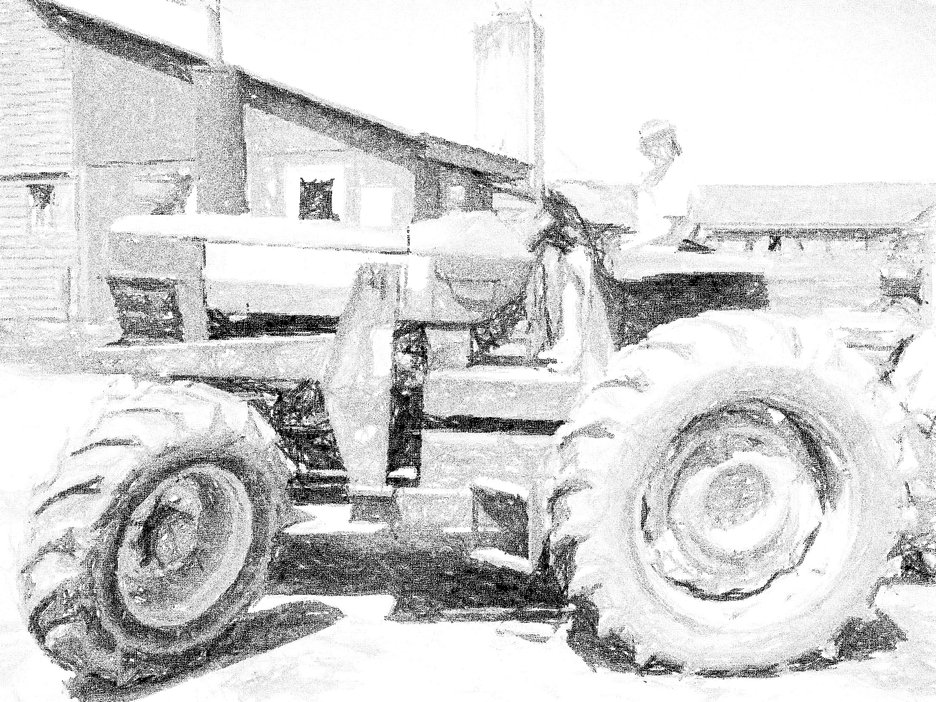
Alternative Income Streams for Farmers & Ranchers
AgrAbility National Training Workshop
Richard J. Brzozowski
richard.brzozowski@maine.edu
Maine AgrAbility Project Director
March 26, 2019

Slide 2
Today’s Process
Please Sign In – Print name and email address
Notes from today’s session will be shared with all participants.
We’ll need 2 scribes on the flip charts.
Ideas will be flowing fast
We’ll need 1 person to type notes on a laptop.
Everyone is encouraged to participate.

Slide 3
Objective #1
Realizing that income generated from agriculture is often uncertain, participants will learn about potential alternative enterprises that might fit their skills & abilities.

Slide 4
Objective #2
Participants will learn to view their agricultural operation by season and cash flow per month.

Slide 5
Objective #3
Participants will learn how to evaluate service-related enterprises focusing on the investment of time, equipment, skills, money, or energy.

Slide 6
Let’s Get Started
Let’s start by listing some possible enterprises that are not animal-based or crop-based. (15 minutes).
Let’s categorize each enterprise as service-based or product-based.

Slide 7
Benefits & Drawbacks of Listed Enterprises
What themes are evident regarding benefits and drawbacks of these enterprises?
Let’s design a chart to help evaluate / compare enterprises.
Let’s develop statements or questions for farmers/ranchers to use when considering a new enterprise.

Slide 8
Let’s Consider Cash Flow
What months of the year are most difficult for farmers and ranchers in regards to income?
Is off-farm employment an option for farmers or ranchers (or family members)? Why or why not?
Are there enterprises (none land-based) that could be used (managed) to generate income for the farm or ranch family?

Slide 9
Take Home Messages
What are your take home messages from this exercise?

Slide 10
Thank You for Participating

