Slide 1
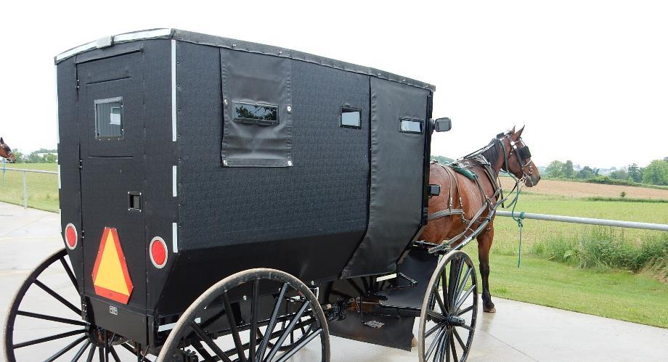
Working With
The
AMISH

Slide 2
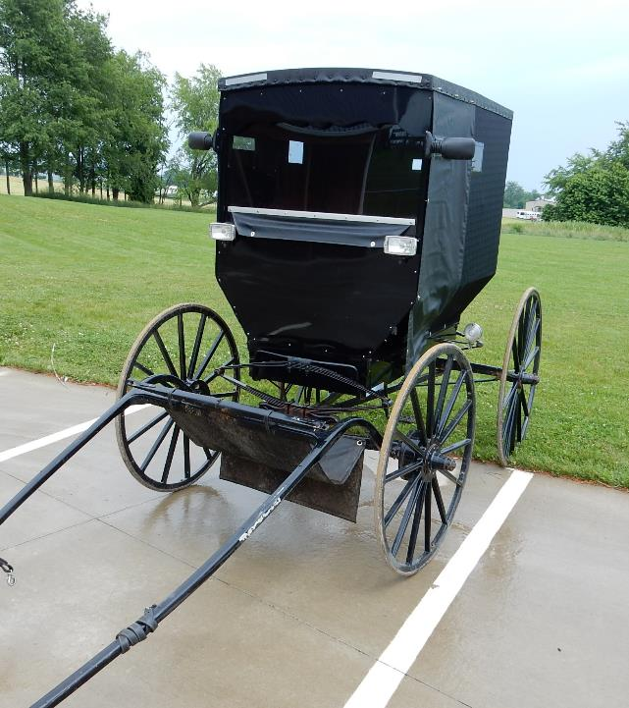
WHO ARE THE AMISH?
Considered by most to be conservative Christians – not a cult
Founded by Jacob Amman in Switzerland in 1693 as a split from the Mennonite movement
First Amish arrived in America in 1736 and settled in Pennsylvania
Almost all members are born into and raised in the faith. Some Amish groups have a very restricted gene pool and are experiencing several inherited disorders as a result.
Notes:
WHO ARE THE AMISH?
Considered by most to be conservative Christians – not a cult
Founded by Jacob Amman in Switzerland in 1693 as a split from the Mennonite movement
First Amish arrived in America in 1736 and settled in Pennsylvania
Almost all members are born into and raised in the faith. Some Amish groups have a very restricted gene pool and are experiencing several inherited disorders as a result.

Slide 3
HIGHER THAN AVERAGE FARM RELATED FATALATIES
More children working on the farm
More families involved in agriculture
Common to use older farm equipment
More Amish beginning to use skid steers
Notes:
Both genetic disorders and high rates of farming accidents are primary reasons that Amish may be interested in working with AgrAbility.
From: https://www.purdue.edu/newsroom/releases/2016/Q3/report-indiana-farm-related-fatalities-up-10-in-2015.html
“Indiana's Amish and Old-Order Anabaptist communities, many of whom use modern technology selectively due to their religious beliefs, continue to experience higher than average rates of farm-related fatalities. Amish families have more children than average American families and mainly work in agricultural occupations, both risk factors for farm injuries and deaths. Elkhart, LaGrange, Adams and Allen counties have some of the largest Amish populations in the state and also have had the highest number of fatalities over the last 40 years, the report said. In addition to farm accidents, collisions between buggies and motor vehicles are significant sources of injury and death.”
This being true in Indiana, it is most likely true in other states with Amish communities. And if Amish fatalities are well above the average rate as compared to the general populace of farmers, it is safe to assume that disabilities related to such accidents is also higher.

Slide 4
DIVERSITY AMONG THE AMISH
Old Order
New Order
Beachy Amish
Amish Mennonites
Many subgroups with different rules
Notes:
Diversity The Amish are not a single unit. There are four main groups — the Old Order, the New Order, the Beachy Amish and Amish Mennonites — with many subgroups and different rules within these categories. For instance, the Beachy Amish and Amish Mennonites often drive cars and use electricity while the others use horse-drawn buggies.
From USA TODAY: “The Amish: 10 things you might want to know” (https://www.usatoday.com/story/news/nation/2014/08/15/amish-ten-things-you-need-to-know/14111249/

Slide 5
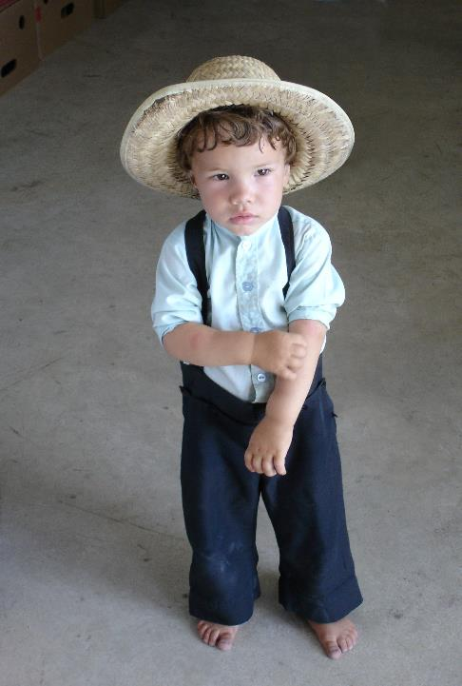
WHY DO AMISH SEEM “OLD-FASHIONED”?
Life governed by the “Ordnung” = German for “Order”
Most Amish groups forbid:
Owning cars
Using public electrical utility lines
Self-propelled farm machinery
Owning a television, radio, or computer
Attending a high school or college
Joining the military
Initiating divorce
Personal photos
Notes:
Amish life is governed by the "Ordnung," a German word for order. The rules vary from community to community. According to the Young Center for Anabaptist and Pietist Studies at Elizabethtown College in Lancaster, Pa., "Most Amish groups forbid owning automobiles, tapping electricity from public utility lines, using self-propelled farm machinery, owning a television, radio, and computer, attending high school and college, joining the military, and initiating divorce." Photos are banned because they might cultivate personal vanity, which runs against the church's prohibition of "hochmut," a word meaning pride, arrogance and/or haughtiness.
From USA TODAY: “The Amish: 10 things you might want to know” (https://www.usatoday.com/story/news/nation/2014/08/15/amish-ten-things-you-need-to-know/14111249/

Slide 6
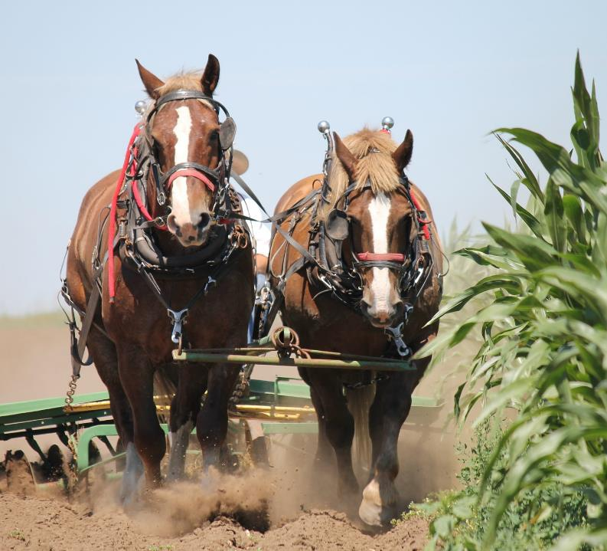
Technology
Not “anti-technology”
“Negotiated cultural compromises” (Kraybill)
Proactive approach to accepting new technology
“Where will this lead us?”
Decisions by local bishops
Notes:
From USA TODAY: “The Amish: 10 things you might want to know” (https://www.usatoday.com/story/news/nation/2014/08/15/amish-ten-things-you-need-to-know/14111249/
According to the Young Center, the Amish do not consider technology evil in itself, but believe that it has the potential to bring about assimilation into the surrounding society. "Mass media technology in particular, they fear, would introduce foreign values into their culture," says an article on the Young Center's website. "By bringing greater mobility, cars would pull the community apart, eroding local ties. Horse-and-buggy transportation keeps the community anchored in its local geographical base." Some of the rules are seemingly contradictory — for instance, 12-volt car batteries are permitted by many communities while 120-volt electricity is not. In addition, most Amish are not permitted to drive motor vehicles but are allowed to hire outsiders — known as "English" — to drive them.
And from: https://www.nytimes.com/1998/04/09/technology/horse-and-blender-car-and-crockpot.html
“What looks hypocritical or downright silly are in fact negotiated cultural compromises where the Amish are trying to preserve their ethnic identity on the one hand and tap the benefits of modern technology on the other,” Dr. Kraybill said. (Donald Kraybill, provost of Messiah College and author of several books about the Amish)

Slide 7
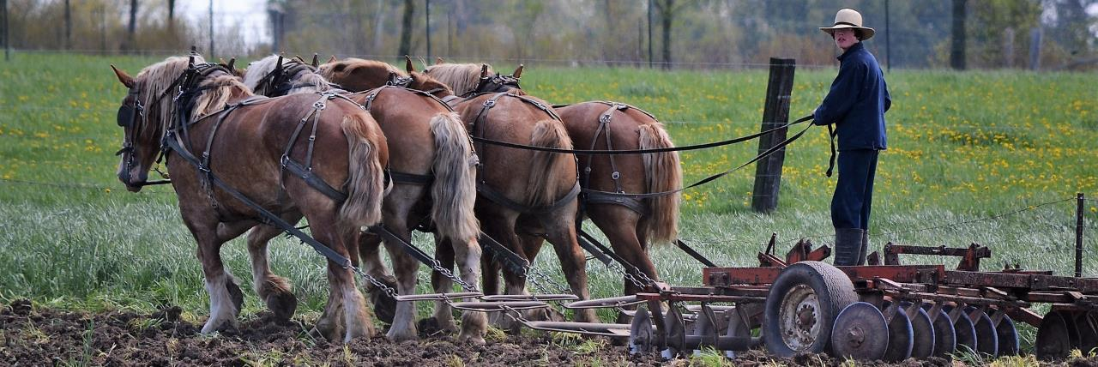
Value of labor-intensive work vs. mass production
Concern about self-propelled machinery used for transportation
Stewards of the land
Farm Technology

Slide 8
WHERE ARE THE AMISH FOUND?
28 States
Province of Ontario, Canada
Notes:
From USA TODAY: “The Amish: 10 things you might want to know” (https://www.usatoday.com/story/news/nation/2014/08/15/amish-ten-things-you-need-to-know/14111249/
The Amish are one of the fastest-growing population groups in America. According to the Young Center for Anabaptist and Pietist Studies at Elizabethtown College in Lancaster, Pa., their population has risen from about 5,000 in 1920 to almost 300,000 today. And much of that growth has occurred in the last three decades. The center estimates there were just 84,000 Amish in 1984, meaning the population has more than tripled during that time. The population explosion is due to a belief in large families, seen as a blessing from God. The large number of children also provide labor for their farming enterprises.
Amish have long been identified with the state of Pennsylvania, but are in fact present today in 28 states as well as the province of Ontario in Canada.
The states with the largest Amish populations are Ohio and Pennsylvania. The largest individual settlements, are found at Holmes County, Ohio, and Lancaster County, Pennsylvania. Indiana has the third highest Amish population. Together these three states are home to roughly two-thirds of all Amish.
Here is a list of the current SRAP states according to their Amish populations:

Slide 9
SRAP STATES BY AMISH POPULATION (2015)
Ohio 69,255
Pennsylvania 68,820
Indiana 50,955
Wisconsin 17,665
Michigan 14,495
Missouri 11,230
Kentucky 11,010
Illinois 7,280
Tennessee 2,750
Kansas 2,025
Nebraska 810
Colorado 675
Maine 675
North Carolina 135
South Dakota 95
Texas 75
Notes:
From World Atlas: https://www.worldatlas.com/articles/us-states-by-amish-population.html

Slide 10
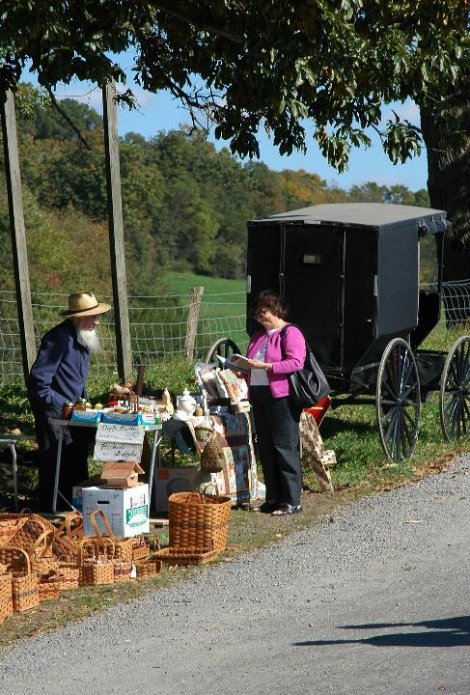
GUIDELINES FOR WORKING WITH THE AMISH COMMUNITY

Slide 11
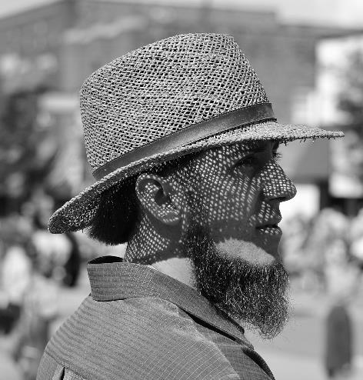
INDIVIDUALIZE THE AMISH CLIENT
Determine which Amish group the family belongs to
Remember that Amish persons value face-to-face relationships
Amish clients may ask personal questions of the professional
Don’t be concerned if formal titles are not used to address you
Notes:
From: “GUIDELINES FOR PROFESSIONALS WHEN WORKING WITH THE AMISH COMMUNITY” (https://tinyurl.com/y2pvmz9m )
Determine which Amish group the family belongs to, on a continuum of conservative to liberal, as this will influence decisions about accepting professional care and services.
Remember that Amish persons value face-to-face relationships.
Amish clients or patients may ask personal questions of the professional, such as “Are you married?,” “Do you have children?,” “Where do you live?,” and, “Are you related to certain persons?” This helps them to individualize you and determine your place in the overall community. Respond to these questions briefly, but be open and honest.
Don’t be concerned if formal titles are not used to address you. This is not meant to be disrespectful, only to establish a genuine relationship.

Slide 12
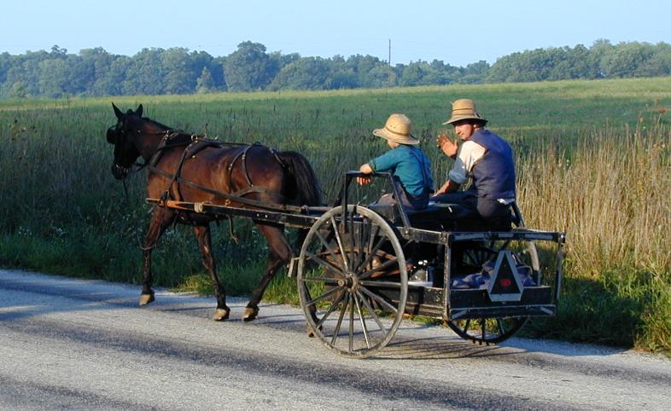
START WHERE THE AMISH CLIENT IS, AS AN INDIVIDUAL AND AS A COMMUNITY MEMBER
Acknowledge Amish values, beliefs, customs, and attitudes.
Modify service delivery to accommodate Amish preferences and to overcome the barriers of distance, technology choices, and cost.
Notes:
From: “GUIDELINES FOR PROFESSIONALS WHEN WORKING WITH THE AMISH COMMUNITY” (https://tinyurl.com/y2pvmz9m )
START WHERE THE AMISH CLIENT IS, AS AN INDIVIDUAL AND AS A COMMUNITY MEMBER
Acknowledge Amish values, beliefs, customs, and attitudes.
Modify service delivery to accommodate Amish preferences and to overcome the barriers of distance, technology choices, and cost. Taking services to the Amish community is appreciated, for example, offering wellness checks at a local livestock auction barn.

Slide 13
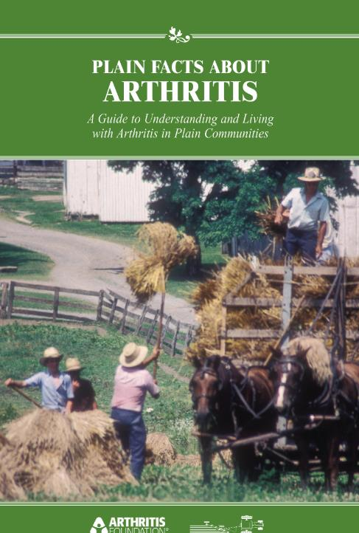
AMISH AND AGRABILITY AS A GOVERNMENT PROJECT
Separation of church and state
Reticence in accepting free literature
Notes:
From: https://groups.etown.edu/amishstudies/social-organization/government/
“The Amish emphasize the separation of church and state. They prefer not to receive subsidies from government programs. They will typically not serve in government committees or commissions, but will often consult and cooperate with local officials. The Amish generally avoid holding public office and engaging in political activism. They are, however, permitted to vote. The rate of voting is typically low unless a local issue is on the ballot.”
---------------------------------------
For some Amish, this may lead to a reticence about taking free AgrAbility literature, as AgrAbility is a government/state project. Often, this can be overcome by explaining that AgrAbility does not ask them to sign anything, doesn’t cost them anything, does not require documented proof of disability, and in its approach is more like neighbors helping neighbors than a project coming to impose its own ideas on Amish society.
---------------------------------------
In Indiana, Amish seem to especially appreciate AgrAbility’s “Plain Facts About Arthritis” booklet and the coloring/activity book “Weeds In Our Garden” produced by Field and Associates

Slide 14
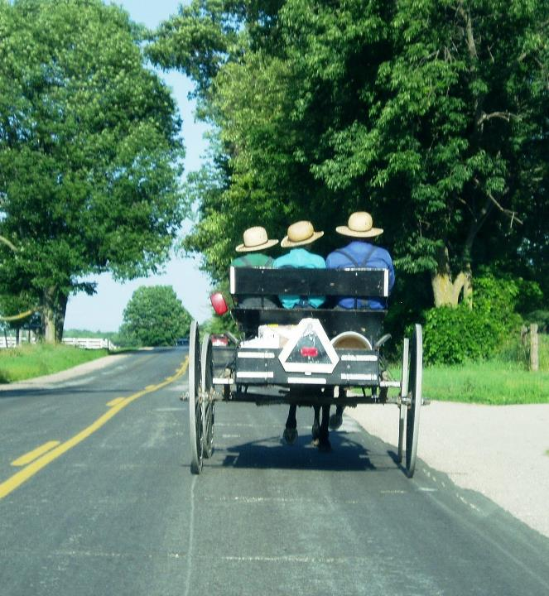
Observe Amish holidays and respect Sunday as a day of rest.
Public holidays
Thanksgiving
New Year’s Day
Amish religious holidays
Christmas
Easter
Good Friday
Easter Monday (day after Easter)
Second Christmas (December 26)
“Old Christmas” (January 6)
Ascension Day (39 days after Easter)
Pentecost
Fall Fast Day (October 11)
Notes:
From Amish America (http://amishamerica.com/what-holidays-do-amish-celebrate/ )
Amish observe a variety of religious holidays, and some public holidays as well
Amish appreciate time off just as any other Americans do, in order to rest, spend time with family and for religious observation. The Amish holiday schedule differs somewhat from that of the typical American, however.
Public holidays
Amish generally do not celebrate public holidays, though may be granted days off from work depending on their employer. Amish do recognize Thanksgiving as well as New Year’s Day. In some settlements Amish might take in fireworks on the Fourth of July, for example. Amish do not observe Halloween, but may display decorative pumpkins (uncarved) and gourds during the autumn months.
Amish religious holidays
Among religious holidays, like other Christians, Amish celebrate Christmas, Easter (Easter always falls on the first Sunday after the first full moon on or after the vernal equinox = March 20 or 21.), and Good Friday. Additional religious days observed by the Amish include Easter Monday (day after Easter), second Christmas on December 26th, (Some also celebrate “Old Christmas” on Jan. 6th, 12 days after the 25th and the traditional day of the Wise Men’s visit to Bethlehem. In the Middle Ages, there were 12 days of feasting starting on the 25th, and this is where the song “The 12 Days of Christmas” comes from. This holiday is also known as “Epiphany”.) Pentecost (50 days after Passover – in OT, was the “Feast of Weeks” celebrating the end of the harvest, “Pentecost” = Greek name for “50” and the “Feast of Weeks”. Pentecost also signaled the beginning of the Church age.), and Ascension Day (40th day of Easter = 39th day after Easter). Pentecost, Easter Monday, and second Christmas may not be celebrated in all communities (Enterprise, Kraybill/Nolt).
Good Friday and St. Michael’s Day (September 29) are days of fasting as well
Among other free days, non-Amish employees are given time off for Memorial Day, July Fourth, and Labor Day. In place of these holidays, Amish are exempt from working on Ascension Day, Pentecost Monday, and Fall Fast Day (Oct. 11) – Amish businesses will be closed.

Slide 15
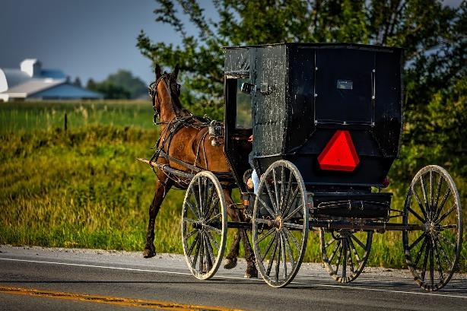
MOVE AT THE AMISH CLIENT’S PACE
Remember the pace of Amish life is slow
Learn the art of “chit-chat”
Don’t rush the conversation, and allow enough time for discussion of an issue
Notes:
From: “GUIDELINES FOR PROFESSIONALS WHEN WORKING WITH THE AMISH COMMUNITY” (https://tinyurl.com/y2pvmz9m )
Remember the pace of Amish life is slow-an Amish buggy travels at about 10 to 20 miles per hour.
Learn the art of “chit-chat” and spend a few minutes initially talking about the weather, crops, local news, and events.
Don’t rush the conversation, and allow enough time for discussion of an issue.

Slide 16
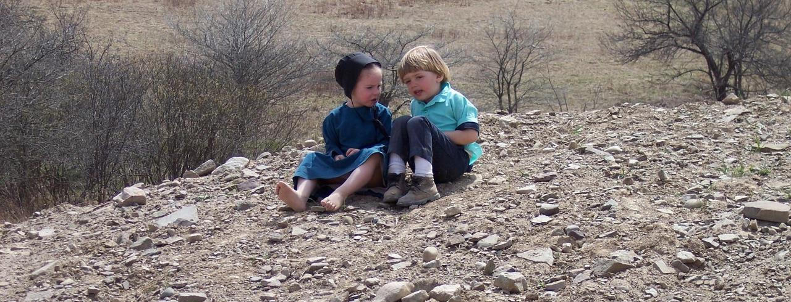
Remember that language is not a barrier between Amish and non-Amish, except for preschool children who may not speak English
Notes:
From: “GUIDELINES FOR PROFESSIONALS WHEN WORKING WITH THE AMISH COMMUNITY” (https://tinyurl.com/y2pvmz9m )
Remember that language is not a barrier between Amish and non-Amish, except for preschool children who may not speak English.

Slide 17
REMEMBER THE AMISH CLIENT’S RIGHT TO SELF-DETERMINATION
Involve Amish bishops or other representatives in planning programs and services targeted at the Amish community.
Notes:
From: “GUIDELINES FOR PROFESSIONALS WHEN WORKING WITH THE AMISH COMMUNITY” (https://tinyurl.com/y2pvmz9m )
Remember the Amish client’s right to self-determination:
Involve Amish bishops or other representatives in planning programs and services targeted at the Amish community.

Slide 18
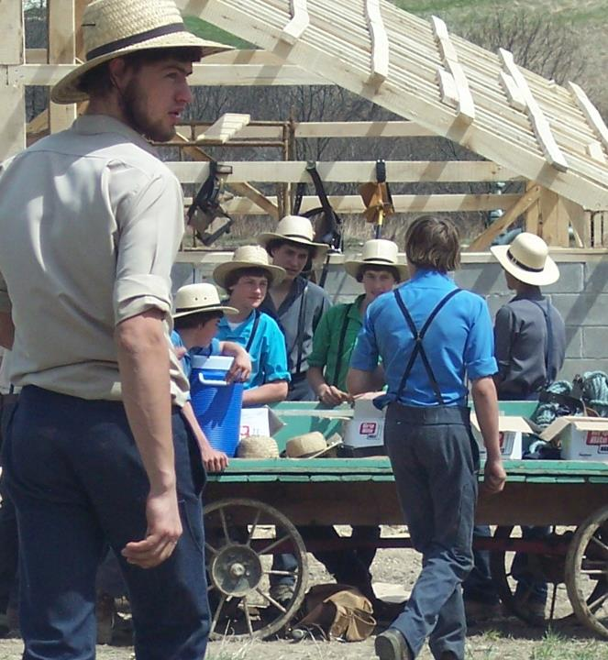
ABOVE ALL, TREAT AMISH CLIENTS WITH DIGNITY AND RESPECT
Recognize the patriarchal nature of Amish society, but also be aware that Amish women will participate in decision making.
Dress modestly, especially when visiting an Amish home.
Notes:
From: “GUIDELINES FOR PROFESSIONALS WHEN WORKING WITH THE AMISH COMMUNITY” (https://tinyurl.com/y2pvmz9m )
Above all, treat Amish clients/patients with dignity and respect:
Recognize the patriarchal nature of Amish society, but also be aware that Amish women will participate in decision making.
Dress modestly, especially when visiting an Amish home.

Slide 19
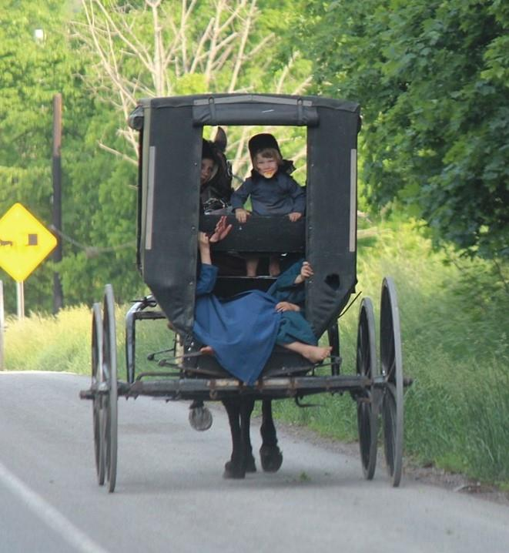
ABOVE ALL, TREAT AMISH CLIENTS WITH DIGNITY AND RESPECT
Speak with a soft voice and do not use jargon or slang unless it is commonly used in the local Amish community.
Allow a comfortable physical space between you and the Amish client.
Avoid physical touch, especially between genders, unless appropriate and necessary for professional care.
Notes:
From: “GUIDELINES FOR PROFESSIONALS WHEN WORKING WITH THE AMISH COMMUNITY” (https://tinyurl.com/y2pvmz9m )
Speak with a soft voice and do not use jargon or slang unless it is commonly used in the local community.
Allow a comfortable physical space between you and the Amish client.
Avoid physical touch, especially between genders, unless appropriate and necessary for professional care.

Slide 20
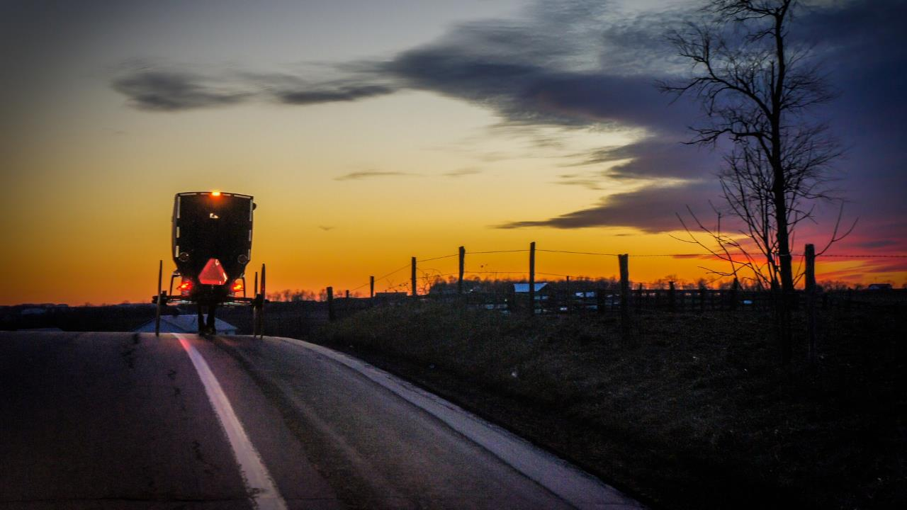
Q & A

