Slide 1
Social Security Disability Considerations for Farmers and Ranchers

Slide 2
agenda
Overview of Social Security Disability Programs (SSDI & SSI)
Special considerations for farmers/ranchers and families
Importance of & Accessing Benefits Planning Services

Slide 3
Social Security
Disability Programs
Title II Social Security Disability insurance (SSDI/CDB)
Title XVI Supplemental Security Income (SSI)
Funded by the Social Security trust fund
Entitlement program based on insured status (work history)
Insures the worker, the worker’s widow/widower, and worker’s disabled adult child
Medicare Part A, B, and D eligibility after 24 months
Funded by federal tax dollars, not the SS trust fund
Needs based program for the aged, blind, and disabled who have limited income and resources
Comes with eligibility for Medicaid
“Payer of last resort”
Please do not copy without permission.

Slide 4
Applying for
Disability Benefits
Separate applications for both Title II and SSI benefits
Multiple eligibility factors
  Non-disability requirements – Social Security field office
  Medical determination – Disability Determination Services
Different definitions of disability – medical
  Child definition – under 18
  Adult definition – 18 and over
Notes:
Non-disability requirements:
Age
Citizenship
Unearned Income and resources
Employment and earnings
Marital status
Insured status
Child definition
Broad areas of functioning:
-Acquiring and using information
-Attending and completing tasks
-Interacting and relating with others
-Moving about and manipulating objects
-Caring for themselves
-Health and physical well-being

Slide 5
Special considerations - eligibility
Land ownership – Income and/or Resource
  i.e. adjacent land vs. non-adjacent land, land trust, special needs trust
How farm business is set up
  i.e. Sole Proprietorship, LLC, S-Corp, etc…
Individuals, spouses, or other family members who work on the farm/ranch, but do not pay into Social Security – not insured for SSDI
Ambivalence about applying or asking for help

Slide 6
Introduction to Social security work incentives

Slide 7
Intro to Social Security Work Incentives
Title II and SSI programs each have their own set of work incentives.
Purpose of work incentives are to allow a person to attempt work, see how much they can work, see if they can maintain employment, etc…
Eligibility for disability benefits can be protected by the use of work incentives.
Allows a person to work substantially and keep medical insurance.

Slide 8
Special considerations – work
How farm business is set up (Sole Proprietorship, LLC, S-Corp, etc) may affect availability of work incentives
Self-employment
  Net Earnings from Self-Employment (NESE)
  Substantial Gainful Activity (SGA)
  Property Essential to Self Support (PESS)
Equipment and/or home modifications
  Funding sources (i.e. VR, Disability Benefits, Medicare/Medicaid, Loan Programs)

Slide 9
benefits planning
Benefits planning services are individualized and address the effects that work and other life situations will have on disability benefit programs.
Benefits planning also addresses any other federal, state or local benefits received.

Slide 10
Why is Benefits
Planning Important?
Cash and associated medical insurance are valuable resources as individuals transition to work
Early intervention and education about benefits and work incentives helps prevent future problems
  i.e. overpayments, underpayments, crisis decisions, incorrect eligibility determinations
Notes:
Help ensure smooth transition for cash and medical benefits

Slide 11
Benefits planning – help is available
Work Incentives Planning & Assistance (WIPA) Projects
  Contract with the Social Security Administration to provide work incentives counseling (Benefits Planning) services to SSDI/SSI beneficiaries throughout the respective service area
Social Security Ticket to Work (TTW) Program
  Employment Networks (EN) contract with the Social Security Administration to provide or connect SSDI/SSI beneficiaries to a variety of services
    Career Counseling Services
    Job Placement Services
    Benefits Planning Services
    Job Retention Services
Notes:
Help ensure smooth transition for cash and medical benefits

Slide 12
benefits planning – nebraska
Work Incentives Planning & Assistance (WIPA):
  Easterseals Nebraska:
  Raina Gulbrandson
  800-471-6425, ext 104
Employment Network, Ticket to Work Program
  Easterseals Nebraska, Nebraska Ticket to Work Program:
  Lorri Billeter
  800-471-6425, ext 102
Notes:
Mention how we work with Nebraska VR and other Community Partners to provide Benefits Planning Services.

Slide 13
Find help – outside of nebraska
WIPA, State VR Agencies and/or Employment Networks
  Website: https://choosework.ssa.gov/findhelp/result?option=directSearch

Slide 14
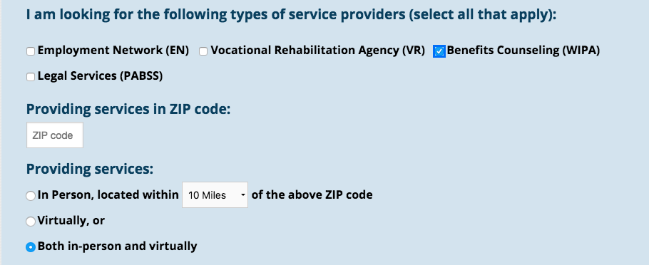
Website search - Example

Slide 15
resources
Social Security Website:
https://www.socialsecurity.gov/disability/
Social Security Red Book:
https://www.ssa.gov/redbook/
The Work Site, Social Security:
https://www.ssa.gov/work/
Nebraska Ticket to Work:
http://nebraskatickettowork.org/

Slide 16
questions
Shauna Dahlgren
Office: 402-930-4044
Cell: 402-889-8425
sdahlgren@ne.easterseals.com

