Slide 1
Massage for Well Being
By Amy Rolnick, LMT

Slide 2
Amy Rolnick, LMT
Licensed Massage Therapist since 1991
Massage Therapy Instructor for 8 years
“Save Your Body Mechanics Workshop” for LMTs

Slide 3
Definition
Massage therapy is manual manipulation of soft body tissues (muscle, connective tissue, tendons and ligaments) to enhance a person's health and well-being. There are dozens of types of massage therapy methods (also called modalities).

Slide 4
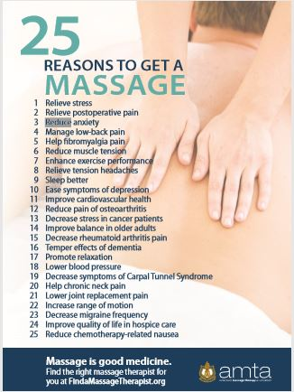

Slide 5
Self Care
In General
Self Massage Techniques
Tennis Balls

Slide 6
Massage Licensing
There are five states that do not license Massage Therapists at this time. Those states are Wyoming, Kansas, Oklahoma, Minnesota and Vermont. Alaska has passed legislation that will require the regulation of Massage Therapists in the state. Massage Therapist Certification is required in California, Indiana and Virginia. Every other state has developed their own requirements for Massage Therapists to obtain licensure. Several states have similar requirements yet others have very distinct requirements to become a Licensed Massage Therapist.

Slide 7
What to Look For
Massage License (if applicable for your state)
Education and Continuing Education
Website for Information and Credentials
Google Reviews
Testimonies on Website or Written Marketing Materials
Referral from Friend or Health Care Provider

Slide 8
Questions to Ask
Where are you located (home office or other)?
What is your area of expertise?
Have you ever worked with ‘this’ issue?
What length sessions do you offer?
How much does it cost?

Slide 9
Creative Ways to Get Sessions when you have Budgetary Concerns
Local Massage School (clinics, volunteer hours, externships)
Groupon, ½ price deals
Save $ each week
Ask for holiday gifts from family and friends
Massage membership establishment

Slide 10
Other Ideas
Watch Youtube Videos to learn more about different types of massage
Ask friends or health care providers for a referral
Use AMTA Find a Massage Therapist FindaMassageTherapist.org

Slide 11
Q & A

