Slide 1
Identifying Fatality and Injury Risks for Senior Farmers
Sean Tormoehlen, Graduate Student
W. E. Field, Professor
Agricultural Safety and Health Program
Purdue University

Slide 2
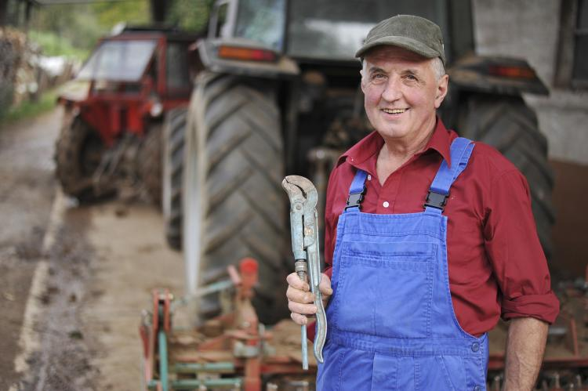
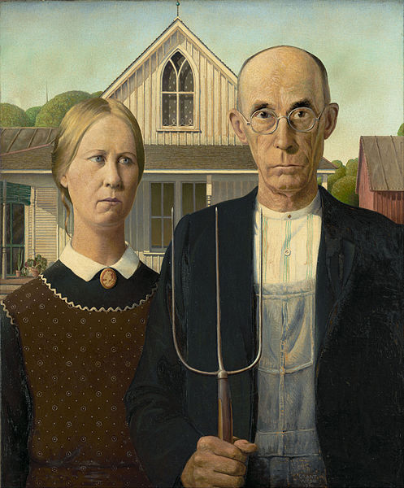
Our Aging Agricultural Population
Average age of farmers is 58.3 (USDA, Census of Agriculture)
One third are 65 or above
About 12% are over 75 years
Strong feelings towards agriculture
42% of 1,288 older farmers defined health as the ability to work (Reed et al, 2012)
27% of 418 farmers said “they intended never to retire” (Duffy et al, 2000)
Financial issues
Only 15% of 972 farmers said they would sell farmland or other assets for retirement funds (Baker and Epley, 2009)
Social security only accounts for around 13% of farmers total income (Mishra et al, 2005)
©iStockphoto.com/irman
Grant Wood

Slide 3
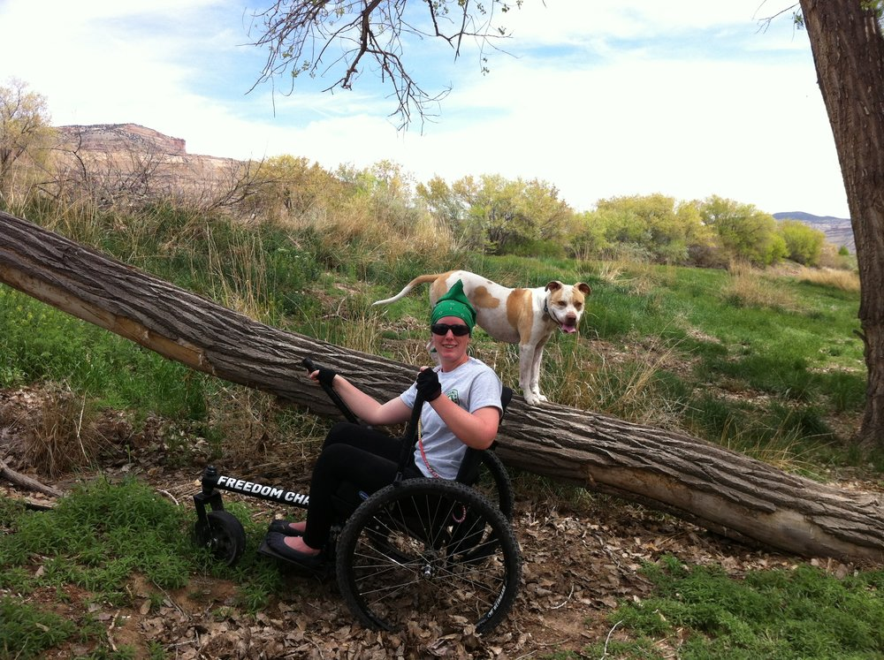
Physical and Mental Effects of Aging
Mobility
Older farmers with mobility issues are twice as likely to experience farm work injuries (Heaton et al., 2012)
Hearing
Hearing loss is common with aging (NIHCD, 2017)
Farming increases loss of hearing sensitivity (Plakke & Dare, 1992)
Hearing loss increases the risk of sustaining farm related injuries (Getts, Ploss, & Brusnighan, 1995)

Slide 4
Physical and Mental Effects of Aging
Vision
Age increases probability of blindness or vision impairment (Kahn et al, 1977)
Changes in the eyes reduce the amount of light received by the retina
2/3 amount of light captured by the retina is lost from age 20 to age 60 (LRC, 2017)
Mental Reaction Time/Judgement
Aging leads to slower reflexes and reaction times (Kenney, 1982)

Slide 5
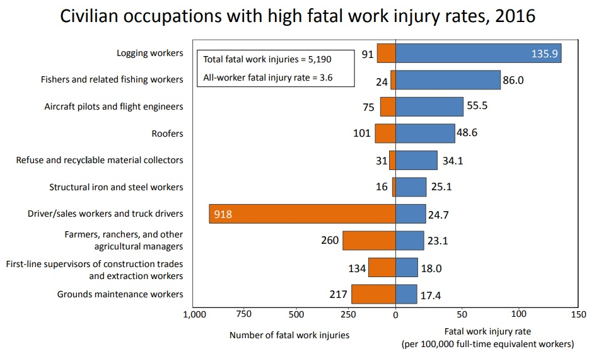
Risks of Agriculture
Farming is a dangerous profession
Census of Fatal Occupational Injuries (CFOI)
2016 had an fatal work injury rate of 3.6 for all workers (CFOI, 2016)
23.1 for farmers (CFOI, 2016)
National Safety Council
2015 had an fatal work injury
Census of Fatal Occupational Injuries, 2016
rate of 3.0 for all workers (National safety council, 2017)
22.6 for farmers (National safety council, 2017)
Important note
Farming has been combined with fishing and forestry profession for reporting fatalities

Slide 6
How does this relate to AgrAbility?
The Vision of AgrAbility is “to enhance quality of life for farmers, ranchers, and other agricultural workers with disabilities.”
Aging is included in the scope of AgrAbiliy’s mission
41.8% of AgrAbility clients during the 2016-2017 period were 60 years or older

Slide 7
Methodology
Conducted a literature review
AgrAbility Plowshare - Potential Health and Safety Risks of Farming/Ranching with a Disability
Address the lack of literature on woodlot accidents
Occasional woodcutters are three times the risk of injuries compared to professional loggers (Fischer et al, 2005)
Analyzed the Indiana farm fatality data for people 60 years or older from 1997 to 2016
Identify most frequent injury types
Explore contribution that aging has to injury type
Develop possible strategies to reduce the frequency and severity of injuries to older farmers
Notes:
Feel free to share any literature or sources with me (Always looking to read more papers)

Slide 8
Purdue Farm Fatality Summaries
Purdue Agricultural Safety and Health Program has complied farm fatality data since 1960
Cases are collected from published news reports, web searches, voluntary reporting, and personal interviews
Not comprehensive
Nonfatal injuries are not often reported
Used to measure trends in farm fatalities over time
Recent summaries have reported the frequency of fatalities of senior farmers on the rise in Indiana
Half of reported fatality cases since 2012 were farmers 60 years or older (Cheng, 2017)

Slide 9
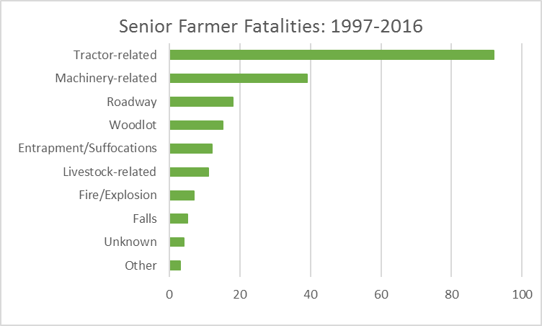
Breakdown of Senior Farmer Fatalities
206 fatality cases
198 males versus 8 females
Majority of female fatalities were roadway incidents
Average age was 72.6 years of age
Tractors are the biggest cause of fatalities
Nearly 50% of all deaths
Average age was 72.56 years of age

Slide 10
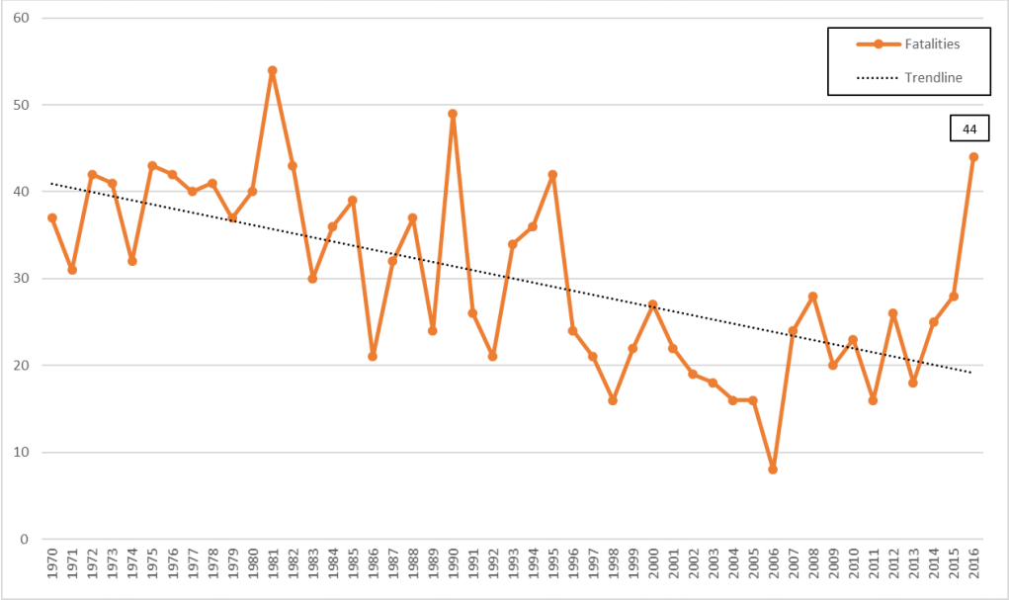
Comparison to all ages
Comparison of fatalities of all ages vs senior farmers
Orange = All ages
Green = Senior farmers
There is an increasing trend in the frequency of fatalities for those 60 and over

Slide 11
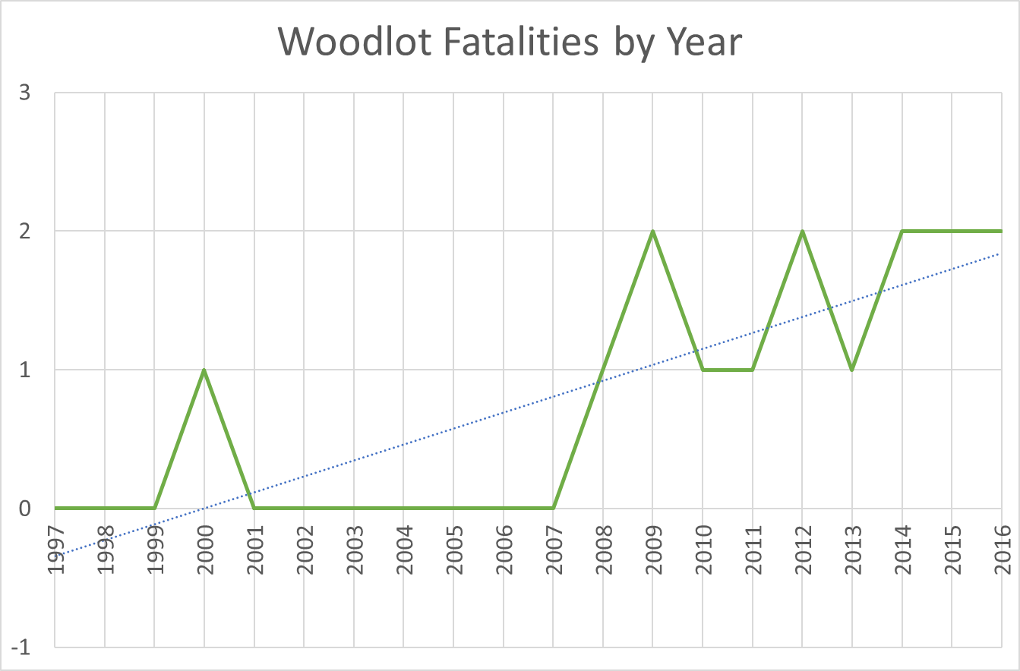
Strategies to Reducing Senior Farmer Fatalities
How to help senior clients at risk
Understand safety risks and practices
Communicate it with the client
Focus on two groups
Tractors
Largest agent of death
Woodlots
Increasing number of reported cases
Lack of literature
Notes:
Feel free to share any literature or sources with me (Always looking to read more papers)

Slide 12
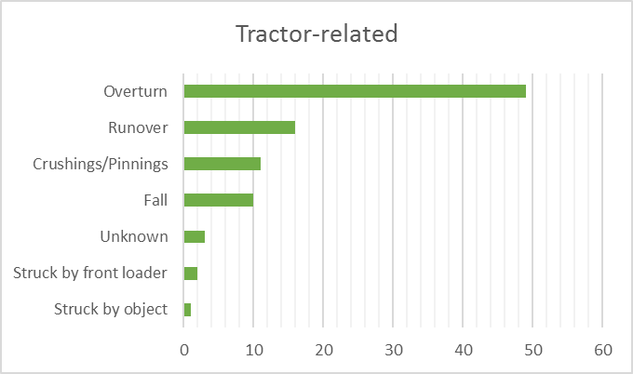
Tractor-related Incidents
Overturns were the most common fatality risk
accounted for nearly 25% of all deaths in senior farmers

Slide 13
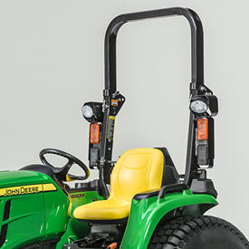
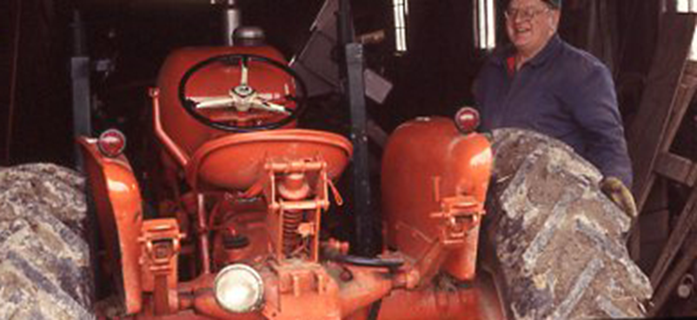
Reducing Tractor-related Incidents
Overturns
Factors that contribute to overturns
Lack of rollover protection structure (ROPS) – became standard on new tractors in 1986 (ASABE, 1985)
High center of gravity
Rear-wheel drive
Improper hitching of tow chain to points above the draw bar
Driving on uneven ground
Most frequent cases are side and rear overturns (Great Plains Center for Agricultural Health, 2014)
Older farmers tend to keep older tractors
Solutions
Install ROPS
Protects farmers from getting crushed
Only 59% of tractors had ROPS in 2011 (NASS, 2013)
http://salesmanual.deere.com/sales/salesmanual/images/NA/tractors/cuts/3_series/r4d098786_roll_gard.jpg
Reduce the social acceptance for using antique tractors for production purposes

Slide 14
Reducing Tractor-related Incidents
Runovers
Types of runovers
Operators
Bystanders
Factors that contribute to operator runover incidents
Starting the tractor from the ground (Bypass starting)
Failure to shutting off the tractor and using the parking brake when getting down
Mounting or dismounting a moving tractor
Factors that contribute to bystander runover incidents
Extra riders on tractor
Reduced driver visibility because of attachments (front loaders, bale spears, etc.)
Solutions
Always start the tractor while sitting in the seat
Make sure the parking brake is engaged whenever dismounting while the machine is running
Never dismount a moving tractor
Do not have additional riders on the tractors
Installing cameras to the tractor or attachments (i.e. Backup cameras)

Slide 15
Reducing Tractor-related Incidents
Falls
Common Causes
Slipping on steps because of moisture, mud or grease
Tripping on objects in the cab or on the deck
Solutions
Wear slip resistant footwear
Maintain a clean work area

Slide 16
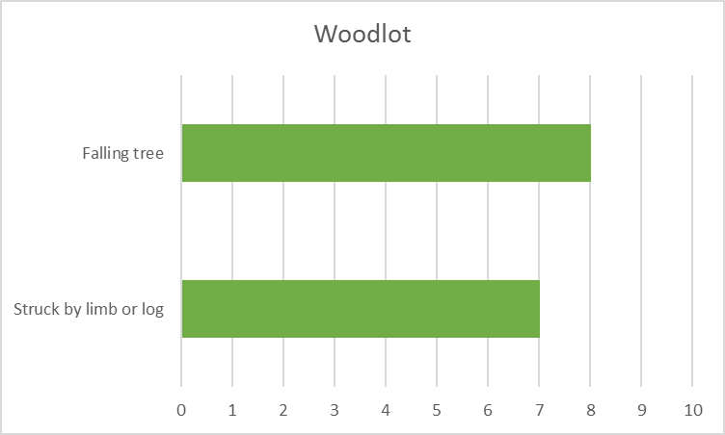
Woodlot Incidents
Felling trees were the most common fatality risk
Chainsaw related incidents were not reported as causes of fatalities
Similar to a summary of non occupational logging fatalities in Vermont (CDC, 2008)

Slide 17
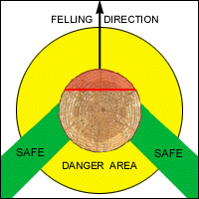
Woodlot
Risks
Several factors can play into where a tree falls (Arbor Global, 2012)
Includes wind, lean of the tree, and any weak spots.
Lack of experience
No safety gear
Solutions
Take a chainsaw safety and felling course
Offered by universities and extension programs
https://www.osha.gov/SLTC/etools/logging/manual/felling/retreat_path.html
Wearing appropriate safety gear (University of Alaska Fairbanks, 2016)
Head protection
Chainsaw chaps
Protective footwear
Nonslip gloves
Always work in pairs
Have access to communication devices (radios, cellphones, and so on)

Slide 18
Communicating with Clients
How do you pass on safety practices to clients?
Remember that many farmers have strong feelings about farming
Have conversations with clients
Listing off numbers of fatalities is not always the best method
Talk about safety concerns with clients
Have conversations with client’s family and friends
Interventions
Mediate compromises
Creating nontraditional safety material
Findings suggested nontraditional methods or formats such as a sign with a picture of a young kid telling their granddad to buckle-up to be effective (Whitman & Field, 1995)
Notes:
Feel free to share any literature or sources with me (Always looking to read more papers)

Slide 19
Activity
Scenario (Michigan FACE Program, 2004)
A 78 year old farmer often travels alone in his International Farmall Cub tractor (no ROPS system) with an attached trailer around his hilly property to cut firewood for maple syrup production.
His wife has contacted AgrAbility regarding his safety while in the woods
Instructions
There are cards with an assigned roles (wife, grandchild, two adult son, two neighbors, two AgrAbility staff)
Imagine that this farmer, played by me, has agreed to have an open conversation with all of you
What would this conversation sound like?

Slide 20
Conclusion
Farming is a profession that involves performing dangerous tasks
Senior farmers are at a high risk for severe injuries and fatalities
AgrAbility serves a large audience of older farmers
Tractors incidents are the most prevalent agents of death
Number of woodlots incidents are increasing
Education, safety awareness and practice can reduce injuries and fatalities
Only important if this can be related to clients in effective manne
AgrAbility staff can play a role in preventing injuries to other clients

Slide 21
Questions?

Slide 22
References
https://engineering.purdue.edu/~agsafety/IRSHC/fatalitySummary.html (Indiana Farm Fatality Summaries)
http://nasdonline.org/67/d001618/safety-for-aging-farmers.html
https://www.betterhealth.vic.gov.au/health/healthyliving/farm-safety-machinery
http://nasdonline.org/1878/d001821/roadway-safety-lighting-and-marking-of-agricultural-equipment.html
http://www.public-health.uiowa.edu/gpcah/wp-content/uploads/2015/01/GPCAH_older_farmers_2014.pdf
Heaton, K., Azuero, A., Phillips, J. A., Pickens, H., & Reed, D. (2012). The effects of arthritis, mobility, and farm task on injury among
Reed, D. B., Rayens, M. K., Conley, C. K., Westneat, S., & Adkins, S. M. (2012). Farm elders define health as the ability to work. Workplace Health Safety, 60(8), 345-351.
https://www.nidcd.nih.gov/health/age-related-hearing-loss
http://usda.mannlib.cornell.edu/usda/current/FarmSafe/FarmSafe-05-30-2013.pdf (NASS Survey)
Preventing tractor runover incidents. (2013). Farm and Ranch eXtension in Safety and Health (FReSH) Community of Practice. Retrieved from http://www.extension.org/pages/67752/preventing-tractor-runover-incidents.
http://nasdonline.org/static_content/documents/1672/d001572.pdf (falling off tractors)
http://nasdonline.org/1120/d000914/front-end-loader-safety.html
https://www.cdc.gov/niosh/face/pdfs/15Ky041.pdf (Lawnmower rollover recommendations)
https://extension.psu.edu/power-take-off-pto-safety (PTO safety)

Slide 23
References (continued)
Lighting Research Center [LRC]. 2017. Lighting the Way: A Key to Independence. Rensselaer Polytechnic Institute, Troy NY
Kahn HA, Leibowitz HM, Ganley JP: The Framingham Eye Study. I. Outline and major prevalence findings. Am J Epidemiol 106:17–32, 1977
Duffy, M. D., Baker, J., & Lamberti, A. (2000). Farm succession in Iowa. Unpublished paper, Department of Economics, Iowa State University, Ames, Iowa. Retrieved May 30, 2006 from: www.econ.iastate.edu/faculty/duffy/Pages/farmsuccession.pdf
(Baker, J.R. and Epley, E. (2009). Iowa farmers business and transfer plans. Ames, IA: Iowa State University) https://www.extension.iastate.edu/bfc/files/page/files/Farm%20Business%20Transfer%20Plan.pdf
(Mishra, A.K., Durst, R.L., and ElOsta, H.S. (2005). How do U.S. farmers plan for retirement? Amber Waves, 3(2), 12-18.) https://search.proquest.com/docview/204851989?pq-origsite=gscholar
Kenney, R. A. 1982. Physiology of Aging. A Synopsis. Chicago, Ill.: Yearbook Medical Publishers
National Safety Council Injury Facts (http://viewer.zmags.com/publication/20020222#/20020222/1)
Fischer, V., Young, N., Mueller, C., & Stueland, D. T. (2005). Three times the injuries among occasional wood cutters compared to professional loggers: sample of emergency rooms in central and northern Wisconsin. American journal of industrial medicine, 47(3), 246-253.
Centers for Disease Control and Prevention. (2008). Nonoccupational logging fatalities--Vermont, 1997-2007. MMWR: Morbidity and mortality weekly report, 57(10), 260-262
Whitman, S. D., & Field, W. E. (1995). Assessing senior farmers’ perceptions of tractor and machinery-related hazards.
http://www.agrability.org/wp-content/uploads/2015/11/ps23.pdf (Farming with a hearing impairment plowshare)

