Slide 1
New Staff Training AgrAbility NTW March 19, 2018 Portland, Maine
National AgrAbility Project
Purdue University

Slide 2
Session Overview
Overview of National AgrAbility Project (NAP)
History
Goals
Structure
Services
Personnel
Resources

Slide 3
Whom Does AgrAbility Serve?
AgrAbility addresses a wide variety of functional limitations in agriculture, including, but not limited to:
Amputation
Arthritis
Back impairment
Deafness/hearing impairment
Development disabilities, such as cerebral palsy or autism
Disabling diseases, such as cancer or heart disease
Mental/behavioral health problems
Respiratory diseases
Spinal cord injuries
Stroke
Traumatic brain injury
Visual impairments
Importance of staying with your realm of expertise!
Notes:
Not a comprehensive list. Point out this disability is a wide continuum and that many people with disabilities don’t consider themselves to be disabled. We essentially deal with any type of disability.

Slide 4
Disability within the Agricultural Community
Causes of disability
Traumatic injury (agriculture is one of the most hazardous occupations). Many injuries also come from off-farm incidents.
Disease
Aging (Average age of U.S. farmers is 57+)
Prevalence of disability
Approximately 15-20% of farm population impacted by disability
1.04 – 2.23 million of the U.S. farm, ranch, and agricultural community impacted by disability
Notes:
Deboy, G.R., P.J. Jones, W.E. Field, J. Metcalf, and R.L. Tormoehlen. Estimating the Prevalence of Disability within the U.S. Farm and Ranch Population. Journal of Agromedicine, 13(3).

Slide 5
Whom Does AgrAbility Serve?
Just as disability is wide continuum, agriculture is also:
Row crops: corn, soy, wheat, cotton, etc.
Ranching
Sheep and goats
Dairy
Produce, including organic
Orchards
Agritourism
Niche markets, like llamas, herbs, etc.
Floriculture
Aquaculture
Hydroponics
Aquaponics
Notes:
Not a comprehensive list. We are supposed to focus on production agriculture.

Slide 6
AgrAbility History
AgrAbility began in 1991 as part of the USDA Cooperative State Research, Education, and Extension Service (now NIFA)
In 1991, there were 8 funded state and regional AgrAbility projects (SRAPS); as of 2017, there are 20 SRAPs and several previously-funded affiliate projects
One National AgrAbility Project (NAP) supports the SRAPs
Notes:
Included in 1990 Farm Bill; funded in 1991. Other pre-AgrAbility models existed in Vermont and Iowa. Maximum number of funded AgrAbility projects was 23 covering 25 states – reduced since 2013.

Slide 7
AgrAbility Projects 2017
Notes:
As of October 2014

Slide 8
AgrAbility Partnerships
All AgrAbility projects – state projects and the national project – are partnerships between a land-grant university and at least one disability-services program.
1862 and 1890 land-grant institutions are eligible to apply for AgrAbility grants.
Current 1890 grant holder = North Carolina A&T
1890 institutions are partners with 1862 institutions in at least 6 other states.
Notes:
Many projects have more than one partner. Land-grant university Extension service must hold the grant. 1862 and 1890 land-grants are eligible to apply. 1994 are currently not eligible.

Slide 9
Current NAP Partners
Breaking New Ground Resource Center, Purdue University (lead organization)
Goodwill of the Finger Lakes (NY)
APRIL (Association of Programs for Rural Independent Living)
Colorado State University (evaluation specialists)
Washington State University (evaluation specialists)
Consultants
Many unfunded partners: FVC, RESNA, FFA, etc.

Slide 10
AgrAbility Services/Priorities
Education
Workshops; resource development; online education
Networking
Leveraging efforts with other groups; peer support
Direct Assistance
Site visits; consultations; business planning
Marketing
Publics awareness activities and materials
Notes:
These are the priority areas listed in the RFAs. Not exhaustive lists

Slide 11
Special Responsibilities of the NAP
Provide support to the state and regional AgrAbility Projects
Training
Resources
Consultations with NAP specialists
Provide limited direct services to customers in states without AgrAbility projects
Notes:
SRAPs complete annual assessment of NAP and also suggestions for future work. Services in non-AgrAbility states generally consist of email or phone contact.

Slide 12
What Does AgrAbility Not Provide?
Funding
Equipment
Most funding for assistive technology comes through state vocational rehabilitation systems
Other sources of grants and loans are available (see 2017 AgrAbility Harvest)
Some state Assistive Technology Act projects can provide free or low-cost AT + loan programs
Notes:
Some states partner with AT Act Projects, which usually have a lending “library” of AT or an AT re-use program.

Slide 13
What if Your State Doesn’t Have an AgrAbility Project
Can still get technical support from the National AgrAbility Project
Resources available at www.agrability.org
Encourage your state’s land-grant university(s) to apply for an AgrAbility grant
RFA process open now; deadline = Monday, April 30, 2018

Slide 14
Resources for Farmer/Ranchers with Disabilities in All States
State Vocational Rehabilitation (VR) Agencies
U.S. Department of Veterans Affairs
Centers for Independent Living
State Assistive Technology Act Projects
Cooperative Extension
USDA
FSA
NRCS

Slide 15
Questions?

Slide 16
NAP Key Personnel
Bill Field, Project Director
Founder of Breaking New Ground
Overall project oversight
Liaison with USDA

Slide 17
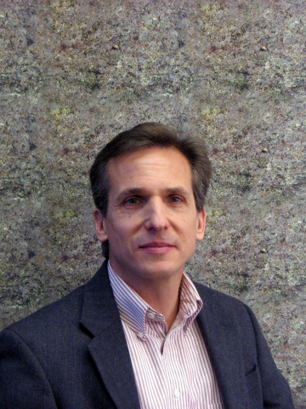
NAP Key Personnel
Paul Jones, Project Manager
Management of daily activities
Resource development

Slide 18
NAP Key Personnel
Steve Swain, Assistive Technology Specialist
Toolbox process
Liaison with RESNA

Slide 19
NAP Key Personnel
Chuck Baldwin, Special Populations Outreach Coordinator & Demographic Data Specialist
Networking with 1890 and 1994 land-grant institutions, Latino farmworker organizations, others
Coordinate demographic data collection process

Slide 20
NAP Key Personnel
Cindy Chastain, Veteran Outreach Coordinator
Outreach to veterans with disabilities interested in agriculture and organizations that serve them

Slide 21
NAP Key Personnel
Shawn Ehlers, Technology Outreach Coordinator
Advancing and modernizing resources related to assistive technology and safe working practices, development and instruction of training and outreach material, and providing technical expertise

Slide 22
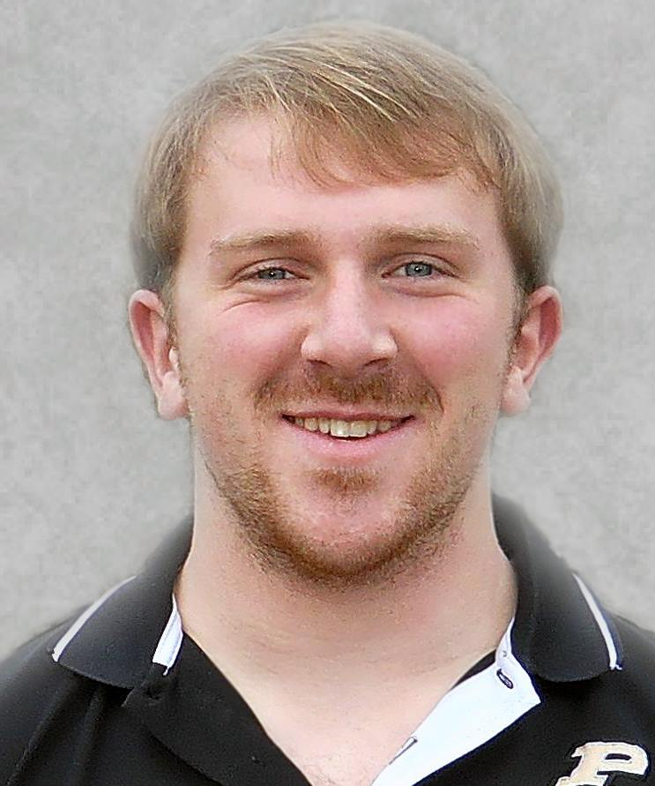
NAP Key Personnel
Sean Tormoehlen, Graduate Student
Focusing on issues of aging and their relationship to farm safety and AgrAbility

Slide 23
NAP Key Personnel
Katherine Prasuhn, Veteran Outreach Assistant
Helping ensure that veterans received needed assistance from AgrAbility

Slide 24
NAP Key Personnel
Richard Fox, Information Technology Specialist
Maintenance of NAP web site and assistive technology database

Slide 25
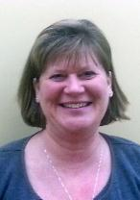
NAP Key Personnel
Goodwill of the Finger Lakes
Promotion of the Goodwill/AgrAbility partnership
National Training Workshop
Regional workshops
24-hour call center
JoBeth
Rath
Tess
McKeel

Slide 26
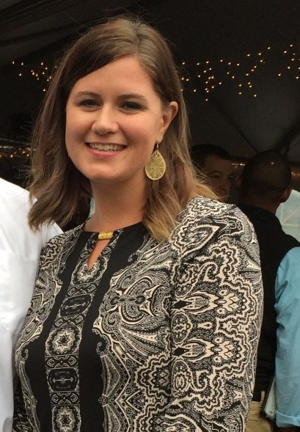
NAP Key Personnel
APRIL (Association of Programs for Rural Independent Living)
Promotion AgrAbility resources to CILs
Connecting CILs and SRAPs
Outreach to rural youth with disabilities
Billy
Altom
Sierra
Royster

Slide 27
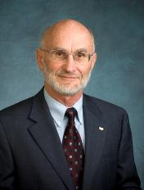
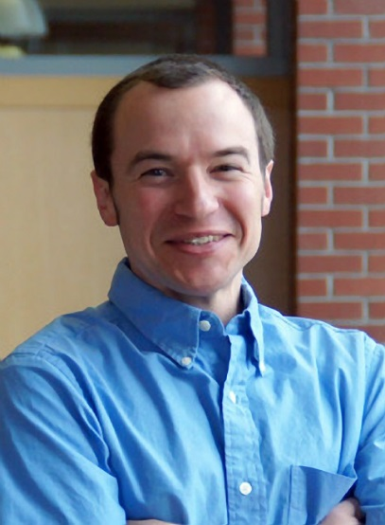
NAP Key Personnel
Evaluation Team
Objective analysis of NAP activities
Annual staff needs assessment
Demographic data
Quality of life evaluation
Bob Fetsch, Colorado State
University
Brian French
Washington State University

Slide 28
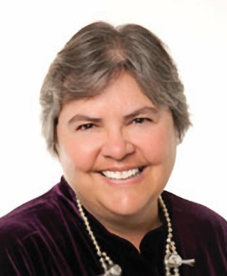
Consultants
Steve Etheridge
Vocational rehabilitation issues
Former VR counselor
Carla Wilhite
Occupational therapy issues
Professor at University of New Mexico and former AgrAbility staff member

Slide 29
Consultants
Ed Bell
Farmer
Former AgrAbility client
Public speaker

Slide 30
Questions?

Slide 31
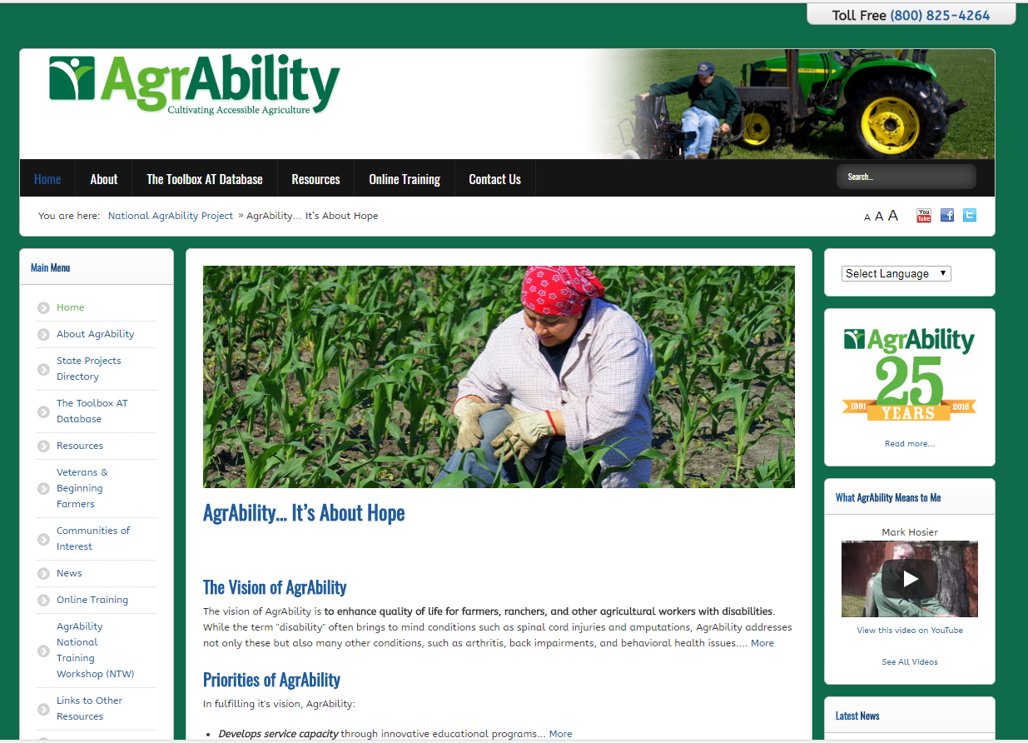
Educational Resources: www.agrability.org
Project information and contacts
Downloadable resources
Online training
Staff extranet: marketing, evaluation, staff resources
Mobile friendly
Notes:
Discuss importance of site and give tour if feasible.

Slide 32
The Toolbox Assistive Technology Database
Print, CD, and web versions www.agrability.org/Toolbox
1400 products to help farmers and ranchers with disabilities

Slide 33
Recent Publications

Slide 34
BACK on the Farm, BACK in the Saddle
Back problems = most common disabling conditions reported by AgrAbility clients.
21-page booklet discusses many aspects of back problems in ag settings
www.agrability.org/ resources/back
Notes:
Newest print resource. 30,000 copies in print.

Slide 35
Arthritis Resources
www.arthritis-ag.org
Arthritis and Agriculture
Plain Facts about Agriculture
¿Podrá ser la Artritis lo que me causa Dolor? (Could Arthritis be the cause of my Pain?)
Gaining Ground on Arthritis DVD
Notes:
Arthritis and Agriculture is AgrAbility’s most popular print resource with 70,000 copies in print. Plain Fact is for Old Order/Amish Communities. ¿Podrá ser la Artritis lo que me causa Dolor? is a fotonovla (comic book) in Spanish for migrant/seasonal workers.

Slide 36
Plowshares
30 technical reports on specific topics, such as farming with a spinal cord injury
Currently being updated

Slide 37
Conducting Agricultural Worksite Assessments
Step-by-step guide for evaluating farms and ranches
Reproducible assessment form
Electronic database for recording data and printing reports

Slide 38
AT Secondary Injury Evaluation
Step-by-step guide for evaluating AT for secondary injury hazards
Reproducible assessment forms

Slide 39
Newsletters
AgrAbility Harvest
Annually to national audience
AgrAbility e-Note
Monthly to AgrAbility staff members and other interested parties

