Slide 1
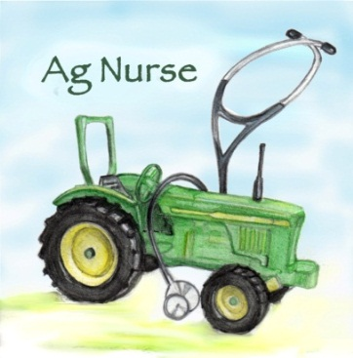
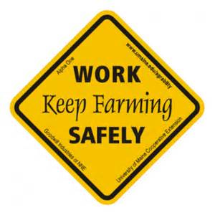
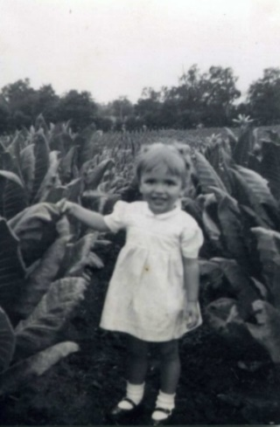
Farmer stress
depression and suicide: the unacknowledged epidemic
Deborah B. Reed, PhD, RN, FAAOHN
University of Kentucky College of Nursing and College of Agriculture, Food and Environment
dbreed01@uky.edu

Slide 2
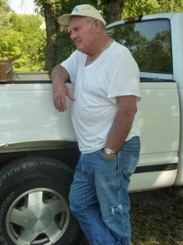
Objectives
Identify leading stressors in agriculture
Use simple tools to aid in referrals and interventions
Share case stories that can aid in communications

Slide 3
What kind of stress are we talking about?
Distress
pain or suffering affecting the body, a bodily part, or the mind
a state of danger or desperate need
great pain, anxiety, or sorrow; acute physical or mental suffering; affliction; trouble.
Eustress
stress that is deemed healthful or giving one the feeling of fulfillment
De-stress
to relax your body or mind
to stop feeling the effects of stress

Slide 4
How can stress be good?
Stress is simply the body's response to changes that create taxing demands
EUSTRESS – Positive Stress | DISTRESS – Negative Stress
Motivates, focuses energy Is short-term Perceived as within our coping abilities Feels exciting Improves performance | Causes anxiety or concern Can be short- or long-term Perceived as outside of our coping abilities Feels unpleasant Decreases performance Can lead to mental and physical problems

Slide 5
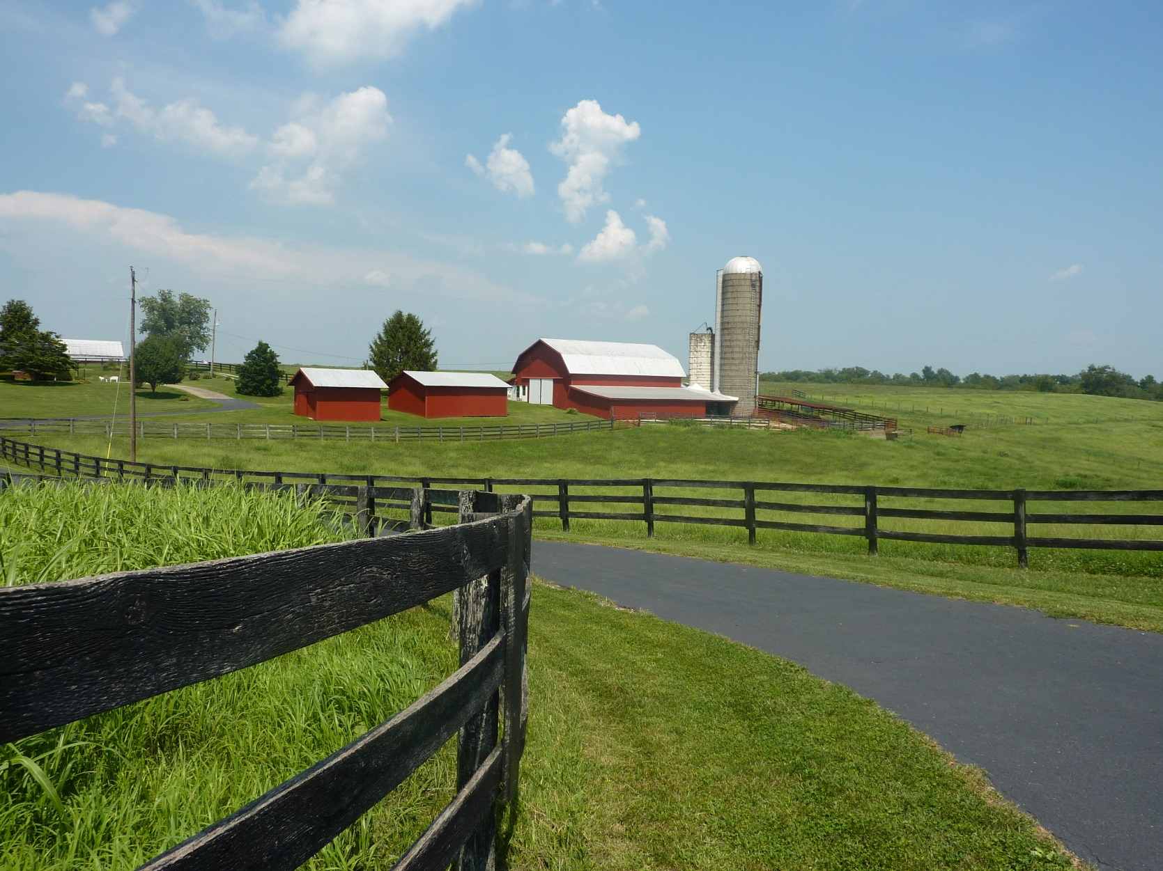
The Farm – Picture Perfect?
Notes:
To most ‘Outsiders” farms are bucolic and restful places. Farms are places of rest and beautiful scenery. But to farmers and their families the land is like a dependent- and meeting its demands can carry a high price. Natural disasters, financial crisis, even disruption in the rhythm of work can bring about increased stress on the caretakers of the land. And, a health problem can totally derail both the rhythm and the systems in farming. While I wouldn’t trade growing up on our family farm for anything, looking back I see I was totally unaware of the challenges.

Slide 6
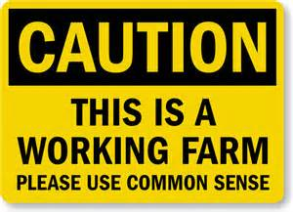
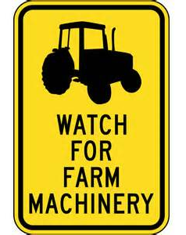
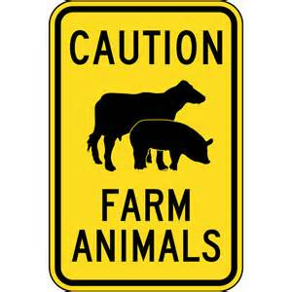
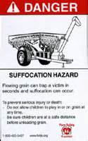
Notes:
So many warning signs, yet none of them warn us about our own reactions and responses to what is happening in the farm environment.

Slide 7
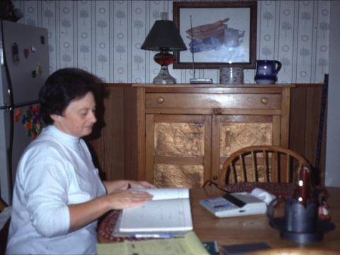
What makes Farming so Stressful?
Life on the farm… not what it used to be
Half of todays’ farmers hold an off-farm job
Biotechnology
Advanced mechanization
Global markets
Farmers are exposed to multifaceted stress and pressure
Hard physical labor
Long days throughout the year
Must be able to endure the vagaries of nature and livestock, adverse weather conditions, market fluctuations, government policy changes, and family pressures
Farmers have the highest suicide rates of any occupation
Notes:
Global issue- not just US

Slide 8
Agriculture and Risk
Agriculture ranks among the most hazardous industries
Farmers are at high risk for:
fatal and nonfatal injuries
noise-induced hearing loss
work-related lung diseases
skin diseases, and certain cancers associated with chemical use and prolonged sun exposure
Notes:
Most of us know about these external hazards but these also cause changes within the body that increases stress

Slide 9
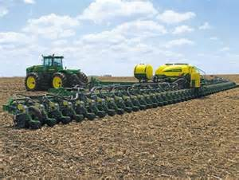
Farming Today
Farm machinery is changing
Farm techniques are changing
Mental stress is on the rise

Slide 10
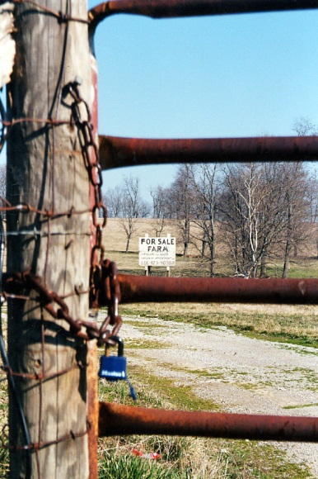
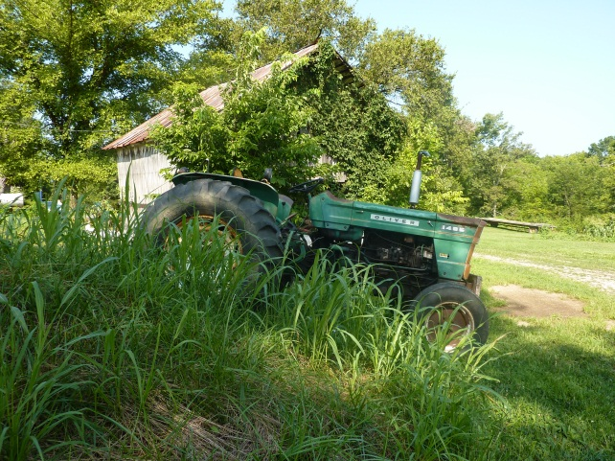
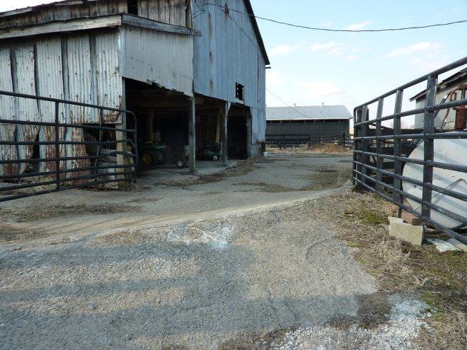
Farmers and Suicide
Peaks at oldest ages
Males are at higher risk than females
Source: Browning, Westneat, & McKnight, 2008
Notes:
This slide is usually a shocker. But think about watching your farm go downhill and you no longer able to keep it pristine. Older farmers tend to remain in the farm homestead, even after passing the work along to someone else. “This is what I’ve worked for, this is who I am .”

Slide 11
Suicide Risk
Farmers and agricultural workers have higher rates of suicide deaths than any other occupation in the US.
1980-1988 (North, Midwest area)
rate 48.1/100,000
1990-1998 (3 Southeastern states)
Age 75-84 O.R. 2.0 (CI: 1.70-2.45)
Age > 85 O.R. 2.6 (CI: 2.02-3.54)
Very little research has been conducted regarding stress, depression and suicide among farm populations- but it is global
Notes:
This multitude of stressors places aging farmers at greater risk for depression and suicide as the literature illustrates. A study conducted by Gunderson et al. looked at suicide rates among farmers in Wisconsin, Minnesota, North Dakota, South Dakota, and Montana from 1980 to 1988. They found that the suicide rate for these farmers was 48.1 per 100,000 individuals, which is more than twice as high as the overall suicide rate for adults in the United States. (Hovey & Seligman, 2006)
In a later study, Browning and colleagues (2008) examined suicides among farmers in three states (Kentucky, North Carolina, and South Carolina), during the period of 1990 to 1998. The results of the study confirmed an increased suicide mortality rate among white male farmers compared to the total white male population in these three states. They found that the increased rate of suicide was especially high among those aged 25-34 years, 75-84 years, and age 85 years and older. Male farmers in the 75-84 age group were twice as likely to die from suicide compared to the total white male population and male farmers 85 years or older were 2.6 times more likely to die from suicide.

Slide 12
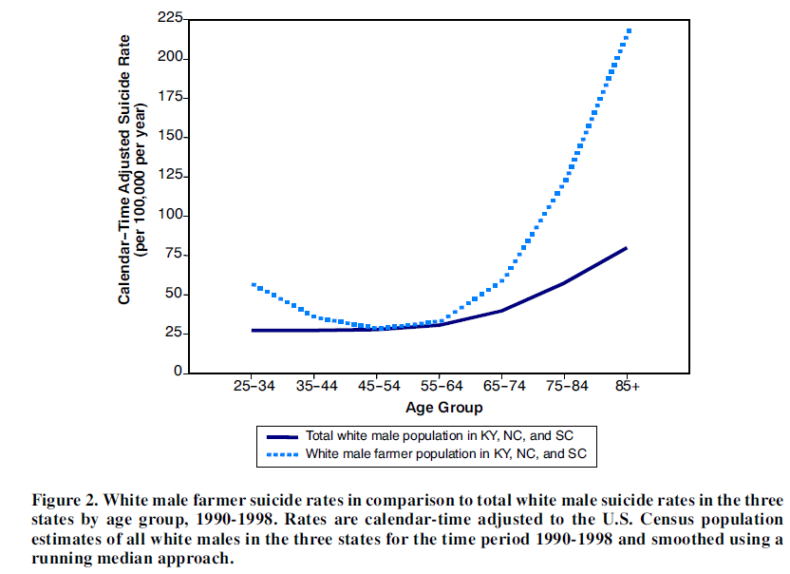
Suicide rates by age groups
Source: Browning, Westneat, & McKnight, 2008
Notes:
Browning, S. R., Westneat, S. C., & McKnight, R. H. (2008). Suicides among farmers in three southeastern states, 1990-1998. Journal of Agricultural Safety and Health, 14(4), 461-472.

Slide 13
So Why Farm?
“I can’t imagine not farming.
I’d rather die than not farm…”

Slide 14
WORK AND ITS MEANING
To be a farmer is to “carry on the family tradition”
To be a farmer is to become part of the land itself
Farming and farm work is a part of the self-identity
Notes:
Farmers have their self-identity in the work they do and the land they work on. Not tending the land would be like abandoning one’s own child. The production of their work is self-evident and tangible not only through economics but through all the senses. One can see clean fencerows, smell the crops as they ripen, and taste the produce. The work sustains your family nutritionally, economically, and spiritually, but only because you are a careful steward of the land. How can you trust this important work to anyone but yourself?

Slide 15
Perspectives on Health Status
How would you best define good health? | Under 65 N=749 | 65 - 69 N=267 | 70+ N=407 | Total Sample N=1,423
Absence of pain | 14.5 | 15.3 | 10.9 | 13.7
Ability to work | 39.1 | 40.0 | 41.8 | 40.0
Absence of major disease | 25.4 | 25.5 | 23.4 | 24.9
Not having to take medications | 17.0 | 16.5 | 18.1 | 17.2
Some other definition | 3.9 | 2.8 | 5.9 | 4.2
Source: Reed, Rayens, Conley, Westneat, & Adkins, 2012
Notes:
Unlike the general population, farmers thought more of health as the ability to work, This is consistent with the limited literature from the 80’s that explored this concept. With the exception of “absence of pain” the definitions were fairly consistent across age groups.

Slide 16
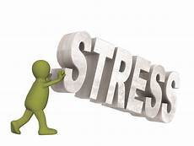
Physiologic factors that increase stress
Hearing loss
Fatigue
Cardiovascular disease (including hypertension)
Dehydration

Slide 17
Prolonged Stress
Stress causes the body to produce cortisol
Over time cortisol damages the interior of the blood vessels, creating the basis for hypertension.
It also deposits in the brain and may have role in dementia and other neurological conditions
Bottom line: excessive cortisol secretion does more harm than good

Slide 18
STRESS
CVD
Impaired cognitive function
Diabetes
Chronic immunosuppression
Inflammatory response
↑ abdominal fat
↑ blood pressure
↑ blood sugar
immunosuppression
↑ C-reactive protein
Cortisol
(adrenal cortex)
TIME
TIME
↑ energy
↑ memory
↓ pain
↑ immunity
Relaxation
Return to normal levels

Slide 19
Focus group results
Three groups (March-May, 2017)
N=34
Farmers, farm family members, community agriculture service, rural faith community nurses
Strong agreement that a systematic approach is needed to identify stress factors and develop farmer-friendly interventions, and to equip professionals who interact with farmers (health care and service providers) with evidence-based programs and resources that they can use to assist the farm community
Notes:
In spring 2017, we conducted three exploratory focus groups with farmers, farm family members, and community agriculture service professionals to examine interest in the topic of farm stress and to gain insight into the factors thought to contribute to farmer stress, resources available, and interventions that may be acceptable to this population. Interest in the topic exceeded our expectations: 34 persons from 9 states participated in the sessions, despite very short notice. Stress was acknowledged to be widespread in agriculture, but almost nothing was known about how farmers deal with their stress, the resources they access, or current interventions tailored to farmers. There was strong agreement among the participants that a systematic approach to identify stress factors and develop farmer-friendly interventions, and to equip professionals who interact with farmers (health care and service providers) with evidence-based programs and resources that they can use to assist the farm community is needed

Slide 20
Canada
Washington, DC
California
Colorado
Georgia
Indiana
Illinois
Kansas
Kentucky
Maine
Wisconsin
Washington DC
Canada

Slide 21
Sample n = 34
Gender | Female – 27 Male – 7
Experience in current job | Mean = 14.89 years Range: 2 months – 42 years
Farm status | Currently farm – 9 Other farm exposure – 24
Suicide exposure | Attempt/completion = 15
Notes:
Suicide attempts/completions based either on multi-generational issues ( family matters) or financial downturn.

Slide 22
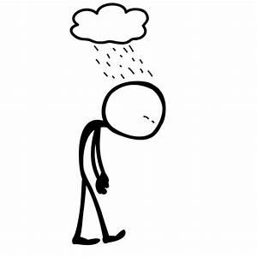
A dismal portrait
Farmers feel beaten down
Community disintegration
Trust disintegration
Loss of control- “can’t do anything right”

Slide 23
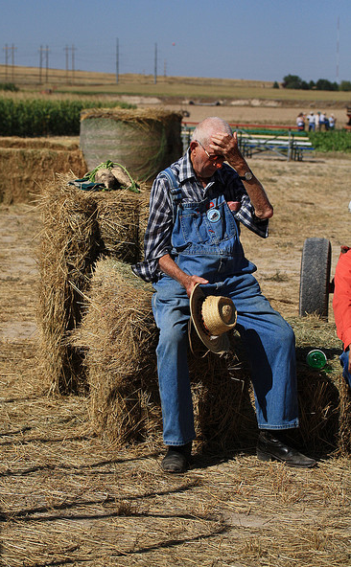
Denial or Stigma?
“If a heart attack kills a farmer, farmers get CVD screening, but when suicide occurs no one seeks mental screening...”
“farmers are tight-lipped”

Slide 24
Themes
Society has changing expectations of agriculture.
The farm community is increasingly isolated and insular.
Generational issues increase stress.
Farmers continue to be “tight lipped” about their personal issues.

Slide 25
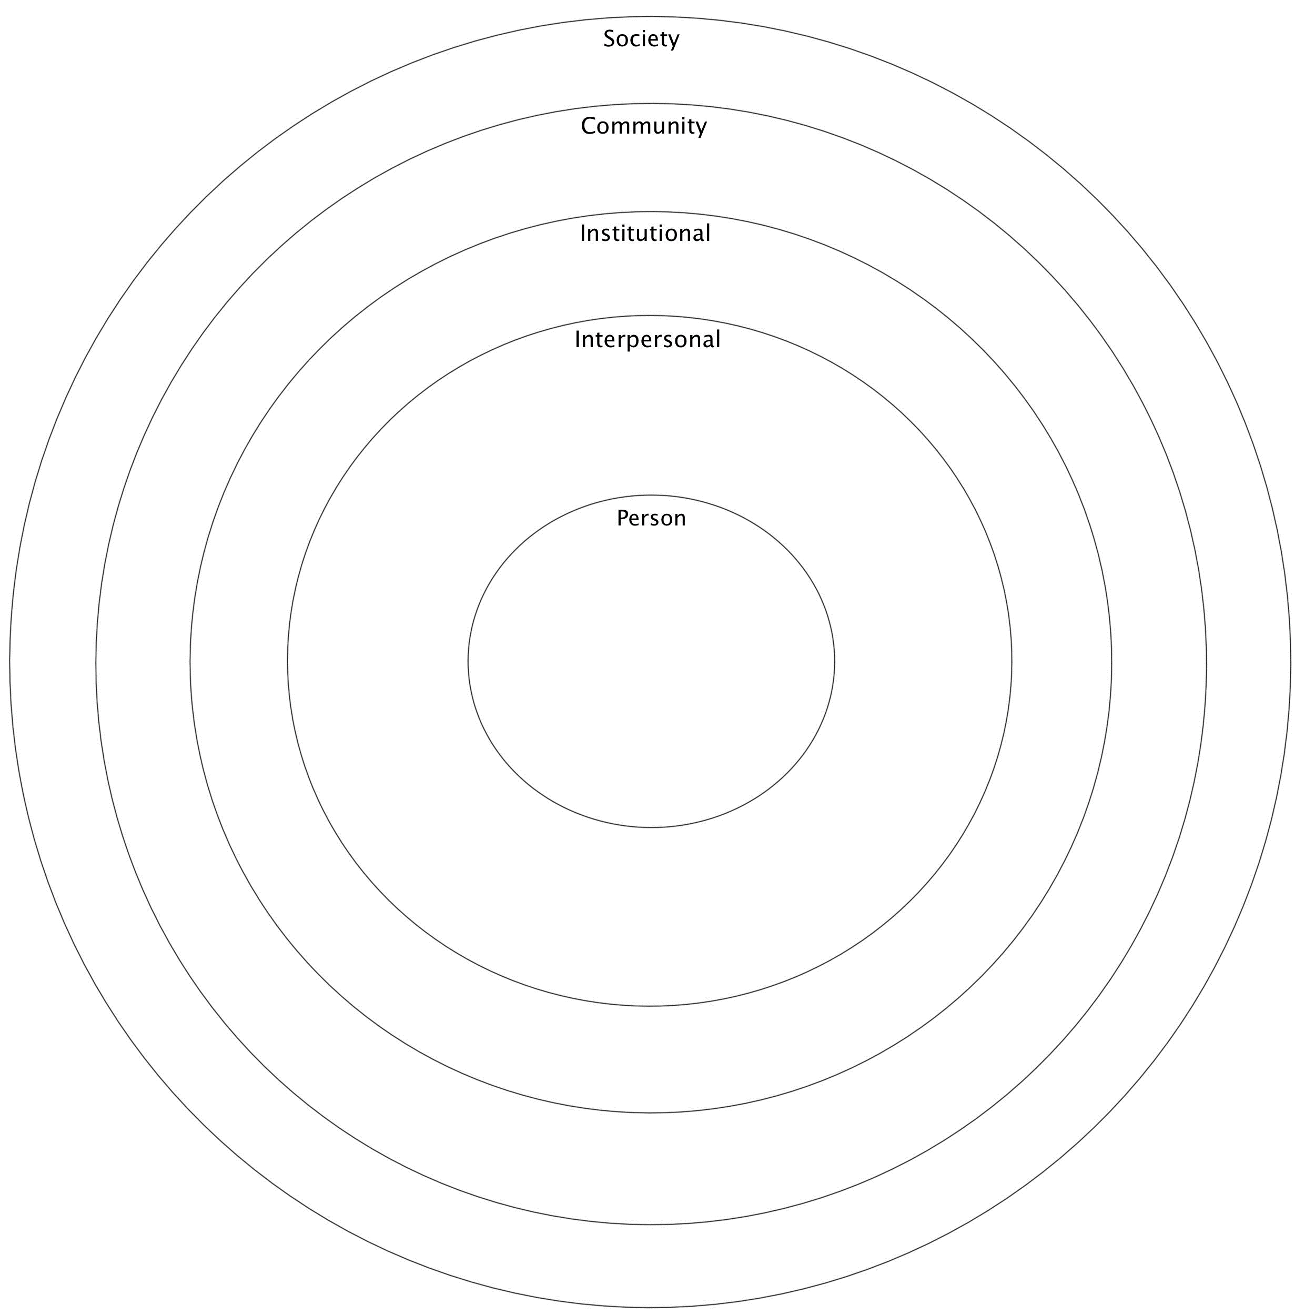
SEM Model
Negativity
↓ gathering sites
“dog eat dog”
↑ regulations
Programs
↑ suburbs
Young farmers
Intergenerational issues
New farmers not welcome
Changing regulations
“Romantic” concept of agriculture
Lack of insurance
(crops)
Risk takers
“tight lipped”
Work ethic
Anger – Denial
faith
Continued stigma of mental health
↓ sense of family
Lack of time
(demands)
↑ isolation
↑ costs
↓ # of farms
Land succession
Children leaving farm
Weather
Changing commodities
Market volatility
↓ land availability
Lack of labor
Lack of mental health resources
↑ part-time farmers

Slide 26
Let’s do Something!
What resources are available in our community to handle stressful situations in farming?
Hotline
Use of e-extension tools on mental health and other apps.
Peer support
Resource listing
Health screenings at stockyard

Slide 27
How do we fight this? Farm stress literacy
Need more people trained to socialize and hang out with farmers
Use strategies to increase awareness
Erase stigma through talking, sharing
Use motivational speakers at meetings attended by farmers (turns down dial on “temperature”)
Use partners and collaborative efforts (i.e. Farm Bureau) to design and deliver stress messages
Message to farmers should be taken by diverse groups (extension, veterinarians, and mail carriers)
Share messages in groups with couples not just with farmers
Location for discussion is important. The Farm Bureau office may be good location

Slide 28
Possible interventions
Grow health care professionals in rural communities to enhance understanding of farmers (insider vs outsider)
Design “respite” program allowing farmers to take a vacation
Create center with one stop shop for all services to avoid stigma of mental health issue
Involve schools and churches in addressing the problem
Work with local community
Always refer to intervention as stress reduction not suicide prevention. Begin programs with stress, then depression, followed by suicide prevention. Do not start with suicide prevention.

Slide 29
Picking up on hints
Pay attention to “last lines” that each person shares with you as these “lines” may reveal a hint of suicide ideation
Farm appears more run –down
Farmer unusually fatigued
“…They are so tired anymore, just so very tired..”
Animals not cared for or abused
“you can tell just by looking something’s not right”

Slide 30
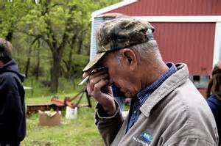
More hints
Giving things away- especially sentimental objects
Being unusually happy when they have been “down”
Include a mental health assessment in all assessments
.
Start the conversation
Practice asking farmer how they feel.

Slide 31
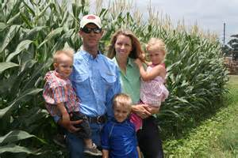
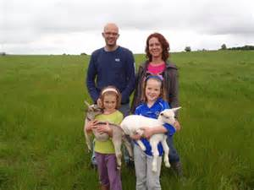
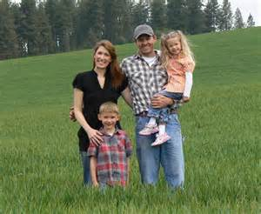
Farming and Families
Farming is one of the few industries in which the families (who often share the work and live on the premises) are also at risk for stress related problems.

Slide 32
Resources
The National AgrAbility Project:
http://www.agrability.org/resources/mental-behavioral-health/Stress and communications
http://www.extension.umn.edu/family/tough-times/farm-families/ -includes modules to do at home (website no longer works)
https://www.extension.umn.edu/family/live-healthy-live-well/healthy-minds/dealing-with-stress/education-series/workshops/

Slide 33
You Tube videos
Why is Stress management useful for farmers? Michigan State Extension About three minutes posted Mar 10, 2017 Focuses on the right mindset. Self-talk and other mental strategies. https://www.youtube.com/watch?v=HAbWYvgk7jg
Farmers on Stress FMB Insurance published July 18, 2017 Australia? Livestock farming. Young farmers, talks about family also five minutes https://www.youtube.com/watch?v=WZu9CXumWEg
Depression on the farm. Attitude. New Zealand. 30 minutes, ex-dairy farmer (lost the family farm after four generations), leads into another family with suicide. https://www.youtube.com/watch?v=VjfeXcukBRM
Farmer Depression UTIA (Published Mar 4, 2008).very focused – may be good as a template. Not sure the resources they mention still exist. https://www.youtube.com/watch?v=yykJBtzY52c

Slide 34
Resources
AgNurse | http://www.facebook.com/Agriculture.nurse
National AgrAbility | http://agrability.org/
AgriSafe | http://www.agrisafe.org/
AgriWellness | http://agriwellness.org/
NIOSH Ag Centers | http://www.cdc.gov/niosh/agctrhom.html
NASD – National Agriculture Safety Database | http://www.cdc.gov/niosh/nasd.html http://www.nasdonline.org/
National Institute for Mental Health National Suicide Prevention | https://www.nimh.nih.gov/index.shtml

Slide 35
NURSE-AP
JOIN US ON FACEBOOK
http://www.facebook.com/Agriculture.nurse
OR dbreed01@uky.edu
Advancing agricultural health and safety through emerging research, education and communication strategies with farmers, farm organizations and health care professionals around the globe
Notes:
Addresses barriers to optimal care created by delayed access to agricultural health and safety research; lack of evidence-based nursing practice tailored to local farm communities; and the limited number of nurses with expertise in agricultural health and safety

Slide 36
Case Study
Matt and Susan are beginning farmers who have purchased 10 acres and are clearing and revitalizing the land. Matt is a veteran and served two tours overseas. You make your first visit to assess what AgrAbiltiy can do to help them with mobility issues. Matt has a partial amputation of his hand and lower limb amputation. He is happy to meet you. He seems very tired and when Susan comes in he snaps at her about something rather insignificant. As the visit progresses you notice that Matt just doesn’t seem as engaged as you thought he would be.

Slide 37
Listening –guiding the conversation
When you are walking over the land and Matt shows you the layout he says, “I don’t know. Susan is the one who really wanted to farm. I want to get her set up right.”
“What about you?” you ask.
“It doesn’t really matter. I just want it to be easy for her.”
What red flags are in this conversation? How would you approach them?

Slide 38
6 MONTHS LATER: follow up visit
You know that the solar powered gate openers have been installed. Susan called you to ask about the quick hitch. It has been installed but they don’t seem to be able to work it as efficiently as they had hoped, she tells you.
As you approach the farm you notice all the weeds that have grown up. Tools and equipment are scattered about.
Susan comes out to your car. Matt slowly comes out of the house. He is using a cane today. He slumps as he walks. After a glance at him you look at Susan who just shrugs. She looks so tired.
What do you do next? This feels awkward.

Slide 39
Should you…
Ask Susan if everything is ok?
Just concentrate on getting the hitch to work?
Wait until Matt arrives and ask them both if everything is ok?
What else might you do?

Slide 40
And the answer is….
Things are not going well on the farm. The weather has not cooperated and most of the garden has been washed away twice.
They don’t believe they can make their next payment- due in three months
Neither of them is sleeping, eating, or have any energy

Slide 41
And you….
Tell me what you do next.

Slide 42
NURSE-AP
JOIN US ON FACEBOOK
http://www.facebook.com/Agriculture.nurse
OR dbreed01@uky.edu
Advancing agricultural health and safety through emerging research, education and communication strategies with farmers, farm organizations and health care professionals around the globe
Notes:
Addresses barriers to optimal care created by delayed access to agricultural health and safety research; lack of evidence-based nursing practice tailored to local farm communities; and the limited number of providers with expertise in agricultural health and safety

