Slide 1
Generation Rx: Train the Trainer
AgrAbility National Training Workshop, March 21, 2018, Portland, Maine
Dee Jepsen, PhD
Program Director:
Ohio AgrAbility
Laura Akgerman
Disability Services Coordinator:
Ohio AgrAbility
Jami Dellifield
Extension Educator:
Family & Consumer Sciences
Amanda Raines
Extension Educator: 4-H

Slide 2
The opioid epidemic impacts which of the following sectors of the community?
Low income individuals
People with medical insurance
College educated individuals
Single parent families

Slide 3
Why should AgrAbility, community members and
Extension get involved in education and advocacy?
Opioid addiction crosses all socio-economic boundaries
Addiction impacts all communities – rural and urban

Slide 4
How are opioids impacting America?
As many as 2.5 million in people in the US are addicted to opioids, and an additional 467,000 are addicted to heroin
Up to 80% of the people who are addicted to opioids began with prescription pain medications
National Rural Health Association Policy Brief: Treating the Rural Opioid Epidemic: https://www.ruralhealthweb.org/NRHA/media/Emerge_NRHA/Advocacy/Policy%20documents/Treating-the-Rural-Opioid-Epidemic_Feb-2017_NRHA-Policy-Paper.pdf retrieved 2/27/18
Notes:
Statistics from National Rural Health Association policy brief

Slide 5
How are opioids impacting rural America?
Rural states report the largest increases
in opioid injury and death
Notes:
National Rural Health Assoc. report (2014 data, report published in 2017)
Rural states report the largest increases in opioid injury and death (Kentucky, West Virginia, Alaska and Oklahoma)

Slide 6
Is opioid use higher in
urban or rural areas?
Drug related deaths in rural areas (non-metropolitan counties) have increased at three times the rate of drug related deaths in metropolitan counties
Rural adolescents are more likely to use opioids (without a prescription) than in urban areas

Slide 7
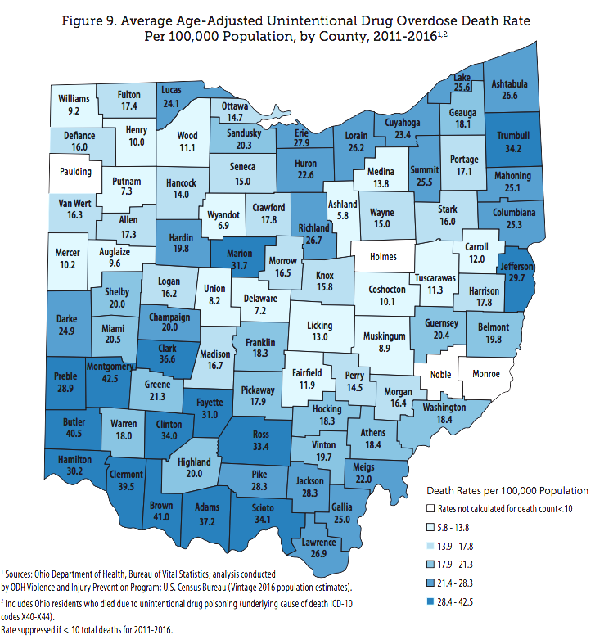
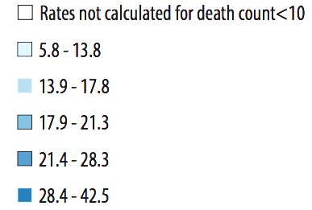
Many of Ohio’s rural counties have high drug overdose mortality rates
Average Age-adjusted unintentional drug overdose death rate per 100,000 population, by county, 2011-2016
Ohio Department of Health: 2016 Ohio Drug Overdose Data: General Findings: https://www.odh.ohio.gov/-/media/ODH/ASSETS/Files/health/injury-prevention/2016-Ohio-Drug-Overdose-Report-FINAL.pdf

Slide 8
Why are rural adolescents & adults using opioids?
Increased availability and access
Lower perception of harm
Self-medicating for pain (adolescents & adults)
Understanding the Rural-Urban differences in Nonmedical Prescription Opioid Use and Abuse in United States: https://www.ncbi.nlm.nih.gov/pmc/articles/PMC3935688/ retrieved 2/27/18
Notes:
Increased availability and access
Getting drugs from someone with a prescription, or buying from a dealer
Lower perception of harm
Prescription drugs are not as dangerous as street drugs (even if the prescription is not theirs)

Slide 9
Possible reasons for increased drug use in rural areas
More availability in rural areas
Young people are leaving rural areas
Social and kinship networks
Stressors of modern rural living
Understanding the Rural-Urban differences in Nonmedical Prescription Opioid Use and Abuse in United States: https://www.ncbi.nlm.nih.gov/pmc/articles/PMC3935688/ retrieved 2/27/18
Notes:
More availability in rural areas
Rural populations are often older than urban populations, more prescriptions
Drug companies marketed heavily to rural areas
(increased demand from doctors & pill mills?)
Young people are leaving rural areas
Less economic opportunity
Young people who stay
Young people who stay may have may be at greater risk for drug abuse
Social and kinship networks
Close family ties, easier to get drugs?
OxyContin use has been significantly associated with increased social capital in rural areas – distribution & social networks are integrated
Stressors of modern rural living
Changing labor markets, unemployment, poverty

Slide 10
American Farm Bureau Survey Results
What do farmers and people
from rural communities say about
opioid use and availability?
Methodology: Morning Consult, on behalf of American Farm Bureau Federation, conducted an online survey of 2,201 rural adults from October 26 – 29, 2017.

Slide 11
How are opioids impacting rural America?
45% of rural adults are or have been directly impacted by opioid abuse
74% of farmers and farmworkers say they have
been directly impacted by the opioid epidemic
Notes:
45% of rural adults are or have been directly impacted by opioid abuse
know someone
family member who is addicted
taken an illegal opioid
dealing with addiction themselves

Slide 12
Is opioid use higher in urban or rural areas?
Rural adults who say opioid abuse is a major problem in:
Urban communities 57%
Rural communities 47%

Slide 13
Many of the Ohio counties with the highest opioid prescription rates per person are in rural areas
Opioid prescription rate per 100 persons
Jackson County
133.8 Rx per 100 persons
Population 33,225
Washington County
119.9 Rx per 100 persons
Population 61,778
U.S. county prescribing rates, 2016: https://www.cdc.gov/drugoverdose/maps/rxcounty2016.html
Notes:
After a steady increase in the overall national opioid prescribing rate from 2006, the total number of prescriptions dispensed peaked in 2012 at more than 255 million and a prescribing rate of 81.3 prescriptions per 100 persons.
The overall national opioid prescribing rate declined from 2012 to 2016, and in 2016, the prescribing rate had fallen to the lowest it had been in more than 10 years at 66.5 prescriptions per 100 persons (over 214 million total opioid prescriptions).
However, in 2016, prescribing rates continue to remain very high in areas across the country.
In about a quarter of U.S. counties, enough opioid prescriptions were dispensed for every person to have one.
While the overall opioid prescribing rate in 2016 was 66.5 prescriptions per 100 people, some counties had rates that were seven times higher than that.
Prescribing rates for opioids vary widely across different states and counties. Emerging hotspot areas are identified by the darker colors on the maps.

Slide 14
Is it easy to access large amounts of opioids without a prescription?
Yes! According to:
46% of rural adults
77% of farmers
Methodology: Morning Consult, on behalf of American Farm Bureau Federation, conducted an online survey of 2,201 rural adults from October 26 – 29, 2017. Results from the full survey have a margin of error of +/- 2%.

Slide 15
Only 1 in 3 rural adults believe it would be easy
to access addiction treatment
How many rural adults believe they could find treatment that is:
Effective 45%
Covered by insurance 40%
Convenient 39%
(close to home or work)
Affordable 29%
Notes:
Some substance abuse treatment providers see MAT as switching from one addiction to another, and don’t use MAT.
Some insurance will not cover MAT, or set restrictions on dosage, lifetime quotas, ad “fail first” policies – which requires abstinence treatment to be tried first
Limited number of doctors who have received a special waiver for MAT (2.2%) of practicing docs), 90% in urban areas
Rural docs who do prescribe MAT are overwhelmed, and may be unable to meet demand & support patients in treatment
People who receive Medication Assisted Treatment have the highest success rates for reducing illicit drug use and and accidental overdose; less than 40% of people who are addicted have access to MAT (typically available in urban areas)
MAT:https://www.ruralhealthweb.org/NRHA/media/Emerge_NRHA/Advocacy/Policy%20documents/Treating-the-Rural-Opioid-Epidemic_Feb-2017_NRHA-Policy-Paper.pdf

Slide 16
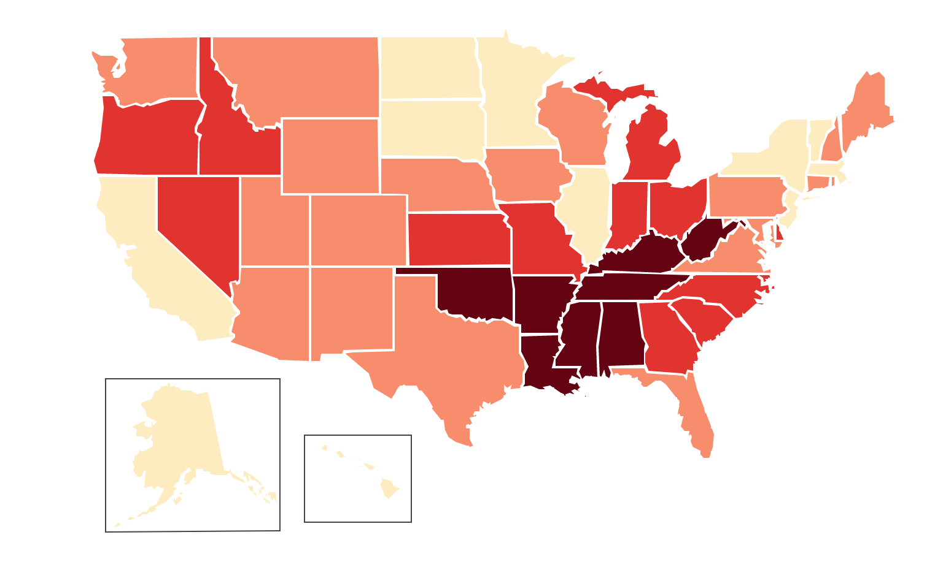
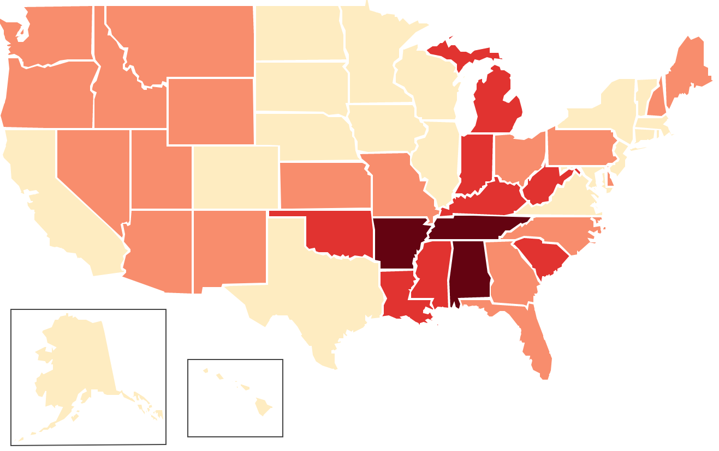
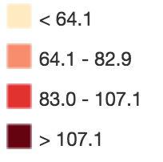
Opioid prescriptions in US have decreased from 2014 to 2016
2014
2016
Prescriptions per
100 persons
U.S. State prescribing rates: https://www.cdc.gov/drugoverdose/maps/rxrate-maps.html
Notes:
According to a study by the Center for Disease Control, 2012 had the highest number for opioid prescriptions

Slide 17
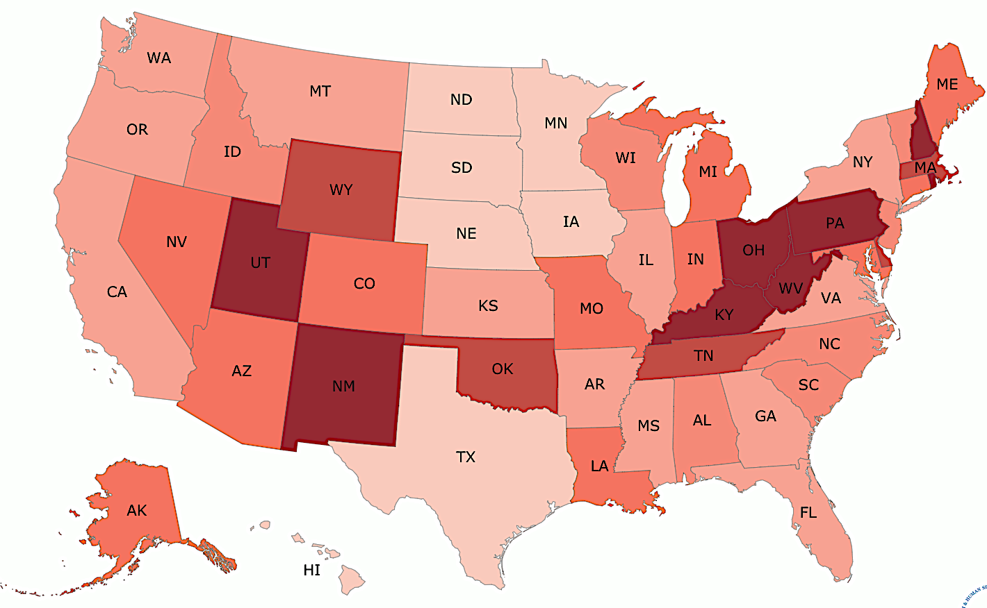
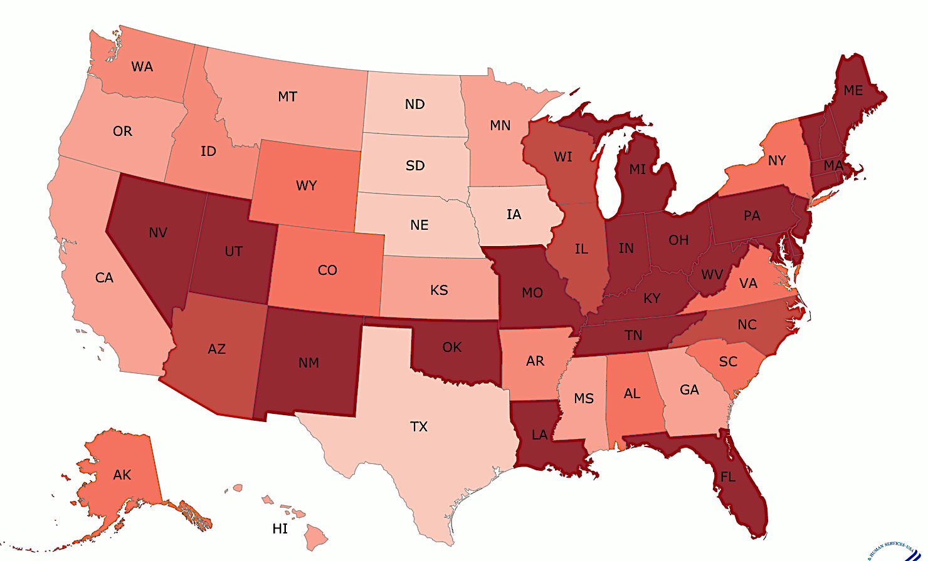
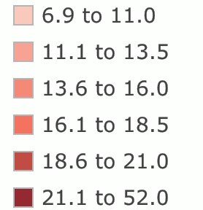
Even in states where prescriptions have decreased, there may be an increase in overdose deaths
2014
2016
Drug overdose deaths per 100,000
Drug overdose death data maps: https://www.cdc.gov/drugoverdose/data/statedeaths.html
Notes:
In 2016, the five states with the highest rates of death due to drug overdose were West Virginia (52.0 per 100,000), Ohio (39.1 per 100,000), New Hampshire (39.0 per 100,000), Pennsylvania (37.9 per 100,000) and (Kentucky (33.5 per 100,000)

Slide 18
What are Ohio AgrAbility and OSU Extension doing about the Opioid epidemic?
OSU Extension is working with other state agencies, schools and communities to provide education and resources to combat opioid addiction, reduce stigma, and support families and communities impacted by opioids
Ohio AgrAbility staff attend trainings and meetings, talk to clients, workshop attendees, and other stakeholders about safe medication practices and available resources

Slide 19
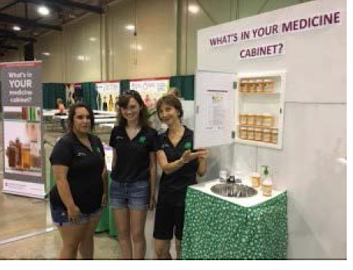
4-H Medicine Cabinet
“The Face
in the Mirror
Could be You”…
Who has access to your medicine cabinet?

Slide 20
How could you impact your community?
Where could you share this information?

Slide 22
We are Generation Rx
Over 4 billion prescription filled in retail U.S. pharmacies last year
Pharmaceutical populism
– “…a growing culture of self- diagnosis and self-prescription”

Slide 23
Generation Rx and the opioid crisis
The US represents ~5% of the world’s population…
…but consumes 80% of
the world’s prescription opioid supply

Slide 24
Generation Rx and the opioid crisis
OxyContin®
Heroin
People who are addicted to prescription opioid painkillers are
40x more likely to be addicted to heroin

Slide 25
Generation Rx and the opioid crisis
The vast majority of heroin users started misusing prescription opioid painkillers first.

Slide 26
About The Generation Rx Initiative
Started in 2007 at the College of Pharmacy
– Now a national movement
Our mission: educate people of all ages about the potential dangers of misusing prescription medications

Slide 27
www.generationrx.org

Slide 28
The Generation Rx resources
Educational toolkits
Digital activities

Slide 29
We’ve got a toolkit for that…

Slide 30
So you need to talk to the general public…

Slide 31
Overview: Adult education resources
Includes:
Facilitator guide
Introductory letter
Q&A session guide
PowerPoint presentation with facilitator talking points
Take Action handout

Slide 32
Overview: Adult education resources

Slide 33
So you need to talk to youth…

Slide 34
Overview: “My Generation Rx”
Teen Education resources
Includes:
Facilitator guide
Five stand-alone activities:
Interactive presentation
Game (Family Feud)
Two skit-based activities
Set of “minute” activities
Tips & Advice handout

Slide 35
Overview: “My Generation Rx”
Teen education resources

Slide 36
Overview: “Medication Safety Patrol” Elementary education resources
Includes:
Facilitator guide
Teaching activities:
Activity stations
Games
Worksheets
Supportive handouts
Letter to parents
Visual aids

Slide 37
Overview: “Medication Safety Patrol” Elementary education resources
Dear Parent or Guardian,
Today your child earned his or her “Medication Safety Patrol” badge! After participating
in a variety of educational activities, he or she should now better understand key medicine safety principles including:
Only take medicine with the permission of a parent or guardian.
Do not share medication or take someone else’s medication.
Keep medications in their original containers to avoid confusion with candy or other medicines.
Always store medicines in a safe place, such as a locked cabinet or a high shelf that children can’t reach.
The activities in which your child participated are part of an educational toolkit created by The Ohio State University College of Pharmacy and the Cardinal Health Foundation. Because prescription and over-the- counter medicines are typically accessible and visible in our homes, we believe children should understand prescription and over-the-counter medication safety at an early age. We hope that this knowledge will equip them with a solid foundation of how to properly take medicines, particularly before they reach the teenage and adult years.
Research shows that an individual’s risk of misusing prescription medications increases as they reach middle and high school. Please keep in mind that there are actions that you can take to help prevent your child from engaging in this dangerous behavior, including:
Talk to your child about how to safely use, store, and dispose of medication.
Secure your medicines in a locked medicine cabinet.
Properly dispose of extra medications, or participate in your local community’s drug take- back events.
If you would like to review the free materials and/or extend the learning process at home, we encourage you to visit GenerationRx.org.
Thank you for your help in spreading this important message! Sincerely,

Slide 38
Digital resources:
Medication safety sleuths

Slide 39
Digital resources:
Is it candy or medicine?

Slide 40
The Generation Rx Learning Collaborative

Slide 41
The Generation Rx Learning Collaborative

Slide 42
The Generation Rx resources are…
Free and ready-to-use
Brandable
Research-based
– Wade-Mdivanian et al, Prevention Researcher, 2012

Slide 43
The Generation Rx resources are…
Effective
After participating in Generation Rx programming:
93.9% of teens agreed that, “I will not use prescription drugs that are not prescribed for me” (n=2557)
98.2% of adults agreed that, “I will only use prescription drugs as directed by a health professional in the future” (n=408)
100% of seniors agree that, “I will store prescription medications in a secure location” (n=69)
[The OSU Community & Youth Collaborative Institute, 2013]

Slide 44
Resources and Evaluation
Ohio AgrAbility
https://agrability.osu.edu/resources/printable-resources
Quarterly follow-up
Generation Rx
https://www.generationrx.org/take-action/
Notes:
Ohio AgrAbility staff will e-mail you quarterly to follow up on when and where you have used Generation Rx Resources

Slide 45
Questions?

