Slide 1


NC AgrAbility:
The 1890 Experience
Dr. S. Janine Parker, Director
Beatriz Rodriguez, Manager
March 21, 2018

Slide 2

Sister institution to 1862 land-grant
Mostly work with small, limited-resources, and socially disadvantaged farmers

Slide 3









Slide 4
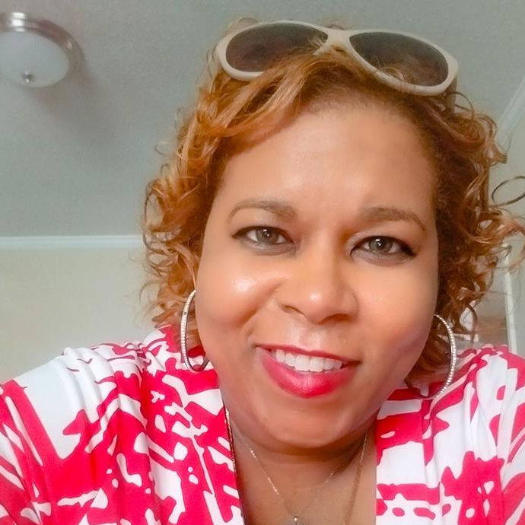
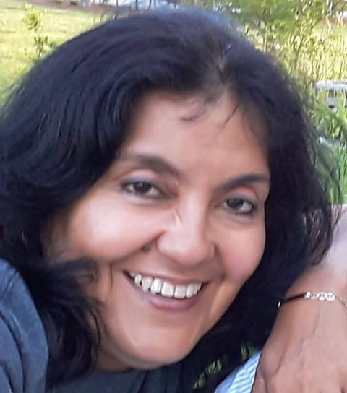
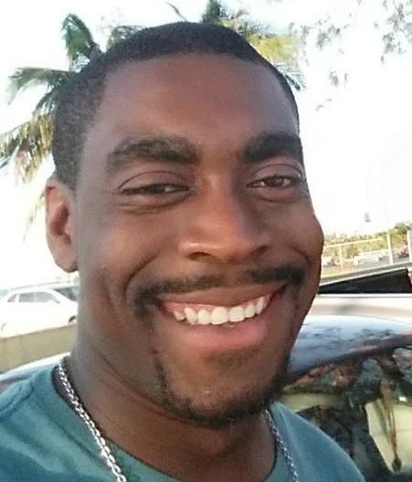
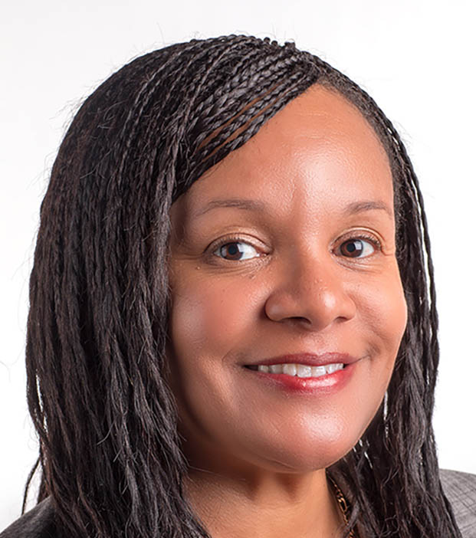
Dr. S. Janine Parker
PI/ Project Director
Mrs. Betty Rodriguez
Manager
Mr. Kristoff Minus
Graduate Student
Dr. Paula Faulkner
Co-PI

Slide 5
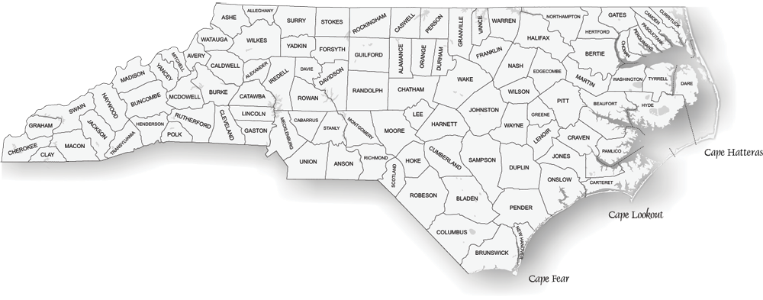
NC Farming Demographics

Slide 6
7%
< $50K 76.7% 52.5% 79.5% 86.3%

Slide 7
13%
< $50K 67.7%

Slide 8

Barriers for Small, Limited-Resource, and Socially Disadvantaged Farmers

Slide 9
Don’t know what’s available to them
Recorded history of discrimination from government services
Don’t want to give access to financial records
No trust
No time for process
Misunderstanding process and paperwork
Cultural differences
No access to internet at home
Fear of conflicting resources

Slide 10
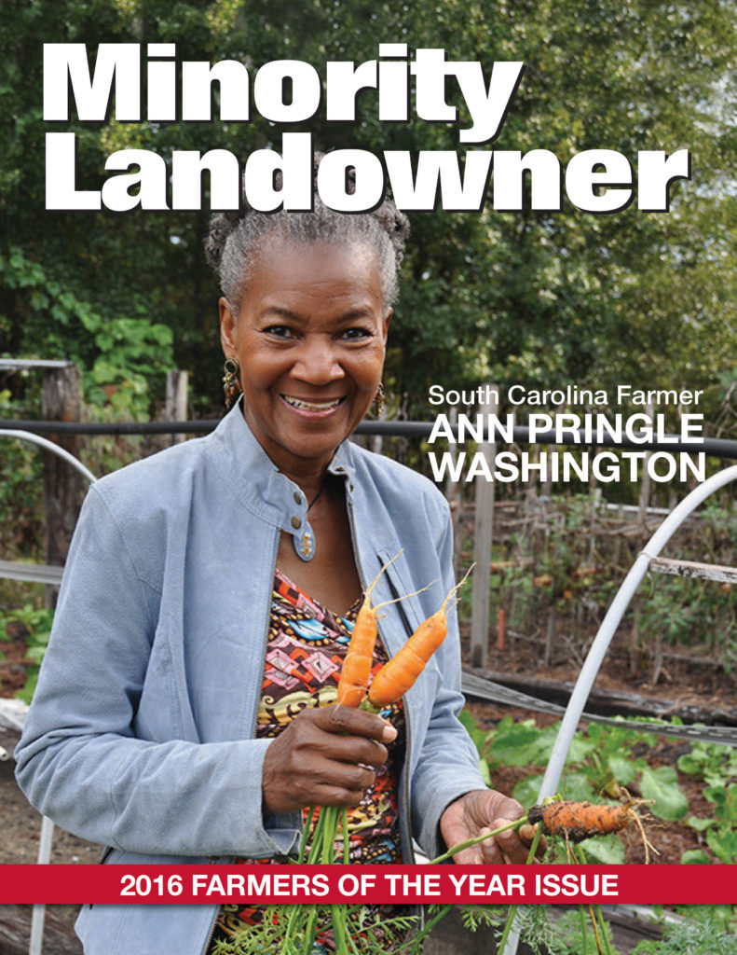
Meeting Them Where They Are

Slide 11
NC AgrAbility
Farm Laborer Workshops
Safety Conference
Minority Landowners Conference
Women in Agriculture Conference
NC Cooperative Extension
Veteran Farmer Trainings
Regional Rehab Conference

Slide 12
Training for county Cooperative Extension Agents
Services NC AGrAbility provides
Services our partners provide
Tools available through NC AgrAbility
Survey to push through county agents
Training for Vocational Rehab Counselors

Slide 13

Voc Rehab Counselor Training
Veteran Farmer Workshops

Slide 14
If your state has an 1890 or 1994 institution, how are you partnering with them?
If not, how do you create or strengthen partnerships?

Slide 15
THANK YOU
Dr. S. Janine Parker
sjparker1@ncat.edu
336-285-4686
NC AgrAbility:
The 1890 Experience
March 21, 2018

