Slide 1
Connecting with Local Resources
Mental Health Awareness

Slide 2
Contact Information
Jami Dellifield, Family & Consumer Sciences Educator
dellifield.2@osu.edu
Amanda Raines, 4-H Youth Development Educator
raines.74@osu.edu
Notes:
Introduce ourselves

Slide 3
Mental Health
On your mobile device or in your browser go to:
http://kahoot.it
When asked for a game pin, type:
PIN: 2490070
Enter your nickname and you’re in the game!
Notes:
AMANDA Share pin and explain game

Slide 4
Mental Health
What is mental health?¹
Includes emotional, psychological, and social well-being
Affects our thoughts, feelings, and actions
Determines how we handle stress, relate to others, and make choices.
Contributing factors:
Biological (genetic and brain chemistry)
Life experience
Family history of mental health problems
Notes:
JAMI Mentalhealth.gov

Slide 5
Definitions²
Mental disorder/illness- a diagnosable illness that affects an individual’s thinking, emotional state, and behavior. Affects ability to work, daily activities, and relationships.
Mental health problem- includes disorders and symptoms of disorders, but severity does not merit the diagnosis of a mental health disorder.
Notes:
JAMI Talk about continuum

Slide 6
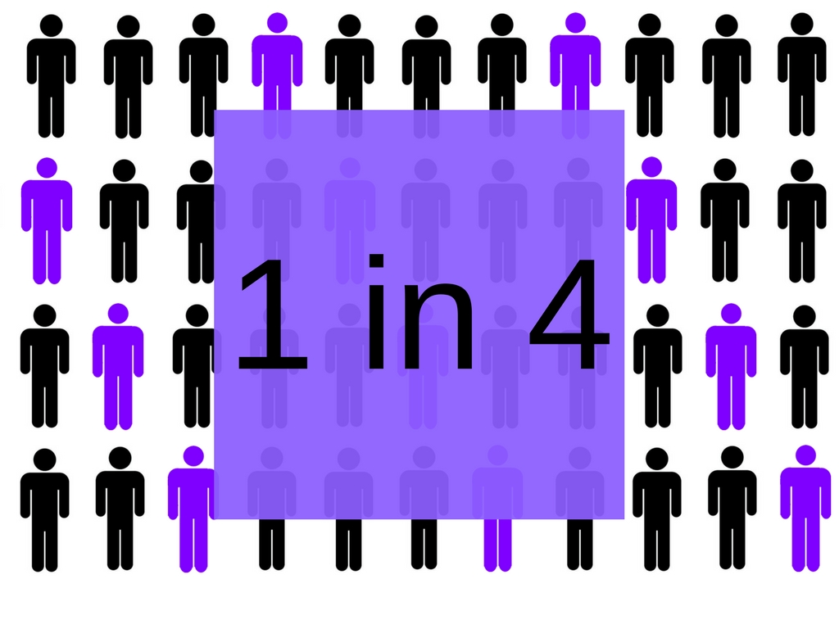
Statistics²
1 in 4 American adults experience a mental health disorder each year
Anxiety disorders- 19.1%
Substance Use Disorder- 8%
Major Depressive Disorder- 6.8%
Bipolar Disorder- 2.8%
Eating Disorders- 2.1%
Schizophrenia- 0.45%
Half of all mental disorders begin by age 14 and 75% by age 24.
Notes:
AMANDA

Slide 7
Mental Health & You
All lives are affected by mental health disorders and/or problems.
Clientele, colleagues, partners, and loved ones could all be experiencing a mental health problem at any time.
Chances are you interact with someone facing mental health problems on a daily basis.
Mental health issues and problems do not discriminate. Anyone can be affected regardless of race, gender, economic status, sexuality, age…
Notes:
AMANDA

Slide 8
https://www.youtube.com/watch?v=UR13qfZan3k
Notes:
JAMI

Slide 9
MENTAL HEALTH IN
OUR COMMUNITY
Notes:
JAMI Talk with those close to you about how mental health impacts your work, personal lives, clients, etc. Will report out after 2 minutes.

Slide 10
Local Resources
We do NOT:
Need to be experts
Make diagnosis
Have all the answers
Need to be afraid
Pass judgment
Support the stigma
We DO:
Need to know local resources
Need to refer
Know where to find answers
Listen empathetically
Provide support
Have a plan
Respect privacy
Need continuing education
Notes:
AMANDA

Slide 11
LOCAL RESOURCES
Health departments
Mental Health and Recovery Services
Local hospitals
Law Enforcement agencies
County elected officials/administrators
Judicial officials
Private medical practices
Notes:
AMANDA – ask for shout outs of local resources
Health department, mental health and recovery services boards, local hospitals, law enforcement agencies, county commissioners, judicial officials,

Slide 12
REGIONAL
RESOURCES
National Alliance for Mental Health
Land Grant Universities
Mental Health First Aid® Instructors
State Level Mental Health Boards
Notes:
JAMI – CAPE, NCRCRD, Our book (in process of national 4-H Council peer review)

Slide 13
NATIONAL
RESOURCES
USDA/NIFA
eXtension.org
National Institute on Health
National Institute on Mental Health
SAMSHA
National Council on Behavioral Health
National Institute on Drug Abuse
Department of Health and Human Services
Notes:
JAMI – impact collaboratives, designathons

Slide 14
CRISIS LINES
http://suicideprentionlifeline.org
1-800-273-8255
http://www.crisistextline.org/
Text START to 741741
Notes:
JAMI

Slide 15
Mental Health First Aid®
Notes:
AMANDA – explain MHFA and we are trainers. Ohio’s state’s work. How to find a class

Slide 16
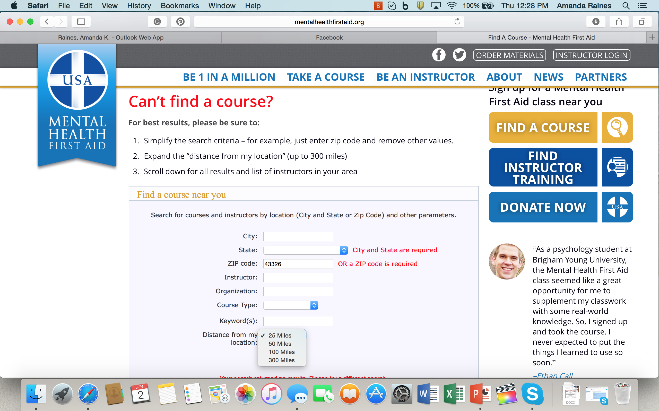
Notes:
AMNDA

Slide 17
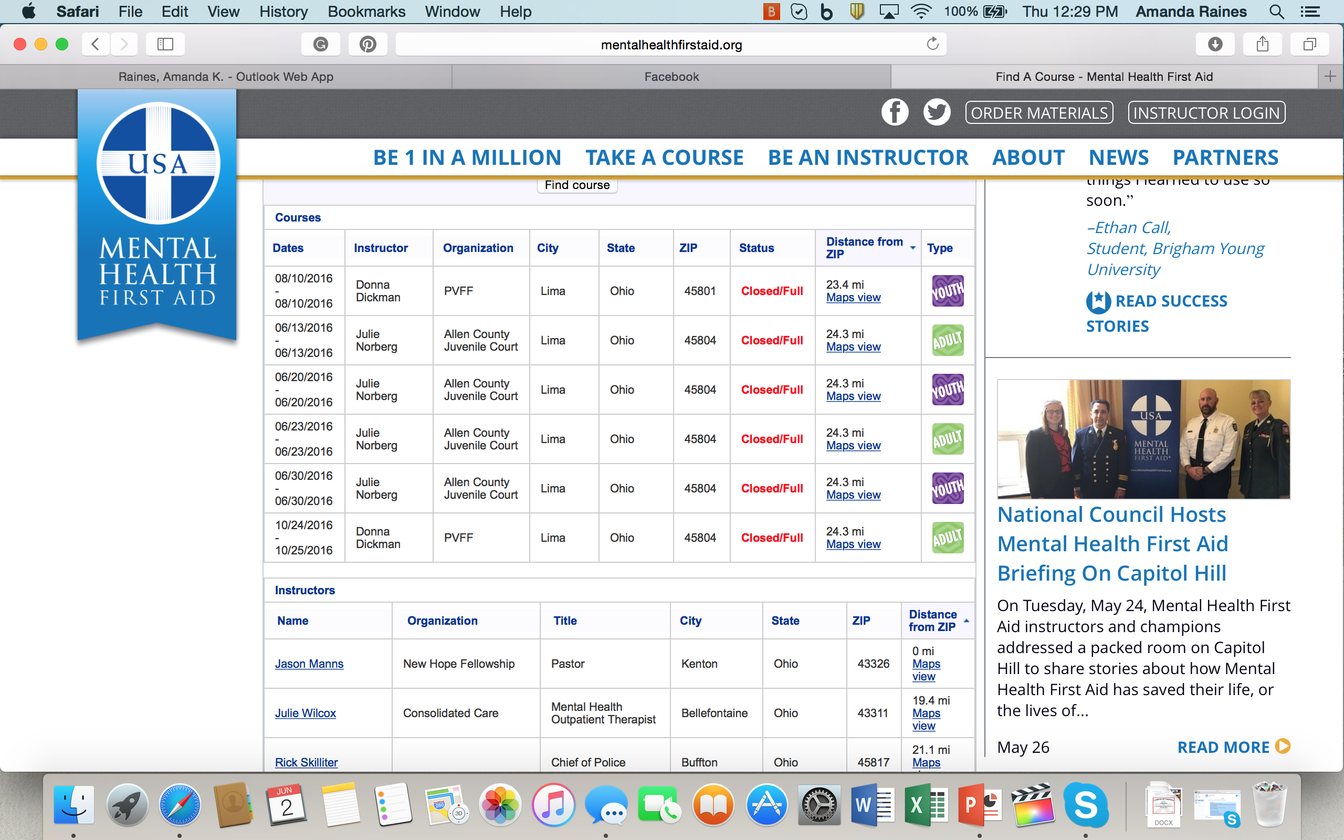
Notes:
AMANDA

Slide 18
What’s Next?
What can you do now?
Assess for risk
Listen Non-judgmentally
Give reassurance and information
Encourage professional help
Encourage self help
Notes:
JAMI

Slide 19
Starting the Conversation
Don’t be afraid to ask hard questions.
“Are you thinking about killing yourself?”
Share your observations using “I” statements
I have noticed you’ve been less active in Farm Bureau lately. Why is that?
I am concerned because you seem sad and disinterested lately. Can we talk about it?
Avoid stigmatic language
Offer to assist in getting professional help.
Continue to offer support over a longer period of time.
Notes:
JAMI

Slide 20
OUR MENTAL HEALTH RESOURCES
Your Thoughts Matter 4-H Project Book - https://projectcentral.ohio4h.org/publications/your-thoughts-matter/
Working Differently in Extension with Bob Bertsch Podcast http://bobbertsch.com/tag/mental-health/
eXtension.org webinar series https://learn.extension.org/events/2679
Identifying Suicide Risks podcast https://www.agriculture.com/podcast/successful-farming-podcast/identifying-and-assessing-suicide-risks-with-jami-dellifield
Mental Health First Aid Find a Course http://mentalhealthfirstaid.org

Slide 21
OTHER MENTAL HEALTH ONLINE RESOURCES
eXtension.org Impact Collaborative https://publish.extension.org/impactcollab2018/
https://www.samhsa.gov
https://nifa.usda.gov
https://www.nami.org
https://www.nimh.nih.gov/index.shtml
https://www.mentalhealth.gov
https://youth.gov/youth-topics/youth-mental-health
https://www.hhs.gov

Slide 22
Questions?
Remember: this is not TABOO, so ask anything.

Slide 23
Contact Information
Jami Dellifield, Family & Consumer Sciences Educator
dellifield.2@osu.edu
Amanda Raines, 4-H Youth Development Educator
raines.74@osu.edu

