Slide 1


International Opportunities for AgrAbility
Aida Balsano, Ph.D.
National Program Leader
AgrAbility NTW – International Panel
March 21, 2018
Notes:
From Bill Field: The goal of the session is to increase awareness on rehabilitation practices outside the U.S. and to consider potential opportunities to share skills through short-term international out-reach efforts.

Slide 2
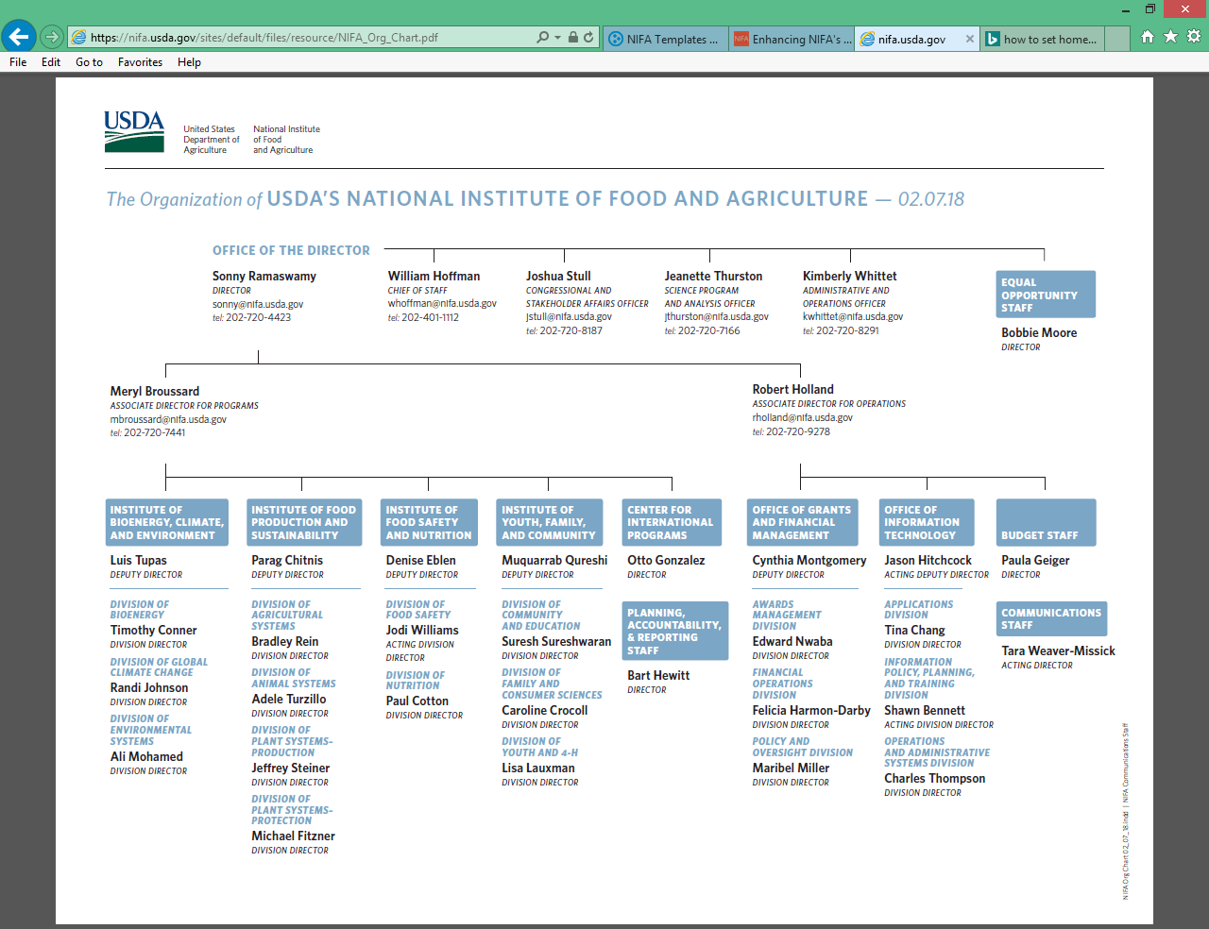


Notes:
Goals of NIFA’s Center for International Programs:
* Provide information and ideas to universities and colleges seeking to expand their international involvement in agriculture and build the global effectiveness of their agricultural programs.
* Help facilitate partnerships between NIFA and other countries and international organizations to enable NIFA-supported researchers at U.S. colleges and universities to identify potential international collaborators with whom they can align their efforts to achieve greater global impact as well as in the U.S.
* Lead NIFA’s participation in international activities with USDA’s Foreign Agricultural Service, and other parts of the U.S. Government such as the U.S. Agency for International Development, and U.S. Department of State, as well with international organizations where the knowledge and expertise of NIFA and the institutions it serves can be used to improve global food security, and address other issues of global concern or interest to U.S. agriculture.
* Organize briefings and webinars on international issues of interest to NIFA and its stakeholders.
* Meet with foreign visitors representing governments or international organizations interested in learning more about how USDA works with universities, colleges, and other organizations in supporting research, education, and extension to solve agricultural problems, or who may want to partner with U.S. institutions to address agricultural problems of mutual interest.

Slide 3

Contact: Otto Gonzalez, Director, Center for International Programs, otto.Gonzalez@nifa.usda.gov.
Notes:
Step 1: See if your interest fits within a NIFA Competitive or Capacity grant program.
Step 2: Determine how an international collaboration or activity is important in helping you to accomplish your project objectives.
Step 3: Identify potential collaborators, institutions, or locations.

Slide 4

NIFA Competitive Grant Programs with Opportunities for International Activities
Examples:
  Agriculture and Food research Initiative (AFRI)
  1890 Institution Teaching, Research and Extension Capacity Grants
  Higher Education Challenge Grants (HEC)
  Food and Agricultural Sciences National Needs Fellowships (NNF)
  Higher Education Multicultural Scholars Program (MSP)
  Hispanic Serving Institutions Grants (HSI)
  Small Business Innovation Research (SBIR)
  Women and Minorities in STEM
For a comprehensive list, visit https://www.nifa.usda.gov/opportunities-global-engagement

Slide 5

Broadening Students’ Experiences and Expanding their Career Competencies through International Experiential Learning Opportunities (HEC Grant)
Texas A&M University (TAMU) and Prairie View A&M University (PVAMU)
Partnered with the University of Namibia and Namibia-based research centers.
Faculty-led study abroad program in Namibia
To address food security issues
Developed course materials to integrate
learning from the study abroad experience
into courses back at TAMU and PVAMU.
Notes:
Faculty at Texas A&M University (TAMU) and Prairie View A&M University (PVAMU) teamed to broaden their students’ academic experiences and career competencies through a faculty-led study abroad program in Namibia, partnering with the University of Namibia and Namibia-based research centers. Recruiting students traditionally underrepresented in study abroad programs was an important objective. Faculty included Namibians’ knowledge of community-based natural resource management strategies, and how to use these strategies to address food security issues. TAMU and PVAMU faculty with colleagues in Namibia developed course materials, and aimed to integrate learning from the study abroad experience into courses back at their universities.

Slide 6
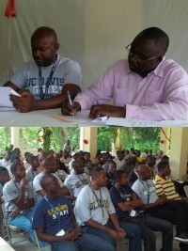
Collaborations with
Federal and International Organizations
Haiti Vocational Agricultural Education Project
2013 – present
USAID-funded
Reestablish 3 vocational agricultural schools
Implemented by the
University of California – Davis
Created a curriculum
Trained school administrators and
newly hired agricultural teachers.
Notes:
We often collaborate with USDA's Foreign Agricultural Service to develop and implement programs overseas. Additionally, we use funds that we receive to support partners from U.S. universities and colleges as they implement internationally-focused extension, research, and teaching programs. Such an extensive partnership network ensures that our programs meet our Nation's needs and are helpful overseas.
HAITI: NIFA is assisting USDA’s Foreign Agricultural Service on a USAID-funded vocational agricultural education project in Haiti. The primary goal of the project is to reestablish three vocational agricultural schools throughout the country. It is being implemented by a team of agricultural educators from the University of California – Davis (UC Davis) During the last three years, the UC-Davis team created a curriculum and trained school administrators and newly hired agricultural teachers. Thirty seven students are attending classes at the newly opened vocational agriculture school in Dondon.

Slide 7

Notes:
In the late 1800’s, researchers discovered adults in the farming community did not readily accept new agricultural developments on university campuses, but found that young people were open to new thinking and would experiment with new ideas and share their experiences with adults. In this way, rural youth programs introduced new agriculture technology to communities. The idea of practical and “hands-on” learning came from the desire to connect public school education to country life. Building community clubs to help solve agricultural challenges was a first step toward youth learning more about the industries in their community. That is how 4-H was formed.
4-H National Headquarters is housed in the Division of Youth and 4-H at NIFA. Additional support is provided to 4-H by National 4-H Council (a private, non-profit organization) and conducted through the land-grant university extension 4-H offices.
It is USDA/NIFA’s policy to promote positive youth development in the United States, and to draw upon that deep experience to assist with similar positive youth development activities around the world. For more than a century, USDA/NIFA has used legislative authority to authorize the 4‐H program within the United States in close collaboration with the Cooperative Extension Systems of the Land‐grant institutions. While the 4‐H program‐ its name, emblem, and brand ‐ is authorized for enriching the lives of America’s youth, much of the experience gained over the years by Cooperative Extension youth development leaders is relevant to those around the world who want to organize programs for promoting positive development of their young citizens.

Slide 8
Source: https://4-h.org/about/global-network/
Notes:
4‑H is uniquely positioned to meet urgent global needs. The young people of today are the farmers who will feed the world in 2050, and there are more than one billion people between 12 and 24.
Positive youth development is not about a specific program in any particular country; it’s about the power of young people. 4-H teaches youth to make better choices and create positive change in their communities. Land‐grant institutions may elect to mentor another country in the development of positive youth development programming, using their own 4‐H program as a model. International exchange programs are conducted under the sponsorships of a State 4‐H Program. U.S. institutions do not, however, have the authority to authorize the use of the 4‐H Name and Emblem outside of their own state geographic boundaries.
To learn how you can partner on a project in your community, contact your local Extension Office. If you would like to explore a state programming partnership, please contact the State 4-H Office.

Slide 9
NIFA Contacts
Aida Balsano
National Program Leader for the AgrAbility Program
ABalsano@nifa.usda.gov
202-720-4436
Otto Gonzalez
Director, Center for International Programs
Otto.Gonzalez@nifa.usda.gov
202-720-3801

Slide 10


