Slide 1

Commonwealth of Massachusetts
Massachusetts Office On Disability
National Agrability Training Workshop 2018
Accessible Agritourism
Presenter:
Rita DiNunzio, Asst. Director for Communications & Policy
March 20, 2018
For educational purposes only. Does not constitute legal advice.

Slide 2
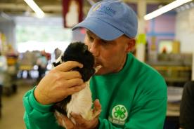
Accessible Agritourism
What is Agritourism?
Activity that involves visiting a working farm or any horticultural / agri-business operation to:
Enjoy the rural setting
Learn
Participate in special activities or programs
Purchase produce or goods
Photo: Topsfield Fair
Notes:
Why this training?
“Just over 33,000 farms offered agritourism and recreational
services such as farm or winery tours, hayrides, hunting,
fishing, and other such activities in 2012.” —U.S. Census of Agriculture clearly
Data shows an increasing trend in agritourism & related recreational programs
“Rural sightseeing” in Top 5 leisure activities for U.S. domestic travelers (U.S. Travel Association)
Approximately 56.7 million (18.7% noninstitutionalized population) Americans are PWDs (Brault 2010 report)
Representing more than $200 billion in discretionary spending (Brault 2010 report)
We age into disability
We know we have an increasing population of older americans
“Baby boomers” aging and are most affluent generation of americans yet
Except to continue traveling and participating in recreational activites

Slide 3
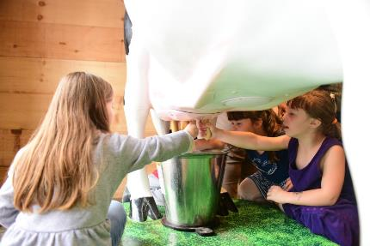
Real Agritourism Examples
Wreath making Workshop
Holiday Open House
Kids in The KITCHEN
Winter Farmers’ Market
Seasons Unplugged: Acoustic Tunes
Wine & Wine Jelly Tasting
Mindfulness on the Farm
Annual Winter Gala
Wreath Decorating Workshop
Grand Spirits Tasting
Gingerbread House Workshop
Winter Solstice Walk
Annual Harvest and Holiday Festival
Farmers' Indoor Market
Winter Solstice Fondue Night
Latkes & Lanterns
Farm-to-Table Cooking Class
Cultures to Rinds: Cheese Making Fundamentals
Winter Conference 2017
Winter Fare Beekeeping and beyond, with Queen Bee Honey
Winter Fare Kids
Photo: Topsfield Fair
Notes:
Examples JUST from MASS farms
BEYOND apple-picking and farmers’ markets
Retreat centers
Tours
Camps- day & overnight
B&B and other lodging
Workshops
Classes
Galas
Weddings
Conferences
Equestrian programs
Shooting & hunting
Hayrides, sleigh, sled-dog & tractor rides
Artisan and craft fairs
Animal exhbibits
Museums

Slide 4
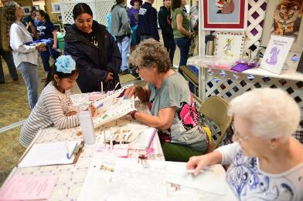
Real Agritourism Examples
Food Security Forum
Film Screening: INHABIT
Workshop: Pollinate Your Garden!
2017 Annual Meeting Massachusetts Farm Wineries & Growers Association
Green Industry Winter Forum
Seeking the Sacred on the Farm
Massachusetts Farm Wineries Day
Seminar: Why Buy Local?
New England Cheese Day
10th Annual Ag & Food Conference
Pancakes at the Farm
5th Annual Massachusetts Urban Farming Conference
Farm Fiber Days
Perennials The Best of Yesterday, Today and Tomorrow
Growing an Organic Vegetable Garden
38th Annual UMass Community Tree Conference
Spring Hive Management for Beekeepers
Photo: Topsfield Fair
Notes:
Operate in a nondiscriminatory manner by ensuring individuals with disabilities have the same opportunity to participate in and benefit from the services, activities, and goods offered as all other customers, patrons, or clients;
Ensure that communication with individuals with disabilities is as effective as with others by providing auxiliary aids and services when necessary to eliminate communication barriers;
Make reasonable modifications to their policies, practices, and procedures; A public accommodation is required to provide auxiliary aids and services which are necessary to ensure equal access to the goods, services, facilities, privileges, or accommodations it offers, unless an undue burden or a fundamental alteration would result.
Provide accessibility by removing barriers, providing alternatives to barrier removal, and ensuring accessibility in renovations and new construction
Title III is enforced by the U.S. Department of Justice (DOJ).
------------------------------------------------------------------------------------------------------------------------------------------------------------------------------------------------------------------------------------------------------
A public accommodation may exclude an individual with a disability from participation in an activity, if that individual's participation would result in a direct threat to the health or safety of others.
The public accommodation must determine that there is a significant risk to others which cannot be eliminated or reduced to an acceptable level by reasonable modifications to the public accommodation's policies, practices, or procedures or by the provision of appropriate auxiliary aids or services.
The determination that a person poses a direct threat to the health or safety of others may not be based on generalizations or stereotypes about the effects of a particular disability. It must be based on an individual assessment.

Slide 5
Why this training?
“Just over 33,000 farms offered Agritourism and recreational services such as farm or winery tours, hayrides, hunting, fishing, and other such activities in 2012.” —U.S. Census of Agriculture
Data shows an increasing trend in Agritourism & related recreational programs
“Rural sightseeing” in Top 5 leisure activities for U.S. domestic travelers
Between 40-56 million (12-18% noninstitutionalized population) Americans are people with disabilities…
…Representing more than $200 billion in discretionary spending
Leisure & recreation = health & wellness
Notes:
Why this training?
“Just over 33,000 farms offered agritourism and recreational
services such as farm or winery tours, hayrides, hunting,
fishing, and other such activities in 2012.” —U.S. Census of Agriculture clearly
Data shows an increasing trend in agritourism & related recreational programs http://www.agmrc.org/commodities-products/agritourism/agritourism-profile/
“Rural sightseeing” in Top 5 leisure activities for U.S. domestic travelers (U.S. Travel Association)
Approximately 56.7 million (18.7% noninstitutionalized population) Americans are PWDs (Brault 2010 report)
Representing more than $200 billion in discretionary spending (Brault 2010 report)
We age into disability
We know we have an increasing population of older americans
“Baby boomers” aging and are most affluent generation of americans yet
Except to continue traveling and participating in recreational activites

Slide 6
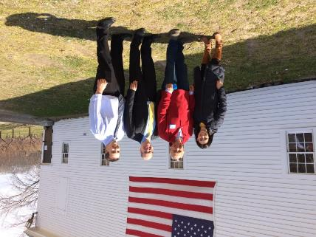
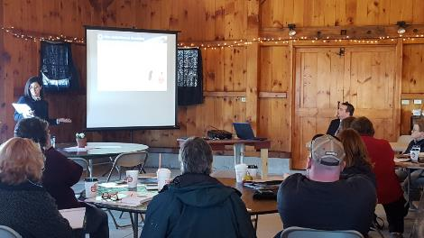
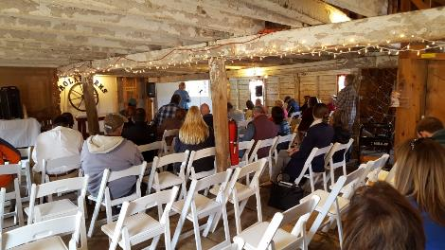
MA Agritourism Workshops
Combined effort among
Dept. of Agriculture
Dept. of Travel & Tourism
MA Office on Disability
Notes:
Background on this training
Originated as part of “Agritourism workshops”
Created by MDAR & MOTT
Offered free to Mass farm owners
For chance to learn about Agritourism
Aim to boost farming & tourism revenue
To their credit- thought to include an ADA component – where MOD came in
First farmers heard from successful farmers with lucrative AT programs
Then we came in….
To discuss ADA obligations
MOD & the insurance rep

Slide 7
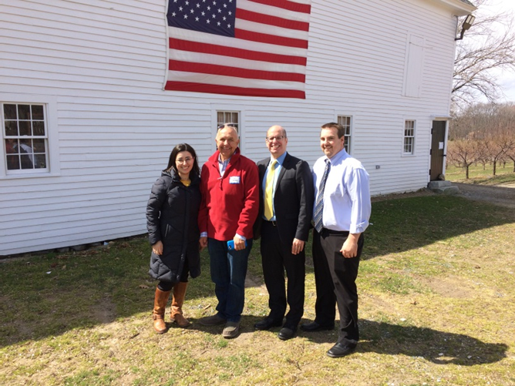
MA Agritourism Workshops
“Do I have to put an elevator in my barn?”
“Do I have to pave all of my land?”
Beyond wheelchair access
Part of the cost of doing business
Good for business! Competitive edge
“Reasonable”
For educational purposes only. Does not constitute legal advice.
Notes:
“Does my birdhouse have to be accessible?”
Accessibility & ADA compliance is more than just wheelchair access.
Numerous ways to increase accessibility and compliance without making everything 100% wheelchair accessible
These are UNIQUE programs and sites
It IS challenging
Sometimes an individual’s disability will determine the extent to which s/he is able to participate in an activity and this will be beyond what ADA requires of a business
Opening your business to the public brings all kinds of concerns and liabilities
Smolak farms poisonous spider accusation

Slide 8
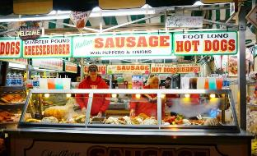
Entities with ADA Obligations
Title I: Employers
  Private employers with 15 or more employees and all state & local government employers must provide qualified individuals with disabilities an equal opportunity to benefit from the full range of employment-related opportunities available to others.
more Agritourism = more staff
Permanent, temporary, & contracted employees
  Be aware of state laws
  Photo: Topsfield Fair
For educational purposes only. Does not constitute legal advice.

Slide 9
Entities with ADA Obligations
Title II: State & Local Governments
All programs & services when viewed in their entirety, must be readily accessible to and usable by individuals with disabilities.
State & county fair
Meetings & events
Outdoor recreation facilities: parks, playgrounds, pools, etc.
For educational purposes only. Does not constitute legal advice.

Slide 10
Entities with ADA Obligations
Title III: Places of Public Accommodation (private businesses)
Places of lodging- inns, B&Bs
Establishments serving food or drink - wineries, concession stands
Places of exhibition or entertainment – stadiums, concert halls
Places of public gathering - conference venues, meeting rooms
Sales or rental establishments - farm stand, famers markets, gift shops
Places of public display or collection - museums, galleries
Places of exercise or recreation – golf courses, pools
Places of recreation - petting zoos, corn mazes, hayrides, pick-your-own operations i.e. farms with Agritourism activities!
For educational purposes only. Does not constitute legal advice.

Slide 11
ADA Standards for Accessible Design
2010 Standards for basis for barrier removal
Describe minimum requirements for accessibility in buildings and facilities subject to Titles II & III
Apply to new construction and to renovation or alteration
Apply to permanent & temporary buildings
For educational purposes only. Does not constitute legal advice.
Notes:
The ADA Design Standards are not building code, they are design standards that indicate how an architectural element can be built in a non-discriminatory manor.
Since the ADA is a civil rights obligation, so are the design standards. It will tell you, for example, how steep a ramp should be as it relates to a persons civil rights. This is a very different concept that the AAB codes we just discussed.
provide criteria for ensuring “programmatic access” for Title II (State and Local Government) entities and for “readily achievable barrier removal” for Title III (Public Accommodation) entities. This means that when entities are making alterations to achieve programmatic access or to remove barriers, the alteration should be built in compliance with the design standards.
The design standards became in effect on January 26, 1993 for Title III entities (businesses such as drug store, theatres, box stores, etc). So, any renovation or new construction after that date needed to comply with the 1991 revision of the ADAAG.
In 2012, DOJ updated their design standards to be more comprehensive. Just like before, any renovations or new construction after the 2012 date needed to comply with the 2012 revision of the ADAAG.
The AAB and ADA Design Standards differ in what they require. If renovating or building new, you need to comply with the most stringent requirement. For example, ramps have different requirements under the ADA and AAB, with the AAB having the more stringent requirement.
The ADA Design Standards, unlike the AAB regulations, DO COVER employee spaces.
There is a very big difference under the ADA However…. NEXT SLIDE.

Slide 12
State Codes
Many state building codes include construction standards for accessible buildings
May differ from the ADA Standards for Accessible Design
Many based on ADA Standards for Accessible Design
Others based on International Building Code (IBC)
Sections of one code may be more stringent than sections in the other
  Stronger or more stringent of the two codes prevails.
For educational purposes only. Does not constitute legal advice.
Notes:
Many state building codes include construction standards for accessible buildings.
codes can differ from the ADA Standards for Accessible Design.
Many states base their building codes on the ADA Standards for Accessible Design,
while other states base their codes on a standard from the American National Standards Institute (ANSI A117.1).
States may choose to apply for a certification of equivalency from the Department of Justice (DOJ). To receive a certification of equivalency, states must show that their state code meets or exceeds the requirements of the ADAAG / ADA Standards for Accessible Design.
However, in some instances, sections of one code may be more stringent than the similar sections in the other code.
For example: The ADA code governing one element may place a greater burden for access than the state code, or vice versa. When this happens, the stronger or more stringent of the two codes prevails.

Slide 13
Existing Facilities
Free of
Architectural barriers: steps, curbs, features such as drinking fountains and counters that are mounted too high, moveable impediments like furniture, etc.
Communication barriers: conventional signage inaccessible to people who have vision impairments, audible alarm systems inaccessible to people with hearing impairments, etc.
    2010 ADA Standards provide criteria for alterations made to achieve “programmatic access” or “barrier removal”
For educational purposes only. Does not constitute legal advice.
Notes:
Readily Achievable Barrier Removal requires that an architectural barrier, which prevents people from obtaining the programs, activities and/or services offered in a Title III entity, must be remedied if it is “easily accomplishable to be carried out without much difficulty or expense.”
For example, a building or element, built in 1980, prior to the ADA Design Standards were around… and discounting that the AAB had regulations in effect at that time… The ADA required barrier removal to that existing building or element EVEN if no work was planned.
III-4.4000 Removal of barriers
III-4.4100 General. Public accommodations must remove architectural barriers and communication barriers that are structural in nature in existing facilities, when it is readily achievable to do so.
What is an architectural barrier? Architectural barriers are physical elements of a facility that impede access by people with disabilities. These barriers include more than obvious impediments such as steps and curbs that prevent access by people who use wheelchairs.
In many facilities, telephones, drinking fountains, mirrors, and paper towel dispensers are mounted at a height that makes them inaccessible to people using wheelchairs. Conventional doorknobs and operating controls may impede access by people who have limited manual dexterity. Deep pile carpeting on floors and unpaved exterior ground surfaces often are a barrier to access by people who use wheelchairs and people who use other mobility aids, such as crutches. Impediments caused by the location of temporary or movable structures, such as furniture, equipment, and display racks, are also considered architectural barriers.
What is a communication barrier that is structural in nature? Communication barriers that are "structural in nature" are barriers that are an integral part of the physical structure of a facility. Examples include conventional signage, which generally is inaccessible to people who have vision impairments, and audible alarm systems, which are inaccessible to people with hearing impairments. Structural communication barriers also include the use of physical partitions that hamper the passage of sound waves between employees and customers, and the absence of adequate sound buffers in noisy areas that would reduce the extraneous noise that interferes with communication with people who have limited hearing.
How does the communication barrier removal requirement relate to the obligation to provide auxiliary aids? Communications devices, such as TDD's, telephone handset amplifiers, assistive listening devices, and digital check-out displays, are not an integral part of the physical structure of the building and, therefore, are considered auxiliary aids under the Department's title III regulation. The failure to provide auxiliary aids is not a communication barrier that is structural in nature. The obligation to remove structural communications barriers is independent of any obligation to provide auxiliary aids and services.
What is a "facility"? The term "facility" includes all or any part of a building, structure, equipment, vehicle, site (including roads, walks, passageways, and parking lots), or other real or personal property. Both permanent and temporary facilities are subject to the barrier removal requirements.
The ADA has an obligation for existing facilities under Title III known as Readily Achievable Barrier Removal. So, even if no renovations have been done to a building that existed prior to the 1993 date on the last slide, there are obligations that must be met.

Slide 14
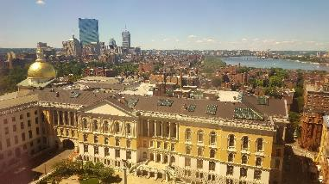
Existing Facilities:
Title II
State & local governments– held to high standard:
Self evaluation
Transition plan
Removing structural barriers
Programmatic access
For educational purposes only. Does not constitute legal advice.
Notes:
Title II – held to high standard, Self evaluation & transition plan, Programmatic access
Title III- Public accommodations are only required to remove architectural barriers in existing facilities if removal is "readily achievable" (see III-4.4200). If making the main entrance to a place of public accommodation accessible is not readily achievable, the public accommodation can provide access to the facility through another entrance, even though use of the alternative entrance for individuals with disabilities woul
Title II – held to high standard, Self evaluation & transition plan, Programmatic access
Title III enforcement brought by private suit or DOJ complaint
-Case-by-Case Basis
-Funding streams? Public/private?
The ADA establishes different standards for existing facilities and new construction. In existing facilities, where retrofitting may be expensive, the requirement to provide access is less stringent than it is in new construction and alterations, where accessibility can be incorporated in the initial stages of design and construction without a significant increase in cost.
1) The nature and cost of the action;
2) The overall financial resources of the site or sites involved; the number of persons employed at the site; the effect on expenses and resources; legitimate safety requirements necessary for safe operation, including crime prevention measures; or any other impact of the action on the operation of the site;
3) The geographic separateness, and the administrative or fiscal relationship of the site or sites in question to any parent corporation or entity;
4) If applicable, the overall financial resources of any parent corporation or entity; the overall size of the parent corporation or entity with respect to the number of its employees; the number, type, and location of its facilities; and
5) If applicable, the type of operation or operations of any parent corporation or entity, including the composition, structure, and functions of the workforce of the parent corporation or entity.
The Department's regulation contains a list of 21 examples of modifications that may be readily achievable:
1) Installing ramps;
2) Making curb cuts in sidewalks and entrances;
3) Repositioning shelves;
4) Rearranging tables, chairs, vending machines, display racks, and other furniture;
5) Repositioning telephones;
6) Adding raised markings on elevator control buttons;
7) Installing flashing alarm lights;
8) Widening doors;
9) Installing offset hinges to widen doorways;
10) Eliminating a turnstile or providing an alternative accessible path;
11) Installing accessible door hardware;
12) Installing grab bars in toilet stalls;
13) Rearranging toilet partitions to increase maneuvering space;
14) Insulating lavatory pipes under sinks to prevent burns;
15) Installing a raised toilet seat;
16) Installing a full-length bathroom mirror;
17) Repositioning the paper towel dispenser in a bathroom;
18) Creating designated accessible parking spaces;
19) Installing an accessible paper cup dispenser at an existing inaccessible water fountain;
20) Removing high pile, low density carpeting; or
21) Installing vehicle hand controls.
Each of these modifications will be readily achievable in many instances, but not in all.
A public accommodation generally would not be required to remove a barrier to physical access posed by a flight of steps, if removal would require extensive ramping or an elevator.
The readily achievable standard does not require barrier removal that requires extensive restructuring or burdensome expense.
Does the ADA require barrier removal in historic buildings? Yes, if it is readily achievable. However, the ADA takes into account the national interest in preserving significant historic structures. Barrier removal would not be considered "readily achievable" if it would threaten or destroy the historic significance of a building or facility that is eligible for listing in the National Register of Historic Places under the National Historic Preservation Act (16 U.S.C. 470, et seq.), or is designated as historic under State or local law.

Slide 15
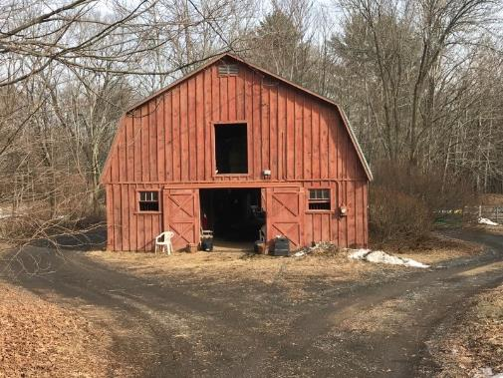
Existing Facilities:
Title III
Must remove barriers when it is readily achievable to do so
“easily accomplishable and able to be carried out without much difficulty or expense”
Case-by- case
  Funding streams?
  Cost of removal?
  Deficit?
  Financial history?
  Example for educational purposes
For educational purposes only. Does not constitute legal advice.
Notes:
Title II – held to high standard, Self evaluation & transition plan, Programmatic access
Title III- Public accommodations are only required to remove architectural barriers in existing facilities if removal is "readily achievable" (see III-4.4200). If making the main entrance to a place of public accommodation accessible is not readily achievable, the public accommodation can provide access to the facility through another entrance, even though use of the alternative entrance for individuals with disabilities woul
Title II – held to high standard, Self evaluation & transition plan, Programmatic access
Title III enforcement brought by private suit or DOJ complaint
-Case-by-Case Basis
-Funding streams? Public/private?
The ADA establishes different standards for existing facilities and new construction. In existing facilities, where retrofitting may be expensive, the requirement to provide access is less stringent than it is in new construction and alterations, where accessibility can be incorporated in the initial stages of design and construction without a significant increase in cost.
1) The nature and cost of the action;
2) The overall financial resources of the site or sites involved; the number of persons employed at the site; the effect on expenses and resources; legitimate safety requirements necessary for safe operation, including crime prevention measures; or any other impact of the action on the operation of the site;
3) The geographic separateness, and the administrative or fiscal relationship of the site or sites in question to any parent corporation or entity;
4) If applicable, the overall financial resources of any parent corporation or entity; the overall size of the parent corporation or entity with respect to the number of its employees; the number, type, and location of its facilities; and
5) If applicable, the type of operation or operations of any parent corporation or entity, including the composition, structure, and functions of the workforce of the parent corporation or entity.
The Department's regulation contains a list of 21 examples of modifications that may be readily achievable:
1) Installing ramps;
2) Making curb cuts in sidewalks and entrances;
3) Repositioning shelves;
4) Rearranging tables, chairs, vending machines, display racks, and other furniture;
5) Repositioning telephones;
6) Adding raised markings on elevator control buttons;
7) Installing flashing alarm lights;
8) Widening doors;
9) Installing offset hinges to widen doorways;
10) Eliminating a turnstile or providing an alternative accessible path;
11) Installing accessible door hardware;
12) Installing grab bars in toilet stalls;
13) Rearranging toilet partitions to increase maneuvering space;
14) Insulating lavatory pipes under sinks to prevent burns;
15) Installing a raised toilet seat;
16) Installing a full-length bathroom mirror;
17) Repositioning the paper towel dispenser in a bathroom;
18) Creating designated accessible parking spaces;
19) Installing an accessible paper cup dispenser at an existing inaccessible water fountain;
20) Removing high pile, low density carpeting; or
21) Installing vehicle hand controls.
Each of these modifications will be readily achievable in many instances, but not in all.
A public accommodation generally would not be required to remove a barrier to physical access posed by a flight of steps, if removal would require extensive ramping or an elevator.
The readily achievable standard does not require barrier removal that requires extensive restructuring or burdensome expense.
Does the ADA require barrier removal in historic buildings? Yes, if it is readily achievable. However, the ADA takes into account the national interest in preserving significant historic structures. Barrier removal would not be considered "readily achievable" if it would threaten or destroy the historic significance of a building or facility that is eligible for listing in the National Register of Historic Places under the National Historic Preservation Act (16 U.S.C. 470, et seq.), or is designated as historic under State or local law.

Slide 16
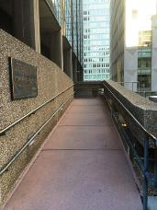
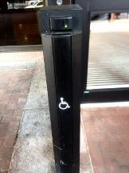
Existing Facilities
What are the Priorities?
Getting In: ramps, accessible parking, path of travel, wider doorways, hand levers
Getting to the Goods or Services: interior ramps, braille signage, lower counter, directions & signage
The Restroom: remove obstructions, lower threshold, grab bars
Everything Else: drinking fountains, etc.
Checklist for existing facilities: http://adachecklist.org/
For educational purposes only. Does not constitute legal advice.
Notes:
Can be overwhelming to decide where to begin removal of barriers,
The DOJ offered guidance of the 4 priorities for barrier removal.
Barriers to Getting in
Parking
Accessible route to the entrance/element
The entrance itself
Barriers to Getting to the Goods and Services offered.
Counters
Aisles
Level Changes
Barriers to The Restroom (if available to the public)
Grab Bars
Maneuvering Space
Sinks
Barriers to Everything Else
Drinking Fountains
Public Telephones
It has been 23 years since this requirement came to be in effect. The DOJ, the enforcement arm of these regulations, will require barrier removal to be almost complete if not completed already.
RABR can to carried out in PHASES
The Standards do not provide direct solutions to all of the various barriers that may be www.adata.org 6 2015 encountered, but instead give basic guidelines for resolving most problems.

Slide 17
Readily Achievable Barrier Removal
Tax Credit: to help small businesses cover ADA-related “eligible access expenditures” : sign language interpreters, accessible formats of printed materials, removal of architectural barriers.
  Businesses that had either revenues of ≤ $1,000,000 or ≤ 30 full-time employees
  Max of $5,000 per year
  Adaptations to existing facilities required by ADA
Tax Deduction: for the removal of architectural or transportation barriers.
  A business of any size
  Max of $15,000 per year
  Renovations must comply with applicable accessibility standards
Visit the IRS website and check with your state’s department of revenue
For educational purposes only. Does not constitute legal advice.
Notes:
Tax Incentives available to help businesses cover the cost of improving access
Two tax incentives are available to businesses
to help cover the cost of making access improvements.
The first is a tax credit that can be used for architectural adaptations, equipment acquisitions, and services such as sign language
interpreters.
The second is a tax deduction that can be used for architectural or transportation
adaptations.
(NOTE: A tax credit is subtracted from your tax liability after you calculate your taxes, while a tax deduction is subtracted from your total income before taxes, to establish your taxable income.)
Tax Credit
The tax credit, established under Section 44 of
the Internal Revenue Code, was created in 1990
specifically to help small businesses cover
ADA-related “eligible access expenditures.” A
business that for the previous tax year had
either revenues of $1,000,000 or less or 30 or
fewer full-time workers may take advantage of
this credit.
The credit can be used to cover a variety of
expenditures, including:
provision of readers for customers or
employees with visual disabilities
provision of sign language interpreters
purchase of adaptive equipment
production of accessible formats of printed
materials (i.e., braille, large print, audio
tape, computer diskette)
removal of architectural barriers in facilities
or vehicles (alterations must comply
with applicable accessibility standards)
fees for consulting services (under certain
circumstances)
Note that the credit cannot be used for the costs
of new construction. It can be used only for
adaptations to existing facilities that are required
to comply with the ADA.
The amount of the tax credit is equal to 50% of
the eligible access expenditures in a year, up to
a maximum expenditure of $10,250. There is no
credit for the first $250 of expenditures. The
maximum tax credit, therefore, is $5,000.
Tax Deduction
The tax deduction, established under Section
190 of the Internal Revenue Code, is now a
maximum of $15,000 per year—a reduction
from the $35,000 that was available through
December 31, 1990. A business (including
active ownership of an apartment building) of
any size may use this deduction for the removal
of architectural or transportation
barriers. The renovations under Section 190
must comply with applicable
accessibility standards.
Small businesses can use these incentives in
combination if the expenditures incurred
qualify under both Section 44 and Section 190.
For example, a small business that spends
$20,000 for access adaptations may take a tax
credit of $5000 (based on $10,250 of expenditures),
and a deduction of $15,000. The
deduction is equal to the difference between
the total expenditures and the amount of the
credit claimed.
EXAMPLE: A small business’ use of both tax credit
and tax deduction
$20,000 cost of access improvements
(rest room, ramp, 3 doors
widened)
– $5,000 maximum credit
$15,000 remaining for deduction
Produced by Adaptive Environments Center under contract to Barrier Free Environments, NIDRR grant #H133D10122 2FACT SHEET 4
Tax Incentives for Improving Accessibility
3
Annual Incentives
The tax credit and deduction can be used
annually. You may not carry over expenses
from one year to the next and claim a credit or
deduction for the portion that exceeded the
expenditure limit the previous year. However, if
the amount of credit you are entitled to exceeds
the amount of taxes you owe, you may carry
forward the unused portion of the credit to the
following year.
For further details and information, review these
incentives with an accountant or contact your
local IRS office or the national address below.
FOR MORE INFORMATION…
Request IRS Publications 535 and 334 for further
information on tax incentives, or Form 8826 to
claim your tax credit.
Publications and Forms
(800) 829-3676 Voice
(800) 829-4059 TDD
Questions
(800) 829-1040 Voice
(800) 829-4059 TDD
Legal Questions
Internal Revenue Service
Office of the Chief Counsel
CC: PSI: 7
1111 Constitution Avenue, NW, Room 5115
Washington, D.C. 20224
(202) 622-6120 Voice/Relay
Produced by Adaptive Environments Center under contract to Barrier Free Environments, NIDRR grant #H133D10122
www.irs.gov/plain/forms_pubs/pubs/p90705.htm

Slide 18
Effective Communication
Entities must provide appropriate “auxiliary aids,” to ensure effective communications with individuals with hearing, vision, or speech impairments.
qualified interpreters
assistive listening devices
CART
brailled materials
large print materials
electronic format
And more
Entities may not charge a fee for the use of an auxiliary aid.
For educational purposes only. Does not constitute legal advice.
Notes:
ILLUSTRATION 1: H, an individual who is deaf, is shopping for film at a camera store. Exchanging written notes with the sales clerk would be adequate to ensure effective communication.
ILLUSTRATION 2: H then stops by a new car showroom to look at the latest models. The car dealer would be able to communicate effectively general information about the models available by providing brochures and exchanging notes by pen and notepad, or perhaps by means of taking turns at a computer terminal keyboard. If H becomes serious about making a purchase, the services of a qualified interpreter may be necessary because of the complicated nature of the communication involved in buying a car.
ILLUSTRATION 3: S, an individual who is blind, visits an electronics store to purchase a clock radio and wishes to inspect the merchandise information cards next to the floor models in order to decide which one to buy. Reading the model information to S should be adequate to ensure effective communication. Of course, if S is unreasonably demanding or is shopping when the store is extremely busy, it may be an undue burden to spend extended periods of time reading price and product information.
ILLUSTRATION 4: S also has tickets to a play. When S arrives at the theater, the usher notices that S is an individual who is blind and guides S to her seat. An usher is also available to guide S to her seat following intermission. With the provision of these services, a Brailled ticket is not necessary for effective communication in seating S.
ILLUSTRATION 5: The same theater provides S with a tape-recorded version of its printed program for the evening's performance. A Brailled program is not necessary to effectively communicate the contents of the program to S, if an audio cassette and tape player are provided.

Slide 19
Effective Communication
Iowa State Fair website:
ASSISTED LISTENING DEVICES
Available for the Penningroth Media Center Cattle Barn, Pioneer Livestock Pavilion and Richard O. Jacobson Exhibition Center when the State Fair sound system is being used. For more information, call 515.262.3111, ext. 322, at least 72 hours in advance.
SIGN LANGUAGE INTERPRETERS
Sign language interpreters will be on hand in Fun Forest to assist visitors with hearing loss. All shows on the Fun Forest Stage will be ASL interpreted. To arrange for a sign language interpreter for a Grandstand event, please call 515.262.3111, ext. 222, at least two weeks in advance.
  Examples for educational purposes
For educational purposes only. Does not constitute legal advice.
Notes:
Title II vs III
ILLUSTRATION 1: H, an individual who is deaf, is shopping for film at a camera store. Exchanging written notes with the sales clerk would be adequate to ensure effective communication.
ILLUSTRATION 2: H then stops by a new car showroom to look at the latest models. The car dealer would be able to communicate effectively general information about the models available by providing brochures and exchanging notes by pen and notepad, or perhaps by means of taking turns at a computer terminal keyboard. If H becomes serious about making a purchase, the services of a qualified interpreter may be necessary because of the complicated nature of the communication involved in buying a car.
ILLUSTRATION 3: S, an individual who is blind, visits an electronics store to purchase a clock radio and wishes to inspect the merchandise information cards next to the floor models in order to decide which one to buy. Reading the model information to S should be adequate to ensure effective communication. Of course, if S is unreasonably demanding or is shopping when the store is extremely busy, it may be an undue burden to spend extended periods of time reading price and product information.
ILLUSTRATION 4: S also has tickets to a play. When S arrives at the theater, the usher notices that S is an individual who is blind and guides S to her seat. An usher is also available to guide S to her seat following intermission. With the provision of these services, a Brailled ticket is not necessary for effective communication in seating S.
ILLUSTRATION 5: The same theater provides S with a tape-recorded version of its printed program for the evening's performance. A Brailled program is not necessary to effectively communicate the contents of the program to S, if an audio cassette and tape player are provided.

Slide 20
Reasonable Modifications
Public & private entities must make reasonable modifications to policies, practices, and procedures when necessary to ensure equal opportunity and avoid discrimination.
Examples:
Reading a menu for a blind or low vision customer
Serving a person with a mobility impairment by retrieving an out-of-reach item from a shelf
For educational purposes only. Does not constitute legal advice.
Notes:
ADA: Provides Accommodations: Most civil rights laws prohibit discrimination and provide mechanisms for enforcement. The ADA goes one step further by requiring covered entities to provide the accommodations, within reason, to the way things are typically done when necessary to ensure equal opportunity and or to avoid discrimination.
What is reasonable modification under the ADA?
When necessary to ensure equal opportunity and avoid discrimination, public and private entities must make reasonable modifications to their policies, practices, and procedures.
This obligation requires public and private entities to deal flexibly with unanticipated situations in a way that does not deny people with disabilities an equal opportunity. The obligation applies to written as well as informal policies, practices and procedures.
If a public or private entity can demonstrate that a modification would fundamentally alter the nature of its service, program, or activity, it is not required to make the modification.
Example: In one complaint settled by the Department of Justice, a person with a mobility impairment said a tour of a Nebraska State building was not accessible to her because of the rapid pace set by the tour guide. The building management agreed to modify the pace of the tour, as needed, and to provide a staff person to assist if requested for all future tours. Management also apologized for the way the complainant was treated during the tour.
Example: A person, who used a wheelchair and was assisted by a service animal, complained that he was denied access to a California restaurant. The owners of the restaurant apologized for their employee's conduct and agreed to comply with the ADA. They also agreed to provide training to be conducted by a trade association to educate its employees about the ADA and service animals.
The obligation applies to formal and informal policies, practices and procedures.

Slide 21
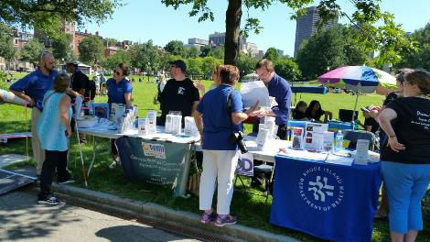
Staff & Volunteers
Train staff & volunteers interacting with the public to:
Ask before offering assistance to persons with disabilities and to only help as directed
Speak directly to the person, not companion or guide
Know accessible routes, restroom, entrances, parking spaces
Understand concept of reasonable modifications
Designate an “ADA Coordinator” or point-person
For educational purposes only. Does not constitute legal advice.
Notes:
Lets get to some related specifics:
Corn Mazes – The AAB would require that corn mazes be accessible. If the corn maze is recreated every year, you would need to consider the following for accesibility:
The route of travel, such as the surface, the width, any changes in level along the route (look out towers).
With that said, the look out towers would most likely require a variance to not be accessible, and it might be granted if there is an accessible route around the tower to continue the maze.
Outdoor events – The ADA and AAB would require accessible features at event tents and other amenities related to it.
A portion of the tables would need to be accessible.
The ground surface would need to be accessible.
If portable toilets are provided, accessible ones also need to be provided.
Stores and Farm Stands – The ADA and AAB would require accessible features here.
The entry,
The accessible route around the store,
The checkout area
Gazebos – The ADA and AAB would require access onto the gazebo.
Picnic Benches – The ADA and AAB would require some of the picnic benches to be accessible to pwd’s.
Christmas Tree Farms – The AAB would require that there be an accessible route to, maybe not the entire tree farm, but to at least all of the different types of trees offered.
Apple Picking – The AAB would also require something similar to the Christmas tree example. There may not be an accessible route to all of the apple trees on the farm, but would require access to the different types of apples to be picked.

Slide 22
Before Arrival
Ability to obtain information, directions & request reasonable modifications before arrival
  Website information
  Affirm commitment to accessibility
  “The Minnesota State Fair is committed to providing equal access and a pleasant experience for all its guests. Services provided include electric mobility scooters, strollers, wagon and wheelchair rentals, accessible parking, a wheelchair accessible park & ride, a passenger drop-off area, assistive listening devices, sign language interpreters, accessible seating at all entertainment venues, curb cuts throughout the fairgrounds and Care & Assistance … All of these services are described in our 2017 Accessibility Guide (when available, view it under "Quick Links").”
  Example for educational purposes
For educational purposes only. Does not constitute legal advice.
Notes:
Let’s start with finding out about the program and work our way through…
People with disabilities must be able to obtain or enjoy the same goods, activities, services, and benefits that are available to other members of the public. At a temporary event participants with disabilities must be able to:
Obtain information and directions prior to the event.
Arrive at the site in the same ways as others can (e.g. via private automobile, taxi, public transportation, event shuttles).
Find and use accessible parking.
Get from accessible parking to entrances.
Obtain additional information and directions on site.
Move around the site as needed.
Attend performances, participate in activities, and enter exhibits.
Experience and enjoy activities, even if the participant’s disability affects their ability to communicate.
Select and purchase items at concessions.
Use public toilet rooms, telephones, water fountains, shelters, first aid stations, and other common amenities.
Equal Opportunity: Individuals with disabilities must not be denied an equal opportunity to participate and benefit from programs and services. The opportunity must be equal to and as effective as the opportunity provided to others.
Entities Must:
Ensure programmatic access
Ensure the most integrated setting
Entities May Not:
Deny participation
Provide separate or different
Examples of unequal benefit:
No assistive listening devices
Inaccessible website
Restroom with no accessible stall
Part of Equal Opportunity: ADA prohibits eligibility criteria that:
intend to screen out people with disabilities unless the criteria are necessary for the provision of the service, program or activity.
tend to screen out people with disabilities unless necessary for the provision of services or activities.
are neutral but have the effect of screening out people with disabilities.
ADA: Provides Accommodations
Most civil rights laws prohibit discrimination and provide mechanisms for enforcement. The ADA goes one step further by requiring covered entities to provide the accommodations, within reason, to the way things are typically done when necessary to ensure equal opportunity and or to avoid discrimination.
This means:
Entities must be flexible in handling unanticipated situations.
Obligation applies to formal and informal policies, practices and procedures.
Examples:
Helping a person to fill out a form that consumers are usually obligated to complete themselves.
Providing a letter in Braille or large print for a blind or vision-impaired consumer
Allowing a person with a disability to prove identity with identification other than a driver’s license
Providing a diabetic meal at a luncheon
Serving a person with a mobility impairment at an alternate location in a multi-story building that is not accessible

Slide 23
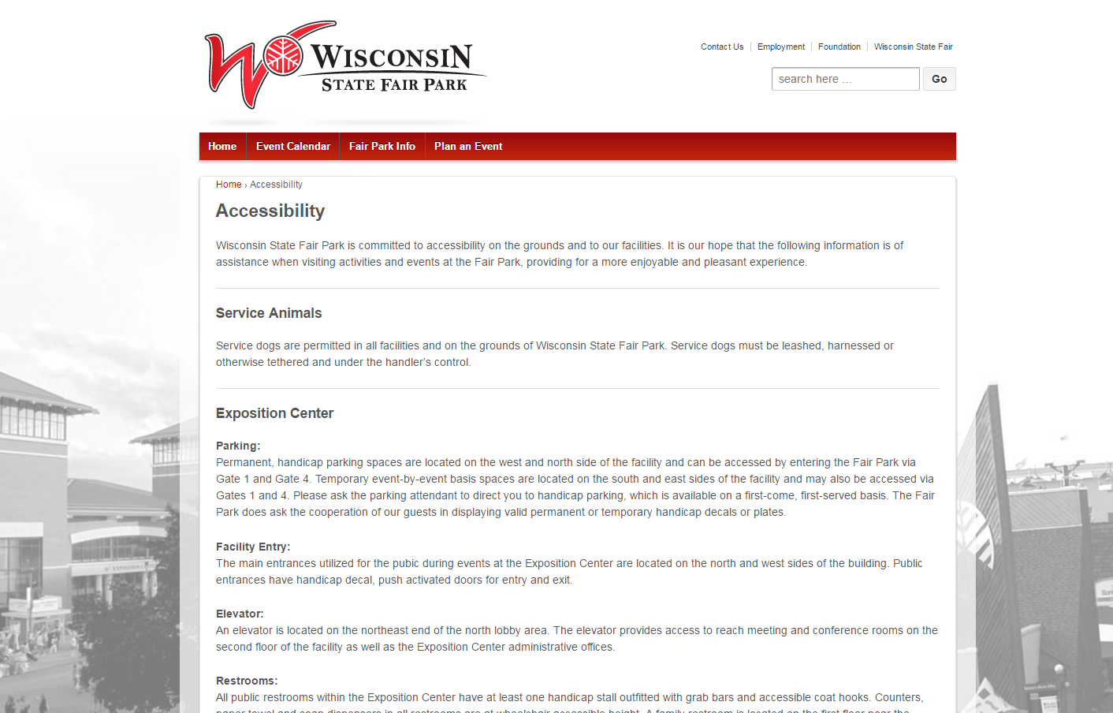
Accessibility Information
  Example for educational purposes
Notes:
Let’s start with finding out about the program and work our way through…
People with disabilities must be able to obtain or enjoy the same goods, activities, services, and benefits that are available to other members of the public. At a temporary event participants with disabilities must be able to:
Obtain information and directions prior to the event.
Arrive at the site in the same ways as others can (e.g. via private automobile, taxi, public transportation, event shuttles).
Find and use accessible parking.
Get from accessible parking to entrances.
Obtain additional information and directions on site.
Move around the site as needed.
Attend performances, participate in activities, and enter exhibits.
Experience and enjoy activities, even if the participant’s disability affects their ability to communicate.
Select and purchase items at concessions.
Use public toilet rooms, telephones, water fountains, shelters, first aid stations, and other common amenities.
Equal Opportunity: Individuals with disabilities must not be denied an equal opportunity to participate and benefit from programs and services. The opportunity must be equal to and as effective as the opportunity provided to others.
Entities Must:
Ensure programmatic access
Ensure the most integrated setting
Entities May Not:
Deny participation
Provide separate or different
Examples of unequal benefit:
No assistive listening devices
Inaccessible website
Restroom with no accessible stall
Part of Equal Opportunity: ADA prohibits eligibility criteria that:
intend to screen out people with disabilities unless the criteria are necessary for the provision of the service, program or activity.
tend to screen out people with disabilities unless necessary for the provision of services or activities.
are neutral but have the effect of screening out people with disabilities.
ADA: Provides Accommodations
Most civil rights laws prohibit discrimination and provide mechanisms for enforcement. The ADA goes one step further by requiring covered entities to provide the accommodations, within reason, to the way things are typically done when necessary to ensure equal opportunity and or to avoid discrimination.
This means:
Entities must be flexible in handling unanticipated situations.
Obligation applies to formal and informal policies, practices and procedures.
Examples:
Helping a person to fill out a form that consumers are usually obligated to complete themselves.
Providing a letter in Braille or large print for a blind or vision-impaired consumer
Allowing a person with a disability to prove identity with identification other than a driver’s license
Providing a diabetic meal at a luncheon
Serving a person with a mobility impairment at an alternate location in a multi-story building that is not accessible

Slide 24
Arrival
Individuals with disabilities should have the opportunity to:
Arrive at the site in the same ways as others can:
  Drop off area
  Find and use accessible parking
For educational purposes only. Does not constitute legal advice.
Notes:
Let’s start with finding out about the program and work our way through…
Arrival points: exterior sidewalks, bus stops, drop off areas, parking lots
An accessible route is critical to the successful use of a site. A single continuous accessible pedestrian path should be wide, smooth, as level as possible, and without low or overhanging hazards or obstructions. Accessible routes can include ramps but not stairs (see Figure 1).

Slide 25
Parking
Number of Accessible Parking Spaces Required specified in ADA Standards -1 in 6 must be van accessible
Total parking spots in lot | Minimum number of accessible spaces required*
1 to 25 | 1
26 to 50 | 2
51 to 75 | 3
76 to 100 | 4
101 to 150 | 5
151 to 200 | 6
201 to 300 | 7
301 to 400 | 8
401 to 500 | 9
501 to 1000 | 2 percent of total
1001 and over | 20 plus 1 for each 100 over 1000
Notes:
Nuance- 4 or less
Number of Accessible Parking Spaces Required
At a minimum, there should never be fewer accessible parking spaces than specified in the ADA Standards (Table 1). Of these, at least one in every six accessible parking spaces must be “van accessible.” Van spaces, to be usable, must be wider than those designed for cars.
Table 1: Number of Accessible Parking spaces as Specified in the ADA Standards
*Note that one of every six accessible spaces, or fraction of six, must be van accessible. For example, if eight accessible spaces are required, two of those eight spaces must be van accessible.

Slide 26
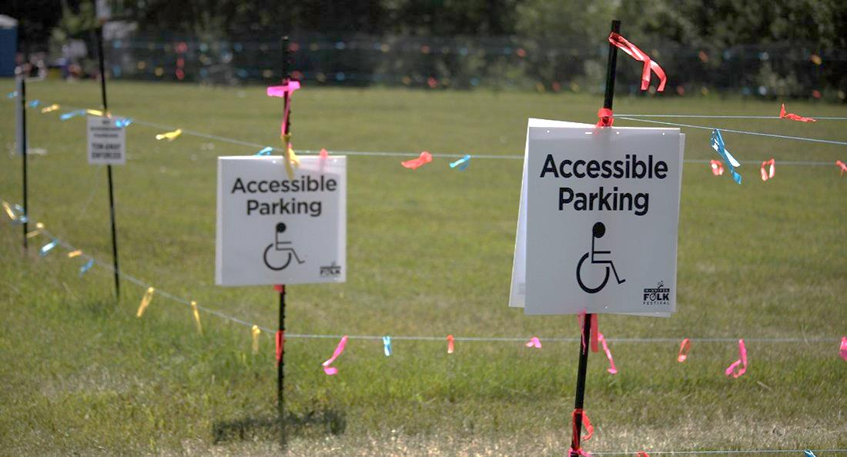
Arriving & On-Site
    Dirt & grass lots are not exempt
    Cones
    Fencing
    Signage
    Keep grass short
    Level ground
    Rubber matting
    Attendants
    Enforcement
Photo: Montana League of Cities and Towns
For educational purposes only. Does not constitute legal advice.
Notes:
Let’s start with finding out about the program and work our way through…
People with disabilities must be able to obtain or enjoy the same goods, activities, services, and benefits that are available to other members of the public. At a temporary event participants with disabilities must be able to:
Obtain information and directions prior to the event.
Arrive at the site in the same ways as others can (e.g. via private automobile, taxi, public transportation, event shuttles).
Find and use accessible parking.
Get from accessible parking to entrances.
Obtain additional information and directions on site.
Move around the site as needed.
Attend performances, participate in activities, and enter exhibits.
Experience and enjoy activities, even if the participant’s disability affects their ability to communicate.
Select and purchase items at concessions.
Use public toilet rooms, telephones, water fountains, shelters, first aid stations, and other common amenities.
Equal Opportunity: Individuals with disabilities must not be denied an equal opportunity to participate and benefit from programs and services. The opportunity must be equal to and as effective as the opportunity provided to others.
Entities Must:
Ensure programmatic access
Ensure the most integrated setting
Entities May Not:
Deny participation
Provide separate or different
Examples of unequal benefit:
No assistive listening devices
Inaccessible website
Restroom with no accessible stall
Part of Equal Opportunity: ADA prohibits eligibility criteria that:
intend to screen out people with disabilities unless the criteria are necessary for the provision of the service, program or activity.
tend to screen out people with disabilities unless necessary for the provision of services or activities.
are neutral but have the effect of screening out people with disabilities.
ADA: Provides Accommodations
Most civil rights laws prohibit discrimination and provide mechanisms for enforcement. The ADA goes one step further by requiring covered entities to provide the accommodations, within reason, to the way things are typically done when necessary to ensure equal opportunity and or to avoid discrimination.
This means:
Entities must be flexible in handling unanticipated situations.
Obligation applies to formal and informal policies, practices and procedures.
Examples:
Helping a person to fill out a form that consumers are usually obligated to complete themselves.
Providing a letter in Braille or large print for a blind or vision-impaired consumer
Allowing a person with a disability to prove identity with identification other than a driver’s license
Providing a diabetic meal at a luncheon
Serving a person with a mobility impairment at an alternate location in a multi-story building that is not accessible

Slide 27
Arriving & On-Site
    New York State Fair: “A free wheelchair accessible tram is available to shuttle those in the paved Accessible Parking Lot.”
IOWA State Fair: “SHUTTLES: Trams provide convenient transportation on the lower fairgrounds at several locations. Operating daily beginning at 8 a.m., these trams feature a curbside electric/hydraulic lift, making them wheelchair accessible.”
  Example for educational purposes
For educational purposes only. Does not constitute legal advice.
Notes:
Let’s start with finding out about the program and work our way through…
People with disabilities must be able to obtain or enjoy the same goods, activities, services, and benefits that are available to other members of the public. At a temporary event participants with disabilities must be able to:
Obtain information and directions prior to the event.
Arrive at the site in the same ways as others can (e.g. via private automobile, taxi, public transportation, event shuttles).
Find and use accessible parking.
Get from accessible parking to entrances.
Obtain additional information and directions on site.
Move around the site as needed.
Attend performances, participate in activities, and enter exhibits.
Experience and enjoy activities, even if the participant’s disability affects their ability to communicate.
Select and purchase items at concessions.
Use public toilet rooms, telephones, water fountains, shelters, first aid stations, and other common amenities.
Equal Opportunity: Individuals with disabilities must not be denied an equal opportunity to participate and benefit from programs and services. The opportunity must be equal to and as effective as the opportunity provided to others.
Entities Must:
Ensure programmatic access
Ensure the most integrated setting
Entities May Not:
Deny participation
Provide separate or different
Examples of unequal benefit:
No assistive listening devices
Inaccessible website
Restroom with no accessible stall
Part of Equal Opportunity: ADA prohibits eligibility criteria that:
intend to screen out people with disabilities unless the criteria are necessary for the provision of the service, program or activity.
tend to screen out people with disabilities unless necessary for the provision of services or activities.
are neutral but have the effect of screening out people with disabilities.
ADA: Provides Accommodations
Most civil rights laws prohibit discrimination and provide mechanisms for enforcement. The ADA goes one step further by requiring covered entities to provide the accommodations, within reason, to the way things are typically done when necessary to ensure equal opportunity and or to avoid discrimination.
This means:
Entities must be flexible in handling unanticipated situations.
Obligation applies to formal and informal policies, practices and procedures.
Examples:
Helping a person to fill out a form that consumers are usually obligated to complete themselves.
Providing a letter in Braille or large print for a blind or vision-impaired consumer
Allowing a person with a disability to prove identity with identification other than a driver’s license
Providing a diabetic meal at a luncheon
Serving a person with a mobility impairment at an alternate location in a multi-story building that is not accessible

Slide 28
Arriving & On-Site
ACCESSIBLE PATH of TRAVEL connecting arrival points to entrance & all activities, programs, services & amenities
Continuous
Pedestrian
Level
Wide
No overhanging hazards/ obstructions
No steps
Not blocked by obstacles e.g. equipment, pooled water, debris
For educational purposes only. Does not constitute legal advice.
Notes:
An accessible route is critical to the successful use of a site. A single continuous accessible pedestrian path should be wide, smooth, as level as possible, and without low or overhanging hazards or obstructions. Accessible routes can include ramps but not stairs (see Figure 1).

Slide 29
Accessible Path & Surfaces
Concrete
Asphalt
Crushed rock
Broken rock
Rock mixture containing all sieve sizes
Passes through a ½-inch screen
Rock material in 3- to 4-inch layers
Moist before compacted
Compacted by machine or hand tamping
(rather than by use)
Treated soils
Stone dust
Rubberized surfaces (interlocking tiles)
Mats (perforated, synthetic, etc.)
Firm
Stable
Slip-resistant
  Check state laws!
For educational purposes only. Does not constitute legal advice.
Notes:
Advisory 302.1 General. A stable surface is one that remains unchanged by contaminants or applied force, so that when the contaminant or force is removed, the surface returns to its original condition. A firm surface resists deformation by either indentations or particles moving on its surface. A slip-resistant surface provides sufficient frictional counterforce to the forces exerted in walking to permit safe ambulation.
ABA: DESIGN TIP—Building a firm and stable surface
A firm and stable surface does not always mean concrete and asphalt. Some natural soils can be compacted so that they are firm and stable. Other soils can be treated with stabilizers without drastically changing their appearance. Designers are encouraged to investigate the options and use surfacing materials that are consistent with the site’s level of development and that require as little maintenance as possible.

Slide 30
Accessible Path & Surfaces
“The diversity of trails in this country is only matched by the diversity of environments in which they are located. A surface that might be firm and stable in one region of the country may be not firm and not stable in another; a surface that may be firm and stable in July may be not firm and not stable in December; and a surface that was firm and stable last year, may be not firm and not stable this year. These are just a few of the problems faced by Land Managers who are trying to make decisions on natural surfacing materials that create a firm and stable trail.”
                —National Trail Surfaces Study
                National Center on Accessibility, 2014
For educational purposes only. Does not constitute legal advice.
Notes:
Advisory 302.1 General. A stable surface is one that remains unchanged by contaminants or applied force, so that when the contaminant or force is removed, the surface returns to its original condition. A firm surface resists deformation by either indentations or particles moving on its surface. A slip-resistant surface provides sufficient frictional counterforce to the forces exerted in walking to permit safe ambulation.
ABA: DESIGN TIP—Building a firm and stable surface
A firm and stable surface does not always mean concrete and asphalt. Some natural soils can be compacted so that they are firm and stable. Other soils can be treated with stabilizers without drastically changing their appearance. Designers are encouraged to investigate the options and use surfacing materials that are consistent with the site’s level of development and that require as little maintenance as possible.

Slide 31
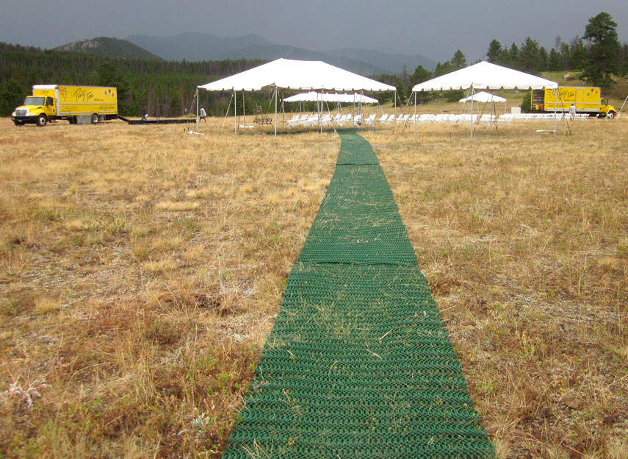
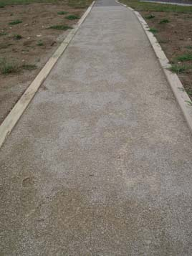
Path Surfaces
Photo: Montana League of Cities and Towns
Photo: National Center on Accessibility
For educational purposes only. Does not constitute legal advice.
Notes:
Advisory 302.1 General. A stable surface is one that remains unchanged by contaminants or applied force, so that when the contaminant or force is removed, the surface returns to its original condition. A firm surface resists deformation by either indentations or particles moving on its surface. A slip-resistant surface provides sufficient frictional counterforce to the forces exerted in walking to permit safe ambulation.
ABA: DESIGN TIP—Building a firm and stable surface
A firm and stable surface does not always mean concrete and asphalt. Some natural soils can be compacted so that they are firm and stable. Other soils can be treated with stabilizers without drastically changing their appearance. Designers are encouraged to investigate the options and use surfacing materials that are consistent with the site’s level of development and that require as little maintenance as possible.

Slide 32
On-Site
Obtain additional information and directions
  Clear signage
  Consider providing an accessible route map
Move around site
Attend performances, participate in activities, enter exhibits
Select and purchase items
Use public restrooms, shelters, first aid stations, & other amenities
For educational purposes only. Does not constitute legal advice.
Notes:
Once on site….
Clear, easy to read signage

Slide 33
Access to Activities
Concessions & Vendors
Height of service counters do not exceed 36 inches
Food and drink trailers may install a low folding shelf for condiments and menus
Or shared condiment table in or adjacent to nearby eating areas
People should be able to reach each area provided for dining and be able to pull up under at least 5% of tables
Accessible route to the area & adequate maneuvering space around and under tables
For educational purposes only. Does not constitute legal advice.
Notes:
Concessions offered by the event organizer and those offered by individual vendors should be accessible.
Food and Drink
Many of the ADA specifications for fixed facilities (restaurants, cafeterias, etc.) can be used in making temporary food service counters, trailers and tables accessible. The height of service counters must not exceed 36 inches. Food and drink offered from mobile trailers may need to install a low folding shelf.
While other accommodations may still be needed when actually serving food, condiments and menus can be placed on this auxiliary shelf within easy reach. It also may be possible for event vendors to jointly provide a condiment table in or adjacent to nearby eating areas.
People with mobility disabilities should be able to reach each area provided for dining and should be able to pull up under at least five percent of the tables. There must be an accessible route to the area and adequate maneuvering space around and under tables.
Where there are no tables near eating areas, consider providing one or two and some chairs. Such a courtesy will be helpful for many people with conditions that affect balance or stamina and who have trouble eating while standing or traveling.

Slide 34
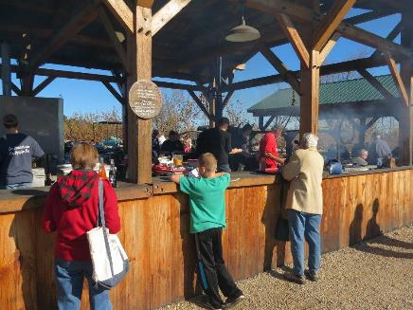
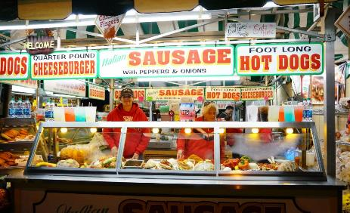
Access to Activities
Concessions & Vendors
  Photo: Topsfield Fair
  Examples for educational purposes
Notes:
Photo: Counter too high - even child is struggling
Concessions offered by the event organizer and those offered by individual vendors should be accessible.
Food and Drink
Many of the ADA specifications for fixed facilities (restaurants, cafeterias, etc.) can be used in making temporary food service counters, trailers and tables accessible. The height of service counters must not exceed 36 inches. Food and drink offered from mobile trailers may need to install a low folding shelf.
While other accommodations may still be needed when actually serving food, condiments and menus can be placed on this auxiliary shelf within easy reach. It also may be possible for event vendors to jointly provide a condiment table in or adjacent to nearby eating areas.
People with mobility disabilities should be able to reach each area provided for dining and should be able to pull up under at least five percent of the tables. There must be an accessible route to the area and adequate maneuvering space around and under tables.
Where there are no tables near eating areas, consider providing one or two and some chairs. Such a courtesy will be helpful for many people with conditions that affect balance or stamina and who have trouble eating while standing or traveling.

Slide 35
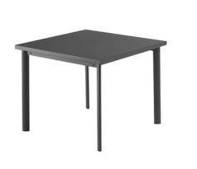
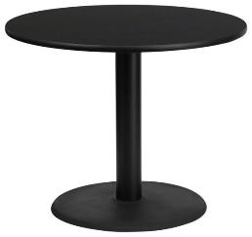
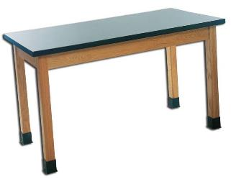
Access to Activities
Tables
Knee clearance- 27” min high
No center post
Caution with aprons
27 inches min
For educational purposes only. Does not constitute legal advice.
Notes:
The big message is that tables with center posts don’t work for people who use wheelchairs. At least some (preferably all) of the tables should have four legs with no apron or a small enough apron to provide 27 inch knee clearance.

Slide 36
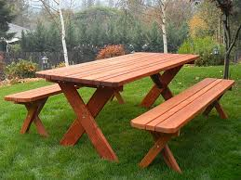
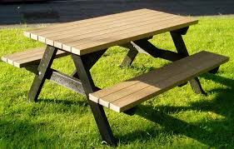
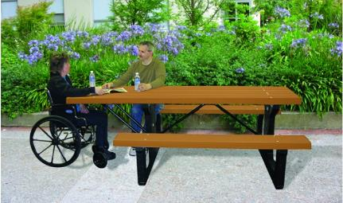
Access to Activities
Picnic Benches –some must be accessible
  Examples for educational purposes
Notes:
A “regular” picnic table will work if the benches aren’t attached. No need to buy an accessible one with the end sticking out unless the benches are attached.

Slide 37
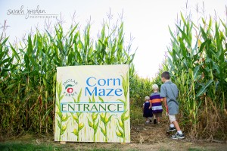
Access to Activities
Corn Mazes – accessibility considerations:
Route of travel:
No changes in level
appropriate width
hard-packed surface
free from pooling of water
Consider:
Vertical features: lookout towers, overpass
“3D” mazes
For educational purposes only. Does not constitute legal advice.
Notes:
Lets get to some related specifics:
Corn Mazes – The AAB would require that corn mazes be accessible. If the corn maze is recreated every year, you would need to consider the following for accesibility:
The route of travel, such as the surface, the width, any changes in level along the route (look out towers).
With that said, the look out towers would most likely require a variance to not be accessible, and it might be granted if there is an accessible route around the tower to continue the maze.
Outdoor events – The ADA and AAB would require accessible features at event tents and other amenities related to it.
A portion of the tables would need to be accessible.
The ground surface would need to be accessible.
If portable toilets are provided, accessible ones also need to be provided.
Stores and Farm Stands – The ADA and AAB would require accessible features here.
The entry,
The accessible route around the store,
The checkout area
Gazebos – The ADA and AAB would require access onto the gazebo.
Picnic Benches – The ADA and AAB would require some of the picnic benches to be accessible to pwd’s.
Christmas Tree Farms – The AAB would require that there be an accessible route to, maybe not the entire tree farm, but to at least all of the different types of trees offered.
Apple Picking – The AAB would also require something similar to the Christmas tree example. There may not be an accessible route to all of the apple trees on the farm, but would require access to the different types of apples to be picked.

Slide 38
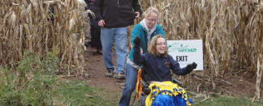
Access to Activities
“Many people bring wheelchairs and strollers through the maze and the other attractions at the maze. You should be aware that each phase of the maze has a bridge, which is not accessible to wheeled vehicles, but paths are cut to go around them. Also, the ground tends to be uneven and bumpy in places.”
“Corn Maze dirt paths are wide enough for wheelchairs, but may have ruts or mud during and after inclement weather.”
“The maze is wheelchair friendly. Please call or check our website before visiting the maze to get current maze conditions…When we have dry conditions, the maze paths are smooth enough for wheelchairs and strollers.”
“We are semi-accessible. Conditions are dependent on ground moisture, when the ground is soft after a rain, it would be difficult to maneuver. We’d recommend the Hay Maze, which is on the black top for wheel chairs!”
  Examples for educational purposes
For educational purposes only. Does not constitute legal advice.
Notes:
Lets get to some related specifics:
Corn Mazes – The AAB would require that corn mazes be accessible. If the corn maze is recreated every year, you would need to consider the following for accesibility:
The route of travel, such as the surface, the width, any changes in level along the route (look out towers).
With that said, the look out towers would most likely require a variance to not be accessible, and it might be granted if there is an accessible route around the tower to continue the maze.
Outdoor events – The ADA and AAB would require accessible features at event tents and other amenities related to it.
A portion of the tables would need to be accessible.
The ground surface would need to be accessible.
If portable toilets are provided, accessible ones also need to be provided.
Stores and Farm Stands – The ADA and AAB would require accessible features here.
The entry,
The accessible route around the store,
The checkout area
Gazebos – The ADA and AAB would require access onto the gazebo.
Picnic Benches – The ADA and AAB would require some of the picnic benches to be accessible to pwd’s.
Christmas Tree Farms – The AAB would require that there be an accessible route to, maybe not the entire tree farm, but to at least all of the different types of trees offered.
Apple Picking – The AAB would also require something similar to the Christmas tree example. There may not be an accessible route to all of the apple trees on the farm, but would require access to the different types of apples to be picked.

Slide 39
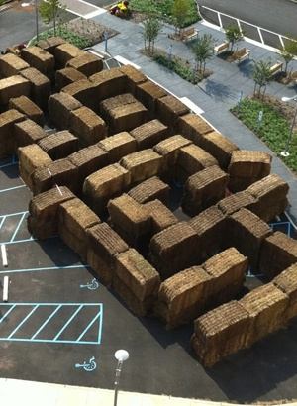
Access to Activities
  Example for educational purposes
Photo: JR Global Events www.jrglobalevents.com
Notes:
Lets get to some related specifics:
Corn Mazes – The AAB would require that corn mazes be accessible. If the corn maze is recreated every year, you would need to consider the following for accesibility:
The route of travel, such as the surface, the width, any changes in level along the route (look out towers).
With that said, the look out towers would most likely require a variance to not be accessible, and it might be granted if there is an accessible route around the tower to continue the maze.
Outdoor events – The ADA and AAB would require accessible features at event tents and other amenities related to it.
A portion of the tables would need to be accessible.
The ground surface would need to be accessible.
If portable toilets are provided, accessible ones also need to be provided.
Stores and Farm Stands – The ADA and AAB would require accessible features here.
The entry,
The accessible route around the store,
The checkout area
Gazebos – The ADA and AAB would require access onto the gazebo.
Picnic Benches – The ADA and AAB would require some of the picnic benches to be accessible to pwd’s.
Christmas Tree Farms – The AAB would require that there be an accessible route to, maybe not the entire tree farm, but to at least all of the different types of trees offered.
Apple Picking – The AAB would also require something similar to the Christmas tree example. There may not be an accessible route to all of the apple trees on the farm, but would require access to the different types of apples to be picked.

Slide 40
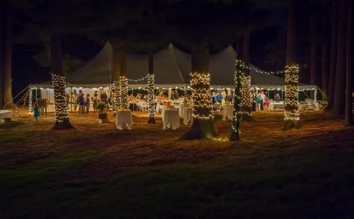
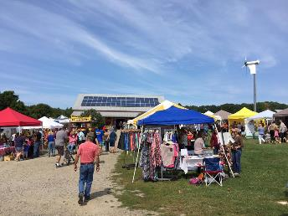
Access to Activities
Outdoor & Temporary events
  A portion of tables accessible.
  Accessible ground surface
  If portable toilets are provided, some must be accessible
  Examples for educational purposes
For educational purposes only. Does not constitute legal advice.
Notes:
Gravel not accessible- need hard-packed
Grass is not accessible- tents should be closer
Stone dust
Permanent or temporary?

Slide 41
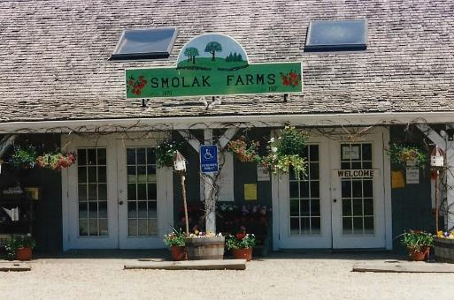
Access to Activities
Stores and Farm Stands
  Accessible entry
  Accessible route around the store
  Accessible checkout area
For educational purposes only. Does not constitute legal advice.
  Example for educational purposes
Notes:
Lets get to some related specifics:
Corn Mazes – The AAB would require that corn mazes be accessible. If the corn maze is recreated every year, you would need to consider the following for accesibility:
The route of travel, such as the surface, the width, any changes in level along the route (look out towers).
With that said, the look out towers would most likely require a variance to not be accessible, and it might be granted if there is an accessible route around the tower to continue the maze.
Outdoor events – The ADA and AAB would require accessible features at event tents and other amenities related to it.
A portion of the tables would need to be accessible.
The ground surface would need to be accessible.
If portable toilets are provided, accessible ones also need to be provided.
Stores and Farm Stands – The ADA and AAB would require accessible features here.
The entry,
The accessible route around the store,
The checkout area
Gazebos – The ADA and AAB would require access onto the gazebo.
Picnic Benches – The ADA and AAB would require some of the picnic benches to be accessible to pwd’s.
Christmas Tree Farms – The AAB would require that there be an accessible route to, maybe not the entire tree farm, but to at least all of the different types of trees offered.
Apple Picking – The AAB would also require something similar to the Christmas tree example. There may not be an accessible route to all of the apple trees on the farm, but would require access to the different types of apples to be picked.

Slide 42
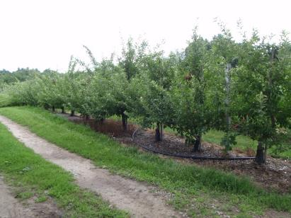
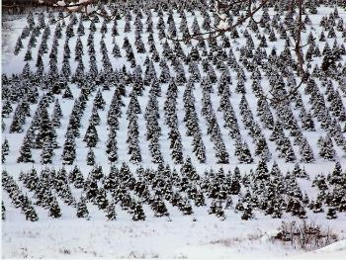
Access to Activities
Pick-Your-Own
Accessible route to, maybe not the entire tree farm, but at least to each different type of tree
For educational purposes only. Does not constitute legal advice.
Notes:
Lets get to some related specifics:
Corn Mazes – The AAB would require that corn mazes be accessible. If the corn maze is recreated every year, you would need to consider the following for accesibility:
The route of travel, such as the surface, the width, any changes in level along the route (look out towers).
With that said, the look out towers would most likely require a variance to not be accessible, and it might be granted if there is an accessible route around the tower to continue the maze.
Outdoor events – The ADA and AAB would require accessible features at event tents and other amenities related to it.
A portion of the tables would need to be accessible.
The ground surface would need to be accessible.
If portable toilets are provided, accessible ones also need to be provided.
Stores and Farm Stands – The ADA and AAB would require accessible features here.
The entry,
The accessible route around the store,
The checkout area
Gazebos – The ADA and AAB would require access onto the gazebo.
Picnic Benches – The ADA and AAB would require some of the picnic benches to be accessible to pwd’s.
Christmas Tree Farms – The AAB would require that there be an accessible route to, maybe not the entire tree farm, but to at least all of the different types of trees offered.
Apple Picking – The AAB would also require something similar to the Christmas tree example. There may not be an accessible route to all of the apple trees on the farm, but would require access to the different types of apples to be picked.

Slide 43
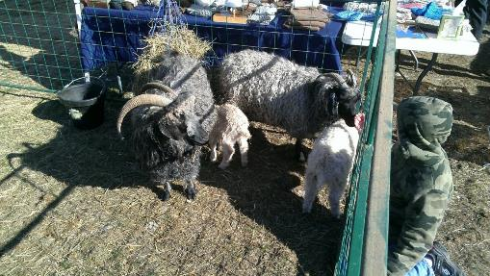
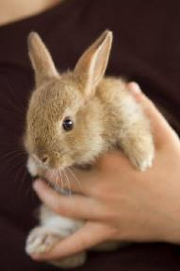
Access to Activities
Petting Zoos
  An accessible route to the petting area
  Access into the area
  Food distribution containers at an accessible reach height.
For educational purposes only. Does not constitute legal advice.
Notes:
More examples:
Parking – The ADA and AAB would require parking to comply with the regulations. Parking provided on a temporary basis has specific obligations that differ from permanent parking lots.
Nature Trails – The AAB would require certain elements of nature trails to be accessible. However, given the uniqueness of nature trails, variances are often granted for certain portions.
Petting Zoos – The ADA and AAB would require certain elements to be accessible, such as
An accessible route to the petting area
Access into the area if available
Food distribution containers need to be at an accessible reach height.
Playgrounds – The ADA and AAB both have obligations that cover this ranging from the surface and route around the equipment as well as the ADA having specific obligations for the equipment itself, depending on the number of elements provided.

Slide 44
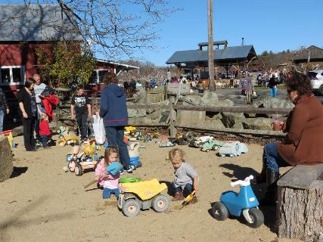
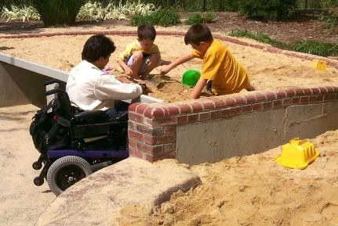
Access to Activities
Playgrounds – surface, route around equipment, play elements
Research: A Longitudinal Study of Playground Surfaces, National Center on Accessibility, Indiana University - Bloomington
Photo: Centers for Disease Control/ Richard Duncan
  Examples for educational purposes
For educational purposes only. Does not constitute legal advice.
Notes:
Recommended but no ADA obligation for accessible equipment, just accessible route to one of each type.
Sandbox- Accessible route to and into
Access to elements in sandbox
Rubberized surface for wheelchair user access
More examples:
Parking – The ADA and AAB would require parking to comply with the regulations. Parking provided on a temporary basis has specific obligations that differ from permanent parking lots.
Nature Trails – The AAB would require certain elements of nature trails to be accessible. However, given the uniqueness of nature trails, variances are often granted for certain portions.
Petting Zoos – The ADA and AAB would require certain elements to be accessible, such as
An accessible route to the petting area
Access into the area if available
Food distribution containers need to be at an accessible reach height.
Playgrounds – The ADA and AAB both have obligations that cover this ranging from the surface and route around the equipment as well as the ADA having specific obligations for the equipment itself, depending on the number of elements provided.

Slide 45
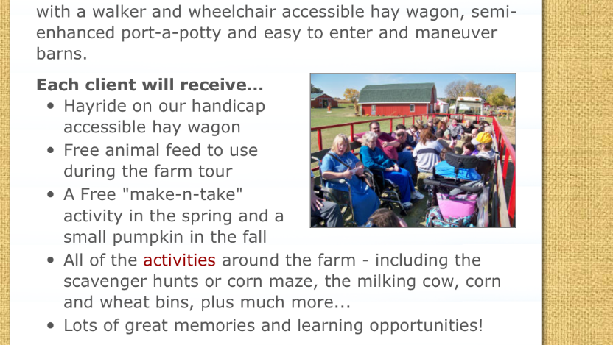
Access to Activities
Example for education purposes
For educational purposes only. Does not constitute legal advice.
Notes:
Sandbox- Accessible route to and into
Access to elements in sandbox
Rubberized surface for wheelchair user access
More examples:
Parking – The ADA and AAB would require parking to comply with the regulations. Parking provided on a temporary basis has specific obligations that differ from permanent parking lots.
Nature Trails – The AAB would require certain elements of nature trails to be accessible. However, given the uniqueness of nature trails, variances are often granted for certain portions.
Petting Zoos – The ADA and AAB would require certain elements to be accessible, such as
An accessible route to the petting area
Access into the area if available
Food distribution containers need to be at an accessible reach height.
Playgrounds – The ADA and AAB both have obligations that cover this ranging from the surface and route around the equipment as well as the ADA having specific obligations for the equipment itself, depending on the number of elements provided.

Slide 46
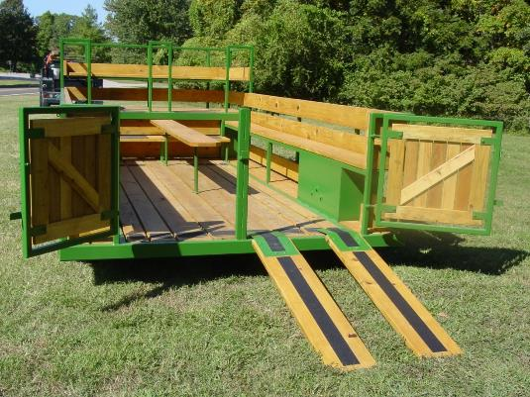
Access to Activities
“St. Louis County Parks and Recreation carpentry crew researched, designed and built a new hay wagon that makes this annual autumn tradition available to everyone.”
  Example for educational purposes
Notes:
Options could allow persons with mobility disability to enter the bog
“Tank” allows someone who cannot enter the bog to experience a simulation
There are earthen ramps leading into some of the bogs. The earthen ramps are a firm, sloped, grassy
surface that allows entry to the bog. The bog surface is also a firm, stable, solid surface to which the
cranberry vines are attached. People entering the bog wear waist high waders as the water can be cold in
October.
Not all bogs have the earthen ramps, which are provided primarily for harvesting operations, not for the
touring programs. During our discussion, you mentioned that, eventually, you would like to have earthen
ramps at all of the bogs.
You also mentioned that determining which bog can be used for the tours is often chosen a couple of days
before, if not the day of, the scheduled tour due to the current harvesting operations. Sometimes bogs
without earthen ramps must be chosen due to the limited availability.
The earthen ramps provide a unique entry point for people participating in the “Be the Grower Experience”
tour. They vary in slope as the topography of each bog is different.
There are a couple of options that could be implemented to improve the accessibility into the bogs with
earthen ramps provided:
1. Provide a “fish tank” experience near the bog and/or in the museum. Create a simulated bog
within a see‐through tank that people who cannot enter the bog can use to experience the
ecosystem of the bog and possible “harvesting” of the tank.
2. A portable platform system that has handrails attached to assist people with entering the bog.
The pictures below are only concept ideas.

Slide 47
Access to Activities
Cranberry Bog Example: “Be The Grower” Experience Tour
Earthen ramps - firm, sloped, grassy surface that allows entry to the bog
Vary in slope as the topography of each bog is different
People entering the bog wear waist high waders
  Example for educational purposes
Notes:
Options could allow persons with mobility disability to enter the bog
“Tank” allows someone who cannot enter the bog to experience a simulation
There are earthen ramps leading into some of the bogs. The earthen ramps are a firm, sloped, grassy
surface that allows entry to the bog. The bog surface is also a firm, stable, solid surface to which the
cranberry vines are attached. People entering the bog wear waist high waders as the water can be cold in
October.
Not all bogs have the earthen ramps, which are provided primarily for harvesting operations, not for the
touring programs. During our discussion, you mentioned that, eventually, you would like to have earthen
ramps at all of the bogs.
You also mentioned that determining which bog can be used for the tours is often chosen a couple of days
before, if not the day of, the scheduled tour due to the current harvesting operations. Sometimes bogs
without earthen ramps must be chosen due to the limited availability.
The earthen ramps provide a unique entry point for people participating in the “Be the Grower Experience”
tour. They vary in slope as the topography of each bog is different.
There are a couple of options that could be implemented to improve the accessibility into the bogs with
earthen ramps provided:
1. Provide a “fish tank” experience near the bog and/or in the museum. Create a simulated bog
within a see‐through tank that people who cannot enter the bog can use to experience the
ecosystem of the bog and possible “harvesting” of the tank.
2. A portable platform system that has handrails attached to assist people with entering the bog.
The pictures below are only concept ideas.

Slide 48
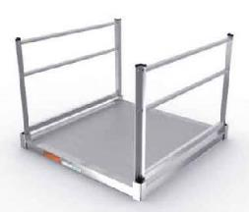
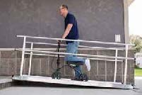
Access to Activities
“Be The Grower” Experience Tour
Potential ways to improve accessibility:
Create a simu-bog within a see‐through tank that people who cannot enter the bog can use to see/ experience the ecosystem of the bog and possible “harvesting” of the tank.
Portable platform system with handrails could assist people with entering the bog.
  Example for educational purposes
Notes:
Provide a “fish tank” experience near the bog and/or in the museum.
Options could allow persons with mobility disability to enter the bog
“Tank” allows someone who cannot enter the bog to experience a simulation
There are earthen ramps leading into some of the bogs. The earthen ramps are a firm, sloped, grassy
surface that allows entry to the bog. The bog surface is also a firm, stable, solid surface to which the
cranberry vines are attached. People entering the bog wear waist high waders as the water can be cold in
October.
Not all bogs have the earthen ramps, which are provided primarily for harvesting operations, not for the
touring programs. During our discussion, you mentioned that, eventually, you would like to have earthen
ramps at all of the bogs.
You also mentioned that determining which bog can be used for the tours is often chosen a couple of days
before, if not the day of, the scheduled tour due to the current harvesting operations. Sometimes bogs
without earthen ramps must be chosen due to the limited availability.
The earthen ramps provide a unique entry point for people participating in the “Be the Grower Experience”
tour. They vary in slope as the topography of each bog is different.
There are a couple of options that could be implemented to improve the accessibility into the bogs with
earthen ramps provided:
1. Provide a “fish tank” experience near the bog and/or in the museum. Create a simulated bog
within a see‐through tank that people who cannot enter the bog can use to experience the
ecosystem of the bog and possible “harvesting” of the tank.
2. A portable platform system that has handrails attached to assist people with entering the bog.
The pictures below are only concept ideas.

Slide 49
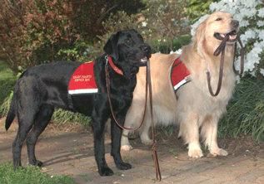
Service Animals

Slide 50
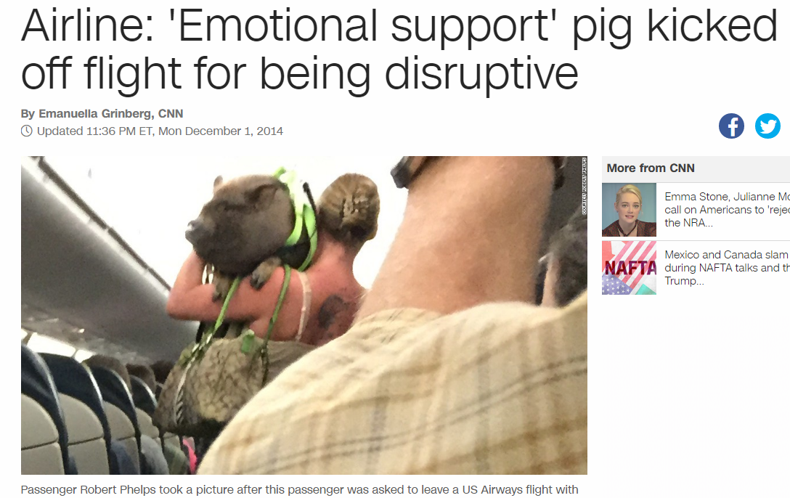
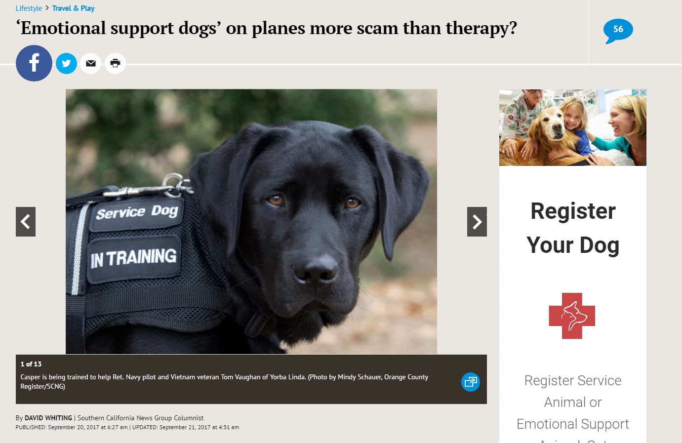
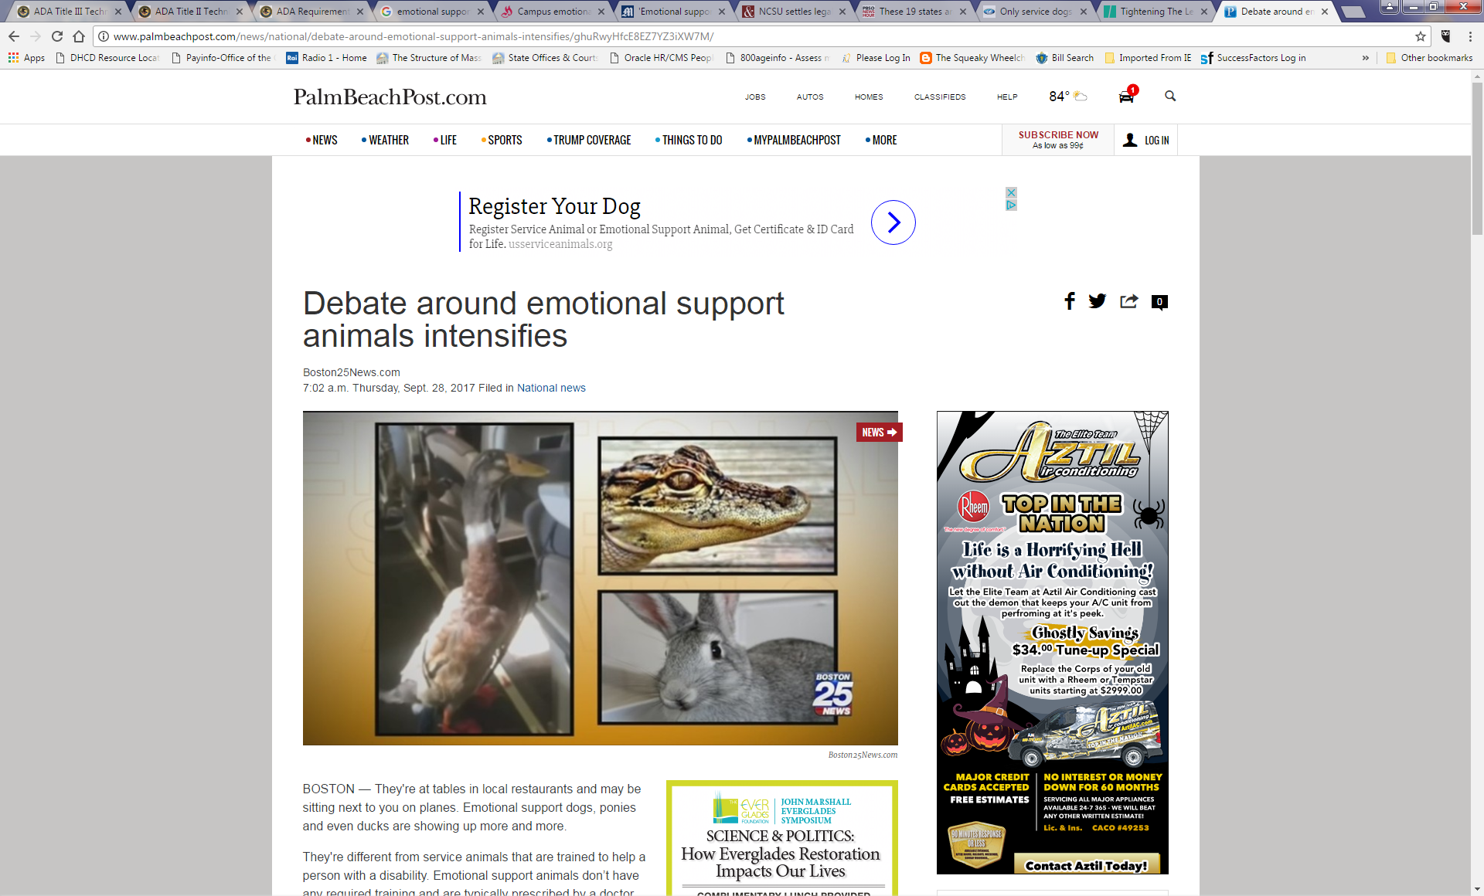
Misconceptions
For educational purposes only. Does not constitute legal advice.
Notes:
To clarify- air carriers are covered under a DIFFERENT LAW
We are dealing with SERVICE dogs & SERVICE mini horses only- in public places

Slide 51
ADA Definition
Service animals: dogs individually trained to perform tasks for people with disabilities.
“Perform tasks” trained to take a specific action when needed:
Guiding people who are blind
Alerting people who are deaf
Pulling wheelchairs
Protecting a person who is having a seizure
Retrieving objects
Etc.
People with disabilities have the right to train the dog and are not required to use a professional service dog training program.
For educational purposes only. Does not constitute legal advice.

Slide 52
Psychiatric Service Animals
Psychiatric service animals - considered service animals by DOJ
Trained to provide a task or service for an individual with a psychiatric disability.
“recognize & respond”
Distinct from “emotional support” and “companion” animals
      Calming person during panic attack
      Reminding person to take medication
      Assisting someone with PTSD
      Interrupting compulsive behavior
For educational purposes only. Does not constitute legal advice.

Slide 53
Miniature Horses
24” - 34” in height
70 - 100 lbs.
Covered entities must permit miniature horses
based on:
whether miniature horse is housebroken
whether miniature horse is under control
whether the facility can accommodate horse’s type, size, and weight
whether horse’s presence will compromise legitimate safety requirements necessary for safe operation of the service.
For educational purposes only. Does not constitute legal advice.

Slide 54
Rights & Responsibilities
Permitted anywhere the handler may go: cafeterias, restrooms
Any breed weight, size
Working animals and not pets
Under control at all times
Housebroken
May not pose direct threat to health or safety
For educational purposes only. Does not constitute legal advice.
Notes:
According to DOJ FAQ: “Service animals can be restricted from areas where the animals on display are the natural prey or natural predators of dogs, where the presence of a dog would be disruptive, causing the displayed animals to behave aggressively or become agitated. They cannot be restricted from other areas.”
In Mass, under M.G.L. c. 129, Section 39F Training animals in training are permitted where service animals are permitted.
Can proof of rabies vaccination be requested of service animals? 302 CMR 12.13(7) omits service animals from the list of animals required to produce proof of rabies vaccine.
A service animal user can be asked whether their animal is up-to-date on its rabies vaccination; HOWEVER, they cannot be asked to produce documentation or other proof of vaccination, and the service animal cannot be automatically excluded if it does not have its rabies vaccination. A service animal without its rabies vaccination can only be excluded if its behavior constitutes a “direct threat” or if there is a documented outbreak of rabies in the geographic vicinity or some other fact which causes a reasonable person to believe that there is a high likelihood that this particular animal has rabies (this scenario might also be considered a direct threat).
Can service animals be prohibited from an area that serves as a water source based upon the risk that a service animal could defecate and contaminate the water source?
If the area is open to the public, a service animal cannot be precluded based upon the potential for the animal to defecate. The expectation of the ADA is that service animals are trained to go to the bathroom in appropriate settings only. If there is a direct threat (imminent) that the animal will go to the bathroom – based upon its current behavior or if that particular animal has a track record of defecating in prohibited areas - then that particular animal could be precluded. But, such decision cannot be based on fear, generalization, or presumption.
An endanger species has a defined habitat that is markedly adverse to dogs. Dogs moving through the habitat have the risk of ruining the habitat and harming the species. While humans are allowed to enter it, must service animals be allowed in the habitat?
If science demonstrates that service animals would cause a direct threat (imminent, clear, not based on supposition or stereotype) to the health and safety of the piping plover then service animals may be prohibited from the habitat area.

Slide 55
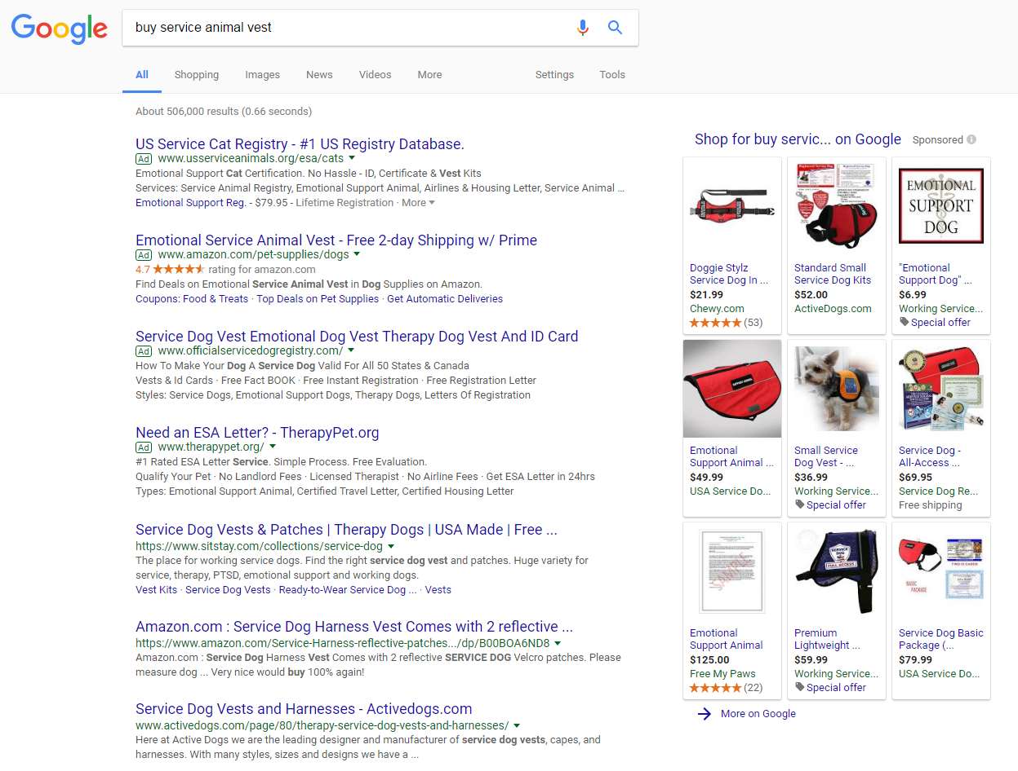
Misconceptions
For educational purposes only. Does not constitute legal advice.
Notes:
According to DOJ FAQ: “Service animals can be restricted from areas where the animals on display are the natural prey or natural predators of dogs, where the presence of a dog would be disruptive, causing the displayed animals to behave aggressively or become agitated. They cannot be restricted from other areas.”
In Mass, under M.G.L. c. 129, Section 39F Training animals in training are permitted where service animals are permitted.
Can proof of rabies vaccination be requested of service animals? 302 CMR 12.13(7) omits service animals from the list of animals required to produce proof of rabies vaccine.
A service animal user can be asked whether their animal is up-to-date on its rabies vaccination; HOWEVER, they cannot be asked to produce documentation or other proof of vaccination, and the service animal cannot be automatically excluded if it does not have its rabies vaccination. A service animal without its rabies vaccination can only be excluded if its behavior constitutes a “direct threat” or if there is a documented outbreak of rabies in the geographic vicinity or some other fact which causes a reasonable person to believe that there is a high likelihood that this particular animal has rabies (this scenario might also be considered a direct threat).
Can service animals be prohibited from an area that serves as a water source based upon the risk that a service animal could defecate and contaminate the water source?
If the area is open to the public, a service animal cannot be precluded based upon the potential for the animal to defecate. The expectation of the ADA is that service animals are trained to go to the bathroom in appropriate settings only. If there is a direct threat (imminent) that the animal will go to the bathroom – based upon its current behavior or if that particular animal has a track record of defecating in prohibited areas - then that particular animal could be precluded. But, such decision cannot be based on fear, generalization, or presumption.
An endanger species has a defined habitat that is markedly adverse to dogs. Dogs moving through the habitat have the risk of ruining the habitat and harming the species. While humans are allowed to enter it, must service animals be allowed in the habitat?
If science demonstrates that service animals would cause a direct threat (imminent, clear, not based on supposition or stereotype) to the health and safety of the piping plover then service animals may be prohibited from the habitat area.

Slide 56
FAQ
Q: How can I tell if an animal is really a service animal and not just a pet?
A: If you are not sure that a dog is a service animal, you may ask the handler ONLY:
if it is a service animal required because of a disability and
what work it performs.
For educational purposes only. Does not constitute legal advice.

Slide 57
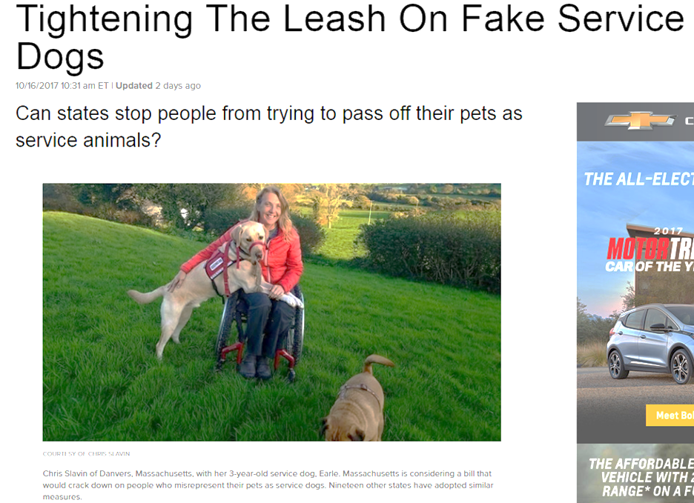
FAQ
Q: What if I think the person is lying about the animal being a service animal?

Slide 58
FAQ
Q: What if I think the person is lying about the animal being a service animal when answering the two questions?
A: The law requires you to take the person at their word.
For educational purposes only. Does not constitute legal advice.

Slide 59
FAQ
But remember, service animals must be:
Under control at all times
Housebroken
May not pose direct threat to health or safety
If handler does not correct behavior, you may ask handler to remove the animal.
You must still provide access & services to the person.
For educational purposes only. Does not constitute legal advice.

Slide 60
Recommendations
Plan ahead
Identify a point-person for accessibility (ADA Coordinator or other)
Select most accessible site available
Train staff and volunteers
Make a checklist of programs, activities, services, amenities, etc.
Survey the program/activity
Review policies, practices
Ensure effective communication
Budget for accommodations
Good faith effort
On-going assessment
For educational purposes only. Does not constitute legal advice.

Slide 61
Resources
U.S. Access Board: www.access-board.gov
  Standards for Outdoor Developed Areas
  Requirements for Recreation Facilities in the ADA
ADA National Network: adata.org
  A Planning Guide for Making Temporary Events Accessible to People with Disabilities
National Center on Accessibility: www.ncaonline.org
  Trail Surfaces Study
  Playground Study

Slide 62




Thank You
Contact Us:
The Massachusetts Office On Disability
1 Ashburton Place, Room 1305
Boston, MA 02108
617 727-7440
mass.gov/mod
blog.mass.gov/mod
@Massdisability
Mass Office on Disability

Slide 63
Accessible Agritourism
  Examples used throughout this presentation are for educational purposes only.
  They are not necessarily intended to serve as recommendations for best practices or endorsements of particular businesses, programs, activities, or products.
mass.gov/mod
blog.mass.gov/mod
@Massdisability
Mass Office on Disability

