Slide 1
3 diverse stories and
1 collaborative process
Jeannie Sharp, AT Ag Specialist
Cassie Ramon, AT Ag Specialist

Slide 2
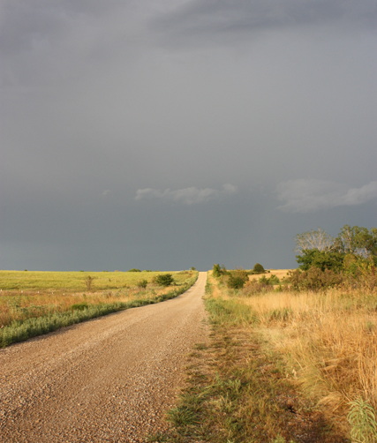
Road map
Kansas AgrAbility
Collaborative Process
3 Case Studies and Solutions
Questions

Slide 3
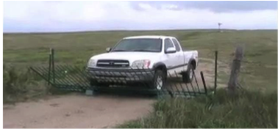
Kansas agrability purpose
Promoting success in agriculture for producers with disabilities or chronic health conditions, including family members and employees.

Slide 4

Kansas agrability partners
Kansas State University
Southeast Kansas Independent Living
Assistive Technology for Kansans
Notes:
1. Land grant school; 2. largest rural center for independent living in KS – provides services across the state; 3. statewide AT program

Slide 5
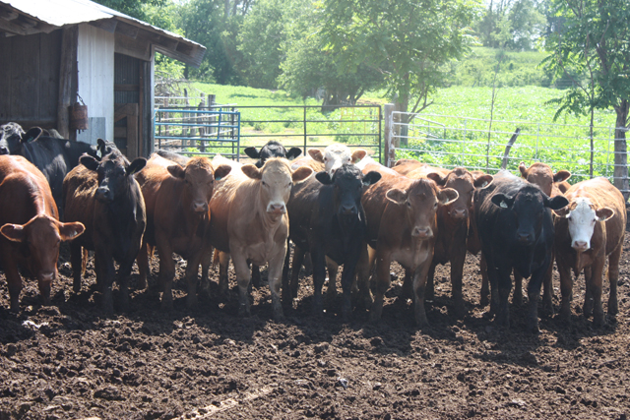
Collaboration is the key
Focus is on the customer’s priorities and concerns.
Family is involved whenever possible.
Multiple partners are discussed as needs and solutions are considered.
Goals with timelines and responsible parties are developed with the customer and team.
Goals are reviewed to examine progress.
Data is collected on completed goals to determine customer’s satisfaction, financial value of any solution funded, and if it accomplished the original purpose.
  KS does participate in pre and post service questionnaires as part of the Impact Evaluation study with many other SRAPs.
Notes:
Collaborative process: discuss options, possible partners, set goals, implement plans, meet goals, and evaluate the outcomes.

Slide 6

Onsite review of all aspects of daily routines, including tasks that are not possible at this time.
Share information on possible solutions.
Discuss possible partners for problem solving, resource identification, and funding.
Set goals and implement action to achieve them.
Provide options of visiting with others who use these solutions.
  Trial use when possible.
  Seek funding for customer needed modifications.
Evaluate the results.
Notes:
Collaborative process discuss options, possible partners, set goals, implement plans, meet goals, and evaluate the outcomes

Slide 7
Case 1: Cattle handling
Western KS rancher had difficulty walking, maintaining balance on different surfaces, and had a hearing loss.
  Chronic meningitis and other factors contributed to these issues.
The ag operation consisted of field/grain crops and cattle.
Kansas AgrAbility staff met with the rancher and his wife. No other family was on site.
  Collaborative process: discuss options, possible partners, set goals, implement plans, meet goals, and evaluate the outcomes.

Slide 8
Case 1: partners
After consensus was reached with the customer and his wife, AgrAbility staff contacted:
  Occupational therapist with experience in ag settings
  Temple Grandin, Colorado University
  Kansas Ag Mediation
  Local banker
  Vocational Rehabilitation
  Kansas WORKS program (Personal attendant funds)
Notes:
OT – review issues relevant to balance and access
Grandin – national expert on cattle handling pens who was a speaker for AgrAbility a few months earlier
Ag Mediation: financial advice, review his operation, business plan and future priorities
VR: services and financial resources
WORK Program - reviews possible supports to maintain independence and employment

Slide 9
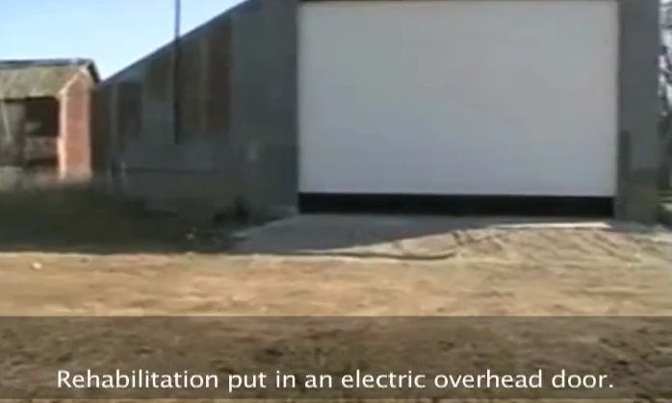
Case 1: farm site solutions
Replacement of heavy sliding shop doors with overhead electric shop door
Installation of concrete apron to the shop door found at found at https://www.youtube.com/watch?v=AM4c4xjOsVo&list=PLnf_161Gez5Ul2EUluioP7WSyHwt3442J
Notes:
OT conducted onsite assessment of farm site and fields/pastures where he worked cattle.
VR provided funding supports.
Local vendor installed door and bin steps.

Slide 10
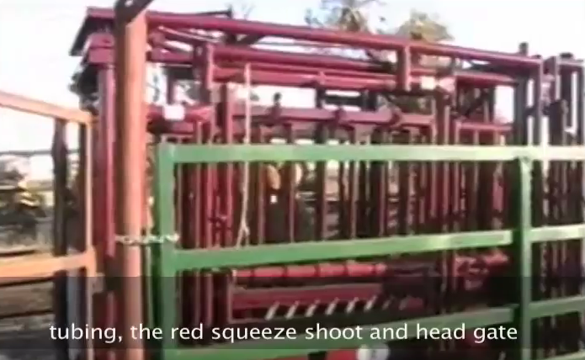
Case 1: cattle handling solutions
Custom portable cattle panels
Squeeze shoot and head gate
Truck with bale bed
  Pickup upgraded
Custom cattle pens at https://www.youtube.com/watch?v=Qm30XhcLPVg&list=PLnf_161Gez5Ul2EUluioP7WSyHwt3442J
Notes:
KS WORKS provided a direct services worker who assisted with tasks that were a problem due to balance and strength issues.
T Grandin designed the corral handling system.
VR provided funds.

Slide 11
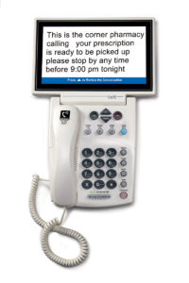
Case 1: home solutions
Accessible smoke detectors and signalers
Captioned telephone
  App for emergency alerts
Notes:
FEMA grant provided the accessible detectors and signalers.
Phone provided by KS TAP.

Slide 12
Summary – outcomes
Farmer was able to work independently with some assistance from his personal attendant.
  Family’s concerns about his safety were addressed.
Farm equipment and out buildings were accessible for the client.
Customer was able to continue in all areas of his agricultural operation.
Customer was safer in his home with improved communication options and accessible fire/smoke detectors and alarms.

Slide 13
Case 2: field/grain crops
Kansas farmer with a spinal cord injury had difficulty with reaching, lifting, mobility, and access to machinery and work sites.
  Diagnosed with paraplegia so he had some fine motor dexterity.
The ag operation consisted of field/grain crops with some livestock.
Kansas AgrAbility staff met with the farmer and his girlfriend.
  Collaborative Procedure: discuss options, possible partners, set goals, implement plans, meet goals, and evaluate the outcomes.

Slide 14
Case 2: partners
After consensus reached with the customer and his girlfriend, AgrAbility staff reached out to:
  Madonna Rehabilitation driving program
  ATV dealer
  Local construction company and local churches
  Vocational rehabilitation
  Local welder identified by a KS AgrAbility customer for hand control fabrication
  Travis Roy Foundation
  League of Human Dignity
  ATK reuse program, KEE

Slide 15
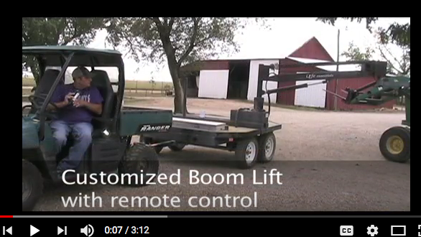
Case 2: farm site solutions
Hand controls on pickup
Tractor boom lift, found at https://www.youtube.com/watch?v=ZFj5roffCIc&list=PLnf_161Gez5Ul2EUluioP7WSyHwt3442J
Manual wheelchair used to get to 4 wheeler
Standing wheelchair used in the house
Notes:
Madonna Rehab driving program. Farmer with SCI who no longer needed his hand controls made by a local welder.
Vocational rehabilitation. Installed by vendor.
Private insurance, VR. ATK reuse – KEE but it was returned.

Slide 16
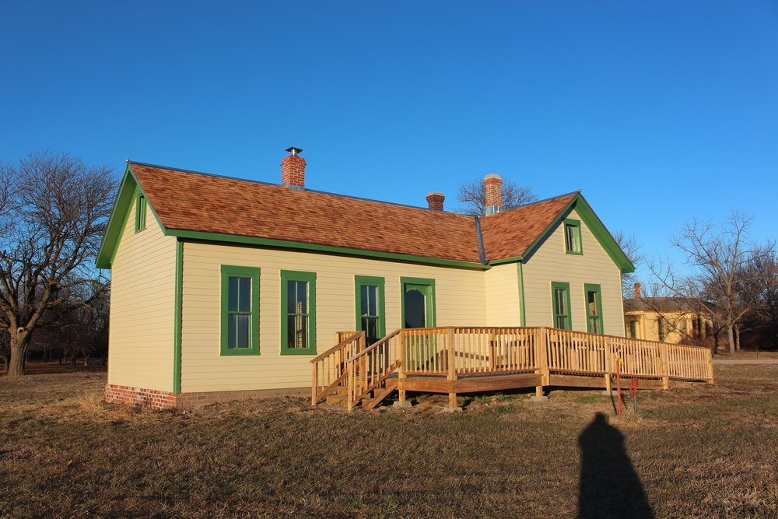
Case 2: home solutions
Front and back door ramps
Driveway and sidewalks poured
Notes:
Important to be independent around his worksite since he lived alone
Vocational rehabilitation funded. Local contractor although considered local church options for ramps.

Slide 17
Summary - outcomes
Farm site was accessible with manual wheelchair and the 4-wheeler.
Farmer was able to drive his pickup, access all equipment, and continue in his field/grain and cattle management.
Goal not achieved: Identifying an accessible saddle that allowed him to handle cattle from horseback on his operation’s hilly terrain.
  Safety issues due to difficulty with balance, terrain demands, and inability to anticipate animals’ behavior.
  Riding for recreation (or event mental health) was not an interest at that time.

Slide 18
Case 3: New farm ventures
A farmer in eastern Kansas has a spinal cord injury and chronic health conditions associated with transverse myelitis.
He wants to continue a small cattle operation, field crops and is considering a new agribusiness venture.
Kansas AgrAbility staff met with the farmer who lives alone. No other family is onsite.
  Collaborative process: discuss options, possible partners, set goals, implement plans, meet goals, and evaluate the outcomes.

Slide 19
Case 3: partners
After consensus was reached with the customer, AgrAbility staff reached out to:
  Veterans Administration since he is a veteran
  VA Vocational Rehabilitation & Employment
  Kansas Vocational Rehabilitation
The farmer uses hired help so they are another resource.
Notes:
Found the champion in the system – empathetic to farming and AT supporter

Slide 20
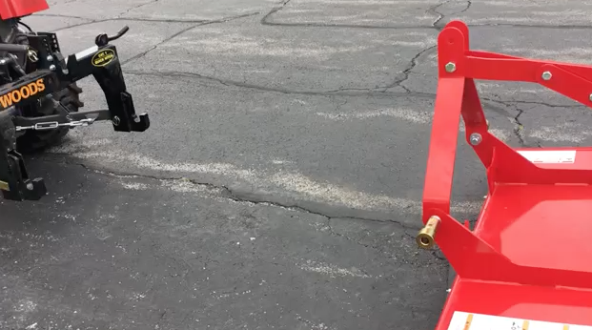
Case 3: work site solutions
Pilot lift on trailer to access multiple devices
Tractor for mowing and feeding cattle – wider door access
Hand controls for the tractor
Quick release hitches found at https://www.youtube.com/watch?v=uYexb_5G3RM
Notes:
PTO quick hitch video – not ours, but a good example (Delta Hook is this one) 2 min 21 seconds

Slide 21
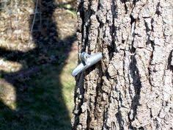
Case 3: new ag operation
Walnut syrup – new business plan
  4 wheel vehicle
  Review sap collection system, evaporation and filtering demands for accessibility issues

Slide 22
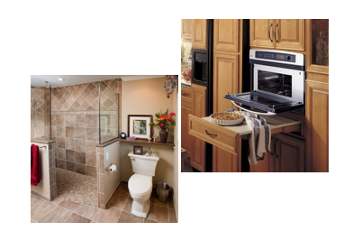
Case 3: accessible home
Planning an accessible home
  Prioritizing bathroom and entrances, but other areas are being considered.
  Kitchen is his 2nd priority for practical and entertainment reasons.

Slide 23
Summary - outcomes
The case is still in process.
The farmer is positive about the solutions discussed and may meet other AgrAbility customers to talk about their equipment solutions.
There is some frustration with the timeliness of the VA’s VR&E system, but the supervisor for the program is supportive of assistive technology and excited about working with farmers so support is there.

Slide 24
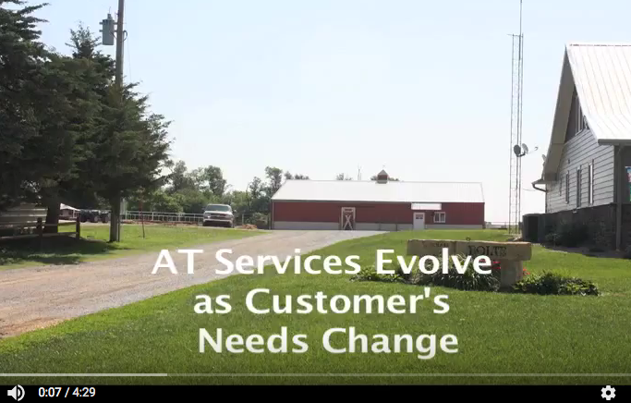
Collaboration involves long term considerations
Finally, the collaborative process has to address the future.
Disabilities can progress.
Secondary injuries must be considered so they can be avoided.
Boltes tell their story at https://www.youtube.com/watch?v=n8zy5EpU3mI&feature=youtu.be

Slide 25
Questions?
Jeannie Sharp, AT Ag Specialist
  Oakley, KS
  785-672-3125, jsharp@nkesc.org
Cassie Ramon, AT Ag Specialist
  Salina, KS
  785-827-9383, cramon@occk.com
800-526-3648
KS AgrAbility is at http://www.bae.ksu.edu/extension/agrability/
ATK is at http://atk.ku.edu.

