Slide 1
Worksite and Secondary Injury Assessment and Documentation
Stephen J. Swain, ATP, Assistive Technology Specialist
Dr. Shawn Ehlers, ATP, Technology Outreach Coordinator
Dr. Bill Field, NAP Project Director
National AgrAbility Project

Slide 2
Overview
Principles for Providing Assistive Technology
Agricultural Worksite Assessment Tool
Assistive Technology Assessment Steps
Updates to Worksite Assessment Tool
Demonstrate Fillable PDF Update
Assistive Technology Solutions
Liability
AT Do’s and Don’ts
Secondary Injury Assessment Tool

Slide 3
What is Assistive Technology? (AT)
Any item, piece of equipment, or product system, whether acquired commercially, modified, or customized, that is used to increase, maintain, or improve functional capabilities of individuals with disabilities. (Assistive Technology Act of 1998)

Slide 4
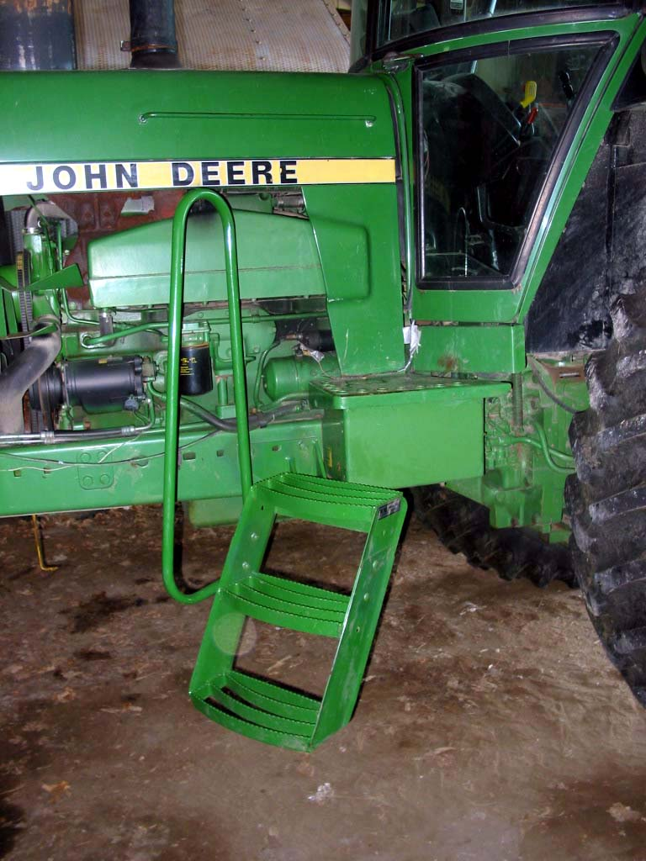
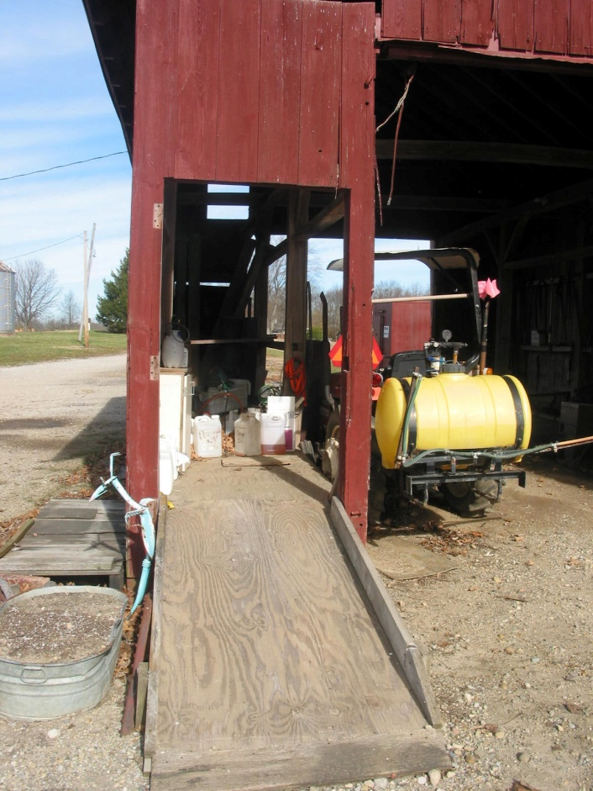
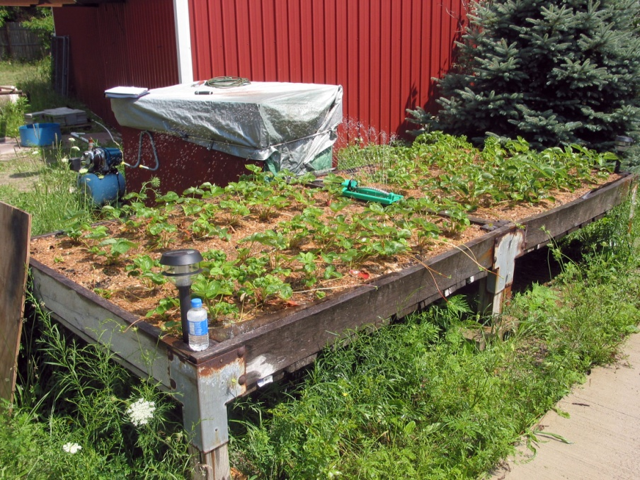

Slide 5
Principles for Providing AT
Do no harm
Keep the consumer and his goals as the central focus
Focus on functional abilities and potential
Offer simplest but still effective solutions

Slide 6
ADA Guidelines
When making recommendations, it is best to use the ADA Guidelines whenever possible.
http://www.ada.gov/

Slide 7
ADA Guidelines
Ramp slope: 1 inch rise per 12 inches of run
Thresholds no greater than ¾ inch for wheelchairs (door thresholds)
Doors no less than 32 inches wide
Pathways at least 36 inches wide
Reach up no more than 52 inches, sideways 24 inches, down 18 inches

Slide 8
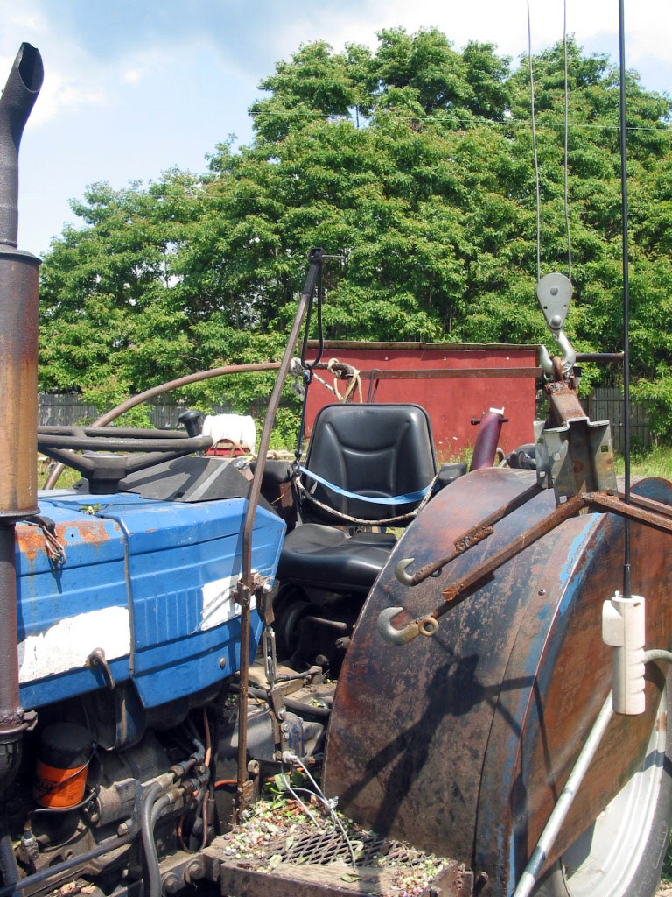
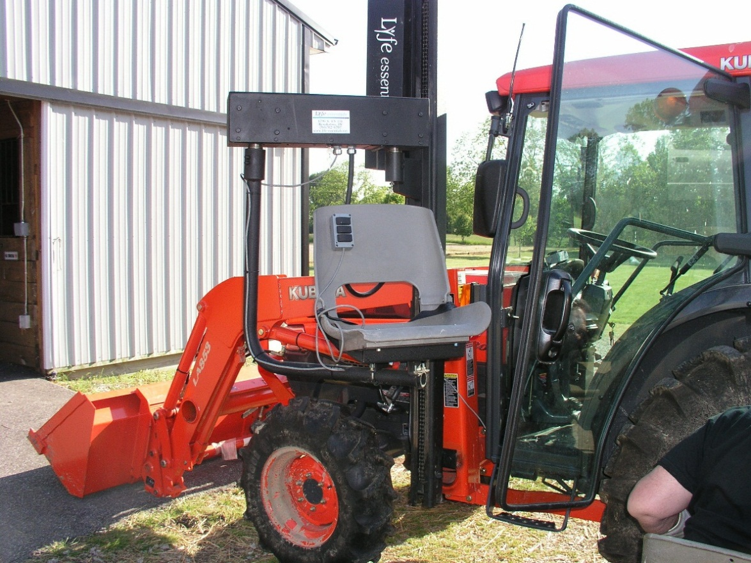

Slide 9
Assessment Equipment
Camera
Clipboard
Pad of paper
Tape measure
Angle finder
Fish scale
String level
Assessment tool
Wire brush
Circuit tester
Pliers
Magnifying glass
Utility Knife

Slide 10
Worksite Assessment Tool
Conducting Agricultural Worksite Assessments: A User’s Guide for Professionals Assisting Farmers and Ranchers with Physical Disabilities

Slide 11
Worksite Assessment Tool
Who is it for?
Professionals
“Textbook” for new staff
Step-by-step approach
Designed to cover all the bases
“Playbook” for experienced staff
Improve assessment effectiveness
New angles, ideas

Slide 12
Contents
Preface (Including Liability Statement)
Value of Assessments
Preparing for and Conducting Assessments
What is the Tool and How to Use It
Explanation of Tool ‘Questions’

Slide 13
Contents Continued
5. Client Records—Confidentiality, etc.
6. Examples of Completed Assessments
7. Related Resources
8. Appendix: Forms, Supplier List, Hotlines

Slide 14
http://www.agrability.org/resources/worksite-and-vocational/

Slide 15
2005 Edition
Introduced Microsoft Access forms and electronic storage.
Provided Examples of Completed Forms
Client with a Spinal Cord Injury
Client with an Arm Amputation
Client with a Leg Amputation
Client with a Back Impairment

Slide 16
2018 Draft
Update Assessment Tool narrative for current agricultural enterprises – GPS, auto steer, greenhouses,
Update Assessment Tool form for current agricultural enterprises and to duplicate demographic form on page 1
Produce Electronic Assessment Tool to be used with a smart phone, tablet or laptop

Slide 17
Electronic Tool Demonstration

Slide 18
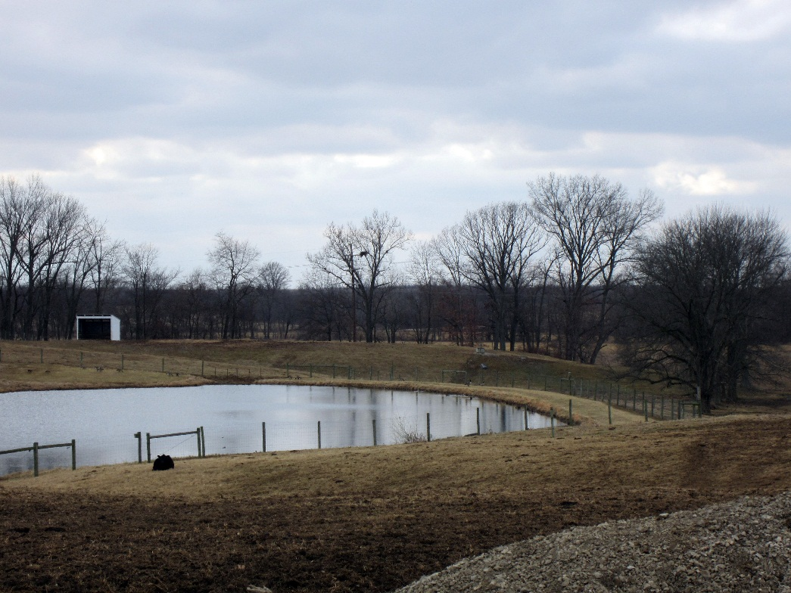
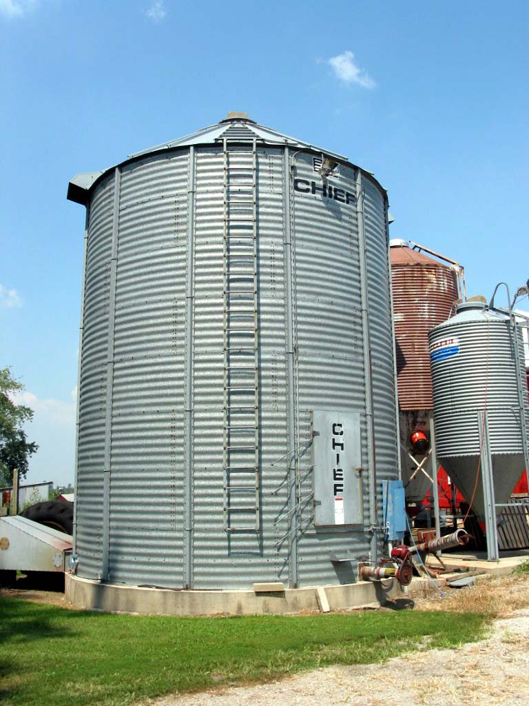
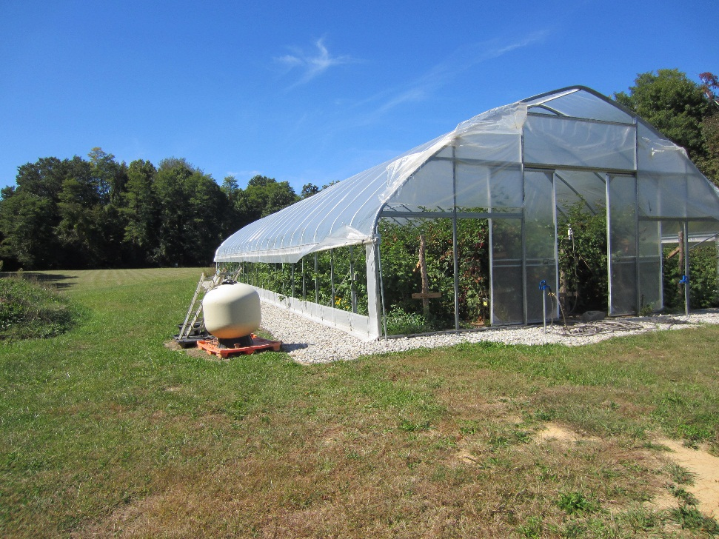

Slide 19
The AT Assessment
Step 1. Gather information
- Interview the consumer and team
Step 2. Clarify the problems
- Interpret findings
- Integrate the information – consumer, tasks, technology, environment

Slide 20
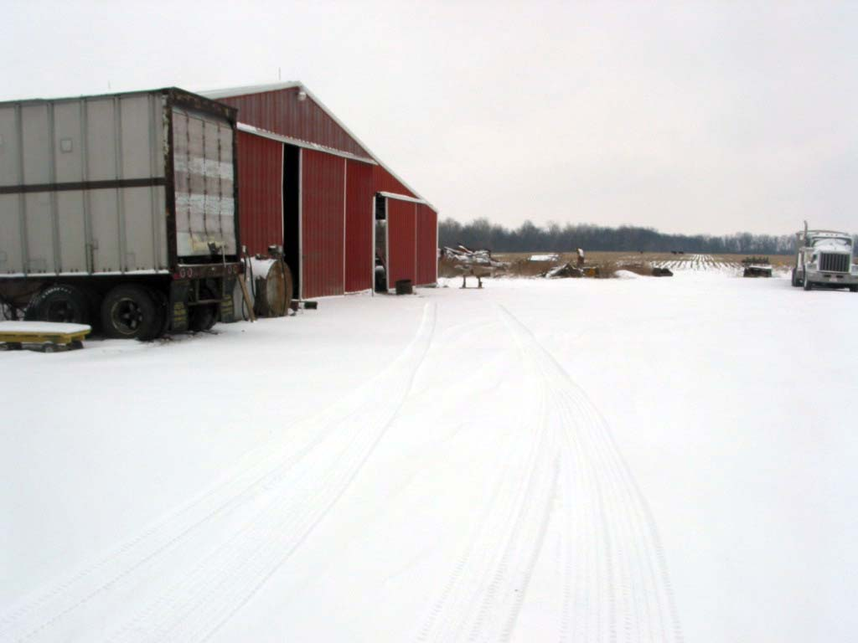
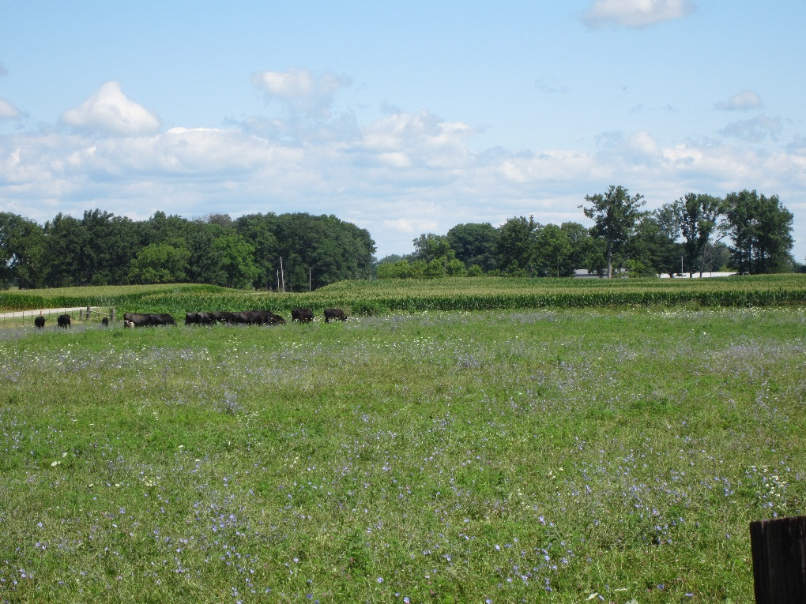
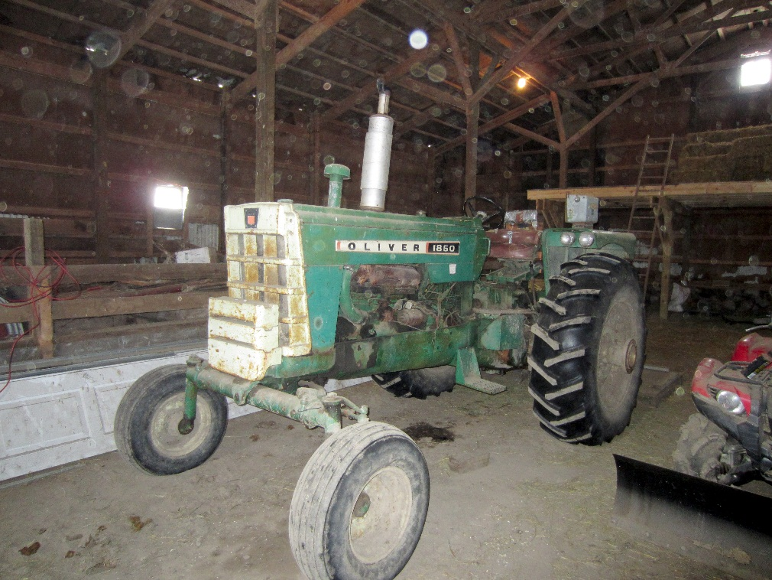

Slide 21
The AT Assessment
Step 3. Produce a list of goals and desired outcomes
- Prioritize
- Should reflect consumer’s needs and preferences

Slide 22
The AT Assessment
Step 4. Identify and describe the generic attributes the solution will need.
- Develop several potential solutions
- Explore different options and strategies
- Perform simulations or trials of possible strategies

Slide 23
The AT Assessment
Step 4. Continued
- Consider both short and long term consequences.
-Consider impact of changes or new equipment on existing function and lifestyle.
-Assure compatibility with existing or anticipated equipment.

Slide 24
The AT Assessment
Step 5. List several intervention options that meet the desirable outcomes
- Explore broad range of options
-Match desirable attributes to features of available equipment

Slide 25
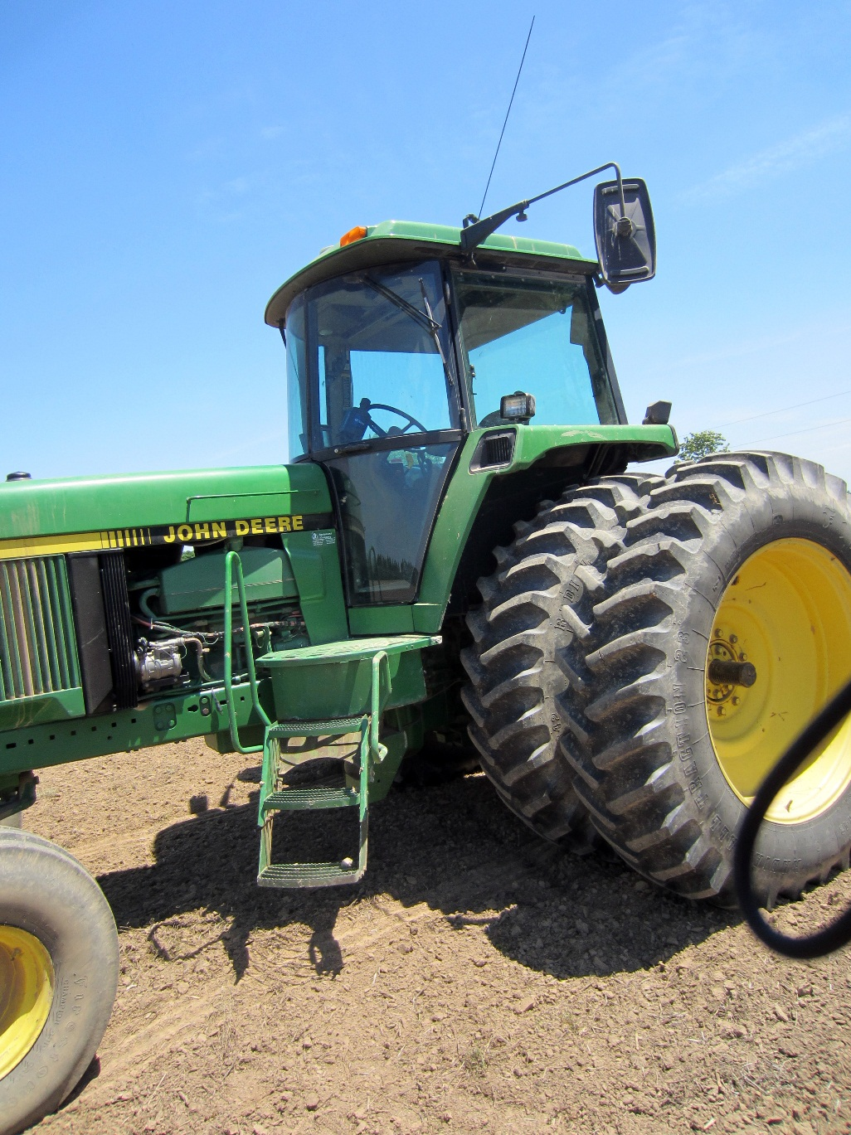

Slide 26
Step 5 Continued
- Consider using equipment of different levels of complexity (low tech to high tech, off-the-shelf to custom).
-Evaluate each for ability to match features desired and to meet goals.
- Recognize appropriate and improper use of equipment and advise accordingly

Slide 27
The AT Assessment
Step 6. Restate the preliminary goals.
- Revise goals that may have changed as a result of the information and analysis
- Assist to resolve trade-offs and prioritize goals
- List chosen goals

Slide 28
Step 6 Continued
- Select a measurable outcome for each goal.
- Gain consensus on the selected goals from the consumer and team members

Slide 29
The AT Assessment
Step 7. Select the most desirable intervention option.
- Confirm the effectiveness of the option to meet the established goals.
- Gain consensus on the selected intervention.

Slide 30
The AT Assessment
Step 8. Make recommendations.
- Include specifics and details of new or modified equipment or technology
- Include training, follow-up, and other recommended services.

Slide 31
Step 8 Continued
- Include other appropriate solutions –
- Surgery
- Job training
- Prosthetics, etc.
- Communicate the recommendations in a written report

Slide 32
Funding AT
AgrAbility cannot provide direct funding or equipment
State Vocational Rehabilitation (VR)
Veterans Administration (VA-VR)
Non-profit organizations
Foundations
Local sources
FAQ

Slide 33
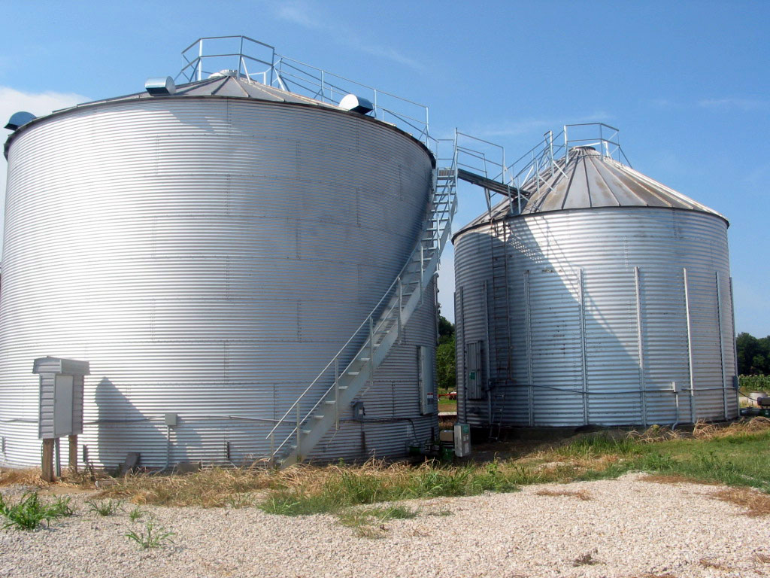
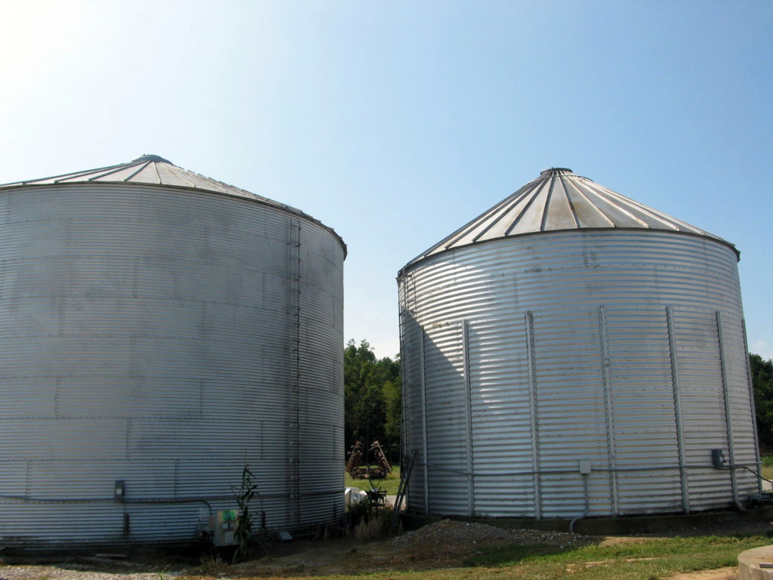

Slide 34
Let’s Look at some AT for Agriculture
The Toolbox Assistive Technology Database
Available in print, CD, and online at www.agrability.org/toolbox
Many products are not specifically designed for use as AT

Slide 35
Additional Resources
www.agrability.org/Resources
Plowshares technical articles
Assistive Technology
Worksite and Vocational Issues
Able Data: www.abledata.com
Public Assistive Technology Database – Georgia Tech – www.assistivetech.net

Slide 36
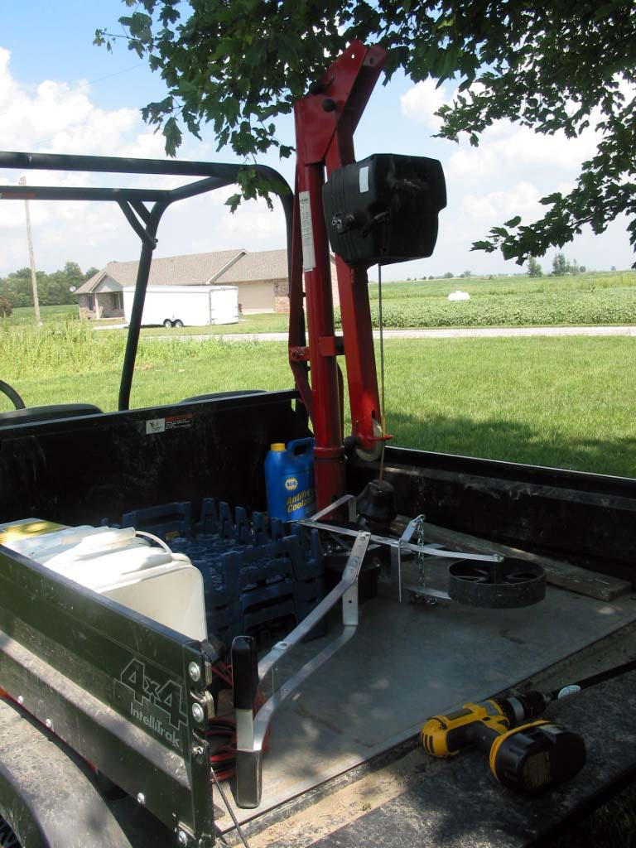
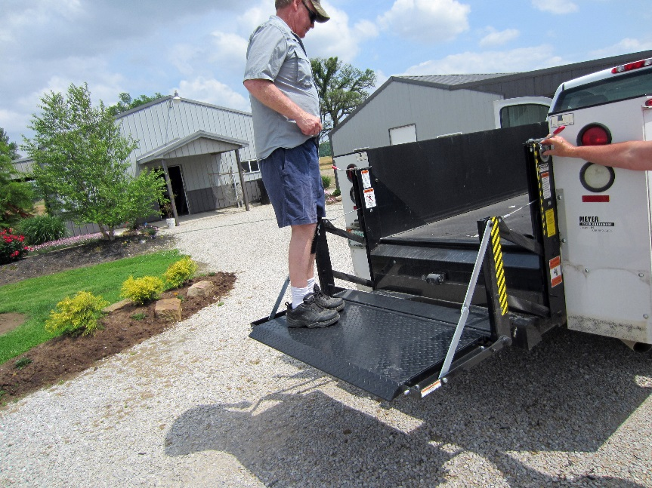
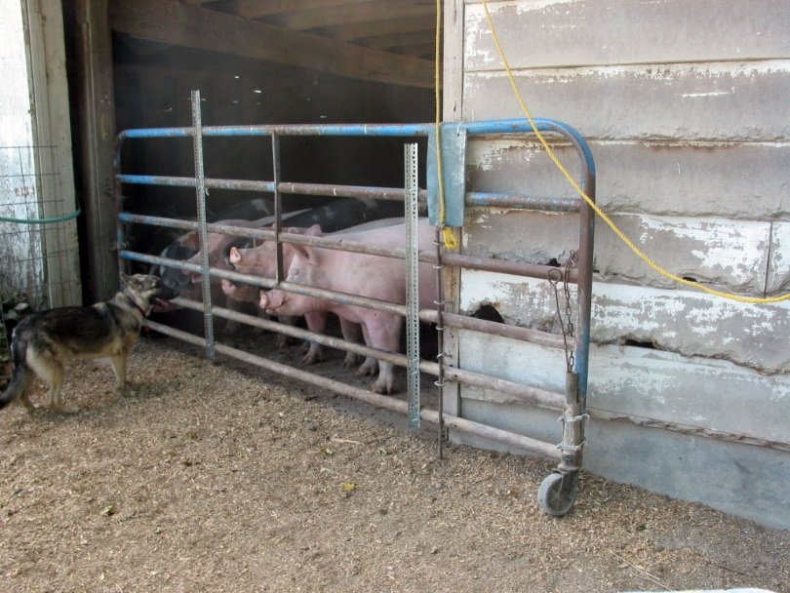
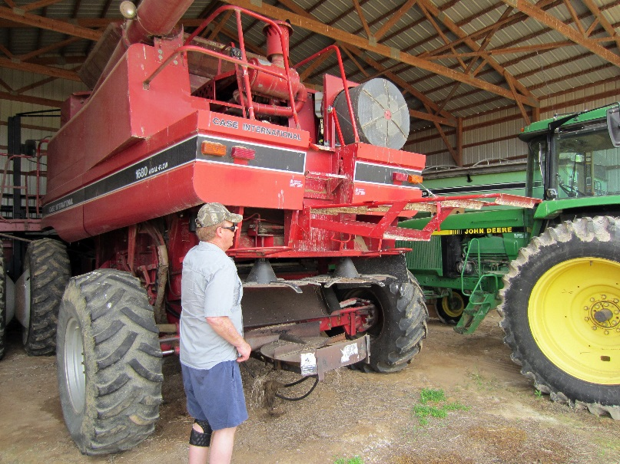

Slide 37
Liability
Liability is all about managing risk.
You must be aware of both “professional” and “product” liability and/or risk.
Agriculture is inherently risky
Products and practices pose professional liability risks for AgrAbility staff

Slide 38
Do No Harm

Slide 39
Limiting Liability
One of the best ways to manage or limit your liability or risk is to never practice outside your educational or “experiential” role.
Document, document, document

Slide 40
Three categories of product liability
Product design
Product manufacture or assembly
Product labeling – warnings and instructions

Slide 41
Professional Liability Protection
How to Protect Yourself
Professional liability insurance
Maintain proper and complete documentation
Follow the “safety hierarchy”

Slide 42
Safety Hierarchy
“There are multiple layers or approaches for dealing with safety problems. The ones at the top of the safety hierarchy are best. You don’t have to exhaust all the possibilities at the top, but you need to do what you can do, to do the things at the top versus the things on the bottom of the safety hierarchy.”

Slide 43
Safety Hierarchy
Level 1 – Eliminate the hazard entirely
Level 2 – Add safeguarding technology
Level 3 – Use warning signs, labels, decals, etc.
Level 4 – Thoroughly train and instruct the operator/user to deal with hazards
Level 5 – Provide personal protective equipment

Slide 44
Home fabricated AT – Home Access Lift Issues?

Slide 45
Home-fabricated AT – Tractor Lift Issues?

Slide 46
Secondary Injury Assessment
Provide an evaluation tool for funding agencies to estimate safety of home-made AT
A training tool for rehab professionals
Secondary injury prevention
Help identify potential for injury
Provide suggestions for remedial action

Slide 47
Secondary Injury Assessment
Steps in the process
Reference sheets w/descriptions and pictures
Assessment example with worksheets filled out
Copy ready assessment sheets

Slide 48
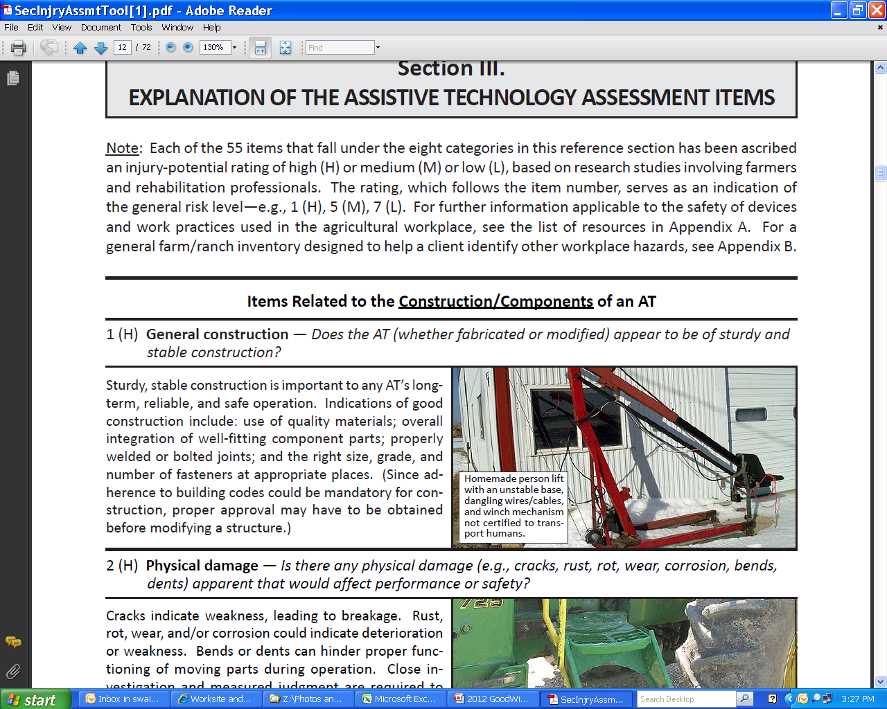

Slide 49
Examples of Safety Concerns

Slide 50
Questions?

