Slide 1
Working with Individuals who have a Brain Injury Maureen Cunningham Brain Injury Association of Missouri Executive Director AgrAbility NTW March 20, 2018

Slide 2
Agenda
Discuss statistics and causes of brain injury.
Discuss effects and impact of brain injury.
Discuss modifications and adaptions to assist someone with brain injury continue farming or ranching.

Slide 3
Statistics
Every 18 seconds someone sustains a brain injury
Of the 1.4 million people who sustain a traumatic brain injury each year in the United States
50,000 die
235,000 hospitalized
118,000 individuals in Missouri are living with a long-term disability due to brain injury

Slide 4
Statistics
32% of Missourians live in rural areas.
Fewer health professionals and services for persons with traumatic brain injury in rural areas.
Many professionals in rural areas are not trained in traumatic brain injury.

Slide 5
Brain Injury Defined
Traumatic Brain Injury: (TBI) a blow or jolt to the head or body that interrupts the normal operation of the brain. Common causes are falls, struck by or against an object, assault, sports concussion.
Acquired Brain Injury (ABI): non hereditary, internal injury to the brain caused by stroke, near drowning, oxygen deprivation, substance use, tumors or diseases

Slide 6
“The Invisible Disability”
Brain injuries range from mild to severe.
Brain injury can be an open head injury or a closed head injury.

Slide 7
Common Effects after Brain Injury
Physical Impairments
Communication/Language Impairments
Cognitive/Thinking/Memory Impairments
Psychological/Social Impairments

Slide 8
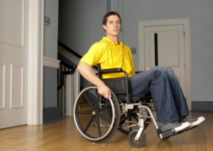
Physical Impairments: What Can You Do?
Set up environment to maximize physical abilities
Place items within reach
Remove obstacles
Good lighting
Be prepared for possible long term effects of accident/injury

Slide 9
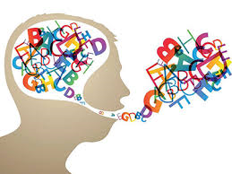
Communication Impairments: What Can You Do?
Encourage use of speech and language
Present information in simple manner
Allow time for reduced processing speed
Face the person and make eye contact

Slide 10
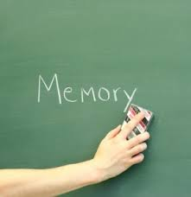
Cognitive/Thinking Impairments:
May include:
Memory
Attention
Organization
Problem-Solving/Reasoning
-Lack of Awareness of Deficits
-Poor initiation

Slide 11
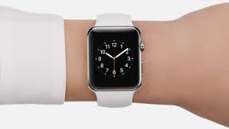
Cognitive Impairments: What Can You Do?
The number one thing you can do? Structure
The basis of maximizing cognition/thinking is daily routines and schedules. Make as structured as possible.

Slide 12
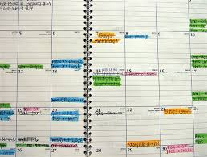
Cognitive and Memory Impairments: What Can You Do?
Calendars
Cell phone reminders
Note-taking
Repetition
Associations

Slide 13
Attention Impairments: What Can You Do?
Minimize distractions (auditory and visual)
Do tasks when attention is best
Reduce sensory overload and dual/alternating attention situations

Slide 14
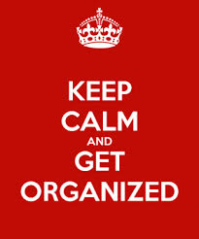
Organization Impairments: What Can You Do?
Make the environment as organized as possible
Labeled drawers, cabinets, labeled storage bins
Organize medications, finance related stuff
For people who cannot remember sequences, make written or picture time line, story sequence

Slide 15
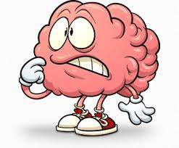
Problem Solving and Reasoning Impairments: What Can You Do?
Always encourage “thinking through” a problem; discourage impulsive thinking
Break large problems into smaller “pieces” and think about it one “piece” at a time

Slide 16
Problem Solving and Reasoning Impairments: What Can You Do?
Know strengths and limitations and provide supervision/guidance accordingly
As long as it’s safe, allow for errors and failures

Slide 17
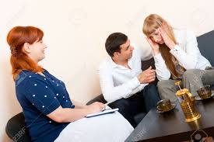
Psychological Impairments: What Can You Do?
Depression, Anxiety
Seek help from physician, counselor, psychologist
Medications, therapy
It is important to not ignore symptoms

Slide 18
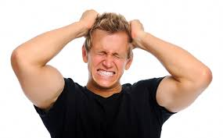
Psychological Impairments: What Can You Do?
Emotional Control
Intervene before the extreme emotions are present
Do NOT try to “stop” extreme emotions
Debrief AFTER emotional outburst

Slide 19
Psychological Impairments: What Can You Do?
Provide concrete, limited choices
Prepare for events that may cause emotions
Do NOT lose control of YOUR emotions!

Slide 20
Social Impairments:
Common after brain injury:
Lack of conversational turn-taking
Lack of ability to recognize nonverbal cues from others
Lack of ability to recognize
emotions in others

Slide 21
Social Impairments:
Also common after brain injury:
Inappropriate comments
Inappropriate conversation topics

Slide 22
Social Impairments: What Can You Do?
Teach survivor to be aware of nonverbal cues from others
When in group settings, have “sign” that things may be not going well
Prepare for social situations and debrief afterwards

Slide 23
Resources
AgrAbility, USDA, and other NIFA opportunities
Vocational Rehabilitation
Brain Injury Association of America, www.biausa.org

Slide 24
For More Information, Contact
Brain Injury Association of Missouri
Maureen Cunningham
MCunningham@biamo.org
314-426-4024
http://www.biamo.org
Facebook/bia.missouri
Twitter/bia_missouri

Slide 25
Disclosure
The Missouri AgrAbility Project is funded in part by the USDA National Institute of Food and Agriculture (NIFA) under sponsored project number 2014-41590-22323

