Slide 1
Production Record Keeping
Practical Application of Production Records to Farming
Calvert Schaefer
Agriculture Record Keeping Professional

Slide 2
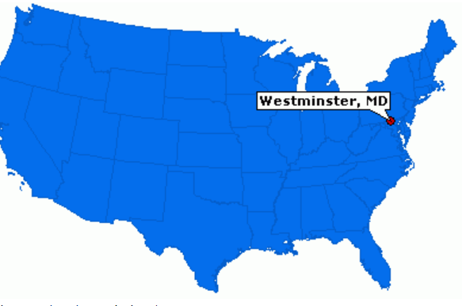
About Me
Calvert Schaefer
Cattle, small grain, hay, produce
Agriculture Record Keeping Professional

Slide 3
Itinerary
Why Record Keeping is Important
Components of Record Keeping
What is the Best Option?
Types of Record Keeping Options
Financial Record Keeping
Production Record Keeping
Alternative Options
Record Keeping Resources
How to use technology to your advantage

Slide 4
Why is Record Keeping Important
Measurement of farm performance
Important for reporting purposes
Accurate records lead to informed management decisions about the future

Slide 5
Example Why Record Keeping Important
Scenario: You forget to record a $20 expense
Taxable Income by $20
Effects: Increases your taxes!
SS tax: $3.06 ($20 x 15.3%)
Fed Income tax: $4 ($20 x 20%)
State Income tax: $1 ($20 x 5%)
Result: $8.06 more in taxes

Slide 6
What is the Best Way to Keep Records?
There is no “Best Method” for record keeping
Consistency is the KEY to good records
How you use > What you use

Slide 7
Types of Record Keeping
Financial
Sales
Expenses
Used for
Taxes
Financial Reports
Production
Production by Sales
Used For
Reporting yields
Enterprise analysis
“Pick Records”
Used For
Variety comparison
Field comparison

Slide 8
Establishing Parameters for Record Keeping
Product type
Organic vs. Conventional
Variety type
Field of origin
Unit of measure
Vary by how product is sold but need to be tracked
Important for calculating total production

Slide 9
Record Keeping Options?
Most Common Record Keeping Systems
Paper
Microsoft Excel
QuickBooks
Other options
Square
QuickBooks GoPayment
Many options available

Slide 10
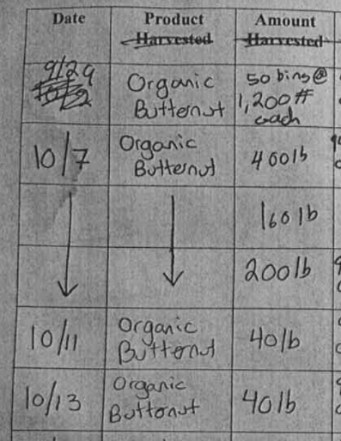
Paper Records
Nothing wrong with paper records
Pros:
Ease of use
No technology required
Cons:
You do the math
Organization
Ex: Packing Center shipment log

Slide 11
Microsoft Excel / Google Sheets
Capabilities
Customize layout to fit your operation
Data is stored in an efficient layout
Pros:
Available on all computers
Calculations are done for you
Templates available
Cons:
Data Entry
Set up and use

Slide 12
New England Farm Account Book Entry

Slide 13
New England Farm Account Book Profit/Loss

Slide 14
New England Farm Account Book Labor

Slide 15
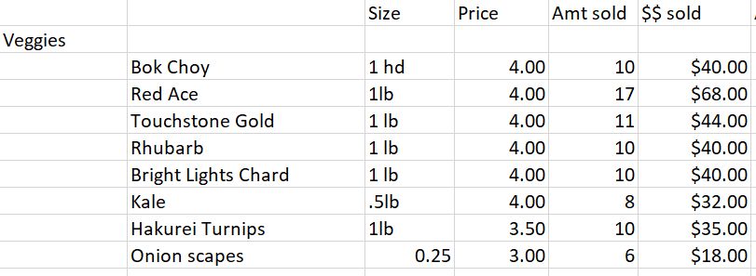
Detailed Production Records in Excel
Tracks sales by variety from field
Identifies:
Product
Variety
UOM
Price
Amount
Ex: Weekly farm stand sales in excel

Slide 16
QuickBooks
Capabilities
Bank statement reconciliation
Detailed tracking of finances
Pros:
Financial reporting
Calculations are done for you
Invoice generation
Bill Tracking
Cons:
Cost
Desktop: $227
Online: $14/month
Initial set up

Slide 17
What Can QuickBooks Do for Me?
Daily Operations
Financial Analysis
Pay bills
Generate invoices
Generate sales receipts
Track expenses
Payroll
Additional fee
Manage 1099s
Profit/Loss
General
Item
Customer
Class
Cash Flow
Balance Sheet
File your taxes
Requires extreme detail

Slide 18
Quickbooks Setup
Seek help from a professional
Find the version that best fits your needs
Setup Chart of Accounts
Categorize income, expenses, liabilities, equity
THIS FOUNDATION OF YOUR QUICKBOOKS USE
Recommended Resources
The Farmers Office
By: Julia Shanks

Slide 19
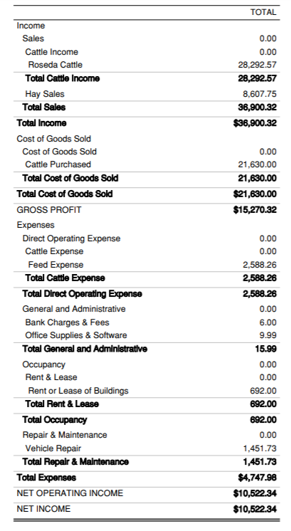
Profit/Loss Example
Basic P/L Report
Tells us how we are doing to date

Slide 20
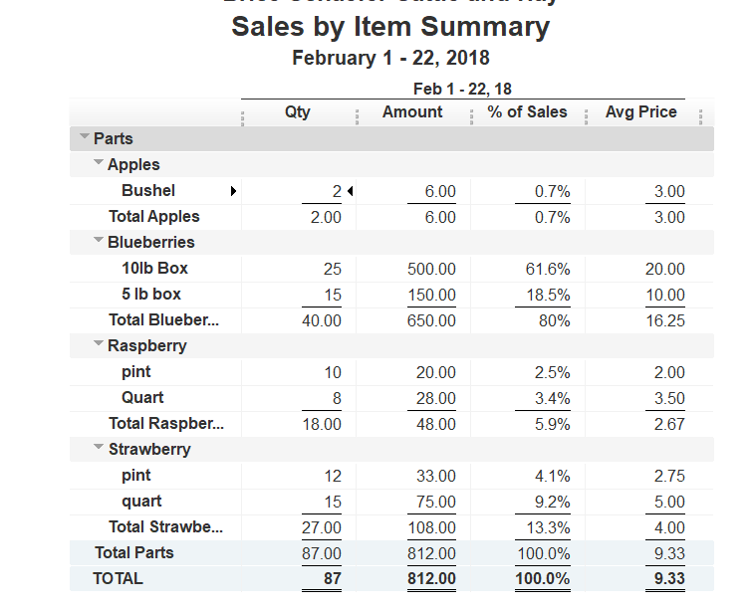
Sales By Item
Report identifies output and unit of measure
Reverse calculation using average weight to find production in lbs
Ex: Sales by Item Summary Report for farm stand year to date

Slide 21
Other Capabilities of QuickBooks
Reports
A/P summary
Vendor reports
Class tracking
Tax Preparation
Assign income accounts to Schedule F
Income Tax Summary Report
Shows estimated taxes based on the info in QuickBooks

Slide 22
Comparison
Paper
Pros
Simplest version
No technology or fees required
Cons
Hand calculations
Time consuming
Microsoft Excel
Pros
Formulas do the math for you
Available on all computers
Best method for production records
Cons
Requires careful entry
QuickBooks
Pros
Analytic Capabilities
Does most of the work for you
Best for financial records
Cons
$220
Data entry and set up

Slide 23
Other Record Keeping Systems
What is it
Cost of Square
Point of sale software
Allows you to accept cards
Track cash sales
Tracking of sales
Register
$1000
Card Reader
$20-$40
Transaction Costs
2.75% per swipe
2.5%+$0.10 per swipe (Register)
Cash: $0.00

Slide 24
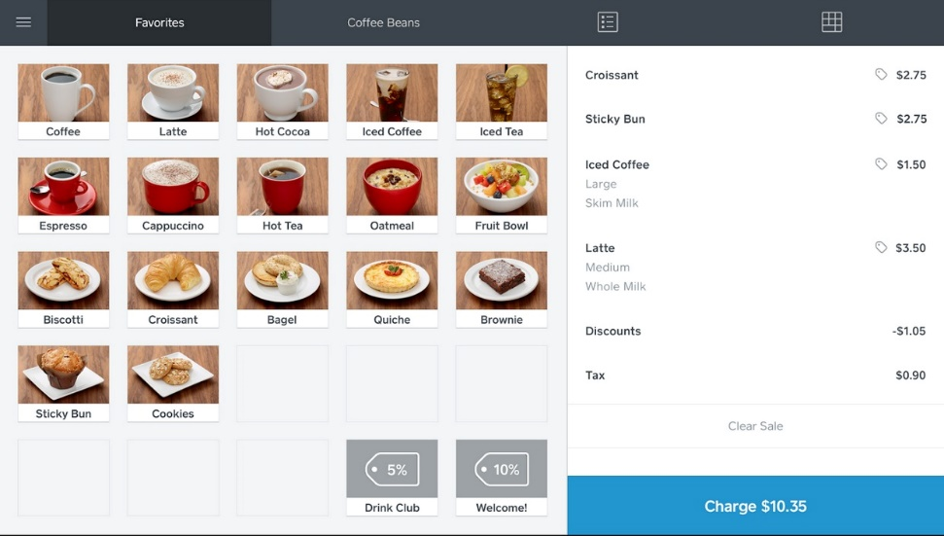
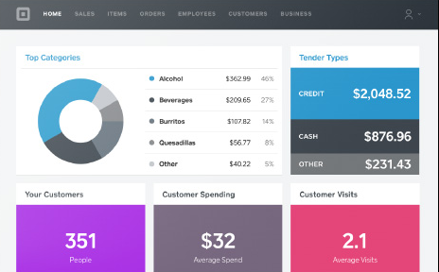
Features of Square
Products
Analytics

Slide 25
Technology
Voice Recognition
Dragon
compatible with QB Pro and most computers
Voice text
Excel Voice command
Smartphones
Office in your pocket
Multiple apps available

Slide 26
In Conclusion
Find the system that works best for YOU
Identify units of measure
Be consistent with your record keeping
Use production records to make informed management decisions about the future
Plant more or change crop?
What to bring to market?
What is making us money?

Slide 27
University of Maine Cooperative Extension
Increasing Access to FSA Risk Management Programs
Calvert Schaefer
5741 Libby Hall, Room 119
Orono, ME 04469
207.735.3244 • calvert.schaefer@maine.edu
The University of Maine is an equal opportunity/affirmative action institution.

