Slide 1
How can APRIL support AgrAbility
Sierra Royster
Youth Transitions Coordinator

Slide 2
We want to learn from you
What would be helpful for you, as farmers/ranchers?
What does AgrAbility staff need?
How do you recruit for jobs that are needed on the farm/ranch?
How are youth/young adults included in what you do? (30 years and younger)
Notes:
10 minutes
10 minutes report out.

Slide 3
Would you rather?
Support Group to come to?
Come to a class to learn a skill?
Connect with someone with the same disability?
Work with someone who is well versed in the resources and farm culture?
Have one person to connect with?
Receive material about the new skill you would like to learn?
Connect with another farmer/rancher?
Work with someone that is well versed in resources that understand what you need and the farm culture.
Notes:
8 minutes

Slide 4
Association of Programs for Rural Independent Living (APRIL)
Who we are: APRIL is a national grassroots, nonprofit membership organization consisting of members from Centers for Independent Living, the satellites and branch offices, Statewide Independent Living Councils, other organizations and individuals concerned with the independent living issues of people with disabilities living in rural America.
Mission: “APRIL provides leadership and resources on rural independent living. As a national membership organization dedicated to advancing the rights and responsibilities of people with disabilities living in rural America by serving as a center of resources and by leading systems change.”
Vision: APRIL is the unified voice of independent living in rural America.

Slide 5
MORE THAN A MONTH
What we are:
We are a grassroots and advocacy membership organization
We provide training and technical assistance.
Through Peer to Peer Mentoring Program, mentors at the CIL, SILC, and youth local levels
Webinars, Teleconference
Information and Referrals or quick assistance
We hold an annual conference (APRIL in October)
This includes a Youth conference embedded in.
Provide leadership opportunities
We have other partnerships including RTCs : IL in Kansas and Montana
Provide a national rural voice on every issue that relates to people with disabilities
Transportation, housing, community accessibility, youth, veterans, policy, AgrAbility.
Disseminate Information for disability issues or opportunities
What we are NOT:
We do not provide direct service.
We do not have a location for trainings and meetings.
We do not oversee/supervise/manage the CILs and SILCs.
CILs are not residential facilities.
IL programs and Centers are not day treatment.

Slide 6
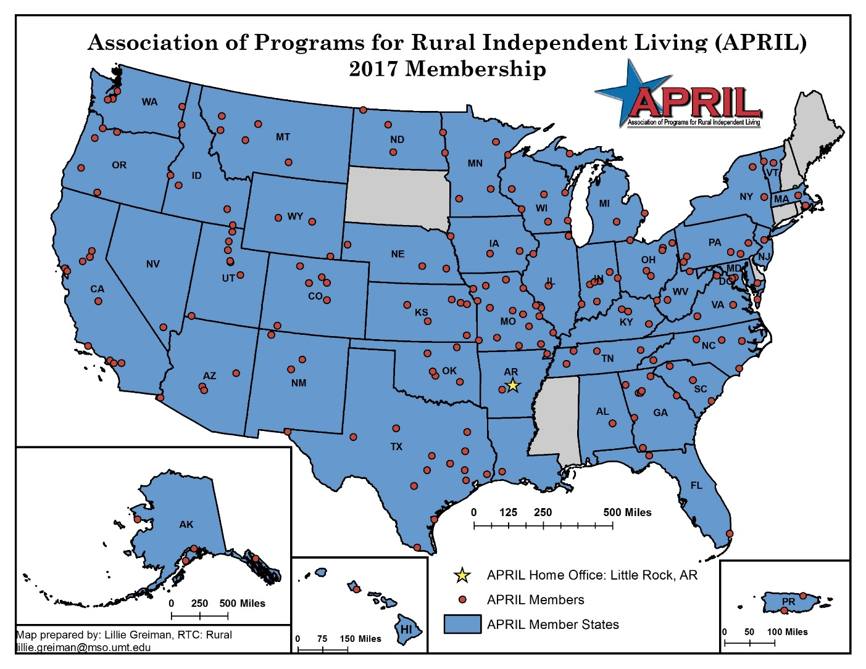
APRIL Membership
https://april-rural.org/index.php/about-us

Slide 7
What is a CIL
Centers for Independent Living are community-based, cross-disability, non-profit organizations that are designed and operated by people with disabilities. CILs are unique in that they operate according to a strict philosophy of consumer control, wherein people with all types of disabilities directly govern and staff the organization. Centers for Independent Living provide:
Peer Support
Information and Referral
Individual and Systems Advocacy
Independent Living Skills Training
Transition
Diversion from Institutions
Transitions from Institutions
Youth Transitions
403 Centers for Independent Living (CILs)
330 branch offices
143ish are APRIL members
http://www.ilru.org/projects/cil-net/cil-center-and-association-directory

Slide 8
What is a SILC
Each state and US territory is required to maintain a statewide independent living council (SILC). The Council and the Centers for Independent Living (CILs) within the state develop a State Plan for Independent Living (SPIL). The SPIL is a document required by law that indicates how the IL Network is going to improve independent living services for individuals with disabilities over the next three years. It identifies the needs and priorities of consumers, providers, and other stakeholders and sets forth goals and objectives to respond to them.
Having a strong network for independent living in a state or territory is crucial. Collaborating on the SPIL development can help create a cohesive and unified vision among all stakeholders who have an interest in issues that impact citizens with disabilities.
56 Statewide Independent Living Councils (SILCs)
32ish are APRIL members
http://www.ilru.org/projects/silc-net/silc-directory

Slide 9
Things to think about going forward?
Where is the person at with their disability?
Are you connected with the local CIL? If not, could APRIL help?
Are you connected with youth in your area? If not, APRIL can help!
Need help with where to go from your ideas here: CONNECT WITH US!!
Sierra Royster
Youth Transition Coordinator
April-sierra@att.net
919-567-3602
www.april-rural.org
Connect with us on:
Facebook at Association of Programs for Rural Independent Living @RURALIL
Twitter @APRIL4ruralIL

