Slide 1
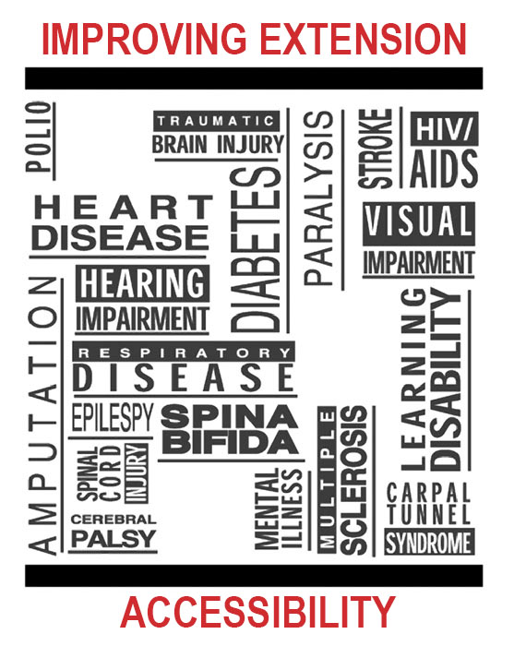
Paul Jones & Stephen Swain National AgrAbility Project Purdue University March 31, 2016

Slide 2
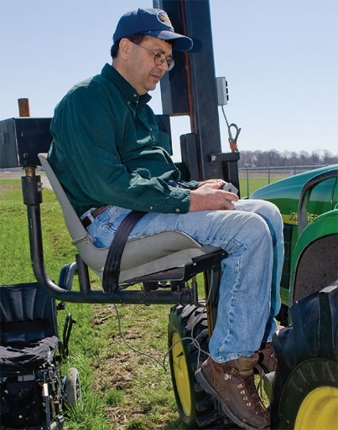
AgrAbility: USDA-sponsored program that assists farmers, ranchers, and other agricultural workers with disabilities.
Partners land grant universities with disability services organizations
Currently 20 state projects
National AgrAbility Project led by Purdue’s Breaking New Ground Resource Center
More information available at www.agrability.org

Slide 3
Session Overview
Defining disability (vs. functional limitation)
Access for Extension employees
Access to Extension facilities
Access for Extension customers
Program examples
Information shared during this session should not be construed as legal advice. Always consult with a legal professional for questions related to the ADA and other statutes.

Slide 4
The Americans with Disabilities Act
The ADA helps us understand what disability means and how best to improve access for those affected by various types of limitations.
Employment (Title I)
Public Services (Title II)
Public Accommodations (Title III)
Telecommunications (Title IV)
Miscellaneous (Title V)

Slide 5
Americans with Disabilities Act (ADA) The term "disability" means, with respect to an individual:
a physical or mental impairment that substantially limits one or more major life activities of such individual;
a record of such an impairment; or
being regarded as having such an impairment

Slide 6
What the ADA says about “major life activities”
Major life activities include, but are not limited to, caring for oneself, performing manual tasks, seeing, hearing, eating, sleeping, walking, standing, lifting, bending, speaking, breathing, learning, reading, concentrating, thinking, communicating, and working.

Slide 7
There are many ways to categorize disabilities
Physical
Sensory
Cognitive/Intellectual
Psychological/Emotional
Chronic Diseases
Developmental

Slide 8
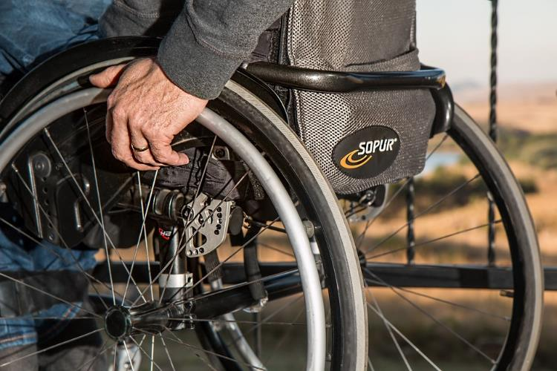
Physical Disabilities
Paralysis
Amputations
Severe arthritis
Many others

Slide 9
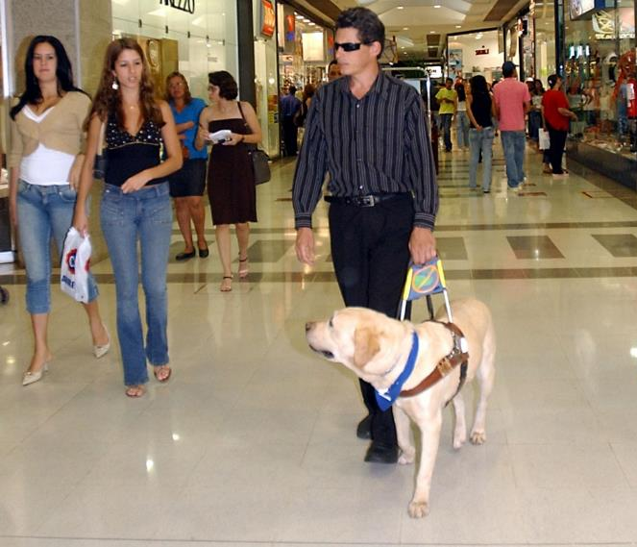
Sensory Disabilities
Deafness
Blindness
Loss of touch/ ability to feel pain
Many others

Slide 10
Cognitive/Intellectual Disabilities
Learning disabilities
Autism
Intellectual disabilities (“mental retardation”)
Many others

Slide 11
Psychological/Emotional Disabilities
Schizophrenia
Major depression
Bipolar disorder
Anxiety disorders
Many others

Slide 12
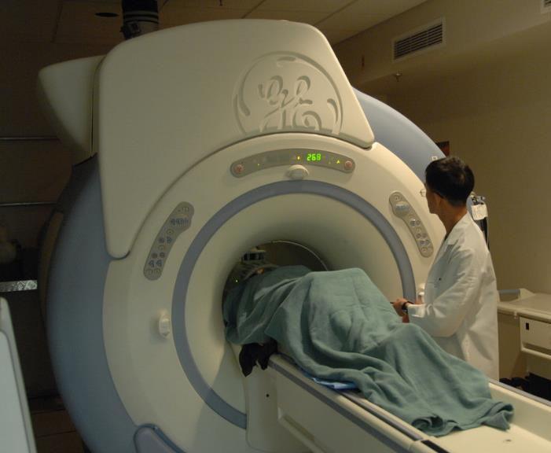
Chronic Diseases
Diabetes
Multiple sclerosis
Muscular dystrophy
Cancer
COPD
Many others

Slide 13
Developmental Disabilities
Developmental disabilities are life-long physical and/or mental disabilities that occur before the age of 18. They include:
Cerebral palsy
Down syndrome
Autism
Many others

Slide 14
Disability Prevalence 2010 U.S. Census Bureau
According to the U.S. Census Bureau, in 2010, 56.7 million Americans (18.7 percent) of the civilian non-institution-alized population reported a disability. About 38.3 million, (12.6 percent) had a severe disability.

Slide 15
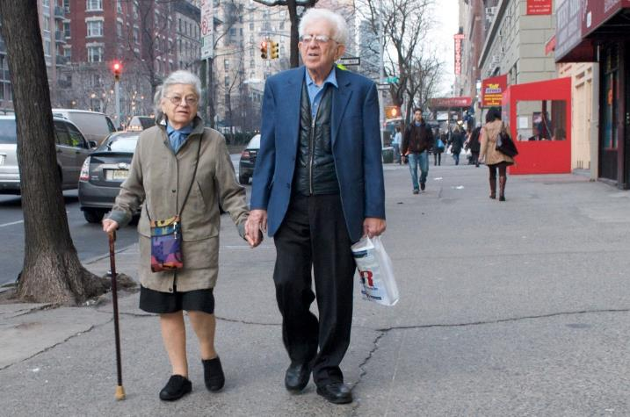
Disability vs. Functional Limitation
Not all limitations rise to the level of an ADA-defined disability, but they can still affect daily life.
Arthritis
Back problems
“Non-severe” emotional issues
Affects of aging
Vision
Hearing

Slide 16
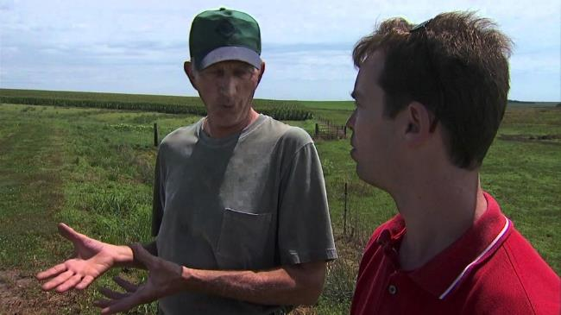
Extension Employees
ADA Title I: Employment
Qualified to perform the essential functions of the job
Obligation to provide reasonable accommodation for employees with disabilities.
Technology
Schedule
Many others

Slide 17
Reasonable Accommodation
Any time an employee indicates that he/she is having a problem and the problem is related to a medical condition, the employer should consider whether the employee is making a request for accommodation under the ADA.
www.askjan.org

Slide 18
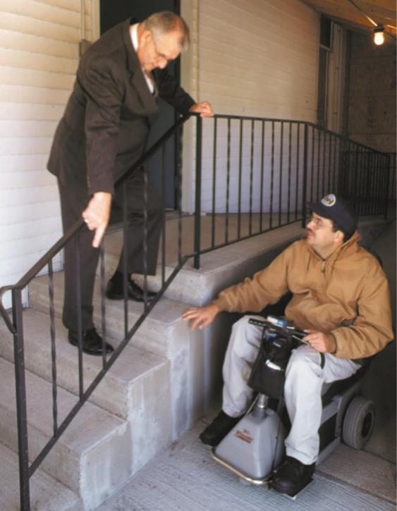
Physical Access
Programs, services, and activities, when viewed in their entirety, are accessible to people with disabilities.
Generally does not require that a (city government) make each facility, or each part of a facility, accessible.

Slide 19
Physical Access
Can move public meetings to accessible buildings and can relocate services for individuals with disabilities to accessible levels or parts of buildings.
There is no "grandfather" clause in the ADA.

Slide 20
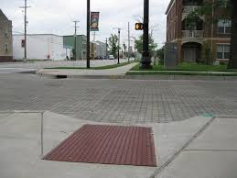
Common Issues Related to Physical Access
Parking
Curb ramps
Ramps into building(s)
Restrooms
2010 ADA Checklist for Existing Facilities
www.tinyurl.com/ada-check

Slide 21
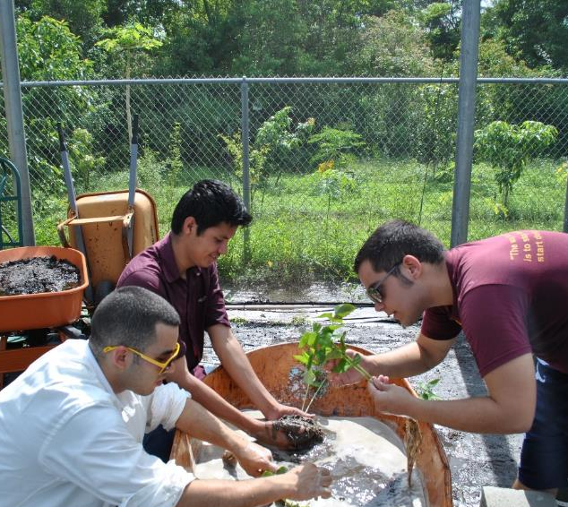
Program Access for Extension Customers
Title II: Program Access. Public services cannot deny services to people with disabilities or deny participation in programs or activities that are available to people without disabilities.

Slide 22
Program Access for Extension Customers
Not required to take any action that would result in a fundamental alteration to the nature of the service, program, or activity in question or that would result in undue financial and administrative burdens.
A wilderness tour company may require all participants to take a swim test in order to participate in a rafting expedition. Even if some people with disabilities might not pass the test, the policy is legitimate because of the actual risk of harm to people who would not be able to swim to safety if the raft capsized.

Slide 23
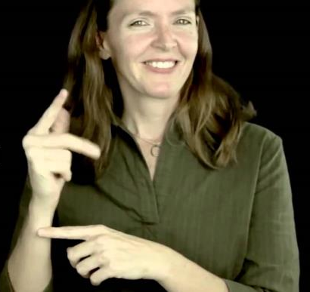
Examples of Accessibility Accommodations
Sign language (ASL) interpreters
Website accessibility
Assistive listening systems
Large print
Service animals (dogs)
(1) is the dog a service animal required because of a disability? and (2) what work or task has the dog been trained to perform?

Slide 24
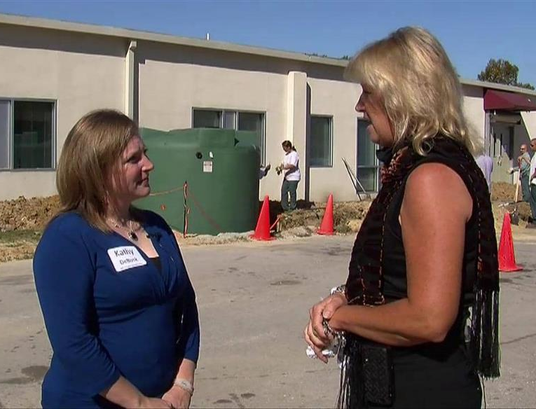
Principles
Treat individuals as individuals.
Ask an expert if you have questions.

Slide 25
Cautions
Paternalism
Overprotecting people from disabilities
Overprotecting yourself from liability?
§ 35.139 Direct threat.
(a) This part does not require a public entity to permit an individual to participate in or benefit from the services, programs, or activities of that public entity when that individual poses a direct threat to the health or safety of others.

Slide 26
Cautions
Not letting 4-Hs with disabilities show animals in ring
“Woman sues K_____ County Fair for wheelchair, ADA non-compliance”

Slide 27
Recent Related Examples
FFA Soil Judging
Student who uses wheelchair wants to participate, but judging is done in soil pit.
Haunted Corn Maze
Can the owner prohibit a service dog from accompanying person with a disability since part of the activities are designed to scare the participants (and thereby, possibly, the dog)?

Slide 28
Resources
Your own Extension guidelines
ADA National Network
www.adata.org
1-800-949-4232
Department of Justice
www.ada.gov
Accessible Temporary Events, A Planning Guide
http://tinyurl.com/temporary-events

Slide 29
Resources - Employees
Job Accommodation Network
www.askjan.org
Equal Employment Opportunity Commission
www.eeoc.gov

Slide 30
Resources: Web compliance
WAVE by WebAIM.org, http://wave.webaim.org/
Functional Accessibility Evaluator (FAE), http://fae20.cita.illinois.edu/

Slide 31
Assistive Technology in Agriculture
The Toolbox Assistive Technology Database www.agrability.org/toolbox

Slide 32
Arthritis and Gardening
Arthritis and Gardening is a 24-page booklet. Topics covered include arthritis basics, gardening pre-planning, tools and accessories, overall health, pain management, and small scale fruit and vegetable production.

Slide 33
Some Accessibility-Friendly Extension Programming

Slide 34
www.agrability.org/Resources/youth

Slide 36
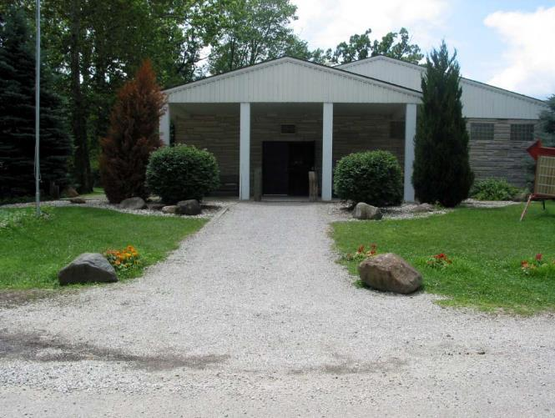
County Fairgrounds Accessibility

Slide 37
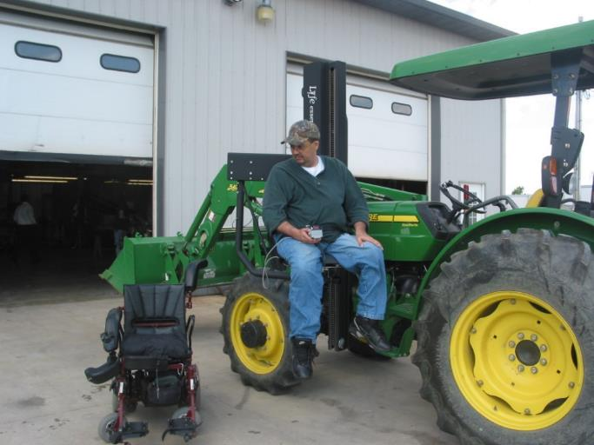
Farm Accessibility

Slide 38
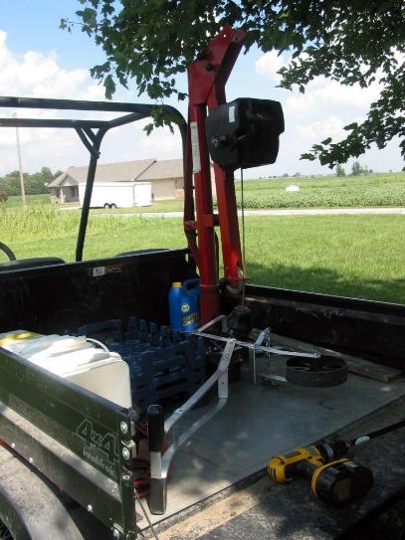
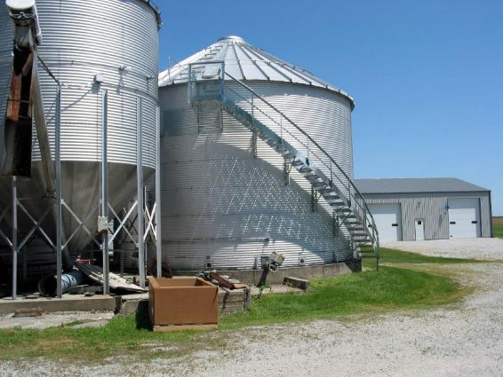
Farm Accessibility

Slide 39
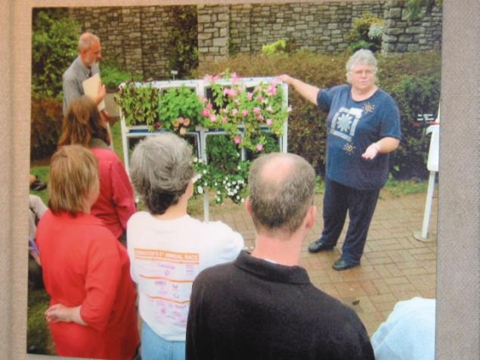
Accessible Gardening Master Gardener Training

Slide 40
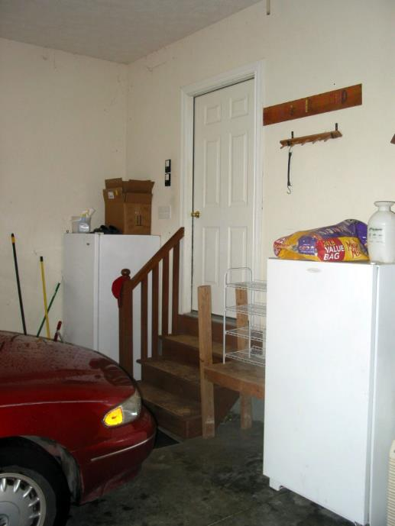
Home Accessibility

Slide 41
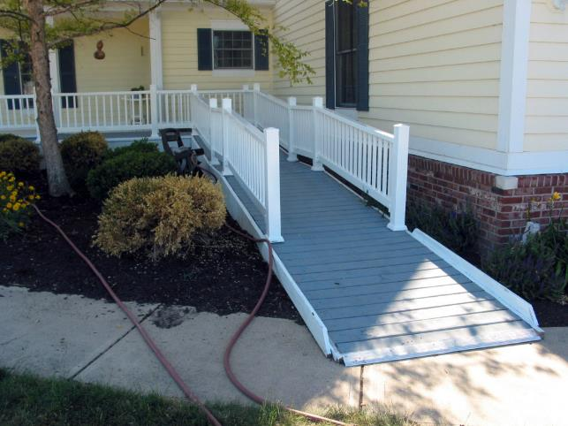
Home Accessibility

Slide 42
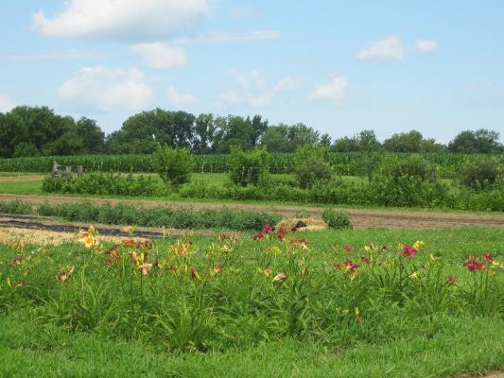
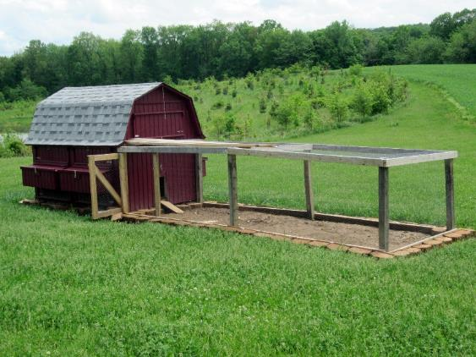
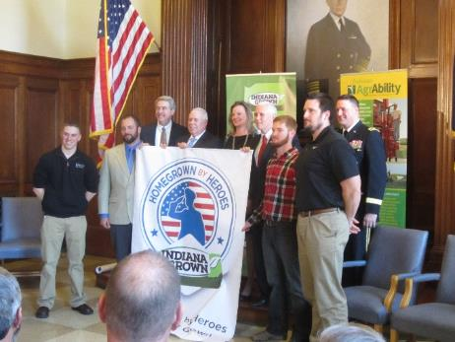
Beginning Farmer Veteran Training

Slide 43
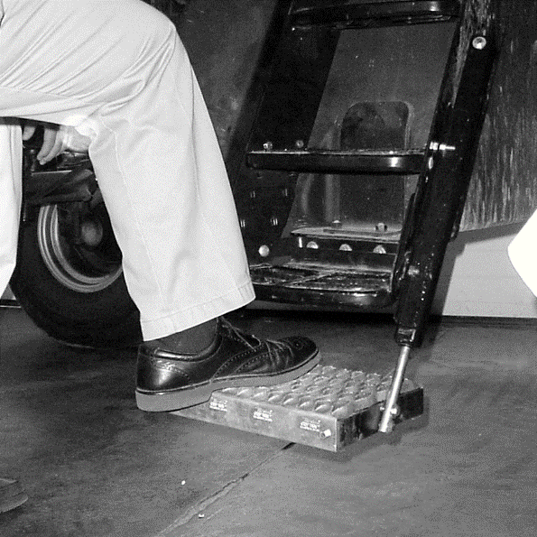
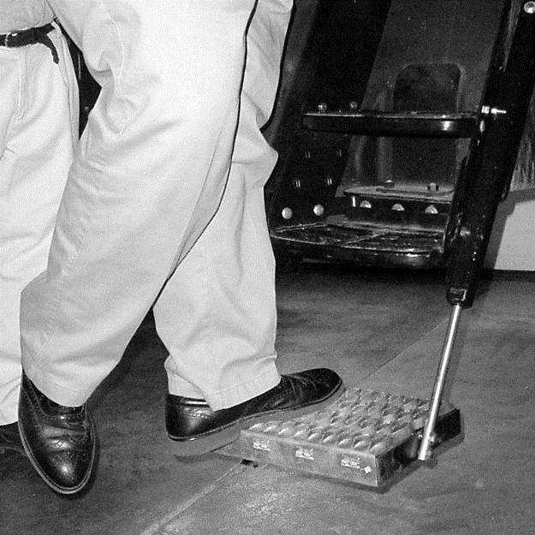
Senior Capstone Projects

Slide 44
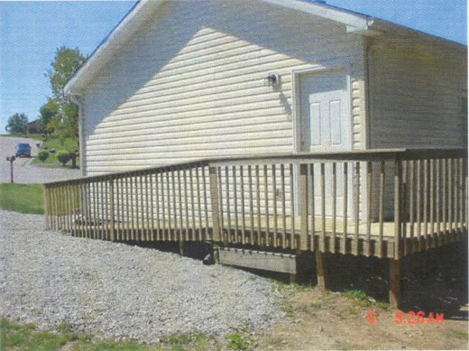
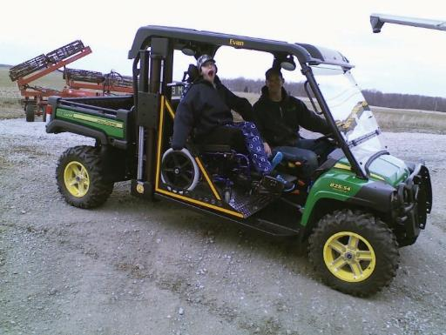
Bridging Horizons

Slide 45
Thank You! Questions? www.agrability.org agrability@agrability.org
The National AgrAbility Project is supported by AgrAbility Project, USDA/NIFA Special Project 2012-41590-20173

