Slide 1
Arthritis and Nutrition: Tips on Eating Well and Feeling Better Amber D. Wolfe, M.S. Arthritis Foundation, Heartland Region Thursday, May 26 3:00 p.m. EDT

Slide 2
Basic Webinar Instructions
Audio available through computer or phone.
Check sound via Audio menu at top left
Closed captions: use arrow to expand or contact the Media Viewer window.
Expand/contract any of the windows in the right-hand column with the arrows. May need to do this to see video of presenter.
Expand/contract the size of the right-hand column.

Slide 3
Basic Webinar Instructions
Questions and comments
Click Chat icon at top right of screen (it should turn blue). Enter message in box, choose who to send it to, and click send. You may enter questions about the presentation at any time. Please don’t use Q & A option.)
In addition, during the Q & A period, if you have a web microphone, click the “Raise Hand” icon to indicate that you have a question. We will enable your microphone or phone connection.

Slide 4
Basic Webinar Instructions
4 quick survey questions + opportunity to share comments
Session recorded and archived with PowerPoint files at www.agrability.org/Online-Training/archived
Problems: use chat window or email agrability@agrability.org

Slide 5
AgrAbility: USDA-sponsored program that assists farmers, ranchers, and other agricultural workers with disabilities.
Partners land grant universities with disability services organizations. Currently 20 state projects
National AgrAbility Project: Led by Purdue’s Breaking New Ground Resource Center.
Partners include:
Goodwill of the Finger Lakes
The Arthritis Foundation, Heartland Region
University of Illinois at Urbana-Champaign
Colorado State University
More information available at www.agrability.org

Slide 6
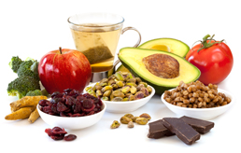
Nutrition and Your Arthritis Get Tips on Eating Well and Feeling Better!
Amber D. Wolfe, M.S.
Arthritis Foundation, Heartland Region

Slide 7
Arthritis is the leading cause of disability in the United States, affecting over 50 million adults and 300,000 children.
Can the foods you eat cause or affect your arthritis? That is a very common question posed to the Arthritis Foundation, and this webinar will address some of the issues related to diet and overall nutrition.
Because symptoms of arthritis can vary from day to day, it is natural to think that what you ate yesterday might have caused or reduced the pain you feel today.

Slide 8
The goal of this one-hour webinar is to:
**identify the roles foods may play in arthritis,
**to understand obesity as it affects the weight-bearing joints,
**how to find a healthy-well-balanced diet, explore supplements, and to
**introduce several educational resources that are available for use in these areas.

Slide 9
Webinar Topics
Arthritis-Food Connection
Diet and Inflammation
Guide to a Healthy Diet
Good Supplements vs. Unproven Diet Claims
Arthritis Foundation Resources

Slide 10
Managing Arthritis
Three main tactics:
Control symptoms
Get moving
Maintain a healthy weight
Notes:
Section 2/Question 4 and 5: What are some ways you can manage your pain? What should you do if you think you might have arthritis?
Control symptoms: Manage pain and limited mobility.
Get moving: Physical activity keeps joints flexible and enhances overall health.
Maintain a healthy weight: Extra pounds put added strain on joints.
Other options include: medications (OTC and prescription); Massage, Physical Therapy
Question 5: Discuss signs/symptoms with your physician. Don’t hesitate as if you have arthritis it’s important to receive the diagnosis, schedule an appointment with a Rheumatologist (specializes in the disease) and form a treatment plan to prevent disease progression.

Slide 11
What Causes Inflammation?
Obesity
Genetics and family history
Lack of moderate exercise
Stress
Diet
Age

Slide 12
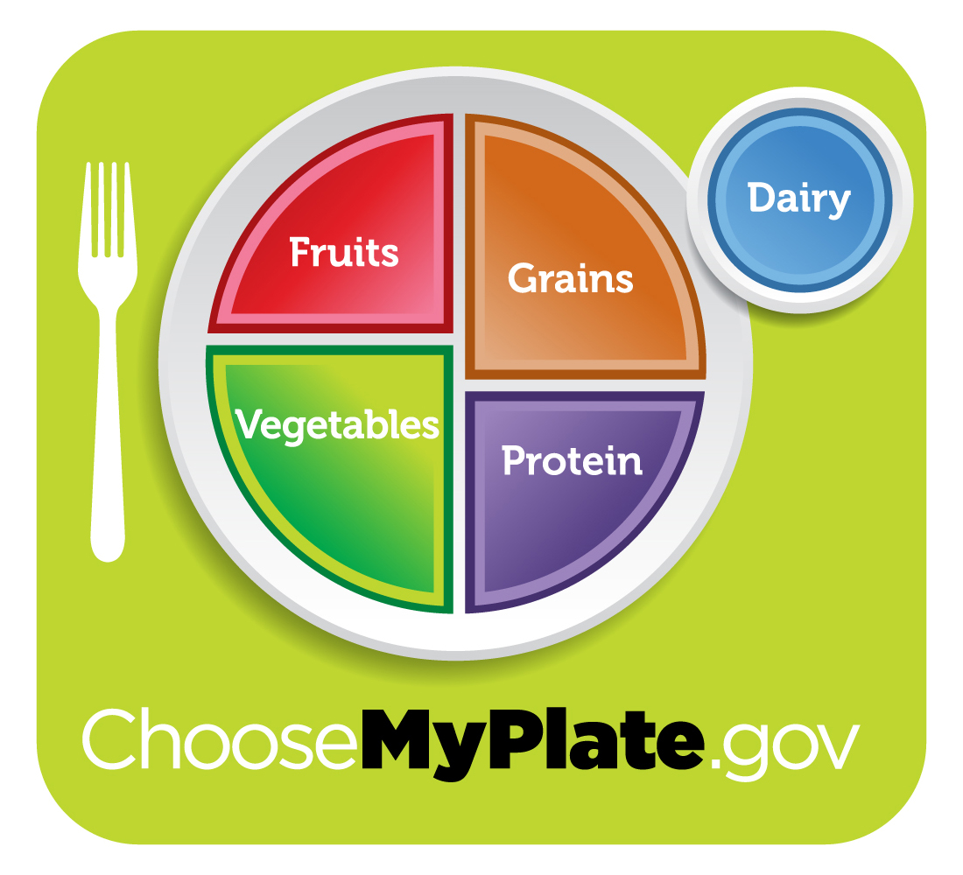
How Does A Healthy Diet Affect Arthritis?
Symptom reduction
Weight control
Immune system support
Protection from chronic illness
Notes:
It can be scary and frustrating when medications do not offer relief from arthritis pain.
A common question from many people with arthritis is “What can I eat to help my joints?”
While there is no specific diet that people with arthritis should follow, researchers have identified several foods that can help manage the pains and complications associated with arthritis.
Symptom reduction:
Good Nutrition is essential in easing arthritis pain and inflammation.
Eating a healthy diet can help to reduce symptoms of arthritis such as joint swelling or pain, morning stiffness, and fatigue.
Reduces cytokine production, which is trigger for inflammation. (Cytokines are one of the inflammatory chemicals produced by fat tissue.)
Weight control: One of the most beneficial aspects of eating a healthy diet is weight control, especially since excess weight is one of the primary causes of worsened arthritis pain. 1 pound of extra weight put 4 extra pounds of pressure on your weight bearing joints.
Immune system support: Certain foods can assist in the immune-system support to help fight off inflammation.
Protection from chronic illness: Finally, eating a healthy diet can help to protect you from other chronic illnesses such as cancer, heart disease, and diabetes, all of which can worsen symptoms of arthritis.

Slide 13
What is a “Good” Diet
Eat a variety of healthy foods
Maintain a healthy weight
Eat fat and cholesterol in moderation
Eat plenty of vegetables, fruits, and whole-grains
Use sugar and salt in moderation
Drink alcohol in moderation
Consume your daily requirements of vitamins and minerals.
Notes:
“Eat a rainbow” food of a variety of color
Sugar is considered an inflammatory

Slide 14
Water
Delivers nutrients to joints
Helps excrete toxins
6 or more 8 oz. glasses per day, more if you exercise regularly
Avoid adding sweeteners
With certain medications, needs are higher
Notes:
Show of hands…how many of us drink water on a regular basis?
Ways to increase water intake…add herbs, cucumbers, lemon, lime, etc.
Sweeteners: artificial sweeteners have been shown to be pro-inflammatory (aspartame, Nutrasweet)

Slide 15
Diet and Inflammation
Pro-Inflammatory Foods
“damaged fats”
Foods high on the glycemic index
Anti-Inflammatory Foods
Healthy fats
Whole foods
Vitamin D
Notes:
Section 2/Question 4 and 5: What are some ways you can manage your pain? What should you do if you think you might have arthritis?
Control symptoms: Manage pain and limited mobility.
Get moving: Physical activity keeps joints flexible and enhances overall health.
Maintain a healthy weight: Extra pounds put added strain on joints.
Other options include: medications (OTC and prescription); Massage, Physical Therapy
Question 5: Discuss signs/symptoms with your physician. Don’t hesitate as if you have arthritis it’s important to receive the diagnosis, schedule an appointment with a Rheumatologist (specializes in the disease) and form a treatment plan to prevent disease progression.

Slide 16
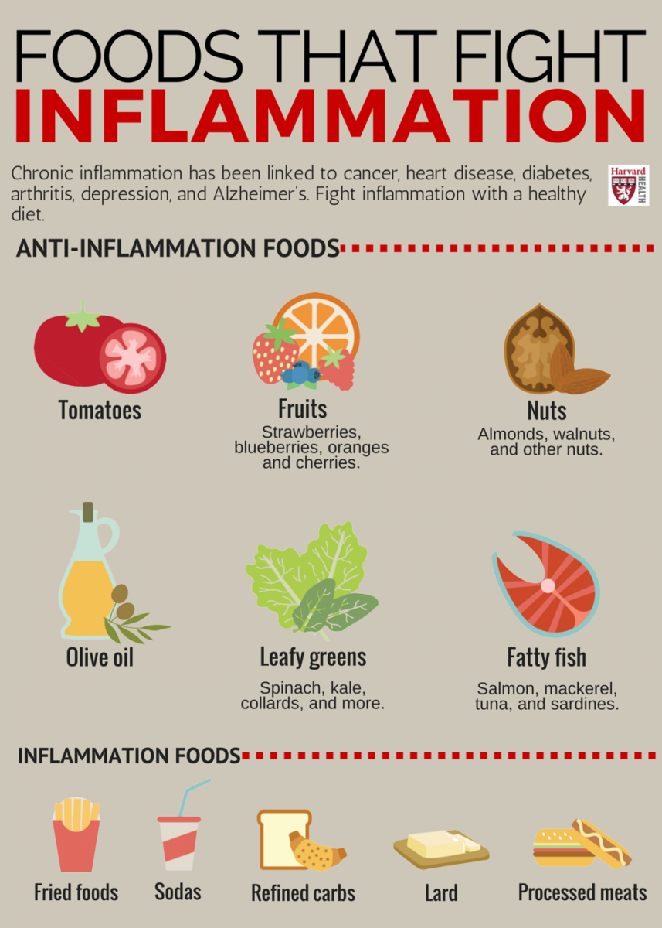
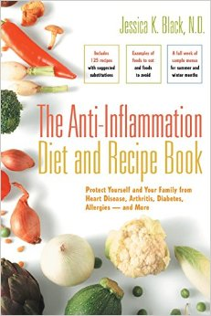

Slide 17
Foods That Inflame
refined carbohydrates, such as white bread and pastries
French fries and other fried foods
soda and other sugar-sweetened beverages
red meat (burgers, steaks) and processed meat (hot dogs, sausage)
margarine, shortening, and lard

Slide 18
Foods That Combat Inflammation
tomatoes and other yellow/orange/red vegetables
olive oil and other Omega-3 fatty acids
dark green leafy vegetables, such as spinach, kale, and collards
nuts and seeds like almonds and walnuts
beans
fatty fish like salmon, mackerel, tuna, and sardines
citrus and other fruits such as strawberries, blueberries, cherries, and oranges
dark chocolate
whole grains

Slide 19
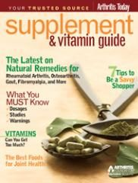
“Good” Supplements
Turmeric Powder
Fish Oil
Avocado-Soybean Oil
Flaxseed
Ginger Root Powder
Pine Bark Powder
Rose Hips
FDA “ Approval” vs. “Regulation” - do your homework!
Arthritis Foundation Supplement Guide
Notes:
Section 2/Question 4 and 5: What are some ways you can manage your pain? What should you do if you think you might have arthritis?
Control symptoms: Manage pain and limited mobility.
Get moving: Physical activity keeps joints flexible and enhances overall health.
Maintain a healthy weight: Extra pounds put added strain on joints.
Other options include: medications (OTC and prescription); Massage, Physical Therapy
Question 5: Discuss signs/symptoms with your physician. Don’t hesitate as if you have arthritis it’s important to receive the diagnosis, schedule an appointment with a Rheumatologist (specializes in the disease) and form a treatment plan to prevent disease progression.

Slide 20
Specific Arthritis Diets
There are no scientifically claimed “cure-all” diets and nutritional supplements
Watch out for diet and supplement frauds
Ask specific questions about when determining whether or not a diet is appropriate
Everyone is different
Notes:
Everyone is different…what may work for someone else may not necessarily work for you…
~Some of the specific diets that are known to have harmful side effects include those that rely on large doses of alfalfa, copper salts or zinc, the low cal, low fat, low protein diet.
Questions to ask about diets:
Does the diet completely eliminate any group of foods from the basic food groups?
Does the diet stress only a few foods or eliminate others?
Does the diet have any potentially harmful effects?
Does the diet have only personal testimonials, rather than scientific evidence to support it?
If you answer yes to any of these, it is probably an unproven diet.
Creating a personal diet should be with the help of your primary care physician or a registered dietitian.
**Elimination of foods should only happen with the direction of your physician or specialist)
Gluten Free diets: While eliminating gluten is essential for people with celiac disease, an autoimmune disease, not everyone who goes gluten-free will find joint pain relief, and some might not benefit at all. The most accredited theory is that gut inflammation triggered by gluten causes activation of T-lymphocytes that can eventually migrate to joints, causing local inflammation and therefore joint pain. This theory is in line with the fact that celiac disease is now defined as a systemic disease that can affect any organ or tissue, including joints.” Joint pain can occur in both celiac disease and gluten sensitivity.

Slide 21
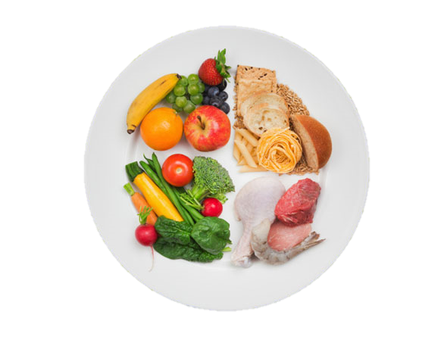
Why Start Eating Better Now?
Reduced inflammation
Increased heart health
Lower risk of chronic illness
Vitality
Energy
Notes:
Overall, losing excess weight is beneficial to anyone, particularly those people living with arthritis. Not only because it helps to reduce inflammation, but also increases heart health, and may lower a person’s risk of developing chronic illness. When it comes to diet, there is miracle elixir, or magic combination, so make sure to consult your doctor before making any drastic dietary changes that may have interactions with your lifestyle or medications
Not only that, but eating a healthy, balanced diet will help increase vitality and energy so that you feel great and can truly live life.

Slide 22
What Can You Do?
Be aware of what affects you
Seek advise from a Registered Dietitian or Nutritionist
Talk to friends and family about diet changes and need of support
Use food to nourish rather than to stimulate or entertain

Slide 23
Additional Information and Resources from the

Slide 24
Notes:
The Arthritis Foundation focuses on breaking down barriers to care and advancing scientific discoveries. We also connect people with arthritis to tools, resources and a wider community of support.

Slide 25
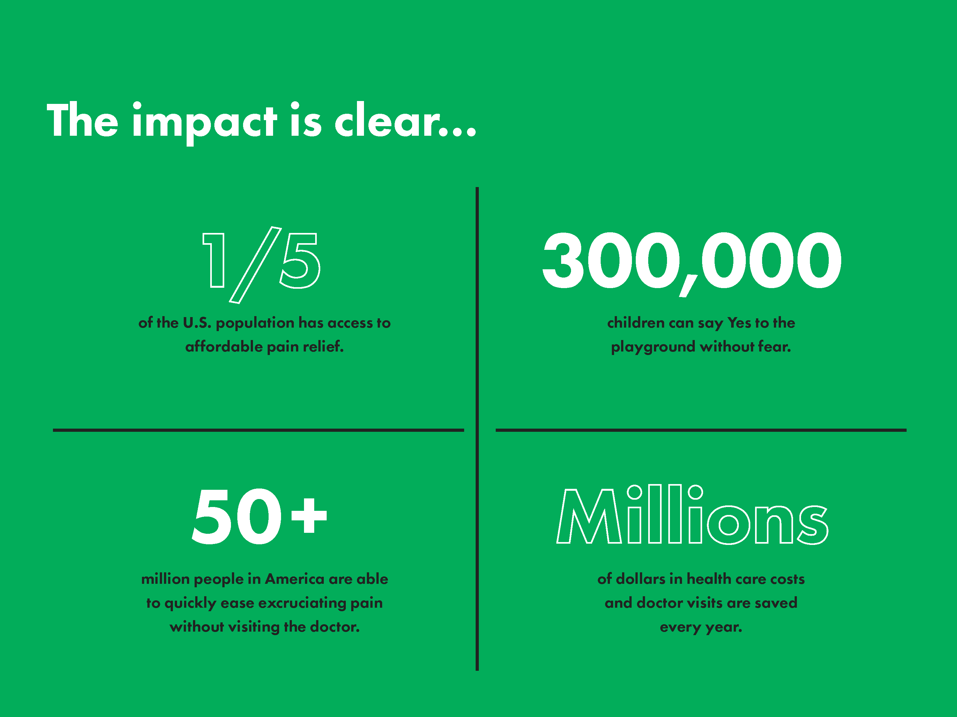
Notes:
By leading the way on many fronts in the fight against arthritis, the Arthritis Foundation improves quality of life, helping people say Yes to things important to them.
We’re making a difference for the one in five Americans who has arthritis – more than 50 million people, including 300,000 children and their families. We’re helping save millions of dollars in health care costs.

Slide 26
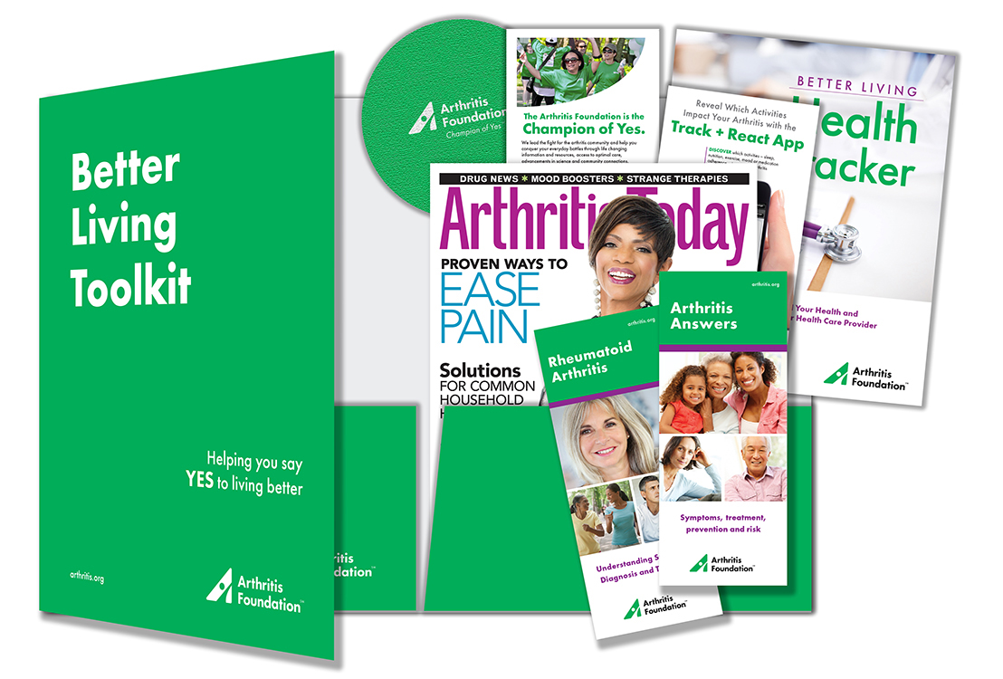
Better Living Toolkit
http://betterlivingtoolkit.org
1-800-283-7800
Notes:
Section 2/Question 4 and 5: What are some ways you can manage your pain? What should you do if you think you might have arthritis?
Control symptoms: Manage pain and limited mobility.
Get moving: Physical activity keeps joints flexible and enhances overall health.
Maintain a healthy weight: Extra pounds put added strain on joints.
Other options include: medications (OTC and prescription); Massage, Physical Therapy
Question 5: Discuss signs/symptoms with your physician. Don’t hesitate as if you have arthritis it’s important to receive the diagnosis, schedule an appointment with a Rheumatologist (specializes in the disease) and form a treatment plan to prevent disease progression.

Slide 27
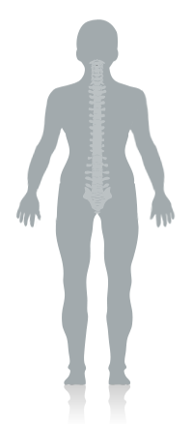
Your Exercise Solution
How it Works
Exercise can help ease arthritis pain – but which one is best? The answer is as unique as you are. Your Exercise SolutionSM tool provides a personalized exercise plan. Once you login, you will be able to:
Identify where you have pain
Select your current fitness level
Choose an activity that is right for you
Learn modifications that let you exercise safely

Slide 28
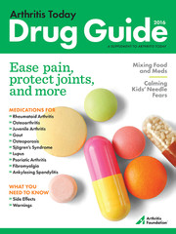
Finding Services
Arthritis Foundation Resource Finder
http://resourcefinder.arthritis.org/

Slide 29
Questions?
awolfe@arthritis.org

