Slide 1
Developing a partnership between AgrAbility and eXtension.org
AgrAbility – National Training Workshop – Wednesday, November 28, 2012

Slide 2
Basic Webinar Instructions
Need speakers or headphones to hear the presentation
Meeting > Manage My Settings > My Connection Speed
Dial-up not recommended
Questions about presentation
If you have a web cam/microphone, click the “Raise Hand” icon to indicate that you have a question
We will activate your microphone
If you don’t have a microphone, type into chat window and hit return

Slide 3
Basic Webinar Instructions
4 quick survey questions
Session recorded and archived with PowerPoint files at www.agrability.org
Problems: use chat window or email jonesp@purdue.edu

Slide 4
Known Webinar Issues
Increased interactivity = increased technical issues
Be patient while we push our boundaries
Meeting > Audio Setup Wizard
Disconnection with presenters
Hang on – we’ll reconnect as soon as possible
Disconnection with participants
Log in again

Slide 5
What is eXtension?
An interactive learning environment delivering research knowledge from 74 universities from across the United States. eXtension offers:
Credible expertise
Peer reviewed user friendly resources
Reliable answers based upon sound research
24/7/365 access
Customized answers to users’ specific needs
Notes:
There are over 50 Communities of Practice that are currently ‘live’.
More CoPs can be added.

Slide 6
Formation of FReSH
FReSH was formed from members of the North Central Extension/Education Research Activity (NCERA 197) Committee
FReSH addresses one of the NCERA 197 agenda goals to increase infrastructure support for agricultural safety and health
Grant received in 2011 and official launch was March 1, 2012.
Notes:
NCERA 197 used to be NCR 197 and began in 2000 to develop strategies to use the Land Grant system’s research and extension capability and the experience of ag producers to reduce work-related injuries, illness, and deaths.
NCERA meets annual via conference call in the fall and F2F in the spring.
NCERA 197 developed a National Agenda for Action which was the first ag safety agenda since 1943.

Slide 7
Funding Sources
Notes:
Original funding received by USDA-NIFA
Additional funding by CHS Inc.

Slide 8
Leadership Team
Richard Brzozowski – University of Maine
Linda Fetzer – Pennsylvania State University
Karen Funkenbusch – University of Missouri
Kitty Hendricks – National Institute for Occupational Safety & Health
Dee Jepsen – The Ohio State University
Carol Jones – Oklahoma State University
Dennis Murphy – Pennsylvania State University
Michael Pate – Utah State University
Cliff Racz – Purdue University
Charles Schwab – Iowa State University
Aaron Yoder – Pennsylvania State University

Slide 9
Content on FReSH
Articles
Categories include 1) topics (subject matter), 2) educational and training programs, 3) national reference documents and visuals, 4) national resource organizations, and 5) education and training presentations (programs without evaluation).
Frequently Asked Questions
Ask the Expert
Online Certificate Course (e.g., AgSafety4u at http://campus.extension.org/)
Notes:
66 CoP members – Upon joining the CoP, members are asked their areas of expertise during the review process of articles and FAQs.
Review process:
Topic pages – 4-5 people.
Programs – At least 2 people
National reference – At least 2 people
National organization – At least 2 people (1 from the org if poss)
Presentations – At least 2 people (1 involved with the program)
FAQS – All FAQs are reviewed by at least 2 people.
Ask the Expert – If a person has an unanswered question, they can submit a question to be answered by an expert.
Event Calendar – Post just about everything that I see come through my email through different ASH listservs.
AgSafety4u is the only certification program on the site at this time but other programs can be added.

Slide 10
www.eXtension.org

Slide 11
Click on Farm then Farm Safety and Health

Slide 12
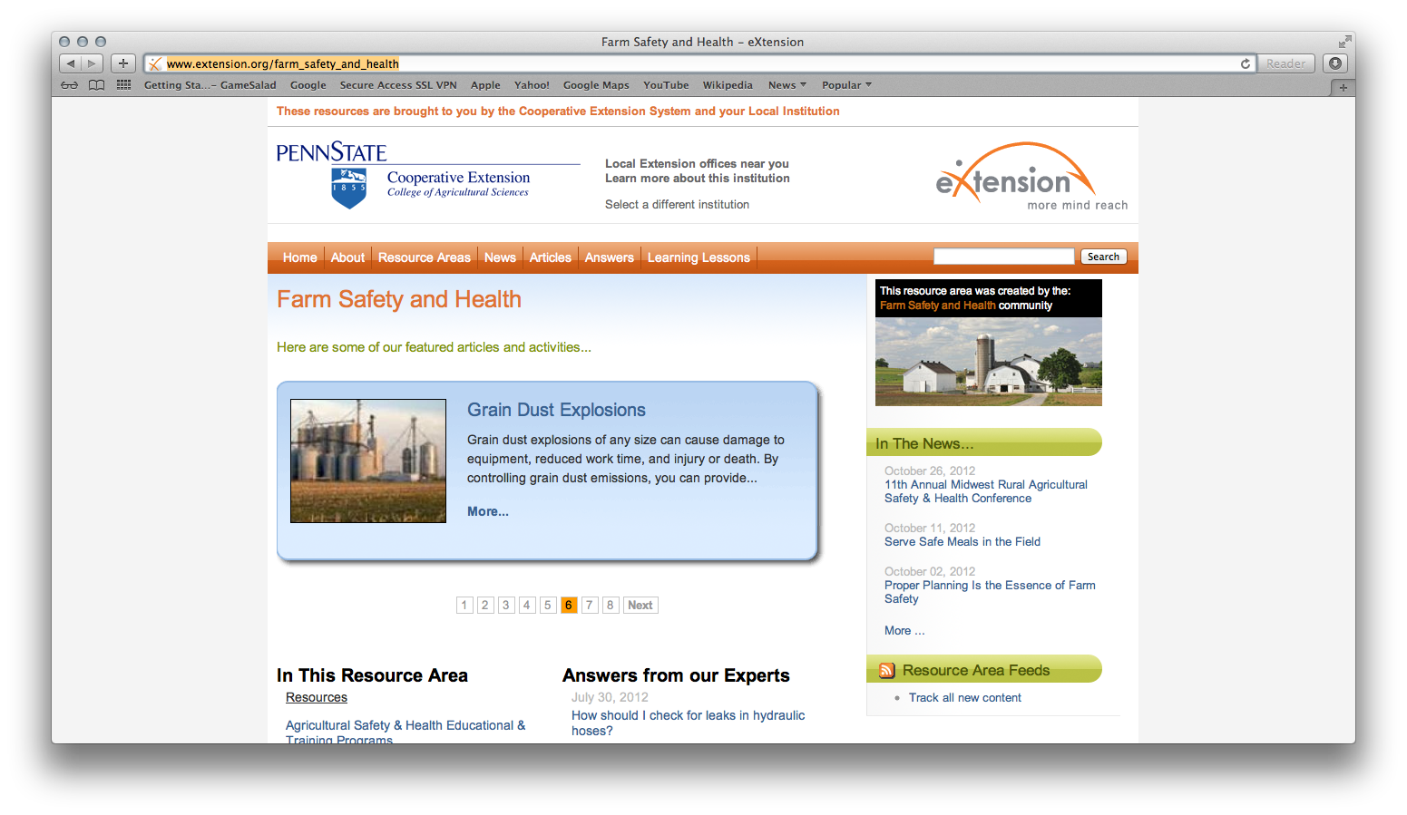
http://www.extension.org/farm_safety_and_health
Notes:
When people access the FReSH site, their local Land Grant university will appear at the top.

Slide 14
Topics Covered in FReSH
Animals
Behavioral Health
Confined Spaces
Crops & Feed
Chemicals
Emergency Response
General
Green Industry
Machinery & Equipment
Occupational Health
Research
Special Populations
Structure & Landscape
Traumatic Injury

Slide 16
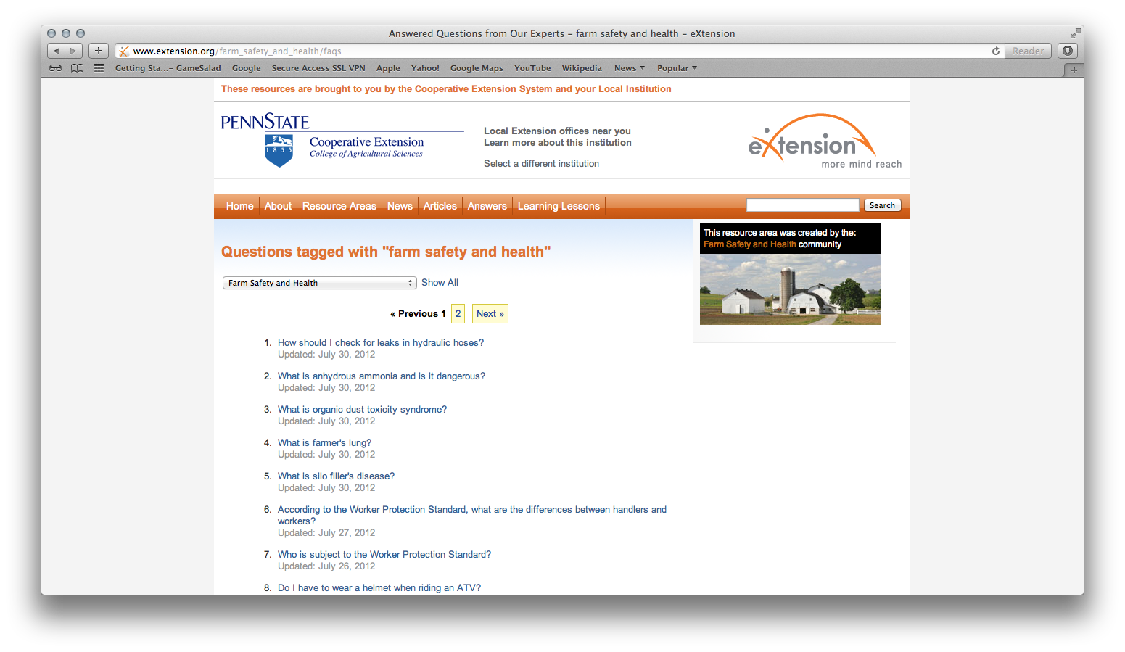
http://www.extension.org/farm_safety_and_health/faqs
Notes:
When people access the FReSH site, their local Land Grant university will appear at the top.

Slide 18
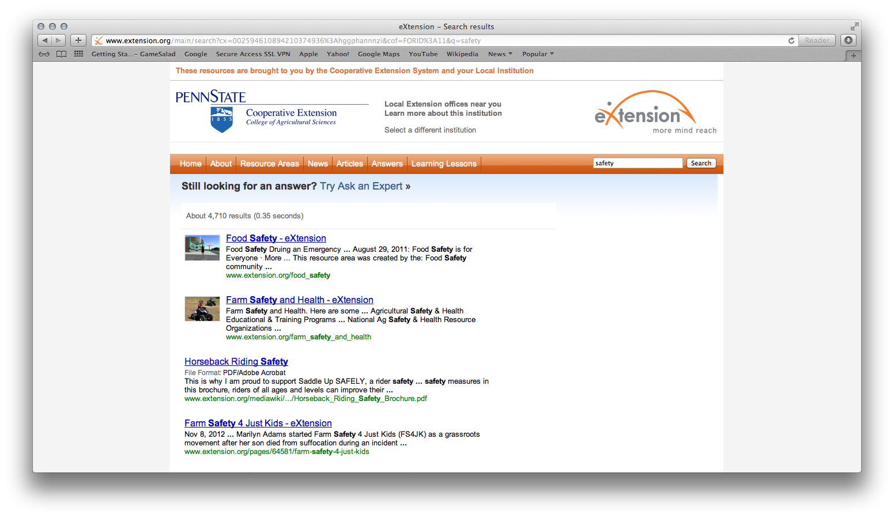
Ask an Expert

Slide 19
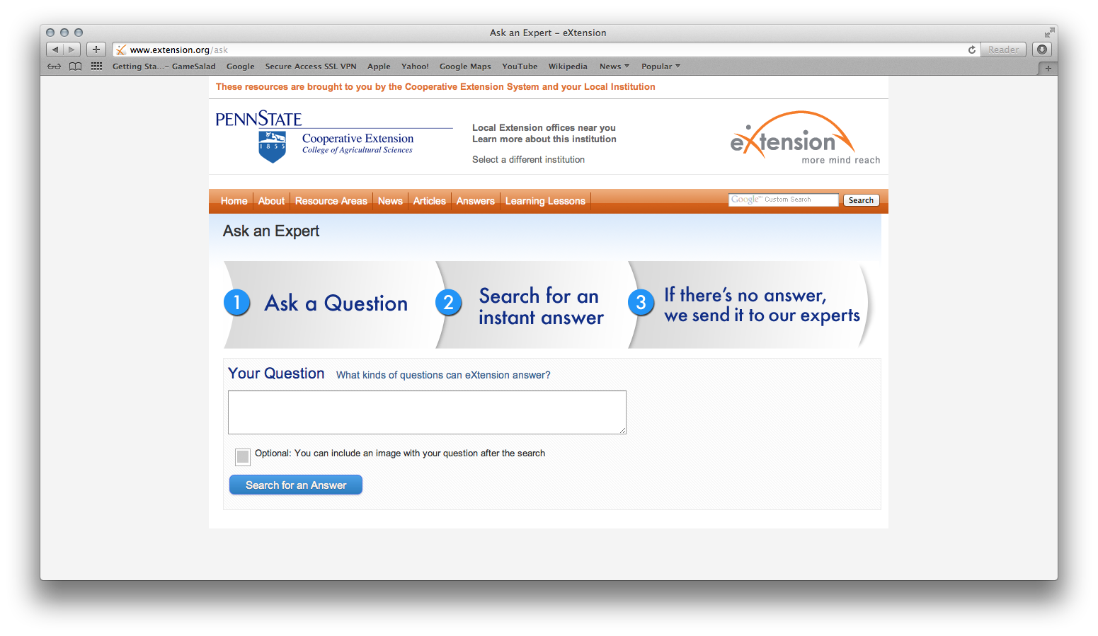

Slide 20
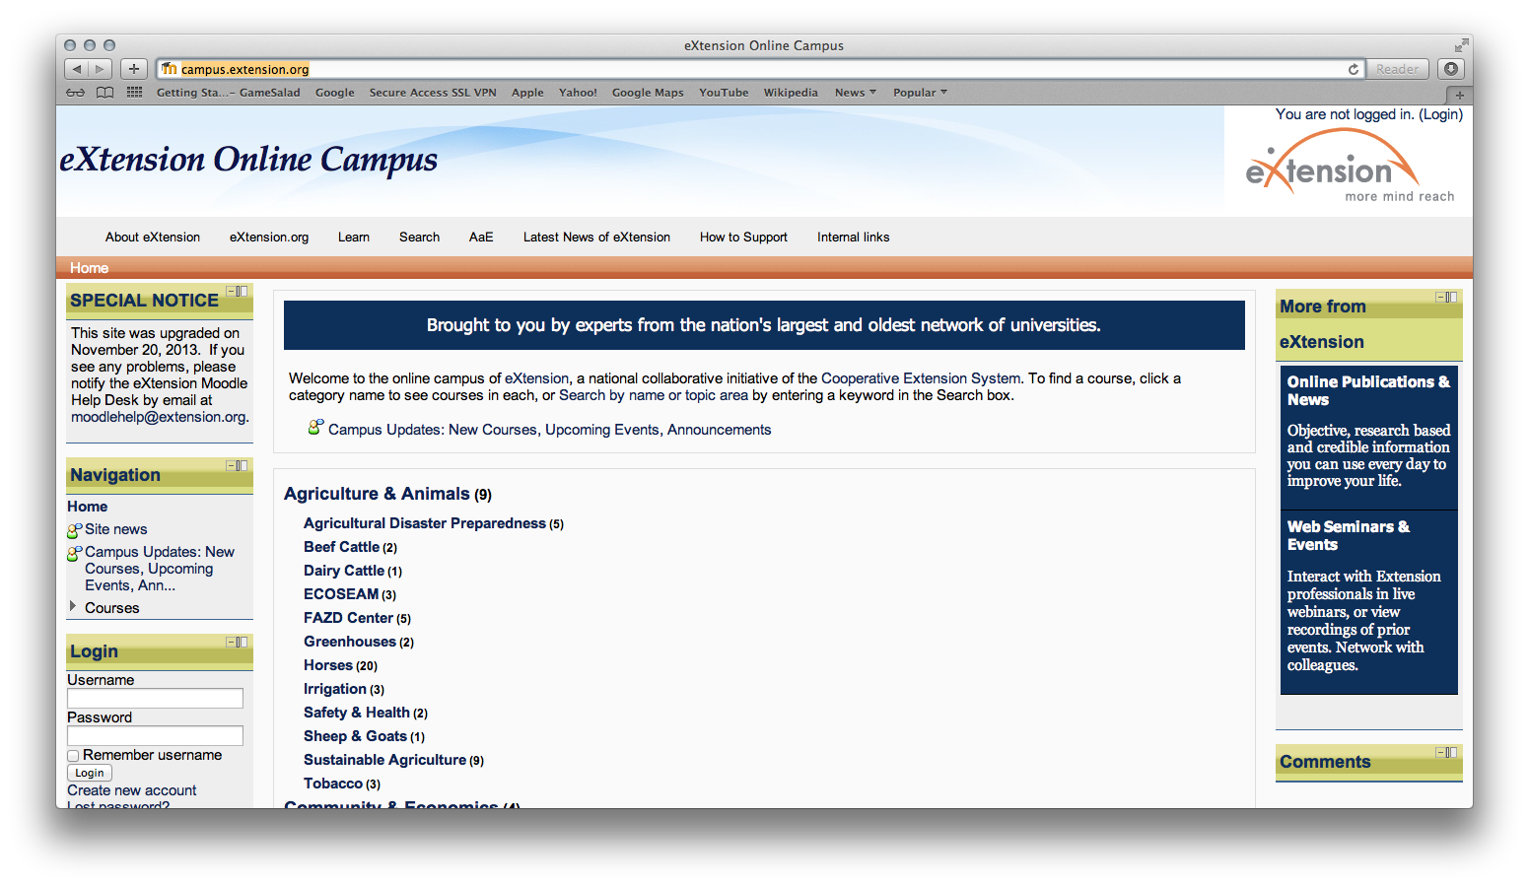
http://campus.extension.org

Slide 21
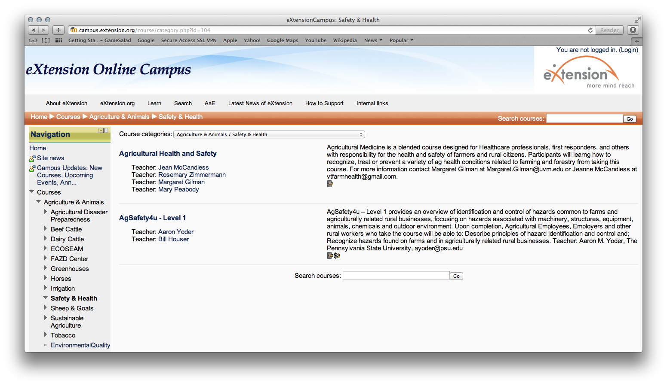

Slide 22
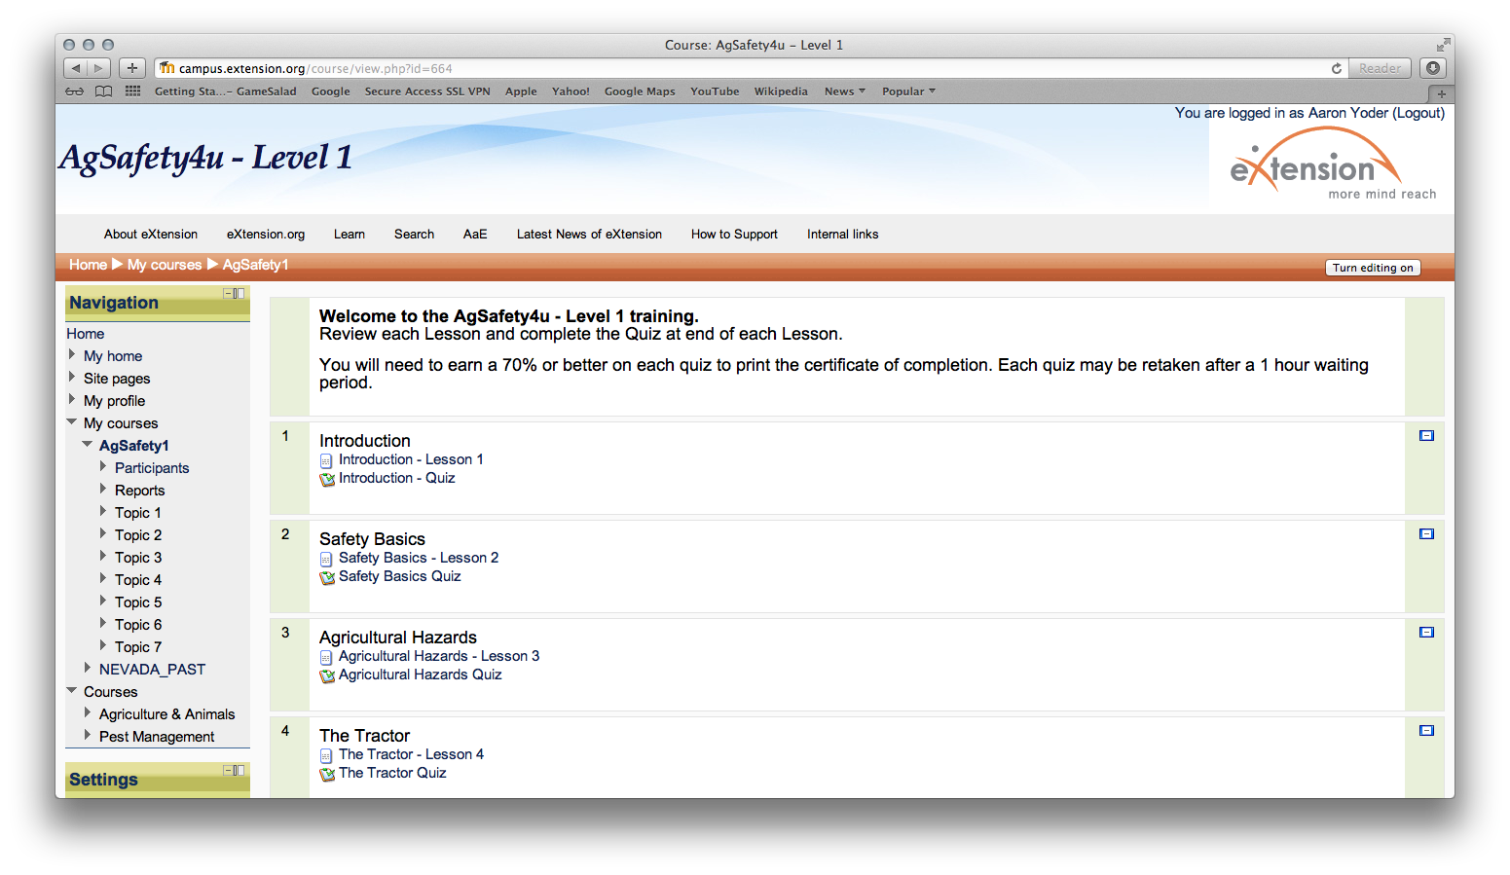

Slide 25
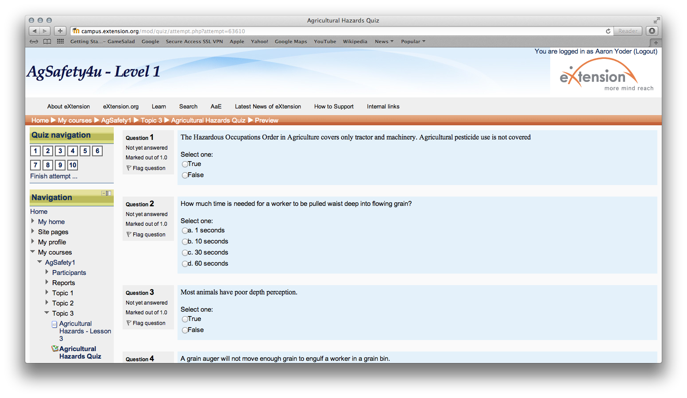

Slide 26
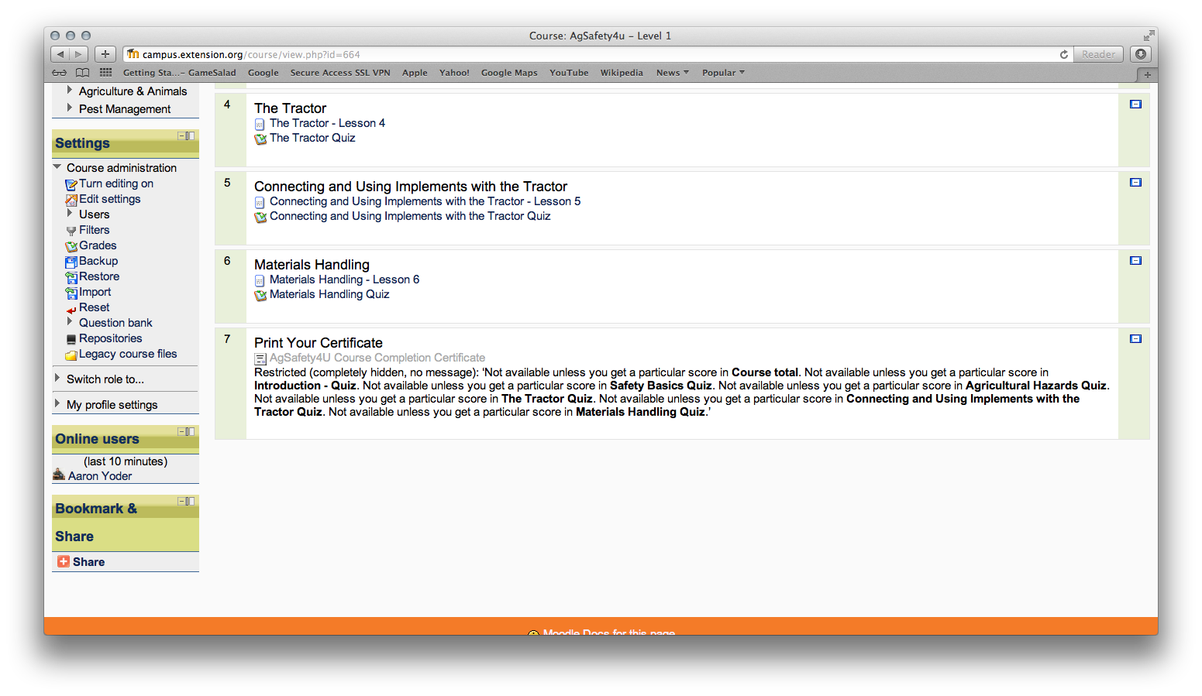

Slide 28
FReSH – GoogleAnalytics
March 1, 2012 – October 31, 2012
7,680 visits
6,720 unique visitors
37,160 page views
4.84 pages/visit
Bounce rate of 56%
Majority of visits are from the United States
Utilized less by mobile devices
Internet Explorer is most popular browser
Most viewed articles: respiratory protection (591 views) and round bale handling safety (591 views)
Notes:
Bounce rate – A single page view and then exit the whole site ending the session.
Beef cattle handling safety
119 page views, 90 were unique
51 entered from this page
Time on page was 2 minutes and 10 seconds
64% bounce rate, 50% exit rate
Anhydrous ammonia safety
98 page views, 78 were unique
70 entered from this page
Time on page was 13 minutes and 28 seconds
74% bounce rate, 71% exit rate

Slide 29
Impact for AgrAbility
Source of current ag safety and health info
Strengthens the link between AgrAbility and eXtension system
Partner with other AgrAbility staff to write, review, and post articles about rural rehab topics
Develop online courses and use Moodle through eXtension to host your program.

Slide 30
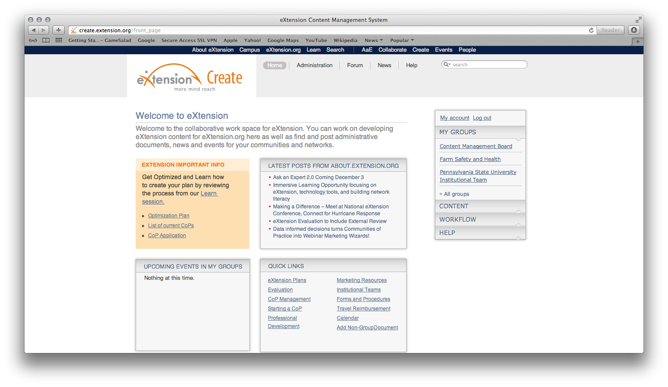
How to Create/Edit an Article or FAQ

Slide 31
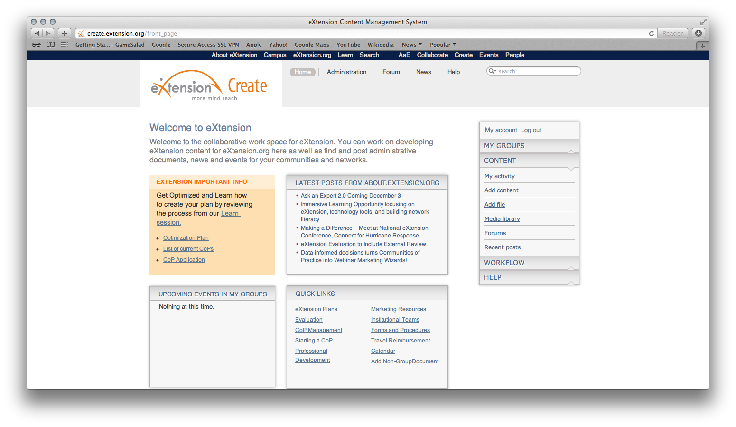

Slide 32
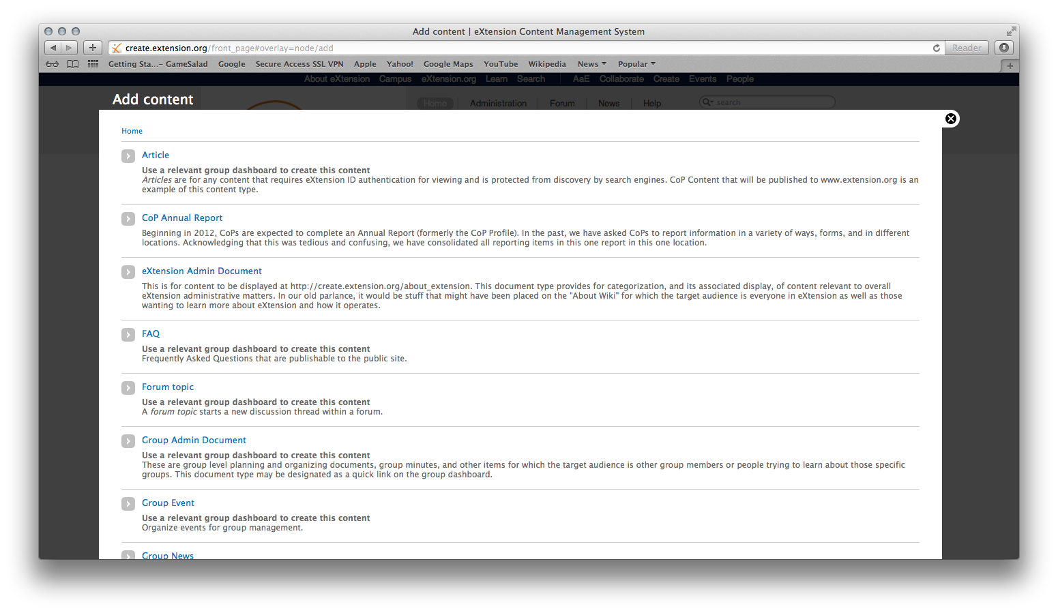

Slide 33
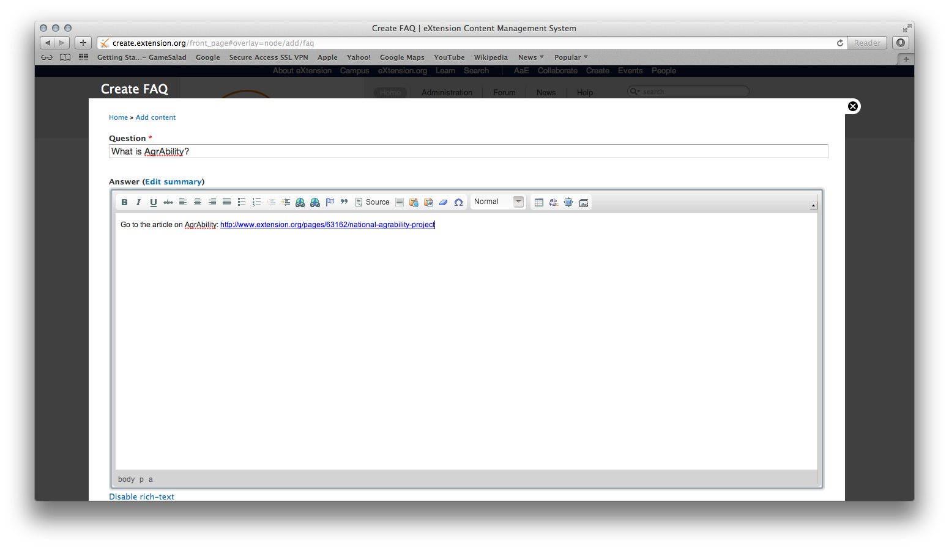

Slide 34
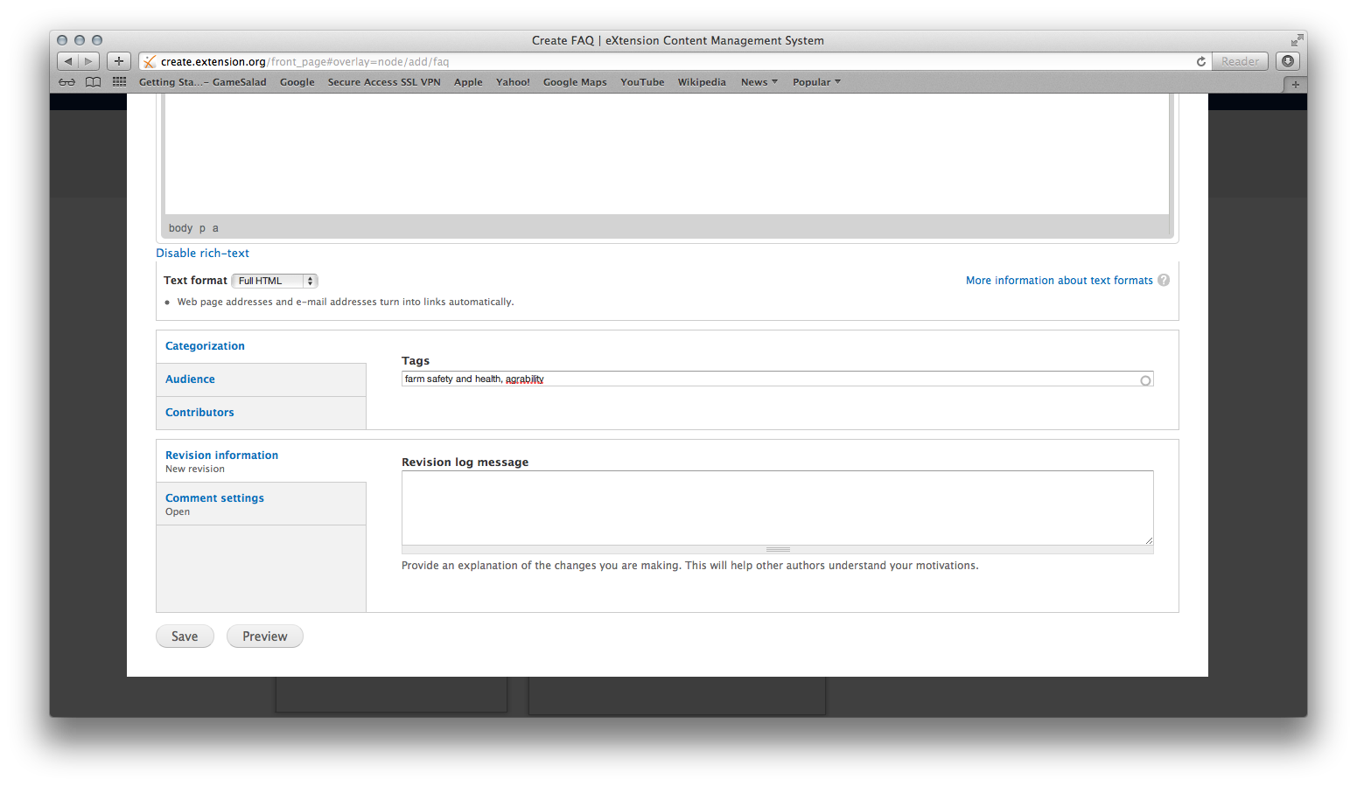

Slide 35
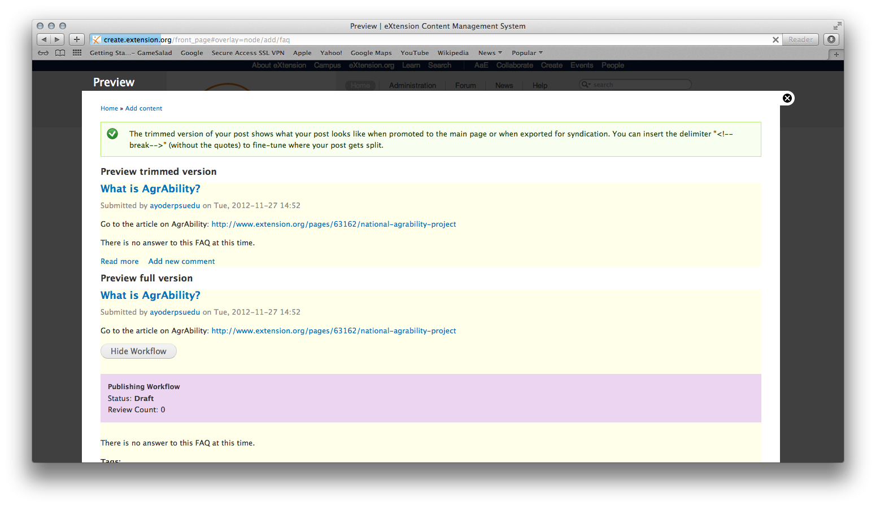

Slide 36
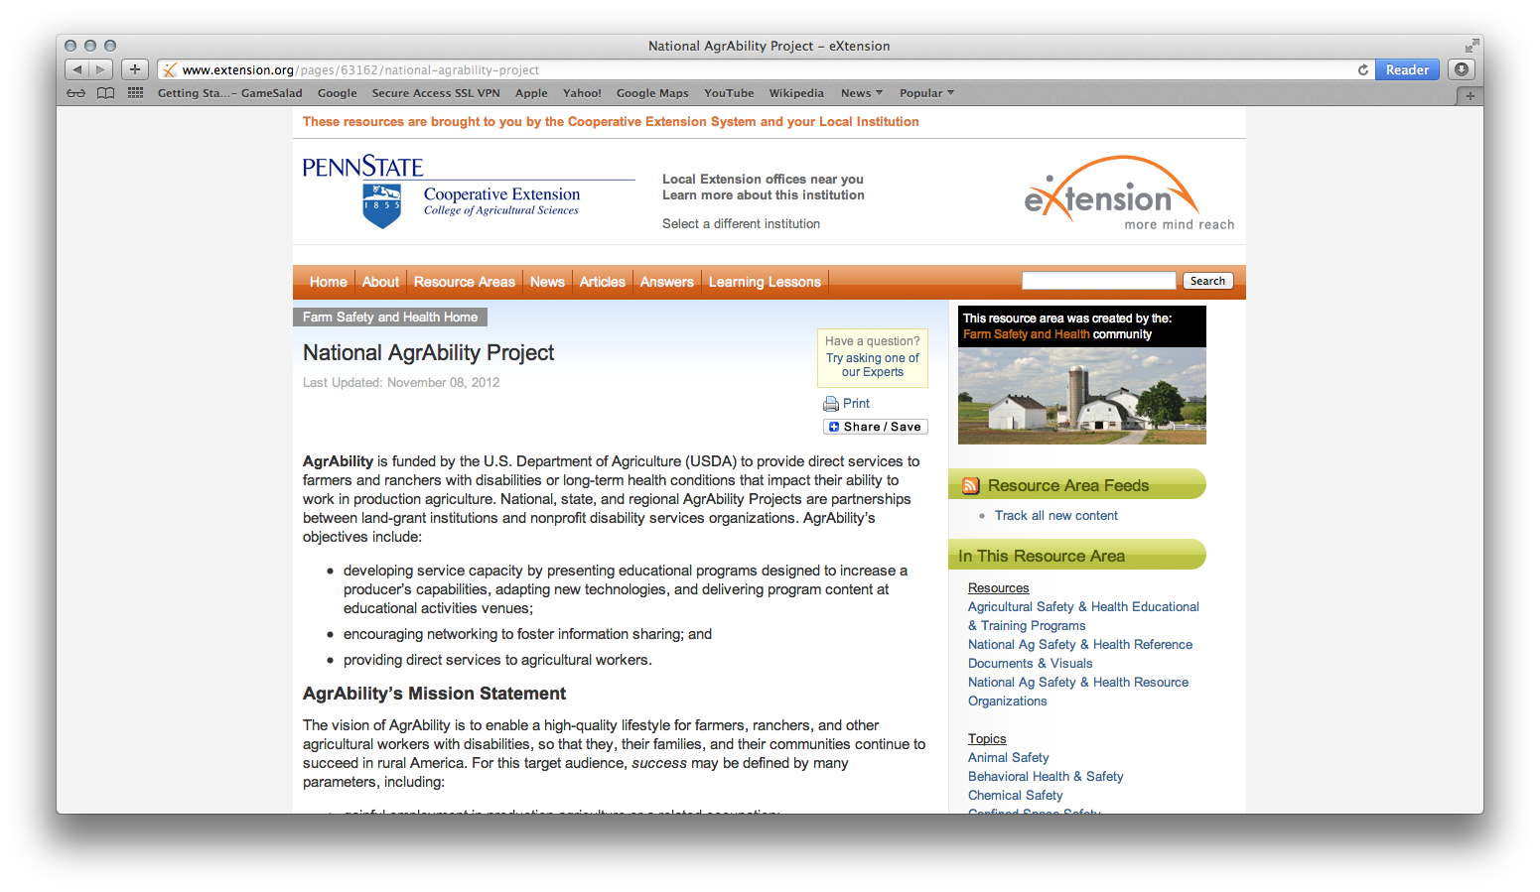

Slide 37
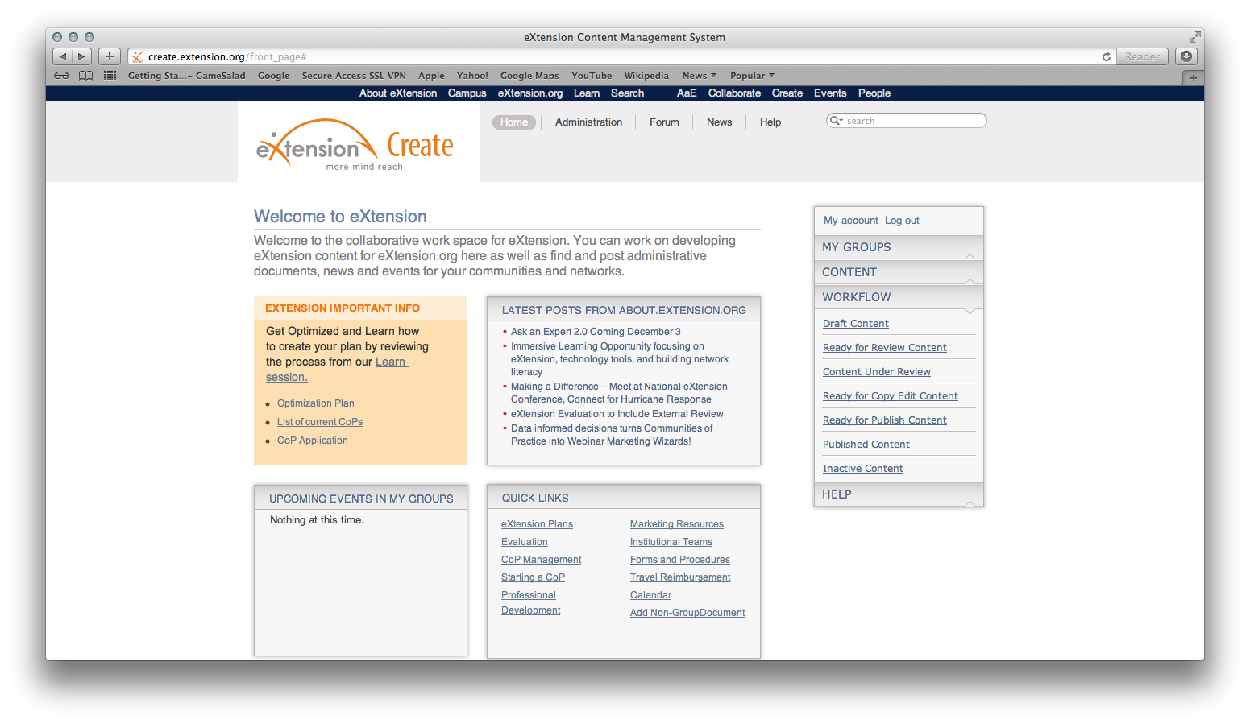
Editing Articles and FAQs

Slide 38
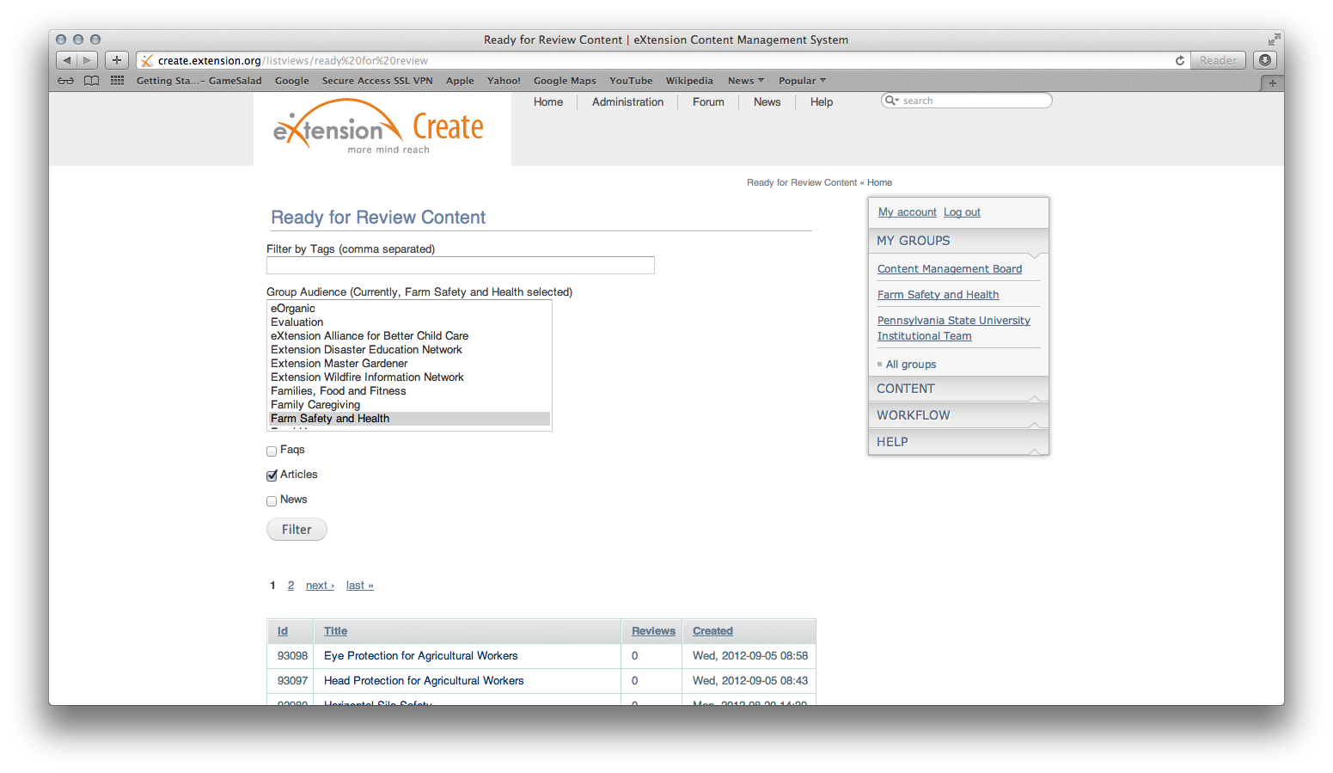

Slide 39
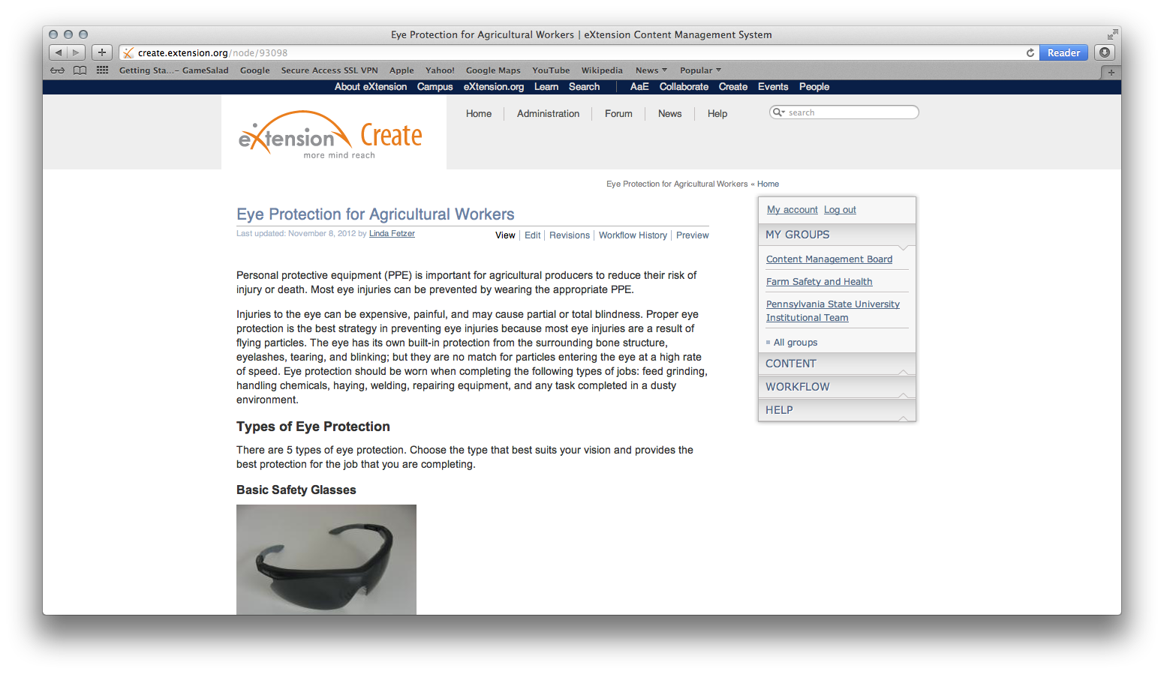

Slide 40
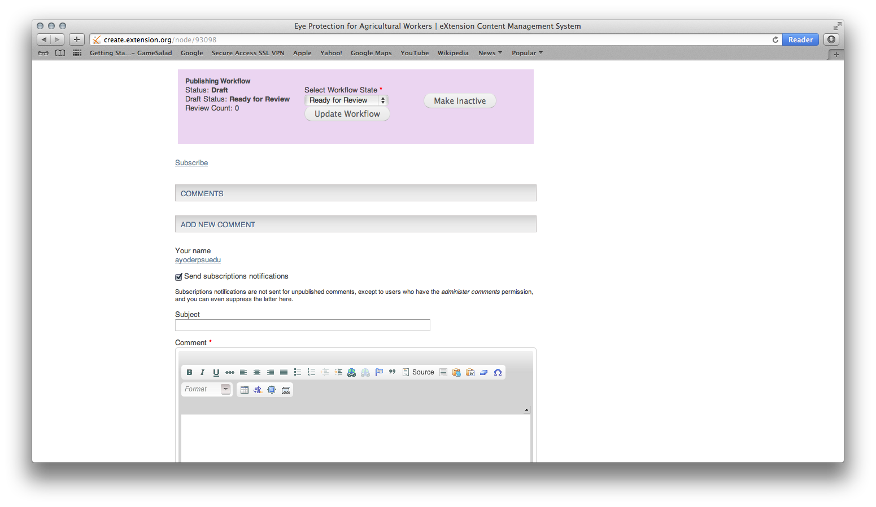

Slide 41
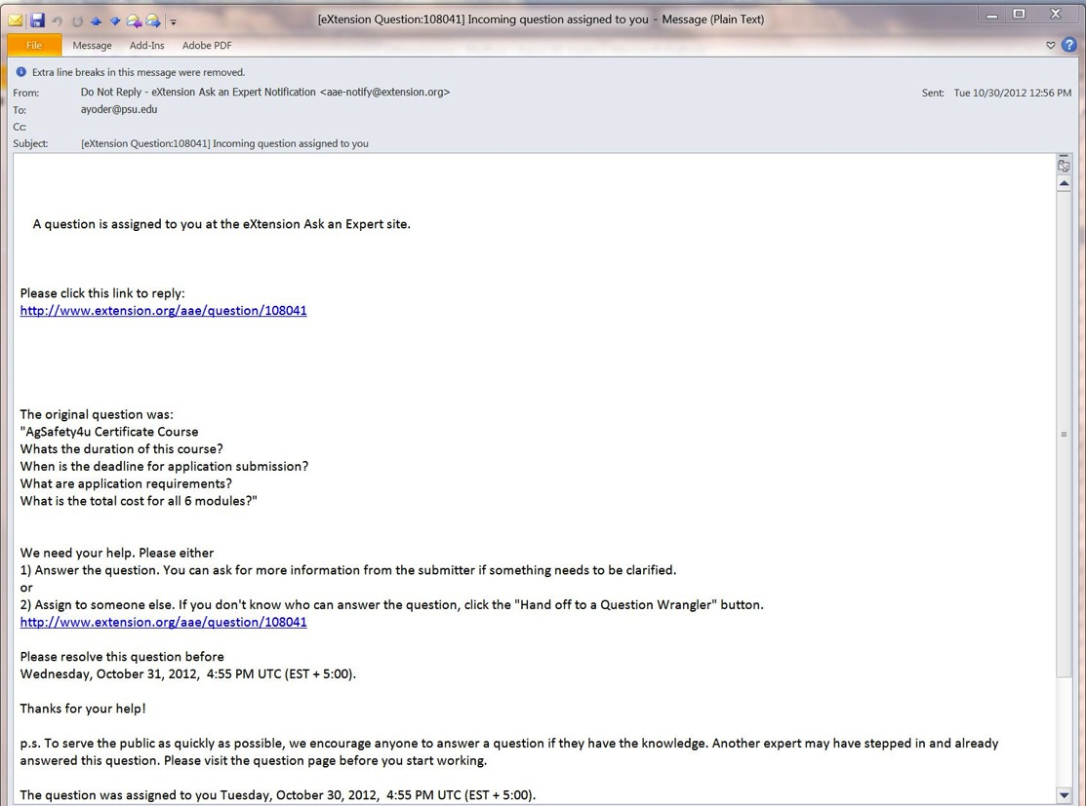
How to Answer an AaE Question

Slide 42
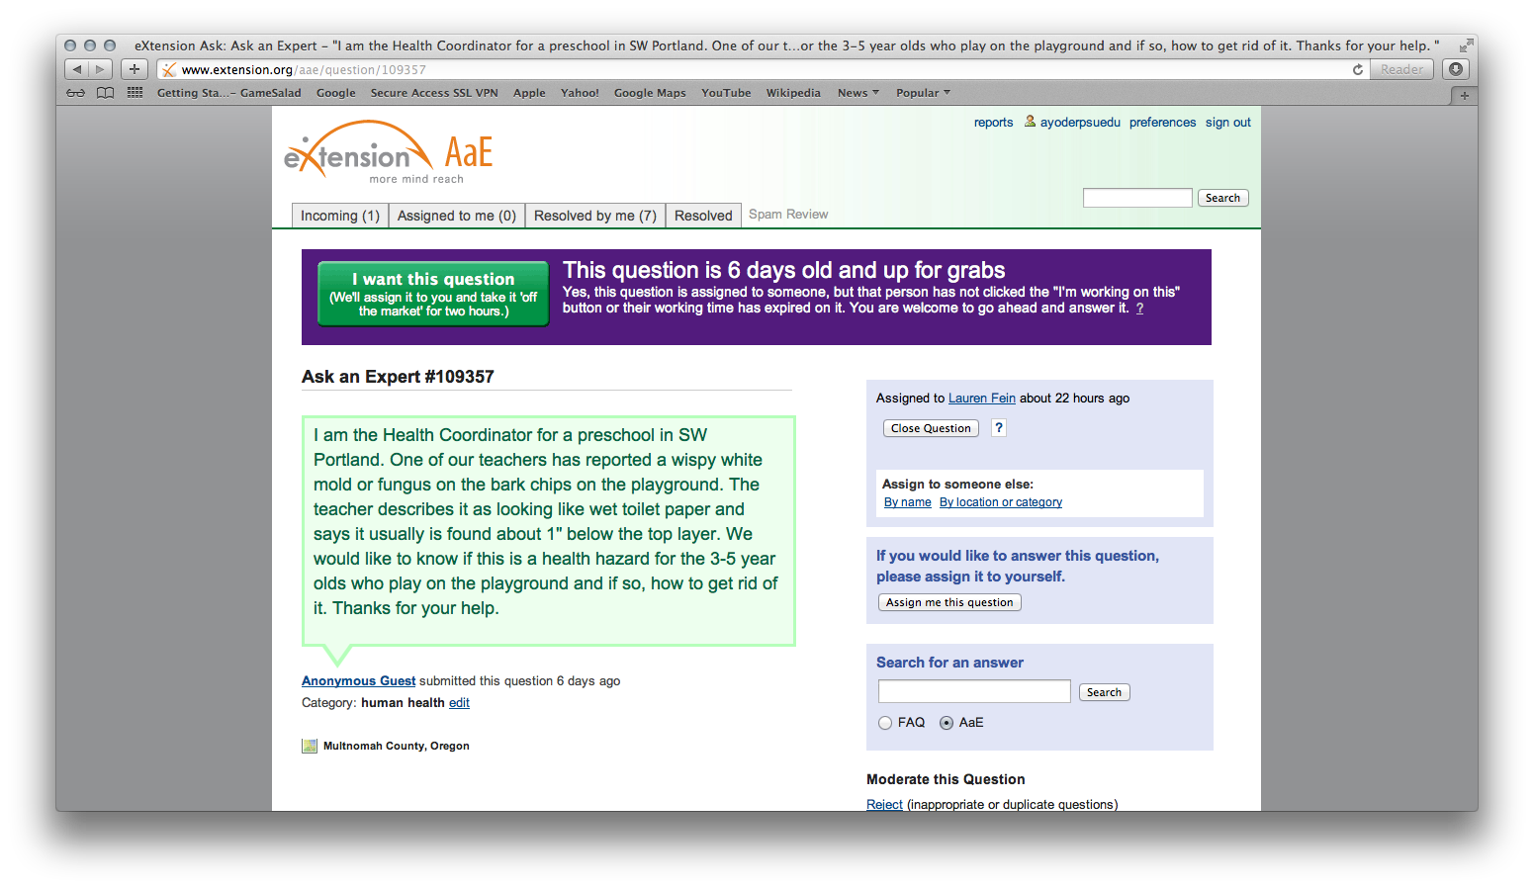

Slide 43
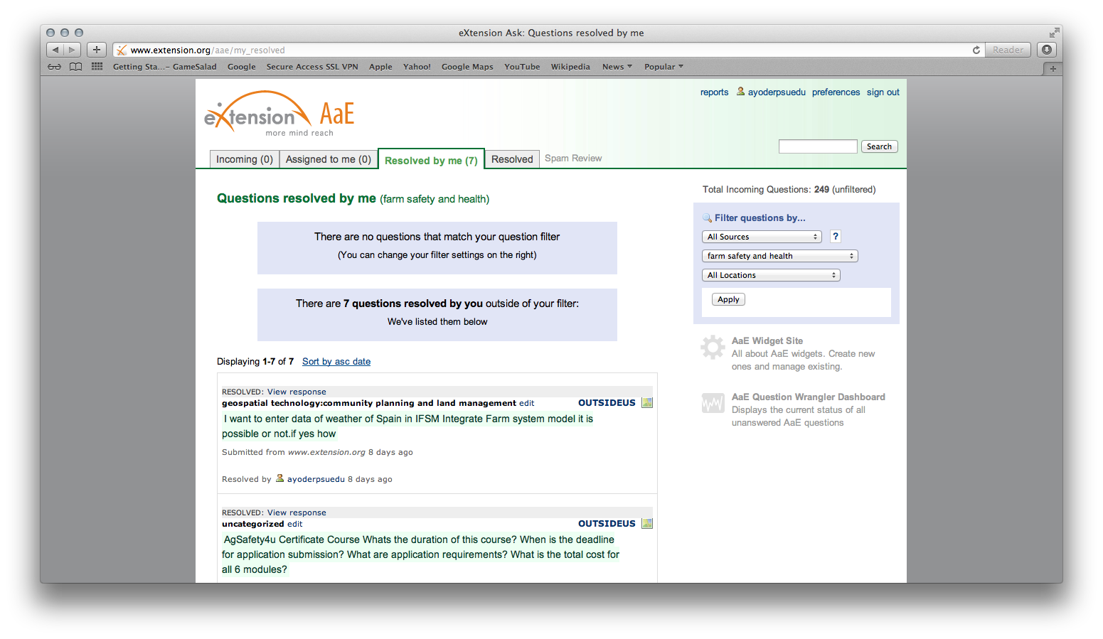

Slide 44
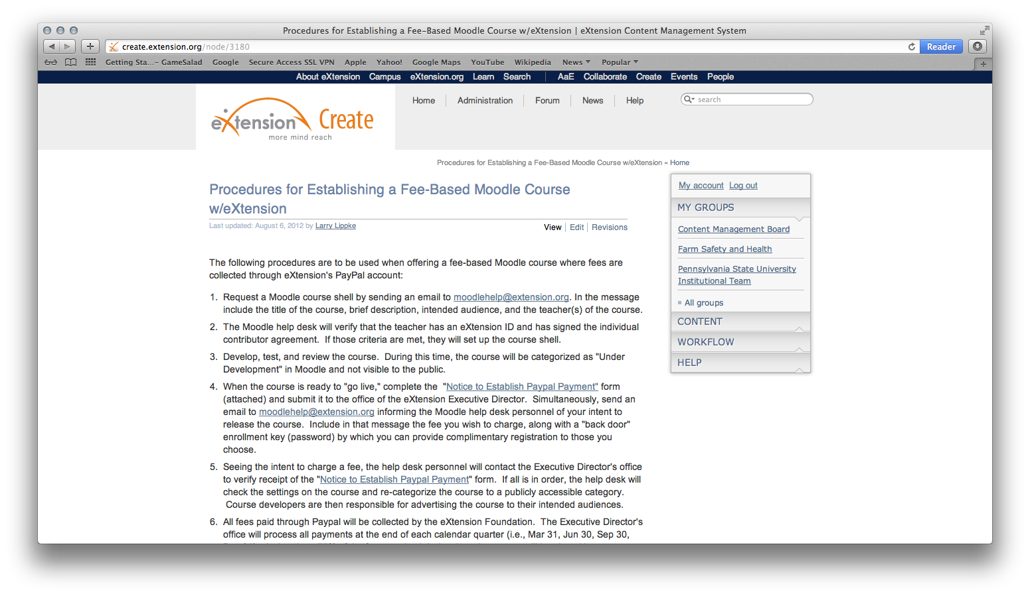
How to Create an Online Course

Slide 45
FReSH and Federal Grants
Federal grants encouraging applicants to work with eXtension
Contact Aaron Yoder at ayoder@psu.edu to discuss the benefits of working with FReSH and to obtain a letter of support.
Dissemination of information
Hosting webinars
Track information usage
Development of online training programs through Moodle

Slide 46
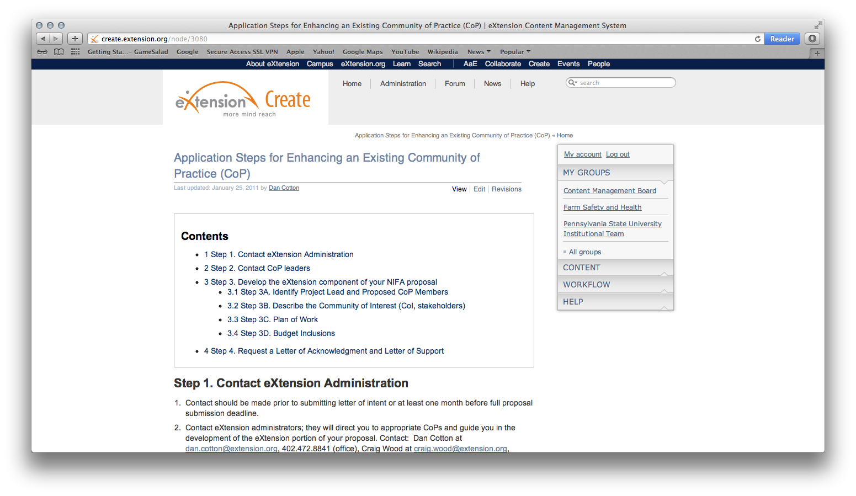

Slide 47
Getting Involved in FReSH:
Join as a CoP member (contact Linda at lmf8@psu.edu to join)
Review articles and FAQs
Write articles and FAQs
Promote the use of FReSH
Use FReSH as a way to share your information (e.g., PowerPoints, webinars, curriculum, etc.)
Notes:
Send me an email and I will send you and invitation to join through eXtension
After joining the CoP, you will receive a Doodle poll from me so you can indicate your areas of expertise.
You will be asked to review articles and FAQs before they go to copy editing.
If you have an event or hosting a webinar, email me the details and I will post it on FReSH to promote your event.
If you have done a presentation or developed curriculum, FReSH can be an outlet for you.

Slide 48
Questions?
Aaron Yoder – ayoder@psu.edu
Linda Fetzer – lmf8@psu.edu

