Slide 1
PTSD and the Disabilities of the Post 9/11 War Veteran
Captain Guy Zierk
Marine Corps Wounded Warrior Regiment
Wednesday, December 2, 2015

Slide 2
Basic Webinar Instructions
Check sound via Audio>Computer Audio Settings.
Please don’t activate camera.
Closed captions: use arrow to expand the Closed Captions window to view.
Expand/contract any of the windows in the right-hand column with the arrows.
Expand/contract the size of the right-hand column.

Slide 3
Basic Webinar Instructions
Questions and comments
Click Chat icon at top right of screen (it should turn blue). Enter message in box, choose who to send it to, and click send. You may enter questions about the presentation at any time
In addition, during the Q & A period, if you have a web microphone, click the “Raise Hand” icon to indicate that you have a question. We will enable your microphone

Slide 4
Basic Webinar Instructions
5 quick survey questions + opportunity to share comments
Session recorded and archived with PowerPoint files at www.agrability.org/Online-Training/archived
Problems: use chat window or email agrability@agrability.org

Slide 5
Potential Webinar Issues
Audio continues, but slides don’t advance
Move your mouse or hit Enter
Disconnection with presenters
Hang on – we’ll reconnect as soon as possible
Disconnection with participants
Log in again

Slide 6
AgrAbility: USDA-sponsored program that assists farmers, ranchers, and other agricultural workers with disabilities.
Partners land grant universities with disability services organizations. Currently 20 state projects
National AgrAbility Project: Led by Purdue’s Breaking New Ground Resource Center. Partners include:
Goodwill of the Finger Lakes
The Arthritis Foundation, Heartland Region
University of Illinois at Urbana-Champaign
Colorado State University
More information available at www.agrability.org

Slide 7
Capt Guy A. “NEO” Zierk
District Injured Support Coordinator
Veteran Integrated Service Network - Ten
United States Marine Corps
Wounded Warrior Regiment

Slide 8
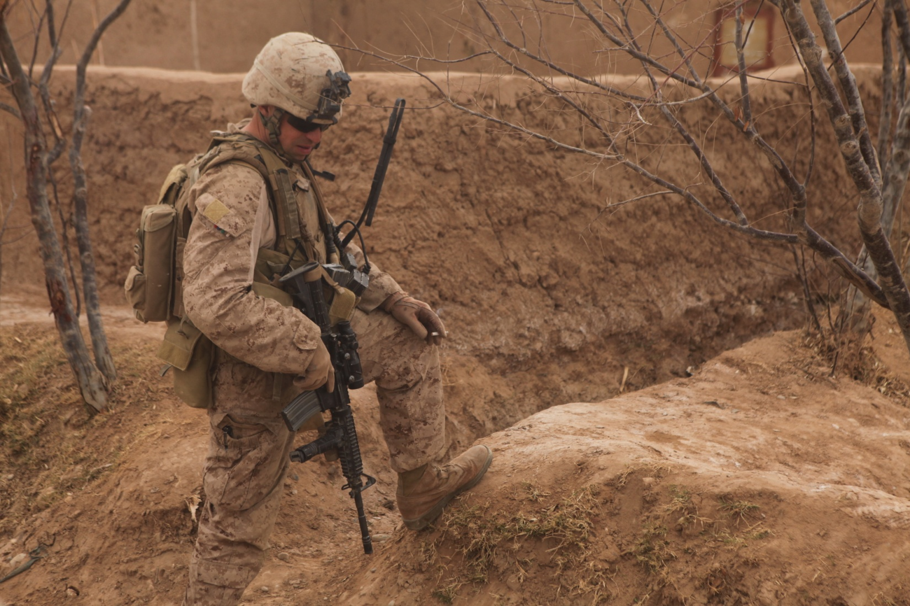
Marjah, Afghanistan – Nov 26th 2010
Notes:
ATTENTION GAINER

Slide 9
Understanding the Invisible Wounds of War
PTSD/PTS
Post Traumatic Stress Disorder
TBI
Traumatic Brain Injury

Slide 10
Today we are going to…
Define PTSD
Dispel the myths about PTSD
Identify the symptoms of PTSD
Learn how to support a Veteran with PTSD
Introduction into the Veterans Administration

Slide 11
PTSD is not a…
Psychotic Disorder
Hear voices other do not
Believe they are being controlled
Cognitive Disorder
Loss of Memory
Inability to learn
Mood Disorder - Severe Depression
Somatoform Disorder - Symptoms of pain
Adjustment Disorder - Chronic coping issues

Slide 12
PTSD defined…
Anxiety Disorder
Signs & Symptoms cluster around excessive irrational fear and dread.
It is treatable though the use of medications & behavioral therapies.
Mental Health Professionals – DSM-5
Veterans Benefits Administration - 38-CFR
Notes:
DSM – Diagnostic and Statistical Manual of Mental Health Disorders
CFR – Code of Federal Regulation

Slide 13
What is PTSD…
It can occur after the exposure to a TRAUMATIC event.
It can affect a persons thoughts, feelings, and behavior.
Sever cases gone untreated it can severely effect one’s life.

Slide 14
Myths about PTSD
“Only weak people get PTSD.”
PTSD changes how an individual responds to the environment.
Military leaders and Medal of Honor recipients have come forward and shared their struggles with PTSD and how they are recovering.

Slide 15
Myths about PTSD
“People who weren’t wounded shouldn’t have PTSD.”
Traumatic events DO NOT have to be physically damaging.
Seeing other injured, responding to those injured, or being subjected to a danger can be equally damaging.

Slide 16
Myths about PTSD
“If PTSD were real… everyone would have it”
Individuals exposed to trauma react differently.
Genetics, past history, and degree or durations of exposure all are factors.

Slide 17
Myths about PTSD
“Treatment does not work”
There are many types of treatment and medications that have been proven to reduce the symptoms.
Cognitive Behavior/Processing Therapy
Prolonged/Narrative Exposure Therapy
Eye Movement Desensitization & Reprocessing
Medication
Group Therapy - Alpha-Stim – Yoga – Meditation
Notes:
CBT – Relationship between thoughts, feelings, and behavior
CPT – Adaptive CBT which focuses on PTSD
PE – characterized by re-experiencing the traumatic event engaging it rather then avoiding it and address the triggers.

Slide 18
Myths about PTSD
“If I have it they will take my guns”
Only if one has been deemed incompetent

Slide 19
Facts about PTSD…
It is a common disorder… even more common after combat.
It can affect anyone… From a private to a General
Nearly 8% of Americans are diagnosed with PTSD.
PTSD though not “curable” is treatable with many different options of treatment.

Slide 20
Indicators of PTSD…
“Since they came home he is different…”
It is more then just having a “bad attitude”…
Very few of the symptoms are visible to others.
Support persons need to look beyond the surface.
Google: Vet Center anonymous PTSD screener

Slide 21
Symptoms of PTSD
Irritable
Easily Startled
Hyper –Alert -Triggers
Avoid Crowds – Triggers
Anxiety Attacks
Dissociation
Nightmares
Strong Reactions - Triggers
Fatigue
Avoidance - Triggers
Insomnia
Poor Concentration

Slide 22
PTSD gone untreated can lead to…
Substance Abuse – Self medication
Anger Management Issues
Loneliness – Isolation
Severe Depression – Ideations of harming one’s self

Slide 23
How can you support…
“A Marine needs to want help in order to get help”
Know your Veteran – Baseline and Anniversaries.
Give your Veteran the “benefit of the doubt”
Know the symptoms of PTSD & don’t be afraid to ask.
Encourage your Veteran to seek help & be available.

Slide 24
Things to avoid…
“Working harder then the Veteran you are supporting”
Acting as a counselor or therapist.
Ignoring a problem – Hold them accountable
Leaving a Veteran alone who is suicidal
“discussing” your Veterans issues

Slide 25
Warrior Care System

Slide 26
Navigating the VA
VETERAN
HEALTH
ADMIN
VETERANS
SERVICE
OFFICERS
Dr / Meds / PT-OT-ST
VETERAN
OEF/OIF/OND
TEAMS
DEPARTMENT OF VETERANS AFFAIRS
PM / CM / RN / TPA
DoD
WWR / AW2
NPOs
VETERAN
BENEFITS
ADMIN
WWP / SFF / GY6
Federal
DoL / SSA / DFAS
State
ODVS / ORS / CVSC
$$$ / GIB / VRE

Slide 27
Questions?
guy.zierk@usmc.mil - (614) 975-7079
www.woundedwarriorregiment.org
Wounded Warrior Call Center -(877) 487-6299

Slide 28
How to talk to a Veteran
Thank them for their service
HOW ARE YOU DOING?
Listen non-judgmentally
Ask open-ended questions about their service and symptoms/disabilities, issues
Be aware of the veterans feelings about shame, survivor’s guilt, problems dealing with stress and civilian life, etc.
Must follow through with offers of help
Ensure their families are involved and know of services available to them also

Slide 29
How NOT to talk to a Veteran
Don’t act like you know how he/she is feeling
Do not get into a discussion on your political analysis of the war
Do not rush the veteran into anything (unless suicidal)
Don’t press for detailed accounts of traumatic events
Don’t tell them that they were lucky
Don’t make decisions for them

Slide 30
Veterans Outreach
County Veteran Service Officers (CVSOs)
Educational Institutions
Veteran Service Organization (VSOs) such as American Legion, Veterans of Foreign Wars (VFW), Disabled American Veterans (DAV), American Veterans (AMVETS)
Active Duty or National Guard installations
Job Fairs, especially those focusing on veterans
Community Based Outpatient Clinics (CBOC)
Warrior Transition Units

Slide 31
Veteran’s Outreach (cont)
Veterans Health Administration (VHA) – Disabled Veterans Outreach coordinators (DVOPs)
Veterans Rural Health Resource Centers
Farmer Veteran Coalition
Senior Centers or Homeless Shelters
Vocational Rehab (state and/or VA)
Posters/newsletters
Yellow Ribbon events
Blue Star or Gold Star Mothers
Other veterans
Social Networking

