Slide 1
Increasing Visual Accessibility on Agricultural Machinery
AgrAbility Webinar Series
July 23, 2014
2:00 p.m. EDT

Slide 2
Basic Webinar Instructions
Need speakers or headphones to hear the presentation. No phone connection.
Check sound via Meeting > Audio Setup Wizard
Questions about presentation
Type into chat window and hit return.
During the Q & A period, if you have a web cam/microphone, click the “Raise Hand” icon to indicate that you have a question.
We will enable your microphone

Slide 3
Basic Webinar Instructions
4 quick survey questions
Session recorded and archived with PowerPoint files at www.agrability.org/Online-Training/archived along with resource materials
Problems: use chat window or email agrability@agrability.org

Slide 4
Known Webinar Issues
Echo
Check to see if you are logged in twice
Disconnection with presenters
Hang on – we’ll reconnect as soon as
possible
Disconnection with participants
Log in again

Slide 5
AgrAbility: USDA-sponsored program that assists farmers, ranchers, and other agricultural workers with disabilities.
Partners land grant universities with disability services
Organizations. Currently 20 projects covering 22 states
National AgrAbility Project: Led by Purdue’s Breaking New
Ground Resource Center. Partners include:
Goodwill of the Finger Lakes
The Arthritis Foundation, Heartland Region
The University of Illinois at Urbana-Champaign
Colorado State University
More information available at www.agrability.org

Slide 6
Assistive Viewing Technology to Improve Agricultural Safety
Presenter Name:
Shawn G. Ehlers
Doctoral Student
Agricultural and Biological Engineering
Purdue University
West Lafayette, IN

Slide 7
Outline
What is assistive viewing technology?
Agricultural equipment design
Advances in viewing technology
Assessment of agricultural equipment visibility

Slide 8
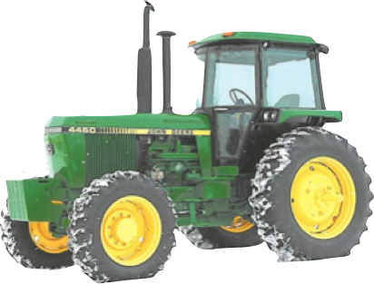
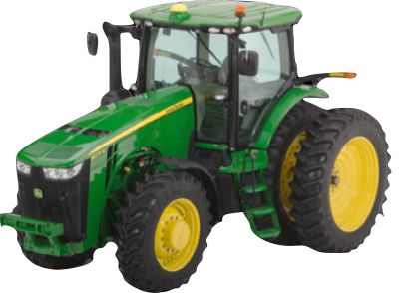
Exterior Visibility Comparison
Lighting
Air intake & exhaust location
Cab design
Hood design
Mirrors
Notes:
*Any instrument that aids in the observation of an individual’s surrounding area.
*Through ergonomic equipment design, mirrors, cameras, etc. individually and collectively working together to improve visibility and minimize blind-spots.
*Lighting: 60 yr old persons eyes receive about 40% of the same light as a 20yr old
360 degree exterior lighting
Light types: Halogen (2000hrs), Xenon (10x life, 4x output, @ 35% less power), and LED (44x life, @ 57% less power)
Lights positioned in direct line of the operators line of sight create maximum illumination of dust particles from operators perspective (Templeton et al ’98)
Cab: “visual obstructions parallel to the eye plane are most intrusive (Templeton)
Hood: wasp like, allows for tight turns and increased visibility

Slide 9
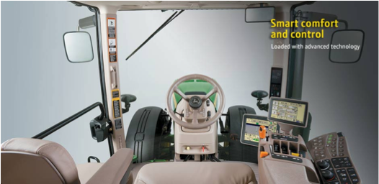
Interior visibility improvements
Ergonomic control positioning
Readable and understandable instrumentation
Entry/exit visibility
Interior mirror with exterior extended arm mirrors
Re-designed forward view
Notes:
Digital instrumentation can be overwhelming in the amount of data displayed, but operator can select specific parameters to focus on should they choose.

Slide 10
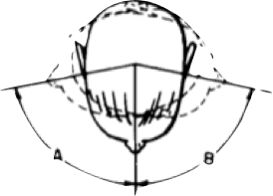
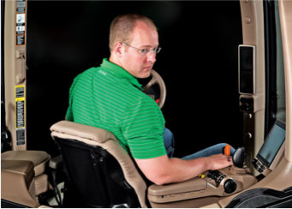
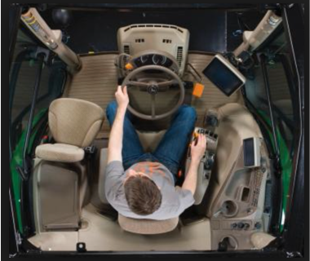
Interior visibility cont.
40 degree rotating seat
with command arm
Notes:
Avg human can turn their head 60-80 deg in either direction.
Operators with impairments require assistive devices to obtain safe awareness of the surrounding area.
Operator controls that move with the seat allow operators to maintain an anchored orientation in full range of motion of the seat. Can lead to improved reaction time to a given situation.

Slide 11
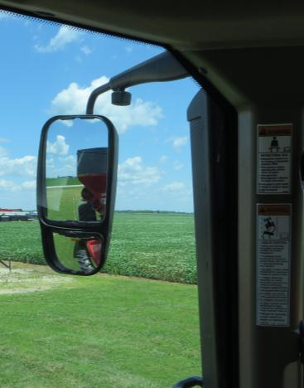
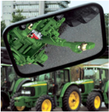
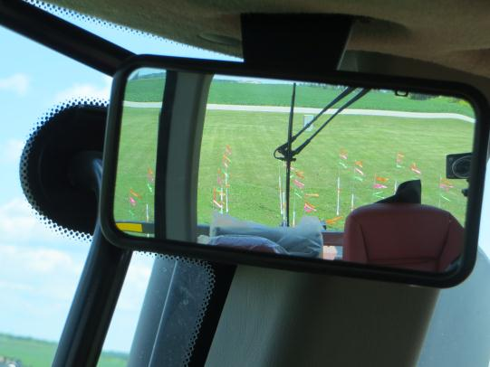
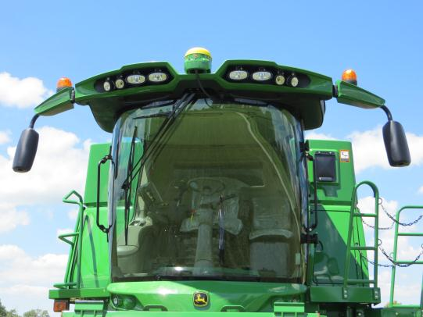
Available technology
Extended-arm mirrors
Interior mirror
Hitching mirror
Notes:
Mirrors can have image distortion due to insufficient vibration isolation and can be prone to breakage due to location. Operators have also complained of image distortion due to the convex design of the mirrors intended to allow for a larger field of view.

Slide 12
Commercial promoting regulation proposed by the National Highway Traffic Safety Administration requiring all new vehicles under 10,000 lb. to have a backup camera by May, 2018

Slide 13
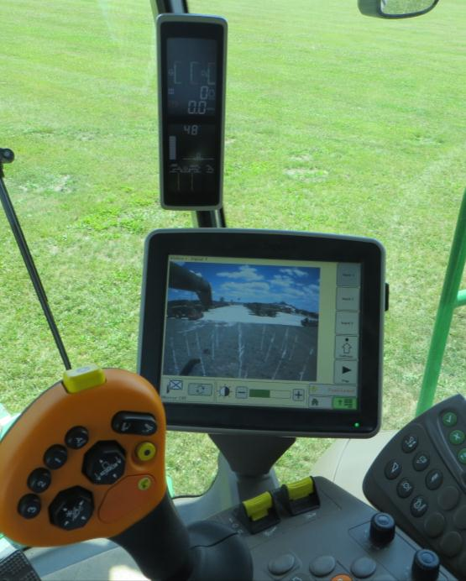
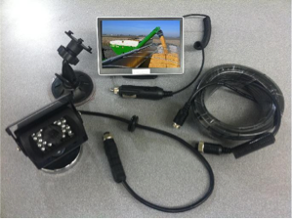
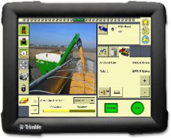
Available technology
Kit: LCD display w/ camera
Existing precision monitor with video input
Notes:
Push in the Auto industry equip vehicles with camera technology, and we have seen some adaption in the Ag industry as well.
Kits can be wired or wireless.
*wired is more reliable due to tendency of wireless to have interference if not in a clear line of sight.
*Cameras typically magnetic base and can be easily moved to various applications.
Reducing clutter of multiple monitors, video inputs are available on most precision monitors. Some equipment mfg.’s come pre-wired for video input.

Slide 14
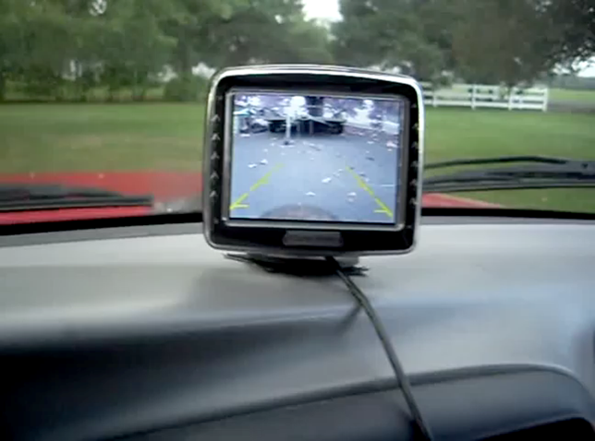
Notes:
Hitching

Slide 15
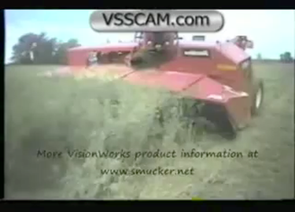
Notes:
Operators can monitor field operation while maintaining a forward posture
Equipment monitoring: hay, silage, combine harvesters, gauge status (pressure, flow, temperature).
Studies show that in some field operations the operator spends up to 40% of their time looking backwards.

Slide 16
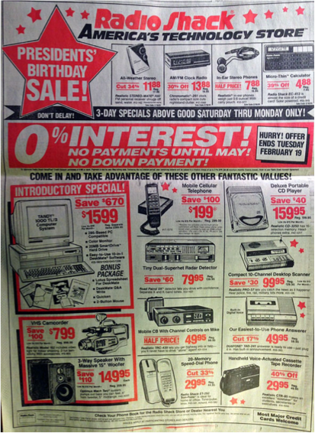
Notes:
Ad from 1991:
Cost of technology has drastically decreased
Over $5000 in present day dollars
Function of every item in ad can be accomplished by a $100 smart phone

Slide 17
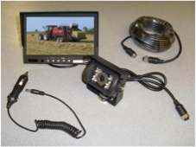
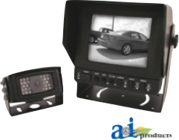
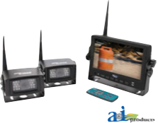
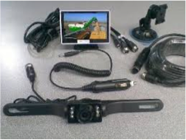
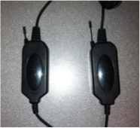
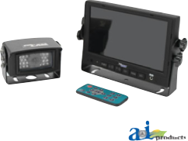
Camera Kits
Vision Works 7” high res $250
CabCam Wireless $545
Cab Cam B&W $180
Vision Works 4” $150
Vision Works wireless kit $99
Cab Cam color $342

Slide 18
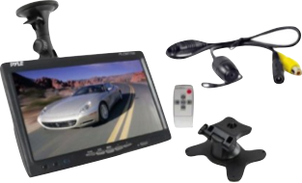
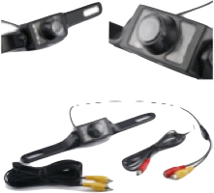
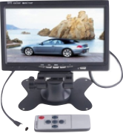
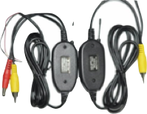
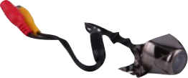
Camera Kits Cont.
7” Window mount with scale lines $78
170deg HD license plate cam $14
7” LCD color monitor $32
2.5G 10M wireless kit $15
170deg HD cam $15
Notes:
kits intended more for auto industry, and may not be a robust as ag specific brand.

Slide 19
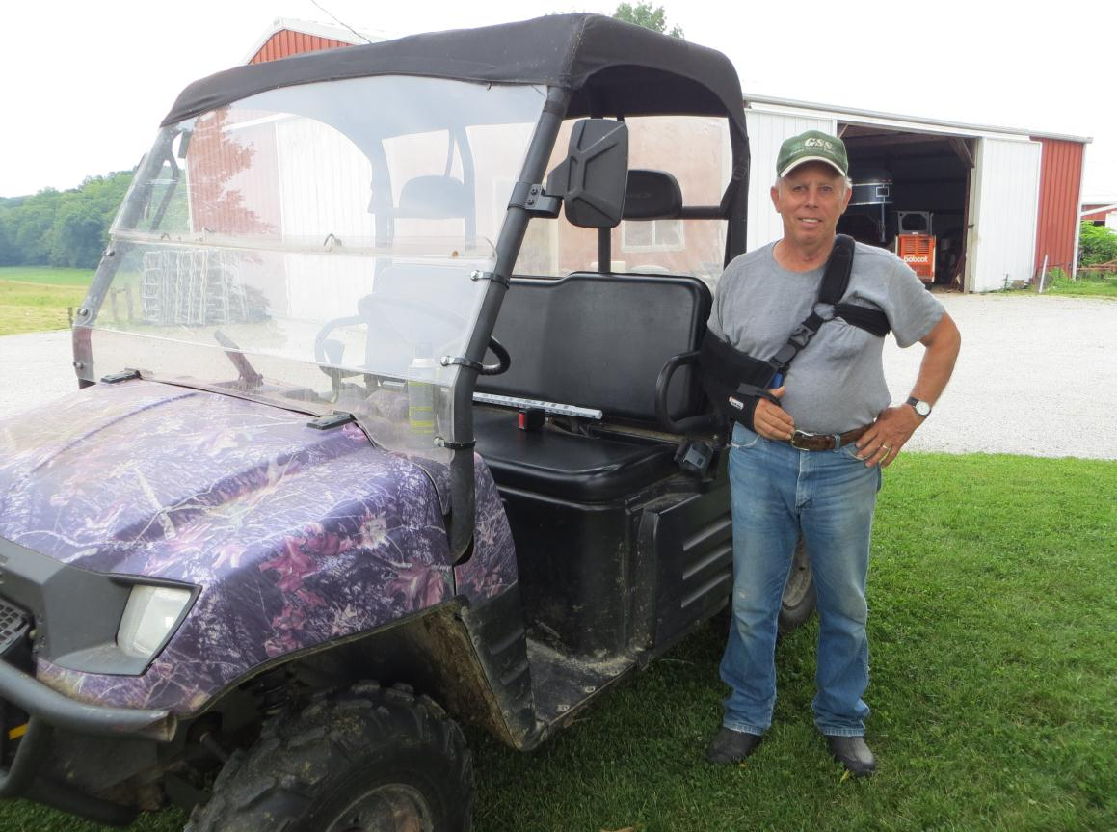
UTV Application
Notes:
limited range of motion due to neck injury, and poor depth perception due to vision loss in one eye.
Uses UTV to check fields and horses. Afraid of backing into something or someone due to frequent visits from grandchildren.

Slide 20
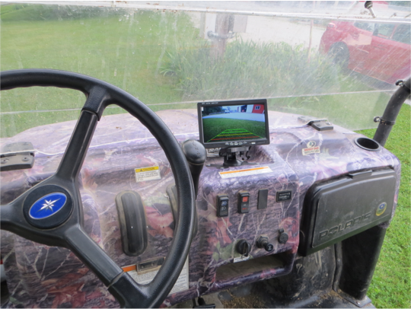

Slide 21
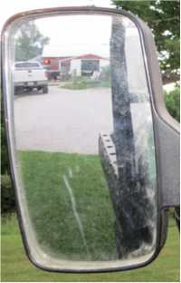
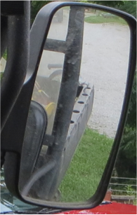
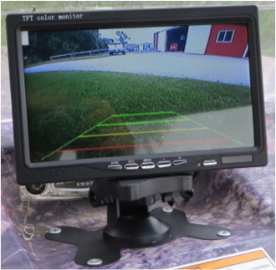
UTV extended arm Mirrors and Camera
Notes:
Camera has grid lines to indicate distance to an object to the rear.

Slide 22
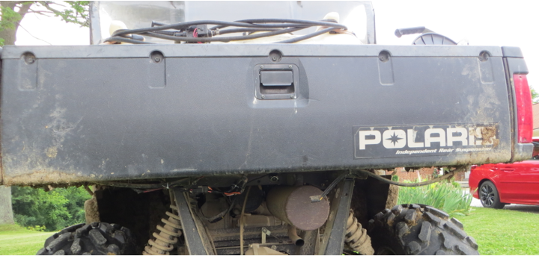
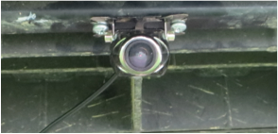
UTV camera mounting Location

Slide 23
Assessing equipment visibility
25’x25’ grid with cell size of 5’x5’

Slide 24
Assessing equipment visibility
25’x25’ grid with cell size of 5’x5’
 | X
Midpoint of each cell has indicator flags representing the average height of an American man, woman and 10-yr old child

Slide 25
ASSESSING EQUIPMENT VISIBILITY
X | X | X | X | X
X | X | X | X | X
X | X | X | X | X
X | X | X | X | X
X | X | X | X | X
MIRRORS
CAMERA
X | X | X | X | X
X | X | X | X | X
X | X | X | X | X
X | X | X | X | X
X | X | X | X | X

Slide 26
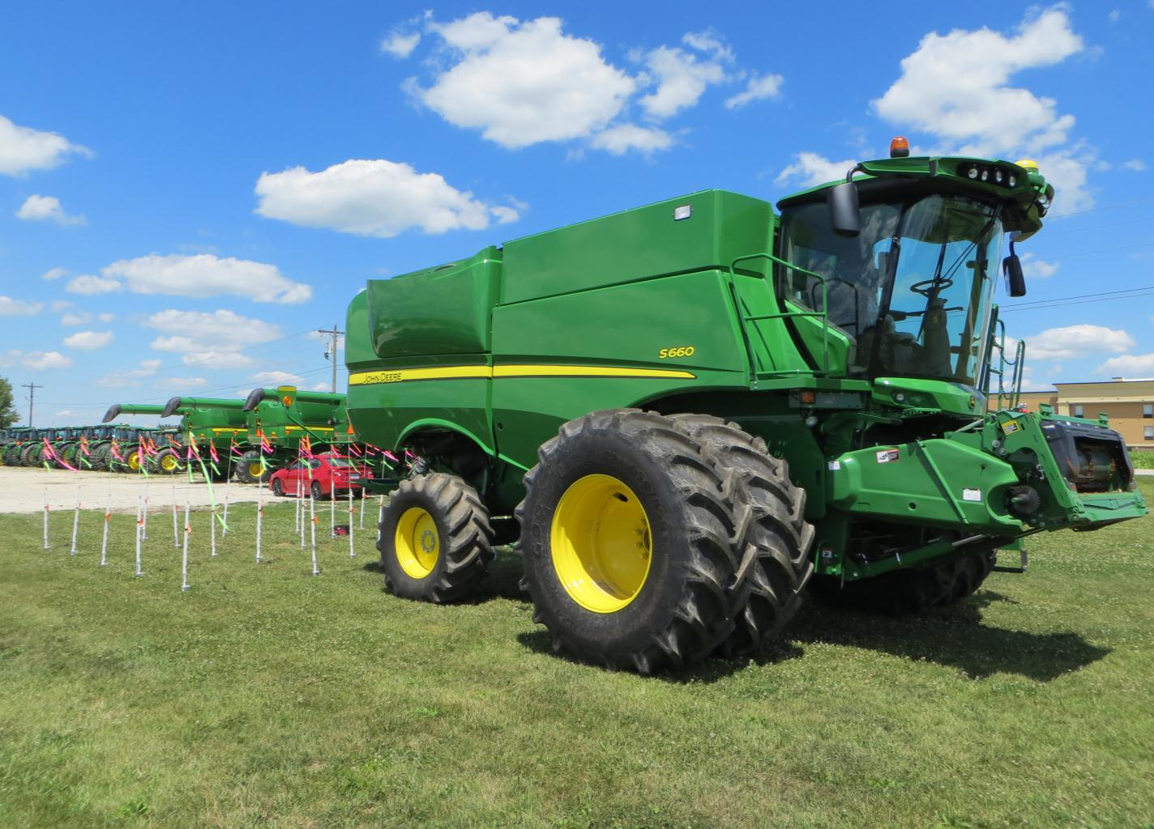

Slide 27
Combine
Obstructed
Visible
Key:
Left extended arm mirror 75% obstructed view
Right extended arm mirror 75% obstructed view

Slide 28
Combine
Obstructed
Visible
Key:
Child not visible
Camera mounted high on rear panel 28% obstructed view

Slide 29
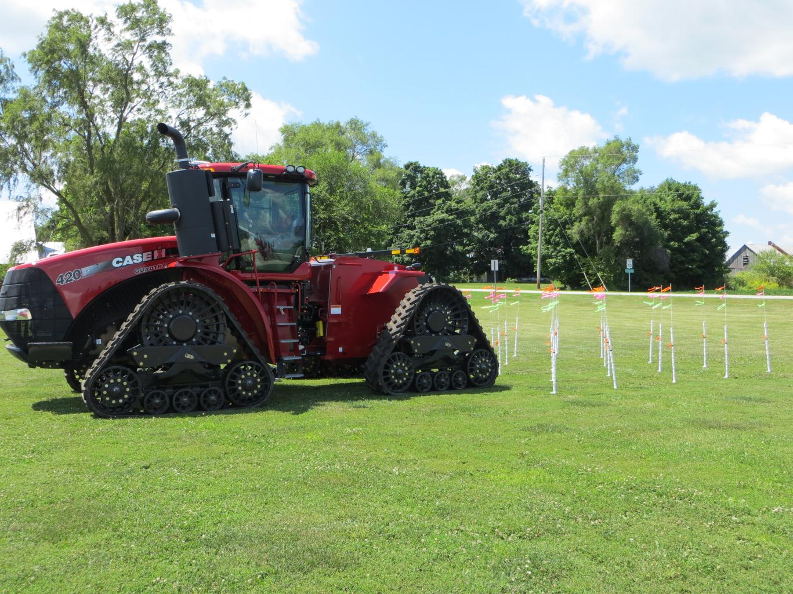

Slide 30
Quadtrac
Obstructed
Visible
Key:
Left extended arm mirror 60% obstructed view
Right extended arm mirror 68% obstructed view

Slide 31
Quadtrac
Obstructed
Visible
Key:
Camera mounted above PTO shield 35% obstructed view

Slide 32
Quadtrac
Obstructed
Visible
Key:
Combination of camera and extended arm mirrors 24% obstructed view

Slide 33
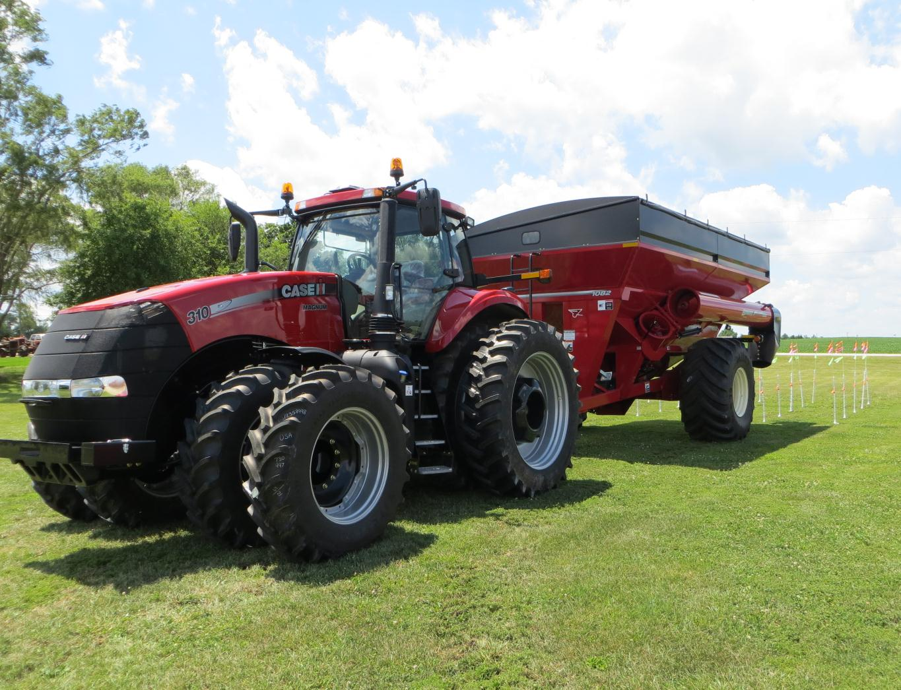

Slide 34
Cart
Obstructed
Visible
Key:
Left extended arm mirror 84% obstructed view
Right extended arm mirror 84% obstructed view

Slide 35
Cart
Obstructed
Visible
Key:
Camera mounted on frame cross member 4% obstructed view

Slide 36
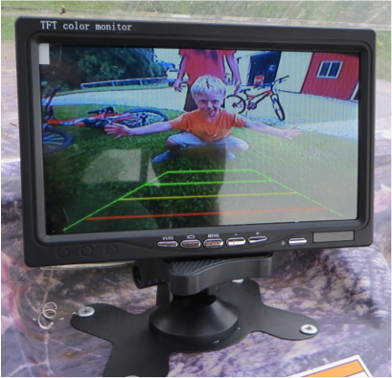
Thank you
Special thanks to:
Dr. Bill Field
Dave N.
Vision Works Cameras (Mr. Rob Smucker & Mr. Mark Riley)

