Slide 1
AgrAbility Webinar Series:
Visual Impairments
and Their Relevance to Agriculture
November 27, 2012

Slide 2
Basic Webinar Instructions
Need speakers or headphones to hear the presentation
Meeting > Manage My Settings > My Connection Speed
Dial-up not recommended
Questions about presentation
Type into chat window and hit return.
During the Q & A period, if you have a web cam/microphone, click the “Raise Hand” icon to indicate that you have a question
We will activate your microphone

Slide 3
Basic Webinar Instructions
4 quick survey questions
Session recorded and archived with PowerPoint files at http://agrability.org/Online-Training/archived along with resource materials
Problems: use chat window or email cookke@purdue.edu

Slide 4
Known Webinar Issues
Disconnection with presenters
Hang on – we’ll reconnect as soon as possible
Disconnection with participants
Log in again

Slide 5
AgrAbility: USDA-sponsored program that assists farmers, ranchers, and other agricultural workers with disabilities.
Partners land grant universities with disability services organizations
Currently 23 projects covering 25 states
National AgrAbility Project: Led by Purdue’s Breaking New Ground Resource Center
Goodwill of the Finger Lakes = funded partner
More information available at www.agrability.org

Slide 6
Visual Impairments and Their Relevance to Agriculture ABVI-Goodwill of the Finger Lakes Vision Rehabilitation Department
AgrAbility

Slide 7
Introductions
Nikki Llewellyn M.S. COMS
nllewellyn@abvi-goodwill.com
Sharon Schwalm M.S. CVRT
sschwalm@abvi-goodwill.com
Christopher Frank
cfrank@abvi-goodwill.com

Slide 8
ABVI
Association for the Blind and Visually Impaired
Located in Rochester, NY
Serves a 9 county region
Provides comprehensive vision rehabilitation services
Mission Statement:
“To prepare and empower people who are blind or visually impaired to be self sufficient and contribute to their families and communities.”

Slide 9
What is Vision Rehabilitation?
Vision Rehabilitation services includes a wide array of professionals and services that can restore functioning after vision loss.
Vision Rehabilitation Therapists provide training on how to adapt everyday activities.
Orientation and Mobility Specialists teach how to travel safely in any environment.
Employment and Training Specialists help to obtain or maintain employment using individualized career services and technology training

Slide 10
What is Vision Rehabilitation?
Low Vision Specialists are specially trained doctors who examine the person’s vision and recommend devices to improve the use of remaining vision. An occupational therapist may be involved in training the individual how to use the recommended devices.
Social workers and therapists provide support through information, referrals, counseling and support groups.

Slide 11
Aspects of vision loss
Acuity
The focus or blurriness of the “picture”
A measure of clarity at a certain distance. 20/20 vision means what is at 20 feet appears to be at 20 feet. 20/200 means what is at 20 feet appears as if 200 feet away. It is sometimes measured in 10 foot increments such as 10/100 etc.
Glasses are the most common way to correct for this, but some eye conditions and acuities can not “be fixed” with normal glasses. This is when magnification is needed.

Slide 12
Aspects of vision loss
Visual Field
The size of the viewing field or how much can be seen in “the picture”.
Visual field is measured in degrees. A straight line is 180 degrees. Most people have about 170 degrees of vision.
Some people’s visual’s fields are so restricted that it is like tunnel vision.
Some people have peripheral or side vision but don’t have vision in the center.

Slide 13
Aspects of vision loss
Contrast sensitivity
Contrast refers to how well the object or viewing target stands out from the background. White on black is high contrast. White on grey has less contrast.
Contrast sensitivity tests measure size and contrast.
A person with low contrast sensitivity may not see the flame on the stove, or be able to tell which light is lit at a traffic light. Extra lighting may help.

Slide 14
contrast
This is an example of poor contrast
This is an example of good contrast

Slide 15
Definitions of blindness
Visual Impairment
Any degree of vision loss that impacts an individuals’ daily activities.
20/70 is a measurement used to indicate visual impairment and may qualify the individual to receive services from a state agency.
Blindness
Acuity measurement of 20/200 or worse, or if nothing can be read on the 20/100 line.
Visual field of less than 10 degrees from center. A visual field loss that closes in to less than 20 degrees (10 degrees from center all around) or a visual field loss that covers all of the central vision to at least 10 degrees around.

Slide 16
Definitions of blindness
Light Perception
LP can refer to light perception – the individual can only tell if the light is turned on or off. It can also refer to light projection which is when the individual can locate the source of the light.
NLP generally stands for no light perception. The individual sees nothing and can not tell if a light is turned on or not

Slide 17
Orientation and mobility (O&M)
COMS- Certified Orientation and Mobility Specialists
Teach safe travel techniques including use of remaining vision, traveling with a long cane, orientation techniques and how to use transportation.
Certified by ACVREP – the Academy for Certification of Vision Rehabilitation Professionals
Mobility Instructors/Travel Trainers – individuals trained by the National Federation of the Blind to teach independent travel techniques including cane use, orientation techniques and how to use transportation.

Slide 18
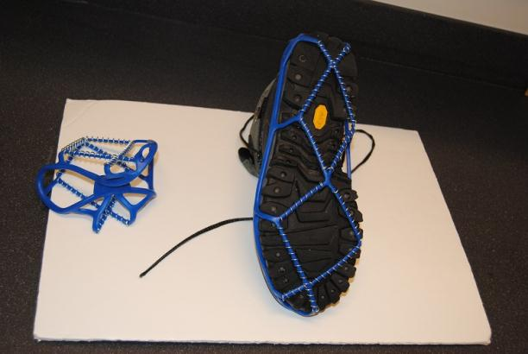
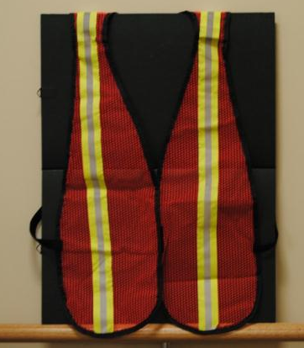
Orientation and mobility (O&M)
Orientation refers to knowing where you are in relation to other people, places or things.
Mobility refers to how an individual with reduced or no vision is going to move through the environment. Various tools are used to move safely and efficiently.

Slide 19
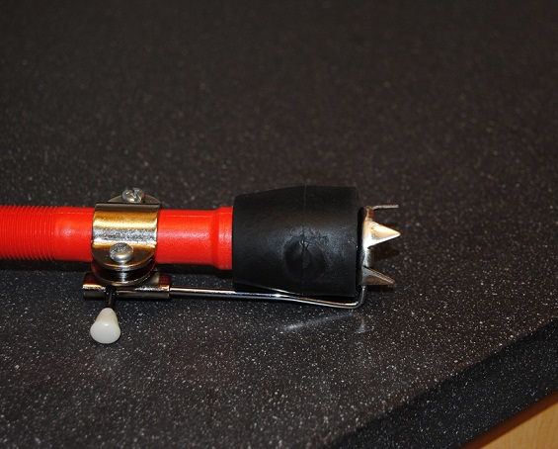
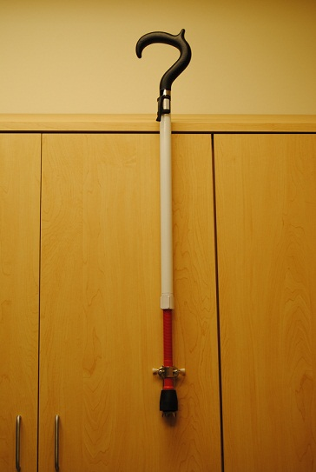
Orientation and mobility (O&M)
O&M Tools

Slide 20
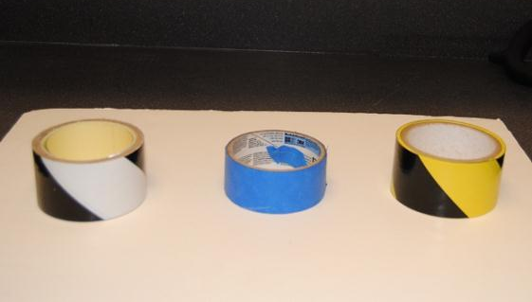
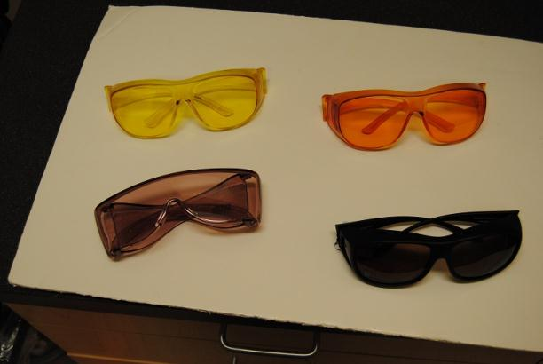
Orientation and mobility (O&M)
Tools
Enhance vision by reducing glare, adding contrast, using a telescope, visual techniques such as scanning and tracking.

Slide 21
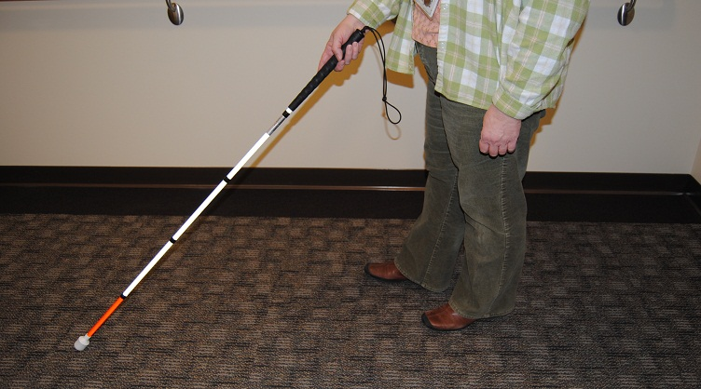
Orientation and mobility (O&M)
Long cane to preview the environment and protect the user from the waist down.

Slide 22
Orientation and mobility (O&M)
Dog guide specially trained from one of the nationally recognized dog guide schools.
Electronic Devices
Sonar Device
Talking Compass
GPS

Slide 23
Orientation and mobility (O&M)
Tips and Techniques
Orientation
Guide wire – run a cable from one location to the next and put a large loop of cable around it that you can slip your arm or hand through it but not have to hold it with your fingers.
Create a guide line on the ground by painting rocks or large heavy objects that will stay in place, (discarded bowling balls from bowling facilities).
Outside make paths with gravel to follow or mow a path and let the grass grow up higher along the path.
Inside use non slip treads or textured rubber coating to provide a textured path that you can feel through shoes and boots.

Slide 24
Orientation and mobility (O&M)
Tips and Techniques
Use a bright light as a landmark or beacon to guide you to a destination.
Check the sky line to find landmarks before you need them – to help guide you.
Use brightly colored bicycle flags on tall poles to mark locations outside.
Use a compass to maintain orientation when in large open spaces.
Use GPS on your phone to mark specific destinations. If you get lost or disoriented set the GPS on your phone to provide you with verbal directions to get to your desired destination.

Slide 25
Orientation and mobility (O&M)
Tips and Techniques
Mobility
Have a long cane in a holster or pouch so that if you need to spot check the depth of something you can use the cane to measure the distance.
Use color contrast to mark steps, drop offs, recessed troughs.
Determine best contrast by painting small boards in various colors and then lay them down on the surface where you need a guide line to determine which provides you with the best contrast.
Indoors run florescent lights overhead along the center of your path so that you can follow them to stay on the path and away from the drop offs to each side.

Slide 26
Orientation and mobility (O&M)
Tips and Techniques
General safety
Make yourself and others (co-workers) more visible by wearing a reflective safety vest.
Keep your hands free to assist with balance. Use a back pack to carry items.
Have a head mount flashlight or one that fits behind your ear that allows you to keep your hands free but provides light where it is needed. These can be purchased at Wal-Mart or Radio Shack and they work great when working under the hood of a car or when you need to access information on dials or buttons of equipment.

Slide 27
Vision rehabilitation therapy (VRT)
Addresses any challenge due to a vision impairment, including but not limited to:
Communication and Financial skills
Meal and Home management
Personal skills and Family Care
Recreation
Service provided in the home, work, or out in the community

Slide 28
Vision rehabilitation therapy (VRT)
Service starts with functional assessment
Work with individual, breaking down each task to determine problem area(s); incorporating task analysis
Paves way for future problem solving new challenges
Teaching adaptations and recommending adaptive equipment as needed for goal attainment
Supplement vision by use of other senses
Show individual ways to maximize usable vision
Increasing color contrast
Reducing glare
Adjusting lighting
Use of optical devices

Slide 29
Vision rehabilitation therapy (VRT)
Cues that Vision Rehabilitation Therapy may be needed:
Holding reading material up close to the face
Bending close to an object while doing an activity
Difficulty locating items
Difficulty or no longer performing everyday activities
Resource
www.visionaware.org

Slide 30
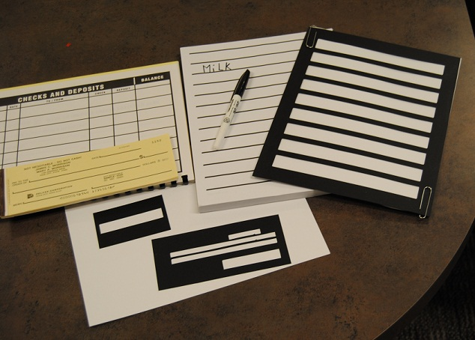
Vision rehabilitation therapy (VRT)
Adaptive Techniques
Change one or more of the steps involved in performing an activity to make it easier to do
May make this change in conjunction with adaptive equipment, labeling and marking materials, lighting, color contrast and magnification devices
Print vs. cursive
Bold medium point or
marking pens
Color contrasting writing guides
Large print (LP) check register
Guide Line Checks (LP)
Purchased through bank
or by calling Deluxe Checks

Slide 31
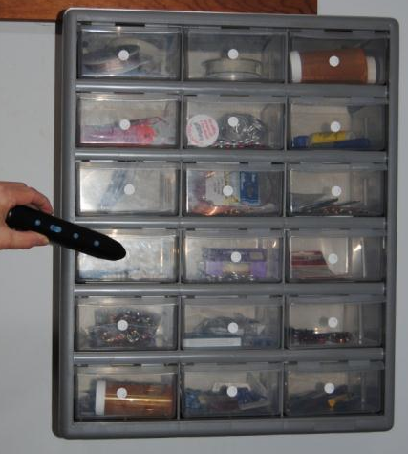
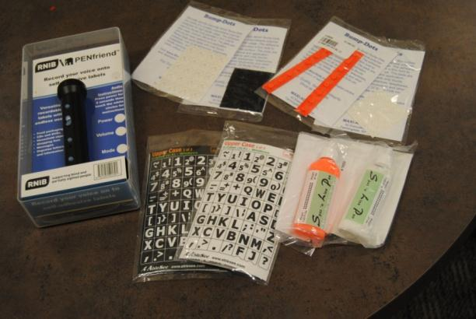
Vision rehabilitation therapy (VRT)
Adaptations: Adaptive Equipment
Any item that is used to change an object making it easier to use or identify.
As simple as a rubber band or as complex as an electronic labeling device
Examples: contrasting bump dots, large print keyboard stickers, spot n line, and example using PENfriend

Slide 32
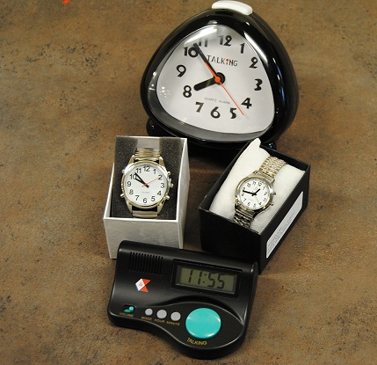
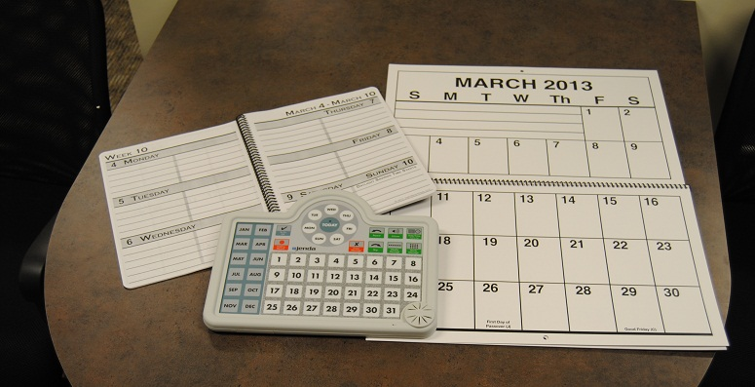
Vision rehabilitation therapy (VRT)
Adaptations: Adaptive Equipment
Or, an object that can be used to change how a task is performed to make it easier to complete
Examples:
Low vision or talking clocks and watches
Large Print and talking calendars

Slide 33
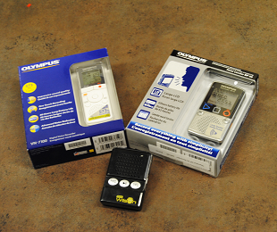
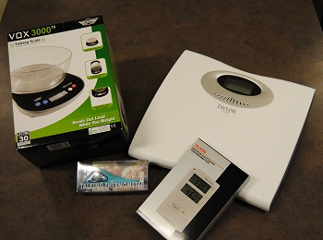
Vision rehabilitation therapy (VRT)
Adaptations: Adaptive Equipment
Talking Kitchen scales can be used to weigh feed supplements, produce, or other product
A talking indoor-outdoor thermometer can provide temperatures in home, greenhouse or outside
I have used LP and talking personal scale to weigh Alpaca cria (baby)
One of our VRT’s had a lesson with a farmer, a cow and a talking clinical thermometer
Digital Recorders
to record notes in the field
Talking kitchen & personal scales
Talking clinical thermometer
Talking Indoor-Outdoor Thermometers

Slide 34
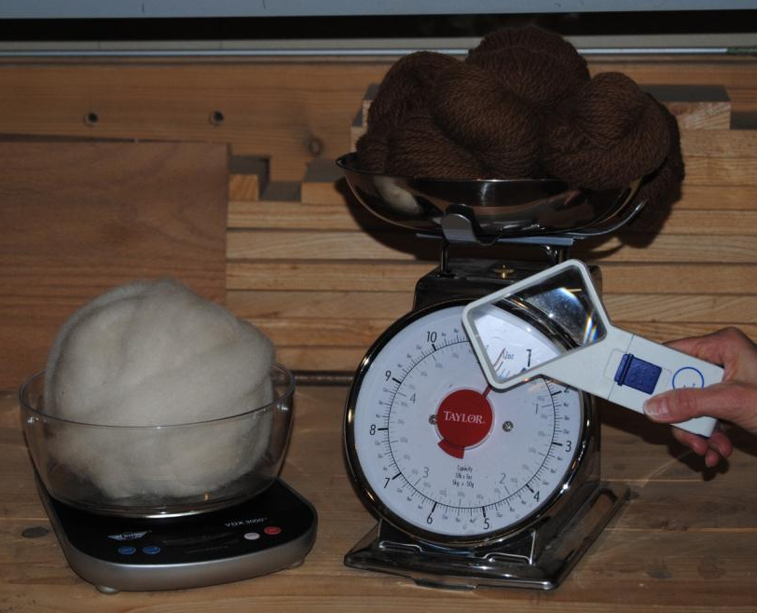
Vision rehabilitation therapy (VRT)
Adaptations: Adaptive Equipment
Talking kitchen scale weighing alpaca roving
Large print scale weighing alpaca yarn with magnifier
Talking measuring tape

Slide 35
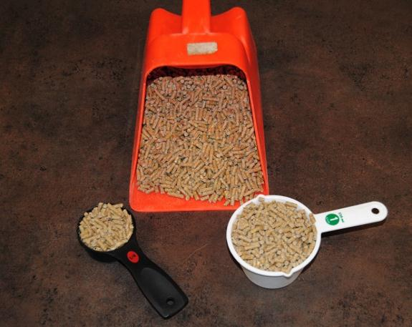
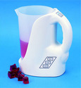
Vision rehabilitation therapy (VRT)
Transferring skills
Skills learned for one activity may work for other activities
Measuring using color contrast, leveling technique or talking measuring cup in the kitchen will work to measure feed or feed supplements

Slide 36
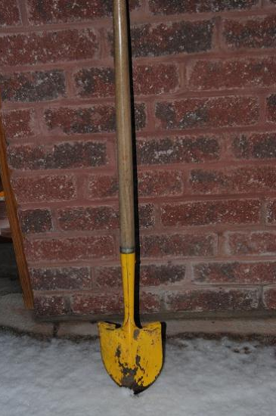
Vision rehabilitation therapy (VRT)
Color Contrast: Increasing color contrast can improve visual performance.
Surveyor’s flagging tape to secure trellising plants and for ease of locating items (landmarks, stakes,)
A tennis or bright colored foam ball placed on top of a plant stake for location and safety
Purchase color contrasting tools
Multi-purpose rubber dip to coat tool handles
Bright colored tape
Paint tools contrasting colors

Slide 37
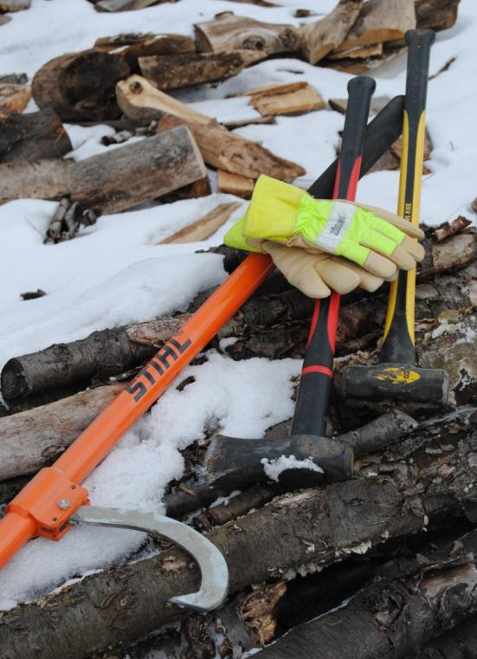
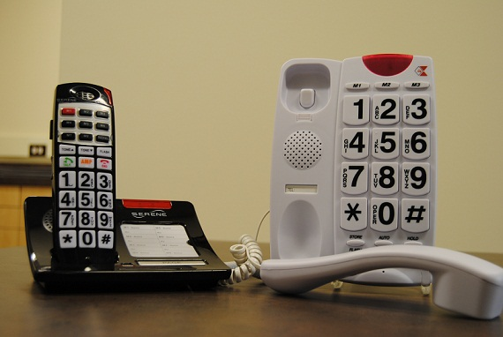
Vision rehabilitation therapy (VRT)
Other examples of color contrast:

Slide 38
Vision rehabilitation therapy (VRT)
Glare Reduction: Glare can be an issue both indoors and out.
Try sitting with your back to a window during indoor activities
Wear hats with caps or visors and sunglasses while inside or outside
Avoid bare light bulbs (Increase light and glare
Anti-glare window film, shades or blinds
Use flat or matte finishes on furniture
Carpets and non-slip floor finishing diffuse light

Slide 39
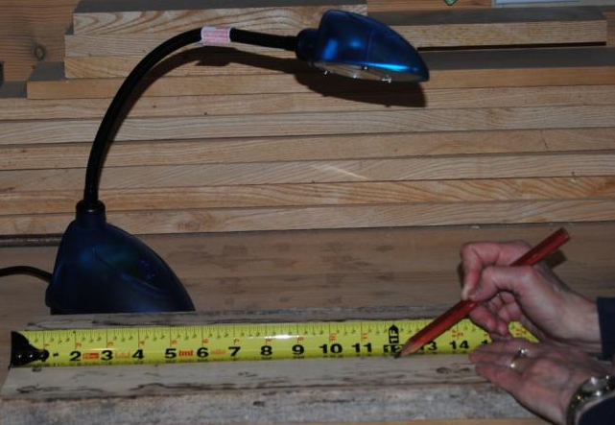
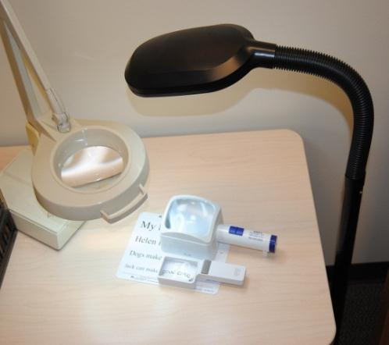
Vision rehabilitation therapy (VRT)
Lighting: Everyone’s lighting needs are different.
Photophobic (Sensitive to light)
Need combination of room and task lighting
Some may feel there is never enough light
Individualized lighting evaluations of the home, barn and storage buildings is essential.
Examples of full or broad spectrum, LED and Fluorescent
task lighting.

Slide 40
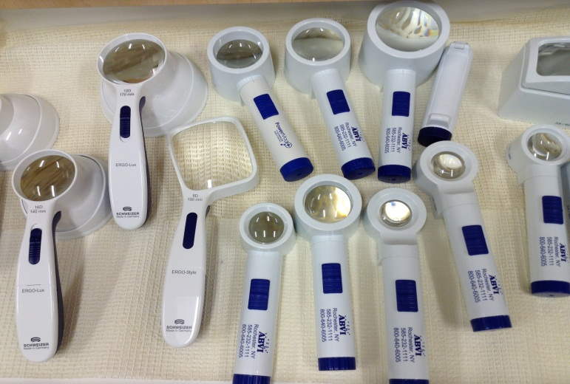
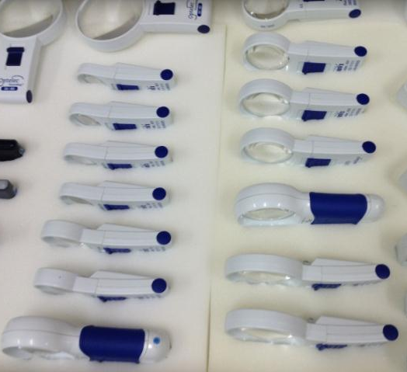
Vision rehabilitation therapy (VRT)
Optical Devices
VRT’s integrate recommended magnification devices during lessons
Hand and stand illuminated magnifiers
Based on curvature of the lens, the smaller
the lens size, the stronger the magnification

Slide 41
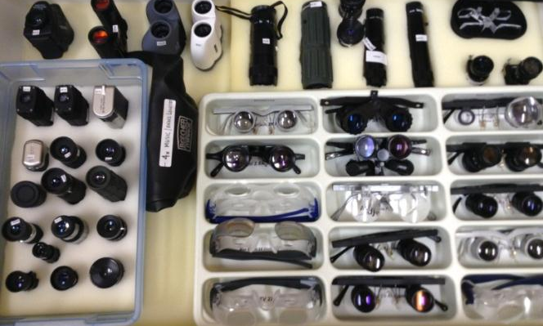
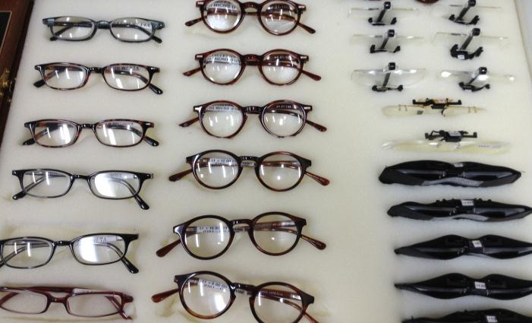
Vision rehabilitation therapy (VRT)
Optical Devices
Spectacles
Binoculars
Monoculars
For distant and near tasks

Slide 42
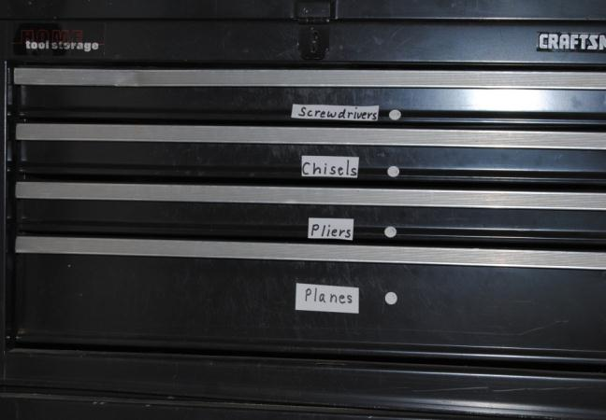
Vision rehabilitation therapy (VRT)
Organization: Organization is key to avoiding lost items
Totes, tool buckets, color contrasting tarps/trays can be used while working on projects
A lazy susan drilled to hold drill bits in order of size labeled appropriately
White washed peg board providing color contrasting background to hang up tools
Contrasting colored nylon rope can
replace string to mark rows for
planting garden
Using large print, Braille or
PENfriend audio labels
to label items in the
home, barn, or storage

Slide 43
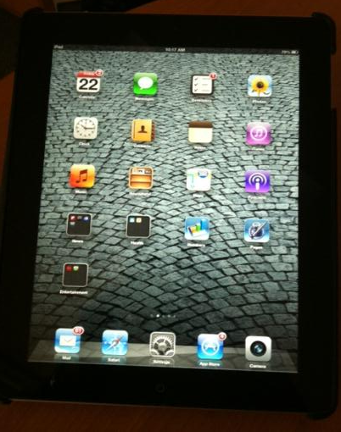
Vision rehabilitation therapy (VRT)
IOS Devices (iphone or ipad) with Voice Over can be used:
Apps for note-taking, color ID, labeling
As GPS on the farm
To take pictures of plant disease, insect infestation, or sore on an animal to enlarge for identification purposes
e-mail to vet or cooperative extension
VRT’s Motto: Whatever Works for an
individual is what is right
for that individual.
Please remember: everyone is different

Slide 44
Adaptive technology
Devices or software that allows a person to access information in print or electronic format
Cues that it may be needed
Squinting
Sitting very close to monitor
Head/eye aches

Slide 45
Adaptive technology
Contrast vs. Enlargement
Good contrast can reduce eye strain
Enlargement allows information to be seen larger, but reduces the amount of information on the screen

Slide 46
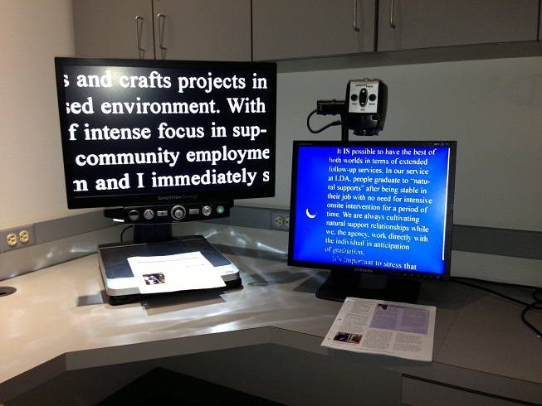
Adaptive technology
Major Devices
CCTVS- Desktop and Compact Portable

Slide 47
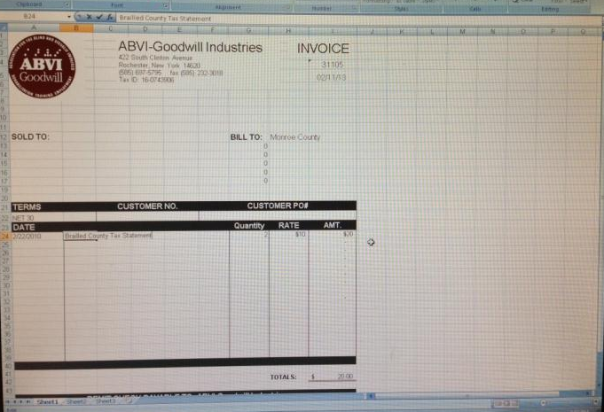
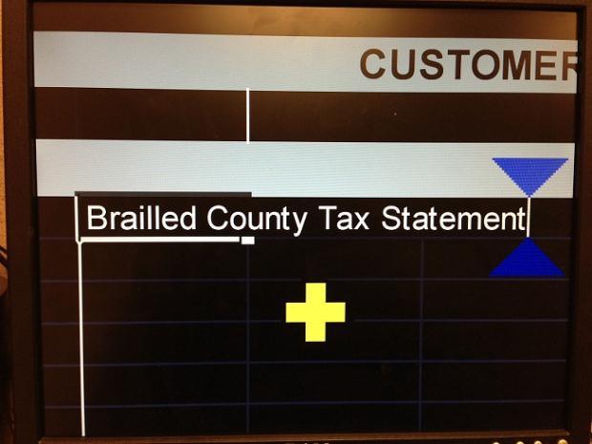
Adaptive technology
Major Devices
Adaptive software for computers
ZoomText, MAGic, Windows Magnifier, Apple Zoom

Slide 48
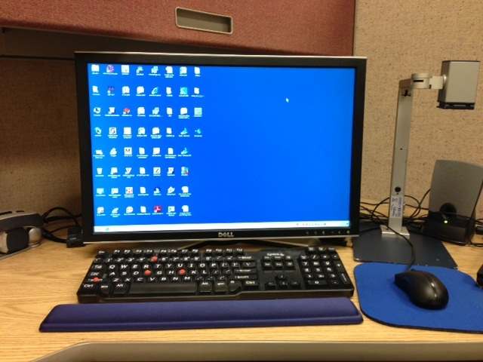
Adaptive technology
Large Monitor

Slide 49
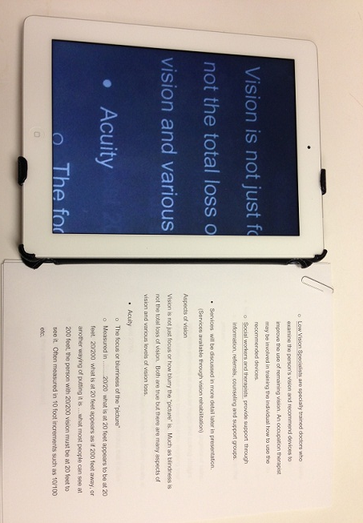
Adaptive technology
Portable Devices
iOS Devices (iPhone, iPod, iPad)
Android Smart Phones
Reverse colors
Zoom in
Large text
Spoken text

Slide 50
conclusion
Additional resources are available on the website
Get connected with a Vision Rehab Agency in your region
Remember that everybody’s vision is different
A little change can make a big difference- get creative!

