Slide 1
Goodwill … More than Stores and Great Deals!

Slide 2
Goodwill Industries International is a global services enterprise that generates opportunities for people to achieve economic stability and build strong families and vibrant communities by offering job training, employment placement services and other community-based programs for people who have disabilities, those who lack education or job experience, or have other barriers and challenges in finding and maintaining employment.

Slide 3
Goodwill is a network of 165 independent, community based Goodwill agencies througout the United States and Canada, as well as 14 affiliates in 13 other countries.
Goodwill’s 2500 donated goods, retail stores and various job centers provide a solid infrastructure and foundation for Goodwill services.
While Goodwill is not always THE service provider in their territory, as partners, Goodwill affiliates connect individuals to services and programs that will be beneficial for their situation.

Slide 4
Member agencies leverage retail stores and online sales channels such as shopgoodwill.com to generate revenue to support programs, as well as create employment opportunities.
Each affiliate has connections to their community in different ways that promote the Goodwill mission to enhance the dignity and quality of life of individuals, families and communities by eliminating barriers to opportunity and helping people in need reach their fullest potential through the power of work.

Slide 5
Why the move from Goodwill Industries International to Goodwill of the Finger Lakes?
From the GII CEO, Jim Gibbons:
“While GII remains in full support of the work of AgrAbility and Goodwill’s involvement with it, we recognize that local Goodwill involvement with AgrAbility is the most persuasive and compelling example of Goodwill’s commitment. We are therefore very excited that Goodwill’s AgrAbility partnership will shift from GII to Goodwill of the Finger Lakes, headquartered in Rochester, NY.”
The important GII Ties we Maintain:
Access to all the GII team members and affiliate Goodwill staff through the MyGoodwill network
Access to publish in My Goodwill today, Working! Magazine, and e-newsletters with a potential reach of 90,000 Goodwill team members nationwide
Access to 165 affliliate members to share in their core competencies
National training conference presence to promote AgrAbility within the Goodwill community
Public Policy connections

Slide 6
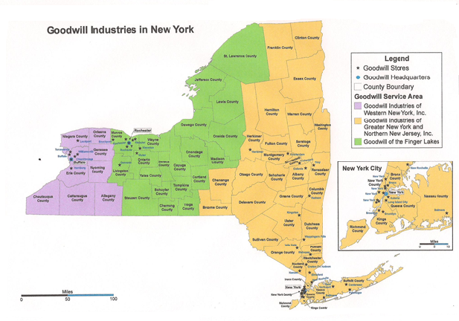
As the Association for the Blind and Visually Impaired (ABVI), providing services to individuals who are blind and visually impaired since 1911.
Affiliate Goodwill member since 1994, broadening the mission to include individuals with other disabilities and barriers.
Goodwill of the Finger Lakes consists of a 20 county territory in Upstate, NY.
Our infrastructure includes 10 retail stores, food service, manufacturing, vision rehabilitation center and a state of the art Contact Center.

Slide 7
ABVI Vision Center
Specialty trained low vision doctors working in consultation with primary eye care providers to evaluate and improve functional vision.
Insight shop and staff providing a resource for evaluation, visual aids, and recommendations to improve visual abilities.
Vision Rehabilitation Therapists skilled in teaching legally blind individuals how to adapt everyday activities through adaptive techniques and adaptive equipment.
Certified Orientation and Mobility Specialists instruct individuals in safe travel skills and ways to establish and maintain orientation.
Occupational Therapists trained to help individuals accomplish important daily activities despite impairment or limitations.
Career and training programs that have provided knowledge and skills to people who are blind or visually impaired.

Slide 8
Manufacturing Division
Through Ability One contract opportunities, as well as some commercial contracts, our ISO certified Manufacturing division participates in the following:
Post-It note production under the SkillCraft brand, which serves government and municpal contracts.
Sewing contracts for the United States Military
Notepad production for the United States Military
Commercial cleaning supply packaging
Fulfillment for the North American Lead hotline, providing mailings and brochures to individuals who have requested them through the hotline
80% of the employees providing these services are legally blind.

Slide 9
Food Services Division
The main campus for ABVI / Goodwill of the Finger Lakes hosts a food service division which provides:
Hot meals on-site for our employees daily, providing individuals who are blind or visually impaired an option for dining within walking distance, and in an area where they have been trained for mobility and can function independently
Catering services for over 1200 individuals daily in senior centers and daycare centers in the region
Specialized catering for on-site events

Slide 10
Contact Center
The state of the art Contact Center, housed in a LEED Gold certified facility is home to several contracts and includes 24/7 services by trained staff providing the following services:
AIRS Certified 211 Information & Referral Services
AAS Certified Crisis intervention services through 211/ Life Line, as well as contracts with the Veterans Administration for work on the National Veterans Suicide Hotline
North American Lead Hotline
Health Care and Human Services Contracts
Several Commercial Customer Service Contracts

Slide 11
Contributing to the Success of AgrAbility
A solid understanding of the power of work, and assisting individuals in overcoming barriers to employment
Utilizing our Contact Center to provide after hours and weekend coverage for the NAP telephone line, extending service hours for potential clients
Utilizing the 211 network to include AgrAbility contacts within that network nationwide, allowing contacts a “one stop” location for finding resources that may be helpful
Expertise in low vision, an area of growing concern as a large segment of our population reaches the age where vision issues begin
Contact Center personnel trained in emotional health and suicide prevention, issues striking rural populations at higher rates than the general population
Links to our affiliate Goodwill membership where expertise exists in many areas including traumatic brain injury, physical disability and developmental disabilities as well as many others

Slide 12
Questions?

