Slide 1
Veterans in Agriculture
Martina Mohrbacher, M.A.
Outreach Specialist Operation Diploma

Slide 2
Basic Webinar Instructions
Need speakers or headphones to hear the presentation
Meeting > Manage My Settings > My Connection Speed
  Dial-up not recommended
Questions about presentation – type into chat window and hit send icon, and they’ll be addressed at the end.
Captioning pod
Problems: use chat window or email cookke@purdue.edu
4 quick survey questions
Session recorded and archived with PowerPoint file at www.agrability.org Online Training link

Slide 3

AgrAbility: USDA-sponsored program that assists farmers, ranchers, and other agricultural workers with disabilities.
  Partners land grant universities with disability services organizations
  Currently 23 projects covering 25 states
  National AgrAbility Project: Purdue’s Breaking New Ground Resource Center, Goodwill Industries International, the Arthritis Foundation-Indiana Chapter, University of Illinois at Urbana-Champaign
  More information available at www.agrability.org

Slide 4
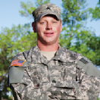

Veterans and Agriculture:
Opportunities for Employment, Entrepreneurship, and Enrichment
A workshop for veterans interested in agriculture and for professionals who work with veterans
November 7-8, 2012
Beck Agricultural Center, Purdue University www.breakingnewground.info/vets

Slide 5
Overview
The Military Family Research Institute at Purdue University
The US military and veterans of recent conflicts
Readjustment issues and strategies
Notes:
The presentation will take about 45 minutes and there will be time to Q&A at the end.

Slide 6
The Military Family Research Institute at Purdue University

Slide 7
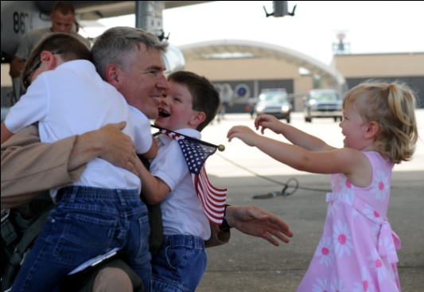
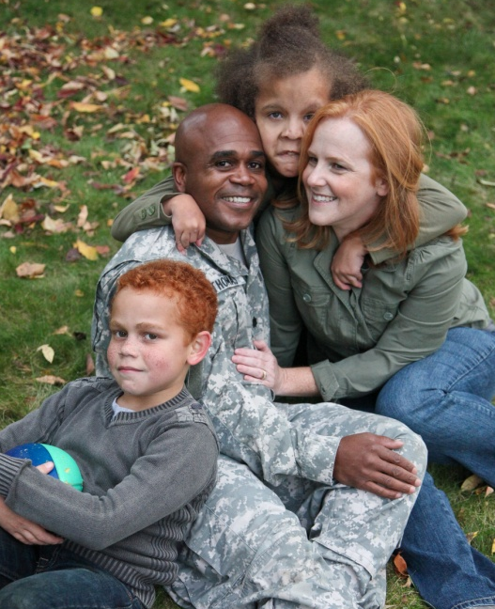
Military Family Research Institute at Purdue University
Making a difference for families who serve
Support the military infrastructures that support military families.
Strengthen the motivation and capacity of civilian communities to support military families.
Generate important new knowledge about military families.
Influence policies, programs, and practices supporting military families.
Create and sustain a vibrant learning organization.
Notes:
MFRI is based at Purdue University and has been in existence since 2000. We began with Department of Defense earmark funding, but as our funders grew, so did our mission. We remain partially funded by DoD, but our primary support comes from Lilly Endowment. MFRI is working with all branches of the military on individual projects as well as with DoD on projects stretching across branches.

Slide 8



Programs
Notes:
This slide shows some of the programs MFRI is currently involved in.
Passport:
Passport Toward Success is designed to assist the children of military families who have been separated due to deployment.
It includes activities designed to help military children reconnect with parents following a deployment.
Sesame Workshop:
Sesame Workshop is the non-profit arm of Sesame Street programs.
In cooperation with the DoD and others, it created the “Talk, Listen, Connect” initiative to help military families deal with deployment, living with a wounded family members, and the death of a parent.
MFRI assisted in evaluating the program’s effectiveness.
SBHP:
It can be difficult for service members and military family members to find behavioral health providers who are knowledgeable about issues service members and military families face.
Star Behavioral Health Providers is a program created by MFRI. It is a collaboration between the DoD Center for Deployment Psychology, the Indiana National Guard, and the Indiana Family Social Services Administration.
SBHP is designed to do two things:
Train civilian behavioral health providers to serve service members and military families.
Create a registry of these trained providers service members and others can use to locate these trained providers.

Slide 9


Generating New Knowledge
Notes:
Shown here are two publications that represent new knowledge generated by MFRI.
The book on the left is a compilation of clinical issues and strategies related to military families designed for professionals who work with military families.
The book on the right is a textbook in family studies.
Shelley MacDermid Wadsworth is the director of MFRI.

Slide 10


Operation Diploma
Help student service members achieve academic goals and transition into meaningful employment.
Notes:
Operation Diploma is part of MFRI.
It was created in 2008 to work specifically with postsecondary education institutions, employers, and student veterans' organizations (SVOs).

Slide 11
US Military and Veterans of Recent Conflicts

Slide 12
Military Branches
Branch | Active Duty | Reserves
Army | 558,000 | 201,000
Navy | 321,000 | 50,000
Air Force | 333,000 | 70,000
Marines | 198,000 | 40,000
Coast Guard | 43,000 | 8,000
Department of Defense (March 2012)
Today’s Military (August 2012)
Notes:
The five US military branches are listed here. For the sake of this discussion, we are listing the Coast guard here, however it belongs to the Department of Homeland Security, not Defense.
All of these branches have both active-duty and reserve members.
The numbers shown are a snapshot in 2012.
Active-duty soldiers work for the military full time; Reserve members train on a regular basis and then can be called to active duty at any time.

Slide 13

National Guard
Branch | Strength
Army National Guard | 358,000
Air National Guard | 107,000
National Guard Bureau Posture Statement (2012)
Notes:
In addition to the active-duty branches, we also have the National Guard. The National Guard typically is under the command of the state governor.
National Guard members are considered citizen soldiers; that is, they work part time for the National Guard and hold civilian jobs as well. They can be called to active duty at any time.
A significant number of the service members deployed in Iraq and Afghanistan have been Guard members. (http://www.nationalguard.mil/about/arng.aspx)
On average, 63,000 National Guard members are either deployed or mobilized at any given time for federal missions and about 5,800 are activated for domestic missions. (http://www.arng.army.mil/News/publications/ApostureStatements/2012_ngps.pdf)

Slide 14





Military Culture
Strong values
High group cohesiveness
Pride in service and branch
Special lingo
Notes:
Explain: Military branches have their own unique cultures. These logos give you an idea of the core values of each military branch.
(“Semper Paratus” in the Coast Guard emblem means “always ready.”)

Slide 15
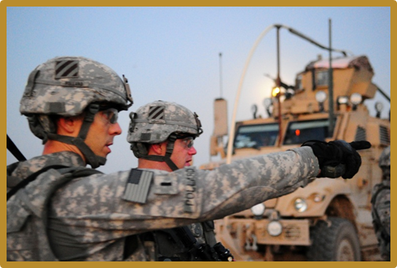
Our Military Since 2001
Approximately 2.4 million US service members deployed for OIF (Iraq) and OEF (Afghanistan) since 2001.
Since 2001 more than 1.4 million service members transitioned from the military to civilian employment.
Of those, about 772,000 have used VA health care.
More than 1 million are expected to transition over the next five years.
US Department of Veterans Affairs, (June 2012)
Institute for Veterans and Military Families (2012)
Spelman, J.F., Hunt, S.C., Seal, K.H. & Burgo-Black, A.L. (2012)
Notes:
9/11 began what has been called the Global War on Terrorism or GWOT. Since then, 2.4 million service members have been deployed to Iraq and Afghanistan.
40% of the returning service members are National Guard and Reserve members. Many will be looking for work.

Slide 16

Consequences of Deployment
Conflict | Ratio Death/Wounded | Wounded That Died
WWII | 1:2.6 | 4.5%
Vietnam | 1:2.6 | 3.3%
OEF/OIF | 1:6 | 2.6%
Statistical and Accounting Branch Office of the Adjutant General (1953)
Leland, A., Oboroceanu, M-J. (2010)
Notes:
The consequences of war have changed drastically over time due to advances in medical care, improved body armor, changes in how wars are fought, etc.
While fewer service members are dying, many more wounded service members are coming home with various types of injuries.

Slide 17
Deployments, Injuries, and Deaths
Operation Iraqi Freedom (OIF), Operation New Dawn (OND), & Operation Enduring Freedom (OEF):
  Over 3 million deployments resulting in multiple deployments for individuals
  6,539 deaths (5,149 hostile)
  49,322 wounded in action
  70,175 medical transports
  Largest reason for injury or death (34,647) is explosive device
Department of Defense (August 2012)
Department of Defense (May 2012)

Slide 18
Mechanism of Blast Injuries
Primary: Overpressure of “blast wave”
Secondary: Flying debris
Tertiary: Body displacement, victim thrown into stationary objects
Quaternary: Any injury or disease not due to other mechanisms like burns, toxic inhalation, radiation exposure, etc.
Center for Deployment Psychology (2012, March)
Notes:
The most common source of injury and death in recent conflicts has been the impact of explosive devices. There are several levels on which explosive devices can cause damage and injury to the human body. Typically, being involved in a blast incident produces multiple injuries to various body systems. For example head trauma usually is accompanied by fractures or sensory deficits or other injuries like burns.

Slide 19

Service-Connected Disabilities
Disabilities by body system for Global War on Terror veterans receiving VA compensation at the end of fiscal year 2011:
  Musculoskeletal: Back strain, knee impairment, or tendon inflammation (45%)
  Skin: Scars and eczema (12%)
  Auditory: Tinnitus and hearing loss (10%)
  Mental: PTSD, depression, and adjustment disorder (7%)
  Neurological conditions (7%)
US Department of Veterans Affairs (2012)
Notes:
These are the five most common types of disabilities compensated for by the VA.
Although the disabilities most often talked about are mental health issues and TBI, the occurrences for which most veterans of the recent conflicts receive compensation are in the areas of musculoskeletal, skin-related and auditory wounds.
However, mental health issues are the fourth most frequent disability compensation is received for. It is also suspected by many studies that mental health issues are widely underdiagnosed.
Although there is always a very strong focus on amputations in media and other reports, partially because those are the most visible injuries / disabilities encountered, the overall number of major traumatic amputations for the OIF/OEF/OND service member and veteran population is comparatively low with a total of 1,288 as of September 2011 (VA Office of Inspector General, March 2012)

Slide 20

Physical Pain
Almost a third of OEF / OIF veterans experience chronic pain.
Service members are exposed to multiple blasts and wear 100 pounds of gear for long hours.
  Chronic headaches
  Lower back pain
  Shoulder, neck, wrist, and knee pain
Spelman, J.F., Hunt, S.C., Seal, K.H. & Burgo-Black, A.L. (2012)
Notes:
Physical pain is a frequent result of a variety of injuries to different body systems.
Many veterans have back, shoulder, and knee problems as a result of wearing body armor and heavy packs. (http://www.usatoday.com/news/health/story/2012-05-28/veteran-disability/55250092/1).
Some non-combat veterans also experience chronic pain as a result of routine activity, such as repeated heavy lifting.

Slide 21

Mental Health Issues
Between 20 and 40% of combat veterans are experiencing mental health issues.
PTSD
Depressive disorders
Suicide
Substance use
Sleep
TBI
Center for Deployment Psychology (2012, March)
Tanelian, T. & Jaycox, L.H. (2008)
Notes:
Mental health issues are also very common among service members and veterans and have been talked about quite frequently in the public and media over the past years. They are most prevalent in combat veterans.
Injuries of these types are often called hidden or silent injuries because they are not always evident.
Depending on the sources, it is estimated that between 20 and 40% of all service members suffer from mental health issues
There also is a high co-morbidity rate for different issues.
Although mental health issues are much less frequent among veterans than other injuries, they on average receive much higher disability ratings than musculoskeletal or auditory disabilities. (Table p.15 VA Benefits report).

Slide 22
Post-traumatic Stress (Disorder)
Post-traumatic stress (PTS): A normal response to exposure to extreme, emotionally charged events.
Post traumatic stress disorder (PTSD): An anxiety disorder that can develop following a traumatic event.
Estimated incidence of PTSD:
  OEF/OIF combat troops: 13–20%
  Civilian population: 3–9%
Institute of Medicine of the National Academies (2012)
Kessler, R., Berglund, P., Demler, O., Jin, R.., Merikangas, K. & Walters, E. (2005)
Notes:
PTS can occur after car accidents, natural disasters, physical abuse, or combat.
PTS does not always progress to PTSD.
It is difficult to determine exactly how many service members and veterans have PTSD due to various limitations of the studies that have been conducted to date.
VA more than doubled funding for PTSD research since 2005 and added more than 7,500 full-time mental health staff. (Institute of Medicine, Report Brief July 2012)

Slide 23
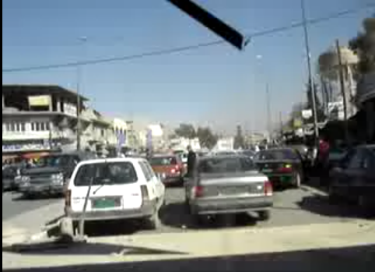
Humvee Traffic Driving in Baghdad
Notes:
This video (http://www.youtube.com/watch?v=Yco1deXOzN8) will give you an idea of what service members face every day, let’s watch a quick video.

Slide 24
PTS(D) Symptoms
Intrusive memories: Flashbacks, reliving traumatic event, upsetting dreams, etc.
Avoidance and numbing: Not talking about the event, memory problems, hopelessness, emotional numbness, etc.
Increased anxiety or hyperarousal: Irritability and anger, self-destructive behavior, easily startled or frightened, hearing or seeing things, etc.
Mayo Clinic (2011)
Notes:
PTSD symptoms can be divided into the three main categories shown here. However, these are not discrete states and individuals can experience symptoms from either category.

Slide 25
Traumatic Brain Injury (TBI)
Bump, blow, or jolt to the head or a penetrating head injury that disrupts normal brain function
For service members, TBI often results from improvised explosive devices (IEDs), mortars, grenades, bullets, or mines.
Incidences of TBI
  OEF/OIF veterans diagnosed by VA (2010): 45,606
  Total diagnosis annually in the US: 1.4 million
Bagalman, E. (2011)
Notes:
TBI has been called the “signature injury” of the conflicts in Iraq and Afghanistan. However, about 1.4 million Americans experience a traumatic brain injury every year according to the Brain Injury Association of America.
The total number of veterans who have experienced TBI isn’t known, both because TBI is hard to identify and because some veterans have not accessed VA health care services.
Most of these cases have been mild (85% per http://www.brainlinemilitary.org/concussion_course/diagnosis.php), and most service members recover from TBI. But for some veterans, TBI has lasting effects.

Slide 26
(m)TBI Symptoms
Headache
Fatigue
Lethargy
Dizziness
Blurred vision
Behavioral or mood changes
Problems with memory, attention, concentration, or thinking
Congressional Research Service (2011)
Notes:
Mild TBI and TBI symptoms. Some occur right after the injury was sustained, some only occur at a later point in time, sometimes even after months. In most cases those symptoms vanish quickly but sometimes they persist and require further treatment.

Slide 27
Co-morbidity
TBI
PTSD
Headache
Sensitivity to light
and noise
Vision problems
Dizziness
Nausea
Fatigue
Insomnia
Cognitive deficits
Irritability
Avoidance
Flashbacks
Hypervigilance
Nightmares
Tension
Center for Deployment Psychology (2012, March)
Notes:
This diagram shows how the signs and symptoms of PTSD and TBI overlap. Several of these symptoms could also be found in connection with other mental health issues like depression.
Therefore, it is in many cases difficult to come to an exact diagnosis.

Slide 28
Readjustment Issues and Strategies:
Dealing with disabilities
Employment
Veterans in agriculture

Slide 29

Concepts of Disability
Public / media concepts
Military concept: “soldier on”
VA disability rating system
Hierarchy of disability within the veteran community
Amanda Kraus (2012)
Notes:
Public concepts range from medical over tragic and pitiful to inspirational.
While in the service, military members are discouraged from showing weakness. Careers depend on being fit for duty
The VA rates disability. Extent of disability is expressed as a percentage from 0% (for conditions that exist but are not disabling to a compensable degree) to 100%, in increments of 10%. Language: Catastrophically Ill and Injured, or “CII”
Hierarchy is from combat related to non-service related.

Slide 30

Veteran’s Attitudes
Reluctance to identify as disabled
Service orientation and cohort mentality
Low self-management skills
Language:
  Wounded warrior
  Injured
Amanda Kraus (2012)
Frain, M., Bethe, M. & Bishop, M. (2010)
Notes:
Reluctance to identify yet the need / hope for high disability ratings with the VA as financial compensation depends on it.
Self-management: Learning and practicing skills necessary to carry on active and emotionally satisfying life in the face of chronic condition.
High levels of self-management skills are linked to higher perceived control over life and lower levels of secondary disability, including mental health issues and substance abuse. Studies have shown, that veterans show on average low self-management skills (Frain, Bethel, Bishop, 2010)

Slide 31

Specific Issues
Disability is newly acquired.
Lack of knowledge of accommodations and services available
Not familiar with mitigating skills and techniques, like Braille

Slide 32
Employment
Group by age | 2010 Unemployment |  | 2011 Unemployment
 | Male | Female | Male | Female
Veteranª 18-24 yrs | 21.9% | 15.3% | 29.1% | 36.1%
Civilian 18-24 yrs | 19.7% | 14.6% | 17.6% | 14.5%
Veteranª 25-34 yrs | 13.0% | 13.6% | 13.4% | 10.6%
Civilian 25-34 yrs | 10.7% | 9.1% | 9.5% | 9.1%
ª Defined as having served during the Gulf War Era II period.
Bureau of Labor Statistics (March 2011)
Bureau of Labor Statistics (March 2012)
Notes:
The following table is filled with data from the Bureau of Labor Statistics and compares male and female veterans (Gulf War Ear II – meaning those who joined after 9/11/11) and their unemployment rates in 2010 and 2011.

Slide 33
Employment by Disability Status
U.S. Bureau of Labor Statistics (2012)
Notes:
Among veterans who served since August 1990, those with service-connected disabilities were less likely to be employed than those without such disabilities.
In August 09 70.7% of disabled veterans who served in the 10 years prior held a job compared to 81.9% veterans without disability related to their military service.
On average, the greater the severity of the disability, the lower the proportion employed. See also MacLean (2010)

Slide 34
Desirable Workplace Skills
Organizational behavior
Leadership and supervision
Interpersonal communication
Business communication
Psychology
Sociology
Accounting
Discipline
Teamwork
Respect and integrity
Leadership
Problem solving
Ability to perform under pressure
American Council on Education. (July 2011)
CareerBuilder (2009)
Notes:
Veterans bring both hard and soft skills to the workplace.

Slide 35
The Legal Framework
Employment
Training
Uniformed Service Employment & Reemployment Rights Act (USERRA)
Work Opportunity Tax Credit (WOTC) – with special provisions for hiring veterans with a disability
VA VetSuccess Program (Chapter 31 Voc Rehab)
Post 9/11 GI Bill (Chapter 33) Funding
REAP (Chapter 1607) for Selected Reserve, Individual Ready Reserve and National Guard
Notes:
USERRA: Regulates Military Leave of Absence, job reinstatement after deployment, seniority accumulation, health insurance, provides protection against discrimination, etc. : http://www.dol.gov/vets/programs/userra/USERRA_Federal.pdf
WOTC: Tax credits up to $4,800 for employees who hire disabled vets who have been recently discharged or have been unemployed for more than six months. http://www.in.gov/dwd/2572.htm
VA Voc Rehab funds are by far not the only monies available to veterans with disability. Chapter 33, REAP and also other, often state provided benefits can pay for licenses, certifications, credentials in postsecondary education and training.

Slide 36
Impact of War on Rural Areas
High survival rate after injuries
Disproportionally affected by consequences of recent conflicts
Less access to medical services like psychotherapy
Offer therapeutic environments for healing and reintegrating wounded warriors
Cully , J., Jameson, J., Phillips, L., Kunik, M. & Fortney, J. (2010)
Frain, M., Bethel, M. & Bishop, M. (2010)
Thorsen Gonzalez, Hartig, Patil, Martinsen & Kirkevold (2011)
Notes:
Almost 43% of VA patients and 15% of vets with a service connected disability are from rural and highly rural areas. Veterans from rural areas make a up a disproportionate share (32%) of OEF/OIF service members enrolled in the VA system (VHA Office of Rural Health, April 2012).

Slide 37
Veterans in Agriculture
6.1 million veterans live in rural communities.
USDA Veterans Employment Program Office
2012 Farm Bill changes
Variety of farming programs targeted towards veterans
Loan programs for new farmers
VHA Office of Rural Health (April 2012)
Notes:
“Rural” is defined by the US Census as “Territory, population, and housing units not classified as urban. “Urban” is defined by the US Census as comprising all territory, population, and housing units in urbanized areas and in places of 2,500 or more persons outside urbanized areas”.

Slide 38

Programs and Activities
Multitude of for-profit and not-for-profit training and educational / therapeutic programs:
  Archie’s Acres
  Veterans Farmers Project
  Vets to Ag by Michigan State University
Interest groups:
  Farmer Veteran Coalition
Therapeutic horticulture
Notes:
“Horticultural therapy uses gardening, plants, floral materials, and vegetation to stimulate clients’ interest in their surrounding and promote the development of leisure or vocational skills.” (Morgan, 1989)

Slide 39
Takeaways
About one million service members will transition to veteran status over the next five years.
Many veterans leave the service with varying degrees of disability.
Veterans have specific reintegration issues and needs.
The veteran unemployment rate is high.
Rural areas are critical for veteran reintegration.

Slide 40
Resources
Military
  The Military Family Research Institute: https://www.mfri.purdue.edu/
  General military information such as service branches, rank structure, insignia and uniforms, etc. at Ourmilitary.mil: http://www.ourmilitary.mil/learn/our-services/
  Free online course on military competence at Center for Deployment Psychology: http://deploymentpsych.org/training/training-catalog/military-cultural-competence
  Dictionary on military terms by Department of Defense: http://www.dtic.mil/doctrine/dod_dictionary/

Slide 41
Resources, Cont’d
Veteran’s Health
  VA Polytrauma/TBI information: http://www.polytrauma.va.gov/understanding-tbi/symptoms.asp
  VA National Center for PTSD: http://www.ptsd.va.gov/public/index.asp
  Free mental health service for military personnel and families: http://www.giveanhour.org/
  Star Behavioral Health Providers: http://starproviders.org/providers/index.php

Slide 42
Resources, Cont’d
Veteran Employment
  USERRA: http://www.inesgr.org/Userra.htm
  WOTC: http://www.doleta.gov/business/incentives/opptax/
  VetSuccess: http://www.vba.va.gov/bln/vre/
  Workplace preparation for returning veterans: http://nod.org/assets/downloads/AmericasBestHiring.pdf
  Guide to veteran employment policies, practices, and resources: http://vets.syr.edu/pdfs/guidetoleadingpractices.pdf

Slide 43
Resources, Cont’d
Veterans in Agriculture
  The Farmer Veteran Coalition: http://www.farmvetco.org/
  The Veteran Farmers Project: http://www.cfra.org/veteran_farmers_project
  Michigan State University, Vets to Ag: http://iat.msu.edu/iat/vets_to_ag
  Nebraska College of Technical Agriculture – Combat Boots to Cowboy Boots: http://liferaydemo.unl.edu/web/ncta/combatcowboyboots
  VHA Office of Rural Health: http://www.ruralhealth.va.gov/index.asp

Slide 44
References
American Council on Education. (July 2011), ACE Military Programs.: www.acenet.edu/AM/Template.cfm?Section=Military_Programs
Bagalman, E. (2011). Traumatic Brain Injury Among Veterans. CRS Report for Congress, 7-5700. Retrieved from Congressional Research Service : http://www.nashia.org/pdf/tbi_among_veterans_may_2011.pdf
Bureau of Labor Statistics (March 2011), Employment Situation of Veterans News Release: http://www.bls.gov/news.release/archives/vet_03112011.htm
Bureau of Labor Statistics (March 2012), Employment Situation of Veterans News Release: http://www.bls.gov/news.release/vet.htm
CareerBuilder (2009), Employers Targeting US Veterans for Hiring: http://www.careerbuilder.com/share/aboutus/pressreleasesdetail.aspx?id=pr523&sd=9%2F10%2F2009&ed=12%2F31%2F2009
Center for Deployment Psychology (2012, March). Traumatic Brain Injury (TBI) in the Military. In Star Behavioral Health Providers training conducted at Purdue North Central, Portage, IN.
Cully , J., Jameson, J., Phillips, L., Kunik, M. & Fortney, J. (2010). Use of Psychotherapy by Rural and Urban Veterans . The Journal of Rural Health, 26, 225-233.
Frain, M., Bethel, M. & Bishop, M. (2010). A Roadmap for Rehabilitation Counseling to Serve Military Veterans with Disabilities. Journal of Rehabilitation, 76, No. 1, 13-21
Institute for Veterans and Military Families, Syracuse University. (2012). Guide to Leading Policies, Practices & Resources: Supporting the Employment of Veterans & Military Families.
Institute of Medicine of the National Academies, Treatment for PTSD in Military and Veteran Populations (2012): http://www.iom.edu/~/media/Files/Report%20Files/2012/PTSD-Initial-Assessment/PTSD_I_RB.pdf

Slide 45
References, Con’t
Kessler, R., Berglund, P., Demler, O., Jin, R., Merikangas, K. &Walters, E. (2005). "Lifetime Prevalence and Age-of-Onset Distributions of DSM-IV Disorders in the National Comorbidity Survey Replication." Archives of General Psychiatry 62: 593-602
Kraus, A. (2012). Understanding Disability in the Student veteran Community. In A. Hamrick , C. Ruman (Eds.), Called to Serve: A Handbook on Student Veterans and Higher Education. Manuscript submitted for publication.
Leland, A., Oboroceanu, M-J. (2010). American War and Military Operations Casualties: Lists and Statistics (CRS Report for Congress). Retrieved from Congressional Research Service website: http://www.fas.org/sgp/crs/natsec/RL32492.pdf
Mayo Clinic, PTSD (2011): http://www.mayoclinic.com/health/post-traumatic-stress-disorder/ds00246/dsection=symptoms
National Guard Bureau Posture Statement (2012): http://www.arng.army.mil/News/publications/ApostureStatements/2012_ngps.pdf
Spelman, J.F., Hunt, S.C., Seal, K.H. & Burgo-Black, A.L. (2012). Post deployment Care for Returning Combat Veterans. Journal of General Internal Medicine, 27 (9), 1200-1209. Retrieved from: http://www.springerlink.com/content/507463m555185p7l/fulltext.pdf
Statistical and Accounting Branch Office of the Adjutant General (1953). Army Battle Casualties and Nonbattle Deaths in World War II: Final Report 7 December 1941 – 31 December 1946. Retrieved from: http://www.ibiblio.org/hyperwar/USA/ref/Casualties/index.html#contents
Tanelian, T., Jaycox, L. H. (2008). Invisible wounds of war: Psychological and cognitive injuries, their consequences, and services to assist recovery. Santa Monica, CA: Center for Military Health Policy Research.

Slide 46
References, Con’t
Thorsen Gonzalez, M., Hartig, T., Grindal Patil, G., Martinsen, E.W. & Kirkevold, M. (2011) A prospective study of group cohesiveness in therapeutic horticulture for clinical depression. International Journal of Mental Health Nursing, 20, 119-129.
Today’s Military (August 2012): http://www.todaysmilitary.com/service-branches
US Department of Defense Active Duty Military Personnel by Rank/Grade (March 2012): http://siadapp.dmdc.osd.mil/personnel/MILITARY/rg1203.pdf
US Department of Defense, Casualty Statistics (August 2012): http://www.defense.gov/news/casualty.pdf
US Department of Defense, Global War on Terrorism Casualty by Reason (May 2012): http://siadapp.dmdc.osd.mil/personnel/CASUALTY/gwot_reason.pdf
US Department of Veterans Affairs, Annual Benefits Report 2011 (2012): http://www.vba.va.gov/REPORTS/abr/2011_abr.pdf
US Department of Veterans Affairs, VA Medical Article Discusses Specialized Iraq and Afghanistan Veteran Health Care Needs (June 2012): http://www.va.gov/opa/pressrel/pressrelease.cfm?id=2327
US Department of Veterans Affairs, VHA Office of Rural Health. (April 2012). Fact Sheet. Retrieved from: http://www.ruralhealth.va.gov/docs/ORH_GeneralFactSheet_April2012.pdf

Slide 47
Acknowledgements
Lilly Endowment Inc.
Shelley MacDermid Wadsworth, Ph.D.
Stacie Hitt, Ph.D.
Lynn Hegewald

