Slide 1
Understanding Vocational Rehabilitation Process
National AgrAbility Project Training
April 13-15
Presenter
Samuel N. Mathew

Slide 2
Federal Mandate
Rehabilitation Act of 1997 as amended in 2001
Any state that submits to the Secretary a State plan eligible to get funding
78% Federal and 22 % State match for funding
Available in all 50 states distributed across each state
Notes:
Vocational Rehabilitation became a part of the national consciousness following World War I, primarily as a response to the number of injured returning veterans who were unable to return to their former employment. Through the years there have been a number of amendments and disability and/or vocationally related pieces of legislation passed each building on previous legislation leading up to the Rehabilitation Act of 1997.

Slide 3
Vocational Rehabilitation Mission
To serve eligible people with disability in obtaining and retaining employment that is commensurate with abilities, interests and limitations.
Meeting individual rehabilitation needs of each person
Managing financial resources that are necessary and reasonable
Notes:
Rehabilitation needs are identified by the completion of a comprehensive assessment. The comprehensive assessment may include such things as the vocational implications of the disability, need for assistive technology, home or vehicle modification, consumer’s level of education, consumer’s vocational interest, etc.
Managing financial resources that are necessary and reasonable; e.g. smooth hard flooring may be necessary to traverse using a wheel chair however solid oak flooring while providing the proper surface may not be reasonable. VR must also consider comparable benefits, e.g. insurance, education scholarships and grants.
Note: There may be instances of consumer contribution, such as the flooring example if the consumer prefers the solid oak flooring they would pay the difference in material and installation costs. I can think of no instance where the consumer incurred a cost that they did not know about up front provided that they received prior approval and authorization from VR before a cost was incurred.

Slide 4
VR Process Flow
00*
Referral
22*
Employment
26*
Successful
Closure
02*
Application
10*
Eligibility &
Plan Dev.
16*
Restoration
18*
Training
20*
Ready for
Employment
12*
IPE Approved
* VR status code
Notes:
00 Referral: The entry point to VR. Referral may be made by the consumer, an agency, doctor, a friend, etc. The following is the minimum information necessary for a referral to be documented and acted upon; a) name and address, b) disability as reported, c) date of birth and gender, d) referral source. Additional information that is helpful is social security number, telephone number.
02 Application: The consumer has completed and signed an application (or similar document) requesting Vocational Rehabilitation services. This requires that the consumer be informed of all decisions affecting the case and it provides a certainty that the consumer knows that they have been referred to vocational rehabilitation. The assessment process to determine eligibility begins immediately. There is a 60 day time limit to status 02, an eligibility determination must be made within that time frame, (exceptions, unforeseen circumstances and the applicant concurs).
10 Eligibility and development of the individualized plan for employment (IPE): A certificate of eligibility must be completed and be part of the case record. The comprehensive assessment begins, the consumer has input into the IPE, under the 1998 amendment to the Rehab Act the consumer may develop the IPE alone, or with the assistance of any other individual including family, friends, and the VRC. However the VRC and in IN the Counselor Supervisor must approve the IPE. Time limit 120 days.
18 Training: vocational skills, post secondary, mobility, driver, on-the-job, etc. Consumer remains in this status until service is completed or terminated.
16 Mental and/or physical restoration: medical, surgical, psychiatric, therapeutic treatment, prosthetic, hearing aids, etc, Consumer remains in this status until services are completed or terminated.
20 Ready for employment: If consumer has completed other services and is ready for an intensive job search to begin, if a consumer has been hired and not yet started the job.
22 In employment: Consumer is employed in a position that they accept as commensurate with abilities, interests and limitations. Close follow-up for 90 days.
26 Successful closure: If consumer has continued employment for no less than 90 days, is performing well on the job, agrees with case file closure. An assessment of post employment needs must be conducted.

Slide 5
Additional Status Codes
06 *
Extended
Evaluation
24*
Service
Interrupted
32*
Post Employment Service
* VR status code
Notes:
06 Extended evaluation: This status is important if an applicant has a disability that has been determined to constitute a substantial impediment to employment however the severity of the impairment raises significant doubts about the applicant’s ability to benefit from services to obtain and retain employment. Extended evaluation requires an individualized plan outlining the evaluation and related services necessary to make a determination of eligibility or ineligibility that is based on clear and convincing evidence. The determination must be objective and not subjective. Time limited to 18 months.
24 Service interrupted: This status is used when services are interrupted due to consumer circumstances or consumer unavailability, not due to agency or counselor shortcomings, overdue in status at six months
32 Post Employment Services: Cases are placed in this status to provide simple short term services to maintain, regain or advance the consumer’s employment. The anticipated need for post employment services must be assessed prior to closure of case file.

Slide 6
Eligibility for Services
To be eligible for VR services an individual must
Have a physical or mental impairment which, for such an individual, constitutes or results in a substantial impediment to employment
Require VR services
Will benefit from these services to successfully obtain and retain employment
Notes:
Example may reference the selected case study, Mr. Beckman has C-3 spinal cord injury (SCI) incomplete, (physical impairment) therefore he is unable to independently climb up into truck or combine to drive to get tools and supplies, or harvest crops, is unable to independently prepare himself to work, etc. (substantial impediment to employment) Will require driver evaluation and training , assistive technology etc, to return to work, Mr. Beckman will benefit from theses services and return to farming.

Slide 7
Types of Services
Assessments
Vocational and other training
Physical and mental restoration
Counseling and guidance
Support - mileage, childcare, living maintenance
Notes:
Essentially services must address one or both of two things, the vocational impediment and the employment goal. Offer basic example of each type of service and circumstance where the service may be necessary.

Slide 8
Types of Services
Interpreter services for deaf
Occupational licenses, tool, supplies
Home and vehicle modification
Job development and placement
Assistive Technology

Slide 9
Types of Services
Small business development
Other goods & services
Referral to other services
Transition services

Slide 10
IPE drives services
Services
IPE
Assessment
Notes:
Comprehensive assessment or evaluation is holistic and considers consumer’s unique strengths, resources, priorities, concerns, abilities, capabilities, interests as well as limitations, and resulting needs. The comprehensive assessment should identify the employment goal that is consistent with the above list of consumer attributes, and the services necessary to reach the employment goal,

Slide 11
Assessment Examples
Current academic skills, how one learns best and psychological well being
Functional capacity evaluation
Hearing evaluation
Seating and positioning evaluation
Assistive technology evaluation
Vehicle or home modification evaluation
Notes:
The assessments or evaluations are completed by licensed or certified professionals, Clinical psychologist, OTs/PTs, Audiologists, SLP, Assistive Technology Professional, etc. Some evaluations may require a Drs. Prescription,

Slide 12
IPE Mandatory Components
Description of the specific employment outcome
Description of the specific rehabilitation services
Timeline for achieving employment outcome and the initiation of services
Description of the vendors chosen by the consumer to provide services
Description of criteria to evaluate progress toward goal
Terms and conditions of the IPE (responsibilities)
Notes:
Specific employment outcome that is commensurate with consumer’s unique strengths, resources etc. Informed choice important, consumer has input into the plan the VRC will not tell them what to do or what vendors to choose, VRC role in simple terms is to make sure that all the consumer has the information necessary to make decisions that are correct for them, and to make sure that what ever they have agreed to have happen does happen.
Specific rehabilitation services that are necessary to achieve the employment outcome, this is where information from evaluation/ assessment is important
Timeline: reminder that employment is the goal and there is an expectation of moving forward, consumer has input into timeline
Description of services and vendors that are to provide the services,
Description of criteria that will be used to evaluate progress, e.g. progress reports, interviews for employment, job offer, retain employment etc.
Terms and conditions: consumer responsibilities, VRC responsibilities,

Slide 13
26 Closure
Consistent with the individual’s abilities, interests and limitations
Can include self-employment, telecommuting, business ownership
Job is in integrated environment (not in isolated environment or sheltered workshop)
After 90 days of status 22
At or above federal minimum wage income
Notes:
Status 26 or successful closure with employment is the goal of vocational rehabilitation services. Note that the employment goal may include self-employment and business ownership. Integrated work environment is very important, not in the sense of different cultures or ethnic groups but that the person with is disability is not hidden away, warehoused and that they have access to the same life/work experiences as others in the work place.
90 days after stable on the job, (case study example most likely the 90 days of employment did not begin when Mr. Beckman earned the driver’s license but when all the other steps to the plan have been completed. At or above minimum wage reported as hourly, or weekly, re: farm income that may be when crops or livestock is sold, one or two times per year, will allow consumer to identify an average weekly wage, etc.

Slide 14
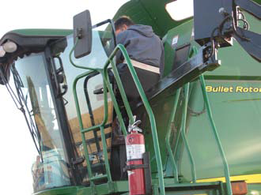
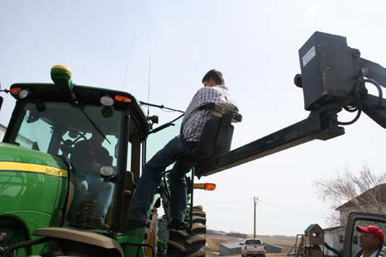
Case Study 1 - Eric Beckman Nebraska AgrAbility

Slide 15
Background before injury
Grandfather’s farm & family tradition of farming
Farming with father Bob & mother Nancy since 1995
550 acres of cash crops
Wife Dana and two young children – Brittni & Aiden
May 6, 2007 - Injury cause, Car hydroplaned into side ditch, hit tree stump and rolled over. No seat belt.

Slide 16
Injury Details
Initially on ventilator
Pin and plate on neck
Incomplete quadriplegic
Third cervical vertebrae area
ASIA * – A complete
Some functions below C-3
Nerve functions down to C-7
Controls body functions such as respiration
* - American Spinal Injury Association

Slide 17
Cervical spinal nerves (C1 to C8)
Control signals to the back of the head,
Neck and shoulders
Arms, hands and the diaphragm.
Upper (C1, C2) injuries can cause loss of involuntary functions including breathing.
Injuries in this area result in quadriplegia.

Slide 18
Personal Goal
Did not want to go back to school
Production agriculture is the chosen goal
Intermediate goals (defined later) to return to farming
Obtain driver’s license
Driving tractor/combine
Complete assessments

Slide 19
AgrAbility Involvement
Introduced to Jason Beck of Colorado AgrAbility in Craig’s Hospital, Denver
Met with Nebraska AgrAbility & VR in Nov. 07
Previously neither agencies had attempted anything close to this – Decided to take ‘one step at a time’
Assessments reports and follow up

Slide 20
VR Services Provided
VR supported evaluation and driving license in Minnesota – passed
2005 pickup truck with Bruno Under vehicle lift bought by Eric –lock down wheelchair and tri-pin steering device
Flatbed truck lift –Life Essentials lift to transfer between machines
Modification on the combine –VR Tri-pin steering control, modification of discharge auger switch

Slide 21
VR Services Provided (Contd …)
Modification on tractor fitted already with IVT and GPS - Tri-pin steering control
Rear vision monitor and camera fitted on tractor and combine
Dragon Naturally Speaking Software for voice recognition for computer use
Hop Lock Spring-loaded door latches (future)

Slide 22
Return on Investment
C1-C3 Treatment
First year $800,000
Yearly $140,000
Lost wages yearly - $65,000
Cost of AT provided
$ 80,000
Family put back on track - Eric, Dana, Brittni and Aiden – Cost not measurable

Slide 23
2005 Pickup truck with UVL

Slide 24
Lift attached to Flatbed truck for transfer between machines

Slide 25
Eric on his flat bed truck with Braun UVL to access truck & Essentials attached lift to access farm equipment

Slide 26
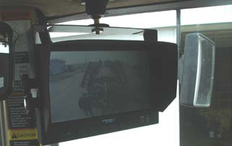
Tri-pin and Rear vision

Slide 27
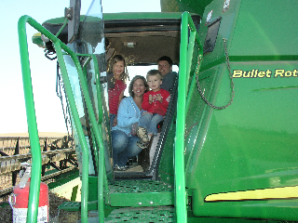
Current Status
Eric continues to farm with his father
Beckman family has rented 300 acres more this year
"This farm family's happiness is why we work with AgrAbility."
- Rod Peterson, Nebraska AgrAbility

Slide 28
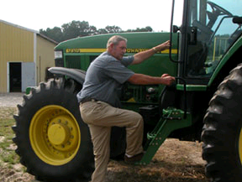
Case Study 2 – JR McGrath Delaware-Maryland AgrAbility Project

Slide 29
Background before injury
68 year old farmer
100 year old family owned farm - 1000 acres of corn and other crops
Stays alone
2004 Incident - Stepping off the tongue of manure spreader – Fracture mistaken for twisted ankle.
Rotator cup injury
Health problems - diabetes, hypertension, heart problems

Slide 30
Injury Details
Broken leg
Mistaken for twisted ankle and no medical attention for three days
Infected leg amputated below knee

Slide 31
Personal Goal
Retain the family farm
Return back to Farming
Stay independent

Slide 32
AgrAbility Involvement
Introduced to Delaware – Maryland AgrAbility when ‘JR’ was recuperating at Genesis Center for Rehabilitation, Salisbury
Referred to Dept. of VR of Maryland (DORS)
Initial assessments and follow up
Stayed on supporting ‘JR’ through the process

Slide 33
VR Services
Added steps and handrail on tractor
Prosthesis
Handrail and stair glide chair at home
Gator
Lift-chair for home
Specialized auger to load grain for simplified seeding method
Ongoing assistance for maintenance of prosthesis
Total cost $33,000

Slide 34
Thanks!
Question time

