Slide 1
Easter Seals Michigan AgrAbility is a non-profit private charity that provides direct services to farmers with injuries, illnesses or aging conditions so they can continue the occupation and lifestyle they love.

Slide 2
History of the AgrAbility Program
Easter Seals Michigan has served farmers with disabilities since 1990.
From 2003-2012 Michigan State University Extension operated AgrAbility with a grant from the USDA.
In May 2012 USDA funding ended and Easter Seals took full responsibility for AgrAbility operations and securing private funding.

Slide 3
2013 Fundraising Plan
Michigan Rehabilitation Services (VR) AT
Fee for service for assessments
AT available at cost
2. Agricultural Business Sponsors
3. Michigan Farm Bureau
4. 3rd Party Events
5. Grant funding
6. AgrAbility Fundraising events
7. Internet & newsletter outreach

Slide 4
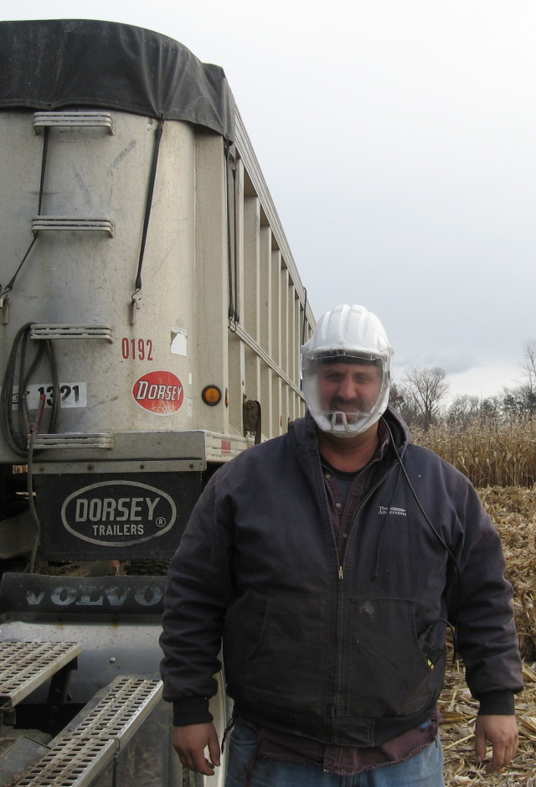
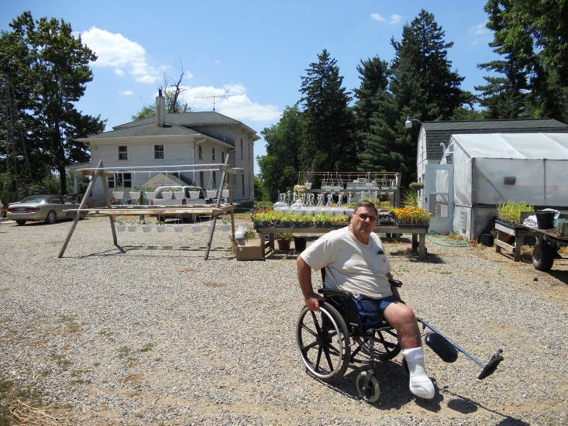
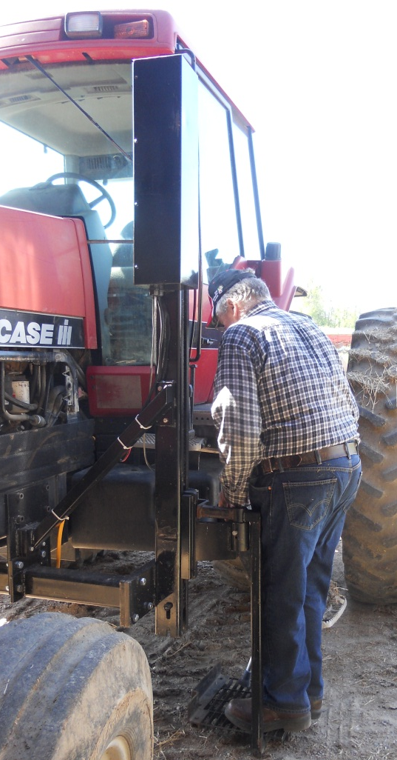
Thank You for Supporting Your Fellow Michigan Farmers

