Slide 1
Suicide Awareness with a Focus on Veterans and Rural Americans
AgrAbility Webinar Series
June 26, 2014
2:00 p.m. EDT

Slide 2
Basic Webinar Instructions
Need speakers or headphones to hear the presentation. No phone connection.
Check sound via Meeting > Audio Setup Wizard
Questions about presentation
Type into chat window and hit return.
During the Q & A period, if you have a web cam/microphone, click the “Raise Hand” icon to indicate that you have a question
We will enable your microphone

Slide 3
Basic Webinar Instructions
4 quick survey questions
Session recorded and archived with PowerPoint files at www.agrability.org/Online-Training/archived along with resource materials
Problems: use chat window or email agrability@agrability.org

Slide 4
Known Webinar Issues
Echo
Check to see if you are logged in twice
Disconnection with presenters
Hang on – we’ll reconnect as soon as possible
Disconnection with participants
Log in again

Slide 5
AgrAbility: USDA-sponsored program that assists farmers, ranchers, and other agricultural workers with disabilities.
Partners land grant universities with disability services organizations
Currently 20 projects covering 22 states
National AgrAbility Project: Led by Purdue’s Breaking New Ground Resource Center. Partners include:
Goodwill of the Finger Lakes
The Arthritis Foundation, Heartland Region
The University of Illinois at Urbana-Champaign
Colorado State University
More information available at www.agrability.org

Slide 6
Presenters
Shye L. Louis, M.Ed., CIRS, CRS
2-1-1/LIFE LINE Manager
Goodwill of the Finger Lakes, Rochester, NY
&
Robert J. Fetsch, Ph.D.,
Extension Specialist & Professor Emeritus,
Human Development & Family Studies
Colorado State University

Slide 7
How is Suicide a Public Health Problem for Those of Us Who Work in Agriculture and in Rural Communities?
By Robert J. Fetsch, Ph.D.,
Extension Specialist & Professor Emeritus,
Human Development & Family Studies
Colorado State University

Slide 8
Farm/Ranch stress
Farming is one of the top 12 high stress occupations.
According to NIOSH, farm owners were second only to laborers in the rate of death for stress-related diseases.
Notes:
DONE
Colorado’s suicide rate at 17.3/100,000 was over 1.5 times the national rate at 11.0/100,000 in 2004, which makes it 6th highest in the nation at roughly 720 deaths each year from suicide
8

Slide 9
Financial stress and depression
In a study of 425 students, poverty and unemployment significantly predicted depressive symptoms even after controlling for demographic and familial risk factors (Dallaire et al., 2008).
Depressive symptoms in childhood predicted adolescent depression, suicide attempts, interpersonal problems and career dissatisfaction in early adulthood (Reinherz et al., 1999).
Notes:
Discuss some of my research regarding overall perception of financial situation.
Difficulty with money has been reported as one of the leading causes of marital stress and divorce (Benjamin, 2001).
Increasing debt contributes to negative marital quality (Skogrand et al., 2005).
9

Slide 10
Farm/Ranch depression
Many farmers/ranchers struggle with depression.
It is not clear whether they experience lower/higher levels of depression and other mental health issues as does the general population.
Notes:
DONE
10

Slide 11
Farm/Ranch depression
Some researchers found a relationship between exposure to pesticides and high levels of depression among CO farmers/ranchers.
ND farmers’ depression levels were almost twice that of other rural populations in the past.
Notes:
DONE
11

Slide 12
Farm/Ranch depression
IA farm men were more likely to experience depression if within the previous year they had:
Lost something of sentimental value
Experienced substantial income decline
Gone deeply into debt
Faced legal problems
Or experienced an increase in health problems.
Notes:
Discuss some of my research regarding overall perception of financial situation.
12

Slide 13
Non-Farm/Ranch depression
Unemployed individuals were more likely to experience chronic depression than employed individuals.
Participants with no/publicly funded health insurance were more likely to experience chronic episodes than individuals with private insurance (Gilmer et al., 2005).
Notes:
13

Slide 14
What is the “common cold” of modern psychology?

Slide 15
The “common cold” of modern psychology is depression.
A major depression interferes with your positive experience and dramatically affects your life.
This is more than the normal “blues.”
Every year 1/10 people experience a major depression.
Depression is very common.
Source: E. Chavez (personal communication, October 16, 2005).

Slide 16
The “common cold” of modern psychology is depression.
What is the best, most effective “cure” for depression?
Combination of taking good care of yourself, counseling, and medication.

Slide 17
What do you think the leading external causes of death on Colorado ranches/farms have been?

Slide 18
What do you think the leading external causes of death on Colorado ranches/farms have been?
1) Suicide
2) Animals
3) Tractors

Slide 19
Farming and ranching are among the most dangerous occupations in the U.S.
Historically, the leading external cause of death on Colorado farms and ranches has been: 1) suicide, 2) animal incidents, and 3) tractor rollovers (1).
(1) T. Daniels (personal communication, August 22, 2000).

Slide 20
Financial stress and suicide
Financial stress has historically been reported as a leading factor in completing suicide (Dublin & Bunzel, 1933).
Financial loss and depressive symptoms are characteristics of individuals experiencing suicidal ideation (Turvey et al., 2002).
Notes:
20

Slide 21
Farm/Ranch suicide rates
Higher rates of suicide among farmers/ranchers have been reported in the United Kingdom, Australia, Canada, Scotland, and the U.S.
Notes:
21

Slide 23
Western mountain states have the highest suicide death rates.
The risk of suicide death increases among older men and is especially high for 75 years plus—especially if they lose their spouse and their dairy/farm.
Most are white and not married.

Slide 24
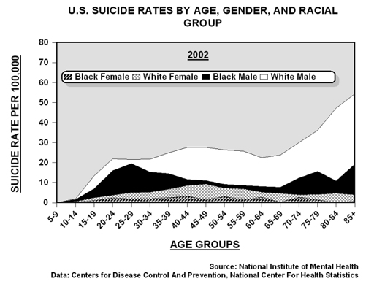
National Institute of Mental Health
Current Suicide Rates in U. S.
Notes:
24
This slide shows the U.S. suicide rates by age, gender, and racial group. Most noteworthy is the rapidly increasing risk for white males aged 75 and older. The older they are, the higher the suicide rate from approximately 30 to 54 per 100,000 (as compared with the overall U.S. suicide rate of 10.93 per 100,000 in 2002). White males who are widowed/single and unemployed are especially at risk of suicide.

Slide 25
2010 WISQARS
U.S. Suicide Rates by Age, Gender, and Racial Group
Suicide Rates per 100,000
Age Groups
Source: http://webappa.cdc.gov/cgi-bin/broker.exe
Notes:
The overall suicide rate in the U.S. was 12.43 in 2010, the latest year for which statistics are available.
The U.S. suicide rate has been rising steadily from 10.48 in 1999 to 12.43 in 2010.
The CO suicide rate rose from 13.71 in 1999 to 17.2 in 2010.
“Since that crisis [the 1980s farm crisis], the suicide rate for male farmers has remained high: just under two times that of the general population.” Kutner, Max. (2014, April 10). Death on the farm. Newsweek, p. 3 of 12. Available from http://www.newsweek.com/death-farm-248127

Slide 26
Why do farmers/ranchers commit suicide at higher rates?
It’s not increased levels of mental health issues.
It may have to do with:
Demands of family farms
Culture of farming communities
Shortage of health care professionals in rural farming communities
High accessibility to firearms
Occupational stress
Financial difficulties
Family problems
Retirement is a trying transition for farmers.
Notes:
26

Slide 27
Masculine “Scripts” (David & Brannon (1976)
No sissy-stuff - men are expected to distance themselves from anything feminine.
Big wheel - men should be occupationally or financially successful.
Sturdy oak - men should be confident and self-reliant.
Give ‘em hell -men should do what is necessary to “make it.”
“When you’re hurting, be a man—keep it inside and tell no one!” (Fetsch, 2009.)
Notes:
I wonder if there could be a #5. When you’re hurting, don’t tell anyone. What do you think?
In CO, where ¾ suicides are committed by men, we think the problem has to do with Masculine “Scripts.”
Do you think this might be true for men and/or women in your state too?
If so, what do we do to address this issue?

Slide 28
What are common predictors of suicide? Source: Colorado Trust, 2002, p. 8
Being an older, white male with risk increasing with age—1/2 suicide deaths are by white males 35 years+.
Work problems, unemployment—1/3 who commit suicide are unemployed at the time of their death.

Slide 29
Facts about Veteran Suicide
~30,000-32,000 US deaths from suicide/ year.
Centers for Disease Control and Prevention
~20% are Veterans.
National Violent Death Reporting System
~18 deaths from suicide/day are Veterans.
National Violent Death Reporting System
No evidence for increased rates in OEF/OIF Veterans relative to sex, age, and race matched people in the population as a whole.
VA Office of Environmental Epidemiology
Veterans are more likely to use firearms as a means.
National Violent Death Reporting System

Slide 30
What Are Some Strategies to Recognize and Assist Someone Who Might Be at Risk of Suicide?
By Shye L. Louis, M.Ed., CIRS, CRS
2-1-1/LIFE LINE Manager
Goodwill of the Finger Lakes,
Rochester, NY

Slide 31
Recognizing Suicide Risk
Who is at risk?
How can you tell?
Notes:
Anyone is at risk.
Statistics are helpful in prevention efforts
Statistics are helpful to get us thinking
But people aren’t statistics.
The person at risk might not be the farmer or the veteran but the wife, or the child
Invitations:
People at risk usually give some kind of signal that they are distressed.
These signals are our invitations to explore further whether suicide is on their mind
Some invitations are overt and obvious (I’m going to kill myself, I just wish I was dead)
Some invitations are subtle. Some invitations are nearly impossible to see.
Invitations can be verbal, physical, changes in behavior

Slide 32
Addressing Invitations
Notes:
Be respectful and sincere
Ask about what is concerning you
Ask open questions to hear more of the story
Use reflective statements (“Sounds like you feel hopeless...”)

Slide 33
About Suicide
Notes:
If you hear direct statements about dying or the person seems to be feeling helpless or hopeless about their situation or other invitations make you concerned about suicide, ASK the person if they are thinking about suicide
Ask with context if possible
Asking does NOT plant the idea in anyone’s head
Ask directly, concretely and openly

Slide 34
Notes:
Listen to the person at risk’s story/pain
Validate their feelings
DON’T judge
DON’T minimize
DON’T Try to fix it or solve it or tell them why not to do it (yet!)

Slide 35
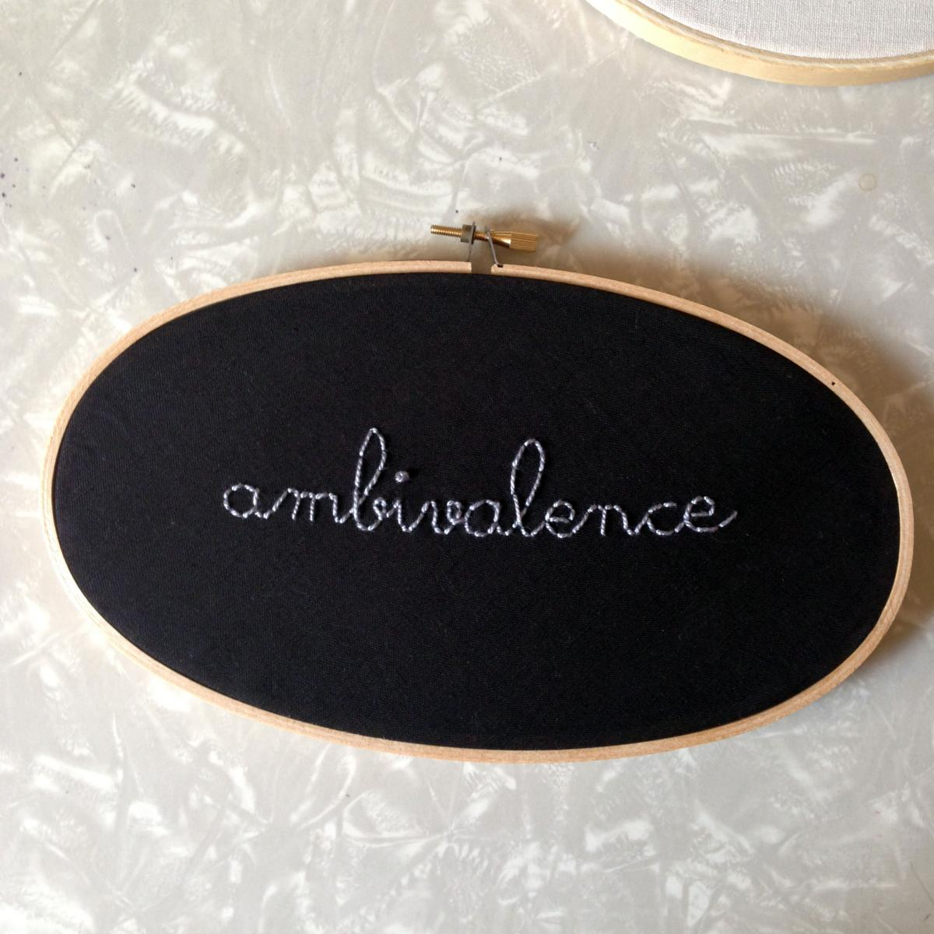
Listen For:
Notes:
Listen for a “BUT” or a turning point. “But what about my children?”
Point out the ambivalence you hear
Explore reasons to live
Some people will have many reasons to want to live
Others will have few or even seemingly none, but even wanting to have reasons to live is a reason not to choose suicide right now – to give the part of you that wants to live a chance
Make an agreement to focus on safety – “safety for now”

Slide 36
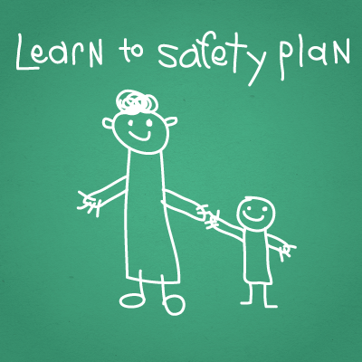
Create a Safety Plan Together
Notes:
Safety Plan
MUST be collaborative, directed by person at risk whenever possible
Safety plan should address RISKS such as any suicide plan, previous history of suicide attempts, lack of resources and supports, mental health diagnosis
If you don’t know about these risks already from hearing the story, you can ask during safety planning.

Slide 37
Safety Plan Elements
Triggers/Warning Signs
Internal Coping Strategies
Social Contacts Who May Distract from the Crisis
Family Members or Friends
Professionals and Agencies to Contact for Help
Making the Environment Safe
Notes:
Are there specific events or feelings that are a trigger for thoughts of suicide?
If we can identify triggers we can plan for them
Internal coping strategies – activities that help address negative feelings.
Distraction is also valid and important, discuss acute nature of impulse to act
Assess support network, identify connections, rebuild old ones
Linking to professional resources
Be aware of the agencies and resources available in your community—what services they offer and what their limitations are.
Listen for signs and symptoms that the person or family needs help which you cannot provide, i.e., financial, legal or personal counseling.
Assess what agency or community resource would be most appropriate to address the person’s/family’s problems.
2-1-1 or NSPL are always good places to start when you don’t know for sure what’s available, or what the person needs exactly, or their needs are outside the bounds of your knowledge
Discuss the referral with the person/family. “It sounds/looks like you’re feeling _____. I think _____, _____, or _____ could help you deal with your situation.”
Plan around barriers to connecting with resources
Follow-Up on connections made
Safety of Environment
Disable the suicide plan or available impulse means
Gun safety vs. pills vs. other methods
Collaborative plan
Involve family

Slide 38
2-1-1 Locator: www.211.org National Suicide Prevention Lifeline: 1-800-273-TALK (Veterans Press 1) Lifeline Crisis Chat: www.suicidepreventionlifeline.org

Slide 39
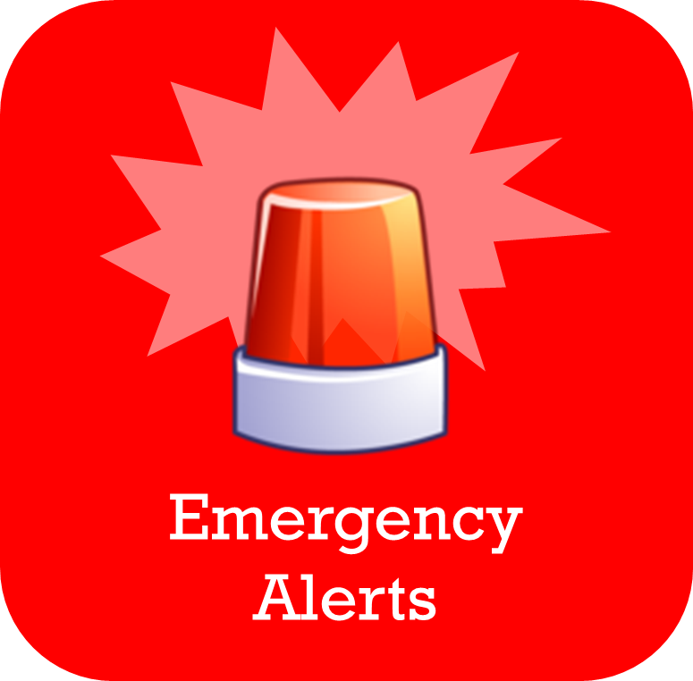
Notes:
When to involve emergency services?
Attempt in progress
Imminent risk (specific, available, lethal plan in the near future)
Person at risk is unwilling/unable to collaborate for their own safety

Slide 40
Notes:
Remember, ultimately you can only be responsible TO the people you serve/care about/come in contact with – you cannot be responsible FOR them
Seek help yourself if you are overwhelmed with trying to help
You don’t have to do it alone, there are people you can safely pass the baton of care to
Mobile crisis teams

Slide 41
Be careful out there. Take good care of yourselves!

Slide 42
Thank you very much!
For More Information, Contact: Shye L. Louis 585-758-1119 slouis@abvi-goodwill.com or Bob Fetsch 970-491-5648 robert.fetsch@colostate.edu

Slide 43
Questions?

