Slide 1
Virtual Unconferencing Session: Getting to the Bottom: AgrAbility's Discussion on Seating Issues in Agricultural Machinery Carla Wilhite University of New Mexico AgrAbility Virtual National Training Workshop Thursday, February 23, 2017 3:00 p.m. ET

Slide 2
Basic Webinar Instructions
Audio available through computer or phone.
Check sound via Audio menu at top left
Closed captions: see Chat window for URL. Must open in a separate browser window. Put the WebEx window and captioning browser side-by-side.
Expand/contract any of the windows in the right-hand column with the arrows. May need to do this to see video of presenter.
Expand/contract the size of the right-hand column.

Slide 3
Basic Webinar Instructions
4 quick survey questions + opportunity to share comments
Session recorded and archived with PowerPoint files at www.agrability.org/Online-Training
Problems: use chat window or email jonesp@purdue.edu

Slide 4
The Unconferencing Principle
The sum of the expertise of the people in the audience is greater than the sum of expertise of the people on stage.
Unconferencing is a structured discussion to tap everyone’s expertise so that each person receives the maximum benefit.

Slide 5
Unconferencing Structure
The discussion leader provides an overview of the topic and general direction for the conversation.
The participants (YOU) provide the majority of the content.
Questions are welcome in addition to comments.

Slide 6
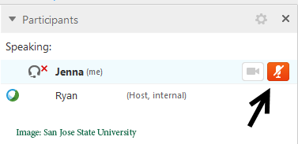
Ways to Contribute
Verbally: use your web microphone or phone connection.
Please keep your line muted unless you’re speaking. Use mute button on WebEx interface or on your phone.

Slide 7
Ways to Contribute
The Chat option
Type your question or comment in the Chat section and click “Send”
We will be taking notes on the whiteboard.

Slide 8
General Topic Questions
What problems in seating are front-line AgrAbility staff seeing during farm visits?
What interventions are being used to improve seating for AgrAbility customers to address these problems?
How are interventions currently being measured for effectiveness/outcome?

Slide 9
Antonio
Xsensor data 9/19/15
Time: 14:22
Temp: 82.8
Relative humidity: 31%
Wind: 3 MPH
LUX: 18,000
Gender: M
Weight: 145 lb
Height: 5 ‘ 08’’
Age: 73
Major health issues: N/A
Clothing: jeans, boots
Minute 1: paved @ 10 MPH
Minute 2-5: dirt field @ 8MPH
Settle: dirt field @ 0MPH (ignition off)
End Time: 16:17
Temp: 83.3
Relative humidity: not recorded
Wind: 3MPH
LUX: not recorded
Subject Comments: N/A
NOTES: No pressure relief was completed during the High Profile ROHO.

Slide 10
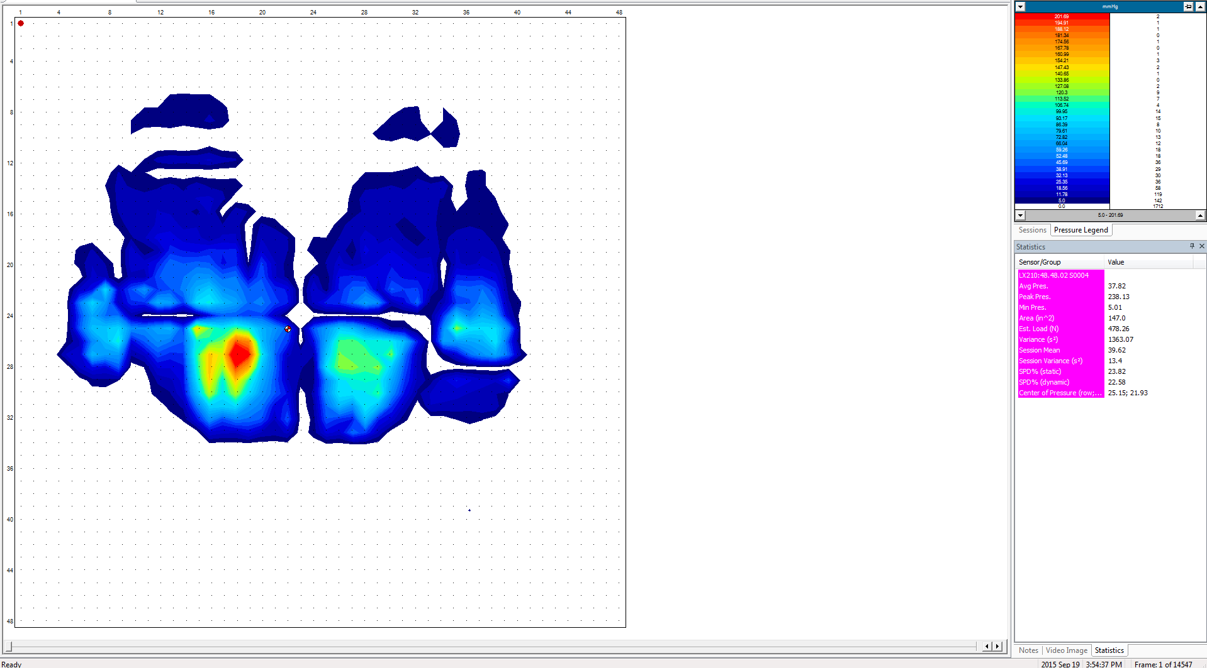
ANTONIO CONTOUR SETTLE (frame 1)
Notes:
Sensor/Group Value
LX210:48.48.02 S0004
Avg Pres. 37.82
Peak Pres. 238.13
Min Pres. 5.01
Area (in^2) 147.0
Est. Load (N) 478.26
Variance (s²) 1363.07
Session Mean 39.62
Session Variance (s²) 13.4
SPD% (static) 23.82
SPD% (dynamic) 22.58
Center of Pressure (row;column): 25.15; 21.93

Slide 11
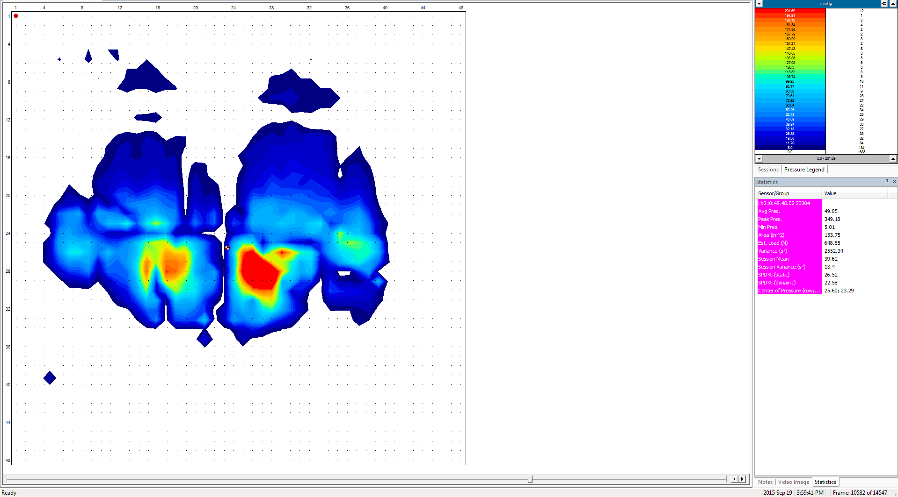
ANTONIO CONTOUR 300 SEC
Notes:
Sensor/Group Value
LX210:48.48.02 S0004
Avg Pres. 43.59
Peak Pres. 228.71
Min Pres. 5.01
Area (in^2) 167.0
Est. Load (N) 626.17
Variance (s²) 1669.82
Session Mean 39.62
Session Variance (s²) 13.4
SPD% (static) 21.97
SPD% (dynamic) 22.58
Center of Pressure (row;column): 23.51; 23.52

Slide 12
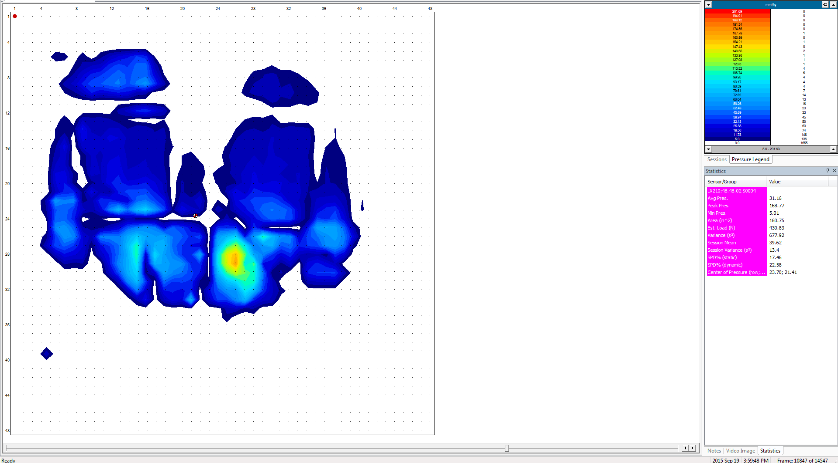
ANTONIO CONTOUR POST PRESSURE RELIEF
5 M 11 SEC
Notes:
Sensor/Group Value
LX210:48.48.02 S0004
Avg Pres. 32.75
Peak Pres. 204.31
Min Pres. 5.01
Area (in^2) 159.0
Est. Load (N) 447.93
Variance (s²) 940.58
Session Mean 39.62
Session Variance (s²) 13.4
SPD% (static) 21.92
SPD% (dynamic) 22.58
Center of Pressure (row;column): 24.82; 22.52

Slide 13
ANTONIO 2 INCH

Slide 14
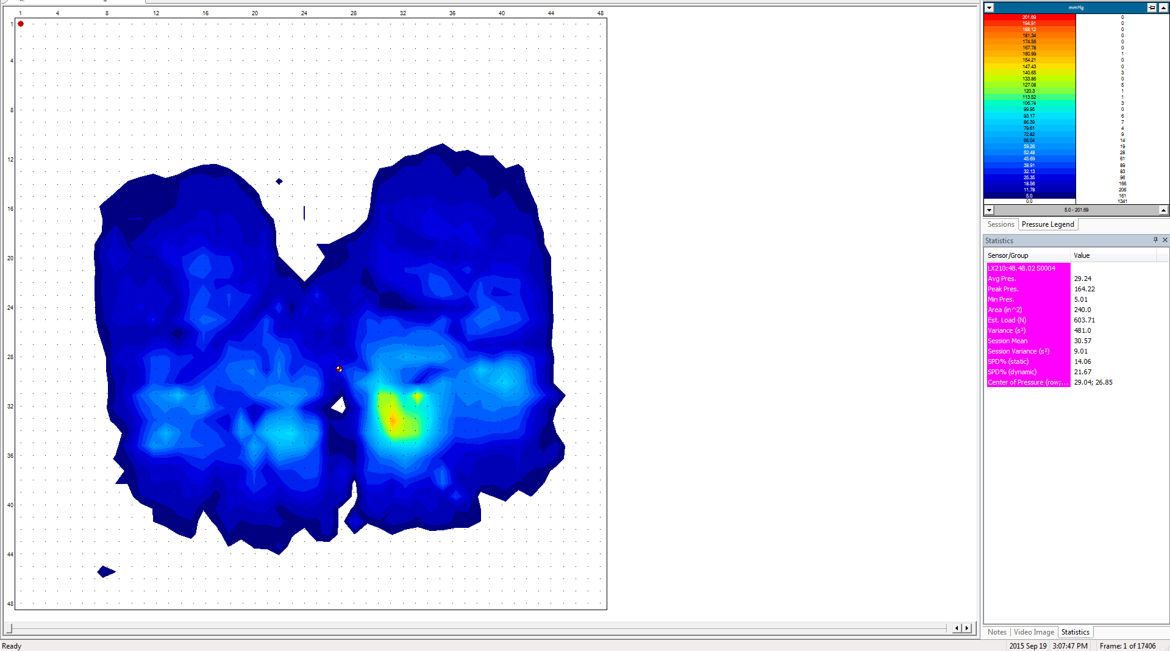
ANTONIO 2 INCH SETTLE (frame 1)
Notes:
Sensor/Group Value
LX210:48.48.02 S0004
Avg Pres. 30.68
Peak Pres. 164.22
Min Pres. 5.32
Area (in^2) 226.5
Est. Load (N) 597.81
Variance (s²) 472.8
Session Mean 32.0
Session Variance (s²) 8.82
SPD% (static) 12.55
SPD% (dynamic) 20.02
Center of Pressure (row;column): 29.04; 26.85

Slide 15
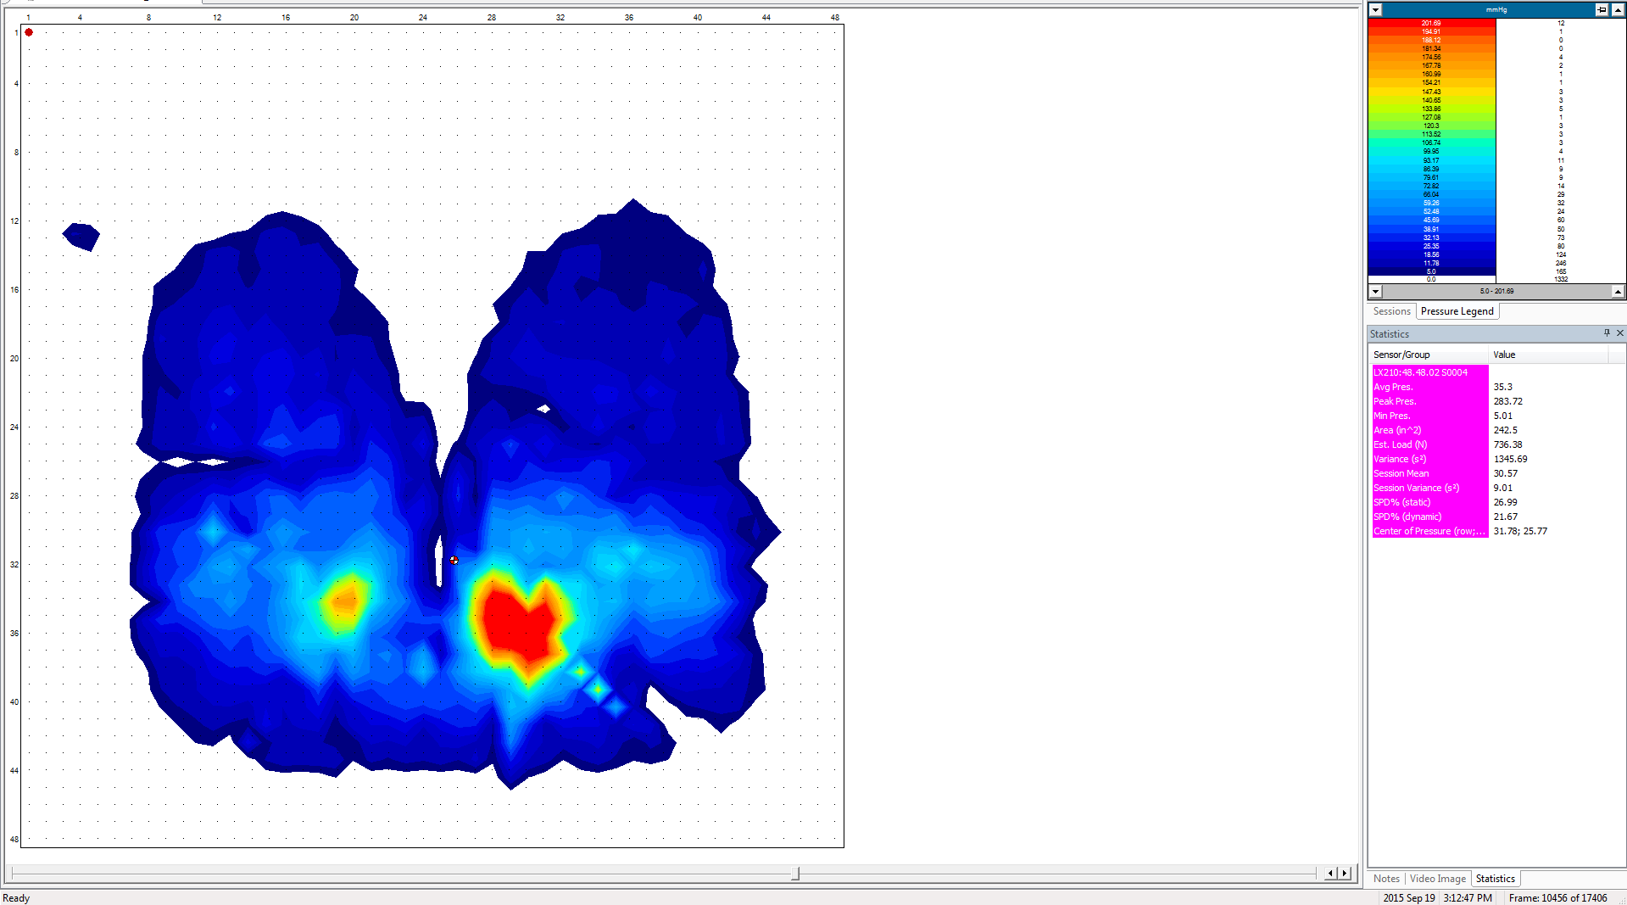
ANTONIO 2 INCH 300 SEC
Notes:
Sensor/Group Value
LX210:48.48.02 S0004
Avg Pres. 34.41
Peak Pres. 254.88
Min Pres. 5.2
Area (in^2) 235.0
Est. Load (N) 695.55
Variance (s²) 1150.79
Session Mean 32.0
Session Variance (s²) 8.82
SPD% (static) 24.3
SPD% (dynamic) 20.02
Center of Pressure (row;column): 31.95; 25.82

Slide 16
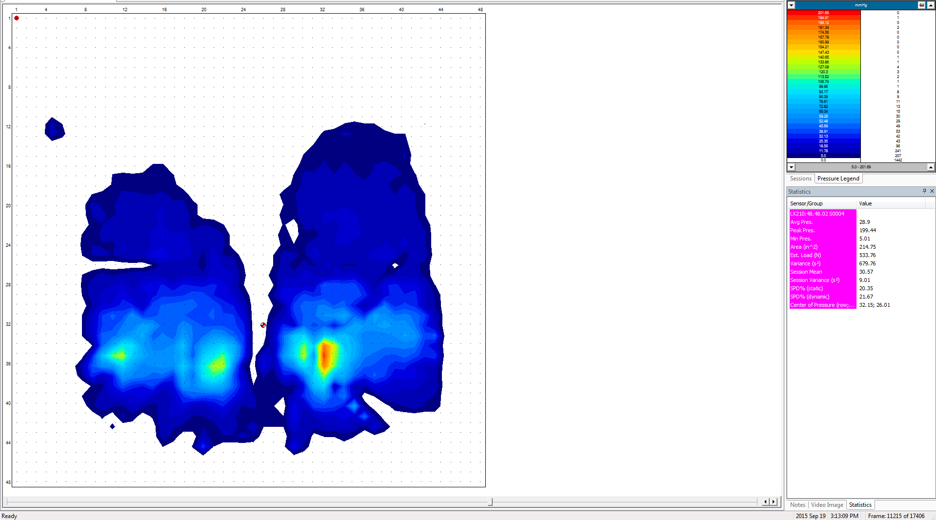
ANTONIO 2 INCH POST PRESSURE RELIEF
Notes:
Sensor/Group Value
LX210:48.48.02 S0004
Avg Pres. 29.01
Peak Pres. 174.7
Min Pres. 5.2
Area (in^2) 205.75
Est. Load (N) 513.37
Variance (s²) 552.93
Session Mean 32.0
Session Variance (s²) 8.82
SPD% (static) 16.43
SPD% (dynamic) 20.02
Center of Pressure (row;column): 31.83; 26.14

Slide 17
Antonio ROHO LOW PROFILE

Slide 18
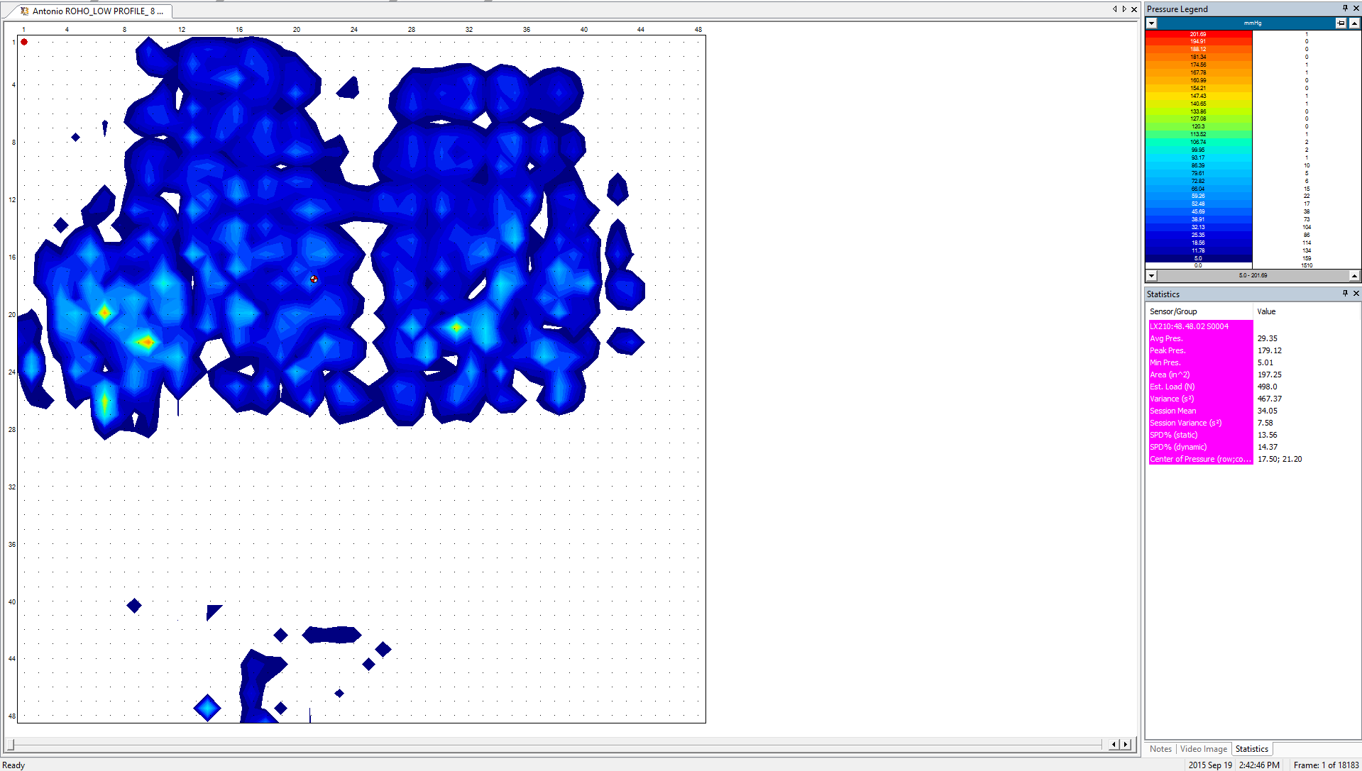
Antonio ROHO_LOW PROFILE SETTLE

Slide 19
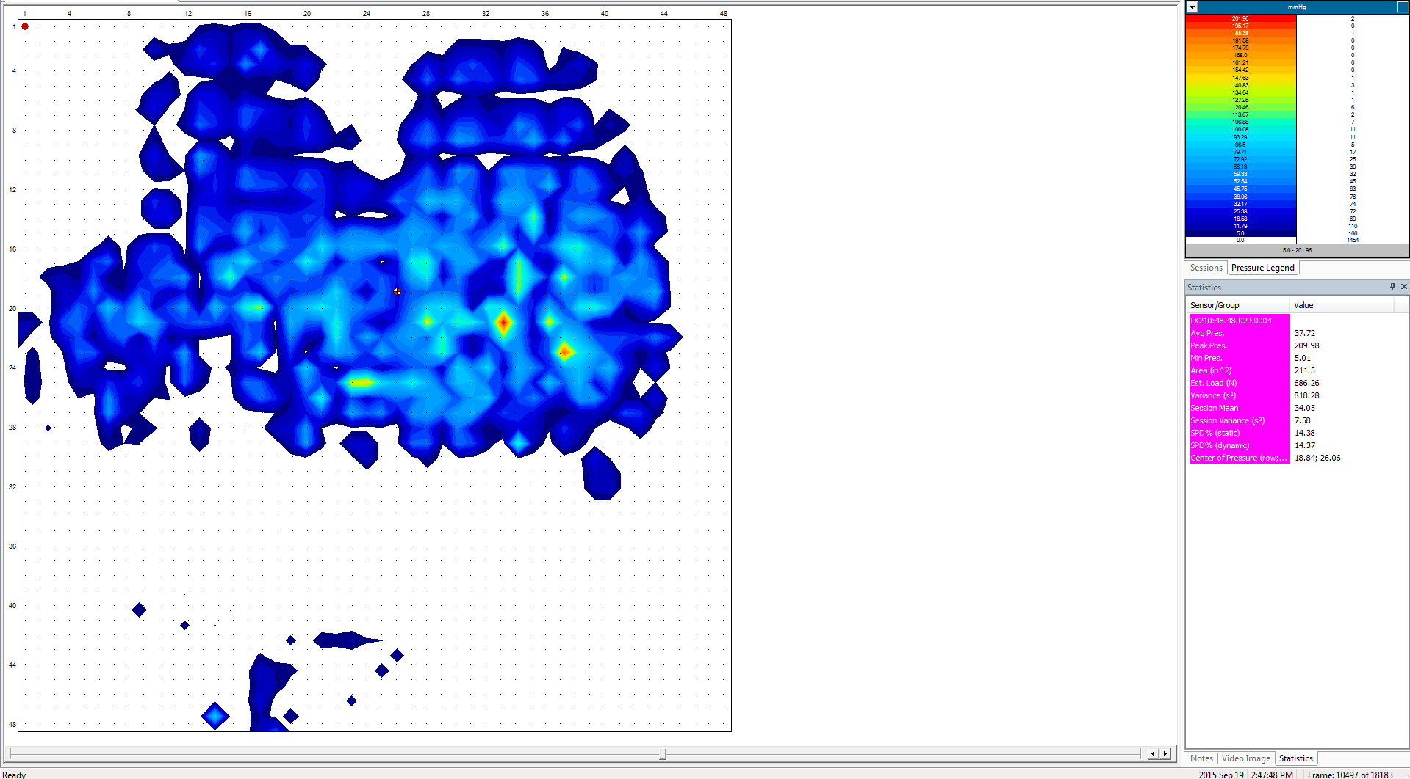
Antonio ROHO_LOW PROFILE 300 SEC

Slide 20
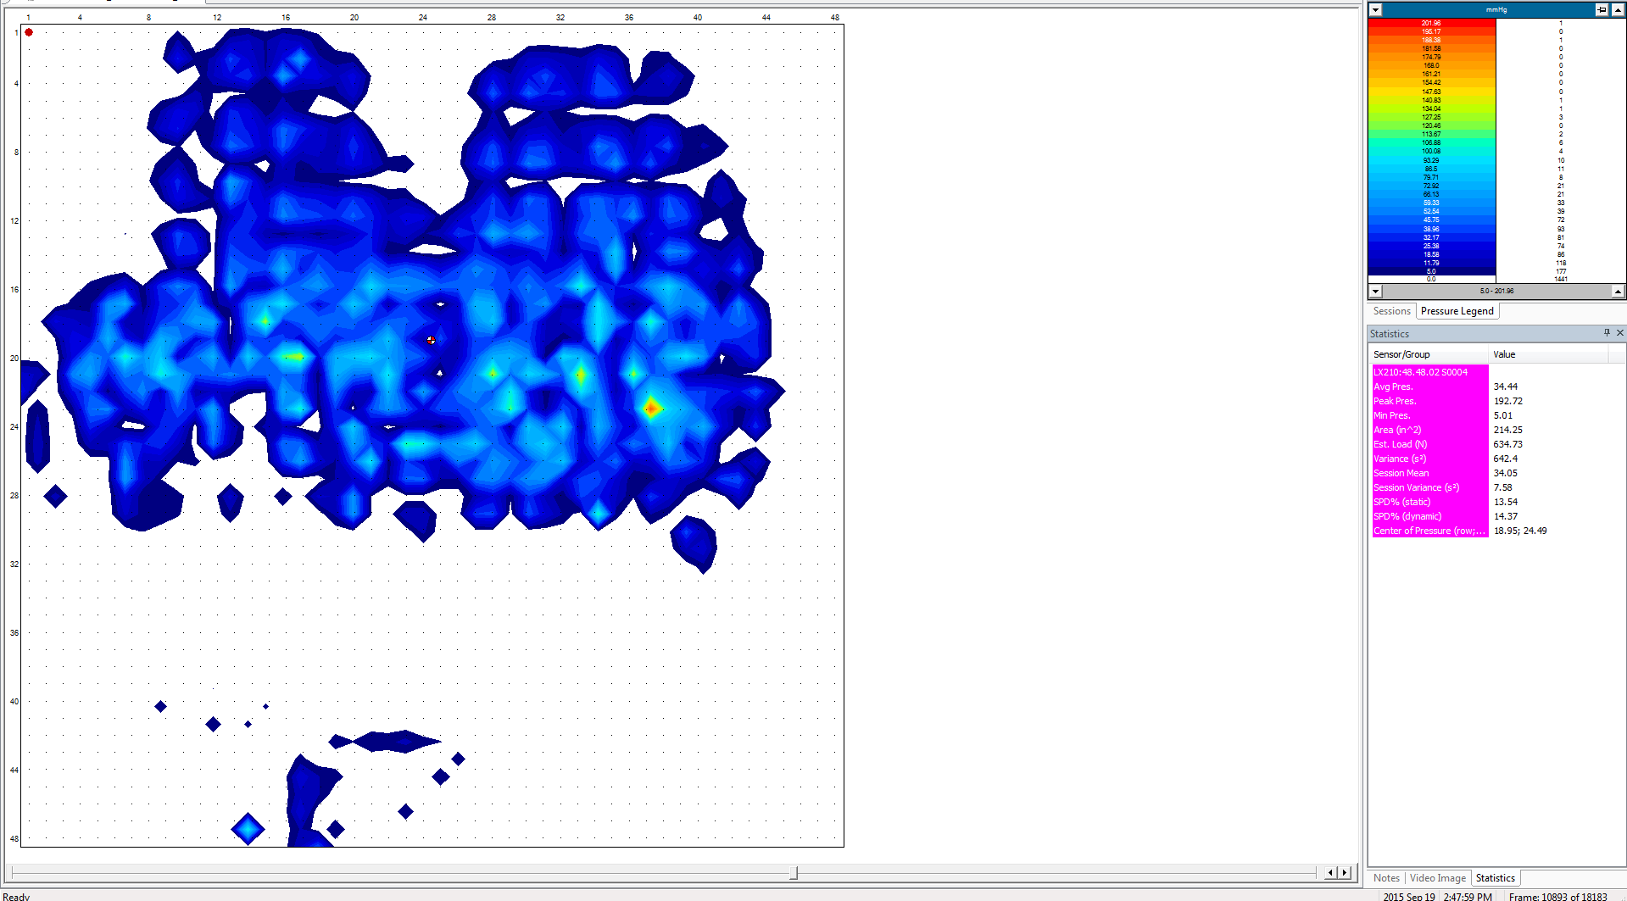
Antonio ROHO_LOW PROFILE POST PRESSURE RELIEF

Slide 21
Antonio ROHO MID PROFILE

Slide 22
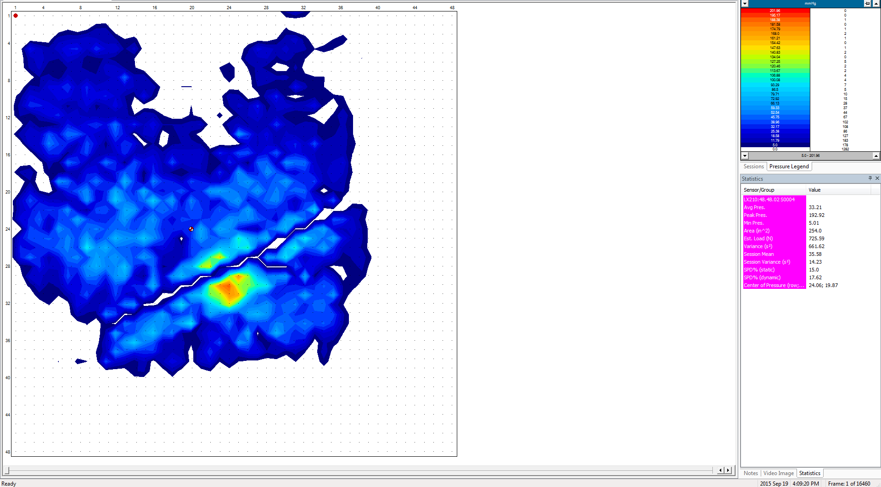
Antonio ROHO_MID PROFILE SETTLE

Slide 23
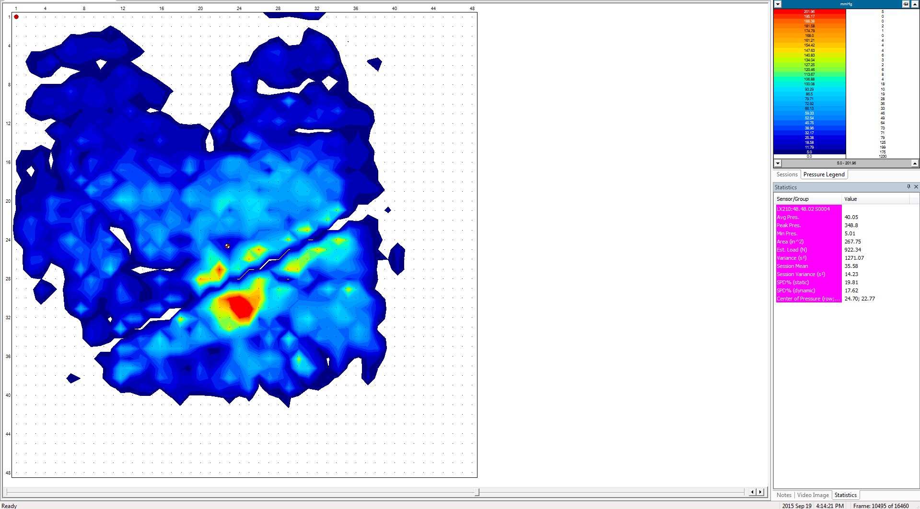
Antonio ROHO_MID PROFILE 300 SEC

Slide 24
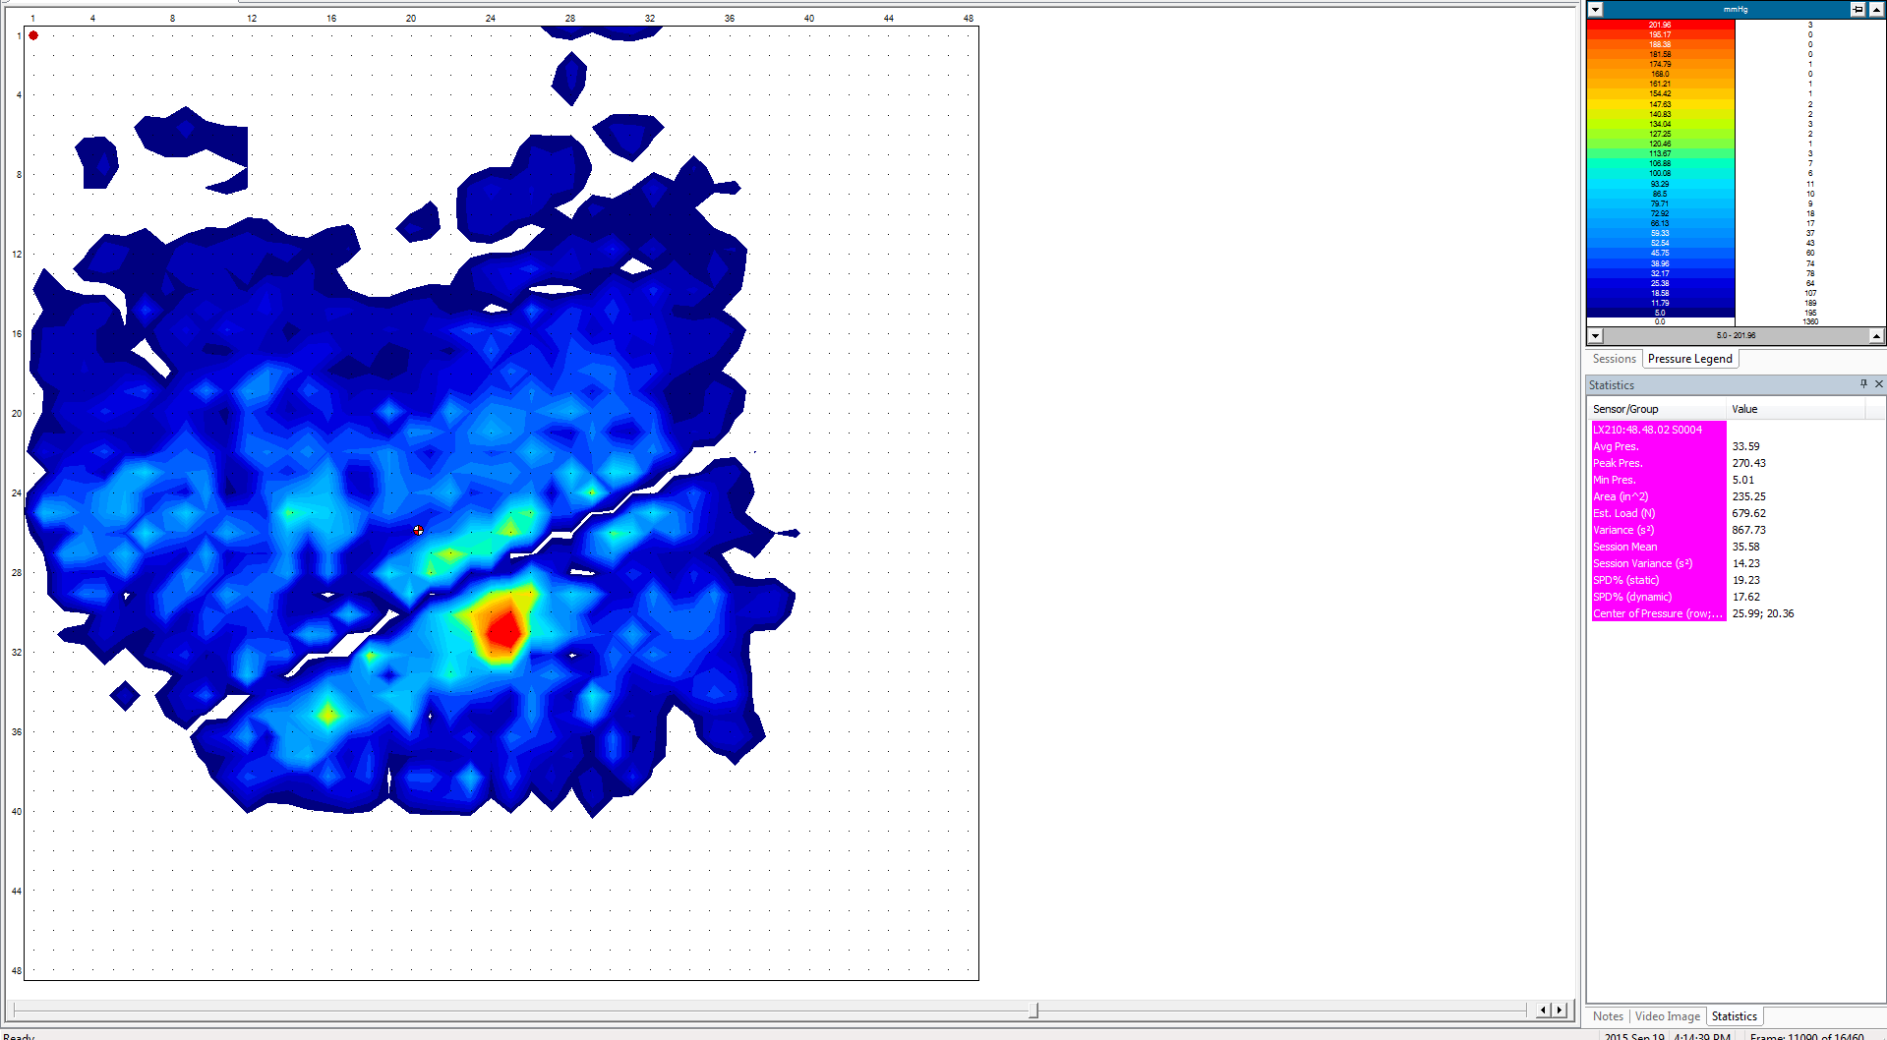
Antonio ROHO_MID PROFILE POST PRESSURE RELIEF

Slide 25
Antonio ROHO HIGH PROFILE

Slide 26
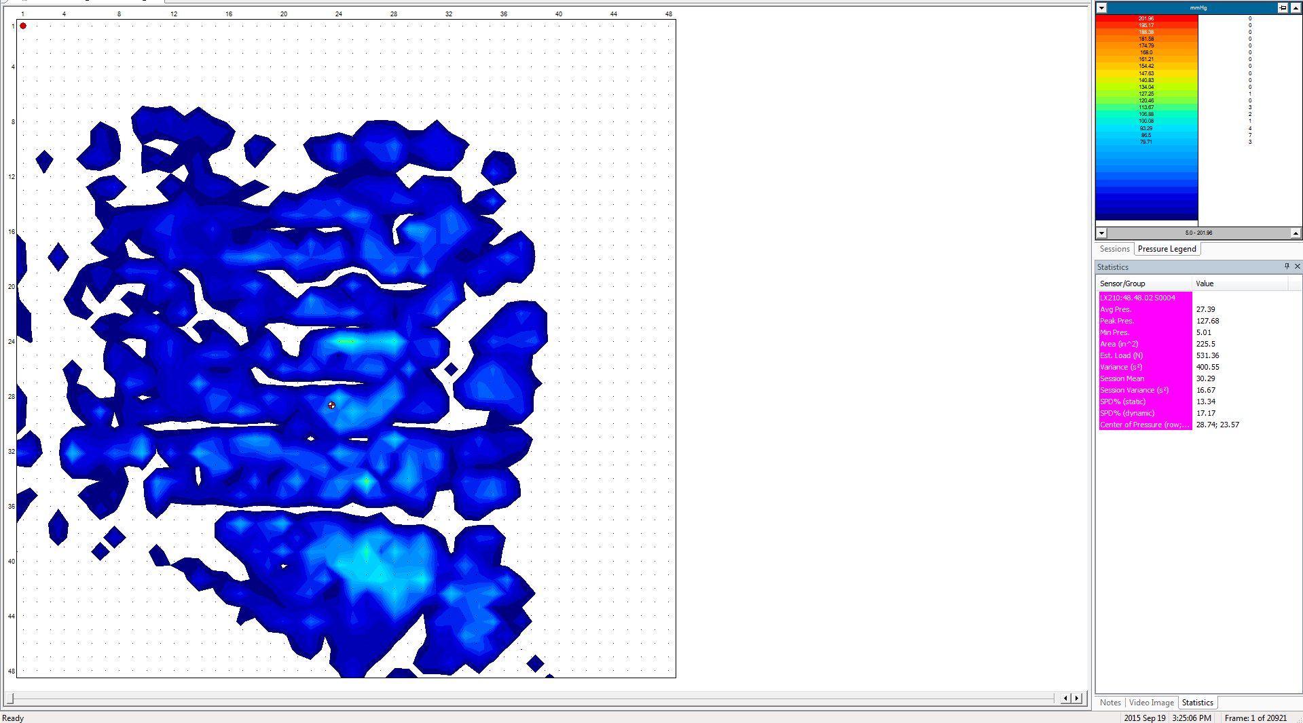
Antonio ROHO_ HIGH PROFILE SETTLE

Slide 27
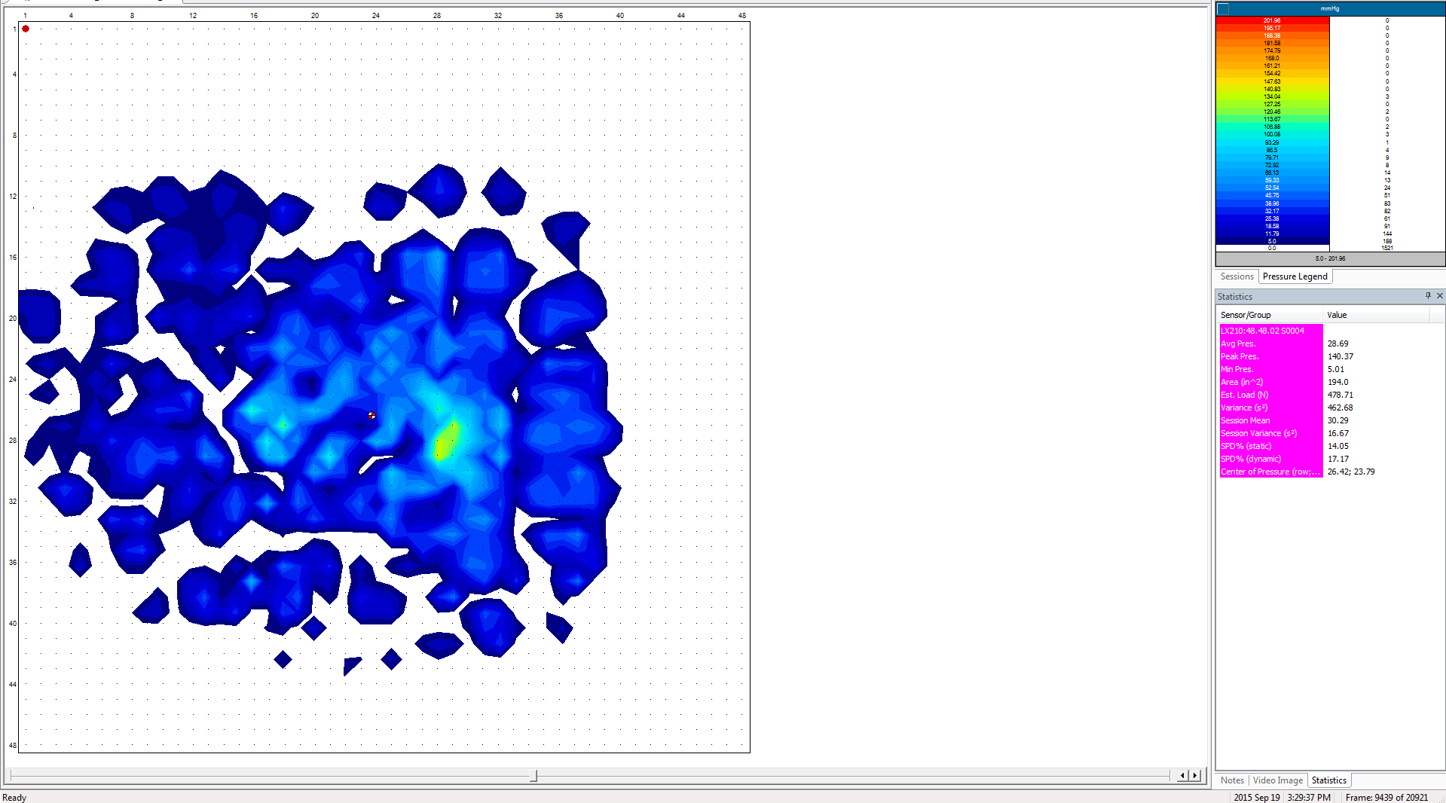
Antonio ROHO_ HIGH PROFILE 270 SEC

Slide 28
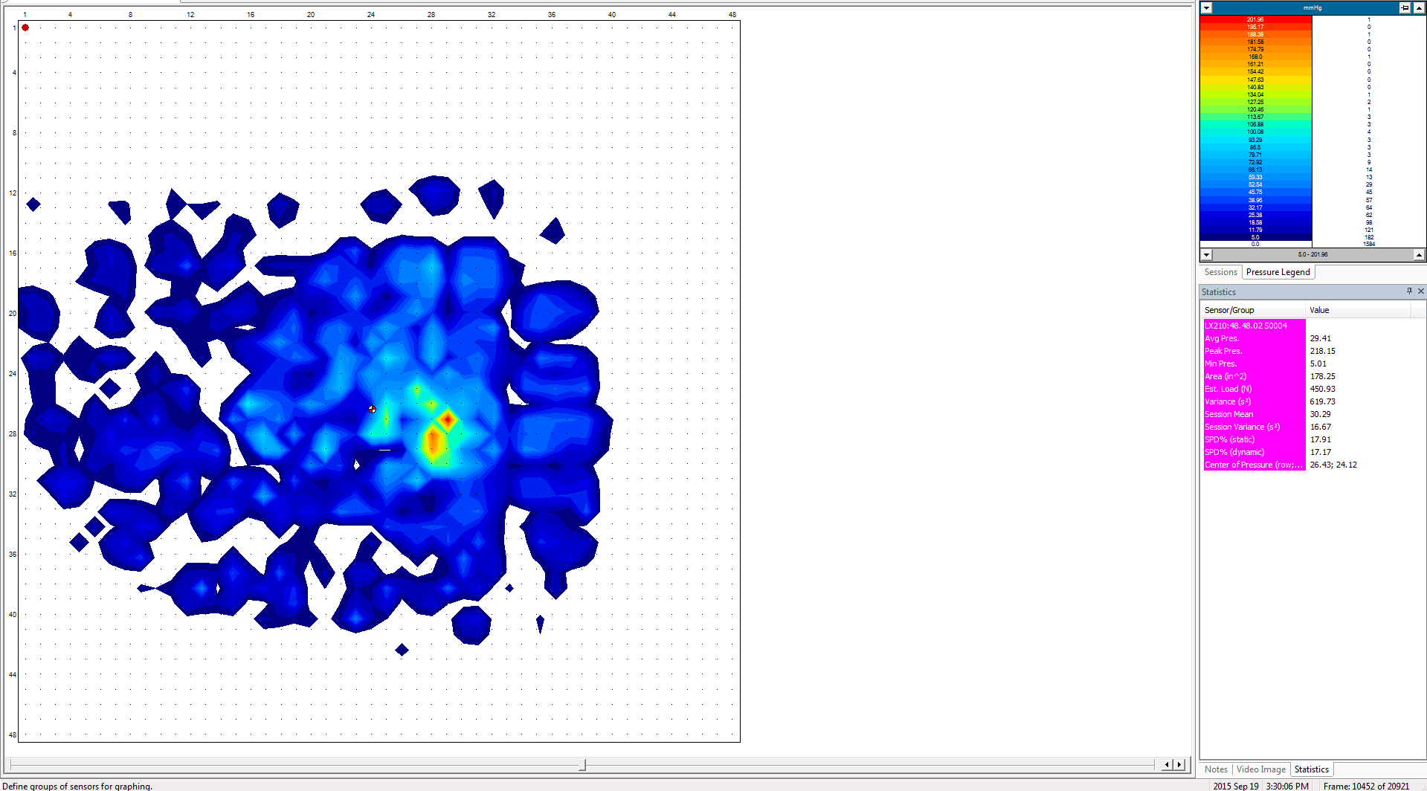
Antonio ROHO_ HIGH PROFILE 300 SEC

