Slide 1
Resources for Veteran Farmers/Ranchers Erin Kimbrough Texas AgrAbility AgrAbility Virtual National Training Workshop Tuesday, February 20, 2017 3:00 p.m. ET

Slide 2
Basic Webinar Instructions
Audio available through computer or phone.
Check sound via Communicate menu at top left
Closed captions: use arrow to expand or contact the Media Viewer window.
Expand/contract any of the windows in the right-hand column with the arrows. May need to do this to see video of presenter.
Expand/contract the size of the right-hand column.

Slide 3
Basic Webinar Instructions
Questions and comments
Click Chat icon at top right of screen (it should turn blue). Enter message in box, choose who to send it to, and click send. You may enter questions about the presentation at any time. In addition, during the Q & A period, if you have a web microphone, click the “Raise Hand” icon to indicate that you have a question. We will enable your microphone or phone connection.

Slide 4
Basic Webinar Instructions
4 quick survey questions + opportunity to share comments
Session recorded and archived with PowerPoint files at www.agrability.org/Online-Training/archived
Problems: use chat window or email jonesp@purdue.edu

Slide 5
AgrAbility: USDA-sponsored program that assists farmers, ranchers, and other agricultural workers with disabilities.
Partners land grant universities with disability services organizations. Currently 20 state projects
National AgrAbility Project: Led by Purdue’s Breaking New Ground Resource Center.
Partners include:
Goodwill of the Finger Lakes
APRIL (Association of Programs for Rural Independent Living
Colorado State University
More information available at www.agrability.org

Slide 6
Resources for Veteran Farmer/Ranchers
The members of Texas A&M AgriLife will provide equal opportunities in programs and activities, education, and employment to all persons regardless of race, color, sex, religion, national origin, age, disability, genetic information, veteran status, sexual orientation or gender identity and will strive to achieve full and equal employment opportunity throughout Texas A&M AgriLife.

Slide 7
Learning Objectives
Identify key resources for Veterans interested in starting/operating agriculture businesses
Understand the goals of the Texas AgrAbility BattleGround to Breaking Ground Entrepreneurial Training Project
Incorporate a diverse set of resources and programs specific for Veteran/Farmer Ranchers

Slide 8
National Farming/Ranching Resources (Veteran Specific)
Farmer Veteran Coalition
Homegrown By Heroes Label
Fellowship Funds
State Chapters
National Center for Appropriate Technology
Armed to Farm
ATTRA
Internships

Slide 9
Other Veteran Specific Resources
www.ebenefits.va.gov/ebenefits/homepage
www.iava.org
www.texvet.org
http://beta.militaryonesource.mil/veteran
https://www.dav.org/
http://www.tvc.state.tx.us/
https://www.uso.org/programs/rp-6
County Service Officers
Notes:
Ebenefits-
Every veteran should have an account on here. It shows where to go for benefits and gives highlights of VA programs.
IAVA
Once signed up on this website, you can request help filing for any benefits you may qualify for.
TexVet
This is Texas’ main site for Veteran resources.
Many other states have similar sites
Beta
This site has quite a few transitional resources for those newly exiting from the military. They can also help with mental health counseling as well.
DAV
This site allows for VA claim representation for those that have service connected disabilities and need them evaluated. They will help you file and see it through to the end.
TVC
Texas Veteran’s Commission. Very helpful in employment, training, and educational resources.
RP/6
A unique transition model facility that in military terms can be coined a “rally point” or civilian “one-stop-shop”. They connect targeted resources for transitioning service members and their families in more efficient, effective, and positive ways.
County Service Officers
Veterans employed by the county to assist other Veterans is finding and applying for services

Slide 10
National Farming/Ranching Resources
USDA Natural Resources Conservation Service
Conservation Planning
Environmental Quality Incentives Program (EQIP)
Conservation Stewardship Program
USDA Farm Service Agency
Direct and Guaranteed Home Ownership Loans
Direct and Guaranteed Operating Loans
Microloans

Slide 11
National Farming/Ranching Resources
USDA Rural Development
Rural Energy For America Program
Value Added Producer Grant
USDA New Farmers
Discovery Tool
USDA Agriculture Marketing Service
Grants https://www.ams.usda.gov/services/grants
Department of Agriculture

Slide 12
National Farming/Ranching Resources
Sustainable Agriculture Education and Research (SARE)
Grants
Education
Farm Credit
Loans
Discounts on Services
Education: https://www.farmcrediteast.com/knowledge-exchange/Webinars
Business Consulting
Grant Writing

Slide 13
National Farming/Ranching Resources
Holistic Management International
Online Courses
Field days
Cornell Small Farms Program
Online Courses
Field Days
National Incubator Farm Training Initiative
Network
Field School
Resources
Farm Answers

Slide 14
BattleGround to Breaking Ground Entrepreneurial Training Project

Slide 15
Long Term Goals
Increase the number of veteran and other new and beginning farmers and ranchers in Texas
Enhance the sustainability of Texas’ veteran and other new and beginning farmers and ranchers

Slide 16
How the project will accomplish these goals
Provide a holistic and relevant educational experience to support farm enterprise education and sustainability through
Face to face and online educational training in farm management and production specific agriculture practices
Individualized educational planning and guidance to support diverse agriculture business interests
Hands-on learning opportunities connected to online course content
Follow-up mentor support.

Slide 17
How the project will accomplish these goals (cont.)
2) Facilitate peer-to-peer learning through a knowledge-to-practice application process utilizing a structured Community of Practice experience
3) Offer an array of veteran transitional and disability support services; (i.e. behavioral health, personal finances, wellness, assistive technology)

Slide 18
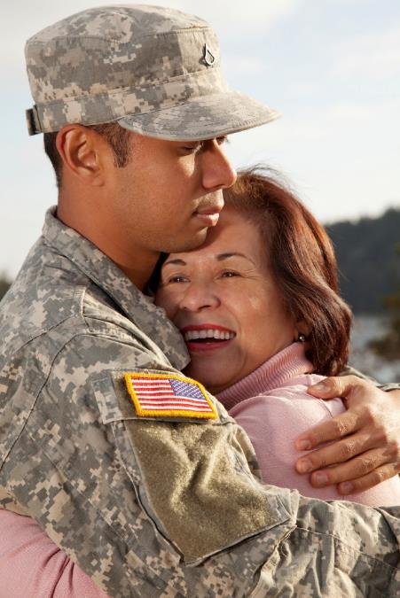
Audience
The primary audience is new and beginning farmers/ranchers in Texas with an emphasis on military veterans. 70% of funds are allocated to serving the military veteran population.

Slide 19
Step One- “Crawl”
Attend Free Ag Workshop
Topics include:
Parts of a business plan
Overview of available resources, services & funding
Brainstorm ideas on how to make money in agriculture
Connect with other veterans

Slide 20
Step 2- “Walk”
Apply to Battleground to Breaking Ground Entrepreneur Training Project
Complete online course training— including but not limited to:
Planning for Profit on Small Scale Farms
Marketing Basics for Small Business
Planning with Budgets

Slide 21
Step 2- “Walk” Continued
Participate in peer-to-peer support network
Explore additional services:
Disability support
Transition services
Financial funding sources
Develop and write a personal business plan

Slide 22
Step 3- “Run”
Complete 100 hours of hands-on training and mentorship
Receive a Certificate of Completion
Provides access to:
Land for lease to start operations
Equipment
Markets

Slide 23
Additional
Field Days
Anticipated Subjects
Hydroponics
Aquaponics
Livestock production
Organic Vegetable Production
Composting

Slide 24
Numbers to Serve
Grant Year | Level 1 Training Introductory Workshops | Level 2 Training (FSA Borrower Education) | Level 3 Training Cohort | Continuing Education (Field Days) | Total Numbers
1 | 100 | 25 |  | 80 | 205
2 | 100 | 50 | 40 | 80 | 270
3 | 100 | 50 | 20 | 80 | 250
Total |  |  |  |  | 725

Slide 25
Key Partners
Farmers Assisting Returning Military-Dallas Area
Incubator Site
Millican Reserve/Millican Alliance-College Station
Incubator Site
Texas Center for Rural Entrepreneurship
Online courses, Community of Practice, Workshops
Vet Advisors
Veteran transitional and disability support services to Veterans

Slide 26
Next Steps
Process Applications
Deadline March 10
Accept First Cohort
Launch Events
April 28, 2017 College Station
June 23, 2017 Dallas

Slide 27
Contact
Erin Kimbrough
Program Coordinator
Phone: (979) 847-6185
empilosi@ag.tamu.edu
B.J. Leggett
Program Assistant
Phone (979)862-1926
Bruce.Leggett@ag.tamu.edu
Rick Peterson
Professor and Extension Specialist
Phone: (979) 845-1877
rlpeterson@ag.tamu.edu
Cheryl Grenwelge
Assistant Professor and Extension Specialist
Phone: (979) 845-3727
chgrenwelge@ag.tamu.edu

