Slide 1
Prostheses: What do farmers and ranchers use; what do they want? - Update with survey results
Craig Heckathorne, MS, Kathryn Waldera, MS, Margaret Parker, MS, Stefania Fatone, PhD, BPO(Hons), and Steven Gard, PhD
Webinar
2014
Notes:
"Prostheses for farmers and ranchers: What is used, what is needed"
This webinar is based on research conducted at the Northwestern University Feinberg School of Medicine Prosthetics-Orthotics Center for Education and Research with contributions by Craig Heckathorne, Kathryn Waldera, Margaret Parker, Stefania Fatone, and Steven Gard and presented by Craig Heckathorne, Project Director.
————————————————————
version 7
————————————————————
Heckathorne and Waldera – primary co-investigators; Waldera was Project Director until January 2012, Heckathorne was Project Director from January 2012 through November 2014
Parker and Fatone – assisted in analysis and interpretation of data
Margaret Parker, Department of Epidemiology and Biostatistics, School of Public Health, University of Illinois at Chicago
Steven Gard – PI on project; approved protocol and all IRB-related actions

Slide 2
Basic Webinar Instructions
Need speakers or headphones to hear the presentation. No phone connection.
Check sound via Meeting > Audio Setup Wizard
Questions about presentation
Type into chat window and hit return.
During the Q & A period, if you have a web cam/ microphone, click the “Raise Hand” icon to indicate that you have a question. We will enable your microphone

Slide 3
Basic Webinar Instructions
4 quick survey questions
Session recorded and archived with PowerPoint files at www.agrability.org/Online-Training/virtualntw along with resource materials
Problems: use chat window or email agrability@agrability.org

Slide 4
Known Webinar Issues
Echo
Check to see if you are logged in twice
Disconnection with presenters
Hang on – we’ll reconnect as soon as possible
Disconnection with participants
Log in again

Slide 5
AgrAbility: USDA-sponsored program that assists farmers, ranchers, and other agricultural workers with disabilities.
Partners land grant universities with disability services organizations. Currently 20 state projects.
National AgrAbility Project: Led by Purdue’s Breaking New Ground Resource Center. Partners include:
Goodwill of the Finger Lakes
The Arthritis Foundation, Heartland Region
University of Illinois at Urbana-Champaign
Colorado State University
More information available at www.agrability.org

Slide 6
Prostheses: What do farmers and ranchers use; what do they want? - Update with survey results
Craig Heckathorne, MS, Kathryn Waldera, MS, Margaret Parker, MS, Stefania Fatone, PhD, BPO(Hons), and Steven Gard, PhD
Webinar
2014
Notes:
"Prostheses for farmers and ranchers: What is used, what is needed"
This webinar is based on research conducted at the Northwestern University Feinberg School of Medicine Prosthetics-Orthotics Center for Education and Research with contributions by Craig Heckathorne, Kathryn Waldera, Margaret Parker, Stefania Fatone, and Steven Gard and presented by Craig Heckathorne, Project Director.
————————————————————
version 7
————————————————————
Heckathorne and Waldera – primary co-investigators; Waldera was Project Director until January 2012, Heckathorne was Project Director from January 2012 through November 2014
Parker and Fatone – assisted in analysis and interpretation of data
Margaret Parker, Department of Epidemiology and Biostatistics, School of Public Health, University of Illinois at Chicago
Steven Gard – PI on project; approved protocol and all IRB-related actions

Slide 7
Project Background
Bureau of Labor Statistics
In 2012 in the USA, farming and ranching together had the
9th highest fatality rate (21.3 per 100,000 FTE workers)
2nd highest number of fatalities (216)
National Safety Council
Among agricultural workers “one out of every ten… will suffer an amputation while on the job” (Kircher, 2003)
5 to 6 % will be major amputations (Brown, 2003)
about 1 in 200 agricultural workers
Notes:
In 2012, the Bureau of Labor Statistics of the U.S. Dept. of Labor ranked farming and ranching together as having the 9th highest fatality rate with the 2nd highest number of fatalities among occupations of the U.S. workforce.
Occupations with a high rate of fatal injuries can be expected to also have a high incidence of non-fatal injuries, and that is indeed the case in farming and ranching.
Some of these injuries result in amputation. According to data from the National Safety Council, one out of every ten agricultural workers will experience a work-related amputation. Most of these amputations involve parts of the fingers, especially the finger tips. However, 5 to 6 % of these are major amputations resulting in complete loss of the hand or foot and, possibly, additional parts of the arm or leg.
In other words, about 1 in 200 agricultural workers will have a major limb amputation.
————————————————————
Bureau of Labor Statistics (2012). National Census of Fatal Occupational Injuries in 2011 (Preliminary Results). USDL-12-1888. News Release, September 20, 2012.
Kircher, R. (2003). Farming with an arm amputation. Oklahoma AgrAbility Newsletter, 2(2), 1-8.
Brown, J. (2003). Amputations: A Continuing Workplace Hazard. http://www.bls.gov/opub/cwc/sh20030114ar01p1.htm. Access Date: 03/21/12.

Slide 8
Project Background
National Institute on Disability and Rehabilitation Research (NIDRR)
Identified farmers with disabilities as an underserved population with regard to assistive technology (Office of Special Education and Rehabilitative Services, 2008)
Many disabled farmers and ranchers are geographically isolated, working in remote settings far away from amputee clinics and prosthetics services.
Notes:
In addition to the relatively high incidence of amputations among agricultural workers, the National Institute on Disability and Rehabilitation Research, in 2008, identified farmers with disabilities as an underserved population with regard to assistive technology, including prosthetic devices.
This situation arises, in part, because disabled farmers and ranchers generally live and work in settings remote from amputee clinics and prosthetics facilities, services that tend to be concentrated in urban and semi-urban environments.
————————————————————
Office of Special Education and Rehabilitative Services (2008). National Institute on Disability and Rehabilitation Research—Disability and Rehabilitation Research Projects and Centers Program—Disability Rehabilitation Research Projects (DRRPs), Rehabilitation Research and Training Centers (RRTCs), and Rehabilitation Engineering Research Centers (RERCs). Federal Register, 73(22), 6132–6146.

Slide 9
Project Background
Environmental and work factors
Exposure to adverse weather and wide temperature range across seasons
cannot choose when and in what conditions you want to work
Exposure to corrosive or damaging liquids
Exposure to airborne particulates
Exposure to biological and chemical contaminants
Factors affect
Durability of prosthesis
Maintenance of health of the limb within the socket
Consequent ability to do work
Notes:
The work environment of farmers and ranchers imposes a number of potentially harmful factors about which most people who use prostheses generally do not need to be concerned. Such factors include:
• exposure to adverse weather and wide ranges of temperature across seasons — because fields and animals need routine and timely tending, farmers and ranchers often cannot choose when and in what conditions they work
• exposure to corrosive or damaging liquids — used in the maintenance of their machinery and equipment
• exposure to airborne particulates from fields
• exposure to biological and chemical contaminants from animals and chemicals used in maintaining crops and pastures
These factors can have a significant effect on the durability of prosthetic components and the health of the residual limb within the socket. Problems with components or limb health will consequently affect the ability to do necessary work.

Slide 10
Project Goals
Determine what prosthetic components farmers, ranchers, and other agricultural workers are using
Determine what work activities are helped or hindered by the use of a prosthesis
Identify problems experienced with prosthetic components
Prioritize problems as a guide for further research and development
Notes:
With the ultimate goal of increasing the ability of farmers and ranchers with amputations to do their work by improving the prosthetic options available to them, we set out to:
• determine what types of prosthetic components are currently used by farmers, ranchers, and other agricultural workers,
• to determine what work is helped or hindered by the use of a prosthesis,
• to identify specific problems occurring with prosthetic components,
• and, then, to prioritize problems as a guide for further research and development.

Slide 11
Collaboration
National AgrAbility Project
Funded by the U.S. Department of Agriculture
Breaking New Ground Resource Center, Purdue University, West Lafayette, Indiana
Provides services to farmers and ranchers with disabilities, including technical assistance, information dissemination and professional training to consumers and professionals
Notes:
To facilitate access to farmers and ranchers with amputations, we established a collaboration with the National AgrAbility Project. This project, funded by the U.S. Department of Agriculture, provides services to farmers and ranchers with disabilities, including technical assistance, information dissemination, and professional training. The National AgrAbility Project coordinates with over two dozen State, Regional, and Affiliate Projects across the U.S.
————————————————————
National AgrAbility Project
http://agrability.org/index.cfm
28 State, Regional, and Affiliate Projects – August 2014
http://agrability.org/Contact-lists/projectscontact.cfm

Slide 12
Methods
Part 1 – Phone and in-person interviews
Identify range of problems to explore through Survey
Part 2 - Survey
Detail types of components being used
Identify relative importance of problems related to the components of a prosthesis
Identify relative importance of problems related to the function of prostheses in work activities
Notes:
Our project was divided into two parts. The first part involved a series of phone and in-person interviews to identify the range of problems to be explored through a generally available survey.
The second part, the survey itself, was intended to: • detail the type of prosthetic components in use by agricultural workers, • identify the relative importance of different problems with components, • and identify the relative importance of different problems with the function of prostheses while doing the work of farming or ranching.

Slide 13
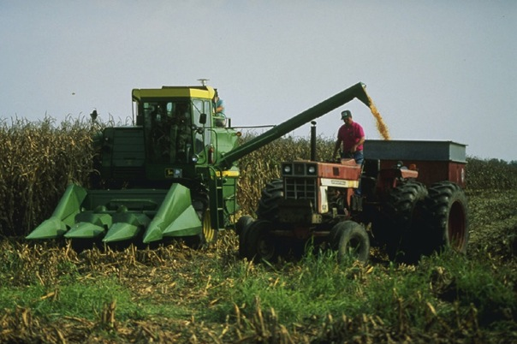
Methods and Participants
Phone and in-person interviews
November 2008 through March 2011
Respondents
40 farmers
goal: 50 farmers and ranchers
26 prosthetists who serve farmers and ranchers in their practice
goal: 25 prosthetists
USDA/Bruce Fritz
Notes:
The phone and in-person interviews were conducted from November 2008 through March 2011. We interviewed 40 farmers, most of whom we contacted with the assistance of one of the AgrAbility Projects. We also interviewed 26 prosthetists who serve farmers and ranchers in their clinical practice. These were prosthetists whom we knew to be working with farmers and ranchers, or referrals from farmers or prosthetists whom we had already interviewed. Although we had a goal of interviewing 50 farmers and ranchers, we ended the interview phase at 40 farmers in order to have time for the survey phase.
————————————————————
photo: http://www.ars.usda.gov/is/graphics/photos/k4912-11.htm — public domain image of U.S. federal government agency

Slide 14
Interview Analysis
Common Themes
Durability
type of failure (catastrophic vs. gradual) and frequency of failure
Cost
direct (out-of-pocket expenses) and indirect (reduced productivity)
Environment
ability to carry out farm and ranch tasks under existing conditions
Adaptation
attitude, routine, modifications to farm machinery
assistive technology: prosthesis and other equipment
Education
knowledge and experience of prosthetist
information and training provided to farmer or rancher
Notes:
Five prominent themes were identified in the texts of the interviews: • Durability of the prosthetic device including the type of failure and frequency of failure; • Cost associated with the prosthesis; both direct and indirect; • The Environment and its influence on the ability to carry out farm and ranch tasks with an amputation and with or without prostheses; • Adaptation to the changed situation following amputation, including attitudes, routines, modifications and assistive technology; • and Education; both the knowledge and experience of the prosthetist and the information and training provided to the farmer or rancher.

Slide 15
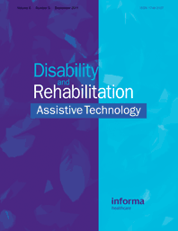
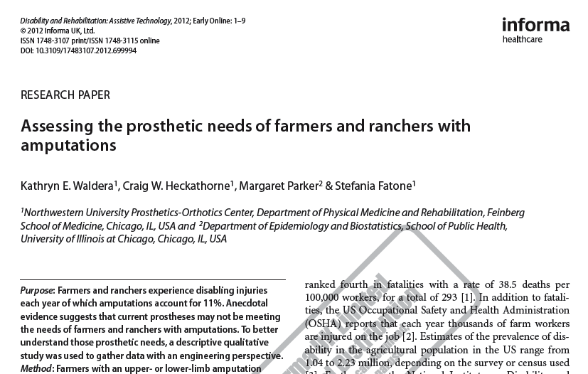
Interview Analysis
Publication
Notes:
Details of the interview analysis and of the identified themes can be found in this publication of our work in the May 2013 issue of Disability and Rehabilitation: Assistive Technology.
————————————————————
Waldera, K., Heckathorne, C., Parker, M., Fatone, S (2013). Assessing the prosthetic needs of farmers and ranchers with amputations. Disability and Rehabilitation: Assistive Technology, 8(3), 204-212.

Slide 16
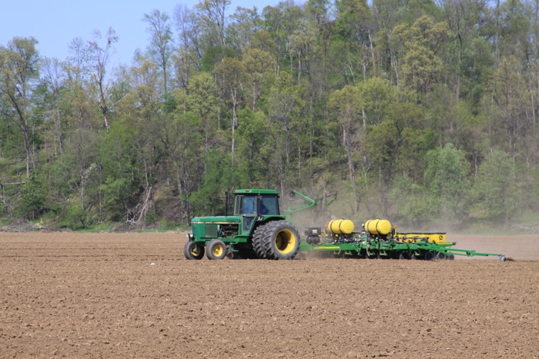
Methods and Participants
Survey
February 2013 through March 2014
Respondents
20 farmers
7 ranchers
1 other agricultural worker
Notes:
The themes identified through our interviews formed the basis of a detailed, generally-available survey conducted from February 2013 through March 2014. During that time, we had 28 valid respondents: 20 farmers; 7 ranchers; and 1 agricultural worker.
————————————————————
photo: http://www.morguefile.com/archive/display/717548 — does not require attribution

Slide 17
Survey
Online and paper format
Detail types of components being used
Identify relative importance of different problems with components of prosthesis
Identify relative importance of different problems with the function of prostheses in work activities
Increase representation of:
types and levels of amputation
types of agricultural work
ranchers
geographic regions
Notes:
The survey, which was available online and in paper format, was intended: • to obtain details as to the types of prosthetic components being used; • to identify the relative importance of problems with components; • to identify the relative importance of problems with the function of prostheses during work activities; • and to increase the representation of different types and levels of amputation; different types of agricultural work (in particular, recruitment of ranchers, who were represented in the interviews only through the prosthetists whom we interviewed), and expand the range of geographic regions.

Slide 18
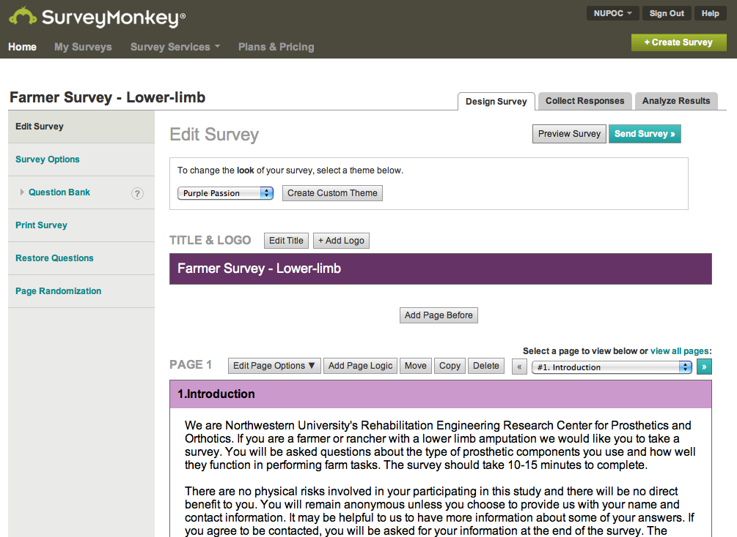
Survey
Notes:
The Survey was developed using the popular surveying application SurveyMonkey. The online version of the Survey dynamically formatted the questions in response to the participant's answers. The print Surveys were tailored to the particular type of amputation which the respondent identified as having. Sixteen different print Surveys (eight upper-limb and eight lower-limb) were available.
————————————————————
https://www.surveymonkey.com/

Slide 19
Survey
Notes:
To help respondents identify the type of prosthetic components they had, pictures were provided with the survey questions. These are some of the images used in the upper-limb Survey.
————————————————————
all photos: copyright Northwestern University Prosthetics-Orthotics Center

Slide 20
Survey
Notes:
And these are some of the images used in the lower-limb Survey.
————————————————————
all photos: copyright Northwestern University Prosthetics-Orthotics Center

Slide 21
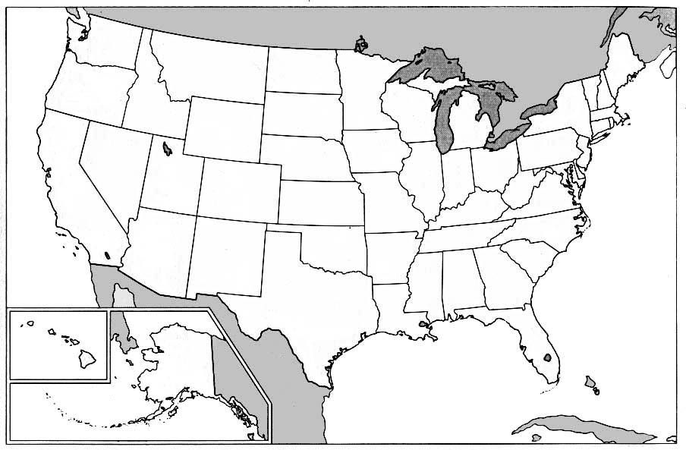
Participants (Interviews + Survey)
Upper-limb Lower-limb
1
2
2
1
1
1
1
4
1
² ₁
1 ₂
1
1
5
7
10
5
2
1
1
1
1
2
1
2
1
1
1
1
1
2
1
Notes:
This map shows the distribution of all agricultural workers who participated in the interviews and survey. Light green shows the number with upper-limb amputations and dark red, the number with lower-limb amputations. Most respondents are concentrated in the central region of the country. Of the 27 states with no representation in the interviews or the survey, only 48% have AgrAbility-related Projects. Of the 23 states with interview or survey participants, 74% have AgrAbility-related Projects.

Slide 22
Participants (Interviews + Survey)
Upper-limb
3 2 Partial hand (PH)
2 2 Wrist disarticulation (WD)
11 11 Below elbow (BE)
5 3 Above elbow (AE)
3 0 Shoulder disarticulation (SD)
1 0 Interscapulothoracic (IST)
3 3 Bilateral BE
1 1 BE / AE
2 1 Bilateral AE
31 participants with
upper-limb amputation
23 use prostheses
Prosthesis use:
PH, WD, BE 95%
AE, SD, IST 36%
Prosthesis users
Notes:
Thirty-one agricultural workers with upper-limb amputations participated in the interviews and Survey. The column of black numbers at the left is a breakdown of the different levels of amputation for all of the thirty-one (with transradial being the most common level). The column of blue numbers represents those who use prostheses in their work. Of the thirty-one participants, 23 use prostheses. Among workers with amputations distal to the elbow, 95% use prostheses. Of those with amputations proximal to the elbow, 36% use prostheses.

Slide 23
Participants (Interviews + Survey)
Lower-limb
23 23 Below knee (BK)
1 1 Knee disarticulation (KD)
12 12 Above knee (AK)
1 1 BK / AK
37 participants with
lower-limb amputation
37 use prostheses
Prosthesis use:
100 %
Prosthesis users
Notes:
Thirty-seven of the interviewed and surveyed agricultural workers had lower-limb amputations, and here is the breakdown of their levels of amputation and use of prostheses. Note that all (100%) of the participants with lower-limb amputations used prostheses in their work, including 13 persons with transfemoral level amputations.

Slide 24
Survey Participants
Survey available from February 2013 through March 2014
56 respondents
55 on-line
28 responses excluded
not agricultural worker
multiple counts of same person who exited and re-entered survey, eventually completing it
not in U.S.A
insufficient information or inconsistent answers with no contact information for verification
1 paper (unsolicited)
5 paper surveys requested; none returned
28 responses included for analysis
14 with upper-limb amputations
14 with lower-limb amputations
Notes:
Looking at just the Survey participants, we had 56 responses with 28 considered to be credible respondents. Of those 28, twenty-seven completed the Survey on-line and one submitted a paper survey. The twenty-eight on-line responses that were excluded were persons who were not agricultural workers; were multiple counts of the same person (meaning that the person entered the survey and exited but eventually returned and completed the Survey); persons who were not residents of the U.S., and persons who provided insufficient information or inconsistent or contradictory answers with no contact information to determine accuracy. Of the twenty-eight accepted responses, there were fourteen with upper-limb amputations and fourteen with lower-limb amputations.

Slide 25
Survey Participants
Characteristics
Occupation
20 farmers
7 ranchers
1 agricultural worker
Work status
10 full-time
16 part-time
2 retired
Gender
25 male
3 female
all with upper-limb amputation
Notes:
Of the twenty-eight, twenty identified themselves as farmers, seven as ranchers, and one as an agricultural worker. Ten were full-time in their occupation, sixteen were part-time and 2 had retired. Part-time employment is common among farmers and ranchers in general, as noted in the 2012 Census of Agriculture conducted by the National Agricultural Statistics Service. Twenty-five of the respondents were male. The three female respondents all had upper-limb amputations.
————————————————————
National Agricultural Statistics Service (2014). 2012 Census of Agriculture. USDA-AC-12-1-51.

Slide 26
Survey Participants
Characteristics
Occupation
20 farmers
7 ranchers
1 agricultural worker
Work status
10 full-time
16 part-time
2 retired
Gender
25 male
3 female
all with upper-limb amputation
75%
Notes:
Looking at the age ranges of respondents, seventy-five percent were below the age of 64 at the time they completed the Survey, with the highest number of respondents in the age range of 45 to 54 years.

Slide 27
Survey Participants
Type of agriculture
Notes:
This graph shows the type of agricultural work of the Survey participants. The category of "other" included small-scale greenhouse and gardening, equipment service manager, and agricultural researcher.

Slide 28
Survey Participants
Type of agriculture
57% selected multiple types of agriculture [16 of 28]
-- cash crop plus beef cattle most common [N=5]
86% handle livestock in their work [24 of 28]
Notes:
The latter two and fourteen other respondents or 57% of the twenty-eight total selected multiple types of agricultural enterprises with the combination of cash crop and beef cattle being the most common. Twenty-four, or 86%, of the respondents handled some type of livestock in their work.

Slide 29
Survey Participants
Cause of amputation
46%
25%
18%
7%
4%
Notes:
With respect to the cause of amputation, 46% had amputations caused by farm or ranch related machinery. These included over half of all upper-limb amputations and over one-third of all lower-limb amputations. The category of “Other” includes accidents not on the farm or ranch (generally at another place of employment), one fall from a height, and one person with congenital transverse limb difference. Fourteen percent of upper-limb amputations and 21% of lower-limb amputations were caused by motor vehicle accidents (MVAs) not related to the farm or ranch.

Slide 30
Survey Participants
Cause of amputation
46%
4 auger
2 power take-off
2 hay baler
2 corn picker
1 hay grinder
1 combine
1 farm MVA
25%
18%
7%
4%
Notes:
Farm machinery that caused amputation included augers, power take-offs, hay balers, corn pickers, a hay grinder, a combine, and one farm equipment motor vehicle accident (MVA).

Slide 31
Survey Participants
Years since amputation
Notes:
Looking at the number of years since the amputation,

Slide 32
Survey Participants
Years since amputation
54%
Notes:
Fifty-four percent of respondents had their amputation fifteen or fewer years when completing the Survey. Those who had had their amputations more than fifteen years included half of the respondents with upper-limb amputations and 43% of those with lower-limb amputations.

Slide 33
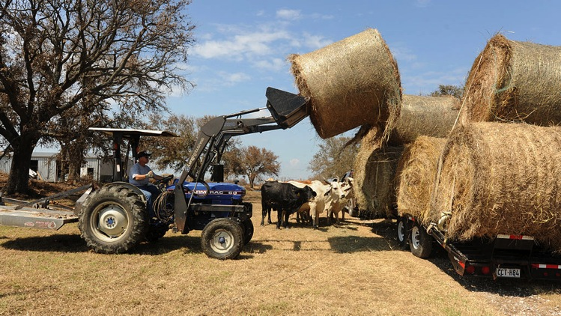
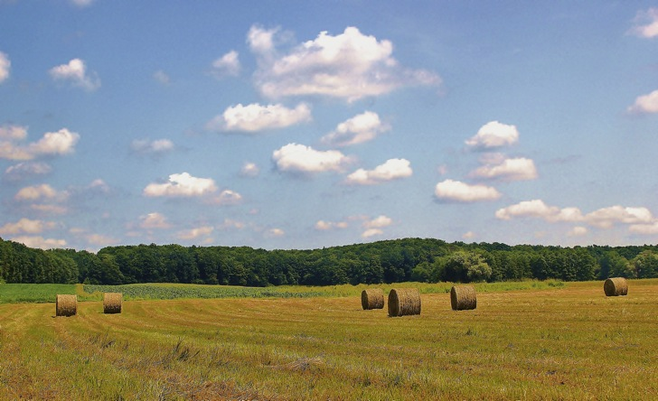
Survey – Analysis
Upper-Limb
FEMA/Jocelyn Augustino
Notes:
I would like to now look in detail, separately, at the responses from those with upper-limb amputations and those with lower-limb amputations, beginning with upper-limb.
————————————————————
photos:
left: http://www.morguefile.com/archive/display/861161 — does not require attribution
right: http://commons.wikimedia.org/wiki/File:FEMA_-_38644_-_Cattle_displaced_by_Hurricane_Ike_get_fresh_hay.jpg — public domain image of U.S. federal government agency

Slide 34
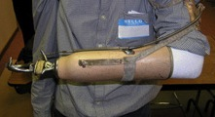
Design Factors – Upper-Limb
Components
11 farmers and ranchers
8 used body-powered prostheses as their primary work prosthesis
1 wrist disarticulation (WD)
2 below elbow (BE)
2 above elbow (AE)
1 bilateral BE (bilateral prostheses)
1 BE / AE (bilateral prostheses)
1 bilateral AE (unilateral prosthesis)
Below elbow prosthesis
Notes:
The fourteen Survey respondents with upper-limb amputations included eleven farmers and ranchers who used prostheses in their work. Of these, eight used body-powered prostheses as their primary work prosthesis and here is the breakdown of their amputation levels. Note that of the three with bilateral amputations, the individual with bilateral transhumeral amputations used a single transhumeral prosthesis. The other two with bilateral amputations used bilateral prostheses.
————————————————————
photo: copyright Northwestern University Prosthetics-Orthotics Center

Slide 35
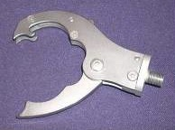
Design Factors – Upper-Limb
Components
10 body-powered prostheses
4 prostheses used with multiple prehension devices
Prehension or terminal device
7 Dorrance #7 Hook
5 Dorrance #5 Hook or similar
1 each for:
other type of split hook
TRS GRIP
assorted tools
Dorrance
#7 Hook
Dorrance
#5 Hook
TRS GRIP
Notes:
Of the ten body-powered prostheses used by the eight farmers and ranchers, four prostheses were used with multiple types of prehension devices. The most common prehension device was the Dorrance #7 Hook, sometimes referred to as the Farmer's or Carpenter's Hook. The next most common device was the Dorrance #5 Hook.
————————————————————
all photos: copyright Northwestern University Prosthetics-Orthotics Center

Slide 36
Design Factors – Upper-Limb
Components
10 body-powered prostheses (continued)
Wrist rotation units
5 friction
5 locking with quick disconnect feature for multiple terminal devices
3 used for quick disconnect feature
Wrist flexion
5 units
1 above elbow
1 bilateral below elbow (only 1 used)
1 below elbow / above elbow (2 used)
1 bilateral above elbow(1 used with unilateral prosthesis)
Elbows (4 above elbow prostheses)
4 mechanical
Notes:
Wrist rotation units included five friction wrists and five locking wrists with a quick disconnect feature. Five prostheses were equipped with wrist flexion units, primarily for those with bilateral arm amputations. All of the elbows used in the four transhumeral prostheses were mechanical, cable-actuated elbows.

Slide 37
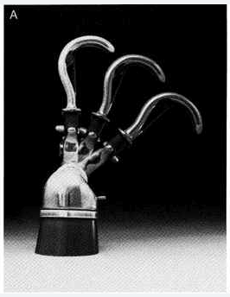
Design Factors – Upper-Limb
Components
10 body-powered prostheses (continued)
Wrist rotation units
5 friction
5 locking with quick disconnect feature for multiple terminal devices
3 used for quick disconnect feature
Wrist flexion
5 units
1 above elbow
1 bilateral below elbow (only 1 used)
1 below elbow / above elbow (2 used)
1 bilateral above elbow(1 used with unilateral prosthesis)
Elbows (4 above elbow prostheses)
4 mechanical
Wrist flexion unit, showing multiple positions
Notes:
Wrist rotation units included five friction wrists and five locking wrists with a quick disconnect feature. Five prostheses were equipped with wrist flexion units, primarily for those with bilateral arm amputations. All of the elbows used in the four transhumeral prostheses were mechanical, cable-actuated elbows.

Slide 38
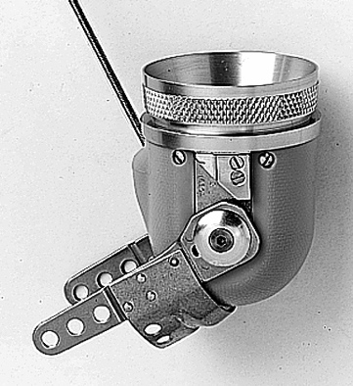
Design Factors – Upper-Limb
Components
10 body-powered prostheses (continued)
Wrist rotation units
5 friction
5 locking with quick disconnect feature for multiple terminal devices
3 used for quick disconnect feature
Wrist flexion
5 units
1 above elbow
1 bilateral below elbow (only 1 used)
1 below elbow / above elbow (2 used)
1 bilateral above elbow(1 used with unilateral prosthesis)
Elbows (4 above elbow prostheses)
4 mechanical
Mechanical elbow
Notes:
Wrist rotation units included five friction wrists and five locking wrists with a quick disconnect feature. Five prostheses were equipped with wrist flexion units, primarily for those with bilateral arm amputations. All of the elbows used in the four transhumeral prostheses were mechanical, cable-actuated elbows.

Slide 39
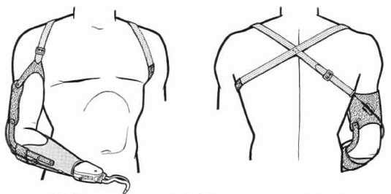
Design Factors – Upper-Limb
Suspension
10 body-powered prostheses (continued)
10 with harness as primary suspension
1 supplemented with a self-suspending socket
below elbow
2 supplemented with a pin and lock system
1 below elbow
1 above elbow
Example below elbow
harness suspension
Notes:
All ten of the body-powered prostheses used a harness as the primary suspension system. Suspension was supplemented in one prosthesis with a self-suspending socket and supplemented in two other prostheses with a pin and lock system.

Slide 40
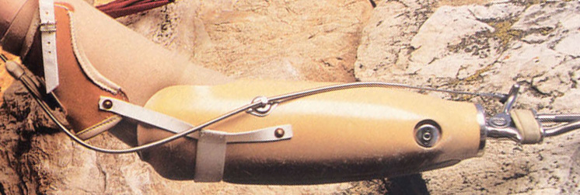
Design Factors – Upper-Limb
Suspension
10 body-powered prostheses (continued)
10 with harness as primary suspension
1 supplemented with a self-suspending socket
below elbow
2 supplemented with a pin and lock system
1 below elbow
1 above elbow
Self-suspending socket, with anatomical contouring above the elbow joint
Notes:
All ten of the body-powered prostheses used a harness as the primary suspension system. Suspension was supplemented in one prosthesis with a self-suspending socket and supplemented in two other prostheses with a pin and lock system.

Slide 41
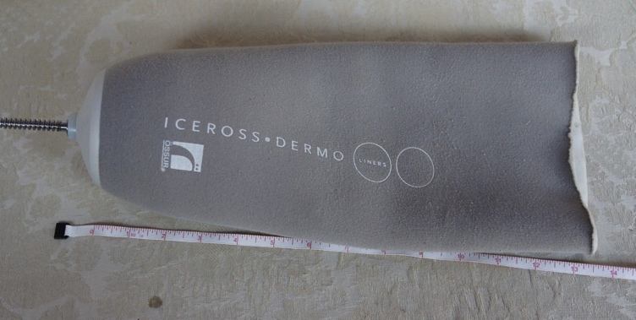
Design Factors – Upper-Limb
Suspension
10 body-powered prostheses (continued)
10 with harness as primary suspension
1 supplemented with a self-suspending socket
below elbow
2 supplemented with a pin and lock system
1 below elbow
1 above elbow
Elastic suspension sleeve with pin
Notes:
All ten of the body-powered prostheses used a harness as the primary suspension system. Suspension was supplemented in one prosthesis with a self-suspending socket and supplemented in two other prostheses with a pin and lock system.

Slide 42
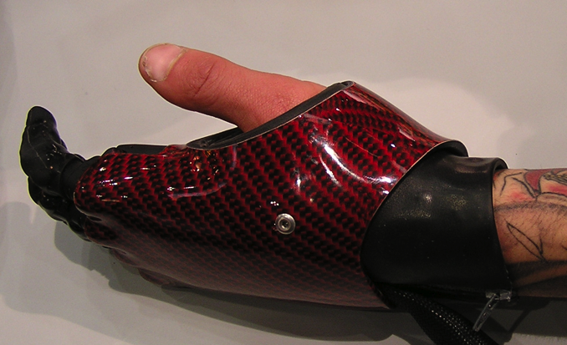
Design Factors – Upper-Limb
Components
3 electric-powered prostheses as primary work device
1 partial hand with intact thumb
i-limb digits (four fingers)
suction suspension
2 below elbow
1 with electric hand
1 with electric hook
both with electric wrist rotators
both with manual wrist flexion units integral with prehension device
both with self-suspending sockets
all controlled myoelectrically
Example of partial hand prosthesis with i-limb digits and intact thumb
Notes:
Three farmers used electric-powered prostheses as their primary work prosthesis. One had a partial hand amputation and used a four-finger i-limb digits prosthesis. Two had transradial amputations and used an electric-powered hand or hook, electric wrist rotators and manually-positioned wrist flexion devices. All prostheses were controlled myoelectrically.

Slide 43
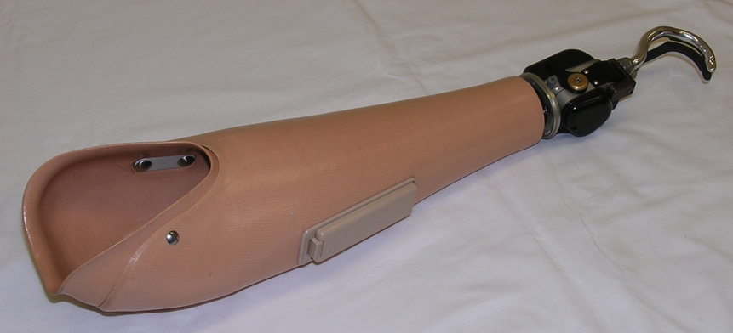
Design Factors – Upper-Limb
Components
3 electric-powered prostheses as primary work device
1 partial hand with intact thumb
i-limb digits (four fingers)
suction suspension
2 below elbow
1 with electric hand
1 with electric hook
both with electric wrist rotators
both with manual wrist flexion units integral with prehension device
both with self-suspending sockets
all controlled myoelectrically
Example of below elbow prosthesis with electric-powered hook
Notes:
Three farmers used electric-powered prostheses as their primary work prosthesis. One had a partial hand amputation and used a four-finger i-limb digits prosthesis. Two had transradial amputations and used an electric-powered hand or hook, electric wrist rotators and manually-positioned wrist flexion devices. All prostheses were controlled myoelectrically.

Slide 44
Survey – Ratings
Notes:
The Survey included sections where the respondent was asked to rate certain problems or factors associated with their prosthesis or the use of their prosthesis in their work. The items in these lists were derived from the themes and comments in the interviews that preceded the Survey. This is a section from one set of problems to be rated. For each item, the degree of “being a problem” was rated on a 4-point scale, from “not a problem” with a value of 1.0 to a “very big problem” with a value of 4.0. In the following slides, the ratings are reported as the average value for all respondents with a higher value indicating the factor being more of a problem.

Slide 45
Survey – Analysis – Upper-Limb
Design Factors — Ranking as a problem [N=10]
Not a
problem
Somewhat
of a problem
Big
problem
Very Big
problem
Notes:
With respect to design factors common to all of the upper-limb prostheses -- durability, frequency of repairs, fit of the socket, ability to clean the prosthesis and failure of the suspension system -- all factors were a problem to some extent, although, on average, no greater than "somewhat of a problem". “Durability of components” had the highest ranking as a problem. However, it’s average rating of “somewhat of a problem” was unexpected given that the pre-survey interviews of 40 farmers indicated that durability was considered a primary problem.

Slide 46
Survey – Analysis – Upper-Limb
Body-Power Design Factors — Ranking as a problem [N=7]
Not a
problem
Somewhat
of a problem
Big
problem
Very Big
problem
Notes:
With regard to design factors specific to body-powered prostheses in conjunction with common design factors, all factors were closer to “somewhat of a problem” except for “fit of prosthetic socket” and “hooks bend during use”, which were closer to “not a problem”. “Cables breaking” and “harness chafes and/or irritates skin” were the factors of most concern as problems in the design of body-powered prostheses.

Slide 47
Survey – Analysis – Upper-Limb
Electric-Power Design Factors — Ranking as a problem [N=3]
Not a
problem
Somewhat
of a problem
Big
problem
Very Big
problem
Notes:
Looking at design factors specific to the three electric-powered prostheses along with common design factors, we found greater levels of concern. The factors “electric components get wet”, “durability of components”, and “fit of prosthetic socket” were rated at or closer to being a “big problem”. These concerns are reasonable. Moisture can damage unsealed motors and electronics. Motors, transmissions and electronics add complexity to designs and the many small, high-precision parts that they incorporate make them generally less durable, less robust, than mechanical components. Sockets for myoelectrically-controlled prostheses have to fit more intimately than is required for body-powered systems suspended with a harness. The factor “failure of the suspension system”, which was suction for the farmer with a partial hand and self-suspending socket designs for the two farmers with transradial prostheses, was the only factor closer to being “not a problem”.

Slide 48
Survey – Analysis – Upper-Limb
Functional Factors — Ranking as a problem [N=10]
Not a
problem
Somewhat
of a problem
Big
problem
Very Big
problem
All U-L
AE [3]
WD, BE [7]
N/A
Notes:
Functional factors relate to the use of the prosthesis in the work of farming or ranching. Among the functional factors common to all-types of upper-limb prostheses “problems with sweat in socket” and “can’t grip tight enough when handling tools”, were considered the most problematic, with both closer to a “big problem”. An assessment of the overall "ability to perform farm or ranch tasks with a prosthesis" was rated near "somewhat of a problem". "Difficulty driving" was the lowest ranked functional factor with a rating near to "not a problem".

Slide 49
Survey – Analysis – Upper-Limb
Functional Factors — Ranking as a problem [N=10]
Not a
problem
Somewhat
of a problem
Big
problem
Very Big
problem
All U-L
AE [3]
WD, BE [7]
Notes:
If we separate out the three respondents who had amputations proximal to the elbow -- at the unilateral transhumeral (TH), bilateral transhumeral (TH/TH) and bilateral transradial/transhumeral (TR/TH) levels -- “problems with sweat in socket” remains a factor closer to a “big problem”. However, the factor “prosthetic elbow can’t lift enough weight” was the functional factor with the highest average rating, at a “big problem”. Driving was also rated as being more problematic for persons with amputations proximal to the elbow, with an average value closer to "somewhat of a problem".

Slide 50
Survey – Analysis – Upper-Limb
Functional Factors — Ranking as a problem [N=10]
Not a
problem
Somewhat
of a problem
Big
problem
Very Big
problem
All U-L
AE [3]
WD, BE [7]
1.0
N/A
Notes:
For the seven respondents with amputations distal to the elbow -- at the transradial (TR), wrist disarticulation (WD), and partial hand (PH) levels -- sweat in the socket and gripping tightly enough on tools remained the most problematic factors. Except for driving, all other factors were closer to being “somewhat of a problem". Driving was rated, on average, as “not a problem” (with a value of 1.0).

Slide 51
Survey – Analysis – Upper-Limb
Service Factors — Ranking as a problem [N=10]
Not a
problem
Somewhat
of a problem
Big
problem
Very Big
problem
Very
useful
Somewhat
useful
Not
useful
Not
provided
Notes:
Factors related to service included an overall assessment of the “quality of prosthetic care”, the time needed to make repairs, and the usefulness of information received about the prosthesis and the training in the use of the prosthesis. In general, the results do not show any great dissatisfaction, with the overall assessment of quality of prosthetic care closer to “not a problem”. The “time it takes to repair” prostheses was the most important problem and was rated at “somewhat of a problem”. Both information received and training in prosthesis use were closer to “somewhat useful” rather than “very useful”, indicating that some improvement is needed in these areas.

Slide 52
Survey – Analysis – Upper-Limb
Cost Factors — Ranking as a problem [N=10]
Not a
problem
Somewhat
of a problem
Big
problem
Very Big
problem
Notes:
Cost factors included direct costs (such as the cost of the prosthesis and cost of repairs) and indirect costs (factors which affect productivity, such as lack of a back-up prosthesis, frequency of repairs, and time it takes to make repairs. "Cost of the prosthesis" was closer to a “big problem” with all other factors having average ratings at or closer to “somewhat of a problem”.

Slide 53
Survey – Analysis – Upper-Limb
Cost Factors — Ranking as a problem [N=10]
Not a
problem
Somewhat
of a problem
Big
problem
Very Big
problem
3 had back-up
prosthesis for work,
average rating = 2.7
Notes:
Interestingly, the three respondents who had back-up upper-limb prostheses rated "lack of a back-up prosthesis" closer to a "big problem" than to "somewhat of a problem. This might reflect the importance they place of having a back-up prosthesis.

Slide 54
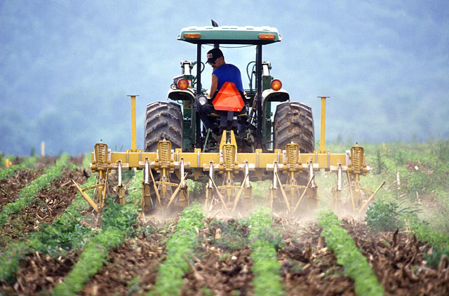
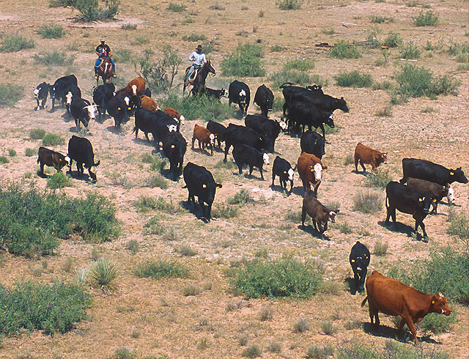
Survey – Analysis
Lower-Limb
USDA/Keith Weller
USDA/Scott Bauer
Notes:
Turning now to the ratings from respondents with lower-limb amputations.
————————————————————
photos:
left: http://www.ars.usda.gov/is/graphics/photos/nov00/k9102-6.htm — public domain image of U.S. federal government agency
right: http://www.ars.usda.gov/is/graphics/photos/k5197-3.htm — public domain image of U.S. federal government agency

Slide 55
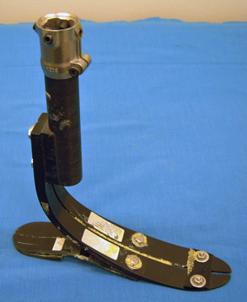
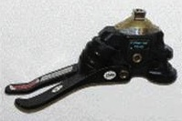
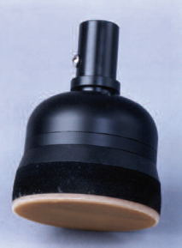
Design Factors – Lower-Limb
Components
14 farmers, ranchers, and agricultural worker
Feet (14 below knee and above knee)
8 dynamic response
2 multi-axial
2 single-axis
1 peg (Terra Foot)
1 unknown
Knees (6 above knee)
4 microprocessor-controlled knee (MPK)
1 swing and stance control
1 single-axis
Dynamic response foot
Multi-axial foot
Terra foot
Notes:
Of the fourteen, all of whom used prostheses, the most common type of foot was a "dynamic response" foot. Among the six with transfemoral amputations, four used microprocessor-controlled knees, one used a swing-and-stance-control knee, and one used a single-axis knee. Only one of the fourteen specifically indicated that his prosthesis incorporated a "shock absorbing component". Four of the fourteen indicated that they had an "ankle component" but did not identify or describe it.
————————————————————
all photos: copyright Northwestern University Prosthetics-Orthotics Center

Slide 56
Design Factors – Lower-Limb
Components
14 farmers, ranchers, and agricultural worker
Feet (14 below knee and above knee)
8 dynamic response
2 multi-axial
2 single-axis
1 peg (Terra Foot)
1 unknown
Knees (6 above knee)
4 microprocessor-controlled knee (MPK)
1 swing and stance control
1 single-axis
Example above knee prosthesis with microprocessor- controlled knee
Notes:
Of the fourteen, all of whom used prostheses, the most common type of foot was a "dynamic response" foot. Among the six with transfemoral amputations, four used microprocessor-controlled knees, one used a swing-and-stance-control knee, and one used a single-axis knee. Only one of the fourteen specifically indicated that his prosthesis incorporated a "shock absorbing component". Four of the fourteen indicated that they had an "ankle component" but did not identify or describe it.
————————————————————
all photos: copyright Northwestern University Prosthetics-Orthotics Center

Slide 57
Survey – Analysis – Lower-Limb
Design Factors — Ranking as a problem [N=14]
Not a
problem
Somewhat
of a problem
Big
problem
Very Big
problem
All L-L
AK [N=6]
BK [N=8]
Notes:
Of the design factors common to all lower-limb prostheses, “failure of suspension system” had the highest ranking as a problem, with an average rating closer to “somewhat of a problem”. The least problematic was the "ability to clean the prosthesis", which was closer to “not a problem”. This factor had a lower rating than that given by users of upper-limb prostheses and may be due to lower-limb prostheses being covered by protective clothing and footwear; whereas, the prehension device and distal part of an upper-limb prosthesis are generally exposed.

Slide 58
Survey – Analysis – Lower-Limb
Design Factors — Ranking as a problem [N=14]
Not a
problem
Somewhat
of a problem
Big
problem
Very Big
problem
All L-L
AK [N=6]
BK [N=8]
1.0
Notes:
The ranking of design factors was not affected by the level of leg amputation, but the magnitude of the rating was. Persons with transtibial amputations rated all design factors as more of a problem than did persons with transfemoral amputations. It is possible that farmers and ranchers with transtibial amputations are more active and more demanding of their prosthesis than those with transfemoral amputations and, therefore, have more problems with the prosthesis, but this is conjecture. “Failure of suspension system” was the most problematic design factor for both users of transtibial and transfemoral prostheses.

Slide 59
Design Factors – Lower-Limb
Suspension
AK [N=6]
BK [N=8]
Notes:
These are the suspension systems identified by the respondents with lower-limb amputations. Pin-locking and vacuum suspension systems are the most common.

Slide 60
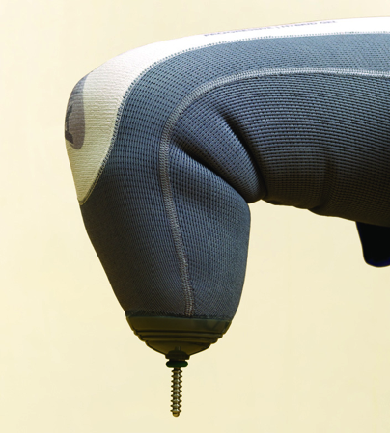
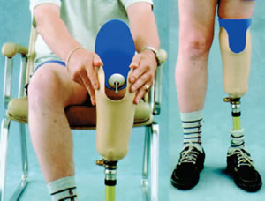
Design Factors – Lower-Limb
Suspension
Pin locking suspension system
AK [N=6]
BK [N=8]
Notes:
These are the suspension systems identified by the respondents with lower-limb amputations. Pin-locking and vacuum suspension systems are the most common.

Slide 61
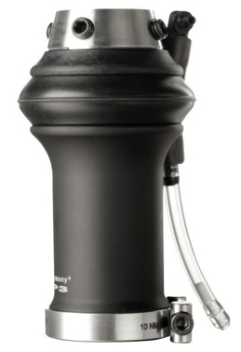
Design Factors – Lower-Limb
Suspension
Vacuum suspension system
AK [N=6]
BK [N=8]
Notes:
These are the suspension systems identified by the respondents with lower-limb amputations. Pin-locking and vacuum suspension systems are the most common.

Slide 62
Design Factors – Lower-Limb
Suspension
Not a
problem
Somewhat
of a problem
Big
problem
Very Big
problem
N=4
N=5
AK [N=6]
BK [N=8]
Notes:
Of the two systems, failure of suspension was considered more of a problem with the vacuum system, with an average rating closer to a “big problem”; whereas, failure of suspension for the pin-locking system had a rating closer to “not a problem”.

Slide 63
Survey – Analysis – Lower-Limb
Functional Factors — Ranking as a problem [N=14]
Not a
problem
Somewhat
of a problem
Big
problem
Very Big
problem
All L-L
AK [N=6]
BK [N=8]
Notes:
Of the functional factors associated with use of the lower-limb prostheses during farm and ranch work, “problems squatting”, “walking through fields with tall plants”, and “problems due to sweating”, were ranked as the most problematic factors, with ratings closer to a “big problem”. All other functional factors were closer to “somewhat of a problem” except for “problems due to cold weather”, which was rated closer to being “not a problem”.

Slide 64
Survey – Analysis – Lower-Limb
Functional Factors — Ranking as a problem [N=14]
Not a
problem
Somewhat
of a problem
Big
problem
Very Big
problem
All L-L
AK [N=6]
BK [N=8]
Notes:
Separating the transfemoral respondents from the transtibial respondents showed the transfemoral respondents generally rated functional factors as less of a problem than transtibial respondents (6 of 9 “Functional Factors”). For transfemoral respondents, only “problems squatting” was closer to a “big problem” with all other functional factors “somewhat of a problem” except for “dust or dirt causing problems” and “problems due to cold weather” which were rated closer to “not a problem”. For transtibial respondents, “problems squatting”. “walking through fields with tall plants”, and “problem due to sweating”, were still rated as a “big problem". “Problems kneeling” and “walking on uneven terrain” had higher ratings for this sub-group, and were also closer to a “big problem”. Given the particular concerns of these two groups, both groups rated their general “ability to perform farm or ranch tasks” at average values less than but closer to “somewhat of a problem”.

Slide 65
Survey – Analysis – Lower-Limb
Causes of falls
AK [N=6]
BK [N=8]
Notes:
Twelve of the 14 survey respondents with lower-limb amputations indicated that they had fallen while using their prosthesis. Environmental factors – tripping over or stepping on objects or slipping on wet, snowy or icy surfaces – dominate over design factors of the prosthesis – such as breakage, failure of suspension, or knee buckling.

Slide 66
Survey – Analysis – Lower-Limb
Causes of falls
10 respondents with
lower-limb amputation used ATVs to travel distances they would have walked without an amputation
ATV use:
above knee 67%
below knee 75%
Notes:
Ten of the respondents with lower-limb amputations used ATVs to travel distances they would have walked if they did not have an amputation.

Slide 67
Survey – Analysis – Lower-Limb
Service Factors — Ranking as a problem [N=14*]
Not a
problem
Somewhat
of a problem
Big
problem
Very Big
problem
All L-L
AK [N=6]
BK [N=8]
1.0
Very
useful
Somewhat
useful
Not
useful
Not
provided
Notes:
Farmers and ranchers with transtibial amputations were generally less satisfied (higher ratings) than those with transfemoral amputations.

Slide 68
Service Factors – Lower-Limb
What information or training would have been more helpful?
[Having an] actual C-leg user [with me] when I got mine to help explain things with the physical therapist.
My prosthetist is very patient oriented and provides me with more information than most due to distance ... taught how to perform most of my own adjustments at home if needed and troubleshooting procedures with elevated vacuum system.
Notes:
Asked to comment on what information or training would have been more helpful, one respondent wrote that "[Having an] actual C-leg user [with me] when I got mine to help explain things with the physical therapist". Another commented that "My prosthetist is very patient oriented and provides me with more information than most due to distance ... taught how to perform most of my own adjustments at home if needed and troubleshooting procedures with elevated vacuum system."

Slide 69
Survey – Analysis – Lower-Limb
Cost Factors — Ranking as a problem [N=14]
Not a
problem
Somewhat
of a problem
Big
problem
Very Big
problem
All L-L
AK [N=6]
BK [N=8]
Notes:
As with the upper-limb respondents, the “cost of the prosthesis” was considered a “big problem” by lower-limb respondents. Unlike upper-limb prosthesis users, lower-limb prosthesis users rated “frequency of repairs” and “time it takes to repair your prosthesis” closer to “not a problem”.

Slide 70
Survey – Analysis – Lower-Limb
Cost Factors — Ranking as a problem [N=14]
Not a
problem
Somewhat
of a problem
Big
problem
Very Big
problem
All L-L
AK [N=6]
BK [N=8]
Notes:
When separating the responses to cost factors by transfemoral prosthesis users from the responses by transtibial prosthesis users, the same tendency for transtibial prosthesis users to rate factors as more of a problem is evident. For transtibial respondents, “cost of the prosthesis” was closer to being a “very big problem”; whereas, transfemoral respondents rated it as “somewhat of a problem”. With regard to “lack of a back-up prosthesis”, the average rating among lower-limb prosthesis users was closer to “somewhat of a problem”.

Slide 71
Limitations of Survey
Sample size: N=28
Validity of respondents who cannot be verified
Accuracy with which respondents can identify components
Interpretation of problem rating
rated both "durability" and "frequency of repairs" as "somewhat of a problem"
Biggest problems are a part breaking too often and the prosthesis wears out too soon.
Notes:
The latter point brings up some of the limitations of the Survey. • The sample size of 28 is relatively small and the results should be considered with that in mind. • The Survey was anonymous unless the respondent chose to provide contact information; therefore, the validity of anonymous responses must be assessed on the consistency and reasonableness of the responses. • Even with photographs as a guide, there is the possibility that respondents could mis-identify their components. • There may be differences in how people assess and interpret the problem ratings. For example, one respondent wrote that the "Biggest problems are a part breaking too often and the prosthesis wears out too soon." and yet that person rated "durability" and "frequency of repairs" as only "somewhat of a problem".

Slide 72
Conclusions
Upper-limb and Lower-limb
Farmers and ranchers with lower-limb amputations or upper-limb amputations below the elbow joint are more likely to use prostheses in their work than those with amputations above the elbow joint.
The majority of survey respondents handled livestock in their work (86%).
Just under half of survey respondents had amputations caused by accidents involving farm machinery (46%).
Farmers and ranchers who used upper-limb and lower-limb prostheses on average ranked “durability of components” as “somewhat of a problem”.
Notes:
Conclusions: • Farmers and ranchers with lower-limb amputations or upper-limb amputations distal to the elbow are more likely to use prostheses in their work than farmers and ranchers with amputations proximal to the elbow. • The majority of survey respondents handled livestock in their work. • Almost half of survey respondents had amputations caused by accidents involving farm machinery. • Farmers and ranchers who used upper-limb and lower-limb prostheses rated “durability of components”, on average, as “somewhat of a problem”.

Slide 73
Conclusions
Upper-limb and Lower-limb
Problems with sweat while wearing prostheses was rated as a “big problem” by upper-limb and below knee prosthesis users
Survey respondents were moderately satisfied with their prosthetic service, rating related factors between "not a problem" and "somewhat of a problem" and the information and training they received as "somewhat useful".
"Cost of the prosthesis" was ranked as a "big problem" by both upper-limb and lower-limb prosthesis users.
Notes:
• Survey respondents were moderately satisfied with their prosthetic service, rating related factors between "not a problem" and "somewhat of a problem" and the information and training they received as "somewhat useful". • "Cost of the prosthesis" was rated as a "big problem" by both upper-limb and lower-limb prosthesis users.

Slide 74
Conclusions
Upper-limb prosthesis users
The majority use body-powered systems (73%).
On average, “problems with sweat in socket” was rated as a "big problem”.
users with amputations below the elbow joint also rated “can’t grip tight enough when handling tools” as a “big problem”
users of above elbow body-powered prostheses also rated “prosthetic elbow can’t lift enough weight” as a "big problem”
Respondents who used electric-powered upper-limb prostheses rated design factors of their prostheses as more problematic than did users of body-powered upper-limb prostheses.
Notes:
Specific to upper-limb prosthesis users: • The majority use body-powered systems. • Among all upper-limb prosthesis users, “problems with sweat in socket” was rated as a "big problem”. Users with amputations distal to the elbow also rated "can't grip tight enough when handling tools" as a "big problem", and users of transhumeral body-powered prostheses also rated “prosthetic elbow can’t lift enough weight” as a "big problem". • Respondents who used electric-powered upper-limb prostheses rated design factors of their prostheses as more problematic than did users of body-powered upper-limb prostheses.

Slide 75
Conclusions
Lower-limb prosthesis users
Dynamic response feet were the most common type of foot used (8 of 14)
Microprocessor-controlled knees were being used by farmers with above knee amputations (4 of 6).
Below knee prosthesis users rated most factors as more of a problem than did above knee prosthesis users.
Vacuum suspension systems were considered to be more problematic than pin-locking suspension systems.
Notes:
Conclusions specific to users of lower-limb prostheses for farming and ranching: • Microprocessor-controlled knees were being used by farmers with transfemoral amputations. • Transtibial prosthesis users rated most factors as more of a problem than did transfemoral prosthesis users. • Vacuum suspension systems were considered to be more problematic than pin-locking systems. • Transtibial prosthesis users were more likely to have problems with their liners than transfemoral users.

Slide 76
Conclusions
Lower-limb prosthesis users
"Problems squatting" was ranked as a "big problem" by all lower-limb prosthesis users.
Most have fallen while using their prosthesis due to environmental factors rather than device failure.
Most use ATVs to traverse distances they would have walked if they had no amputation.
Notes:
• "Problems squatting" was rated as a "big problem" by all lower-limb prosthesis users. • Most lower-limb prosthesis users have fallen while using their prosthesis due to environmental factors rather than device failure. • And most use ATVs to traverse distances they would have walked if they had no amputation.

Slide 77
Recommendations
Prosthetics Service
Listen to the farmer or rancher and gain an understanding of the environment and types of work he or she must do.
Try to arrange for peer counseling, preferably another farmer or rancher.
Provide training in the use of the prosthesis with a focus on the farm or ranch work.
Consider the demands of handling and caring for livestock and the unpredictable nature of animals.
Provide basic troubleshooting and repair training to minimize extended travel and down time.
When practical, provide a selection of relatively inexpensive hardware and spare parts that are likely to break or be lost.
Notes:
The results of the Survey and of the interviews that preceded the Survey suggest a number of recommendations for prosthetics service, clinical prosthesis design, and prototype device design and development. With respect to prosthetics service: • Listen to the farmer or rancher and gain an understanding of the environment and types of work he or she must do. This may not be your typical client. • Try to arrange for peer counseling, preferably another farmer or rancher. Contact your AgrAbility Project if you have one in your state or the peer counseling services and support groups listed on the Amputee Coalition website. • Provide training in the use of the prosthesis with a focus on the farm or ranch work. Teach the proper way to fall, especially if the farmer or rancher has a lower-limb amputation. • Consider the demands of handling and caring for livestock and the unpredictable nature of animals. • Provide basic troubleshooting and repair training to minimize extended travel and down time. And if it is practical, provide a selection of relatively inexpensive hardware and spare parts that are likely to break or be lost.

Slide 78
Recommendations
Design of Contemporary Clincal Prostheses
Simplicity and maintainability are generally preferred.
More complicated equipment is generally viewed as not durable.
However, there are examples of successful applications of electric-powered devices in the farm/ranch environment.
Mechanical devices or sealed devices are preferred because they can be cleaned with soap and hot water.
Most farmers will attempt to do some of their own repairs or modifications.
pride in self-sufficiency
practical needs of the occupation – when the device needs to be repaired “time is money”
consider providing a back-up prosthesis
Notes:
With respect to clinical prosthesis design: • Simplicity and maintainability are generally preferred. And even though more complicated equipment is typically viewed as not durable, there are examples of successful applications of electric-powered devices in the farm/ranch environment. Consider the complete situation and all relevant options when deciding on a type of prosthesis with the client. • Mechanical devices or sealed devices are preferred because they can be cleaned with soap and hot water. These prostheses will often need to be cleaned, especially upper-limb prostheses, before they can be used in the home or family vehicle. • Most farmers will attempt to do some of their own repairs or modifications. This is both a matter of pride in self-sufficiency and a matter of the practical demands of farm or ranch work. When the device is in for repairs, the farmer or rancher will be less productive -- time is money. Consider providing a temporary or back-up prosthesis or refurbishing a replaced prosthesis to be used as a back-up.

Slide 79
Recommendations
Prototype Design and Development
Lowest cost possible to achieve desired performance
Durable materials and construction
Socket design that maintains health of limb
Consistent performance within wide temperature range
Resistance to corrosive or damaging liquids
Resistance to airborne particulates
Withstand cleansing of biological and chemical contaminants
Maintainable, as much as practical, by farmer or rancher
Notes:
For those interested in developing new prosthetic options for farmers and ranchers, consider these factors: • design for the lowest cost possible to achieve the performance necessary for the intended purpose. Field tests -- literally -- will be both illuminating and likely humbling when designing for farmers. • use durable materials and construction • create socket designs that promote and maintain the health of the limb • design knowing that consistent performance will be expected over a wide temperature range • having resistance to corrosive and damaging liquids as well as airborne particulates is important in the farm/ranch environment • the device should be able to withstand cleansing of biological and chemical contaminants • and, the device should be designed to be maintainable by the farmer or rancher, as much as possible, with basic tools and repair methods

Slide 80
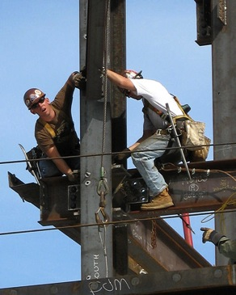
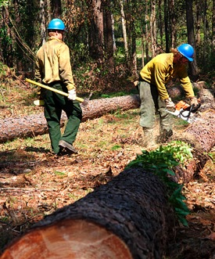
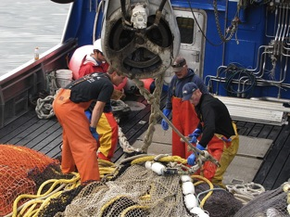
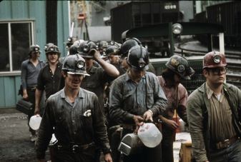
Wider Applications
Lower cost and more durable and maintainable prosthetic components for farmers and ranchers may also benefit persons with amputations who work in other physically demanding occupations such as:
Construction
Forestry
Fishing
Mining
CC/Doug Knuth
FEMA/Ed Edahl
CC/Paul Keheler
National Archives/Jack Corn
Notes:
Prosthesis designs for farmers and ranchers that incorporate lower cost and more durable and maintainable components could be of benefit to persons with amputations who work in other physically demanding occupations such as construction, forestry, fishing, and mining, or make these occupations more accessible to persons with amputations. Such designs may also have application for prostheses used by military personnel or by anyone engaged in activities that routinely take them far from professional clinical services.
————————————————————
Photos:
left: http://commons.wikimedia.org/wiki/File:Construction_Workers.jpg — Creative Commons License
middle: http://commons.wikimedia.org/wiki/File:FEMA_-_17024_-_Photograph_by_Ed_Edahl_taken_on_10-11-2005_in_Texas.jpg — public domain image of U.S. federal government agency
right, top: http://commons.wikimedia.org/wiki/File:Alaska_fishermen_working_with_net.jpg — Creative Commons License
right, bottom: http://commons.wikimedia.org/wiki/File:Miners_at_the_Virginia-Pocahontas_Coal_Company_Mine.jpg — public domain image of U.S. federal government agency

Slide 81
Acknowledgements
This research was funded by the National Institute on Disability and Rehabilitation Research (NIDRR) of the U.S. Department of Education under Grant No. H133E080009.
The National AgrAbility Project and Breaking New Ground Resource Center at Purdue University (supported under USDA Special Project 2012-41590-20173) for assistance with this study.
State and regional AgrAbility Projects and Affiliated Programs for assistance in contacting farmers and ranchers.
The opinions contained in this presentation are those of the grantee and do not necessarily reflect those of the Department of Education or the Department of Agriculture.
Notes:
I would like to acknowledge the support of the National Institute on Disability and Rehabilitation Research of the U.S. Department of Education for funding this project. I also want to acknowledge the National AgrAbility Project and Breaking New Ground Resource Center at Purdue University for assistance with this study and the State and regional AgrAbility Projects and Affiliated Programs for assistance in contacting farmers and ranchers. The opinions expressed in this presentation are those of the researchers of the Northwestern University Prosthetics-Orthotics Center and do not necessarily reflect those of the Department of Education or the Department of Agriculture.

Slide 82
References
Boyatzis, R. (1998). Transforming Qualitative Information: Thematic Analysis and Code Development. Thousand Oaks: SAGE Publications.
Brown, J. (2003). Amputations: A Continuing Workplace Hazard. http://www.bls.gov/opub/cwc/sh20030114ar01p1.htm. Access Date: 03/21/12.
Bureau of Labor Statistics (2012). National Census of Fatal Occupational Injuries in 2011 (Preliminary Results). USDL-12-1888. News Release, September 20, 2012.
Kircher, R. (2003). Farming with an arm amputation. Oklahoma AgrAbility Newsletter, 2(2), 1-8.
National Agricultural Statistics Service (2014). 2012 Census of Agriculture. USDA-AC-12-1-51.
Office of Special Education and Rehabilitative Services (2008). National Institute on Disability and Rehabilitation Research—Disability and Rehabilitation Research Projects and Centers Program—Disability Rehabilitation Research Projects (DRRPs), Rehabilitation Research and Training Centers (RRTCs), and Rehabilitation Engineering Research Centers (RERCs). Federal Register, 73(22), 6132–6146.
Petrea, C., Brusnighan, D.A., and Schweitzer, J.M. (1996). Farming with a Lower Extremity Amputation or Impairment. Plowshares #24, Breaking New Ground Technical Report, Purdue University.
Notes:
References for specific publications cited in this presentation are available here.

Slide 83
References
Prosthetic Limbs Inadequate for Farmer, Rancher Use. O&P Business News, 21(10), 31-32, Fall 2012.
Reed, D. (2004). Understanding and Meeting the Needs of Farmers with Amputations. Orthopaedic Nursing, 23(6), 397-405.
Reed, D.B., Claunch, D.T. (1998). Returning to Farming after Upper-extremity Loss: What the Farmers Say. Journal of Agricutural Safety and Health Special Issue (1), 129-137.
Waldera, K., Heckathorne, C., Parker, M., Fatone, S (2013). Assessing the prosthetic needs of farmers and ranchers with amputations. Disability and Rehabilitation: Assistive Technology, 8(3), 204-212.
Wilkomm, T.M., Field, W.E. (1986). Prosthetic and Worksite Modifications for Farmers with Upper Extremity Amputations. Plowshares #3, Breaking New Ground Technical Report, Purdue University.
Notes:
And here.

Slide 84
Resources
National AgrAbility Project
http://agrability.org/index.cfm
State and Regional AgrAbility Projects
http://agrability.org/Contact-lists/projectscontact.cfm
Amputee Coalition
http://www.amputee-coalition.org/
Notes:
These are the websites for resources that have been mentioned.

Slide 85
Photo Credits
Slide 75
“Construction Workers” by Paul Keheler
http://commons.wikimedia.org/wiki/File:Construction_Workers.jpg
This work is licensed under the Creative Commons Attribution 2.0 Generic License (http://creativecommons.org/licenses/by/2.0/)
The original image has been cropped.
“Alaska fishermen working with net” by Doug Knuth
http://commons.wikimedia.org/w/index.php?title=File:Alaska_fishermen_working_with_net.jpg&oldid=71605943
This file is licensed under the Creative Commons Attribution-Share Alike 2.0 Generic
(https://creativecommons.org/licenses/by-sa/2.0/deed.en) license.
The original image has been cropped.
All other images are copyrighted by Northwestern University, are free of copyright from agencies of the United States federal government, or are stock images not requiring attribution. For specific details, contact one of the indviduals listed on the “Contact Information” slide.
Notes:
Photo Credits

Slide 86
Thank you!
Notes:
Thank you for your interest in improving the prosthetics options available to farmers, ranchers, and other agricultural workers.

Slide 87
Contact Information
Craig Heckathorne, MS
Project Director, Assessing and Responding to the Prosthetics Needs of Farmers and Ranchers (NIDRR)
c-heckathorne@northwestern.edu
phone: 312-503-5700
Steven Gard, PhD
Co-Principal Investigator
sgard@northwestern.edu
Stefania Fatone, PhD, BPO(Hons)
Co-Principal Investigator
s-fatone@northwestern.edu
Notes:
If you have questions or comments about the content of this webinar, you are welcome to contact these individuals who participated in the research.

Slide 88
Northwestern University Prosthetics-Orthotics Center
680 North Lake Shore Drive, Suite 1100
Chicago, IL 60611
Telephone 312-503-5700
Fax 312-503-5760
www.nupoc.northwestern.edu
Notes:
If you would like to know more about the mission and projects of the Northwestern University Prosthetics-Orthotics Center, please contact us or visit our website.

