Slide 1
Maximizing Vision Tools and Techniques for Individuals With Visual Impairments ABVI – Goodwill of the Finger Lakers AgrAbility Webinar Series Monday, June 19, 2017 2:00 p.m. ET

Slide 2
Basic Webinar Instructions
Audio available through computer or phone.
Check sound via Communicate menu at top left
Closed captions: use arrow to expand or contact the Media Viewer window.
Expand/contract any of the windows in the right-hand column with the arrows. May need to do this to see video of presenter.
Expand/contract the size of the right-hand column.

Slide 3
Basic Webinar Instructions
Questions and comments
Click Chat icon at top right of screen (it should turn blue). Enter message in box, choose who to send it to, and click send. You may enter questions about the presentation at any time. Please send to “All Panelists”.
In addition, during the Q & A period, if you have a web microphone, click the “Raise Hand” icon to indicate that you have a question. We will enable your microphone or phone connection.

Slide 4
Basic Webinar Instructions
4 quick survey questions + opportunity to share comments
Session recorded and archived with PowerPoint files at www.agrability.org/Online-Training
Problems: use chat window or email jonesp@purdue.edu

Slide 5
AgrAbility: USDA-sponsored program that assists farmers, ranchers, and other agricultural workers with disabilities.
Partners land grant universities with disability services organizations. Currently 20 state projects
National AgrAbility Project: Led by Purdue’s Breaking New Ground Resource Center.
Partners include:
Goodwill of the Finger Lakes
APRIL (Association of Programs for Rural Independent Living
Colorado State University
More information available at www.agrability.org

Slide 6
Maximizing Vision
Tools and Techniques for Individuals With Visual Impairments

Slide 7
Association for the Blind and Visually Impaired – an Affiliate of Goodwill of the Finger Lakes
Located in Rochester, NY, serving a 9 county region in Western NY
Provides comprehensive vision rehabilitation services
Mission Statement:
“To prepare and empower people who are blind or visually impaired to be self sufficient and contribute to their families and communities.”

Slide 8
What is Vision Rehabilitation?
Vision Rehabilitation services include a wide array of professionals and services that can restore functioning after vision loss.
Vision Rehabilitation Therapists provide training on how to adapt everyday activities.
Orientation and Mobility Specialists teach how to travel safely in any environment.
Career Development Specialists help to obtain or maintain employment using individualized career services and technology training

Slide 9
Today’s Presenters:
Nikki Llewellyn, M.S. COMS
Janie Baker, M.S. COMS
James Hallahan, Assistive Technology Instructor
Joette Vahey, Career Development Specialist

Slide 10
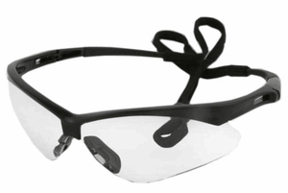
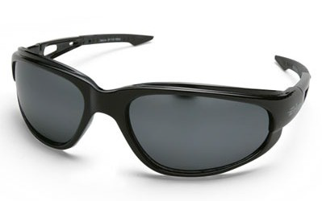
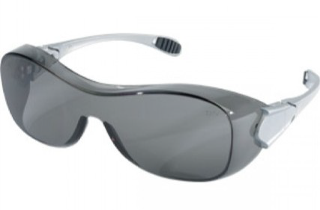
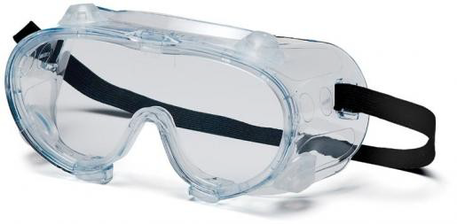
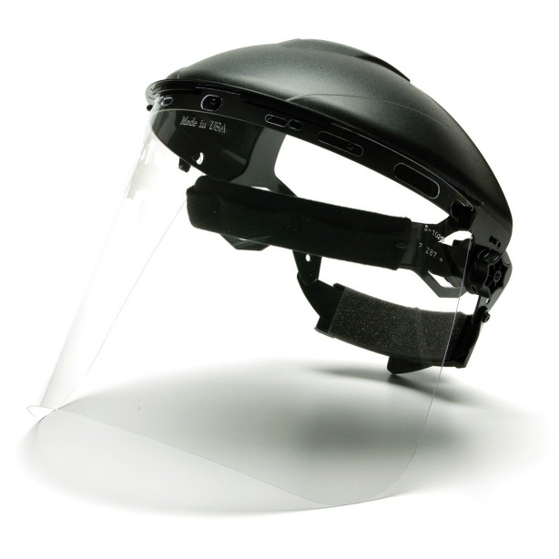
Protect What We’ve Got!
Prevent Blindness America estimates 90% of eye injuries are preventable.
Selecting appropriate protection from sun; particles; sparks and
chemicals is key!

Slide 11
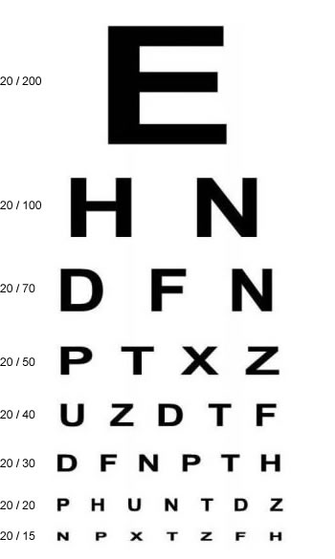
Aspects of Vision Loss
Visual Acuity
The sharpness of vision, measured by the ability to discern letters or numbers at a given distance according to a fixed standard.
20/20 vision means what is at 20 feet appears to be at 20 feet. 20/200 means what is at 20 feet appears as if 200 feet away.

Slide 12
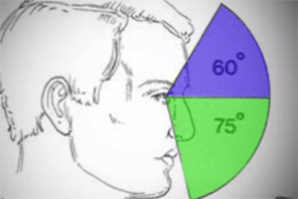
Aspects of Vision Loss
Visual Field
Refers to the total area in which objects can be seen in the side (peripheral) vision as you focus your eyes on a central point.

Slide 13
Aspects of Vision Loss
Contrast Sensitivity
An important measure of visual function, especially in situations of low light, fog or glare, when the contrast between objects and their background often is reduced.
Changes in contrast may improve an individual’s ability to see items and read. Technology makes this possible in many ways!

Slide 14
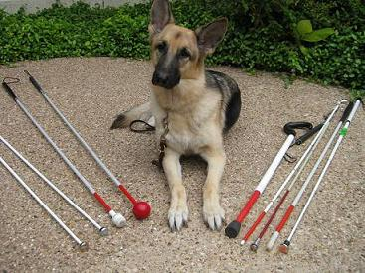
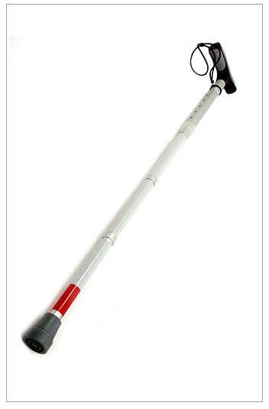
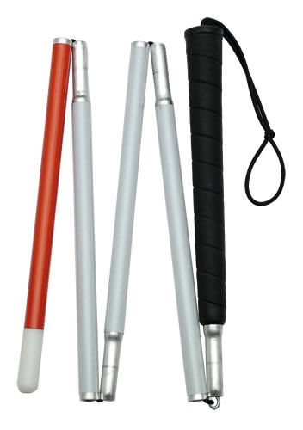
Cane Types

Slide 15
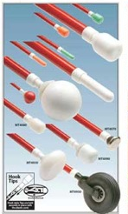
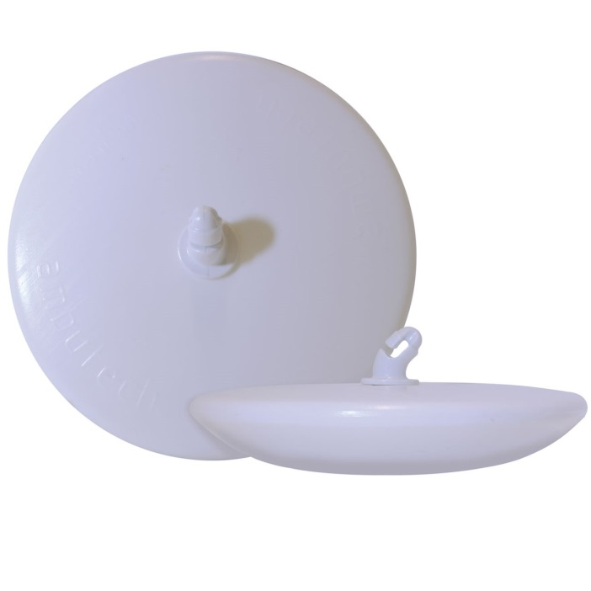
Cane Tips
Just as different canes are appropriate in different settings, cane tips make a difference as well.

Slide 16
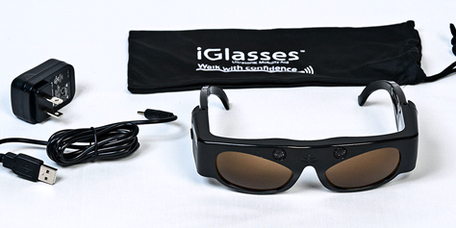
iGlasses
While a cane assists with objects below the waist, iGlasses utilize ultasonic sensors to detect items above the waist such as tree branches.
As obstacles get nearer the frequency of the vibration will increase.

Slide 17
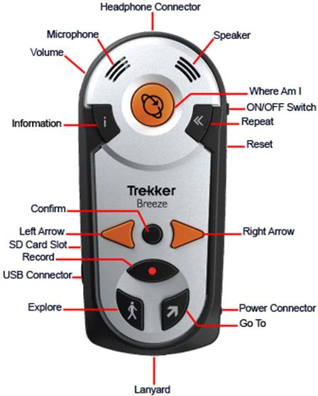
Trekker Breeze
Easy-to-use device for people who are not sophisticated computer users
GPS technology on which you are walking. When you are about 30 feet from an intersection--the Breeze describes the intersection, for example, "Four-way intersection, Queens Boulevard crossing Ascan Avenue.“
Contains points of interest from a commercial database, including restaurants, banks, schools, and gas stations.

Slide 18
Smart Phone Technology

Slide 19
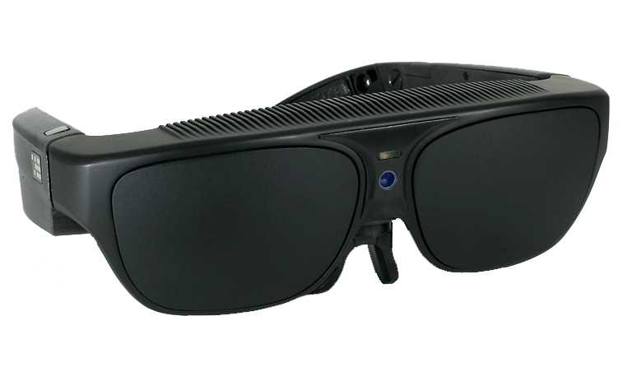
Wearable Technology
NuEyes Pro:
Variable Magnification from 1x-12x
Various contrast and color changes
Voice Activated
Wireless
Lightweight Design
Text-to-Speech (OCR)
Stream TV and Movies to the Glasses
Full Android Computer
Internet Browser
Email
Full functions of an Android tablet with downloadable android apps.
Social Media Applications

Slide 20
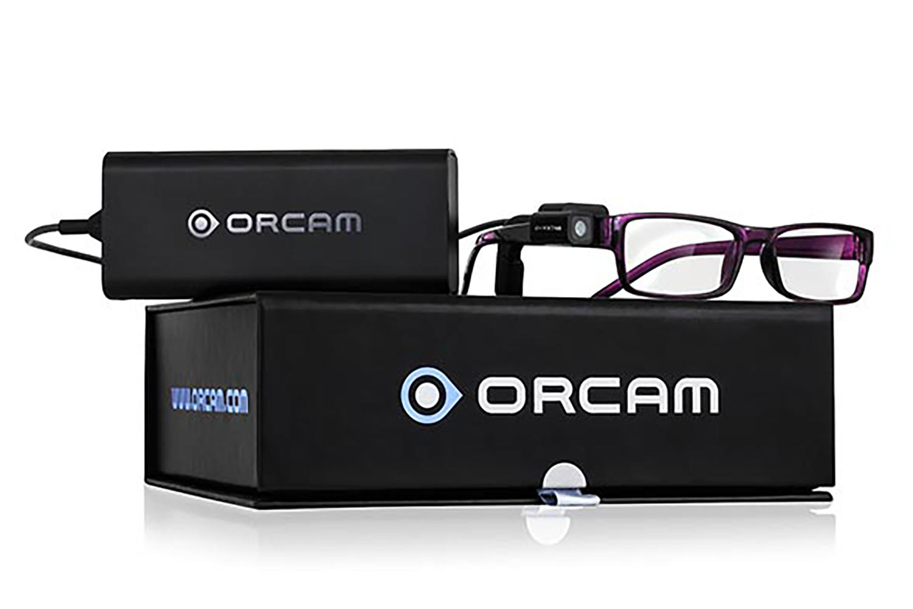
Wearable Technology
OrCam MyEye
Recognizes text and products, and speaks to the person wearing the device via a bone-conduction earpiece.
With the point of the person's finger, the device instantly responds and will infer whether it needs to read, find an item, or recognize a product depending on the environment.
Reads printed text, such as books, newspapers, food labels, restaurant menus, and street signs.
Reads most digital text, such as that on a television or computer.
Recognizes previously entered consumer products, money notes and credit cards to make shopping quicker and easier.
Facial Recognition

Slide 21
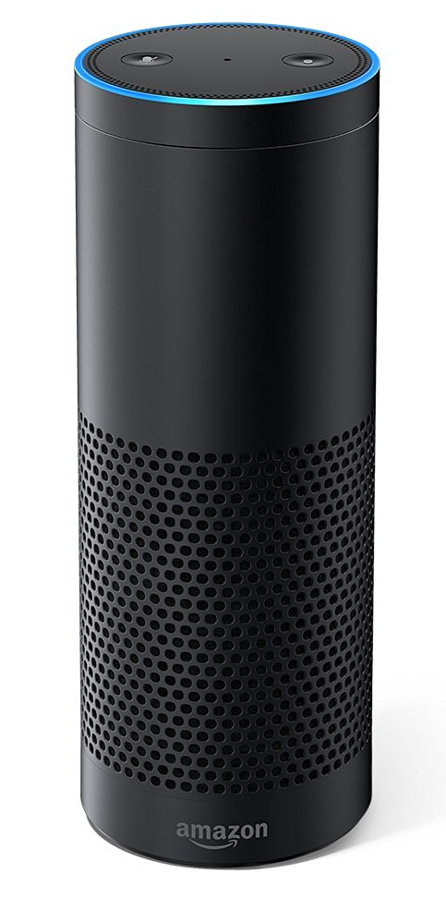
Amazon Echo
Doesn't require using a keyboard, or learning to use a tablet computer or smart phone.
Could open and read a book, provide a weather report, access recent news updates.

Slide 22
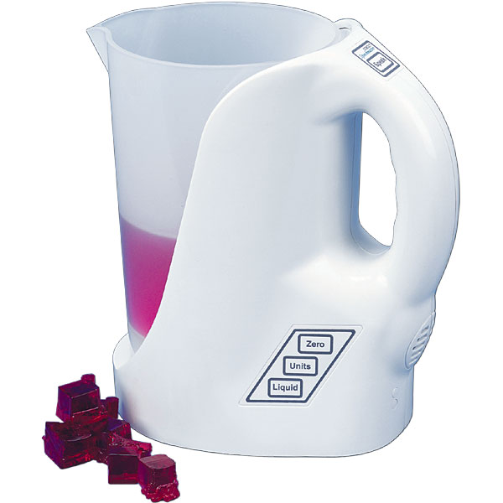
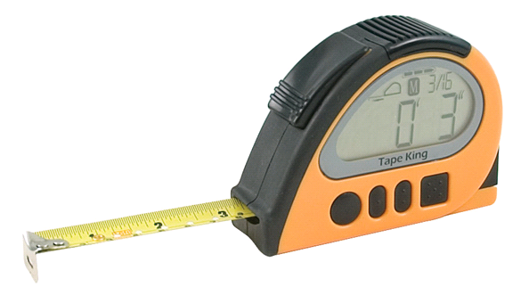
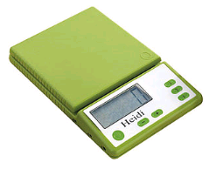
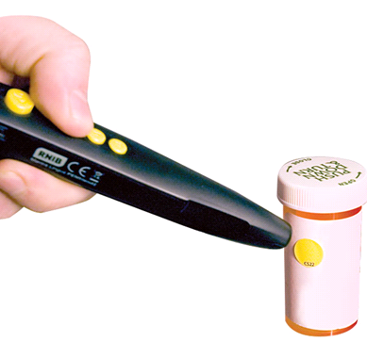
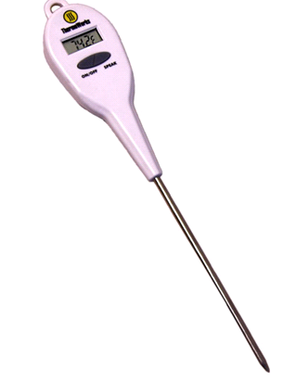
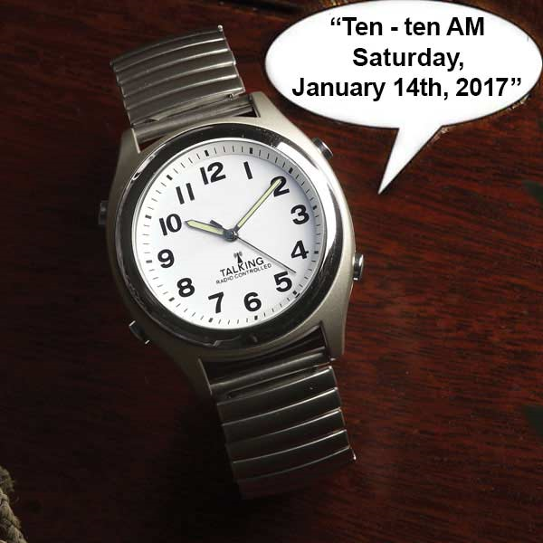
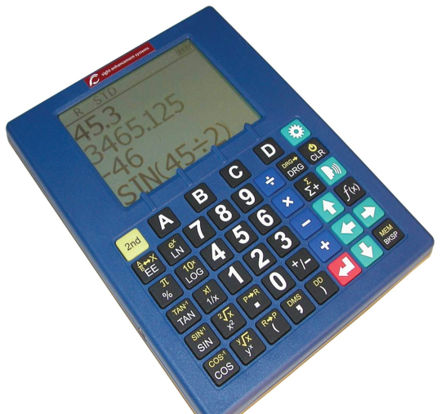
Talking Tools

Slide 23
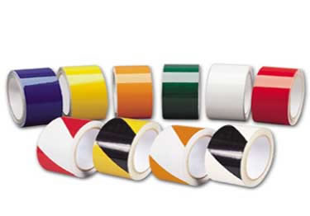
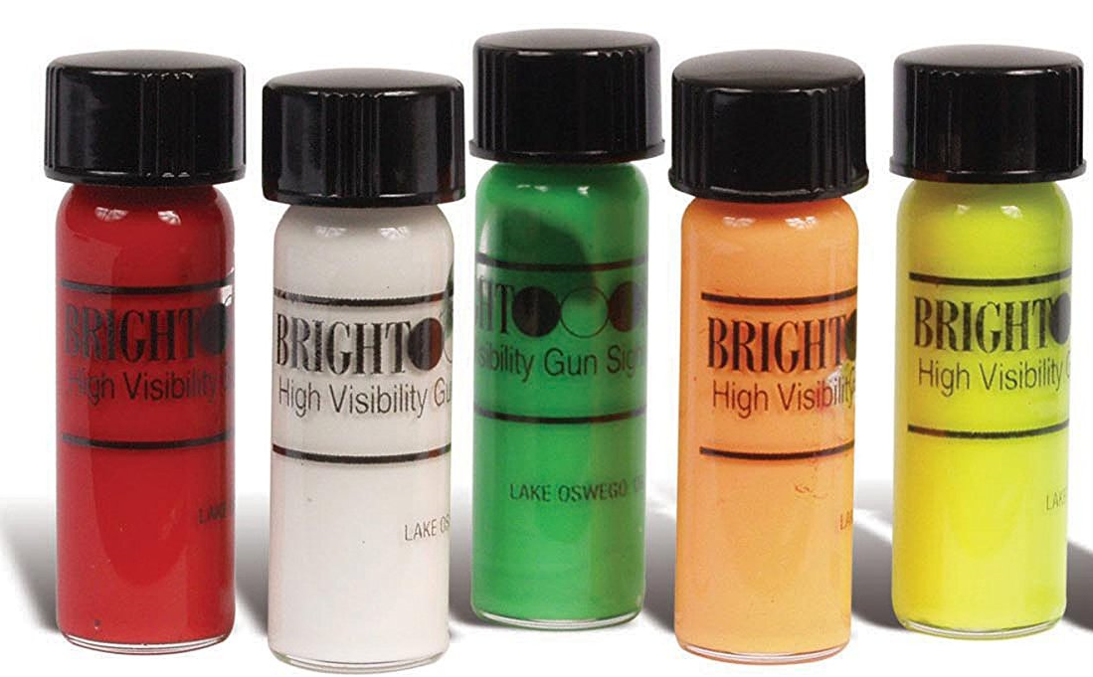
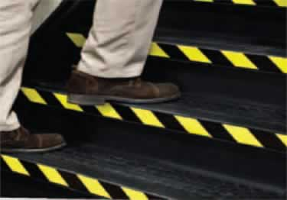
Low Tech Solutions
High Visibility Tapes and Paints can be used to identify obstacles; mark steps; categorize tools; outline work areas, and much more!

Slide 24
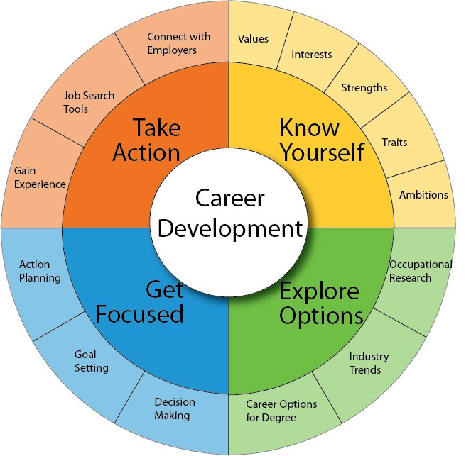
Career Development

Slide 25
Seeing the Possibilities
Help change the mindsets around you for the benefit of the people who come after you.
Confidently discuss and disclose your disability
Advocate for yourself
Explore the possibilities

Slide 26
Contact Us for More Information
Nikki Llewellyn, M.S. COMS
nllewellyn@goodwillfingerlakes.org
Janie Baker, M.S. COMS
jbaker@goodwillfingerlakes.org
James Hallahan, Assistive Technology Instructor
jhallahan@goodwillfingerlakes.org
Joette Vahey, Career Development Specialist
jvahey@goodwillfingerlakes.org
JoBeth Rath, Workforce Development Manager
jbrath@goodwillfingerlakes.org

