Slide 1
Peer Support for People with Disabilities
in Rural and Agricultural Communities
Sierra Royster, APRIL Youth Programs Coordinator
Shari Coatney, SKIL CEO & Kansas AgrAbility Co-PI
Rick Geringer, WIL, Independent Living Specialist
AgrAbility Webinar Series August 2, 2018
3:00 p.m. ET

Slide 2
Basic Webinar Instructions
Audio available through computer or phone.
Check sound via Communicate menu at top left
Closed captions: use arrow to expand or contact the Media Viewer window. You may have to enter some log-in information.
Expand/contract any of the windows in the right-hand column with the arrows. May need to do this to see video of presenter.
Expand/contract the size of the right-hand column.

Slide 3
Basic Webinar Instructions
Questions and comments
Click Chat icon at top right of screen (it should turn blue). Enter message in box, choose who to send it to, and click send. You may enter questions about the presentation at any time. Please send to “All Panelists”.
In addition, during the Q & A period, if you have a web microphone, click the “Raise Hand” icon to indicate that you have a question. We will enable your microphone or phone connection.

Slide 4
Basic Webinar Instructions
Please let me know if more than one person is viewing at your computer
4 quick survey questions + opportunity to share comments
Session recorded and archived with PowerPoint files at www.agrability.org/Online-Training
Problems: use chat window or email jonesp@purdue.edu

Slide 5
AgrAbility: USDA-sponsored program that assists farmers, ranchers, and other agricultural workers with disabilities.
Partners land-grant universities with disability services organizations. Currently 20 state projects
National AgrAbility Project: Led by Purdue’s Breaking New Ground Resource Center. Partners include:
Goodwill of the Finger Lakes
APRIL (Association of Programs for Rural Independent Living)
Colorado State University
Washington State University
More information available at www.agrability.org

Slide 6
Peer Support for People with Disabilities in Rural and Agricultural communities
August 2, 2018
Sierra Royster, APRIL Youth Programs Coordinator
Shari Coatney, SKIL CEO & Kansas AgrAbility Co-PI
Rick Geringer, WIL, Independent Living Specialist

Slide 7
Center for Independent Living (CIL)
Centers for Independent Living are community-based, cross-disability, non-profit organizations that are designed and operated by people with disabilities. CILs are unique in that they operate according to a strict philosophy of consumer control, wherein people with all types of disabilities directly govern and staff the organization. Centers for Independent Living provide:
Peer Support/Peer Counseling
Information and Referral
Individual and Systems Advocacy
Independent Living Skills Training
Transition
403ish Centers for Independent Living (CILs)
330ish branch offices

Slide 8
Why do we do peer support?
Peer relationships mean relationships involving mutual support and assistance among individuals with significant disabilities who are actively pursuing IL goals. Peer role models mean individuals with significant disabilities whose achievements can serve as a positive example for other individuals with significant disabilities.

Slide 9
Why do we do peer support?
In the Rehabilitation Act Title VII we are told what our services must include:
Cross-disability counseling included
IL services include peer counseling
The program is to promote a philosophy of peer support
The CIL shall promote the development of peer relationships and peer role models
Provide evidence in its annual performance report that it promotes the development of peer relationships and peer role models among individuals with significant disabilities
e.g. by using individuals with significant disabilities who have achieved IL goals as instructors in its training programs or as peer counselors

Slide 10
Why do we Provide peer support Continued…
We know it works
Strong research supports the peer support model
Other groups have also successfully utilized peer support models
AA and other 12 Step programs
Weight Watchers
Mental health community

Slide 11
How do CILs carry out peer support services?
Peer support is done one on one or can be provided in a group setting with peers that have similar interests or goals.
Peer support has a purpose and a goal.
Assist others in working towards independence.
As all the services this is completed with empathy, not sympathy.
Help people help themselves.
Confidential
Provides a natural opportunity to create peer relationships that can support one another along with sharing pivotal resources.
It is carried out by:
In-person, by phone, email, social Media, e-mentoring list servs, online only groups
They are not providing medical/professional counseling or therapy.

Slide 12
How do CILs carry out peer support services continued…?
Some provide it just through the work they do as a staff of a CIL that is also a part of the disability community.
When a person with a disability who has learned life strategies, how to be a self-advocate, and how to live independently they are able to assist their fellow brother or sister.
A person providing peer support differs from a counselor or just an advocate. When someone is providing peer support they do not tell him/her peers how to live their life. The person providing the service will share their own experiences, pass along encouragement and support needed for that individual receiving the services to construct their own advocacy and life strategies to bring about their desired goals.
Peer Support Programs
An organized Volunteer Peer Mentor Program trains and supervises volunteers who act as role models and coaches for others with disabilities
This would not include part-time staff, or paid Independent Living Specialists or Advocates
This does not replace staff providing peer support as appropriate, but is an additional support for the consumers

Slide 13
Peer mentoring - KS
National AgrAbility Webinar
August 2, 2018
Shari Coatney, SKIL CEO & Kansas AgrAbility Co-PI

Slide 14
Peer mentoring
The best advice and assistance often comes from another person who has experience with your situation. SKIL provides avenues for individuals with disabilities or health conditions to receive information from peers through group and individual mentoring.
Topics and issues are identified by the individual. SKIL doesn’t give people “what they don’t ask for.”

Slide 15
What can peer mentoring look like?
CRO of Hope: peer group of individuals with mental health issues. The group meets to provide advice/supports for members and selects topics and skills members want to learn more about or master.
Neosho Coalition: advocacy group of people with a range of disabilities who work with local community resources to address barriers and identify ways to include people with disabilities as resources for their communities.
Individual peer & IL skills
Connecting a person with a similar disability, ability, lifestyle, job, goals.
For example, one person with a vision loss teaches another how to manage their budget with Quick Books and screen magnification.

Slide 16
Why is peer mentoring important in rural communities?
Rural CILs employ local people with disabilities.
Rural residents know local resources and possible solutions in their communities. This is particularly important if you are working with a farmer or rancher but don’t know the area they live in.
CILs provide a source for advice and IL skills training that isn’t available to adults with disabilities otherwise.
CILs have many local contracts since they provide services to people with disabilities.
Many CIL staff know local contractors, have extension ties, are active in churches and civic organizations.

Slide 17
What’s peer mentoring look like in Kansas?
KAP customers demographics indicates that customers may want peers for new or progressive disabilities as well as spouse/caregiver supports.
27% injuries (orthotic, spinal cord injury, amputation, etc..)
33% chronic, neurological and neuromuscular diseases (Multiple Sclerosis, arthritis, early onset Alzheimer’s, etc.)
Average KAP owner/operator age is 51 years
What do Peer Supports look like in Kansas? Virtual information to draw you in:
Online videos: KS farmers and ranchers said they wanted to hear it for themselves from other Kansas farmers and ranchers. KAP staff began to collect/edit short videos of solutions obtained for KAP customers and posted to the website, played at information booths, and shown to new customers.
Online resources: KAP adapted safety tips sheets for farming from Purdue, links to the AgrAbility Toolbox as well as our state and national partners are posted on the KAP Resource page.

Slide 18
direct KS peer mentoring opportunities
KAP sponsored workshop and/or product demo events: accessible recreation – fishing, boating, hunting; mobility solutions for rough terrain; Kansas Truck rodeo – accessible pickups and more.
Bus tours of farmers and ranchers served by KAP: veterans, active duty soldiers with injuries, and beginning farmers invited to ride along and visit 2 farms/ranchers of KAP customers who want to show their solutions and share their stories.
Peer partnerships: KAP staff ask KAP customers if they are willing to talk to another farmer or rancher who are facing a similar situation or might use a solution like theirs. Customers who agree have notes made in online records. Contact is only made after a new customer requests the chance to see a solution and the peer customer is contacted by KAP staff first. This has been successful.

Slide 19
What else can cils offer sraps?
CILs focus on people being successful.
CILS vary from state to state – core services (peer counseling, advocacy, IL skills training, information and referral, transition) are always provided.
CIL staff know the culture of the people around them
Rural CILs serve a rural population.
CIL staff probably have rural experiences themselves – many grew up on farms and may still farm.
Great source of referrals and assistance
Specific IL skill training can be provided – something KAP staff don’t have time to do or perhaps the knowledge. For example, how to cook with a newly acquired disability, how to transfer from WC to bed, etc.
Identifying rural youth since CILS have a strong focus on transition (FFA,4-H, high school)

Slide 20
Peer Support-WY
Rick Geringer-WIL

Slide 21
The mission of WIL
Advancing independence, dignity and a world without barriers

Slide 22
Disability in Wyoming
Wyoming least in population, 10th in size, 5.8 persons/square mile
Nearly 70,000 people in Wyoming experience some sort of disability. With a population of 579,315 that
equates to 12% of the state’s population.
Disabilities can been visible or invisible
Physical
Intellectual
Mental or Emotional
Medical

Slide 23
Inclusion
We believe in equal Access and participation for all.
We value the talents and contributions of all individuals

Slide 24
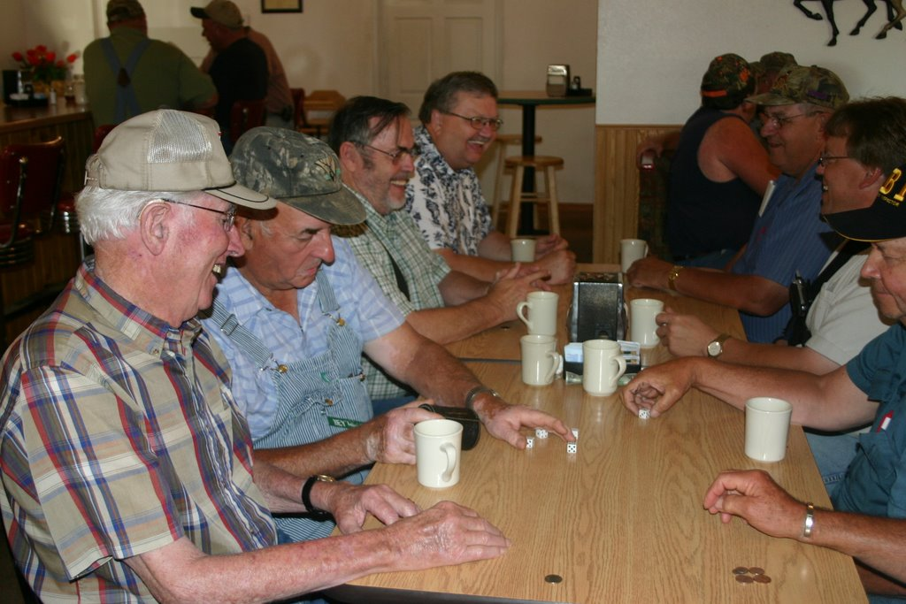
Peer Support in WY
Peer Mentors
Peer Support Groups
Living Well with a Disability

Slide 26
CIL VS. Agrability
How we still provide services to persons in agriculture even though we don’t have AgrAbility in WY.
Philosophy of a Center for Independent Living (CIL) and AgrAbility similar: increased independence.
An independent living center might coordinate getting a ramp installed out of a home.
In AgrAbility a farmer might need an extended step with a rail up to his windrower cab.
As an independent living specialist I could help coordinate either one.

Slide 27
Next steps
If you are interested in
Learning more about WIL’s programs
Participating in WIL events or activities
Talking with someone about barriers you are facing
Connecting with peers in the disability community
Sharing your story of disability and independent living
Becoming a volunteer, mentor or advocate through WIL
Contact Rick Geringer
307-322-9210
rgeringer@wilr.org
www.wilr.org

Slide 28
How do you get connected?
Reach out to Sierra at APRIL.
Can connect you to the local CIL and assist getting the farmers/ranchers connected.
April-sierra@att.net
Check out the ILRU (Independent Living Research Utilization) page to find your CIL.
www.ilru.org
If you do not think this service is being provided we can work together to learn how the CIL is carrying out that service and maybe add to it.
If you have a farmer/rancher you are working with you could always reach out the CIL if you think that individual might be a great peer for someone else to assist a future farmer/rancher.

Slide 29
Resources
APRIL Website
Upcoming Webinar: Peer Support: Bread and Butter of Independent Living, August 15th, 2018
https://april-rural.org/index.php/il-conversations/il-conversations-page
ILRU website search topics on Peer Counseling/Peer Support
http://www.ilru.org/topics/peer-counseling-peer-support
Georgia Peer Support Training Program
http://disabilitylink.org/peer-support/
Administration on Community Living
https://www.acl.gov/programs/aging-and-disability-networks/centers-independent-living

