Slide 1
Arthritis Pain Management
Methods of managing arthritis pain, impacts of arthritis on the quality of life, essential concepts about pain, and options for pain management.
Amber D. Wolfe, BS- AgrAbility Project Coordinator
Arthritis Foundation, Heartland Region
National AgrAbility Project- Purdue University

Slide 2
Basic Webinar Instructions
Need speakers or headphones to hear the presentation. No phone connection.
Check sound via Meeting > Audio Setup Wizard
Questions about presentation
Type into chat window and hit return.
During the Q & A period, if you have a web cam/ microphone, click the “Raise Hand” icon to indicate that you have a question. We will enable your microphone

Slide 3
Basic Webinar Instructions
4 quick survey questions
Session recorded and archived with PowerPoint files at www.agrability.org/Online-Training/archived along with resource materials
Problems: use chat window or email agrability@agrability.org

Slide 4
Known Webinar Issues
Echo
Check to see if you are logged in twice
Disconnection with presenters
Hang on – we’ll reconnect as soon as possible
Disconnection with participants
Log in again

Slide 5
AgrAbility: USDA-sponsored program that assists farmers, ranchers, and other agricultural workers with disabilities.
Partners land grant universities with disability services
Organizations. Currently 20 state projects
National AgrAbility Project: Led by Purdue’s Breaking New Ground Resource Center. Partners include:
Goodwill of the Finger Lakes
The Arthritis Foundation, Heartland Region
University of Illinois at Urbana-Champaign
Colorado State University
More information available at www.agrability.org

Slide 6
PRESENTER
Amber D. Wolfe joined the National AgrAbility Project in 2009 as the AgrAbility project coordinator for the Arthritis Foundation.
Amber serves as a national resource for rural arthritis issues, particularly those related to agriculture. She provides training to professionals and consumers via rural arthritis workshops and also assists in developing resources related to rural arthritis.

Slide 7
Arthritis Pain Management
Why Does Arthritis Hurt?
Notes:
Coping with pain can be the hardest part of having arthritis or a related condition. Just as there are different types of arthritis, there are also different types of pain.
Pain is the body’s natural alarm system, and arthritis-related pain is often chronic (long-term), causing treatment plans to vary drastically based on symptoms and conditions.
The two most common causes of arthritis-related pain are inflammation and joint damage/injury; however, stress and fatigue can also add to the level of arthritis pain.
Note: pain affects individuals differently, so the topics covered in this session will be broad and designed to provide a sound foundation to understanding pain management, thus empowering individuals to work with their health care provider to determine the best course of action for their individual limitations and pain.

Slide 8
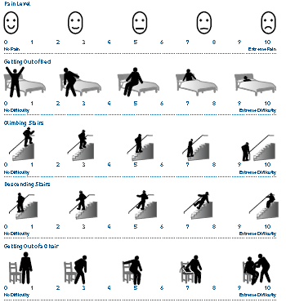
VISITING A HEALTH CARE PROFESSIONAL: How arthritis is diagnosed
Symptom history
Physical examination
Blood and urine tests
X ray (and other tests if needed)
Notes:
Four key things:
Ask about your symptom history. It can provide important clues to your health care provider. It helps them understand the way your body feels and when it feels that way. Writing down your symptoms- such as when you are in pain; when you are not in pain; what activities bring on the pain; and if there is anything you do that makes the pain better or worse—can help your health care provider make a diagnosis more quickly.
The doctor will also perform a physical examination to see if she can feel any deformities, swelling, heat coming from the joints and will also check for limited mobility.
Your health care provider may also order blood and urine tests to look for inflammation in your blood or kidneys.
There may also be X-ray or other tests given (space) to look for damage to the bones and to see how far the disease has progressed.

Slide 9
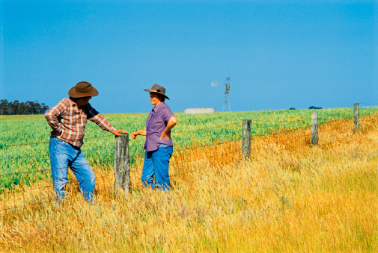
TIPS FOR TALKING TO YOUR DOCTOR Be honest!
Tell your doctor how much pain you have.
Describe how often it affects your mood and your ability to do things.
Share your goals for pain control.
Work with your doctor to create a pain management plan and then make changes as needed.

Slide 10
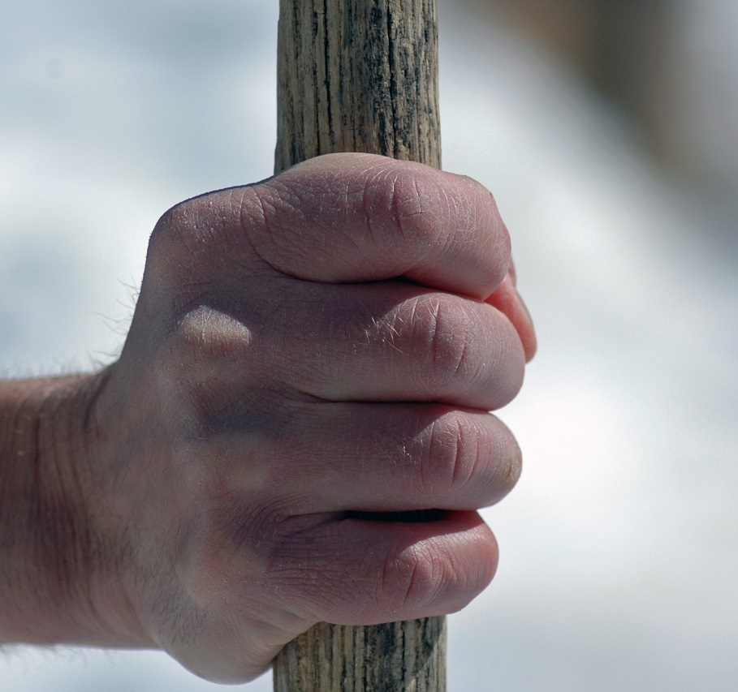
WARNING SIGNS OF ARTHRITIS: When to visit your health care provider
Pain
Swelling around a joint
Stiffness
Difficulty moving a joint
Notes:
How do you know if you have arthritis? Only a health care professional can tell you for sure if it is arthritis, but shown here are some of the things people tend to notice that may point to arthritis as a cause of joint problems. There are four important warning signs that should alert you to talk to a health care provider.
First on our list is pain. Pain is your body’s alarm system. It is a signal that tells you something is wrong. The signal may come from a sudden injury, such as a cut finger, or from a disease that your body is fighting, such as arthritis. Depending on what type of arthritis you may have, pain can be constant or it may come and go. It may occur when at rest or while moving. Pain may be in one part of the body or in many different parts.
Many things can influence how much pain a person feels. Some people simply have a higher sensitivity and feel more pain. Stress, low mood or emotions, poor sleep and other factors may also make pain worse.
Second, we see swelling. Some types of arthritis cause the skin over the affected joint to become red and swollen, feeling warm to the touch.
Next, your joints may feel stiff, especially when waking up in the morning or after sitting at a desk or riding in a car for a long time.
Finally, you may also notice difficulty moving a joint due to any of the three above: pain, swelling or stiffness.
If you have any of these “4 warning signs” in or around a joint and they last more than two weeks, seek medical advice..

Slide 11
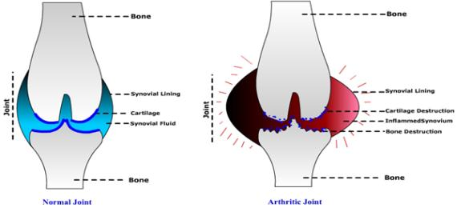
COMMON TYPES OF ARTHRITIS
What does “arthritis” mean?
Arth + Itis = Inflammation of joints
(joint) (inflammation)
Osteoarthritis
Rheumatoid Arthritis
Over 100 related forms of arthritis diseases and disabilities
Notes:
A large part of understanding arthritis treatment and managing the disease comes with knowing which type of arthritis you have. If you know you have arthritis but aren’t sure which type you have, call your health care provider or be sure to ask when you make your next visit.

Slide 12
RHEUMATOID ARTHRITIS
Notes:
Rheumatoid arthritis is a common form of arthritis (1.3 million) and is very different from osteoarthritis.
Rheumatoid arthritis involves inflammation in the lining of joints that leads to warmth, decreased range of motion, swelling and pain in the joint. RA tends to persist for many years and typically affects many different joints throughout the body,. And as you can see from this illustration, it can cause damage to the cartilage, bone, tendons and ligaments of the joints.
In rheumatoid arthritis the immune system reacts against parts of the joint. In very simple terms, the immune system detects something in the joint that it thinks does not belong there and will attack most joints in the body, trying to get rid of it. When this happens, joints begin a long term breakdown of cartilage and bone.

Slide 13
OSTEOARTHRITIS
Notes:
Osteoarthritis, also called degenerative joint disease, or “OA”, is the most common form of arthritis.
It affects more than 27 million people in the United States and is more common than diabetes.
Because osteoarthritis is most common in people who are older than 50, many people believe it is a normal part of aging. But it isn’t. It is a disease. In fact, osteoarthritis can strike at any age. For example, it is not uncommon for people who badly injure joints when they are young to develop osteoarthritis well before their mid- 60s.
There is no single cause of osteoarthritis. However, there are several things that could be connected with its development, some of which we do have control over and some which we do not.
One of the risk factors we cannot control is Age. We know that as we get older we are more likely to develop osteoarthritis.
Another factor is joint injury. People are also more likely to be diagnosed with osteoarthritis if there has been some kind of injury or trauma to a joint earlier in life. Something like a car accident or if we injured ourselves as kids.
Last, inherited traits or genetics from our parents are also things we cannot control but do play a large part in deciding who gets osteoarthritis.
Because OA is the most common, that is the form that we will use in the presentation today for our examples and information.

Slide 14
WHY ARTHRITIS HURTS…
Inflammation of joint tissues
Stress on a damaged joint when it bends and moves
Fatigue of the body
Nerves sending pain signals to brain
Acute Pain- short term, often related to an immediate injury
Chronic Pain- long-lasting, recurring

Slide 15
THE PITFALLS OF PAIN
Loss of muscle strength
Decrease in mobility
Poor quality of sleep
Isolation
Depression
Overall decrease in quality of life
Consequences of not
managing pain effectively!

Slide 16
WHY SOME PEOPLE DON’T PUT PAIN IN IT’S PLACE…
Belief that pain is a normal part of getting older
Belief that nothing can be done for pain
Worry about pain medication and side effects
Fear that activity and movement will make arthritis worse

Slide 17
The Best Way To Beat Pain?
Stop It Before It Starts!

Slide 18
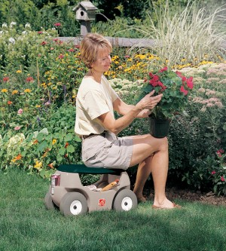
THINGS YOU CAN DO: Pacing your activities
Switch between tasks
Plan rest breaks
Recognize when you need to rest
Don’t overdo it
Notes:
Pacing your daily activities is a simple approach that helps save energy and reduce the chance of developing joint pain. It can also help minimize the amount of strain on one group of joints and muscles.
For example, switch between heavier tasks (like pushing a vacuum) and lighter tasks (like dusting). If possible, spread the most physically demanding things you do over several days instead of trying to get them all accomplished at once.
Also, break up repetitive tasks that require the same movements over and over and that place strain on certain joints (such as weeding your garden) with other tasks that require different movements or joints (such as light raking).
The easiest pacing method is to balance activity with planned rest breaks.
Perhaps most important, learn to recognize your body’s signals that you are getting tired. Don’t keep at a task or activity and end up overdoing it.

Slide 19
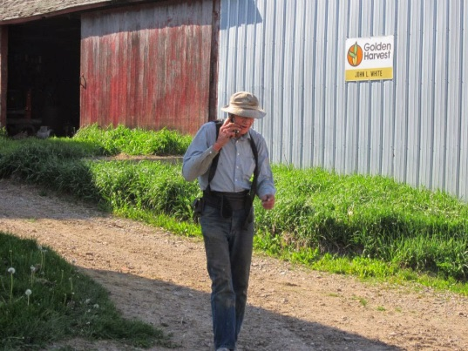
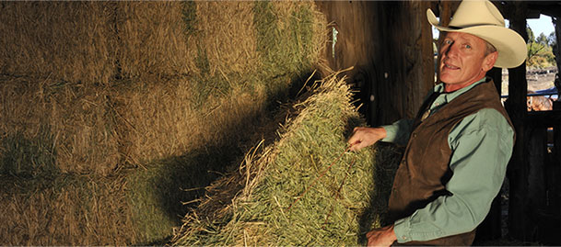
THINGS YOU CAN DO: Protect Your Joints
Avoid activities that stress joints
Use splints, braces, assistive devices
Know how to use joints safely
Practice good posture

Slide 20
THINGS YOU CAN DO: Weight control
Even a
little weight
loss can help!
1 pound = 4 pounds of pressure off your knees
Careful diet changes
Shedding extra weight:
Reduces pain
Improves function
How to lose weight
Physical activity + healthy diet= best success
Notes:
Putting extra weight on your joints can cause more problems than you think. As weight increases, the risk of arthritis also increases.
Also, being overweight makes joint disease in osteoarthritis worse AND can increase the levels of pain and disability from osteoarthritis.
The good news is that even modest weight loss can produce meaningful improvements in pain, physical function and disability. Weight loss of just over 5% of your total body weight, for example, is enough to bring real improvements in people with knee osteoarthritis.
For each 1 pound lost, pressure on the knees is reduced by 4 pounds.
Losing weight is not a simple process, but gradual weight loss through a combination of regular physical activity and a nutritious, balanced diet has been shown to be the most effective and safest approach.

Slide 21
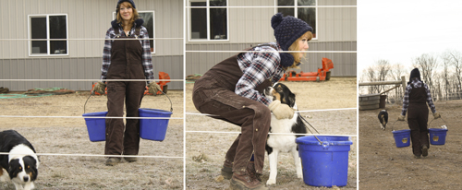
THINGS YOU CAN DO: Physical activity
Moving is medicine!
Any activity is better than no activity
To get the greatest health benefits, chose activities that
Build strength
Increase endurance
Maintain flexibility
It’s never too late to be more active!
Notes:
Moving. Try any kind of activity that moves your body—anything, as long as it is safe and appropriate for you.
You don’t need to become an athlete. Physical activity can be as simple as taking a walk with your dog or your grandchild, dancing, or working in the garden.
Many people fear that physical activity makes arthritis pain worse. This could be because, for a long time, doctors recommended limiting the use of joints affected by osteoarthritis, not knowing this was bad advice. Instead, prolonged rest and inactivity make osteoarthritis worse by contributing to joint stiffness and muscle weakness, whereas regular physical activity improves the symptoms of osteoarthritis.
When done safely and tailored to your capabilities and needs, physical activity helps—not hurts—joints affected by osteoarthritis.
Less pain
Improved ability to do activities they need or want to do
Less disability due to better strength and joint function, and
Better quality of life

Slide 22
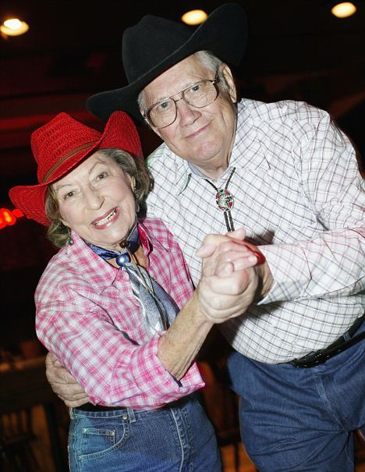
MOVE SAFELY, WISELY, AND OFTEN
Talk to your doctor about types and amounts of activity
Be as active as your fitness and health conditions allow
For greatest benefit, build up to:
Aerobic activity 30 minutes, 5 days a week
Strengthening exercises 2 to 3 times a week
Stretches and flexibility exercises daily
Moves and exercises to improve balance daily
If you can do more, then do more!

Slide 23
THINGS YOU CAN DO: Arthritis Foundation Programs for Better Living
Notes:
The Arthritis Foundation offers a series of self-management programs designed specifically for people with arthritis called Programs for Better Living. They are evidence based and have been proven to control and reduce pain through physical activity and an awareness of the disease. Each of these programs is led by an Arthritis Foundation certified instructor who has been trained to teach you the skills you need to help you feel better.
Participants in these programs report increased flexibility and range of motion, decreased pain and better quality of life.
To find an aquatic, land exercise, Walk With Ease or tai chi program near you go to www.arthritis.org or contact your local Arthritis Foundation Office.
You can also join your own local health care facility as it may have approved courses for arthritis.

Slide 24
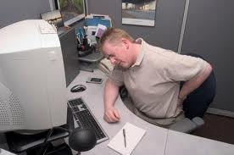
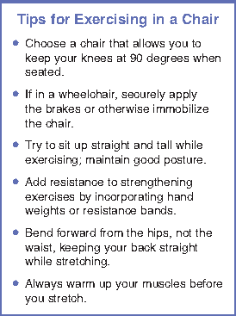
“DESKERCISE”
Finding times to exercise while at work or at home does not have to be difficult.
Some easy, seated exercises take less than 2 minutes to complete and can be done at your desk or in your favorite chair.
Notes:
Office workers commonly suffer from muscle tension in the neck, shoulders and back. Poor posture often plays a role. Prolonged sitting can lead to tight leg muscles, particularly in the hamstrings, and stiff joints. The exercises in this guide will help relieve muscle tension and joint stiffness and increase flexibility.

Slide 25
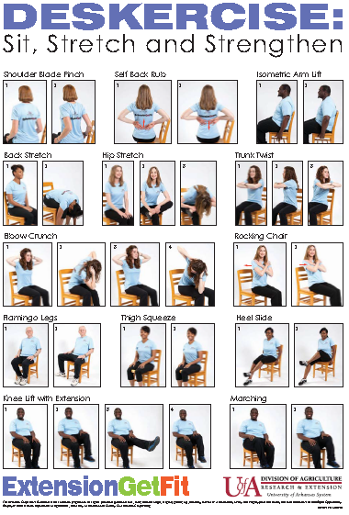
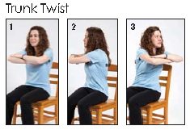
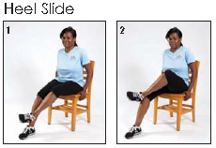
Notes:
The poster – MP524, Deskercise: Sit, Stretch and Strengthen – is available to order from the University of Arkansas Division of Agriculture, Cooperative Extension Service web site at www.uaex.edu (click the “Publications” link). We can share it with you electronically after the presentation if you are interested (can it be archived with the webinar?)

Slide 26
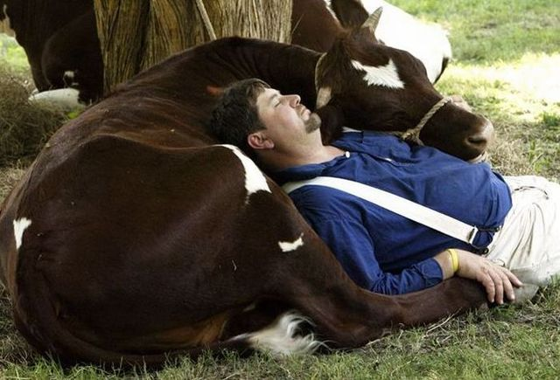
THINGS YOU CAN DO: Ways to improve sleep
Regular physical activity will aid in normal sleep patterns
Avoid alcohol and caffeine late in the day and evening
Set a sleep schedule- stick to it
Take a warm bath before bed
Avoid stress and allow your mind to relax before bed
Better Sleep = Less Pain

Slide 27
Assistive Technologies
Using Tools to Help with Tasks to Lessen Pain

Slide 28
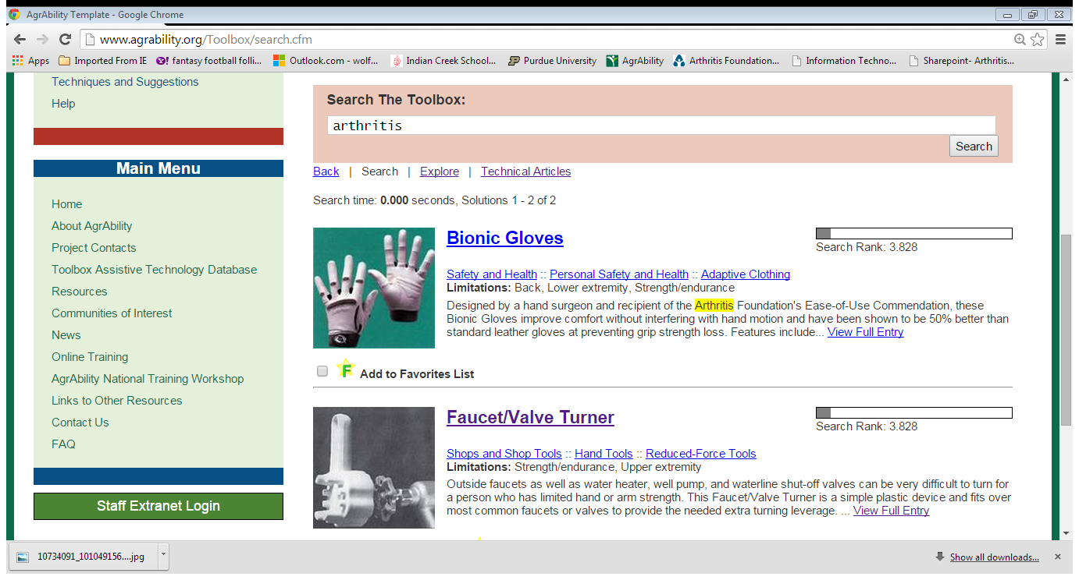
SEARCH THE TOOLBOX!

Slide 29
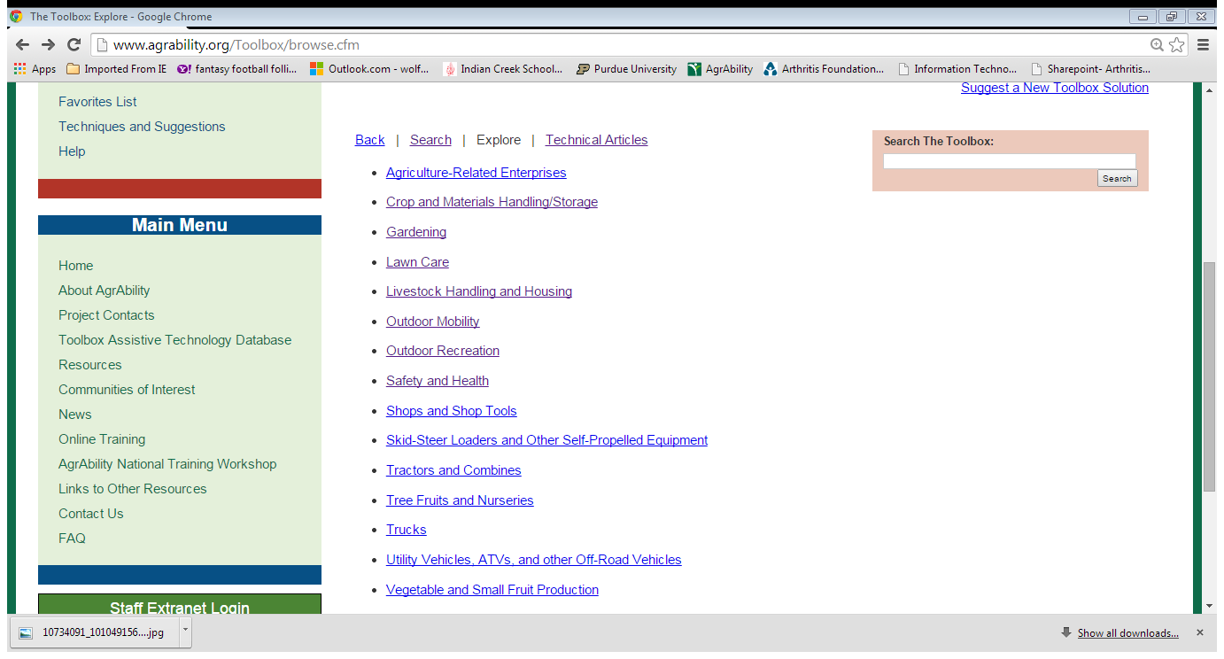
WHAT TYPE OF ACTIVITY GIVES YOU PAIN?

Slide 30
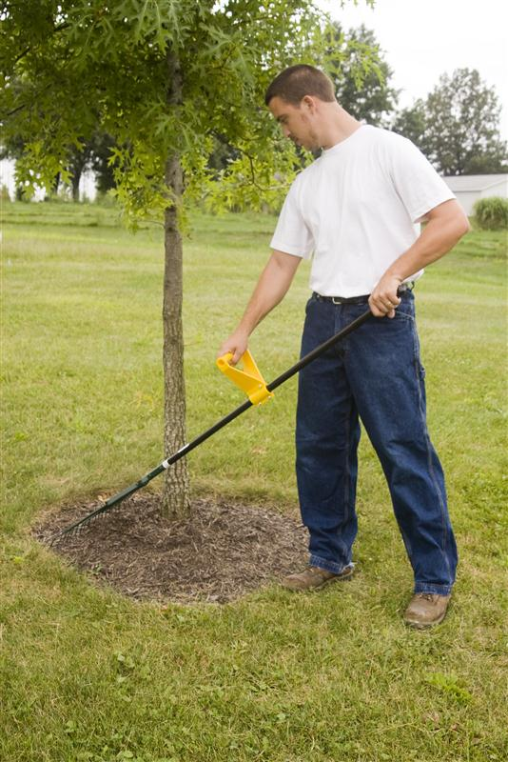
ARTHRITIS PAIN RELIEF TOOLS
Decreased Grip Tools- CanGun1 Spray Can Tool, Tube Grip, Back Saver Grip, Action Life Gloves
Increased Length Tools/Bending Prevention- Leaf Gripper Yard Tongs, Caulk Gun Extender, Long Handled Tools, Snowcaster Wheeled Snow Pusher

Slide 31
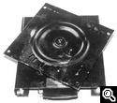
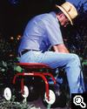
ARTHRITIS PAIN RELIEF TOOLS
Seating Aids- Spine Saver Ergonomic Seat Cushion, Tractor Swivel Seat, Garden Carts and Rocking Stools, etc.
Carrying Aids- Motorized Feed Cart, Lift Mates Box Lifting Tools, Wheel Pump Sprayer, Hand Trucks

Slide 32
What About After The Pain?
Pain Relief Options

Slide 33
DO-IT-YOURSELF PAIN RELIEF
WHAT TO TRY:
Heat and cold treatments
Distraction
Relaxation techniques/visualization
Massage
Aroma Therapy
Diet and Exercise
You can try these methods at home with little-to-no risk and no need for a prescription.
Notes:
These methods have been approved as safe by the Arthritis Foundation and the FDA, but may not have the same success rate for every person. However, they can be helpful and are relatively low-risk for trying them on your own before seeing a doctor.

Slide 34
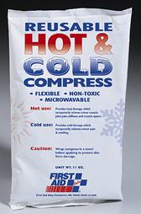
PAIN RELIEF: Application of heat and cold
Heat
Relaxes muscles
Cold
Reduces swelling, numbs
Comfort
Length of time
Notes:
Applying heat or cold to affected joints is one of the easiest ways to relieve arthritis pain and stiffness on a short-term basis.
Heat relaxes and eases tight muscles and joints, as well as stimulates the blood flow and increases the elasticity of connective tissues. It also helps decrease inflammation and buildup of fluid in tissues while also increasing range of motion and reducing muscle spasms.
Heat therapy is effective in relieving pain and reducing soreness and stiffness. It can be used prior to activity to warm up the joints, ease stiffness and increase circulation. But, be sure not to use heat on joints that are already hot and swollen. Some examples of heat are hot packs, heating pads, paraffin wax, heated pools, and warm showers.
Cold therapy is helpful for people who are experiencing joint pain caused by a flare of their arthritis or who have an injury. It works best when used immediately after an injury or after a prolonged period of activity.
Cold therapy numbs the sore area of the body and reduces inflammation and swelling by constricting blood vessels. It also limits bleeding and swelling. Cold therapy should be used as soon as possible following an injury or when pain occurs and is most effective when used for 48 hours in 15 to 20 minute intervals. Cold therapies include a bag filled with ice, a bottle filled with cold water, a bag of frozen vegetables or chemical gel cold packs.
Neither heat nor cold should be applied for more than 20 minutes, and skin should be allowed to return to its normal temperature between applications. Also, you should always have a piece of cloth, whether a towel or clothing, between you and the heat and ice pack to help protect your skin.

Slide 35
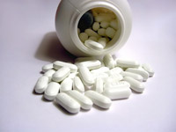
PAIN RELIEF: From The Store
Non-Prescription Drugs
Aspirin-Free Pain Relievers- acetominphen (Tylenol)
NSAID’s- Non-Steroidal Anti-inflammatories- ibuprofen (Motrin) or naproxen (Aleve)
Topicals- rubs, gels, creams, sprays
Muscle Relaxants
Supplements
Notes:
Tylenol is pain only
Motrin/Aleve are pain and inflammation

Slide 36
PAIN RELIEF: Things your health care provider can do
Joint Support/Aids
Physical /Occupational Therapy
Over-The-Counter Meds
Prescription medications
Joint Injections
Surgery
Alternative Therapies- Acupuncture
Notes:
Sometimes, self-management pain strategies are not enough to battle your pain and further help is necessary to get pain under control. There are many options that might be considered and should be talked through with your healthcare provider so that together, you can decide which might be appropriate for you.

Slide 37
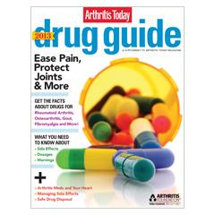
FROM YOUR HEALTHCARE PROVIDER: Prescription Medications
Prescription Level Pharmacy Medicines
Analgesics
Prescription NSAIDS
Cox 2 inhibitors (Celebrex)
Corticosteroids
Disease Modifying
Anti Rheumatic Drugs (DMARD’s) (Methotrexate)
Biologic Response Modifiers (Biologics) (Enbrel, Humira)
Notes:
Some medications are only available by prescription. Here are some common prescription drugs used to treat arthritis.
Opiod analgesics (definition- relief from pain)- (Morphine, Oxycodone, Fentanyl)- interrupt pain signals to the brain, short relief with more side effects
As I have already mentioned, there are some NSAIDS (En-seds) that are available by prescription only. COX-2 inhibitors are a type of NSAID that help with pain and inflammation associated with arthritis. A Cox-2 Inhibitor can decrease pain and inflammation but is safer on your stomach than traditional NSAIDs. An example of this type of drug is Celebrex.
Next on the list are corticosteroids. Corticosteroids are hormones produced by your body that have anti inflammatory properties. Synthetic or man-made forms such as prednisone can treat joint inflammation in arthritis. Studies have shown that joint injections into the knee joint offers some pain relief for people with osteoarthritis of the knee.
Corticosteroids are very effective and fast working at decreasing inflammation, so much so that it can actually spare joints, eyes and organs from suffering irreparable damage in cases of severe rheumatoid arthritis, lupus and other types of arthritis. They are often prescribed in high doses for a short period of time and then taper off as the inflammation decreases. Corticosteroids are very effective but they can have some negative side effects like causing brittle bones, cataracts and elevated blood sugar. Your doctor can further discuss the benefits and drawbacks of using corticosteroids.
For people with conditions such as rheumatoid arthritis, drugs called disease modifying anti rheumatic drugs or DMARDS (Dee-mards) are often prescribed. These drugs decrease the bone and joint damage associated with the disease to a greater extent than aspirin or other NSAIDs. Often, they are prescribed along with other medications, like corticosteroids, as part of your treatment plan since they can take time to show results. DMARDS can suppress the immune system to help control the disease. The earlier in the course of the disease these drugs are started, the less damage there will be.
DMARDS are used to treat rheumatoid arthritis, juvenile rheumatoid arthritis, ankylosing spondylitis, psoriatic arthritis and lupus. Some commonly used DMARDS are hydroxychloroquine, leflunomide and methotrexate.
The newest class of drugs that have been developed are called Biologic Response Modifiers or Biologics which control disease by changing the way processes in your body work. Biologics target parts of the immune system involved in joint inflammation that attacks tissue and can damage joints by blocking the actions of these cells and, as a result, reduce inflammation. Biologics can be given as an injection, or shot, or as an infusion. This class of drug has really changed the way people are living with RA and other inflammatory types of arthritis because of it’s high effectiveness. However, it is important to note that biologics are usually very expensive and can leave patients prone to infections. Some examples biologics you may have heard of are Enbrel, Remicade and Humira.
If you have any questions regarding these drugs and what might be best for you, please speak with your health care provider.

Slide 38
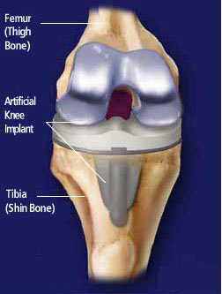
FROM YOUR HEALTHCARE PROVIDER: Surgery
Injections
Nerve Blocks
Arthroscopy
Synovectomy
Joint Replacement
Notes:
Most people with arthritis will never need to have surgery. Occasionally, self management, like physical activity and weight loss, and medications are not effective at relieving joint pain and immobility caused by arthritis. In some cases a variety of surgical procedures can be considered. The type of surgery depends on the joint involved and the cause of the joint dysfunction and pain.
Arthroscopy is a procedure that allows a doctor to see directly into the joint through an instrument called an arthroscope. This type of surgery can be used to find out what kind of arthritis exists and the amount of damage. In the past, arthroscopic surgery was performed to decrease the knee pain associated with arthritis. But a recent study has shown that arthroscopic surgery is no more effective than non-operative treatments, like physical therapy and drug therapy, to treat knee pain associated with arthritis.
Your doctor may suggest a Synovectomy, which is the removal of the synovium (the sac of fluid that surrounds the bones and joints that becomes inflamed when a joint has arthritis). This procedure may result in temporary pain relief and reduction in swelling but synovium can come back and cause the same pain as before the surgery.
Joint replacement means that portions of the damaged joint are replaced with “material components” which can decrease pain and improve mobility.

Slide 39
ADDITIONAL PAIN RELIEF OPTIONS: Supplements and alternative therapies
Glucosamine/Osteo Bi-Flex
Chondroitin sulfate
Omega-3 Fatty Acids/Fish oil (AI)
Green tea extract (AI)
Notes:
In addition to the pain management approaches we’ve talked about today, many people choose to either take a different route entirely or add on to their regular treatment routine. Glucosamine has been found to have the most effect on knee osteoarthritis, but it is still only one possible method of pain management.
You’ll also find a number of dietary supplements or herbal products being sold for “joint health.” Glucosamine and chondroitin are often combined into one product. Studies show that people with moderate-to-severe knee pain and people with hand OA are most likely to get feel relief. If you try it, but don’t get relief after six months, they will probably never have a positive effect.
Glucosamine- found naturally in joints of the body- supplement will help to maintain good glucosamine levels, but will NOT rebuild or replace lost cartilage
Chondroiten- found naturally in the cartilage- supplement can help slow the breakdown of natural cartilage, best in combination with glucosamine.

Slide 40
Put Pain In It’s Place!
Pain Does Not Control You

Slide 41
PAIN DOES NOT CONTROL YOU
Put Pain In It’s Place!
Do something that you enjoy every day.
Do something every day that improved your health and well-being.
Rediscover and use your strengths.
Always try to be active and productive when you can, but rest and find relief when you need it.

Slide 42
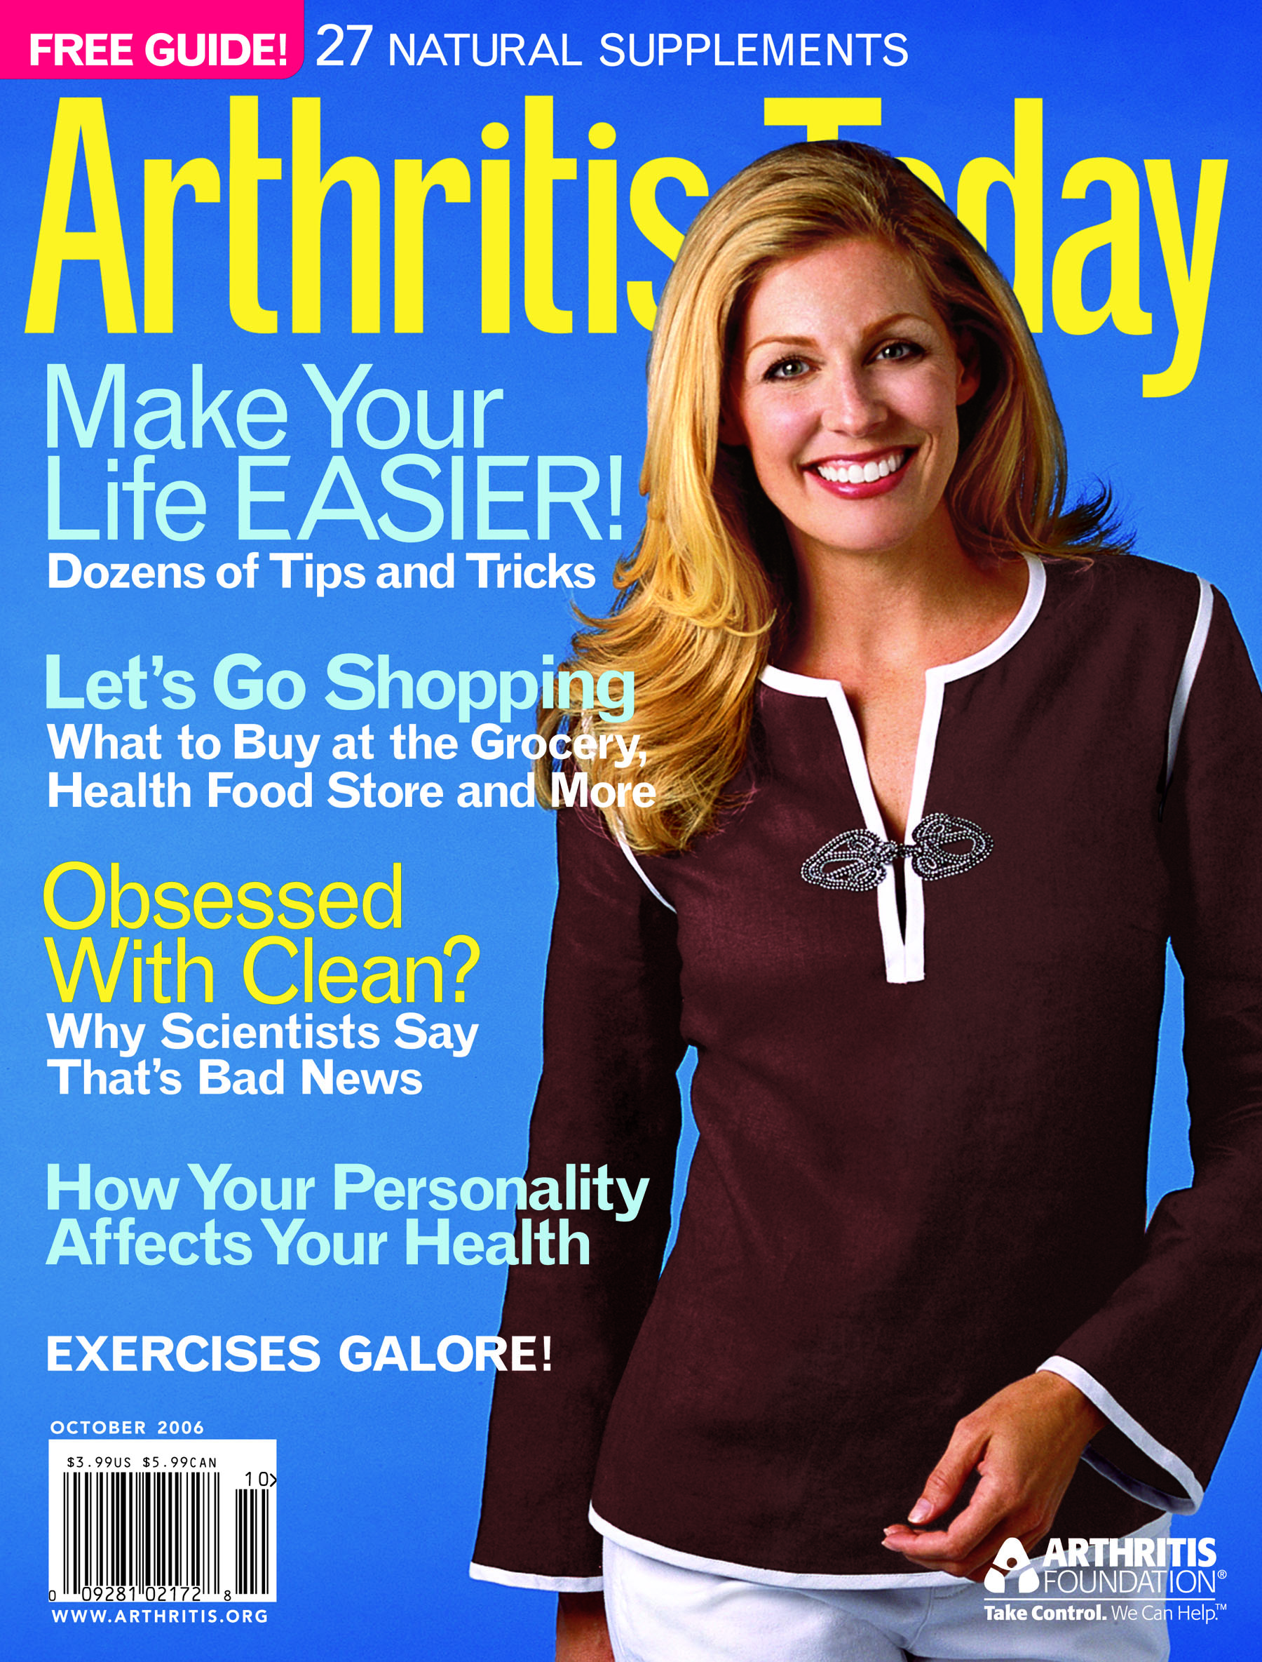
ADDITIONAL RESOURCES
Arthritis Foundation
Information and Referral Line
(800) 283-7800
www.arthritis.org
Arthritis Pamphlets- Managing Your Pain, Back Pain, Nutrition, Exercise, Managing Your Activities, Hot/Cold Therapies, Children and Arthritis, More!
Arthritis Today Magazine
Support Groups
American Chronic Pain Association
(800) 533-3231
http://theacpa.org/condition/arthritis
Living with Arthritis Pain Chart
Resource Guide to Chronic Pain Medication and Treatment
National Council on Aging
(202) 479-6605
www.ncoa.org

Slide 43
AGRABILITY RESOURCES
National AgrAbility Project
(800) 825-4264
www.agrability.org
Arthritis and Agriculture Booklet
Back Pain Booklet
Gaining Ground on Arthritis DVD
Spanish Fotonovela
Toolbox Online Resource
http://www.agrability.org/Toolbox/

Slide 44
QUESTIONS & ANSWERS
Audience Poll Questions
Audience Evaluation Questions
THANK YOU!

Slide 45
Presenter Contact Information
Amber Wolfe
Arthritis Foundation
615 N. Alabama Street, Suite 430
Indianapolis, IN 46204
1-800-783-2342
awolfe@arthritis.org
www.arthritis-ag.org
Find us on Facebook (Arthritis and Agriculture) and Twitter (#ArthritisAg)!

