Slide 1
Occupational Therapy’s Role in Agriculture/Rural Communities
Danyele Clingan, OTS
University of Indianapolis, National AgrAbility Project
AgrAbility Webinar Series Thursday, April 26, 3:00 p.m. ET

Slide 2
Basic Webinar Instructions
Audio available through computer or phone.
Check sound via Communicate menu at top left
Closed captions: use arrow to expand or contact the Media Viewer window. You may have to enter some log-in information.
Expand/contract any of the windows in the right-hand column with the arrows. May need to do this to see video of presenter.
Expand/contract the size of the right-hand column.

Slide 3
Basic Webinar Instructions
Questions and comments
Click Chat icon at top right of screen (it should turn blue). Enter message in box, choose who to send it to, and click send. You may enter questions about the presentation at any time. Please send to “All Panelists”.
In addition, during the Q & A period, if you have a web microphone, click the “Raise Hand” icon to indicate that you have a question. We will enable your microphone or phone connection.

Slide 4
Basic Webinar Instructions
Please let me know if more than one person is viewing at your computer
4 quick survey questions + opportunity to share comments
Session recorded and archived with PowerPoint files at www.agrability.org/Online-Training
Problems: use chat window or email jonesp@purdue.edu

Slide 5
AgrAbility: USDA-sponsored program that assists farmers, ranchers, and other agricultural workers with disabilities.
Partners land-grant universities with disability services organizations. Currently 20 state projects
National AgrAbility Project: Led by Purdue’s Breaking New Ground Resource Center. Partners include:
Goodwill of the Finger Lakes
APRIL (Association of Programs for Rural Independent Living)
Colorado State University
Washington State University
More information available at www.agrability.org

Slide 6
Occupational Therapy’s Role in Agriculture/Rural Communities
Danyele Clingan, OTS
University of Indianapolis
National AgrAbility Project
Notes:
Introduce self

Slide 7
AgrAbility/ Agriculture Overview

Slide 8
Agriculture Overview
Approximately 21.4 million (11% of US workforce) full/part time individuals work in agriculture or related occupations
Average reported number of farm workers for 2016, 730.8 thousand
The US is a leader in agricultural product export at $129.7 billon in 2016
The average farm size has risen from 418 acres in 2007 to 442 acres in 2016
A 2008 study, on prevalence of disabilities within the agriculture population, estimates approximately 1.04-2.23 million individuals have a disability
USDA, 2018; USDA, 2018; Deboy et. al., 2008

Slide 9
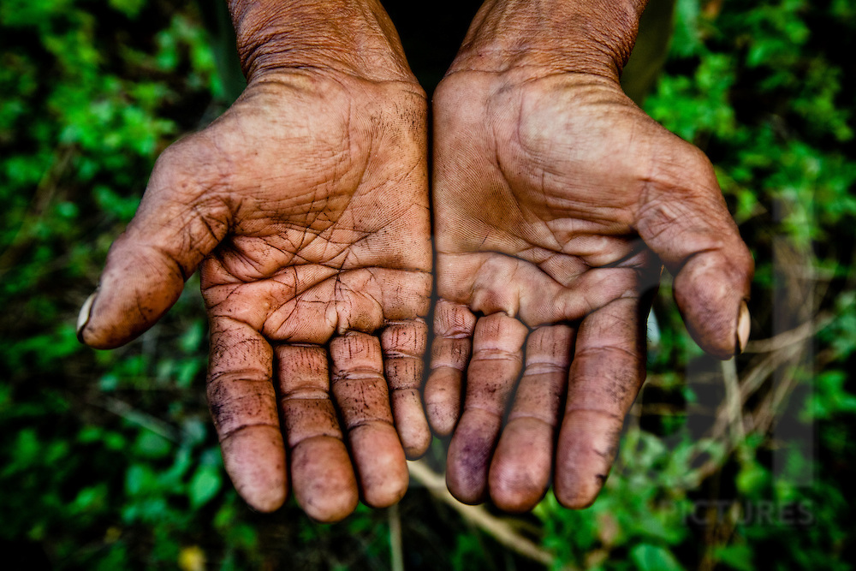
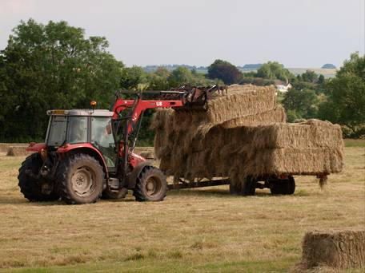
Agriculture Overview: Risk Factors
Extreme weather
Terrain
Farm machinery
Unpredictable situations (fire)
Excessive vibration and motion
Respiratory Hazards (chemicals, dust, molds)
Handling livestock
Falls
Untreated impairments (visual/hearing)
Length of workday
Repetitive tasks
Gruver et. al., 1997

Slide 10
Agriculture Overview: Common Injuries/Conditions
Arthritis
Back pain
Knee pain
Amputations
Visual/hearing impairments
TBI/brain injuries
SCI/paralysis
Congenital diagnoses
Respiratory impairments
Disabling diseases
Eye injuries
Shoulder injuries
Center for Dairy Farm Safety

Slide 11
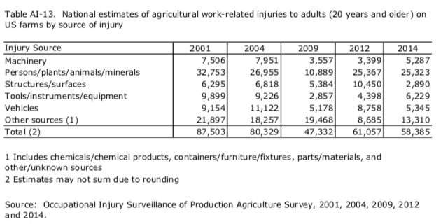
Agriculture Overview: Prevalence of Injuries/Conditions
CDC, 2017

Slide 12
Agriculture Overview: Prevalence of Injuries/Conditions
CDC, 2017

Slide 13
Agriculture Overview: Prevalence of Injuries/Conditions
CDC, 2017

Slide 14
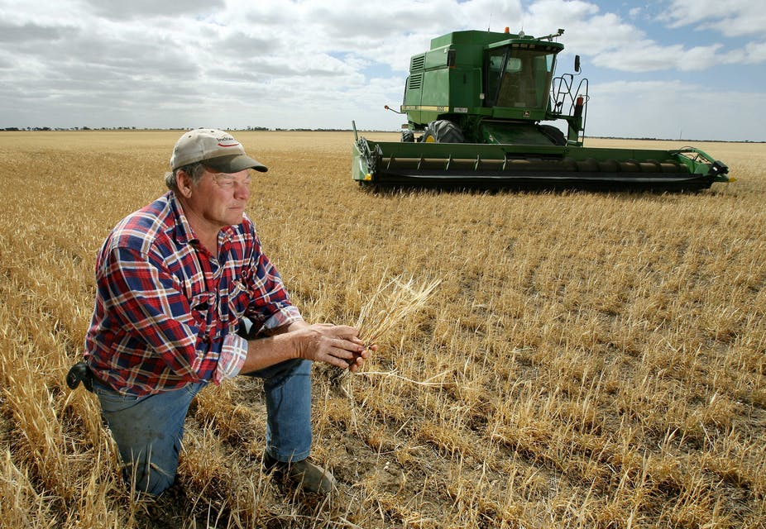
Cultural Philosophy
“Farming is in one’s blood…and it means a lot to losing. It’s almost taking the soul out of [farmers].”
Farming is a way of life, an identify, and a valued role where one feels great pride
Why I Farm: http://www.whyifarm.com/
Waite, 2015; PUExtension, 2011
Notes:
“One of the main themes from my research is that medical professionals didn’t understand where farmers were coming from. They said you need to give up on farming,” she says. “Just understanding that this is the person’s identity can give occupational therapists a big edge. The key is to use therapeutic use of self and be aware that farming is more than a job.”-Brittany Cowgill, OTD, OTR/L

Slide 15
Occupational Therapy Overview

Slide 16
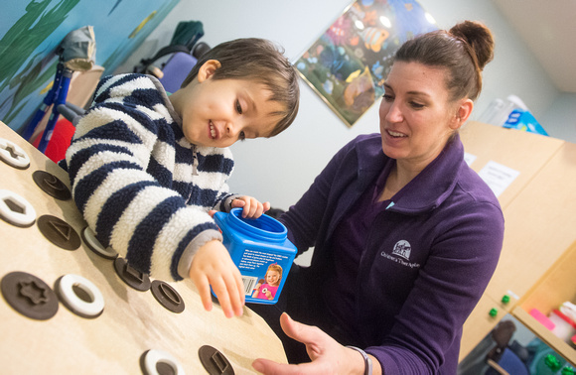
Role of Occupational Therapy
Help individuals of all ages perform the activities they need to do or want to do in their daily lives
Promote function in ones own environment (home, school, community, etc.) while addressing physical, psychological, and cognitive aspects that may impede engagement or participation in ones daily occupations
AOTA, n.d.

Slide 17
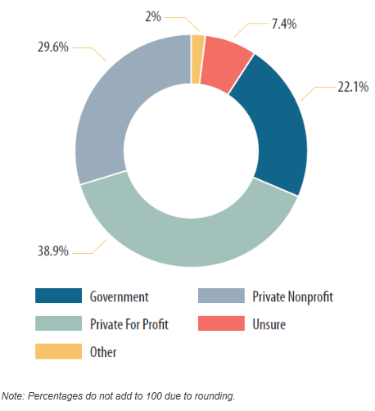
Occupational Therapy: Practice Areas
Direct Client Interventions
Indirect/ Administration
Consultation
Research
Other
Children & Youth
Health & Wellness
Mental Health
Productive Aging
Rehabilitation & Disability
Work & Industry
AOTA, n.d.

Slide 18
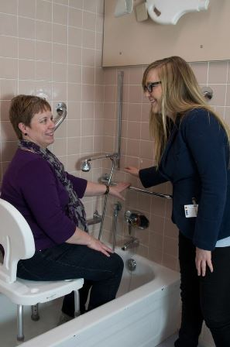
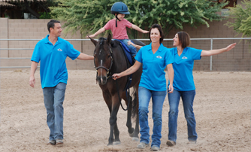
Occupational Therapy: Practice Settings
Academia
Community
Early Intervention
Outpatient
Home Health
Hospital (Inpatient)
Long Term Care/Skilled Nursing
Mental Health
Schools
AOTA, n.d.

Slide 19
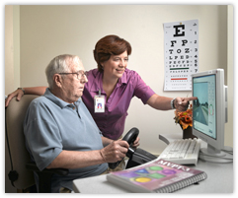
Occupational Therapy: Types of Services Provided
Overarching services
Screening and evaluations
Intervention/treatment plans
Outcomes evaluation/discharge planning
AOTA, n.d.; AOTA, 2000

Slide 20
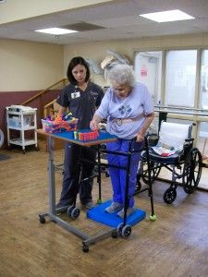
Occupational Therapy: Types of Services Provided
Specific Interventions
Children: social skills, feeding/eating, dressing, handwriting, personal hygiene
Rehabilitation: dressing, personal hygiene, balance, strength/endurance
Mental Health: coping strategies, substance use, stress management, role development, wellness, social skills
Productive Aging: cognitive training, energy conservation, safety education, fall prevention, driving rehabilitation
Community: home or environmental modifications
AOTA, n.d.; AOTA, 2000

Slide 21
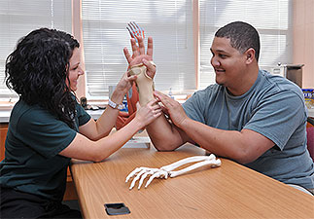
Occupational Therapy: Injuries/Disabilities Commonly Treated
Visual/Hearing Impairments
Spinal Cord Injuries
Brain Injuries
Cerebral Palsy
Hand Injuries
Developmental Delays
Down Syndrome
Chronic Impairments
Rhett’s Syndrome
Dementia/Alzheimer's
Amputations
PTSD
Burns
Arthritis
Stroke

Slide 22
Partnering AgrAbility and Occupational Therapy Services

Slide 23
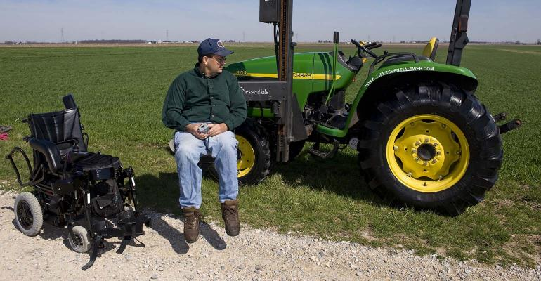
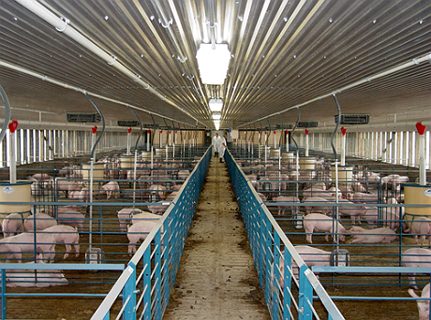
Assistive Technology & Related Interventions
Clinical Relevance
Injuries (acute)
Chronic conditions
Functional Mobility
Mental health
Common Intervention/Modification Ideas
Mechanical lifts
Assistive technology
Energy conservation techniques
Elimination of hazardous environments
Use of safety equipment
Modified work tools
Consideration of lighting

Slide 24
Assistive Technology Resources
Visit the National AgrAbility Project Assistive Technology Toolbox for additional tools and equipment
www.agrability.org/toolbox

Slide 25
Assistive Technology Resources
National AgrAbility Project: agrability.org
Rehabilitation Engineering and Assistive Technology Society of North America: https://www.resna.org/
Life Essentials: www.lifeessentialslifts.com/
EasterSeals: www.easterseals.com/
AbleData: https://abledata.acl.gov/
The National Public Website on Assistive Technology: assistivetech.net/

Slide 26
Assistive Technology Evaluation
Free online resource for evaluating assistive technology for farmers and ranchers created by the National AgrAbility Project entitled, Evaluating Agricultural Workplace Assistive Technology for Secondary Injury Hazards: An Assessment Tool for Professionals Who Assist Farmers and Ranchers with Disabilities
www.agrability.org/wp-content/uploads/2015/11/SecInjryAssmtTool.pdf
National AgrAbility Project, 2010

Slide 27
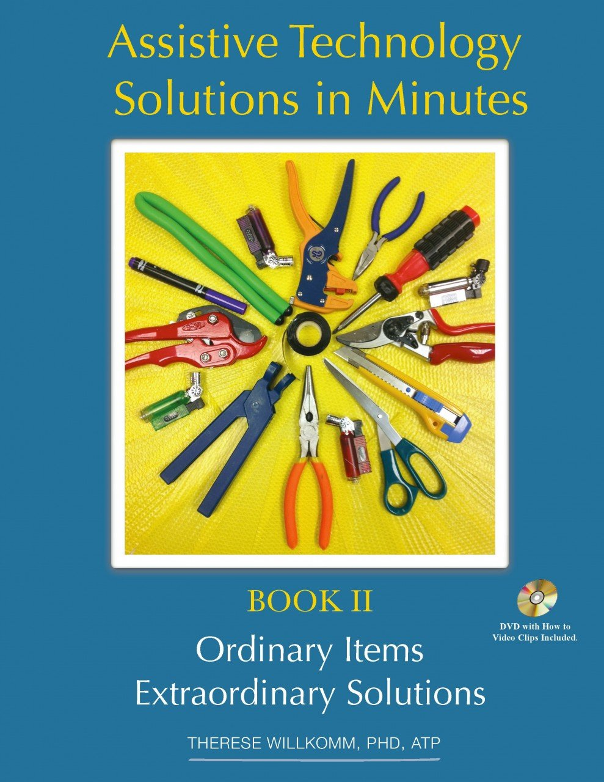
Self-Assembled Assistive Technology
Additional resource on easy assembly assistive technology can be found in Therese Willkomm’s book, Assistive Technology Solutions in Minutes: Ordinary Items Extraordinary Solutions. Resource can be purchased from various retail providers.
Willkomm, 2013

Slide 28
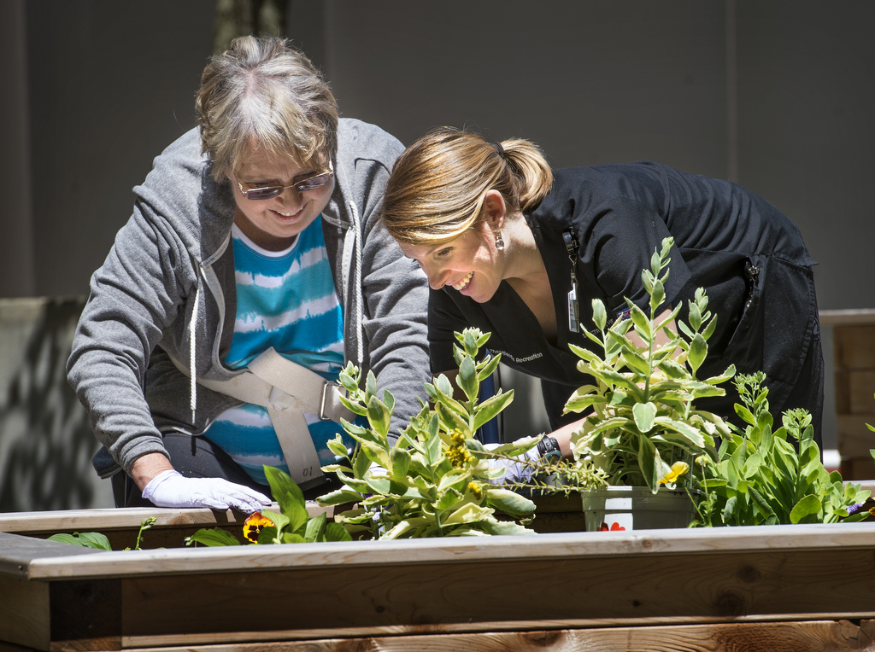
Partnership Opportunities
State AgrAbility Projects
Local extension services
FFA chapters
Local hospitals or clinics
Disabilities organizations
Equipment vendors
Master Gardeners
Farmer Veteran Coalition
Therapeutic riding centers
Health professional organizations
Agriculture service providers (Farm Bureau, Farm Credit Mid America, feed/seed companies, etc.)
Notes:
Shared materials with clinic then clinic shared

Slide 29
Educational opportunities/Outreach Efforts
Areas of Partnership
On-site farm assessments/home modifications
Farm shows
Presentations/training/workshops
Consultants
Publications
Educational/Outreach Efforts
Outreach to health professionals and/or associated community members
Conducting training seminars/workshops
Integrating agricultural topics into graduate curricular work

Slide 30
Publications Discussing Occupational Therapy in Agriculture/Rural Communities
Cowgill, B. (2014). What is the role of occupational therapy in Ohio’s AgrAbility program in helping farmers continue to farm?
Hissong, A. N. and Wilhite, C. S. (2009). Occupational therapy’s role with farmers and ranchers with disabilities: Two perspectives. OT Practice, 14(4), 7-8.
Hissong, A. N. and Wilhite, C. (2008). Occupational therapy’s role with farmers with disabilities or disease: Understanding the cultural factor of farming as a way of life. OT Practice, 13(13), CE1-7.

Slide 31
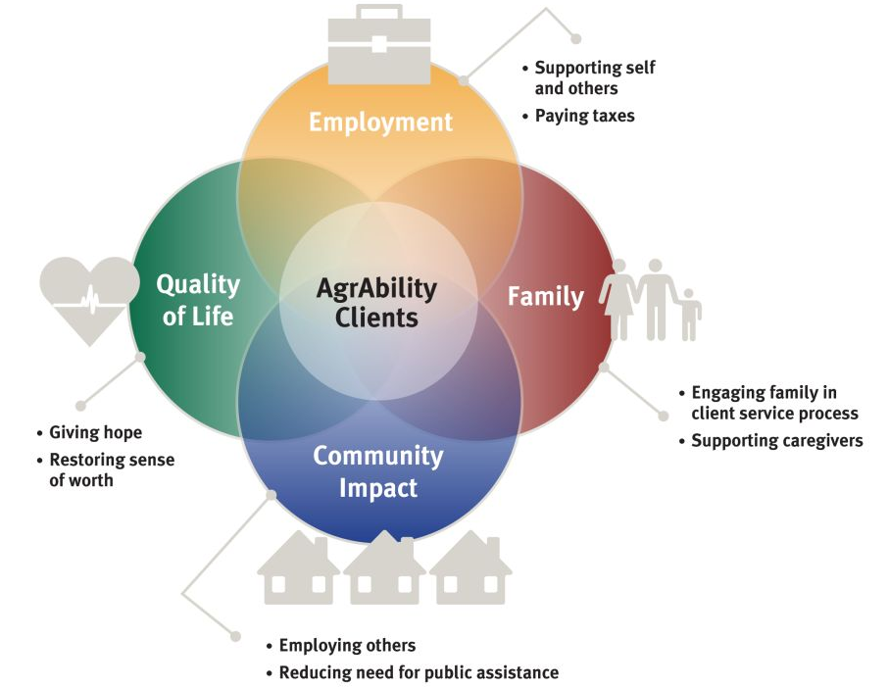
AgrAbility Model vs PEOP Model
AgrAbility, 2017

Slide 32
References
AgrAbility. (2017). A USDA program with demonstrated impact. Retrieved from www.agrability.org/wp-content/uploads/2017/12/AgrAbility_Impact_2017.pdf
American Occupational Therapy Association, Inc. (2000). OT and community mental health. Retrieved from https://www.aota.org/About-Occupational-Therapy/Patients-Clients/MentalHealth/Community/OTandCommunityMentalHealth.aspx
Center for Dairy Farm Saftey-University of Wisconsin River Falls & Wisconsin Extension. Injury Trends. [PDF Format]. Retrieved form https://www.osha.gov/dte/grant_materials/fy11/sh-22318-11/Mod_2_InjuryTrendsInstructorNotes.pdf
Center for Disease Control and Prevention. (2017). Agricultural saftey: Occupational injury surveillance of production agriculture (OISPA) survey. National Institute for Occupational Saftey and Health. Retrieved from https://www.cdc.gov/niosh/topics/aginjury/oispa/injtables.html
Deboy, G.R., Jones, P.J., Field, W.E., Metcalf, J.M., & Tormoehlen, R.L. (2008). Estimating the prevalence of disability within the US farm and ranch population. Journal of Agromedicine, 13(3), 175-189.
Gruver, M. L., Allen, P. B., Field, W. E., & Schweitzer, J. M. (1997). Potential health and safety risks of farming/ranching with a disability. Retrieved from www.agrability.org/wp-content/uploads/2015/11/ps27.pdf
National AgrAbility Project. (2010). Evaluating agricultural workplace assistive technology for secondary injury hazards: An assessment tool for professionals who assist farmers and ranchers with disabilities. Purdue University.
National AgrAbility Project. (n.d.). The toolbox: Assistive technology database. Retrieved from www.agrability.org/toolbox/?mode=browse
PUExtension. (2011). AgrAbility: Its about hope [short version]. Retrieved from: https://www.youtube.com/watch?v=sI3vChVHdoc&feature=youtu.be

Slide 33
References
The American Occupational Therapy Association, Inc. (n.d.). Occupational therapy: Improving function while controlling costs. Retrieved from https://www.aota.org/About-Occupational-Therapy/Professionals.aspx
The American Occupational Therapy Association, Inc. (n.d.). What is occupational therapy? Retrieved from https://www.aota.org/~/media/Corporate/Files/Practice/Manage/Presentation-Resources/Brochure/What-Is-OT-Aging-v2.pdf
The American Occupational Therapy Association, Inc. (n.d.). Work setting trends for occupational therapy: How to choose a setting. Retrieved from https://www.aota.org/Education-Careers/Advance-Career/Salary-Workforce-Survey/work-setting-trends-how-to-pick-choose.aspx
Swain, S. Indiana AgrAbility and assistive technology on the farm. [PowerPoint Slides].
USDA. (2018). 2017 Agricultural Statistics Annual. Retrieved from https://www.nass.usda.gov/Publications/Ag_Statistics/2017/index.php
USDA. (2018). FAQ. Retrieved from https://www.ers.usda.gov/faqs/#Q11
Waite, A. (2015). A growing opportunity: OT’s role helping farmers and ranchers. OT Practice, 12-16.
Willkomm, T. (2013). Assistive technology solutions in minutes: Ordinary items extraordinary solutions (2nd ed.). Durham, New Hampshire: The Institute on Disability at the University of New Hampshire.

Slide 34
Image References
https://www.google.com/search?q=farmers+hands&source=lnms&tbm=isch&sa=X&ved=0ahUKEwihyav-0dXaAhUBx2MKHZX_Bq0Q_AUICigB&biw=1067&bih=696#imgrc=LTK2Hb0S6L_PgM:
https://www.google.com/search?biw=1067&bih=696&tbm=isch&sa=1&ei=wpHgWqvrJIqcjwPw36WQCg&q=farmer+mental+heal&oq=farmer+mental+heal&gs_l=psy-ab.3..0j0i24k1l3.11020.14936.0.15168.22.13.0.0.0.0.377.744.3-2.2.0....0...1c.1.64.psy-ab..20.2.737...0i67k1.0.g_q-TDf4jsk#imgrc=J-hCblTIVXFlPM:
https://www.google.com/search?biw=1067&bih=696&tbm=isch&sa=1&ei=G5LgWunUHoqejwP0lYWoBA&btnG=Search&q=occupational+therapy+working+in+schools#imgrc=f5hkDVQpYWAv3M:
https://www.google.com/search?biw=1067&bih=696&tbm=isch&sa=1&ei=kJXgWr-WGI_qjwPEnbCADA&q=occupational+therapy+working+on+farm&oq=occupational+therapy+working+on+farm&gs_l=psy-ab.3...57537.63197.0.63375.29.19.1.0.0.0.533.2336.0j1j3j0j2j1.7.0....0...1c.1.64.psy-ab..24.2.691...0j0i13k1j0i13i5i30k1j0i8i13i30k1j0i24k1.0.JxjuC-TfzZA#imgrc=jxKE9Yx33DVapM:
https://www.google.com/search?biw=1067&bih=696&tbm=isch&sa=1&ei=BJbgWpecNoTwjwPAhpyYCA&q=occupational+therapy+working+on+driving&oq=occupational+therapy+working+on+driving&gs_l=psy-ab.3...37787.40069.0.40179.12.9.0.0.0.0.349.1266.0j2j1j2.5.0....0...1c.1.64.psy-ab..7.2.688...0i24k1.0.3alycUcNLWI#imgrc=WrKIOtwBRvtJcM:
https://www.google.com/search?biw=1067&bih=696&tbm=isch&sa=1&ei=N5bgWoy_As_GjwOaqaGwDQ&q=occupational+therapy+working+on+standing&oq=occupational+therapy+working+on+standing&gs_l=psy-ab.3...28275.30812.0.30908.14.11.3.0.0.0.163.1150.0j8.8.0....0...1c.1.64.psy-ab..3.0.0....0.yj1Lc1vtwpc#imgrc=RsyuknpXPz6sNM:
https://www.google.com/search?biw=1067&bih=696&tbm=isch&sa=1&ei=gpbgWrrqDY3cjwObpITYAQ&q=agrability&oq=agrability&gs_l=psy-ab.3..0j0i24k1l9.24307.25768.0.25941.10.8.0.0.0.0.385.1348.2-2j2.4.0....0...1c.1.64.psy-ab..6.4.1343...0i67k1j0i30k1j0i5i30k1.0.FNhow5mC6WY#imgrc=fVDgoE4qlrhEYM:
https://www.google.com/search?biw=1067&bih=696&tbm=isch&sa=1&ei=u5bgWqa8IMPqjwPL0YLwDQ&q=lighting+in+a+pig+barn&oq=lighting+in+a+pig+barn&gs_l=psy-ab.3...35467.36827.0.36989.6.5.1.0.0.0.153.730.0j5.5.0....0...1c.1.64.psy-ab..0.0.0....0.JIexpRyQHeM#imgrc=ZG_84gpSdKDnfM:

Slide 35
Image References
https://www.google.com/search?biw=1067&bih=696&tbm=isch&sa=1&ei=45bgWsbhO8OejwPa9ou4Ag&q=agrability+toolbox&oq=agrability+toolbox&gs_l=psy-ab.3..0i24k1.19979.23994.0.24158.18.10.0.5.5.0.438.2062.2-5j1j1.7.0....0...1c.1.64.psy-ab..6.12.2520...0j0i30k1j0i5i30k1.0.PgSiq-nN0FI#imgrc=BcW3D6k9EOwKGM:
https://www.google.com/search?biw=1067&bih=696&tbm=isch&sa=1&ei=AJfgWo2fFoG8jAPNurSYBg&q=resna+logo&oq=resna+logo&gs_l=psy-ab.3..0i13k1l2j0i24k1.19484.21624.0.21830.10.10.0.0.0.0.323.1467.2-5j1.6.0....0...1c.1.64.psy-ab..4.6.1456...0j0i67k1j0i10k1j0i8i30k1.0.v3N1TZGNUwM#imgrc=I4sh0IHMV0zV2M:
https://www.google.com/search?biw=1067&bih=696&tbm=isch&sa=1&ei=GpfgWrXLBYzWjwP_zpHgCQ&q=easterseals+log&oq=easterseals+log&gs_l=psy-ab.3..0i10k1l5j0i24k1j0i10i24k1j0i24k1.26967.30202.0.30382.17.15.0.0.0.0.509.3403.2-5j2j2j1.11.0....0...1c.1.64.psy-ab..6.10.3387.0..0j0i67k1j0i10i67k1.140.mrGvbABSOMI#imgrc=3poMdHnapBMOJM:
https://www.google.com/search?biw=1067&bih=696&tbm=isch&sa=1&ei=cpfgWpS8ENTmjwOEoobwAw&q=ordinary+items+extraodinary+solutions&oq=ordinary+items+extraodinary+solutions&gs_l=psy-ab.3...18830.31678.0.31779.60.47.5.1.1.0.439.7545.0j19j9j6j1.36.0....0...1c.1.64.psy-ab..20.16.4107.0..0j0i10k1j0i10i24k1j0i24k1j0i67k1j0i5i30k1j0i8i30k1j0i30k1.151.5TFUKWD0xkE#imgrc=RQmyBVtx1E15MM:
https://www.google.com/search?biw=1067&bih=696&tbm=isch&sa=1&ei=lZfgWqTwIof6jwOriZSQCQ&q=occupational+therapy+gardening&oq=occupational+therapy+gardening&gs_l=psy-ab.3..0j0i24k1l2.20344.24713.0.24789.30.16.0.6.6.0.424.3703.2-8j4j1.13.0....0...1c.1.64.psy-ab..12.18.3841...0i67k1j0i30k1.0.By8v85OgF_A#imgrc=1qHjuv2cW6KSJM:
https://www.google.com/search?biw=1067&bih=696&tbm=isch&sa=1&ei=lZfgWqTwIof6jwOriZSQCQ&q=occupational+therapy+gardening&oq=occupational+therapy+gardening&gs_l=psy-ab.3..0j0i24k1l2.20344.24713.0.24789.30.16.0.6.6.0.424.3703.2-8j4j1.13.0....0...1c.1.64.psy-ab..12.18.3841...0i67k1j0i30k1.0.By8v85OgF_A#imgrc=bDaRgbrdz12JNM:
https://www.google.com/search?biw=1067&bih=696&tbm=isch&sa=1&ei=sZfgWpDOKsf2jwOutLDQCw&q=peop+model&oq=peop+model&gs_l=psy-ab.3..0j0i67k1j0l4j0i30k1j0i10i30k1j0i24k1l2.36498.38660.0.38848.10.9.0.0.0.0.309.1515.0j1j3j2.6.0....0...1c.1.64.psy-ab..4.6.1505...0i10k1.0.LMkY04c7qr4#imgrc=rImw-3fzNAJegM:

