Slide 1
New Ideas in Rural and Farm Assistive Technology Zach Eltzroth, MBA Adaptive Enterprises LLC AgrAbility Webinar Series Thursday, December 15 3:00 p.m. ET

Slide 2
Basic Webinar Instructions
Audio available through computer or phone.
Check sound via Audio menu at top left
Closed captions: use arrow to expand or contact the Media Viewer window.
Expand/contract any of the windows in the right-hand column with the arrows. May need to do this to see video of presenter.
Expand/contract the size of the right-hand column.

Slide 3
Basic Webinar Instructions
Questions and comments
Click Chat icon at top right of screen (it should turn blue). Enter message in box, choose who to send it to, and click send. You may enter questions about the presentation at any time. Please don’t use Q & A option.)
In addition, during the Q & A period, if you have a web microphone, click the “Raise Hand” icon to indicate that you have a question. We will enable your microphone or phone connection.

Slide 4
Basic Webinar Instructions
4 quick survey questions + opportunity to share comments
Session recorded and archived with PowerPoint files at www.agrability.org/Online-Training/archived
Problems: use chat window or email jonesp@purdue.edu

Slide 5
AgrAbility: USDA-sponsored program that assists farmers, ranchers, and other agricultural workers with disabilities.
Partners land grant universities with disability services organizations. Currently 20 state projects
National AgrAbility Project: Led by Purdue’s Breaking New Ground Resource Center.
Partners include:
Goodwill of the Finger Lakes
APRIL Colorado State University
More information available at www.agrability.org

Slide 6
New Ideas in Rural and Farm Assistive Technology
Adaptive Enterprises LLC
info@adaptiveenterprisesllc.com
(888)896-1970

Slide 7
Our Presenter: Zach Eltzroth
Zach Eltzroth, MBA
Chief Information Officer
Zach has personally evaluated and trained over three hundred clients for Indiana Family and Social Services Administration, Vocational Rehabilitation Services. Zach started his career in Assistive Technology as a consulting developer with Palm Pilot, with the mission of making Palm Pilots accessible to consumers with a variety of disabilities. Zach has a keen interest in teaching and learning information technologies, and their direct application to persons with disabilities. Zach’s primary research interest relates to how artificial intelligence research can help the most severely disabled. In the realm of assistive technology, Zach has served many institutions and companies, some of which include Adobe Systems, Panera Bread, the University of California Community College System, University of Colorado – Boulder, Indiana University, and Mesa State College.

Slide 8
Adaptive Enterprises LLC
About Us
Our team is comprised of individuals from various backgrounds (computer science, neuropsychology, IT training, Vocational Rehabilitation, and mental health) who endeavor to meet the needs of both VR counselors and their consumers. We believe in providing quality evaluations and training that is specific to the individual needs of the consumer and their specific vocational goal. Our specialties are educational technologies, executive functioning and attention, cognitive/organization solutions, mobile technology solutions, computer access, business information technology, and technology for the blind/visually impaired.

Slide 9
Adaptive Enterprises LLC
Evaluations
From the time that a consumer is referred for an evaluation, our goal is to have the completed report to the counselor within 3 weeks (baring any difficulties with contacting/scheduling with the consumer). If we are not able to meet this expectation, we will notify the VR counselor/VRCC as soon as possible.
The evaluation includes the following information:
A summary of the background information we have received (via referral, collateral, and in- person interview)
A breakdown of the specific limitations addressed in the report (along with a description)

Slide 10
Adaptive Enterprises LLC
Evaluations
Descriptions of what technology is recommended to meet each of these limitations and why (often including information regarding why other technology is not anticipated to meet the needs of the consumer)
A simplified list of what equipment (that is not free) is recommended
A comprehensive training plan – detailing an estimate of the time to ensure that the consumer is comfortable with and competent in using the equipment that they have received
An estimate of travel
We seek to answer any specific referral question that is asked of us. If counselors have additional questions upon reading the report, we are always happy to discuss the report and will amend the report as necessary.

Slide 11
Adaptive Enterprises LLC
Training
Adaptive Enterprises LLC recommends comprehensive training in order to reduce equipment abandonment (caused by consumers not really understanding how/when to use their equipment and/or becoming frustrated with the equipment). Because of this, the hours recommended for training may be more than counselors may be used to seeing. As we have worked with consumers who have memory/executive functioning difficulties, cognitive difficulties, and complex disabilities, we find that training that reinforces and builds-upon previous lessons is most successful for these individuals. In situations where the consumer is anticipated to have a greater understanding of how to integrate technology into their lives successfully, the training plans are significantly less. We endeavor to meet consumers where they are.

Slide 12
Adaptive Enterprises LLC
Creative Solutions
The team at Adaptive Enterprises, LLC is inspired by those situations where others may not see a solution. With our diverse backgrounds, we are able to brainstorm solutions with individuals from various disciplines. We seek out the least-cost option that will adequately address the individual’s limitations; from low-tech to high-tech, from widely-available to specialized, and even (when no other solution is found) to customized solutions – such as apps developed specifically for that purpose. Adaptive Enterprises, LLC prides itself on offering creative solutions.

Slide 13
AT and Business Technology for Famers
Analyze the Requirements of the Job
What technology is used for the position
Physical nature of job requirements
Cognitive requirements of the job
Communication requirements
Important Step: Write a job description analyzing and outlining each nuance and requirement of the position. Understand the position as best as possible.
First: Use assistive technology to address aspects of the job that are,
Main procedures of the job
Routine secondary procedures of the job
Occasional procedures of the job

Slide 14
AT and Business Technology for Famers
Second: Use assistive technology to problem solve the occasional procedures of the job
Make a list of what random issues arise. Address those.
Have the consumer and support people keep a journal of what random issues arise.
Use these lists of random issues to collectively problem solve with the consumer, and other support people.
Find trends in the problems
Try to solve the trends with solutions on hand
Solve the issues with solutions with off the shelf products
Solve the issues with custom built products

Slide 15
AT and Business Technology for Famers
Third: Implementation Analysis and Procedures
You must understand where the consumer is in the employment cycle.
Find a job
Return to work
Self-employed
Rehab and Technology
While AT has an integral role in rehab, some job role related AT may not be as important to the immediate, and perhaps basic, rehab needs of the consumer.
Some AT may help with life/basic need associated skills, while employment related AT may take a secondary position.
Implementation
Learn skills before returning to work
Some on the job implementation
Some implementation as “homework”

Slide 16
AT and Business Technology for Famers
Mobility Impairments
Use of Voice Recognition Technologies
Mobile
iOS
Android
Apps to supplement mobility
Desktop
Windows
Apple Mac OS
Third Party Components
Google Voice (Chrome)
Dragon Naturally Speaking
Home
Premium
Professional
Legal

Slide 17
AT and Business Technology for Famers
Mobility Impairments
Use of Voice Recognition Technologies
Uses of Artificial Intelligence
Cortana (Windows 10)
Amazon Echo (Alexa)
IBM Watson
Siri
Google Home
Office Integration
Amazon Echo
Google Home
VOIP Telephone Services
Vonage, Grasshopper, etc.
Traditional telephones with voice recognition engines

Slide 18
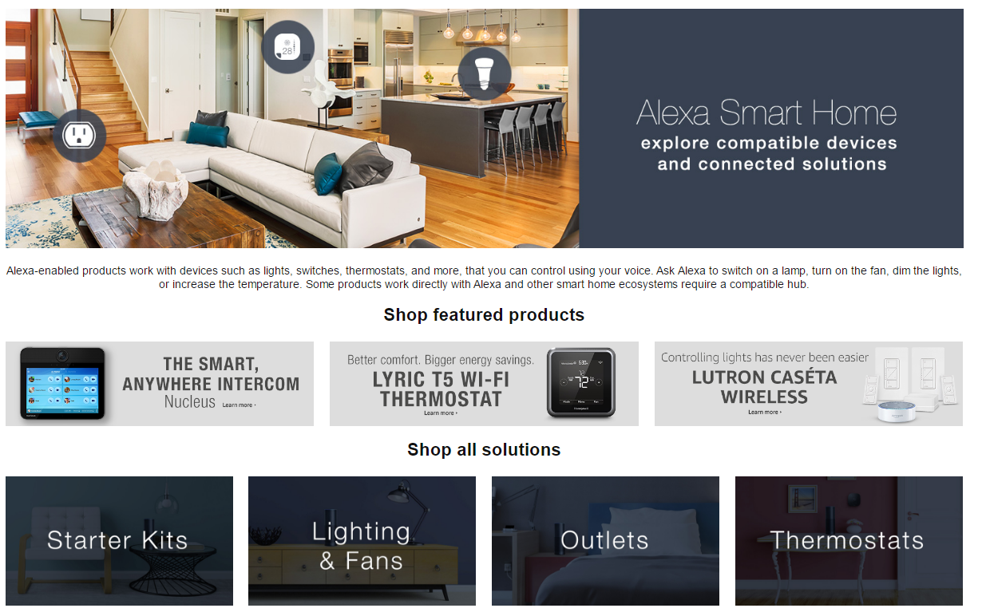
AT and Business Technology for Famers
Mobility Impairments

Slide 19
AT and Business Technology for Famers
Mobility Impairments

Slide 20
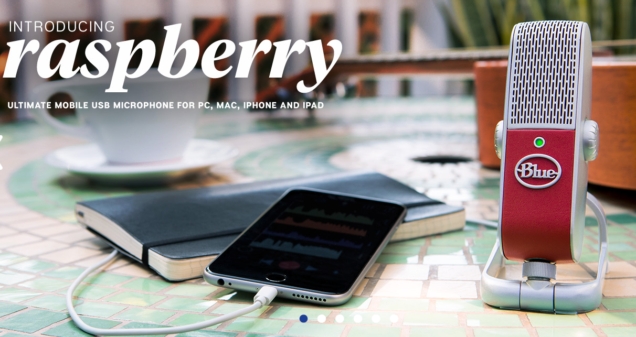
AT and Business Technology for Famers
Mobility Impairments

Slide 21
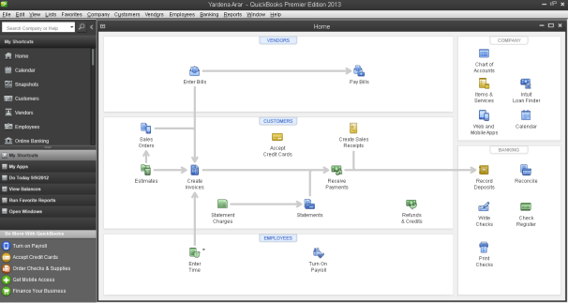
AT and Business Technology for Famers
Mobility Impairments

Slide 22
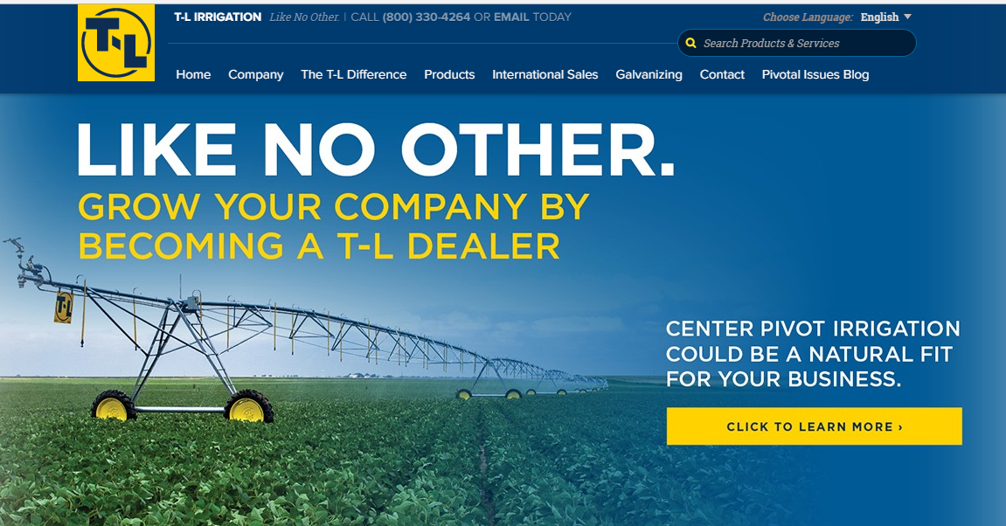
AT and Business Technology for Famers
Mobility Impairments

Slide 23
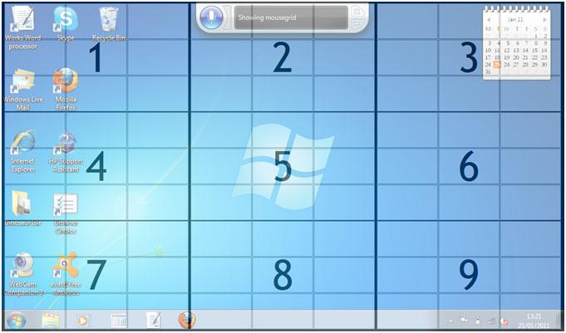
AT and Business Technology for Famers
Mobility Impairments

Slide 24
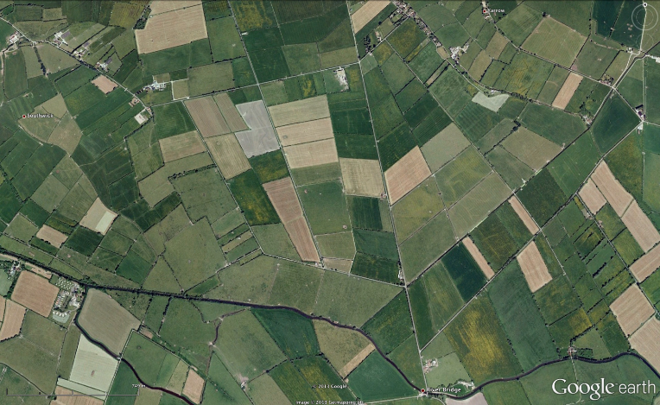
AT and Business Technology for Famers
Mobility Impairments

Slide 25
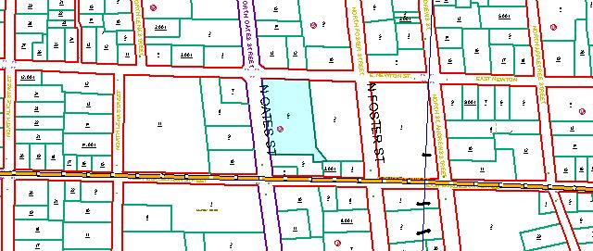
AT and Business Technology for Famers
Mobility Impairments

Slide 26
AT and Business Technology for Famers
Cognitive Impairments
Attention
Executive Functioning
Life Skills
Reading Comprehension
Verbal Expression
Written Expression

Slide 27
AT and Business Technology for Famers
Cognitive Impairments

Slide 28
Planning and Organization - General
Calendar applications/websites (e.g. Google Calendar)
Managing Appointments (initial scheduling and rescheduling)
“Chunking” Time
Calendar Sharing

Slide 29
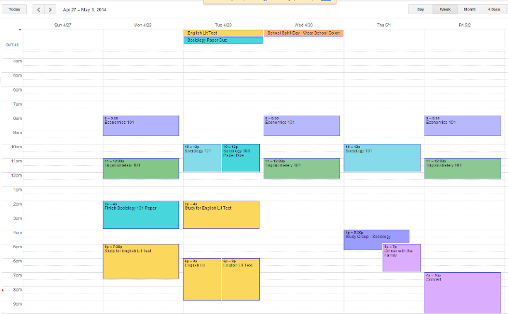
Google Calendar

Slide 30
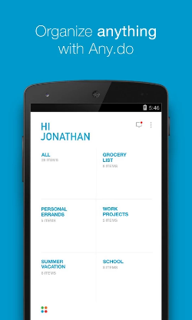
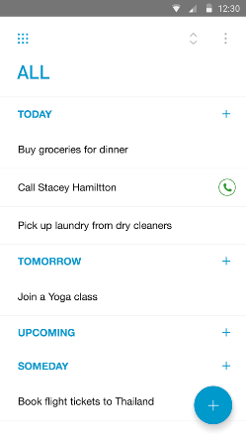
Any.Do
Screenshots from Google Play Store

Slide 31
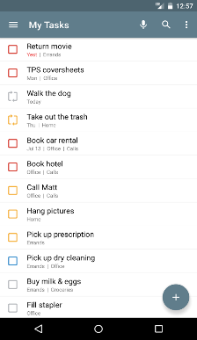
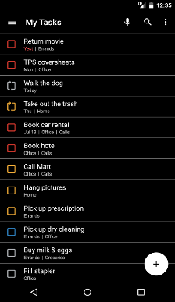
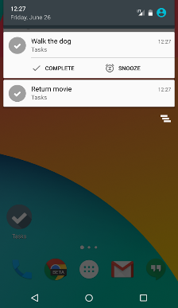
Tasks – Astrid To-Do List Clone
Screenshots from Google Play Store

Slide 32
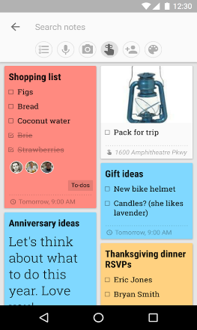
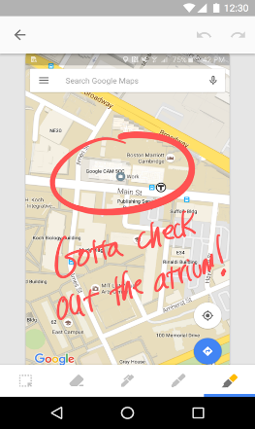
Google Keep
Screenshots from Google Play Store

Slide 33
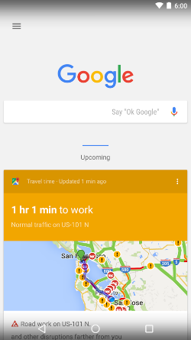
Google Now
Screenshots from Google Play Store

Slide 34
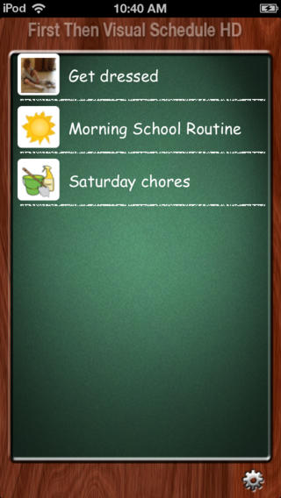
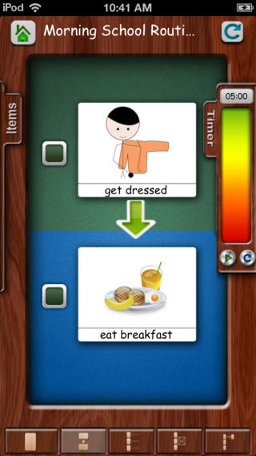
First Then Visual Schedule HD
Screenshots from iTunes Store

Slide 35
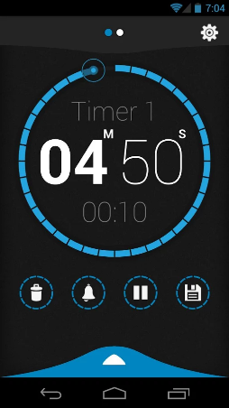
Beautiful Timer (Android)
Screenshots from Google Play Store

Slide 36
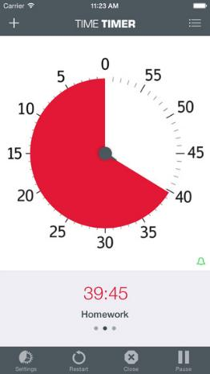
Time Timer
Screenshots from iTunes Store

Slide 37
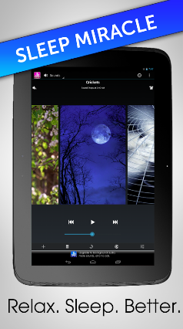
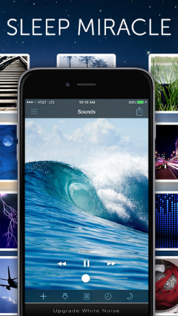
White Noise Free
Screenshots from Google Play Store and iTunes Store

Slide 38
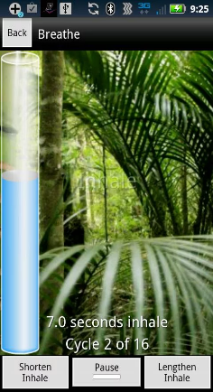
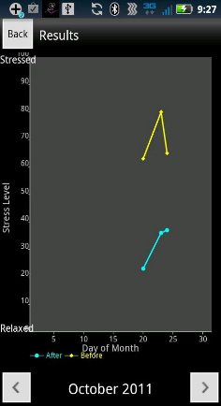
Breathe 2 Relax
Screenshots from Google Play Store

Slide 39
Inhibition/Self-Regulation (Cont)
Visual-Tactile Relaxation Apps (e.g. Pocket Pond and Laser Lights)
Allow user to touch something and view a calming effect
Diary Apps (e.g. MoodTools)
Track Moods (useful in therapy)
Prompting for Activities

Slide 40
Pocket Pond
Screenshots from iTunes Store (also available for Android)

Slide 41
Laser Lights
Screenshots from iTunes Store

Slide 42
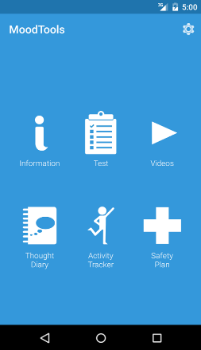
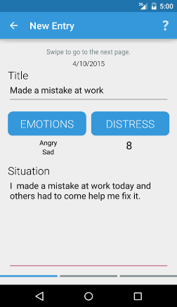
MoodTools
Screenshots from Google Play Store

Slide 43
Planning and Organization - School
Draft:Builder
Collect your thoughts in any order
Organize your thoughts in an outline
Drag/Drop your thoughts to create a paper
Inspiration
Collect your thoughts in a Graphic Organizer
Use the Graphic Organizer to create an outline
Create a presentation with your outline

Slide 44
Draft:Builder
Screenshots from DonJohnston.com

Slide 45
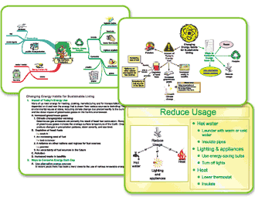
Inspiration
Screenshots from Inspiration.Com

Slide 46
Working Memory
Note Taking Apps/Programs (e.g. AudioNote)
Recorded audio catches information missed while taking notes
Notes are timestamped for easy review
Can use with text prediction software
Smart Pen (i.e. LiveScribe)
Recorded audio catches information missed while taking notes
Notes are timestamped for easy review
Kinsthetic learners are able to use a pen
Must remember 3 items for the system to work (pen, specialized paper and mobile device)

Slide 47
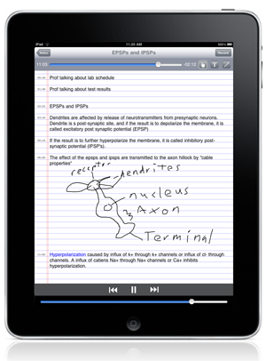
AudioNote
Screenshots from Luminantsoftware.com

Slide 48
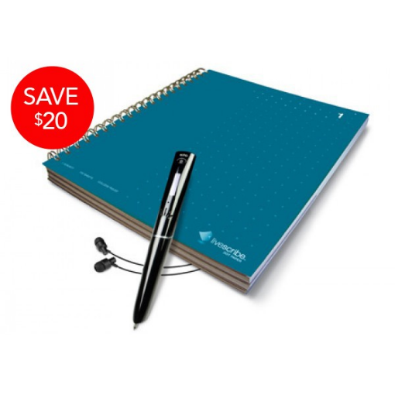
LiveScribe Pen
Screenshots from livescribe.com

Slide 49
Training as Assistive Technology
PL 108-364 (The Assistive Technology Act of 2004) includes “Training or technical assistance for an individual with a disability or, where appropriate, the family members, guardians, advocates, or authorized representatives of such an individual” as an Assistive Technology Service.
Notes:
Training is an important component of the use of assistive technology devices to address disorders of executive functioning. In order to ensure that the training “sticks,” multiple training sessions may be necessary. Training may also require printed guides (customized to the abilities of the consumer).

Slide 50
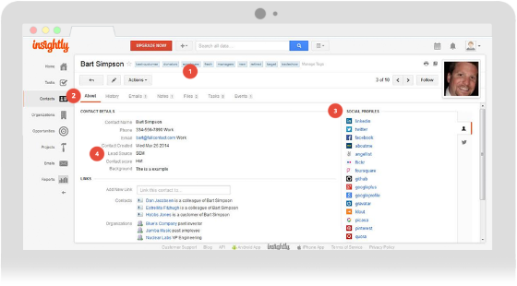
Google Insightly
Free Customer Relationship Management software
Think of it like friendly project and case management software.
Photo credit: Google

Slide 51
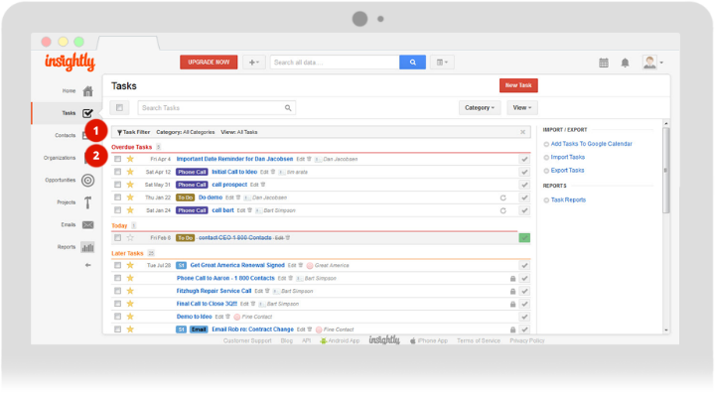
Google Insightly
Photo credit: Google

Slide 52
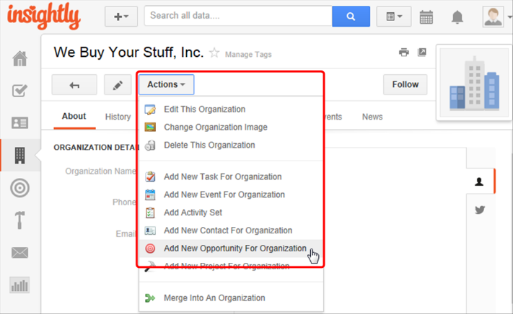
Google Insightly

Slide 53
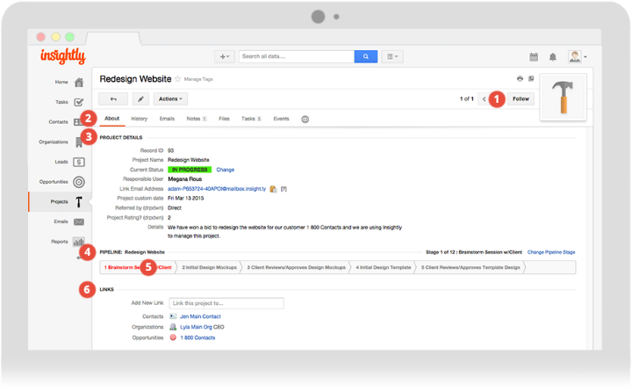
Google Insightly
Photo credit: Google

Slide 54
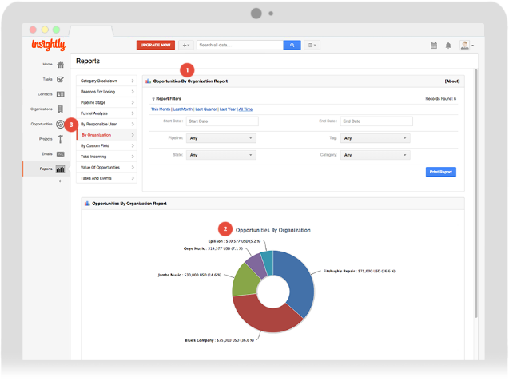
Google Insightly
Photo credit: Google

Slide 55
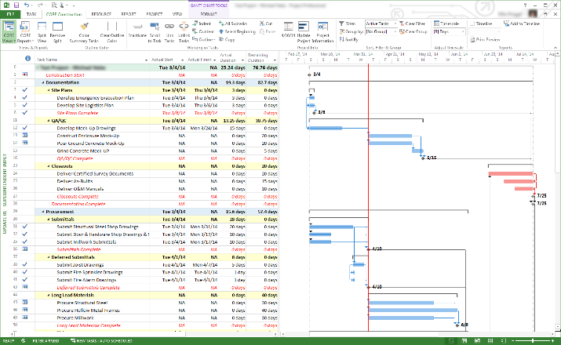
MS Access and Project
Photo credit: MSDN

Slide 56
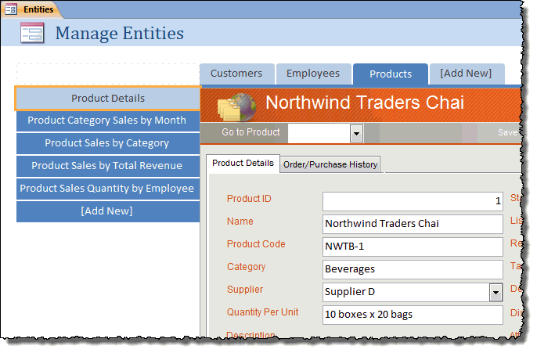
MS Access FORMS
Photo credit: MSDN

Slide 57
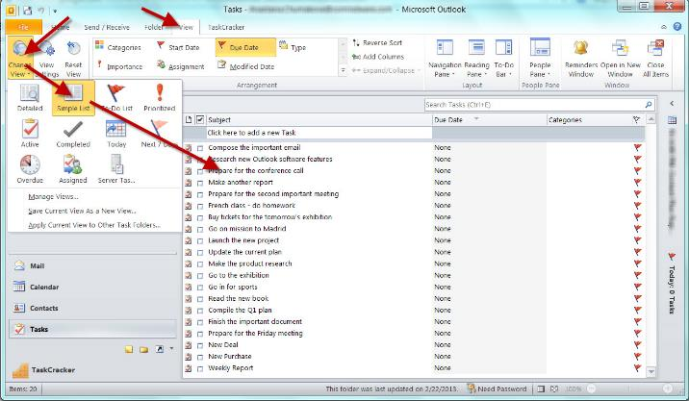
MS Outlook
Photo credit: MSDN

Slide 58
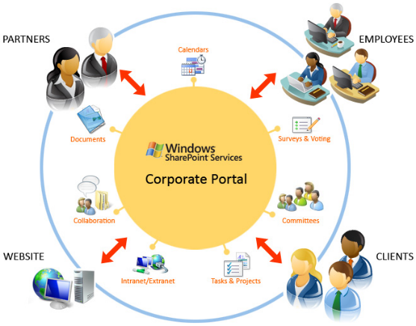
MS Sharepoint and Tools
Photo credit: Microsoft

Slide 59
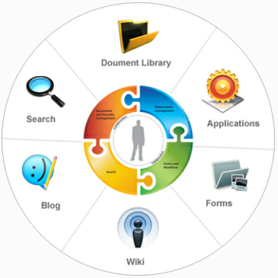
MS Sharepoint and Tools
Photo credit: Microsoft

Slide 60
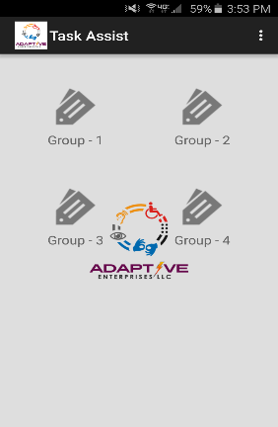
Customized Solutions Sequence IT: The Platform!

Slide 61
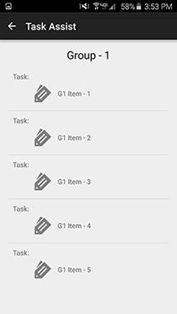
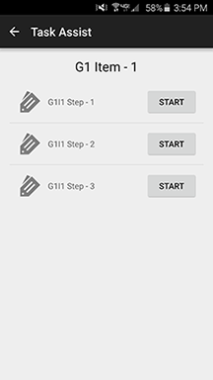
Customized Solutions Sequence IT: The Platform!

Slide 62
Thank you! Questions?
Adaptive Enterprises LLC
info@adaptiveenterprisesllc.com
(888)896-1970

