Slide 1
2012 Federal Update
Washington, D.C.
November 27, 2012

Slide 2
Basic Webinar Instructions
Need speakers or headphones to hear the presentation
Meeting > Manage My Settings > My Connection Speed
Dial-up not recommended
Questions about presentation
If you have a web cam/microphone, click the “Raise Hand” icon to indicate that you have a question
We will activate your microphone
If you don’t have a microphone, type into chat window and hit return

Slide 3
Basic Webinar Instructions
4 quick survey questions
Session recorded and archived with PowerPoint files at www.agrability.org
Problems: use chat window or email jonesp@purdue.edu

Slide 4
Known Webinar Issues
Increased interactivity = increased technical issues
Be patient while we push our boundaries
Meeting > Audio Setup Wizard
Disconnection with presenters
Hang on – we’ll reconnect as soon as possible
Disconnection with participants
Log in again

Slide 5
Bradley Rein P.E.
Director – Division of Agricultural Systems
Institute of Food Production & Sustainability
brein@nifa.usda.gov

Slide 6
Agenda
NIFA AgrAbility Program Management
Introduction of new staff
Program Specialists
National Program Leader
Federal funding updates

Slide 7
Camielle L. Compton
Program Specialist
Division of Agricultural Systems, Institute of Food Production & Sustainability
ccompton@nifa.usda.gov

Slide 8
Alexandra F. Wilson
Program Specialist
Division of Agricultural Systems, Institute of Food Production & Sustainability
afwilson@nifa.usda.gov

Slide 9
Aida Balsano, Ph.D.
NPL - FCS Research and Evaluation
Division of Family and Consumer Sciences, Institute of Youth, Family and Community
abalsano@nifa.usda.gov

Slide 10
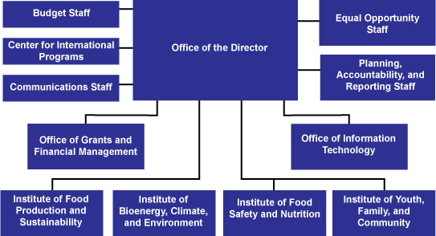

Slide 11
Family and Consumer Sciences
FCS is the integrative, multidisciplinary field of science that studies relationships among humans and their environments to foster quality of life, strengthen communities, and achieve a healthy sustainable world.

Slide 12
NIFA’s Division of Family and Consumer Sciences
To focus on the human dimensions of food and agriculture in addressing priority issues through scientific research and its application, strategic partnerships, Extension education, and the preparation of the next generation of FCS professionals.
- Family & Consumer Economics - Housing & Community Living
- Nutrition & Health - Child & Family Development
- Adult Development & Aging - Military Family & Veterans Programs
- Regional Rural Development - Sustainable Farm Enterprises
- Public & Family Policy & Diversity

Slide 13
Rural Health and Safety Education (RHSE)
In FY12, focus was on:
Individual and Family Nutrition and Health Education Programs;
Farm Safety Education Programs; and
Rural Health Leadership Development Education Programs.
Approx. $1.5 million was available;
Project period: 1 year;
39 grant applications received in FY12; 10 projects recommended for funding;
Awards ranged from $18,000 to $198,000.
http://nifa.usda.gov/funding/rfas/rural_health.html
Notes:
The funded projects will address the following health and topics among individuals and families in rural communities: diabetes prevention and self- management education, hypertension control education, nutrition and fitness education at /near Native American reservations, farm safety education, education on healthy early feeding practices, physical activity promotion among elderly through intergenerational programming, and promotion of health through traditionally-based diet and lifestyle education.

Slide 14
FCS Visiting Scholars Program
An opportunity for faculty/administrators to enhance their professional growth
while cultivating their interests at the federal level;
Faculty must have a teaching, research, and/or extension appointment in FCS, human ecology, rural sociology, or a related discipline at a Land-Grant University;
Duration: 2 weeks – 4 months;
NIFA provides work space and access to NIFA’s electronic communication systems;
The scholar’s institution provides support to the scholar through salary and living expenses.
Contact Ms. Sylvia Montgomery at smontgomery@nifa.usda.gov
Notes:
Division of Agricultural Systems – IFPS (Institute of Food Production and Sustainability)

Slide 15
Federal Funding Updates
Bradley Rein P.E.
Director – Division of Agricultural Systems
Institute of Food Production & Sustainability
brein@nifa.usda.gov

Slide 16
Questions?

