Slide 1
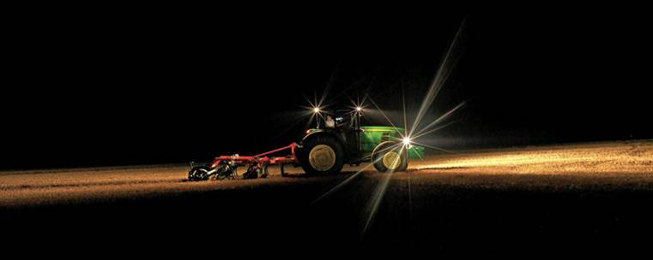
Lighting for Health and Safety in Agricultural Settings
www.deere.co.uk
Robert Stuthridge Ph.D., CPE
Project Ergonomist, National AgrAbility Project, Purdue University
www.agrability.org

Slide 2
Basic Webinar Instructions
Need speakers or headphones to hear the presentation. No phone connection.
Meeting > Manage My Settings > My Connection Speed
Dial-up not recommended
Questions about presentation
Type into chat window and hit return.
During the Q & A period, if you have a web cam/microphone, click the “Raise Hand” icon to indicate that you have a question
We will activate your microphone

Slide 3
Basic Webinar Instructions
4 quick survey questions
Session recorded and archived with PowerPoint files at http://agrability.org/Online-Training/archived along with resource materials
Problems: use chat window or email agrability@agrability.org

Slide 4
Known Webinar Issues
Disconnection with presenters
Hang on – we’ll reconnect as soon as possible
Disconnection with participants
Log in again

Slide 5
AgrAbility: USDA-sponsored program that assists farmers, ranchers, and other agricultural workers with disabilities.
Partners land grant universities with disability services organizations
Currently 23 projects covering 25 states
National AgrAbility Project: Led by Purdue’s Breaking New Ground Resource Center. Partners include:
Goodwill of the Finger Lakes
The Arthritis Foundation, Heartland Region
The University of Illinois at Urbana-Champaign
Colorado State University
More information available at www.agrability.org

Slide 6
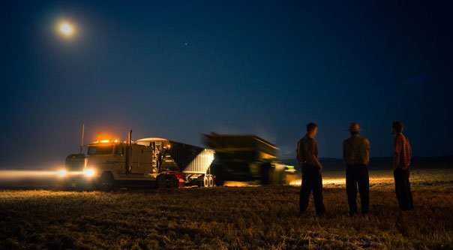
Overview
Importance of proper lighting
Measuring light
Lighting problems
Visual performance
Visual disorders
Visual task demands
Types of lighting
Standards and guidelines
References/Resources

Slide 7
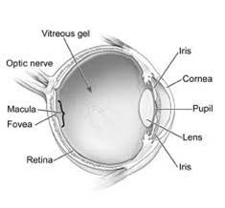
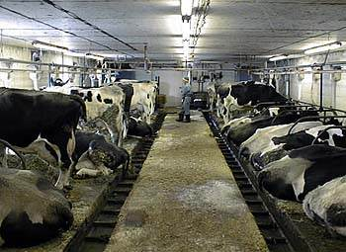
Importance of lighting
People receive about 85% of our information through sight.
Light is essential to sight.
Visibility influences posture: head, neck, and trunk.
Affects visual fatigue/eyestrain.
Critical to safety: Highlights machinery or moving objects.
Trips and falls: 40% of falls in a geriatric care hospital were due to poor lighting (Pinto, et al., 1997).
Affective (psychophysiological): alertness, mood.

Slide 8
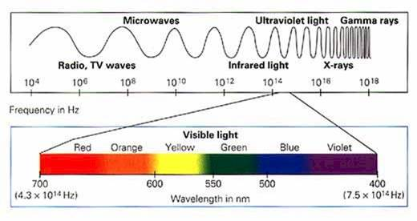
Visibility of light: wavelength
“Light is radiant energy that is capable of exciting the retina and producing a visual sensation” (Illuminating Engineering Society, 1979).
The human eye has two sets of receptors:
Cones: most sensitive to wavelengths around 550nm. Most active in bright light.
Rods: most sensitive to wavelengths around 500nm (blue-green). Dominant in dim light. Blue-Green coloring makes targets more detectable at night.

Slide 9
Measuring Light
Basic terms to describe light:
Luminous flux = power of a light source as perceived by the human eye. Unit = lumen (lm). An objective measure of useful power of a light source. Appears on light bulb packaging.
Luminous Intensity = energy output of a light source. Unit = “candela” (cd).
Illuminance = the quantity of light energy falling on a surface. Unit = “lux” (lx)’ Illuminance is inversely proportional to area.
e.g., 1,000 lumens over 1m² = 1,000 lux.
1,000 lumens over 10m² = 10 lux
Luminance = amount of light energy reflected back from a surface. Unit = cd/m². Luminance (cd/m²) = lux x reflectance
π
Reflectance = ratio of light falling on a surface to the light reflected from a surface, expressed as %.

Slide 10
Measuring Light 2
Typical illuminance levels (lux)
Outdoors, noonday summer sunlight | 160,000
Outdoors, average clear day | 50,000
Outdoors, average overcast day | 5,000
Brightly lit office | 1,000
Well lit office | 500
Domestic living room | 50
Candlelight/good street lighting | 10
Moonlight | 0.5
Approx. reflectance values - common materials (%)
Fresh white plaster | 95
White paint/good quality white paper | 85
Light grey/cream paint | 75
Newsprint, concrete | 55
Plain white wood | 45
Dark grey paint | 30
Good quality printer’s ink | 15
Matt black paper | 5
Illumination levels and luminances (all tables on this page from Pheasant, 1991). π ≈ 3.142
Environment | Illuminance (lux) | Object | Reflectance (%) | Luminance (cd/m²)
Outdoors, clear day, noon summer | 150,000 | Newspaper Grass | 55 6 | 26,000 2,900
Well-lit office | 500 | Fluorescent lamp Window (average day) White paper Dark desk top | - - 75 30 | 10,000 2,500 120 50
Outdoors at night. Good street lighting | 10 | Parked car Asphalt road | 45 6 | 1.5 0.2

Slide 11
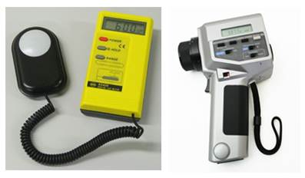
Measuring Light 3
Common tools for measuring light:
“Lux (light) meter,” “Luminance meter”

Slide 12
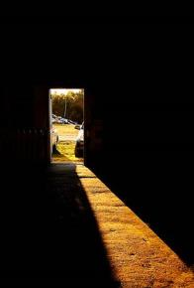
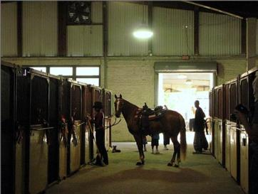
Lighting problems: Gloomy light
Insufficient light for the task/user.
Reduced visual distance; postural effect;
Risk for collisions, trips, slips and falls.
Entering a dimly-lit building from sunlight or strongly lit areas – temporary blindness (light adaptation).

Slide 13
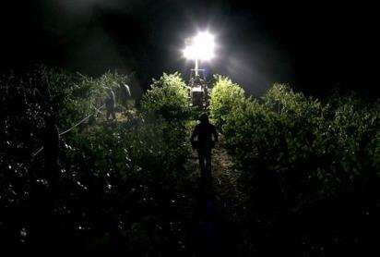
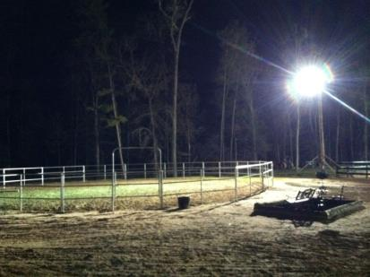
Lighting problems: Glare
Glare – light source is excessive or too bright for the user.
Disability glare: Sources of illumination can disable people with conditions such as corneal edema, lens opacities, various forms of maculopathy, and dry-eye problems (Grosvenor, 2013).
In ergonomics, “disability glare” describes loss of visual information that occurs when a bright light source renders less brightly-lit ambient surroundings invisible, and the task (e.g. walking, driving) unsafe to complete. E.g., “oncoming un-dipped headlamps at night,” or an unshielded bright light source outside a farm building.
Unshielded lights on a farm close to public roads should be shielded to reduce risk of disability glare for passing drivers.

Slide 14
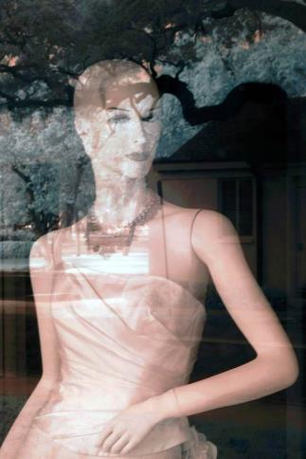
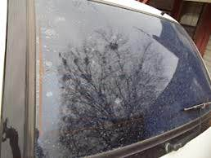
Lighting Problems: Specular glare (reflections)
Task obscured.

Slide 15
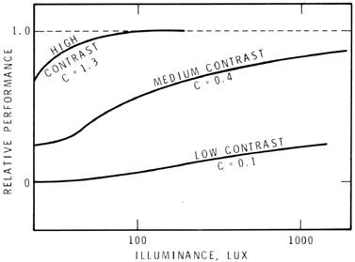
Lighting problems: Poor contrast
Contrast = relationship between the brightness of an object and its background.
Insufficient contrast - hard to distinguish object from its background.
Increased Illuminance does not compensate for insufficient contrast.
Relation of performance, contrast and illuminance. National Research Council, Canada. 1972
Average contrast should be above 0.5

Slide 16
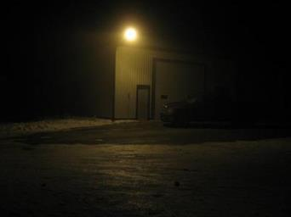
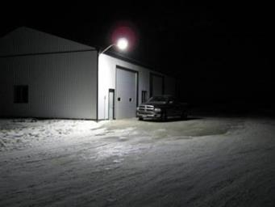
Lighting problems: Color inaccuracy
Poor color rendition. Color of an object depends on the color of the light falling upon it.
An object may absorb or reflect certain colors.
Sunlight or “full spectrum” lighting give most accurate color rendition.
Low pressure 200w sodium vs. 60w LED
www.newledlight.com.cn

Slide 17
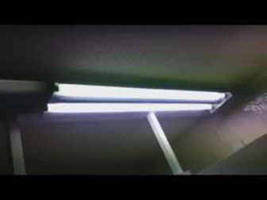
Lighting Problems: Flicker
Flicker = rapidly changing intensity. People perceive up to c.50 flashes/sec. (c.50 Hz) - most sensitive to 10-25 Hz range.
Sensory system can detect flicker much higher than 50Hz.
Eye strain/headaches.
Electronic ballasts >20kHz give fewer health problems.
Combine fluorescent lamps with natural daylight if possible.
To eliminate flicker:
Use energy-efficient electronic ballasts 20,000 - 60,000 Hz.
Replace bulbs regularly - old bulbs flicker more.
Ensure components, especially ballasts, work properly.
Mix tubes

Slide 18
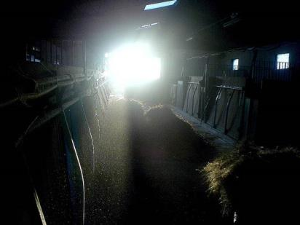
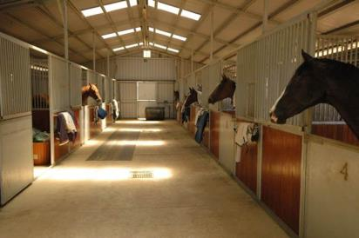
Lighting problems: Shadows
Strongly directional lighting may create strong shadows.
Combine directional and diffuse lighting to eliminate strong shadows.
Light sources behind a worker can cast shadows on the task.

Slide 19
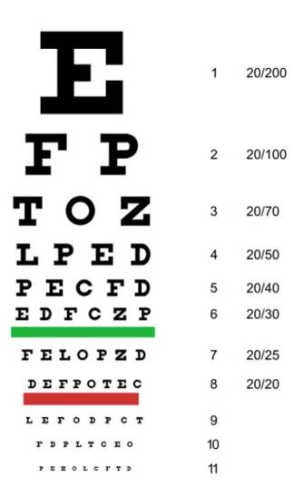
Visual performance: Acuity
Acuity = acuteness or sharpness of vision. Tested using a Snellen Chart .
At 20 feet, a human eye with nominal performance is able to separate lines that are one arc minute apart (equivalent to lines spaced 0.068 inches apart).
20/20 vision is nominal performance for human distance vision. 20/40 is half as good , and 20/10 twice as good as nominal performance.
Typically declines with age.
Acuity is highly dependent on accommodation of the eyes.

Slide 20
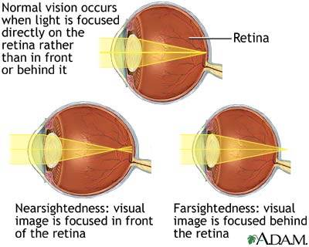
Visual performance - Accommodation
Accommodation is normal when the lens flattens to focus far images on the retina, and bulges to focus near objects.
Nearsightedness (myopia) is where the lens remains bulged, preventing proper focus of distant images.
Farsightedness (hyperopia) is where the lens remains too flat, preventing proper focus of near images.
Age relatedness.
http://health.allrefer.com

Slide 21
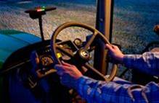
Visual performance
Dark adaptation –
pupil dilates. Admits more light.
Visual purple builds up in retina. Cones lose sensitivity. Rods predominate. Color discrimination declines.
Dark adaptation typically takes 30 minutes or more.
Light adaptation takes a few seconds or minutes at most.
Contrast sensitivity - declines with age – this results in reduced capacity to perceive fine detail in a visual object (Grosvenor, 2013).

Slide 22
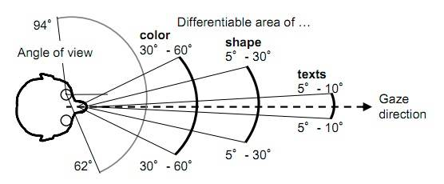
Visual performance – Field of view
Acuity of portions of visual field
http://www.technologyreview.com
Age & field of view: 900 people aged 52-102 years: "Whereas standard field extent changes very little with age, attentional field size decreases dramatically, accompanied by enormous increases in variability. 25% of the oldest age group had no peripheral fields under conditions of divided attention.“ http://www.pacificu.edu/optometry/ce/courses/16554/agingeyepg3.cfm#attentional

Slide 23
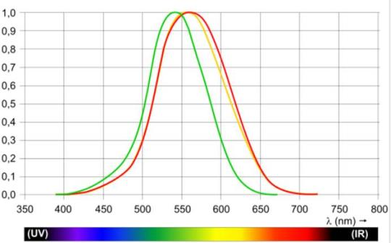
Color blindness
Color blindness changes the sensitivity of the eye as a function of wavelength.
Red/Green or Blue/Yellow commonly problematic.
Protanopia, peak response shifts toward short-wave part of the spectrum (c. 540 nm).
Deuteranopia, peak response shifts upward to about 560 nm. No sensitivity to light of wavelengths >670 nm.
Cataracts shift maximum of sensitivity to the red part of the spectrum and narrow the range of perceived wavelengths.
Protanopic (green) and deuteranopic (red) luminosity functions.
The standard photopic curve is shown in yellow.
Source: http://en.wikipedia.org/wiki/Luminosity_function#Color_blindness

Slide 24
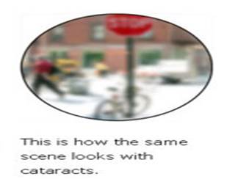
Cataracts
Cataract: yellow-brown pigment clouds the lens. Obstructs light and impairs focusing. Most common cause of blindness globally (51% – WHO).
Problems: Impaired color perception, reduced contrast, driving, reading, recognizing faces, coping with glare.
Lighting: 1) eliminate glare, 2) provide sufficient task illumination and 3) optimize task visibility.
Adjust window shades to reduce direct sunlight.
Incandescent lamps or "warm" fluorescents cause less glare than "daylight" fluorescents, but may not render color so well. Incandescents less efficient, radiate more heat - problem if close to user's face or body.
Use bright primary colors with high contrast.
Wear sunglasses and a hat when outdoors on sunny days. Blue filter sunglasses post surgery.
www.lighthouse.org

Slide 25
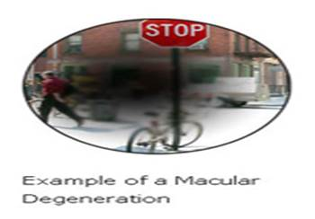
Macular degeneration
Progressive retinal disease, usually occurring at age 55 or older” (AMD Alliance International).
Central visual field (macula) is destroyed.
Lighting:
Chromalux (60/100 watts) – full spectrum lamps may be helpful.
Halogen lamps useful – high intensity light in small areas.
High intensity blue light causes oxidative damage. Lighting should not accentuate the blue spectrum if it is of high intensity or endured for long periods
www.lighthouse.org

Slide 26
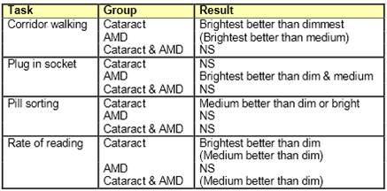
Personal preferences for lighting
People with cataracts and/or macular degeneration vary in personal preference for task-lighting levels.
Nevertheless, different illuminance levels (lux = 50-dim/200-medium/800-bright) were generally preferred according to task and visual disorder.
Evans, B.J.W., et al., A pilot study of lighting & low vision in older people. The Institute of Optometry, London
http://freespace.virgin.net/bruce.evans/Lecture%20handouts_files/Lighting%20&%20low%20vision%20poster.pdf accessed 4-1-2013

Slide 27
Blue light hazard
Blue light hazard (BLH): “the potential for retinal injury due to high-energy short-wavelength light.” CELMA position paper optical safety LED lighting, July 2011.
At very high intensities, blue light (400-500nm) can photochemically cause irreversible damage to retinal cells, up to blindness.
Children are more sensitive to BLH.
Cataracts: Yellowing of lens acts as a natural blue light filter.
Macular degeneration: Long term, blue light can progress AMD.
Alternative light sources which do not emit high levels of blue light are available.
Direct, near-distance viewing of high intensity LED light sources not advisable - shielding and/or diffusing required.

Slide 28
Glaucoma
Minimize glare
Maximize contrast.
Higher levels of illumination preferred by glaucoma patients.
For glaucoma+cataracts, preferred illumination not as high.
Ideal solution allows user to adjust lighting to optimize contrast and eliminate glare.
www.lighthouse.org
Glaucoma = damage to the optic nerve >> progressive, irreversible vision loss.

Slide 29
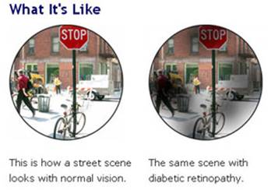
Diabetic retinopathy
Minimize glare
Ensure adequate contrast
Allow user to adjust lighting to his/her needs.
www.lighthouse.org
Blood vessels in the retina are damaged and leak.

Slide 30
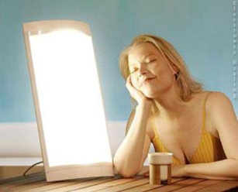
Seasonal affective disorder (SAD)
Seasonal affective disorder = depression associated mainly with lower light levels in the winter months.
Light therapy:
light box (10,000 lux) mimics sunlight.
Follow health care provider's instructions.
May be as effective as drug therapies. May also alleviate depression (Golden, et al., 2005).
Side effects of light therapy: eye strain and headache, mania, (less often). Some drugs can increase light sensitivity - psoriasis drugs, antibiotics, antipsychotics (PubMed Health, 2012).

Slide 31
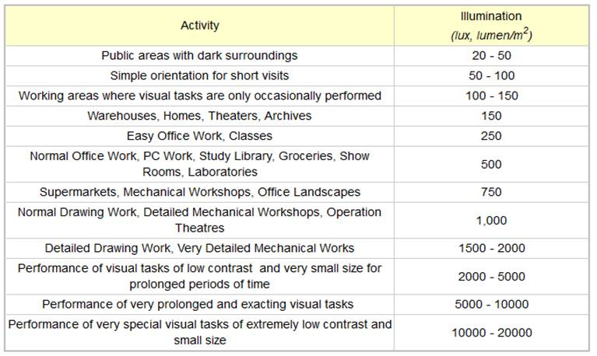
Visual task demands

Slide 32
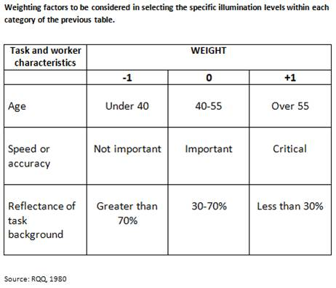
Visual task demands

Slide 33
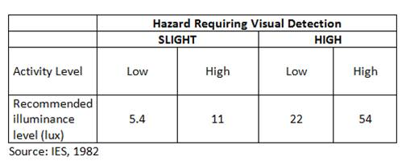
Minimum illuminance for safety

Slide 34
Alphanumeric size by light
Example: Recommended heights of alphanumeric characters for critical and noncritical uses under low and high illumination. 28 inch viewing distance.
 | Height of numerals and letters
 | Low luminance (down to 0.03 fL) | High luminance (1.0 fL and above)
Critical use, position variable | 0.20-0.30 in | 0.12-0.20 in
Critical use, position fixed | 0.15-0.30 in | 0.10-0.20 in
Noncritical use | 0.05-0.20 in | 0.05-0.20 in
For other viewing distances, in inches, multiply distance in inches by 28.
fL = footlamberts
Source: Sanders, M. S., and McCormick, E.J. “Visual Displays of Static Information” Table 4-2 page 92 in Human Factors in Engineering and Design, 6th Edition, 1987. McGraw Hill, New York.

Slide 35
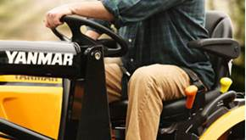
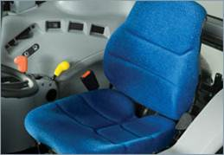
Visual codes and symbols
ASAE EP443.1 FEB04 Color Coding Hand Controls, replaced by ASABE/ISO 15077:2008 Tractors and self-propelled machinery for agriculture--Operator controls--Actuating forces, displacement, location and method of operation.
Limitations of color coding alone – illumination, visual performance. Can combine control stereotyping, shapes, audible warnings…

Slide 36
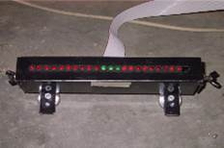
Dynamic displays e.g. lightbars
Central vision: red signal most preferable, then green, yellow, and white.
Peripheral field of view. Colors other than red and green can improve color perception For any background, or environmental light level, blue test lights were recognized at the greatest distance and with the least number of errors.
Blue can be seen up to 83° off the fovea (along the x−axis). Red and green could be seen up to about 76° and 74°, respectively.
Red was confused with green 50% of the time in the periphery. (Ima and Mann, 2004)
Position tractor guidance displays at least 15○ below operator seated eye level (Ima and Mann, 2004, p.98).

Slide 37
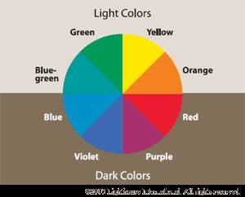
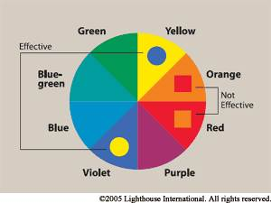
Signs: Color rules
Exaggerate lightness differences between foreground and background colors.
Choose dark colors with hues from the bottom half of the hue circle against light colors from the top half of the circle.
Avoid contrasting hues from adjacent parts of the hue circle, especially if the colors do not contrast sharply in lightness.
Source: Arditi, A., Lighthouse International, 2013

Slide 38
Lighting for safety/performance
Buildings:
Lights on during the day - equalize lighting indoors/outdoors.
Equalize light in rooms and corridors.
Position workers so that windows are behind or to the side. illuminate tasks if shadows are problematic.
Blinds or shades to control bright daylight.
Illuminate floors to at least 300 lux.
Tasks:
Under-counter lighting - increase visibility in work areas.
Work surfaces 500-800 lux. Higher for precision work, but avoid glare.
As task lighting increases, increase room lighting - don’t use a bright lamp in a dark room.
Pedestrian routes: Eliminate glare!

Slide 39
Lighting for safety/performance
Vehicle routes:
Eliminate direct/indirect glare - no unshielded lamps.
Highlight crossing/access points and overhead hazards – especially power lines.
Light color/intensity suited to changing weather conditions (e.g., fog).
Mark routes using reflective paint, markers.

Slide 40
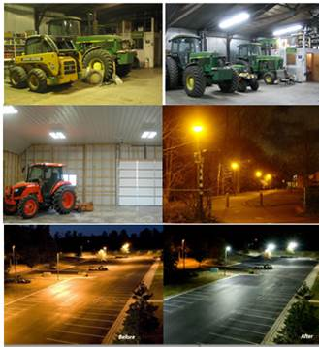
Types of lighting
Sun/moon light
Incandescent
Fluorescent
Low pressure sodium
High intensity discharge (mercury, metal halide, high-pressure sodium)
Light emitting diode (LED)

Slide 41
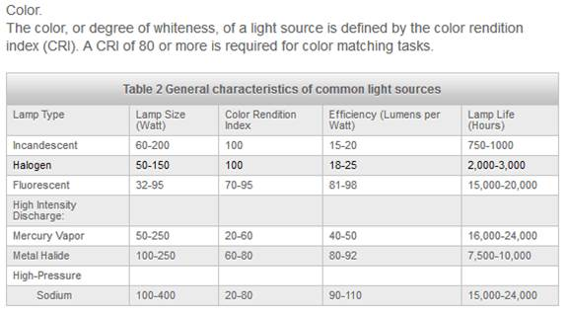
Color and efficiency of artificial lighting
Chastain, J.P., Nicolai:, R. (2007) Dairy lighting system for free stall barns and milking centers http://www.milkproduction.com/Library/Scientific-articles/Housing/Dairy-lighting-system-for-free/

Slide 42
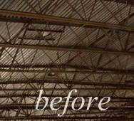
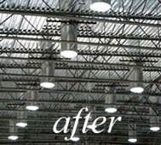
Day (Sky) Light Systems
http://www.nltubular.com
Useful for daytime illumination of dark spaces, transitional lighting, and energy reduction.

Slide 43
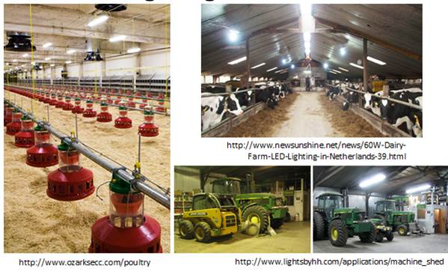
LED Lighting on the farm

Slide 44
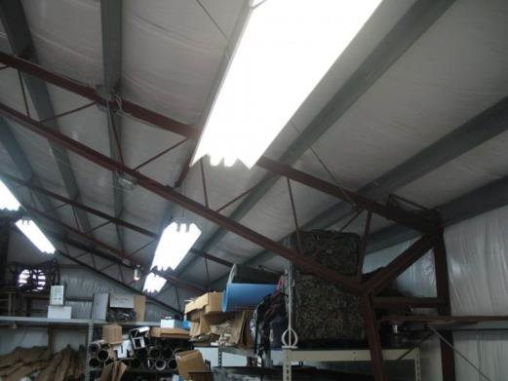
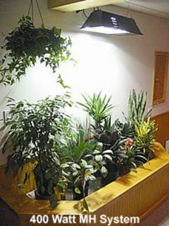
Types of lighting by direction
Direct – ceiling mounted fluorescent lamps or parabolic louvers (silk gloss) (Pinto, et al., 1997)

Slide 45
Types of lighting by direction
Indirect - floor standing high pressure lamp shining upward to ceiling or diffuse reflector and covered lamp shining downward into the room (Pinto, et al., 1997)
Direct-indirect – Luminaires with parabolic louvers (silk gloss) mounted with pendulums below the ceiling, and floor standing high pressure lamp shining upward to ceiling or diffuse reflector and covered lamp shining downward into the room (Pinto, et al., 1997)

Slide 46
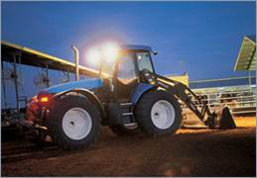
Types of lighting 2
Driving: Zones of illumination depend on task, speed, environment and operating conditions.
Instrumentation: should allow dark adaptation – be dimmable; not white – red or green.
Directional lighting of task – must not render the wider work zone invisible.
www.newholland.com
Placement of a visual target in the cab of a tractor affects the orientation of the eyes and, hence, determines the body posture of the operator (Ima and Mann, 2004).

Slide 47
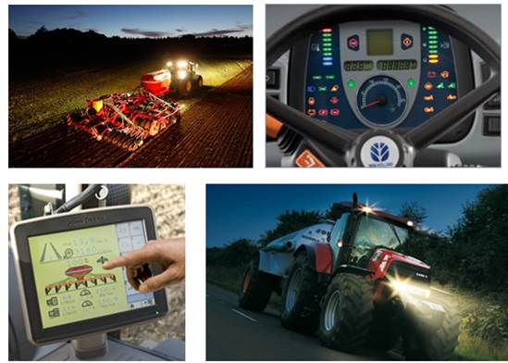
Equipment lighting

Slide 48
Information/Standards, etc.
ASABE. 1993. Lighting for Dairy Farms and the Poultry Industry, ASABE EP344.2, ASABE Standards, 40th edition, St. Joseph, MI 49085-9659. See ASABE EP344.3
OSHA cites ANS A11.1-1965, R1970: Practices of Industrial Lighting – nationally recognized consensus standard (for Industrial applications…may be helpful for ag also). Latest revision: ANSI/IES-RP-7-1991 (Illuminating Engineering Society North America). Minimum standards are set out, but similarity of applications in farming is interpretive, not definitive.
Dairy lighting system for tie stall barns: http://www.milkproduction.com/Library/Scientific-articles/Housing/Dairy-lighting-system/
Light Measurement Handbook: http://www.intl-lighttech.com/applications/light-measurement-apps/light-measurement-handbook A very useful free online manual for people needing to measure/specify lighting for practical applications.

Slide 49
Selected resources
Arditi, A. (2013) Designing for People with Partial Sight and Color Deficiencies. Lighthouse International http://lighthouse.org/accessibility/design/accessible-print-design/effective-color-contrast/
Golden RN, Gaynes BN, Ekstrom RD, Hamer RM, Jacobsen FM, Suppes T, Wisner KL, Nemeroff CB. (2005) The efficacy of light therapy in the treatment of mood disorders: a review and meta-analysis of the evidence. Am J Psychiatry. 2005 Apr;162(4):656-62.
Grosvenor, T. (2013) The Aging Eye: Problems That Affect Acuity and Contrast Sensitivity. Pacific University. http://www.pacificu.edu/optometry/ce/courses/16554/agingeyepg2.cfm#Visual
Ima, C.S. and Mann, D.D. (2004) Ergonomic Concerns with Lightbar Guidance Displays, Journal of Agricultural Safety and Health 10(2): 91−102 2004 ASAE ISSN 1074−7583
Lighthouse International (2013) http://www.lighthouse.org/
National Eye Institute. (2013) http://www.nei.nih.gov/index.asp
National Research Council, Canada (1972) http://archive.nrc-cnrc.gc.ca/eng/ibp/irc/cbd/building-digest-192.html
Pheasant, S. (1991) Ergonomics, Work and Health. Macmillan Press, Basingstoke, pp. 196-211
Pinto, M.R., De Medici, S., Zlotnicki, A., Bianchi, A., Van Sant, C., and Napoli, C. (1997) Reduced visual acuity in elderly people: the role of ergonomics and gerontechnology. Age and Ageing, 1997 26:339-344
PubMed Health. (2012) Season Affective Disorder http://www.ncbi.nlm.nih.gov/pubmedhealth/PMH0002499/
Wilkins, A. J., Nimmo-Smith, I., Slater, A. & Bedocs, L. (1989). Fluorescent lighting, headaches and eye-strain. Lighting Research and Technology, vol. 21, 11-18

