Slide 1
Hand Protection in Agriculture
AgrAbility Webinar Series
September 8, 2011

Slide 2
Basic Webinar Instructions
Need speakers or headphones to hear the presentation
Meeting > Manage My Settings > My Connection Speed
Dial-up not recommended
Questions about presentation – type into chat window and hit arrow, and they’ll be addressed at the end. Complete summary sent to all participants.
Problems: use chat window or email cookke@purdue.edu
4 quick survey questions
Session recorded and archived with PowerPoint file at www.agrability.org Online Training link

Slide 3
AgrAbility: USDA-sponsored program that assists farmers, ranchers, and other agricultural workers with disabilities.
Partners land grant universities with disability services organizations
Currently 23 projects covering 25 states
More information available at www.agrability.org

Slide 4
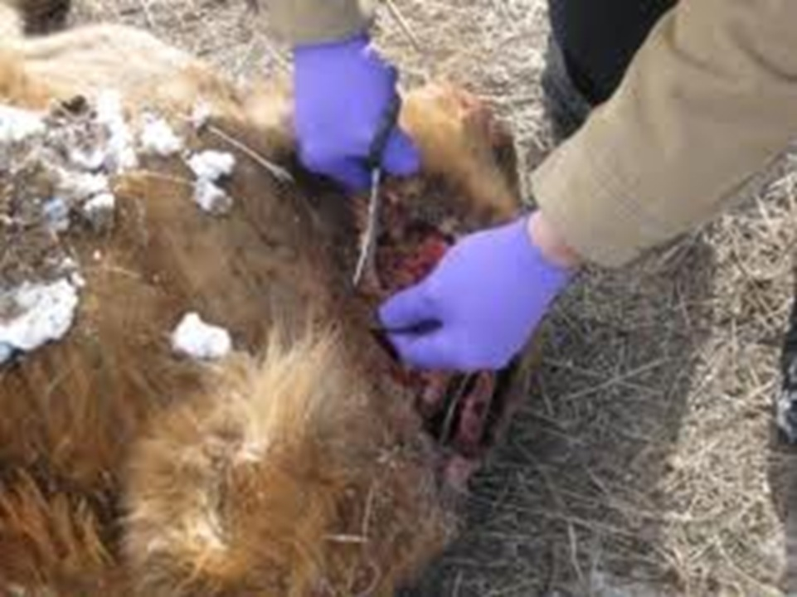
Hand protection in agriculture
Robert Stuthridge, Ergonomist
National AgrAbility Project, Purdue University,
West Lafayette, IN 47907
Tel: 765 494 5088
www.agrability.org

Slide 5
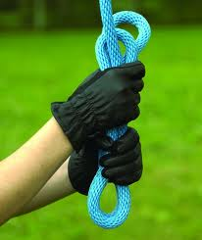
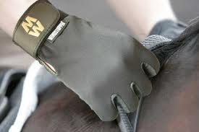
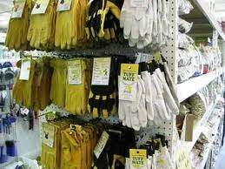
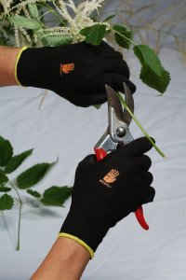
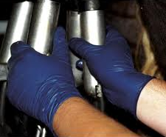
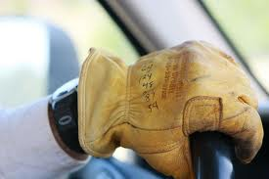
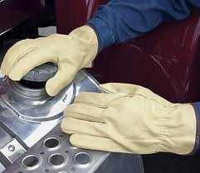
Welcome!
Hand protection from an agricultural perspective.
Useful to professionals advising clients in the selection of appropriate hand protection.
National AgrAbility Project: www.agrability.org
Notes:
Welcome to this webinar presentation, which considers hand protection from an agricultural perspective. Our aim was to provide information that may be useful to health, safety, and assistive technology professionals advising clients in the selection of hand protection appropriate to the user, the tasks, and the work environment. This has been a learning experience for me, because nothing has previously existed that specifically targets agricultural hand protection in any comprehensive way. That said, if there are omissions or errors in the presentation, please point these out, either during the Q&A session at the end of this webinar, or by telephoning or e-mailing the National AgrAbility Project - our contact information may be found at www.agrability.org.
Let’s start with a quick overview of this webinar.

Slide 6
Overview
Introduction;
Definitions;
The need for hand protection in agriculture;
Hazards for the hands in agriculture;
Reducing risk of hand injury;
Preventive (engineering) approach
Protective (PPE) approach
PPE hand protection;
Creams - examples
Gloves - examples
Mittens - examples
Human factors in the adoption of, or resistance to, using hand protection;
References;
Q&A.
Notes:
After a brief introduction to the subject and a couple of definitions, we’ll look at the hazard that give rise to a need for hand protection in this sector, then consider the various methods of protecting the hands from injury at work. Finally, we’ll broach some ergonomics factors relating to the adoption of, or resistance to using hand protection. References are provided, and there will be time for any questions or comments at the end.

Slide 7
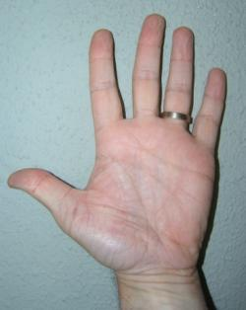
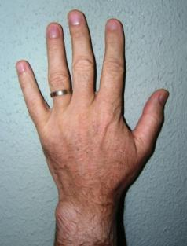
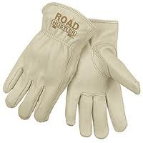
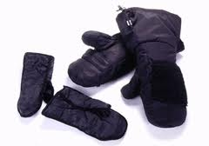
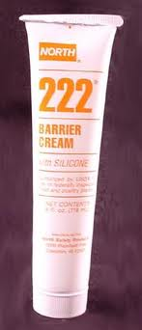
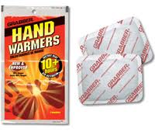
Definitions
“Hand”
fingers,
hand, and
wrist
“Hand Protection” =
gloves,
mittens,
hand warmers,
barrier creams,
skincare creams and
conscious behaviors adopted with the aim of reducing risk of injury to the hands.
Notes:
It is necessary to define a couple of key terms used throughout this presentation. Firstly, when we refer to "hands,“ this includes fingers, hands and wrists, unless stated otherwise.
Secondly, “hand protection" includes gloves, mittens, tapes, hand warmers, barrier creams, skincare creams and conscious behaviors specifically adopted with the aim of reducing risk of injury to the hands.

Slide 8
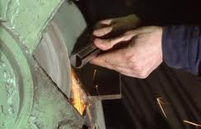
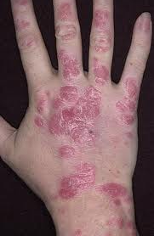
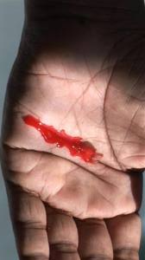
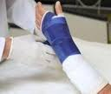
The need for hand protection in agriculture
Hand injuries -> 22% of all work-related nonfatal injuries to adults on US farms (Goldcamp, 2010).
Notes:
There is undoubtedly a need for hand protection in agricultural settings such as farms, ranches, forestry, and aquaculture, because the hands are the body parts most likely to be injured at work from all causes, accounting for around 22% of all work-related nonfatal injuries to adults on U.S. farms (Goldcamp, 2010).
Even superficial injuries to the hands can have more profound outcomes. Damage to the skin may increase the risk of absorption of noxious substances, infection and allergic reactions of the body's immune system. Laceration, abrasion, and disorders such as eczema, or psoriasis will reduce the skin's effectiveness as a barrier to biological pathogens and irritants, toxic chemicals and environmental allergens.
Taken together, these considerations make the protection of the hands an important health and safety goal for everyone working in agricultural settings.

Slide 9
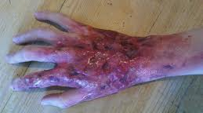
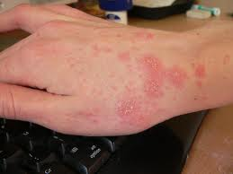
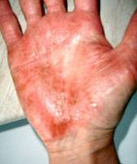
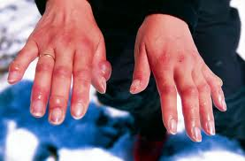
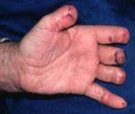
Hazards for the hands in agriculture
NIOSH: main causes of occupational injury to the hands:
Chemical, (e.g., irritants and sensitizers),
Biological, (e.g. parasites, microorganisms, plants and animal materials)
Physical, (e.g., exposure to hot or cold temperatures, UV/solar radiation), and
Mechanical, (e.g., friction, abrasions, vibrations, lacerations and contusions).
Notes:
In terms of hazards encountered in agricultural settings, NIOSH lists the principal causes of hand injury as:
Chemical, (e.g., irritants and sensitizers),
Biological, (e.g. parasites, microorganisms, plants and animal materials),
Physical, (e.g., exposure to hot or cold temperatures, UV/solar radiation), and
Mechanical, (e.g., friction, abrasions, lacerations and contusions).

Slide 10
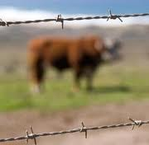
Multiple Hazards - synergistic
Hazards may be synergistic.
Notes:
Multiple causes of hand injury may occur simultaneously, and may synergistically increase risk or severity of harm to the agricultural worker. So, for example, hands may be exposed to laceration and biological hazards, and to cold temperatures and hand-arm vibration when operating power tools. The resulting injury may be more serious compared with those arising from any of these hazards in isolation.

Slide 11
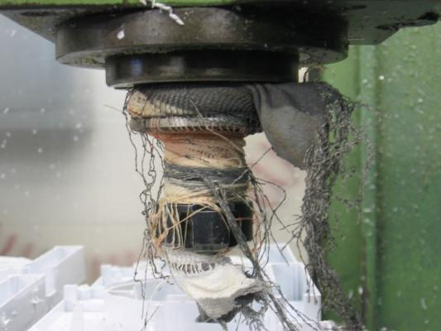
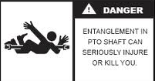
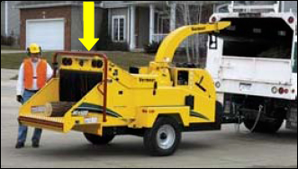
Hand protection
Importance of appropriate hand protection.
Inappropriate hand protection may have adverse effects on health, safety, efficiency, and productivity.
<<< Glove caught in a high-speed milling machine = cuts and fractures of the hand and forearm.
Farm equipment entanglements can be fatal >>>
http://www.hse.gov.uk/press/2010/coi-yh-24410.htm
Notes:
Hand protection that is appropriate to the task, environment, and user, reduces the risks of injury and disability, whereas inappropriate hand protection may have adverse effects on health, safety, efficiency, and productivity.
In the left hand image, an operator’s glove became caught in a high-speed milling machine, leading to cuts and fractures of the hand and forearm, and resulted in the prosecution of the business owner. Other rotating machinery, such as PTO shafts, can also catch on gloves, with severe or fatal consequences. Workers have been pulled through woodchippers when their gloves became caught on branches they were feeding into the chipper. In these cases, the gloves intended to protect the worker were key factors leading to their injury.
The hazards arising from inappropriate hand protection make this subject important not only to health and safety advisers, but also to each of us as consumers of hand protection.

Slide 12
http://www.osha.gov/pls/oshaweb/owadisp.show_document?p_table=STANDARDS&p_id=9788#1910.138(a)
OSHA Standards 1910.138 directs employers to ensure their employees are provided with – and wear - hand protection appropriate both to the task and to the hazards.
Notes:
The need to make the right choices for hand protection is underlined by government standards in this area. The Occupational Safety and Health Agency’s
Standard 1910.138 directs employers to ensure their employees are provided with – and wear - hand protection that is appropriate both to the task and to the hazards. Even though OSHA Standards may not govern agricultural operations, they do provide a valuable framework for best safety practice in this sector, and this Standard is undoubtedly consistent with the hand protection needs of agricultural workers.

Slide 13
ANSI/ISEA 105 (2011)
ANSI/ISEA 105 (2011) American National Standard for Hand Protection Selection Criteria (February 2011, revision of the 105-2005 Standard).
Glove performance and pass/fail criteria for
cut, puncture and abrasion resistance;
chemical permeation and degradation;
detection of holes;
vibration reduction, and
heat and flame resistance.
Uses a numeric rating scheme for classifying hand protection against a variety of performance assessments.
Also includes a recommended hand protection selection procedure, and reference information on:
biological protection,
extreme temperature applications,
cleanroom applications,
hazardous materials response applications,
electrical protection and
radiation hazards. A section on human factors describes how fit, function and comfort are incorporated into selection.
Notes:
There is also an important performance standard for hand protection, available jointly from the American National Standards Institute – International Safety Equipment Association, number 105 recently updated from the 2005 Standard with a February 2011 release.
ANSI/ISEA 105 addresses five aspects of hand protection performance on a pass/fail basis. The Standard also provides a numeric classification by which hand protection that meets the minimum performance standard is rated against a variety of performance tests.
The Standard includes guidance in selection procedures for hand protection, and outlines some ergonomics advice on fit, function and comfort.
It may be useful for health and safety professionals to refer to this Standard when advising clients on hand protection. This webinar does not have the time to go through the Standard in detail, but references are made to the Standard, where appropriate.
We will now turn our attention to the main hazards affecting our choice of hand protection.

Slide 14
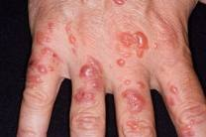
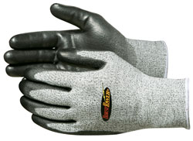
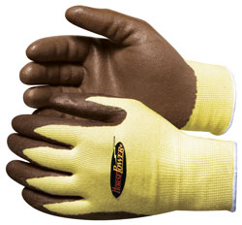
Chemical protection
Irritants & Sensitizers (e.g. pesticides).
The hands are the body part most likely to be contaminated by pesticides.
Contact dermatitis linked to handling pesticides.
For pesticide application, barrier creams do not provide effective protection.
Best protection generally = nitrile/butyl rubber gloves or laminate gloves (4H or Barrier) (Lidén, 2011)
It is important that the gloves are:
used properly;
clean;
in good condition – choose cut-resistant or ‘tear when damaged’ designs.
part of a complete chemical PPE system;
appropriate to the pesticide – many pesticides contain multiple chemicals (Schwope, 1992, ANSI 105-2011)
P/U (L) Nitrile (R) + Kevlar Gemplers.com
Notes:
Chemical protection is concerned with skin irritants and sensitizers. Skin irritants cause reversible damage to the skin. Some irritants may sensitize the skin, so that an allergic response occurs with increased speed and/or severity with each subsequent exposure to the chemical.
Many pesticides contain irritants and sensitizers. The hands are the body part most likely to be contaminated by pesticides, the most frequent outcome of which is contact dermatitis. For pesticide application, barrier creams do not provide effective protection, and the best protection is generally afforded by nitrile/butyl rubber gloves or laminate gloves (4H or Barrier), but specific chemicals necessitate choosing appropriate glove construction. We will discuss glove materials in more detail shortly.
For chemical hand protection to be effective, it is important that gloves are used properly, are clean, are in good condition, with no splits or holes, and are used as part of an appropriate personal protective equipment system. They must overlap the cuffs of a long-sleeved shirt or protective sleeves that are equally appropriate to chemical protection, leaving no exposed skin to be contaminated by spray or splashes; it is of little value wearing gloves but leaving the arms, legs, body or face exposed to contact with the chemical.

Slide 15
Chemical Protection Gloves (OSHA, 2003)
Rubber: natural/latex, butyl, neoprene, nitrile and fluorocarbon (viton);
Plastic: polyvinyl chloride (PVC), polyvinyl alcohol and polyethylene.
These materials can be blended or laminated for better performance.
Thicker glove material generally = greater chemical resistance, but may impair grip and dexterity.
Gloves may fail to protect due to:
Deterioration/degradation of the glove material. Inspect for wear;
Permeation (chemicals pass through on a molecular level) – always select appropriate material to the chemical(s) being handled;
Penetration via holes (damage), pores (e.g. leather), or seams (construction methods). (Konz, 1995)
Notes:
Chemical protection gloves are generally made from either rubber or plastic materials, a blend of several types of material, or laminates of alternate materials. Blended and laminated gloves may afford better chemical resistance, as will thicker materials, but there may be a trade-off in grip and dexterity which could increase injury risk in some situations. It is essential to choose the optimum glove for each task – let’s explore briefly the pros and cons of a few common materials used for chemical protection.
Gloves may fail to protect due to deterioration or degradation of the glove material. It is essential to clean gloves after use and to inspect for wear prior to handling chemicals; Gloves can be checked for holes by filling with water, closing the cuff and exerting pressure – tears, damaged seam welds and holes will be revealed. Dry the glove prior to use. Discard and replace faulty gloves. More subtle migration of irritants from the outside to the inside of the glove can occur by permeation, in which chemicals pass through the glove material on a molecular level. This is why it is essential to select appropriate material for the chemicals being handled, and to read the chemical and glove makers’ safety and application information; Finally, chemicals can penetrate via pores in the glove material, such as in leather, or due to the glove construction method, such as stitched seams. (Konz, 1995)

Slide 16
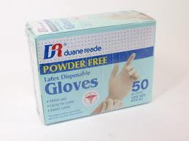
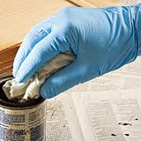
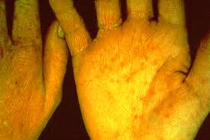
Chemical Protection Gloves (OSHA, 2003)
Natural (latex) rubber:
Comfortable to wear;
High tensile strength, elasticity;
Temperature resistant;
Abrasion resistant;
Protect against most water solutions of acids, alkalis, salts and ketones.
May cause allergic contact dermatitis.
Notes:
Natural, or latex rubber has the advantages of being fairly comfortable to wear, having high tensile strength and elasticity, so resists tearing, is temperature and abrasion resistant, and protects against most water solutions of acids, alkalis, salts and ketones. On the downside, latex rubber is known to cause allergic contact dermatitis in some individuals, which we will consider in more detail shortly.

Slide 17
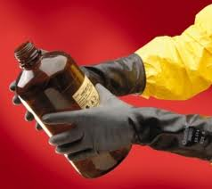
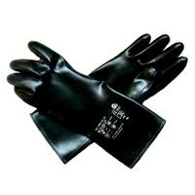
Chemical Protection Gloves (OSHA, 2003)
BUTYL (synthetic rubber) protects against a wide variety of chemicals, such as:
Peroxide;
Rocket fuels;
Highly corrosive acids (nitric acid, sulfuric acid, hydrofluoric acid and red-fuming nitric acid);
Strong bases (e.g. NaOH lye/caustic soda; KOH caustic lye/caustic potash)
Alcohols;
Aldehydes;
Ketones, esters;
Nitro compounds.
Also resists oxidation, ozone corrosion and abrasion.
Remains flexible at low temperatures.
Not good against aliphatic and aromatic hydrocarbons and halogenated solvents.
Notes:
BUTYL, a synthetic rubber, protects against a wide variety of chemicals, resists oxidation, ozone corrosion and abrasion, and remains flexible at low temperatures. It is not a good choice for some solvents found in cleaning agents.

Slide 18
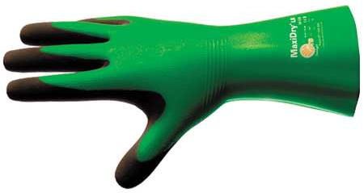
Chemical Protection Gloves (OSHA, 2003)
Neoprene - synthetic rubber
Good pliability;
Finger dexterity;
High density;
Tear resistant.
Protect against:
Hydraulic fluids;
Gasoline;
Alcohols;
Organic acids and alkalis.
Generally have chemical and wear resistance properties superior to natural rubber
Notes:
Neoprene is another synthetic rubber used in gloves. Neoprene affords good pliability, finger dexterity, high density, and tear resistance.
It is a good choice when exposed to hydraulic fluids, gasoline, alcohols, and organic acids and alkalis.
Neoprene gloves generally have chemical and wear resistance properties superior to natural rubber

Slide 19
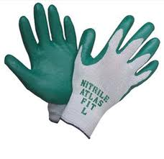
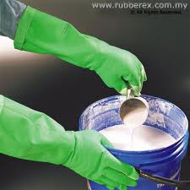
Chemical Protection Gloves (OSHA, 2003)
Nitrile – synthetic copolymer.
Protect from:
Chlorinated solvents (e.g. trichloroethylene, perchloroethylene).
May be optimal for jobs requiring dexterity and sensitivity, yet stand up to heavy use even after prolonged exposure to substances that cause other gloves to deteriorate.
Offer protection when working with oils, greases, acids, caustics and alcohols;
Not recommended for use with strong oxidizing agents, aromatic solvents, ketones and acetates.
Notes:
Nitrile – is a synthetic copolymer. It protects from chlorinated industrial solvents, and may be optimal for jobs requiring dexterity and sensitivity, yet it will stand up to heavy use even after prolonged exposure to substances that cause other gloves to deteriorate. It provides protection when working with oils, greases, acids, caustics and alcohols, but is not recommended for use with strong oxidizing agents, aromatic solvents, ketones or acetates.

Slide 20
(OSHA, 2003)
Notes:
OSHA’s personal protective equipment guide published in 2003, rates from Poor to Very Good the chemical resistance of four different types of chemical glove material against a variety of substances. Not all of these substances are encountered in agriculture, but when buying chemicals – such as pesticides, fertilizers, or cleaning agents, for use on the farm or ranch, it is advisable to determine in advance which glove materials will be effective against contamination by chemicals within the product, and to obtain appropriate protection before handling it. We are reproducing the table in its entirety here, but you are urged to download a copy of the OSHA document, which contains a lot of useful guidance. A link to this free document is given on the next page and again at the end of this presentation.

Slide 21
http://www.osha.gov/Publications/osha3151.pdf

Slide 22
http://www.ansellpro.com/specware/guide.asp
Notes:
Reputable manufacturers will provide information on applications for, and limitations (e.g. splash vs. immersion) of, their gloves. Some provide interactive selection software online, such as this SpecWare system, which also allows the user to combine multiple chemicals in order to arrive at an appropriate glove material specification prior to ordering.

Slide 23
Chemical protection – glove allergies
Glove materials can be irritants and sensitizers.
Latex sensitization is common - caused by a protein in natural latex.
Immune system responds by producing histamine. Response may become increasingly severe, starting with an itchy rash, and in highly sensitive people, causing anaphylactic shock, which can be fatal.
“Snapping off”, gloves - latex particles become airborne directly, or combined with powder inside some gloves, resulting in allergic reaction by inhalation or skin contact over the body and/or face.
Allergy to PVC or nitrile gloves = less common, but not rare (Hayakawa, 2000). Generally, suitable for pesticide use.
Allergy tests determine hypersensitivity to glove materials.
Cotton liners may help, where practicable. Inspect, wash or replace, as necessary.
Notes:
Glove construction materials can also be irritants and sensitizers. Latex sensitization is common, and is caused by a protein occurring in natural latex.
The immune system responds by producing histamine. The response may become increasingly severe, and in highly sensitive people may be fatal.
When gloves are snapped off, particles of latex become airborne, either directly, or combined with the cornstarch powder used inside some gloves, resulting in an allergic reaction by inhalation or skin contact over other parts of the body, including the face.
Allergy to PVC or nitrile gloves is less common, but not rare (Hayakawa, 2000). Generally, they are suitable for pesticide use.
Allergy tests can determine hypersensitivity to glove materials.
Cotton liners may be helpful, but like any glove component, these will need to be inspected for damage, washed or replaced as necessary.

Slide 24
Latex allergy – product labeling
See also: http://www.osha.gov/SLTC/latexallergy/ and http://www.fda.gov/medicaldevices/deviceregulationandguidance/guidancedocuments/ucm070925.htm (May 2011)
Notes:
The FDA has noted that while manufacturers of many products, including latex gloves, increasingly are labeling their products as "hypoallergenic," a term interpreted by consumers to mean that the risk of allergic reactions to any component of the device would be minimal, this is not the case with items containing natural rubber. “Hypoallergenic” labeling not useful and is not allowed on any medical devices that contain natural rubber. At this time, warning labeling regarding latex is required on medical gloves/devices only, and the onus is on the buyer or specifier of non-medical gloves to establish the materials of which gloves are constructed.

Slide 25
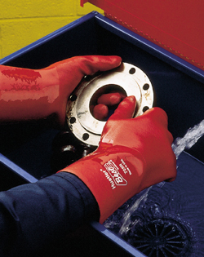
Chemical protection
Handling some metals can cause sensitization.
“Nickel eczema is difficult to heal and may lead to early retirement,” (Konz, 1995).
Chemical-protection gauntlet style gloves recommended (Konz, 1995).
HUSTLER 728R, by BEST GLOVE,
Abrasion and slip resistant nitrile/PVC gauntlet-style glove.
Notes:
Chemical injury is not limited to liquids; handling some metals can lead to sensitization. This is reported for nickel, for example, a known sensitizer that can result in dermatitis and eczema. “Nickel eczema is difficult to heal and may lead to early retirement.” Chemical handling gloves should cover the distal part of the forearms that is, extending over the cuffs of a long-sleeved garment – gauntlet designs are therefore generally recommended, where practicable and safe. The cuffs should ideally be close-fitting as shown here to avoid ingress of chemicals behind the cuff, and to reduce the risk of snagging loose cuffs.

Slide 26
Barrier creams
Barrier creams: oil-based or water-based; may be no more effective than 'skincare' creams;
May increase risk for absorption of hazardous chemical through the skin;
Not suitable for pesticide protection;
May aid removal of oils, greases, resins, less need to wash with irritating abrasives and cleansers;
Not known whether barrier creams are harmful or beneficial in regard to contact dermatitis (Kütting and Drexler, 2003).
Notes:
Barrier creams are sometimes used to protect the skin from contaminants and irritants such as oil, grease, paint, and so on. Barrier creams are made with either an oil or water base. They may be no more effective than products marketed as 'skincare' creams and may even increase the risk for absorption of certain hazardous chemical through the skin. For pesticide application, barrier creams do not provide effective protection.
Some people may find a barrier cream itself to be an irritant. In 2003, a study by Kütting and Drexler concluded that, while many barrier creams serve a useful purpose by facilitating the "removal of sticky oils, greases, and resins from the skin, decreasing the need to wash with potentially irritating abrasives and waterless cleansers," we cannot yet say whether barrier creams are harmful or beneficial in regard to contact dermatitis. Appropriate gloves, together with correct skin cleansing and moisturizing are likely the most effective ways to prevent contact dermatitis, if the handling of irritants is unavoidable.

Slide 27
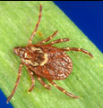
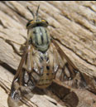
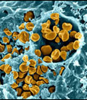
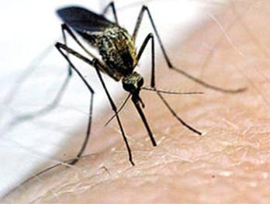
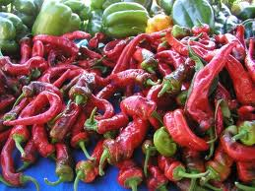
Biological protection
Zoonotic diseases (some fatal) can be transmitted from animals to humans via parasitic bites to the hands, and (as microorganisms) via contact with skin lesions. For an extensive list:
www.petdoc.ws/zoonotic_diseases.htm
Some plants – crops and weeds - may cause chemical injury to the hands (irritants/sensitizers).
Notes:
We turn now to protection of the hands from biological hazards, many of which may be found in agricultural settings. The most important of these hazards are zoonotic diseases, which are diseases that migrate from animals to humans. Some zoonotic diseases can be fatal, and may be transmitted via parasitic bites, or as microorganisms via skin lesions on the hands. Horses, cattle, sheep, poultry, and other animals found in agricultural settings, including rodents, cats, dogs, bats, reptiles, raccoons, wild birds, etc., are all potential hosts for zoonotic diseases. There is a very useful list of these diseases, including symptoms, treatment and prevention approaches, at www.petdoc.ws. The wearing of gloves is frequently mentioned in the prevention element for each disease described on that website.
Additionally, some plants may cause chemical injury to the hands, acting as irritants and sensitizers. Hazardous plants may include crops and weeds. We’ll look at this shortly.

Slide 28
Biological protection: Parasites & Microorganisms
Gloves (and repellents, in some cases) protect against
Ticks (Lyme Disease, Rocky Mountain Spotted Fever, and tularemia);
Biting flies, e.g. deer flies, and mosquitoes (tularemia)
Mites (scabies).
Tapeworms, hookworms, roundworms (may be passed with or without contact with fecal matter).
Protect hands against cuts – open cuts may allow parasites (e.g. ringworm) and microorganisms (e.g. the tularemia bacterium) to enter the body.
Handling animals - bedding, feed, water, or waste.
Contaminated gloves can carry pathogens into the home.
Notes:
Gloves (and repellents, in some cases) protect against diseases transmitted by parasites such as ticks, biting flies, and mites. Gloves also help protect against tapeworms, hookworms, and roundworms, which can enter the body orally when eggs are transferred from contaminated hands to the mouth, or via open wounds to the hands. Handling animals can cause adverse reactions in people who have, or who develop, allergies to organic chemicals and microorganisms that originate from the farmed animal, from parasites and organisms that live on the animal, in its bedding, or in its feed, water, or waste. It is important to remove work gloves before entering the home, so that we reduce the risk of introducing zoonotic diseases and other biological hazards.

Slide 29
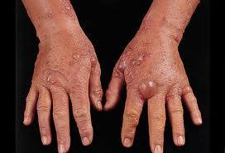
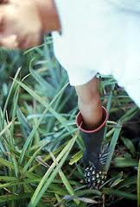
Biological protection - plants
5-10% dermatologic patients - phytodermatitis.
Naturally occurring chemicals in plants >50% of agricultural skin disease – pesticide handling <20% (O’Malley, 1998, in WA.gov 2001)
Prickly pears, pineapples, barberry, bamboo, rose thorns, mustards, chili peppers, pineapple, mayweed, cowhage, yarrow, celery, carrots, parsnips, limes, figs, Queen Anne’s lace, giant hogweed, chrysanthemums, dandelion, goldenrod, black-eyed Susan, tansy (WA.gov, 2001)
NC seasonal tobacco harvesters - contact dermatitis.
Woods , e.g., West Indian mahogany, silver fir, spruce during cutting or sanding.
Grain straw/grain irritation usually due to mites.
Notes:
It is estimated that 5% to 10% of patients attending dermatologic clinics are suffering from phytodermatitis - a form of dermatitis caused by plants or plant products. Naturally occurring chemicals in plants account for more than 50% of agricultural skin disease – pesticide handling accounts for less than 20% Washington State Department of Labor and Industries names a wide variety of plants as sources of mechanical or chemical injury to handlers, from prickly pears and pineapples, to celery, carrots, chrysanthemums and dandelion. Seasonal labor tobacco harvesters in North Carolina developed contact dermatitis from handling the plants, and even woods ,such as West Indian mahogany, silver fir, and spruce can cause contact dermatitis while being cut or sanded.
Handling grain straw or grain is associated with skin irritation, but this is usually due to mites, rather than a direct reaction to chemical irritants in the plant.

Slide 30
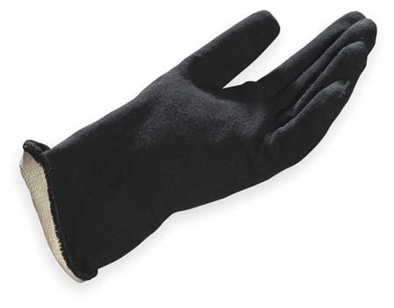
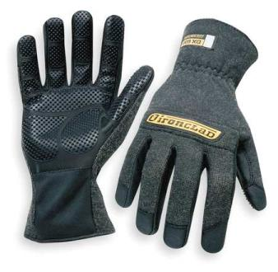
Physical protection - Hot
Some gloves are capable of protecting against multiple hazards, including heat/cold, chemicals, and cuts/abrasions.
Trade-offs in fit/dexterity may be unacceptable for some users/tasks.
But multi-protection gloves may be useful in Ag safety /shop equipment.
Steam is a potential source of injury when cleaning equipment.
MAPA® Temp-Proof® 333 Heat-Insulated Nitrile Gloves - Nitrile polymer layer keeps hands dry in wet or chemical applications. Provide thermal insulation from
-22 to 480°F (-30 to 249°C).
IRONCLAD brand Heat Work Glove, Kevlar/silicone, 600 °F (intermittent). Welding, mechanics, etc.
Notes:
Gloves are often used to provide physical protection. They may be used to insulate the hands from excessive heat, and some gloves protect simultaneously against multiple hazards, including hot and cold, chemicals, and cuts/abrasions. This does not mean we can adopt a “one-glove-for-all-hazards,” approach, since trade-offs inevitably occur for some aspects of protection, and poor fit or reduced dexterity may increase risk for some users and tasks. Still, multi-hazard gloves may be useful additions to Agricultural safety equipment. When choosing gloves to protect against heat, match the specification of the glove to the hazard to be encountered. Steam cleaning equipment and steam itself can cause severe hand injury, and would require a waterproof material, whereas welding gloves would not need this feature, but may require a higher temperature resistance.

Slide 31
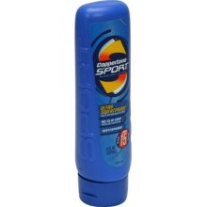
Physical protection – UV radiation
Prolonged ultraviolet (UV) radiation - premature skin aging, skin cancer.
Gloves afford protection (e.g. when worn to reduce against laceration/abrasion).
Bare hands – sunscreen SPF15 or higher. UV-A and U-VB.
Choose a long-lasting waterproof sunscreen, such as Coppertone Sport Sunblock Lotion SPF 15, Ultra Sweatproof.
Notes:
Prolonged exposure to ultraviolet (UV) radiation from the sun is associated with increased risk of premature skin aging and skin cancer. At noon on a clear summer day it can take only 15 minutes to cause sunburn on unprotected fair skin. Sun Protection Factor 15 or higher is suggested for exposed skin. The sunscreen should be effective in filtering both UV-A and UV-B rays; this information will be found on product packaging.

Slide 32
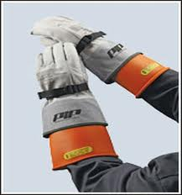
Physical protection – electrical shock
ASTM D120 - 09 Standard Specification for Rubber Insulating Gloves (2009)
Type I (non-resistant to ozone) and Type II (resistant to ozone).
6 classes: 00, 0, 1, 2, 3, 4 depend on voltage – 1,000v (00) to 36,000v (4).
Worn under leather cut-resistant gloves (where dexterity allows).
^ PIPUSA.com
< Westernsafety.com
Notes:
Protection against electrical shock is provided by insulating rubber gloves, which are classed according to ASTM D120. This subdivides gloves into non-ozone resistant and ozone resistant, and then by maximum voltage for which protection is provided. Weere possible, the gloves should be protected from cuts and abrasion damage using leather gauntlet over-gloves, but for some dextrous tasks, the rubber glove alone will be used. The insulating glove must extend significantly beyond the cuff of any over-glove.

Slide 33
Physical protection - cold
Hypothermia; frostbite.
Disabled/elderly workers at greatest risk.
Some medications increase frostbite risk (e.g. beta blockers)
Mittens greatest protection against cold; dexterity trade-off.
Gloves essential when handling liquid gas equipment.
Extreme Arctic Mittens incorporate a palm opening that allows the whole hand to pass through. These mittens have been demonstrated to be effective to -50°F
(-45.6°C). http://www.wiggys.com
Cryo-Glove® Cryogenic Gloves Protects to
–256°F (–160°C) Multilayered insulated construction provides maximum thermal protection while maintaining flexibility and dexterity
Notes:
It is equally important to prevent the hands from becoming excessively cold, since the fingers are particularly susceptible to tissue damage, including frostbite, where hand tissues freeze, due to their distance from core heat sources. Significant amounts of body heat may be lost through bare hands, increasing the risk of hypothermia when working around the farm or ranch in cold weather, or in chilled storage areas. Workers with spinal cord injury, diabetes, arthritis, hypothyroidism, asthma, Parkinson’s disease, alcoholism, cardiac insufficiency, angina pectoris, or stroke together with elderly workers, have increased susceptibility to hypothermia, so people suffering from these health disorders should pay particular attention to protecting the hands from cold. People who take certain beta-blockers, are at elevated risk of frostbite, and should consult their physician to establish whether any particular protective measures are required because of their medication.
Mittens provide the greatest protection against cold, but with a major dexterity trade-off. Gloves are essential for handling low-temperature materials, including liquid gases, which can cause frostbite extremely quickly.

Slide 34
Frostbite
http://www.srh.noaa.gov/ssd/html/windchil.htm
Notes:
The National Weather Service provides a chart indicating the relationship between temperature, wind speed, and average time for exposed skin to suffer frostbite. Note that frostbite can occur within thirty minutes even when the temperature is above freezing (32 degrees Fahrenheit). Hand protection should be specified to cope with the worst case scenario for a given occupational setting, and the risk due to wind chill needs to be part of the calculation that is used to select appropriate hand protection, including not exceeding safe exposure times for ungloved hands.

Slide 35
Physical protection - Cold
Handwear - gloves and mittens – can reduce dexterity and tactile sensitivity;
May increase muscular effort to grip a task (loss of grip). Slip-resistant palms and finger pads for better purchase on smooth objects;
Water and wind resistance, but not thicker than necessary.
Layering may help to adapt handwear to task/operating conditions.
Insulate bare metal grip points if winter handling is possible (use insulating paint, foam pipe insulation or foam tape).
Waterproof Winter Plus by the Youngstown Glove Company - waterproof, windproof, while being designed to maintain dexterity. Similar gloves may incorporate Kevlar palms to resist cuts www.ytgloves.com
<< Heat Wave reusable hand warmers <2 hrs use.
>> Gerbing’s heated glove liners use a 12v DC supply www.berbing.com
Notes:
While protecting the user from cold injury, thermal hand-wear can reduce the wearer’s ability to perform tasks requiring dexterity and tactile sensitivity. Handwear may also increase the amount of muscular effort required to grip an object, compared with gripping using bare hands, which may increase the risk of muscle strain and tendon tears. Gloves and mittens are available equipped with slip-resistant palms and finger pads to provide a better purchase on smooth objects. This will help if additional grip force would otherwise be required to prevent the object from moving in the hand.
Handwear should provide water and wind resistance, but should not be thicker than is necessary to maintain a comfortable finger temperature. It is useful to wear several thin layers of hand protection, allowing some flexibility according to the task.
Mittens may be useful where extremely low temperatures are likely to be experienced, and may be of a type allowing the fingers to be freed for finer dexterous tasks. However, the hazard from cold conduction must be considered before handling any cold metal parts. If such a need is anticipated, coat contact points of bare metal with a heat insulating material before the onset of low temperatures. This will help to reduce the risk of ‘cold burn’ soft tissue injuries.
Hand warmer pads and heated gloves are available, the choice of which will depend on the situation. Hand warmer pads may be of the type worn inside gloves (where they will reduce dexterity), or in a coat pocket for warming between short bouts of working with the bare hands. Some disposable types provide steady heat for up to eight hours. Heated gloves may plug into a 12 volt power supply, or use batteries to heat conductive strands woven into the glove fabric. They generally have thin insulating liners and some include a choice of heat output settings.

Slide 36
Mechanical protection – friction/abrasion
Abrasions are wounds in which the skin is torn or rubbed due to friction. Source of friction e.g., rope handling, handling building materials (blocks, bricks, etc.), grinding tools, etc.
^ MaxFit gloves provide abrasion protection with relatively little loss of dexterity, and offering increased grip compared with bare hands. www.maxfitgloves.com
^ Kimberly-Clark Foam-Coated Glove is rated
Abrasion Resistant
www.kimberly-clark.com
^ Finger tape may be useful. Can be used with/without gloves.
www.flexx-rap.com
Notes:
Turning to mechanical hazards, the hands are often exposed to friction sources, contact with which results in abrasion injuries. Abrasions are wounds in which the skin is torn or rubbed. Sources of friction include rope handling, building materials (blocks, bricks, etc.), powered grinding tools, etc. Gloves provide a barrier against injury, and would be selected on abrasion resistance of contact surfaces. As always, thinner, highly resistant materials, such as those shown here, are preferred over heavy, inflexible materials, wherever the task allows this. Finger tape can also be useful in some situations.

Slide 37
Mechanical protection: vibration
Hand-arm vibration - five types of disorders (HAVS hand-arm vibration syndrome is a combination of two or more of these disorders)
Type A: Circulatory
Type B: Bone & joint
Type C: Neurological
Type D: Muscular
Type E: General disorders, e.g. central nervous system disorders.
Grip force, hand temperature and hand-arm postures are risk factors.
Gloves may improve grip, depending on design and working conditions; relax grip as much as possible to de-couple hand/tool.
Keep hands warm when operating hand tools in cold temperatures.
Position task and operator optimally.
Notes:
Gloves are often proposed to reduce the risk of injuries associated with vibration, which may be encountered when operating power tools, such as chainsaws, brush cutters, pneumatic drills, plate compacters, and so on. Their value for this will be discussed in the next slide. Vibration injuries are of five types, depending on the physiological system that is involved. Hence they are termed circulatory, skeletal (including bones & joints), neurological, muscular, and others of a more complex nature, such as central nervous system disorders. Hand-arm vibration syndrome is commonly mentioned when discussing vibration injuries, and this involves two or more of these bodily systems.
Grip force, hand temperature and hand-arm postures are risk factors for hand-arm vibration syndrome. Gloves may improve grip, depending on design and working conditions, and the operator should adopt a relaxed grip as much as possible. It is important to keep hands warm when operating hand tools in cold temperatures, and to position the task optimally to the operator, or vice versa.

Slide 38
Mechanical protection: vibration
Anti-vibration gloves may not reduce transmitted vibration as much as expected, due to:
Increasing force applied to the handle increases transmission of vibration to the palm.
Inter-subject variability.
ISO 10819:1996 does not deal with spectra of vibration frequencies and magnitudes typically found in hand-operated power tools. Gloves manufactured to meet this Standard may or may not provide the hoped-for protection in any given situation.
Northern Safety Mechanics Gel
www.northernsafety.com
INJURY PREVENTION:
PRIMARY/ENGINEERING
vs.
SECONDARY/GLOVES
Source: Lazlo, 2011
Notes:
Anti-vibration gloves may not reduce transmitted vibration as much as expected – or claimed - due to the fact that increasing the force applied to a vibrating handle increases the transmission of vibration to the palm. Gloves with contact surfaces that resist slipping enable reduced grip forces, and are recommended in preference to heavily padded gloves that are somewhat slippery on the contact surfaces. The variation between different wearer’s hand – a factor known as ‘inter-subject variability’ means that different hands react differently to the same vibration; In addition, the Standard dealing with human exposure to vibration, ISO 10819:1996 , does not deal with spectra of vibration frequencies and magnitudes typically found in hand-operated power tools. Therefore, gloves manufactured to meet this Standard may not provide the hoped-for protection in any given situation.
This is not to say gloves don’t serve a useful purpose in reducing vibration injury risk; keeping the hands warm reduces risk of vibration injury, for example, and gloves with strong slip resistance may allow reduced grip force by the user to maintain control of the tool. Flexibility and fit are critical attributes of gloves worn to protect the wearer from vibration injury. Wherever possible, the vibration should be absorbed mechanically, rather than by the human user. This requires a primary/preventive or engineering approach to risk reduction, rather than secondary interventions, like gloves.

Slide 39
Mechanical protection - lacerations.
Lacerations are a major occupational hazard.
Wherever feasible, hazards and risks should be engineered out of the work, but where this cannot be achieved, gloves and anti-cut tapes can be worn.
Not all materials afford equal protection against cuts
Currently there are three standardized methods for testing cut resistance:
ASTM F1790 (formerly American Society for Testing and Materials, now ASTM International) - U.S.A.) ,
ISO 13997 - International, and
EN 388 - Europe.
Notes:
Lacerations to the hands are a major occupational hazard, second only to back strain as the leading cause of lost work time and physician visits. Hand protection from lacerations is very important. Again, wherever feasible, hazards and risks for lacerations should be engineered out of the work, but where this cannot be achieved, gloves and anti-cut tapes can be worn. Not all materials afford equal protection against cuts, of course, and there are currently three standardized methods for testing the cut resistance of materials: ASTM F1790 in the United States, ISO 13997 Internationally, and EN 388 in Europe.
The ASTM test method assesses the cut resistance of a material when exposed to a cutting edge under specified loads. Data obtained from this test method can be used to compare the cut resistance of different materials. F1790 only addresses that range of cutting hazards that are related to a cutting action across the surface of the material. It is not representative of any other cutting hazard to which the material may be subjected such as serrated edges, saw blades or motorized cutting tools. Nor is it representative of puncture, tear, or other modes of fabric failure. Nevertheless, it provides some indication of the resistance of a fabric to laceration, and these tests offer the only objective cut-resistance guide that safety equipment specifiers have available to them at this time.

Slide 40
ANSI/ISEA 105-2011 Cut Resistance
ANSI/ISEA 105 Performance levels for cut resistance are specified in this standard – see Table 1.
Source: DuPont Kevlar: The Science of Cut protection (access date 8/28/2011)
http://www2.dupont.com/Kevlar_Gloves/en_US/assets/downloads/kevlar_cut_protection_testing.pdf
ANSI/ISEA 105 performance levels for cut resistance
Notes:
Following testing, the cut-resistance of materials is categorized by performance from 0 to 5 in ANSI/ISEA 105-2011, and is indicated by this table. The spread of performance within any category makes it necessary to determine the actual cut-resistance of a glove material when cut-resistance is an important safety feature. So, for example, the difference in cut-resistance between a category one glove and a category two glove may be as little as 1 and as much as 799. It is arguable that it would be a waste of money to pay more for a category 2 glove scoring 500 than one would pay for a category 1 glove scoring 499. Absolute test results are therefore useful when making performance/price comparisons between cut-resistant gloves. Actual test results are not always available, even in the technical literature.

Slide 41
Cut-resistance
Wells Lamont Whizard metal mesh, Category 5 cut-resistant gloves.
Superior Glove SKSMLP Category 5 cut-resistance >3800g resistance.
Notes:
For example, Superior Glove’s SKSMLP Gloves afford Category 5 cut-resistance with over 3800g of cut resistance. These are ideal for handling sheet metal, glass, in forestry work, and so on. As always, sharps hazards should be engineered out of the workplace wherever possible, and safety training provided to reduce the risk of lacerations and amputations.

Slide 42
Mechanical protection – contusions
Bruising or contusions occur because of forceful trauma, e.g., blows or pinching of the skin.
Gloves provide cushioning between hand and object striking it, (or struck by it) absorbing and dispersing the force – reduces risk of deep tissue injury.
Hammer HDX Glove Black
www.instinctgloves.com
Notes:
Another type of mechanical injury is bruising or contusion, which occurs because of forceful trauma, for example blows from a hand tool or pinching of the skin. Gloves can help to reduce the risk of these injuries by providing a cushioning barrier between the hand and the object striking it, absorbing and dispersing the impact so that damage is less likely to affect deeper skin tissues and musculoskeletal structures of the hand. Cushioning is generally the approach adopted, but excessive thickness should be avoided in favor of thinner, force-dispersing materials, with particular protection of the knuckles and wrist joints.

Slide 43
Human factors in hand protection
Matching hand protection to the user:
Physical fit;
Behavioral issues.
Matching hand protection to the task:
Pushing, Pulling;
Dexterity;
Grasping/gripping;
Torque/rotation.
Notes:
Matching hand protection to the user requires consideration both of physical fit and some understanding of issues associated with protective behavior, or lack of it. Matching hand protection to the task will involve an understanding of how the hands are used in the task, and might include looking for Pushing or Pulling actions, dexterity demands, perhaps involving fine manipulation, Grasping or gripping of objects, and the application of torque, or resistance to rotation. Specifying a safe and healthy work equipment always means matching the task to the worker, and hand protection is no different in that respect.

Slide 44
Human Factors: fitting to user
Notes:
Depending on the nature of the task and the duration of use, with gloves, size matters. Snugness of fit is one of the most important attributes reported by glove wearers in terms of comfort and usefulness. This is a challenge for glove manufacturers, since there is considerable variability in all aspects of hand size and shape, such that almost never will one size fit all. The glove wearer needs to find a glove that satisfies not only the task demands, and the protection that involves, but also the degree of fit that makes the glove less of a hindrance, and more of a help. To try to help, glove makers provide glove size charts, examples of which are shown here. Some makers advocate sizing gloves by hand length, another by knuckle circumference, and another by a combination of the two.

Slide 45
Human factors – fitting to user
Gloves that stretch to fit = most comfortable, but materials may be unsuited to task.
Most durable and impervious barrier is least likely to fit the user.
Poor fit causes :
sloppiness when gripping - more exertion is required to grip an object securely,
restricted range of motion - especially splaying the fingers.
Gloves with predetermined knuckle positions cause problems for many.
Gloves should not be unnecessarily protective for the task – forethought/testing are useful. Try-before-you-buy . Each user should choose gloves by this approach.
Notes:
Gloves that stretch to fit are likely to provide the most comfortable solution, but the materials used are often unsuited to the task, whether it be protection from hot or cold, or from dangerous chemicals. Broadly speaking, the more durable and impervious the barrier, the less likely it will be that the glove fits the user. The lack of fit causes issues like sloppiness when gripping, so that more exertion is required to grip an object securely, or restricted range of motion - especially splaying the fingers. Gloves with predetermined knuckle positions may be well-intentioned, but cause as many problems as they solve. It is for this reason that gloves should not be chosen that are unnecessarily protective for the task – this will require some degree of experimentation or forethought when choosing gloves. Try-before-you-buy is a great idea, and each worker should get to choose his or her gloves by the same method.

Slide 46
Human Factors: effect on task
Muscle activity optimal when exerting maximum force in a pushing and pulling direction wearing nitrile glove material.
Maximum torque performance was enhanced wearing a close-fitting glove, compared with an ill-fitting glove or bare handed.
Force precision preferable when barehanded;
Tactility task - optimal with a closely-fitting glove.
Speed and accuracy results, glove fit appeared to have no effect on performance, performance was better barehanded.
Dexterity performance mainly influenced by conditions, resulting in barehanded performance being optimal.
However, if a glove is necessary for a given task, an optimally-fitted glove which is of a thinner material is recommended.
“It is necessary to distinguish the performance components of a task…and select the most appropriate glove for optimal performance and the least risk of overexertion.” (All findings: Stack, 2010)
MaxFit gloves – close-fitting, high dexterity gloves with very high axial grip performance against rotational shear or slip.
Notes:
Gloves also need to match the demands of the task; the wrong gloves can make a task harder to perform.
Recent research for example, found that muscle activity – for a particular task and environment – was optimal when exerting maximum force in a pushing and pulling direction wearing nitrile glove material. The researcher found that maximum torque performance was enhanced wearing a close-fitting glove, compared with an ill-fitting glove or bare handed, but that it was preferable to be bare-handed when applying force with precision; Tactility tasks were optimal with a closely-fitting glove, while for speed and accuracy results, glove fit appeared to have no effect on performance, and performance was better bare-handed.
It was reported that dexterity performance is mainly influenced by task conditions, but that barehanded performance is generally optimal. However, if a glove is necessary for a given task, an optimally-fitted glove which is of a thinner material is recommended, and the researcher concluded that “it is necessary to distinguish the performance components of a task…and select the most appropriate glove for optimal performance and the least risk of overexertion.” (Stack, 2010)

Slide 47
Human Factors: torque/rotation
Stack (2010) found that maximum torque performance was enhanced wearing a close-fitting glove, compared with an ill-fitting glove or bare handed.
Testing by glove manufacturers confirms that the use of stable slip-resistant materials bonded to the gripping surfaces of a close-fitting glove provides significantly improved coupling to resist axial rotation, especially with wet or oily components.
Wearing gloves when manipulating a long handled tool, or when a task requires rotational force, indicates that appropriate gloves are beneficial.
http://www.maxfitgloves.com/wetoily-grip.html
Notes:
Stack’s glove study had found that maximum torque performance was enhanced wearing a close-fitting glove, compared with an ill-fitting glove or bare handed. This is confirmed independently by glove manufacturers, who found that the use of stable slip-resistant material integrated into to the gripping surfaces of a closely-fitting glove provided significantly improved coupling to resist axial rotation, especially in wet or oily conditions. When manipulating a long handled garden tool like a hoe or shovel, therefore, or in tasks requiring the application of rotational force to tighten or loosen threaded components, close-fitting, non-slip gloves will be beneficial.

Slide 48
Behavioral Issues
Behavioral resistance to hand protection in the agricultural sector.
Study (Canan, et.al., 2011) of compliance rates with NAGCAT work practices recommendations for youth cleaning service alleys in stallbarns, leather glove mean compliance rates ranged from:
20.7% (farm resident girls aged 12.7 to 14.7 years).
0.0% (non-farm resident boys aged >14.7 years).
Overall 9.9% for boys, 10.1% for girls.
Easy availability of suitable hand protection, education about hazards, identifying and eliminating barriers to compliance, and employer/familial encouragement should improve compliance.
Notes:
Resistance to using hand protection has been reported for the agricultural sector. In a recent study of compliance rates with NAGCAT work practices recommendations for youth cleaning service alleys in stallbarns, leather glove compliance rates were extremely low, ranging from a mean of 20.7% (farm resident girls aged 12.7 to 14.7 years) to a mean of 0.0% (non-farm resident boys greater than 14.7 years of age). The overall mean compliance rates were 9.9% for boys and 10.1% for girls. Ensuring that appropriate hand protection is available, educating all workers about hand hazards, identifying and eliminating all barriers to compliance, and employer/familial reinforcement of hand protective behavior, may all have a positive impact on compliance

Slide 49
Behavioral Issues
Skin protection and skin care – a unified health system.
Cleansing - neutral pH, non-irritant cleansers ;
Foaming agents common in some soaps, e.g., sodium laurel /laureth sulfate, potential sensitizers for dermatitis;
Moisturize after washing to maintain skin as barrier against injury.
Proper hand-washing /drying facilities close to chemical handling areas (don’t forget eye-wash). Clean or disposable towels.
Irritations – see a clinician before allergy develops.
Photo: University of Maryland http://www.clfs.umd.edu/grad/mlfsc/Harvesting1.html
Notes:
Skin protection and skin care are both necessary parts of an occupational health system.
Cleansing with neutral pH, non-irritant cleansers (foaming agents, such as sodium laurel sulfate, are potential sensitizers for dermatitis), and use of moisturizing skin creams/lotions after washing will help to maintain the skin’s effectiveness as a barrier against injury.
Effective hand-washing and drying facilities should be provided close to where chemicals are to be handled. Clean or disposable towels must be provided and used.
Irritations should be referred to a clinician before an allergy develops, as allergies can affect the entire immune system.

Slide 50
Considerations for farmers and ranchers with disabilities
Does the disability increase the client’s risk for hand injury? If so, in what way?
Consider the design of gloves for tasks throughout the seasons. More than one type of hand protection may be necessary for a single task performed in different environmental conditions.
Notes:
Considering farmers and ranchers with disabilities, we should be aware of whether the disability increases the client’s risk for hand injury and, if so, in what way. We need to consider the design of gloves for agricultural tasks throughout the seasons. More than one type of hand protection may be necessary for a single task performed in different environmental conditions. We have already mentioned earlier the reduced tolerance to cold that attend some disabling conditions.

Slide 51
Effectiveness of gloves in hand protection
Study by Sorock et al., (2004) Risk of acute traumatic hand injury c.60% lower while wearing gloves.
The lower risk was restricted to laceration and puncture injuries.
Subjects were more likely to wear gloves at the time of the injury if:
They were required to;
The subject received safety training on the task; and
If company size <50 employees.
These findings suggest that a similar approach may work in agricultural settings.
It was also noted that an engineering approach - reducing/eliminating or guarding sharp and puncture hazards - would reduce the number of acute hand injuries. Any safety audit should include attention to reducing such hazards.
Training on hand protection should be part of extension outreach and the safety curriculum on Ag courses at all levels.
Notes:
A study by Sorock et al., suggests that the risk of acute traumatic hand injury is around 60% lower while wearing gloves, compared with working bare-handed. The greatest risk reduction relates to laceration and puncture injuries, which are second only to back disorders as causes of absence from work.
Sorock found that subjects were more likely to wear gloves at the time of the injury if they were required to; had received safety training on the task; and if the company size was less than 50 employees. These findings suggest that a similar approach may be appropriate in agricultural settings.
It was also noted that an engineering approach that comprised reducing/eliminating or guarding sharp and puncture hazards would effectively reduce the risk of acute hand injuries. It is right that any agricultural health and safety audit should include attention to reducing sharp hazards. Training on hand protection should be a feature of extension safety outreach and part of the curriculum on Ag safety courses.

Slide 52
References
ANSI/ISEA 105-2011 American National Standard for Hand Protection Selection Criteria http://www.safetyequipment.org/c/std105-2011.cfm
Canan, B. D., et al., Compliance with NAGCAT Work Practices Recommendations for Youth Cleaning Service Alleys in Stall Barns. Journal of Agricultural Safety and Health, 2011. 17(2): p. 127-146.
Goldcamp, E.M., Work-Related Non-Fatal Injuries to Adults on Farms in the U.S., 2001 and 2004. Journal of Agricultural Safety and Health, 2010. 16(1): p. 41-51.
Hayakawa, R., et al., Health Disorders Due To Polyvinyl Chloride (PVC). Source To Surgery November 2000, Vol. 8 Issue 3 http://www.ansellhealthcare.com/america/latamer/source/nov00-4.htm
ISO 10819:1996 Mechanical vibration and shock—hand-arm vibration—method for the measurement and evaluation of the vibration transmissibility of gloves at the palm of the hand International Organization for Standardization, 1996.
Konz, S. Work Design: Industrial Ergonomics, 4th Edition, 1995, Scottsdale, AZ. Publishing Horizons.
Laszlo, H.E., and Griffin, M.J. The transmission of vibration through gloves: eﬀects of push force, vibration magnitude and inter-subject variability Ergonomics Vol. 54, No. 5, May 2011, 488–496
Kütting, B. and H. Drexler, Effectiveness of skin protection creams as a preventive measure in occupational dermatitis: a critical update according to criteria of evidence-based medicine. International Archives of Occupational and Environmental Health, 2003. 76(4): p. 253-259.
Lidén, C., Pesticides, in Contact Dermatitis, J.D. Johansen, P.J. Frosch, and J.-P. Lepoittevin, Editors. 2011, Springer-Verlag: Heidelberg. p. 927-936.
O’Malley, M et al. Surveillance of occupational skin disease using the supplementary data system. Am J Indust Med 1988; 13: 291-299 (cited in WA.gov 2001)
OSHA “Personal Protective Equipment” 3151-12R 2003 http://www.osha.gov/Publications/osha3151.pdf
Schwope, A.D., et al., Permeation resistance of glove materials to agricultural pesticides American Industrial Hygiene Association Journal 1992 53:6 p.352-361
Sorock, G.S., Lombardi, D.A., Peng, D.K., Hauser, R., Eisen, E.A., Herrick, R.F. and Mittleman, M.A. Glove Use and the Relative Risk of Acute Hand Injury: A Case-Crossover Study. Journal of Occupational and Environmental Hygiene, March 2004., 1: 182–190
Stack, J. D. The effects of glove fit on task performance and on the human operator Masters thesis, Rhodes University 2010 http://eprints.ru.ac.za/1866/
WA.gov 2001. Phytodermatitis: Reactions in the Skin Caused by Plants .Safety & Health Assessment & Research for Prevention Report: 63-8-2001 Washington State Department of Labor and Industries August 2001 http://www.lni.wa.gov/Safety/Research/Dermatitis/files/phytoderm.pdf

